Slide 1
Intro x86 Part 2:
More Examples and Analysis
Xeno Kovah – 2009/2010
xkovah at gmail
Approved for Public Release: 10-3348. Distribution Unlimited

Slide 2
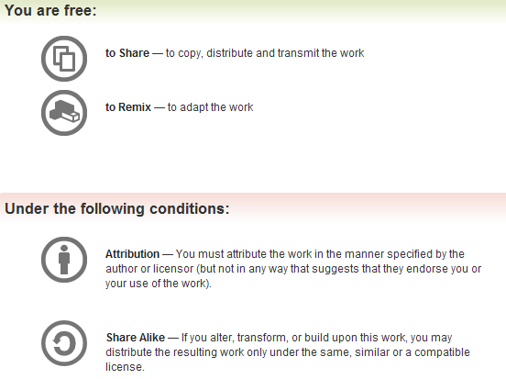
All materials is licensed under a Creative Commons “Share Alike” license.
http://creativecommons.org/licenses/by-sa/3.0/

Slide 3
Control Flow
Two forms of control flow
  Conditional - go somewhere if a condition is met. Think “if”s, switches, loops
  Unconditional - go somewhere no matter what. Procedure calls, goto, exceptions, interrupts.
We’ve already seen procedure calls manifest themselves as push/call/ret, let’s see how goto manifests itself in asm.

Slide 4
Example2.999repeating.c:
(I missed this when I reordered slides and then didn’t want to change everything else again. Also, VS orders projects alphabetically, otherwise I would have just called it GotoExample.c. Say ‘lah vee’ :P)
//Goto example
#include <stdio.h>
int main(){
goto mylabel;
printf("skipped\n");
mylabel:
printf("goto ftw!\n");
return 0xf00d;
}
00401010 push ebp
00401011 mov ebp,esp
00401013 jmp 00401023
00401015 push 405000h
0040101A call dword ptr ds:[00406230h]
00401020 add esp,4
mylabel:
00401023 push 40500Ch
00401028 call dword ptr ds:[00406230h]
0040102E add esp,4
00401031 mov eax,0F00Dh
00401036 pop ebp
00401037 ret

Slide 5
JMP - Jump
10
Change eip to the given address
Main forms of the address
  Short relative (1 byte displacement from end of the instruction)
    “jmp 00401023” doesn’t have the number 00401023 anywhere in it, it’s really “jmp 0x0E bytes forward”
    Some disassemblers will indicate this with a mnemonic by writing it as “jmp short”
  Near relative (4 byte displacement from current eip)
  Absolute (hardcoded address in instruction)
  Absolute Indirect (address calculated with r/m32)
jmp -2 == infinite loop for short relative jmp :)
Book p. 129

Slide 6
Example3.c
(Remain calm)
main:
00401010 push ebp
00401011 mov ebp,esp
00401013 sub esp,8
00401016 mov dword ptr [ebp-4],1
0040101D mov dword ptr [ebp-8],2
00401024 mov eax,dword ptr [ebp-4]
00401027 cmp eax,dword ptr [ebp-8]
0040102A jne 00401033
0040102C mov eax,1
00401031 jmp 00401056
00401033 mov ecx,dword ptr [ebp-4]
00401036 cmp ecx,dword ptr [ebp-8]
00401039 jle 00401042
0040103B mov eax,2
00401040 jmp 00401056
00401042 mov edx,dword ptr [ebp-4]
00401045 cmp edx,dword ptr [ebp-8]
00401048 jge 00401051
0040104A mov eax,3
0040104F jmp 00401056
00401051 mov eax,0DEFEA7h
00401056 mov esp,ebp
00401058 pop ebp
00401059 ret
int main(){
int a=1, b=2;
if(a == b){
return 1;
}
if(a > b){
return 2;
}
if(a < b){
return 3;
}
return 0xdefea7;
}
Jcc

Slide 7
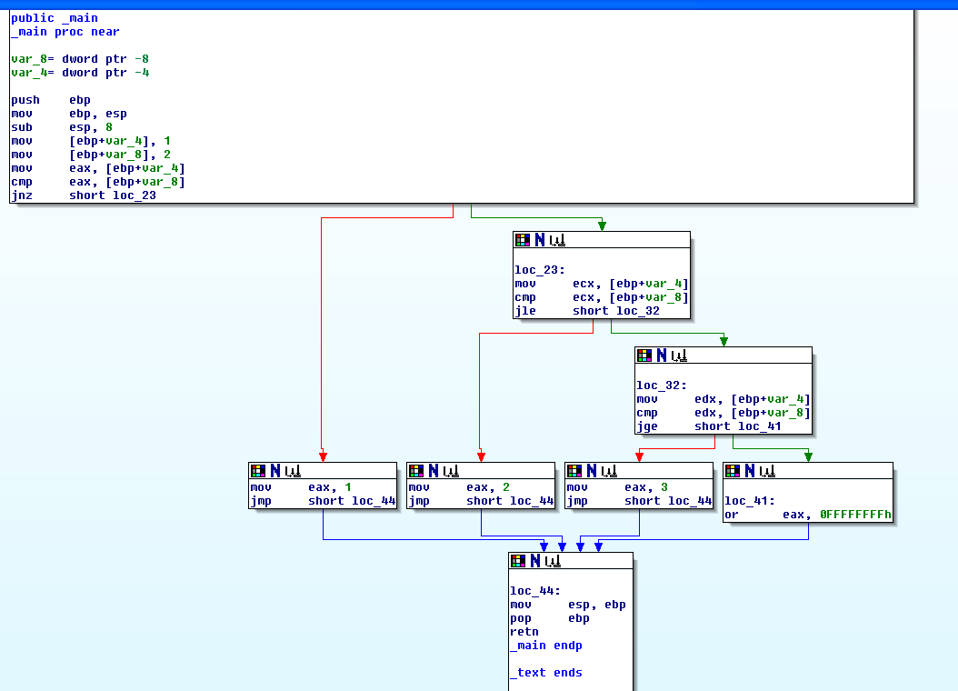
Ghost of Xmas Future:
Tools you won’t get to use today
generate a Control Flow Graph (CFG)
which looks much nicer.
Not that that helps you. Just sayin’ :)

Slide 8
Jcc - Jump If Condition Is Met
11
There are more than 4 pages of conditional jump types! Luckily a bunch of them are synonyms for each other.
JNE == JNZ (Jump if not equal, Jump if not zero, both check if the Zero Flag (ZF) == 0)
Book p. 137

Slide 9
Some Notable Jcc Instructions
JZ/JE: if ZF == 1
JNZ/JNE: if ZF == 0
JLE/JNG : if ZF == 1 or SF != OF
JGE/JNL : if SF == OF
JBE: if CF == 1 OR ZF == 1
JB: if CF == 1
Note: Don’t get hung up on memorizing which flags are set for what. More often than not, you will be running code in a debugger, not just reading it. In the debugger you can just look at eflags and/or watch whether it takes a jump.

Slide 10
Flag setting
Before you can do a conditional jump, you need something to set the condition flags for you.
Typically done with CMP, TEST, or whatever instructions are already inline and happen to have flag-setting side-effects

Slide 11
CMP - Compare Two Operands
12
“The comparison is performed by subtracting the second operand from the first operand and then setting the status flags in the same manner as the SUB instruction.”
What’s the difference from just doing SUB? Difference is that with SUB the result has to be stored somewhere. With CMP the result is computed, the flags are set, but the result is discarded. Thus this only sets flags and doesn’t mess up any of your registers.
Modifies CF, OF, SF, ZF, AF, and PF
(implies that SUB modifies all those too)
Book p. 138

Slide 12
TEST - Logical Compare
13
“Computes the bit-wise logical AND of first operand (source 1 operand) and the second operand (source 2 operand) and sets the SF, ZF, and PF status flags according to the result.”
Like CMP - sets flags, and throws away the result
Book p. 232

Slide 13
Example4.c
main:
00401010 push ebp
00401011 mov ebp,esp
00401013 push ecx
00401014 mov dword ptr [ebp-4],1301h
0040101B mov eax,dword ptr [ebp-4]
0040101E and eax,100h
00401023 je 0040102E
00401025 mov eax,1
0040102A jmp 00401033
0040102C jmp 00401033
0040102E mov eax,2
00401033 mov esp,ebp
00401035 pop ebp
00401036 ret
#define MASK 0x100
int a=0x1301;
if(a & MASK){
return 1;
}
else{
return 2;
}
}
int main(){
jcc
I actually expected a TEST, because the result isn't stored
Eventually found out why there are 2 jmps!
(no optimization, so simple compiler rules)

Slide 14
Refresher - Boolean (”bitwise”) logic
AND “&”
OR “|”
XOR “^”
0 | 0 | 0
0 | 1 | 0
1 | 0 | 0
1 | 1 | 1
0 | 0 | 0
0 | 1 | 1
1 | 0 | 1
1 | 1 | 1
0 | 0 | 0
0 | 1 | 1
1 | 0 | 1
1 | 1 | 0
Operands
Result
NOT “~”
0 | 1
1 | 0

Slide 15
AND - Logical AND
14
Destination operand can be r/m32 or register
Source operand can be r/m32 or register or immediate (No source and destination as r/m32s)
and al, bl
and al, 0x42
 | 00110011b (al - 0x33)
AND | 01010101b (bl - 0x55)
result | 00010001b (al - 0x11)
 | 00110011b (al - 0x33)
AND | 01000010b (imm - 0x42)
result | 00000010b (al - 0x02)
Book p. 231

Slide 16
OR - Logical Inclusive OR
15
Destination operand can be r/m32 or register
Source operand can be r/m32 or register or immediate (No source and destination as r/m32s)
or al, bl
or al, 0x42
 | 00110011b (al - 0x33)
OR | 01010101b (bl - 0x55)
result | 01110111b (al - 0x77)
 | 00110011b (al - 0x33)
OR | 01000010b (imm - 0x42)
result | 01110011b (al - 0x73)
Book p. 231

Slide 17
XOR - Logical Exclusive OR
16
Destination operand can be r/m32 or register
Source operand can be r/m32 or register or immediate (No source and destination as r/m32s)
xor al, al
xor al, 0x42
 | 00110011b (al - 0x33)
XOR | 00110011b (al - 0x33)
result | 00000000b (al - 0x00)
 | 00110011b (al - 0x33)
OR | 01000010b (imm - 0x42)
result | 01110001b (al - 0x71)
XOR is commonly used to zero a
register, by XORing it with itself,
because it’s faster than a MOV
Book p. 231

Slide 18
NOT - One's Complement Negation
17
Single source/destination operand can be r/m32
not al
not [al+bl]
NOT | 00110011b (al - 0x33)
result | 11001100b (al - 0xCC)
al | 0x10000000
bl | 0x00001234
al+bl | 0x10001234
[al+bl] | 0 (assumed memory at 0x10001234)
NOT | 00000000b
result | 11111111b
Xeno trying to be clever on a boring example, and failing…
Book p. 231

Slide 19
Example5.c - simple for loop
main:
00401010 push ebp
00401011 mov ebp,esp
00401013 push ecx
00401014 mov dword ptr [ebp-4],0
0040101B jmp 00401026
0040101D mov eax,dword ptr [ebp-4]
00401020 add eax,1
00401023 mov dword ptr [ebp-4],eax
00401026 cmp dword ptr [ebp-4],0Ah
0040102A jge 00401040
0040102C mov ecx,dword ptr [ebp-4]
0040102F push ecx
00401030 push 405000h
00401035 call dword ptr ds:[00406230h]
0040103B add esp,8
0040103E jmp 0040101D
00401040 xor eax,eax
00401042 mov esp,ebp
00401044 pop ebp
00401045 ret
#include <stdio.h>
int main(){
int i;
for(i = 0; i < 10; i++){
printf("i = %d\n“, i);
}
}
What does this add say about the calling convention of printf()?
Interesting note: Defaults to returning 0

Slide 20
Instructions we now know(17)
NOP
PUSH/POP
CALL/RET
MOV/LEA
ADD/SUB
JMP/Jcc
CMP/TEST
AND/OR/XOR/NOT

Slide 21
Example6.c
//Multiply and divide transformations
//New instructions:
//shl - Shift Left, shr - Shift Right
int main(){
unsigned int a, b, c;
a = 0x40;
b = a * 8;
c = b / 16;
return c;
}
main:
push ebp
mov ebp,esp
sub esp,0Ch
mov dword ptr [ebp-4],40h
mov eax,dword ptr [ebp-4]
shl eax,3
mov dword ptr [ebp-8],eax
mov ecx,dword ptr [ebp-8]
shr ecx,4
mov dword ptr [ebp-0Ch],ecx
mov eax,dword ptr [ebp-0Ch]
mov esp,ebp
pop ebp
ret

Slide 22
SHL - Shift Logical Left
18
Book p. 224
Can be explicitly used with the C “<<” operator
First operand (source and destination) operand is an r/m32
Second operand is either cl (lowest byte of ecx), or a 1 byte immediate. The 2nd operand is the number of places to shift.
It multiplies the register by 2 for each place the value is shifted. More efficient than a multiply instruction.
Bits shifted off the left hand side are “shifted into” (set) the carry flag (CF)
For purposes of determining if the CF is set at the end, think of it as n independent 1 bit shifts.
shl cl, 2
shl cl, 3
 | 00110011b (cl - 0x33)
result | 11001100b (cl - 0xCC) CF = 0
 | 00110011b (cl - 0x33)
result | 10011000b (cl - 0x98) CF = 1

Slide 23
SHR - Shift Logical Right
19
Book p. 225
Can be explicitly used with the C “>>” operator
First operand (source and destination) operand is an r/m32
Second operand is either cl (lowest byte of ecx), or a 1 byte immediate. The 2nd operand is the number of places to shift.
It divides the register by 2 for each place the value is shifted. More efficient than a multiply instruction.
Bits shifted off the right hand side are “shifted into” (set) the carry flag (CF)
For purposes of determining if the CF is set at the end, think of it as n independent 1 bit shifts.
shr cl, 2
shr cl, 3
 | 00110011b (cl - 0x33)
result | 00001100b (cl - 0x0C) CF = 1
 | 00110011b (cl - 0x33)
result | 00000110b (cl - 0x06) CF = 0

Slide 24
Example7.c
//Multiply and divide operations
//when the operand is not a
//power of two
//New instructions: imul, div
int main(){
unsigned int a = 1;
a = a * 6;
a = a / 3;
return 0x2bad;
}
main:
push ebp
mov ebp,esp
push ecx
mov dword ptr [ebp-4],1
mov eax,dword ptr [ebp-4]
imul eax,eax,6
mov dword ptr [ebp-4],eax
mov eax,dword ptr [ebp-4]
xor edx,edx
mov ecx,3
div eax,ecx
mov dword ptr [ebp-4],eax
mov eax,2BADh
mov esp,ebp
pop ebp
ret
Notes:
We already saw that when a C operand is a power of 2, it uses shifts instead of multiplies/divides, but this shows that in other cases, it uses multiply or divide instructions.

Slide 25
IMUL - Signed Multiply
20
Book p. 218
Wait…what? Weren’t the operands unsigned?
  Visual Studio seems to have a predilection for imul over mul (unsigned multiply). I haven’t been able to get it to generate the latter for simple examples.
Three forms. One, two, or three operands
  imul r/m32 edx:eax = eax * r/m32
  imul reg, r/m32 reg = reg * r/m32
  imul reg, r/m32, immediate reg = r/m32 * immediate
Three operands? Only one of it’s kind?(see link in notes)
edx | eax | r/m32(ecx)
0x0 | 0x44000000 | 0x4
eax | r/m32(ecx)
0x20 | 0x4
eax | r/m32(ecx)
0x20 | 0x4
initial
operation
imul ecx
imul eax, ecx
imul eax, ecx, 0x6
edx | eax | r/m32(ecx)
0x1 | 0x10000000 | 0x4
eax | r/m32(ecx)
0x80 | 0x4
eax | r/m32(ecx)
0x18 | 0x4
result
Notes:
http://www.microsoft.com/msj/0698/hood0698.aspx - “There's even a form of the IMUL instruction that takes three operands. To my knowledge, this is the only instruction in the Intel opcode set with this distinction.”
I found that quote while trying to find a way to make visual studio naturally emit a MUL instruction. Also, while things containing an r/m32 can encode a mnemonic which looks like is has more operands, the information is still contained in a the normal combo of one or two bytes

Slide 26
DIV - Unsigned Divide
21
Book p. 221
Two forms
  Unsigned divide ax by r/m8, al = quotient, ah = remainder
  Unsigned divide edx:eax by r/m32, eax = quotient, edx = remainder
If dividend is 32bits, edx will just be set to 0 before the instruction (as occurred in the Example7.c code)
If the divisor is 0, a divide by zero exception is raised.
initial
ax | r/m8(cx)
0x8 | 0x3
edx | eax | r/m32(ecx)
0x0 | 0x8 | 0x3
operation
div ax, cx
div eax, ecx
ah | al
0x2 | 0x2
edx | eax | r/m32(ecx)
0x1 | 0x2 | 0x3
result
Notes:
Note that there’s no form which takes an immediate.

Slide 27
Example8.c
//VisualStudio runtime check
//buffer initialization
//auto-generated code
//New instruction: rep stos
char buf[40];
buf[39] = 42;
return 0xb100d;
}
int main(){

Slide 28
Example8.c
main:
00401010 push ebp
00401011 mov ebp,esp
00401013 sub esp,30h
00401016 push edi
00401017 lea edi,[ebp-30h]
0040101A mov ecx,0Ch
0040101F mov eax,0CCCCCCCCh
00401024 rep stos dword ptr es:[edi]
00401026 mov byte ptr [ebp-5],2Ah
0040102A mov eax,0B100Dh
0040102F push edx
00401030 mov ecx,ebp
00401032 push eax
00401033 lea edx,[ (401048h)]
00401039 call _RTC_CheckStackVars (4010B0h)
0040103E pop eax
0040103F pop edx
00401040 pop edi
00401041 mov esp,ebp
00401043 pop ebp
00401044 ret

Slide 29
REP STOS - Repeat Store String
22
One of a family of “rep” operations, which repeat a single instruction multiple times. (i.e. “stos” is also a standalone instruction)
  Rep isn’t technically it’s own instruction, it’s an instruction prefix
All rep operations use ecx register as a “counter” to determine how many times to loop through the instruction. Each time it executes, it decrements ecx. Once ecx == 0, it continues to the next instruction.
Either moves one byte at a time or one dword at a time.
Either fill byte at [edi] with al or fill dword at [edi] with eax.
Moves the edi register forward one byte or one dword at a time, so that the repeated store operation is storing into consecutive locations.
So there are 3 pieces which must happen before the actual rep stos occurs: set edi to the start destination, eax/al to the value to store, and ecx to the number of times to store
Book p. 284
Notes:
As with other instructions prefixes like “LOCK”, “REP” can only be used with certain instructions - as defined in the manual.

Slide 30
rep stos setup
004113AC lea edi,[ebp-0F0h]
Set edi - the destination
Set ecx - the count
Set eax - the value
Start the repeated store
So what's this going to do? Store 0x3C copies of the dword 0xCCCCCCCC starting at ebp-0xF0
And that just happens to be 0xF0 bytes of 0xCC!
004113BC rep stos dword ptr es:[edi]
004113B7 mov eax,0CCCCCCCCh
004113B2 mov ecx,3Ch

Slide 31
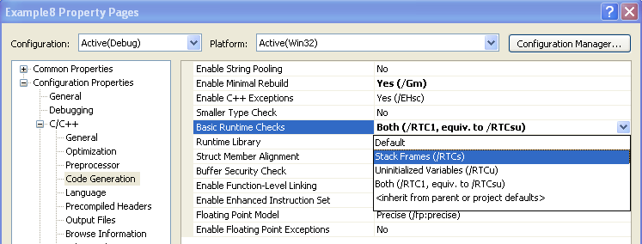
Q: Where does the rep stos come from in this example?
A: Compiler-auto-generated code. From the stack frames runtime check option. This is enabled by default in the debug build. Disabling this option removes the compiler-generated code.

Slide 32
More straightforward without the runtime check
main:
00401010 push ebp
00401011 mov ebp,esp
00401013 sub esp,28h
00401016 mov byte ptr [ebp-1],2Ah
0040101A mov eax,0B100Dh
0040101F mov esp,ebp
00401021 pop ebp
00401022 ret
Notes:
But still not entirely clear :)

Slide 33
Example9.c
Journey to the center of memcpy()
main:
00401010 push ebp
00401011 mov ebp,esp
00401013 sub esp,10h
00401016 mov dword ptr [a],0FFh
0040101D push 8
0040101F lea eax,[a]
00401022 push eax
00401023 lea ecx,[b]
00401026 push ecx
00401027 call memcpy (401042h)
0040102C add esp,0Ch
0040102F mov eax,0ACE0BA5Eh
00401034 mov esp,ebp
00401036 pop ebp
00401037 ret
//Journey to the center of memcpy
#include <stdio.h>
int var1;
char var2[4];
} mystruct_t;
mystruct_t a, b;
a.var1 = 0xFF;
memcpy(&b, &a, sizeof(mystruct_t));
return 0xAce0Ba5e;
}
int main(){
typedef struct mystruct{

Slide 34
It begins…
memcpy:
push ebp
mov ebp,esp
push edi ;callee save
push esi ;callee save
mov esi,dword ptr [ebp+0Ch] ;2nd param - source ptr
mov ecx,dword ptr [ebp+10h] ;3rd param - copy size
mov edi,dword ptr [ebp+8] ;1st param - destination ptr
mov eax,ecx ;copy length to eax
mov edx,ecx ;another copy of length for later use
add eax,esi ;eax now points to last byte of src copy
cmp edi,esi ;edi (dst) – esi (src) and set flags
jbe 1026ED30 ;jump if ZF = 1 or CF = 1
;It will execute different code if the dst == src or if the destination is below (unsigned less than) the source (so jbe is an unsigned edi <= esi check)

Slide 35
1026ED30 cmp ecx,100h ;ecx - 0x100 and set flags
1026ED36 jb 1026ED57 ;jump if CF == 1
;Hmmm…since ecx is the length, it appears to do something
different based on whether the length is below 0x100 or not.
We could investigate the alternative path later if we wanted.
1026ED57 test edi,3 ;edi AND 0x3 and set flags
1026ED5D jne 1026ED74 ;jump if ZF == 0
;It is checking if either of the lower 2 bits of the destination
address are set. That is, if the address ends in 1, 2, or 3. If both
bits are 0, then the address can be said to be 4-byte-aligned.
so it’s going to do something different based on whether the
destination is 4-byte-aligned or not.
Notes:
Remember that a cmp is just a sub(traction) where the result is thrown away. So what is required for a subtraction to need to set the carry bit?
If A - B and A < B, then CF = 1. I.e. if ecx (memcpy length) < 0x100, CF = 1. This makes sense, given the mnemonic “jump if below”

Slide 36
1026ED5F shr ecx,2 ;divide len by 4
1026ED62 and edx,3 ;edx still contains a copy of ecx
1026ED65 cmp ecx,8 ;ecx - 8 and set flags
1026ED68 jb 1026ED94 ;jump if CF == 1
;But we currently don’t get to the next instruction 1026ED6A,
instead we jump to 1026ED94… :(
1026ED6A rep movs dword ptr es:[edi],dword ptr [esi]
1026ED6C jmp dword ptr [edx*4+1026EE84h]
The rep movs is the target of this expedition.
Q: But how can we reach the rep mov?
A: Need to make it so that (length to copy) / 4 >= 8, so we
don't take the jump below
Notes:
Answering this question is the first step in starting to think backwards to try and give input which satisfies some constraint.

Slide 37
REP MOVS - Repeat Move Data String to String
23
One of a family of “rep” operations, which repeat a single instruction multiple times. (i.e. “movs” is also a standalone instruction)
All rep operations use ecx register as a “counter” to determine how many times to loop through the instruction. Each time it executes, it decrements ecx. Once ecx == 0, it continues to the next instruction.
Either moves one byte at a time or one dword at a time.
Either move byte at [esi] to byte at [edi] or move dword at [esi] to dword at [edi].
Moves the esi and edi registers forward one byte or one dword at a time, so that the repeated store operation is storing into consecutive locations.
So there are 3 pieces which must happen before the actual rep movs occurs: set esi to the start source, set edi to the start destination, and set ecx to the number of times to move
Book p. 274 & 278

Slide 38
LEAVE - High Level Procedure Exit
24
1026EE94 mov eax,dword ptr [ebp+8]
1026EE97 pop esi
1026EE98 pop edi
1026EE99 leave
1026EE9A ret
“Set ESP to EBP, then pop EBP”
That’s all :)
Then why haven’t we seen it elsewhere already?
Depends on compiler and options
Book p. 309

Slide 39
Some high level pseudo-code approximation
memcpy(void * dst, void * src, unsigned int len){
if(dst <= src){
//Path we didn’t take, @ 1026ED28
}
if(dst & 3 != 0){
//Other path we didn’t take, @ 1026ED74
}
if((len / 4) >= 8){
ecx = len / 4;
rep movs dword dst, src;
}
else{
//sequence of individual mov instructions
//as appropriate for the size to be copied
}
…
}

Slide 40
Instructions we now know(24)
NOP
PUSH/POP
CALL/RET
MOV/LEA
ADD/SUB
JMP/Jcc
CMP/TEST
AND/OR/XOR/NOT
SHR/SHL
IMUL/DIV
REP STOS, REP MOV
LEAVE

Slide 41
Homework
Write a program to find an instruction we haven’t covered, and report the instruction tomorrow.
Instructions to be covered later which don’t count: SAL/SAR
Variations on jumps or the MUL/IDIV variants of IMUL/DIV also don't count
Additional off-limits instructions: anything floating point (since we're not covering those in this class.)

