Slide 1
Intro x86 Part 4:
Inline Assembly,
Read The Fun Manual, Choose Your Own Adventure
Xeno Kovah – 2009/2010
xkovah at gmail
Approved for Public Release: 10-3348. Distribution Unlimited

Slide 2
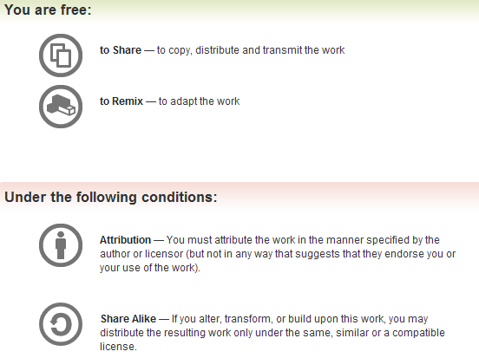
All materials is licensed under a Creative Commons “Share Alike” license.
http://creativecommons.org/licenses/by-sa/3.0/

Slide 3
Inline assembly
Inline assembly is a way to include assembly directly in a C/C++ file. However, the syntax will differ between compilers and assemblers.
There are times when you actually have to code asm in order to do something from a C/C++ file.
  Very common in OS or driver design, because there are many aspects of hardware which can only be accessed with special instructions
  In crypto you might want access to the “rol/ror - rotate left/right” instructions which don’t have corresponding C syntax like shifts do
Or maybe you just want full control over the code being generated for optimization purposes
  Keep in mind the compiler may still optimize your inline asm
Also it’s a great way to simply experiment with instructions
  Though getting the syntax right for the desired instructions is sometimes annoying

Slide 4
VisualStudio inline assembly
VisualStudio syntax - intel-syntax
__asm{ instructions separated by \n};
  That’s two underscores at the beginning
  Don’t even need a semicolon after it, but I put them there since it makes the auto-indent work correctly
__asm{ mov eax, [esp+0x4]
cmp eax, 0xdeadbeef
je myLabel
xor eax, eax
myLabel: mov bl, al
};

Slide 5
VisualStudio inline assembly 2
Syntax using C variables is the same, just put the variable in place of a register name for instance. (The assembler will substitute the correct address for the variable.)
http://msdn.microsoft.com/en-us/library/4ks26t93(VS.80).aspx
int myVar;
//value into C variable from register
__asm {mov myVar, eax};
//value into register from C variable
__asm {mov eax, myVar};

Slide 6
GCC inline assembly
GCC syntax - AT&T syntax
asm(“instructions separated by \n”);
  DO need a semicolon after close parentheses
asm("movl 0x4(%esp), %eax\n"
"cmp $0xdeadbeef,%eax\n"
"je myLabel\n"
"xor %eax, %eax\n"
"myLabel: movw %bx, %ax"
);
http://www.ibiblio.org/gferg/ldp/GCC-Inline-Assembly-HOWTO.html
Book starting on p. 365
Notes:
http://www.cs.virginia.edu/~clc5q/gcc-inline-asm.pdf

Slide 7
GCC inline assembly 2
Syntax using C variables (aka “extended asm”):
asm ( assembler template
: output operands /* optional */
: input operands /* optional */
: list of clobbered registers /* optional */
);
int myVar;
//value into C variable from register
asm ("movl %%eax, %0" : "=r" (myVar) );
//value into register from C variable
asm ("movl %0, %%eax" : : "r" (myVar) );

Slide 8
_emit and .byte
Once you learn about opcodes later on, you can even specify exactly the instructions you want to use by using the “_emit” or “.byte” keywords, to place specific bytes into the code.
Those bytes can then be interpreted as instructions or data
This is sometimes useful if you can’t figure out the inline asm syntax for the instruction you want to use, but you know its opcodes (either from seeing them elsewhere, or by reading the manual)
Examples:
  __asm{_emit 0x55} is __asm{push ebp}
  __asm{_emit 0x89};__asm{_emit 0xE5} is __asm{mov ebp, esp}
  asm(“.byte 0x55”); is asm(“push %ebp”);
  asm(".byte 0x89 ; .byte 0xE5"); is asm(“mov %esp, %ebp”);
Notes:
_emit syntax: http://msdn.microsoft.com/en-us/library/1b80826t(VS.80).aspx

Slide 9
Guess what?
I have repeatedly mislead you!
Simplification is misleading
Time to learn the fascinating truth…
Time to RTFM!

Slide 10
Read The Fun Manuals
http://www.intel.com/products/processor/manuals/
Vol.1 is a summary of life, the universe, and everything about x86
Vol. 2a & 2b explains all the instructions
Vol. 3a & 3b are all the gory details for all the extra stuff they’ve added in over the years (MultiMedia eXtentions - MMX, Virtual Machine eXtentions - VMX, virtual memory, 16/64 bit modes, system management mode, etc)
Already downloaded to the Manuals folder
We’ll only be looking at Vol. 2a & 2b in this class
Notes:
Googling is fine to start with, but eventually you need to learn to read the manuals to get the details from the authoritative source

Slide 11
Interpreting the Instruction Reference Pages
The correct way to interpret these pages is given in the Intel Manual 2a, section 3.1
I will give yet another simplification
Moral of the story is that you have to RTFM to RTFM ;)

Slide 12
AND - Logical AND
Here’s what I said:
Destination operand can be r/m32 or register
Source operand can be r/m32 or register or immediate (No source and destination as r/m32s)
and al, bl
and al, 0x42
 | 00110011b (al - 0x33)
AND | 01010101b (bl - 0x55)
result | 00010001b (al - 0x11)
 | 00110011b (al - 0x33)
AND | 01000010b (imm - 0x42)
result | 00000010b (al - 0x02)

Slide 13
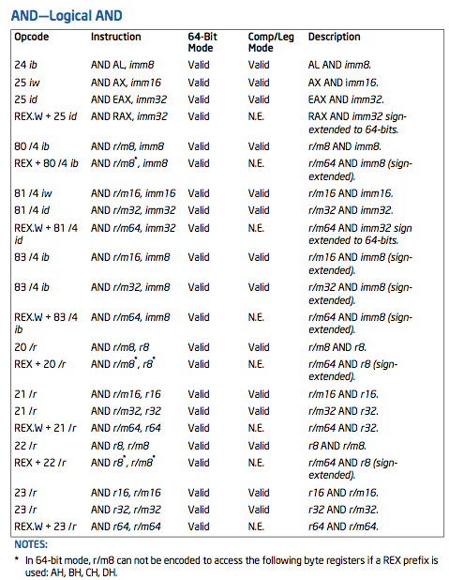
Here’s what the manual says:

Slide 14
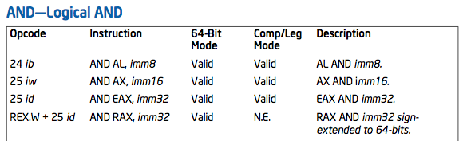
AND truncated
Ignore this line. Register names beginning with R refer to 64bit registers, and are not relevant for this class

Slide 15
Opcode Column
Opcode Column
Represents the literal byte value(s) which correspond to the given instruction
In this case, if you were to see a 0x24 followed by a byte or 0x25 followed by 4 bytes, you would know they were specific forms of the AND instruction.
  Subject to correct interpretation under x86’s multi-byte opcodes as discussed later.
See Intel Vol. 2a section 3.1.1.1

Slide 16
Opcode Column
If it was 0x25, how would you know whether it should be followed by 2 bytes (imm16) or 4 bytes (imm32)? Because the same single opcode byte is used for both, the length of the operand depends on if the processor is in 32bit or 16bit mode. Because we’re only considering 32bit mode in this class, the 4 bytes (“id” aka “imm32” aka “dword”) following 0x25 will always be considered the operand to the instruction.
Notes:
There are many instructions which are “overloaded” with equivalent 16 bit and 32 bit versions shown in the manual.

Slide 17
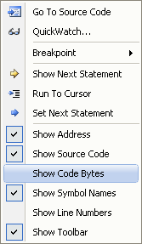
Opcode Column
How to see the opcodes in VisualStudio:
Seeing the exact opcode will
help confirm the exact version of an
Instruction
(I couldn’t find a decent
way to do it in gdb besides
using “x/<num>xb <addr>”)

Slide 18
Instruction Column
Opcode Column
Instruction Column
The human-readable mnemonic which is used to represent the instruction.
This will frequently contain special encodings such as the “r/m32 format” which I’ve previously discussed
See Intel Vol. 2a section 3.1.1.2

Slide 19
64bit Column
Opcode Column
64bit Column
Whether or not the opcode is valid in 64 bit code.
Can be ignored for our purposes.
See Intel Vol. 2a section 3.1.1.3

Slide 20
Compatibility/Legacy Mode Column
Opcode Column
Compatibility/Legacy Mode Column
Whether or not the opcode is valid in 32/16 bit code.
  For 64 bit instructions, the N.E. Indicates an Intel 64 instruction mnemonics/syntax that is not encodable”
Can be ignored for our purposes.
See Intel Vol. 2a section 3.1.1.4

Slide 21
Description Column
Opcode Column
Description Column
Simple description of the action performed by the instruction
Typically this just conveys the flavor of the instruction, but the majority of the details are in the main description text
See Intel Vol. 2a section 3.1.1.5

Slide 22
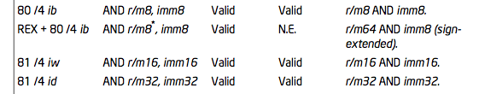
Further AND variations
Looking at some other forms, we now see those “r/m32” things I told you about
We know that for instance it can start with an 0x80, and end with a byte, but what’s that /4?
Unfortunately the explanation goes into too much detail for this class. Generally the only people who need to know it are people who want to write disassemblers. But I still put it in the Intermediate x86 class :)
All you really need to know is that any time you see a r/m8 or r/m32, it can be either a register or memory value.

Slide 23
AND Details
Description
  “Performs a bitwise AND operation on the destination (first) and source (second) operands and stores the result in the destination operand location. The source operand can be an immediate, a register, or a memory location; the destination operand can be a register or a memory location. (However, two memory operands cannot be used in one instruction.) Each bit of the result is set to 1 if both corresponding bits of the first and second operands are 1; otherwise, it is set to 0.
  This instruction can be used with a LOCK prefix to allow the it to be executed atomically.”
Flags effected
  “The OF and CF flags are cleared; the SF, ZF, and PF flags are set according to the result. The state of the AF flag is undefined.”

Slide 24
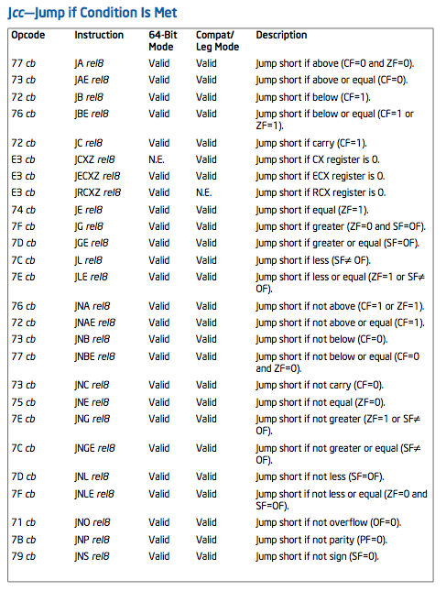
JCC is another good one to revisit

Slide 25
Jcc Revisited
If you look closely, you will see that there are multiple mnemonics for the same opcodes
0x77 = JA - Jump Above
0x77 = JNBE - Jump Not Below or Equal
0x74 = JE / JZ - Jump Equal / Zero
Which mnemonic is displayed is disassembler-dependent

Slide 26
How about looking at the manual when a new instruction is encountered?
//Example6.c
int main(){
unsigned int a, b, c;
a = 0x40;
b = a * 8;
c = b / 16;
return c;
}
//Example6-mod.c
int main(){
int a, b, c;
a = 0x40;
b = a * 8;
c = b / 16;
return c;
}

Slide 27
08048344 <main>: //Example6
8048344: lea 0x4(%esp),%ecx
8048348: and $0xfffffff0,%esp
804834b: pushl -0x4(%ecx)
804834e: push %ebp
804834f: mov %esp,%ebp
8048351: push %ecx
8048352: sub $0x10,%esp
8048355: movl $0x40,-0x8(%ebp)
804835c: mov -0x8(%ebp),%eax
804835f: shl $0x3,%eax
8048362: mov %eax,-0xc(%ebp)
8048365: mov -0xc(%ebp),%eax
8048368: shr $0x4,%eax
804836b: mov %eax,-0x10(%ebp)
804836e: mov -0x10(%ebp),%eax
8048371: add $0x10,%esp
8048374: pop %ecx
8048375: pop %ebp
8048376: lea -0x4(%ecx),%esp
8048379: ret
08048344 <main>: //Example6-mod
8048344: lea 0x4(%esp),%ecx
8048348: and $0xfffffff0,%esp
804834b: pushl -0x4(%ecx)
804834e: push %ebp
804834f: mov %esp,%ebp
8048351: push %ecx
8048352: sub $0x10,%esp
8048355: movl $0x40,-0x8(%ebp)
804835c: mov -0x8(%ebp),%eax
804835f: shl $0x3,%eax
8048362: mov %eax,-0xc(%ebp)
8048365: mov -0xc(%ebp),%edx
8048368: mov %edx,%eax
804836a: sar $0x1f,%eax
804836d: shr $0x1c,%eax
8048370: add %edx,%eax
8048372: sar $0x4,%eax
8048375: mov %eax,-0x10(%ebp)
8048378: mov -0x10(%ebp),%eax
804837b: add $0x10,%esp
804837e: pop %ecx
804837f: pop %ebp
8048380: lea -0x4(%ecx),%esp
8048383: ret
changed
Compiled and disassembled on Linux
Why? Cause VS added an extra, distracting, instruction
Notes:
Looking up the extra instruction which VS adds, and which I had never even seen before doing this example, and which I therefore don’t consider important enough to know, is left as an exercise to the student ;)

Slide 28
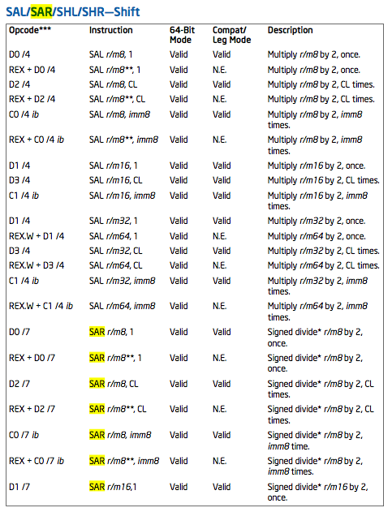
SAR manual

Slide 29
SAR - Shift Arithmetic Right
Book p. 225
Can be explicitly used with the C “>>” operator, if the operands are signed
First operand (source and destination) operand is an r/m32
Second operand is either cl (lowest byte of ecx), or a 1 byte immediate. The 2nd operand is the number of places to shift.
It divides the register by 2 for each place the value is shifted. More efficient than a multiply instruction.
Each bit shifted off the right side is place in CF.
sar ecx, 2
shr ecx, 2
 | 10110011b (ecx - 0xB3)
result | 11101100b (ecx - 0xEC)
 | 10110011b (ecx - 0xB3)
result | 00101100b (ecx - 0x2C)
!=
sar ecx, 2
shr ecx, 2
 | 00110011b (ecx - 0x33)
result | 00001100b (ecx - 0x0C)
 | 00110011b (ecx - 0x33)
result | 00001100b (ecx - 0x0C)
==

Slide 30
Discussion
; semi-colons are comments
mov -0xc(%ebp),%edx ; edx == “b”
mov %edx,%eax ; eax == edx
sar $0x1f,%eax ; If the most significant bit of %eax was 1
; when this happened, %eax == 0xFFFFFFFF,
; else %eax == 0
shr $0x1c,%eax ; if %eax was 0, it’s still 0, else if %eax
; was 0xFFFFFFFF the least significant four
; bits of %eax are set (i.e. 0xF)
add %edx,%eax ; Add 0xF or 0 to the value to be shifted
sar $0x4,%eax ; Now perform the expected shift
But why add something to the least signficant bits when it’s just going to get shifted away?
It turns out the 0xF (four ones) is only because it’s a 4 bit shift. And everything which gets shifted off the right side gets shifted into the Carry Flag (CF). Thus it’s guaranteeing that when the sequence of operations is done, that CF == 1 if and only if the original number was signed (MSB == 1)7.
If we change the C code to b / 32, and hence a 5 bit shift, the shr $0x1c,%eax turns into shr $0x1b,%eax, and the sar $0x4,%eax turns to sar $0x5,%eax
If you analyze Example6-mod.c with VisualStudio, it does the same thing, but it uses different instructions to do it.

Slide 31
Discussion: variable-length opcodes
Any given sequence of bytes can be interpreted in different ways, depending on where the CPU starts executing it from
This has many subtle implications, but it seems to get abused the most in the security domain
Examples: inability to validate intended instructions, return-oriented-programming, code obfuscation and polymorphic/self-modifying code
In comparison, RISC architectures typically have fixed instruction sizes, which must be on aligned boundaries, and thus makes disassembly much simpler

Slide 32
Variable-length opcode decoding example
(gdb) x/5i $eip
0x8048385 <main+17>: movl $0x8048460,(%esp)
0x804838c <main+24>: call 0x80482d4 <puts@plt>
0x8048391 <main+29>: mov $0x1234,%eax
0x8048396 <main+34>: add $0x4,%esp
0x8048399 <main+37>: pop %ecx
(gdb) x/5i $eip+1
0x8048386 <main+18>: add $0x24,%al
0x8048388 <main+20>: pusha
0x8048389 <main+21>: test %al,(%eax,%ecx,1)
0x804838c <main+24>: call 0x80482d4 <puts@plt>
0x8048391 <main+29>: mov $0x1234,%eax
(gdb) x/5i $eip+2
0x8048387 <main+19>: and $0x60,%al
0x8048389 <main+21>: test %al,(%eax,%ecx,1)
0x804838c <main+24>: call 0x80482d4 <puts@plt>
0x8048391 <main+29>: mov $0x1234,%eax
0x8048396 <main+34>: add $0x4,%esp
(gdb) x/5i $eip+6
0x804838b <main+23>: or %ch,%al
0x804838d <main+25>: inc %ebx
0x804838e <main+26>: (bad)
0x804838f <main+27>: (bad)
0x8048390 <main+28>: (bad)
(gdb) x/xb 0x804838e
0x804838e <main+26>: 0xff
(no instruction starts with 0xFF)
Notes:
x86 has been called “self-synchronizing” because it does eventually seem to get back to the correct asm. That’s not a useful property for execution, only for disassemblers trying to speculate on a correct disassembly.

Slide 33
Questions about anything in the class? Stuff you’d like me to go over again?

Slide 34
Choose your own adventure
Effects of compiler optimization/security/debugging options? Goto p35
Dissect the binary bomb? Goto p39
Messing with a disassembler? Goto p41
Mystery box! Goto p52
Why twos compliment? Goto p

Slide 35
Effects of Compiler Options
Our standard build
main:
00401010 push ebp
00401011 mov ebp,esp
00401013 sub esp,28h
00401016 mov byte ptr [ebp-1],2Ah
0040101A mov eax,0B100Dh
0040101F mov esp,ebp
00401021 pop ebp
00401022 ret
//Example8.c
int main(){
char buf[40];
buf[39] = 42;
return 0xb100d;
}

Slide 36
Effects of Compiler Options 2
/O1 (minimum size) or
/O2 (maximum speed)
/Zi -> /ZI (Program database for edit & continue)
main:
0040100F mov eax,0B100Dh
00401014 ret
main:
00411250 push ebp
00411251 mov ebp,esp
00411253 sub esp,68h
00411256 push ebx
00411257 push esi
00411258 push edi
00411259 mov byte ptr [ebp-1],2Ah
0041125D mov eax,0B100Dh
00411262 pop edi
00411263 pop esi
00411264 pop ebx
00411265 mov esp,ebp
00411267 pop ebp
00411268 ret
Debug information format
Disabled (viewed from WinDbg) or
/Z7 (C7 Compatible)
(no change)
main:
00401010 push ebp
00401011 mov ebp,esp
00401013 sub esp,28h
00401016 mov byte ptr [ebp-1],2Ah
0040101a mov eax,0B100Dh
0040101f mov esp,ebp
00401021 pop ebp
00401022 ret

Slide 37
Effects of Compiler Options 3
/GS - Buffer Security Check (default enabled nowadays)
aka “stack cookies” (MS term)
aka “stack canaries” (original research term)
main:
00401010 push ebp
00401011 mov ebp,esp
00401013 sub esp,2Ch
00401016 mov eax,dword ptr [___security_cookie (405000h)]
0040101B xor eax,ebp
0040101D mov dword ptr [ebp-4],eax
00401020 mov byte ptr [ebp-5],2Ah
00401024 mov eax,0B100Dh
00401029 mov ecx,dword ptr [ebp-4]
0040102C xor ecx,ebp
0040102E call __security_check_cookie (401040h)
00401033 mov esp,ebp
00401035 pop ebp
00401036 ret

Slide 38
Effects of source options
Book p. 369
/O1 optimization when the volatile keyword is present
int main(){
volatile char buf[40];
buf[39] = 42;
return 0xb100d;
}
main:
00401010 sub esp,28h
00401013 mov byte ptr [esp+27h],2Ah
00401018 mov eax,0B100Dh
0040101D add esp,28h
00401020 ret
This is a trick I picked up from a 2009 Defcon presentation
http://www.defcon.org/images/defcon-17/dc-17-presentations/defcon-17-sean_taylor-binary_obfuscation.pdf
He also talked a little bit about control flow flattening which is covered in an academic paper in the “Messing with the disassembler” adventure. Goto page 41.

Slide 39
Bomb lab
From CMU architecture class - http://csapp.cs.cmu.edu/public/labs.html
Goal is to reverse engineer multiple phases to determine the program’s desired input
Create a text file with answers, one per line, named “answers”
gdb -x myCmds bomb
run with “r < answers”
Should add/remove breakpoints on the different phases as you go along

Slide 40
GDB/Bomb Lab Cheat Sheet
Christian Arllen found this, and it has many more example of gdb syntax, as well as some help for if you get stuck on the lab
http://condor.depaul.edu/~jriely/csc373fall2010/extras/mygdbnotes.txt
(get it on google cache while you can, because it's gone now)

Slide 41
Messing with a disassembler
Obfuscation of Executable Code to Improve Resistance to Static Disassembly - Linn & Debray
  http://www.cs.arizona.edu/solar/papers/CCS2003.pdf
  Linear sweep vs. recursive traversal disassembly
  Also discusses and measures the “self-repairing” nature of x86 disassembly which we saw earlier
Confusing linear sweep (objdump) by inserting junk bytes after unconditional jumps.
  Could be literally unconditional “jmp”
  Could be a jcc, which must always be true, like “xor eax, eax” and then “jz <addr>”
  Have to do this multiple times because of the self-repairing disassembly

Slide 42
Messing with disassembler 2
Confusing recursive traversal
  3.4.1: Branch functions. All jmps turned into a call to a specific function.
  3.4.2: Call conversion. Branch functions + the junk byte technique which messed with linear sweep.
  3.4.3: Opaque predicates. Create ostensibly conditional jumps which will in fact always follow only one path. The disassembler doesn’t have the smarts to determine this.
  3.4.5: Jump table spoofing. Exploits the fact that the disassembler may try to estimate the size of the jump table based on a constraint. The trick is to add a jump table which will never be reached.

Slide 43
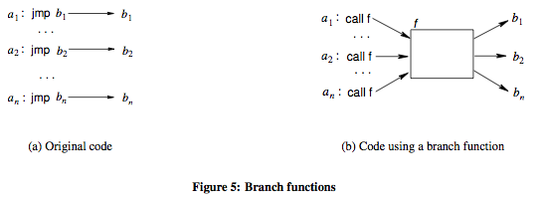
Branch Functions Visualized

Slide 44
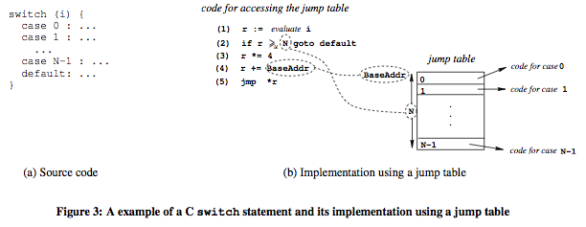
Jump table visualized

Slide 45
Addressing Linn & Debray obfuscations
Static Disassembly of Obfuscated Binaries - Kruegel et al.
  http://www.cs.ucsb.edu/~chris/research/doc/usenix04_disasm.pdf
  Attempt to improve on the state of the art in disassembling, to deal with the Linn & Debray obfuscations
  I don’t know if there are any disassemblers which try to use these improved disassembly methods (objdump and IDA definitely don’t). Confirmed with Kruegel that he’s not aware of anywhere that uses the improvements either.

Slide 46
Digression –
Why Two’s Compliment?
Alternative methods of representing negative numbers (signed magnitude, or just ones compliment), as well as their problems presented on page 166-167 of the book.
  Note to self: show on board quick
The benefit of two’s compliment is due to having only one representation of zero, and being able to reuse the same hardware for addition/subtraction
Dave Keppler suggested expanding on this

Slide 47
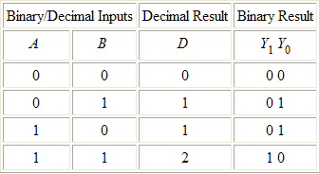
Why Two’s Compliment? 2
Carry
1
1
5d
+ 6d
1b
+ 1b
11d
10b
Table taken from
http://thalia.spec.gmu.edu/~pparis/classes/notes_101/node110.html

Slide 48
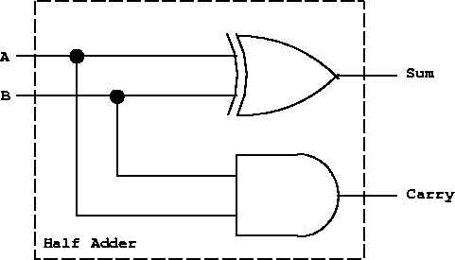
Why Two’s Compliment? 3
A half adder circuit suffices for one bit addition
XOR
AND
Picture taken from
http://thalia.spec.gmu.edu/~pparis/classes/notes_101/node110.html

Slide 49
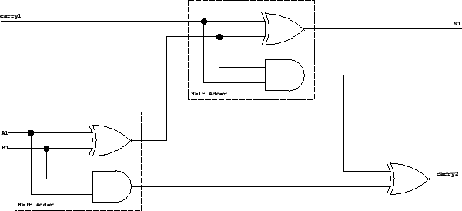
Why Two’s Compliment? 4
Full Adder
You can’t just chain the one bit half adders together to get multi-bit adders. To see why, see the truth table at the link.
Picture taken from
http://thalia.spec.gmu.edu/~pparis/classes/notes_101/node111.html

Slide 50
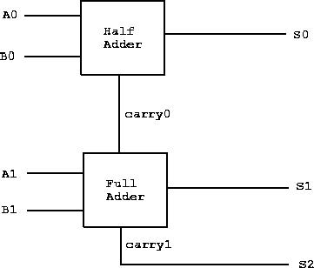
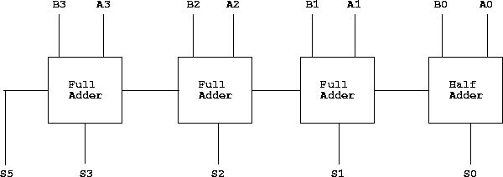
Why Two’s Compliment? 5
Note: we start with a half adder because a full adder would need a carry input at the start. However, if we wanted to use this for subtraction we could use a full adder to start. More on this on next slide.
2 bit adder
4 bit adder
(continue to make n bit adder)
Pictures taken from
http://thalia.spec.gmu.edu/~pparis/classes/notes_101/node112.html
http://thalia.spec.gmu.edu/~pparis/classes/notes_101/node113.html

Slide 51
Why Two’s Compliment? 6
So you have these physical adder circuits in the Arithmetic Logic Unit (ALU), and you can feed both add and subtract to the same circuit. But for this to work, you need to start with a full adder, and then run one the one subtract operand bits through not gates, and then set carry to one on the first full adder.
Keppler’s example of x-y == x+(-y)
  Cause it was right there in my email and I’m lazy ;)
00001010 00001010 (10d) == 00001010 (10d)
+ 00000101 -00000101 (5d) +11111011 (-5d)
---------- --------- ---------
00001111 00000101 1 00000101

Slide 52
What’s in the mystery box!?
?

Slide 53
Wrap up - instructions
Learned around 26 instructions and variations
About half are just math or logic operations
NOP
PUSH/POP
CALL/RET
MOV/LEA
ADD/SUB
JMP/Jcc
CMP/TEST
AND/OR/XOR/NOT
SHR/SHL/SAR/SAL
IMUL/DIV
REP STOS, REP MOV
LEAVE

Slide 54
Wrap up
Learned about the basic hardware registers and how they’re used
Learned about how the stack is used
Saw how C code translates to assembly
Learned basic usage of compilers, disassemblers, and debuggers so that assembly can easily be explored
Learned about Intel vs AT&T asm syntax
Learned how to RTFM

Slide 55
The shape of things to come
How does a system map a limited amount of physical memory to a seemingly unlimited amount of virtual memory?
How does debugging actually work? How can malware detect your debugger and alter its behavior?
How is “user space” actually separated from “kernel space”? I’ve heard there’s “rings”, but where are these fabled rings actually at?
What if I want to talk to hardware beyond the CPU?

Slide 56


