Slide 1


EFES KAZAKHSTAN
Sales Department
BUSINESS CASE · AUTOMATION
Efes Nexus
Promo Management Platform
A single platform that replaces manual work in Excel and Outlook with end-to-end digital processes, automated notifications and AI verification of partner requests.
Promo activities
3 business processes
Efes Kazakhstan
Efes Nexus · business case for the Head of Sales

Slide 2

BPMN · TODAY — WITHOUT THE SYSTEM
Promo activity lifecycle — today
Steps of the BPMN diagram and the responsible roles — how the process works today.
01
Creating a promo activity
1
TRADE MARKETING
→
2
SALES SYSTEMS COMMUNICATION SPECIALIST
→
3
SALES SYSTEMS COMMUNICATION SPECIALIST
→
4
CRM SPECIALIST
→
5
SALES SYSTEMS COMMUNICATION SPECIALIST
Channel, partner, products, quota
Assigning PR-##### code and checking for duplicates
Generating the promo Excel file
Creating the promo activity in Panorama
Manual email to partners
02
Modifying a promo activity
1
TM / ON-TRADE
→
2
SALES SYSTEMS COMMUNICATION SPECIALIST
→
3
CRM SPECIALIST
→
4
SALES SYSTEMS COMMUNICATION SPECIALIST
Request: quota, period or product
Updating the Excel file with changes
Editing the promo activity in Panorama
Synchronization and partner notification
03
Month-end closing and calculation
1
PARTNER
→
2
SALES SYSTEMS COMMUNICATION SPECIALIST
→
3
SALES SYSTEMS COMMUNICATION SPECIALIST
«Request»: liters sold under the promo
Calculating ∑(liters × period price)
Verification of «Requests» and report generation
Efes Kazakhstan
Efes Nexus · BPMN

Slide 3
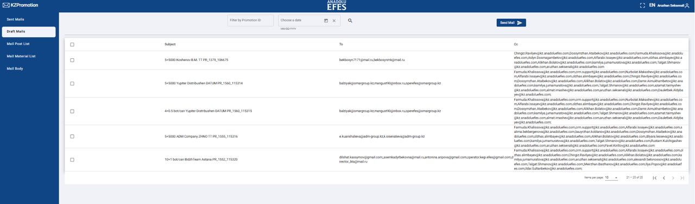
CURRENT TOOLING
The current KZPromotion system — and its limits
Today partner notifications for N+1 promos are sent by KZPromotion. It covers only a small part of the process and still requires constant manual work.
N+1 only
All other promo activity types are not supported.
Manual selection
The Sales Systems communication specialist picks promo activities for mailing by hand.
KZPromotion — partner notification mailing for N+1 promos
OPERATIONAL ISSUES
Quota changes only — automatic
Microsoft changed its internal policies — emails stopped going out, and notifications had to be sent manually.
Notifications about period or product changes have to be sent to partners manually.
Minor failures occur frequently.
Efes Kazakhstan
Efes Nexus

Slide 4

THE RESULT IN NUMBERS
The main effect — time returned
Promo volume grew almost 5× with the same team. The platform gives specialists their working time back by taking over the routine.
PROMOS / YEAR
PARTNERS
PRODUCTS · SKU
PROMO TOTAL / YEAR
×4.6
33
105
2.41 bln ₸
2,187 → 10,112 +362%
31 → 33 · in 6 mo +6.5%
78 → 105 · in 6 mo +35%
1.00 → 2.41 · 2023–2025 +140%
158 h/mo
28% of routine automated
The platform moves data between Excel, Panorama and partner emails by itself. Specialists put that time back into working with partners and checking calculations.
of working time returned · Year 1
Efes Kazakhstan
Efes Nexus

Slide 5
BPMN · WHAT THE SYSTEM AUTOMATES
Promo activity lifecycle — with Nexus
Steps of the BPMN diagram. Blue marks what the system does; gray — human actions and decisions. Red — a new step that does not exist today.
01
Creating a promo activity
1
TRADE MARKETING
→
2
NEXUS
→
3
NEXUS
→
4
NEXUS
→
5
CRM SPECIALIST
→
6
NEXUS
Channel, partner, products, quota
Checking product availability in the distributor's warehouse
Assigning PR-##### code and checking for duplicates
Generating the promo Excel file
Creating the promo activity in Panorama
Auto-notifying partners by email
human
new step
auto
auto
human
auto
02
Modifying a promo activity
1
TM / ON-TRADE
→
2
NEXUS
→
3
CRM SPECIALIST
→
4
NEXUS
Request: quota, period or product
Updating the Excel file with changes
Editing the promo activity in Panorama
Synchronization and partner notification
human
auto
human
auto
03
Month-end closing and calculation
1
PARTNER
→
2
NEXUS
→
3
NEXUS
«Request»: liters sold under the promo
Calculating ∑(liters × period price)
Verification of «Requests» and report generation
human
auto
auto
Not just automation: new steps are added — partner stock checks and promo pre-calculations, so partners send correct requests.
Automated by the system
Human action / decision
New process step
Efes Kazakhstan
Efes Nexus · BPMN

Slide 6
SCOPE
System functionality – N+1, N+KZT
Before:
After:
Scattered Excel files and email communication
(No single source of data, with communication run over email → Trade-marketing specialist – SSC specialist – CRM specialist – SSC specialist – Partners)
A single system to manage promo processes
(A single registry and all communication in one space → full transparency, instant synchronization and no loss of information)
Automated reporting
(Reports generated and sent in seconds → real-time analytics and fast decisions)
Promo Status reports are created manually
(A significant time burden on the employee)
→
Code assignment, compensation calculation and verification of a large volume of requests in a non-automated process
(Risk of duplicates, overpayments and distortions in reports)
Smart calculation and coding algorithms
(The system assigns the code itself, checking for duplicates and product availability in the distributor's warehouse, and calculates the compensation by reconciling it against partner requests)
Dependence on the human factor
(300+ promos per month)
Minimizing the human factor
(A standardized and transparent process → predictable results and lower risks)
Efes Kazakhstan
Efes Nexus

Slide 7

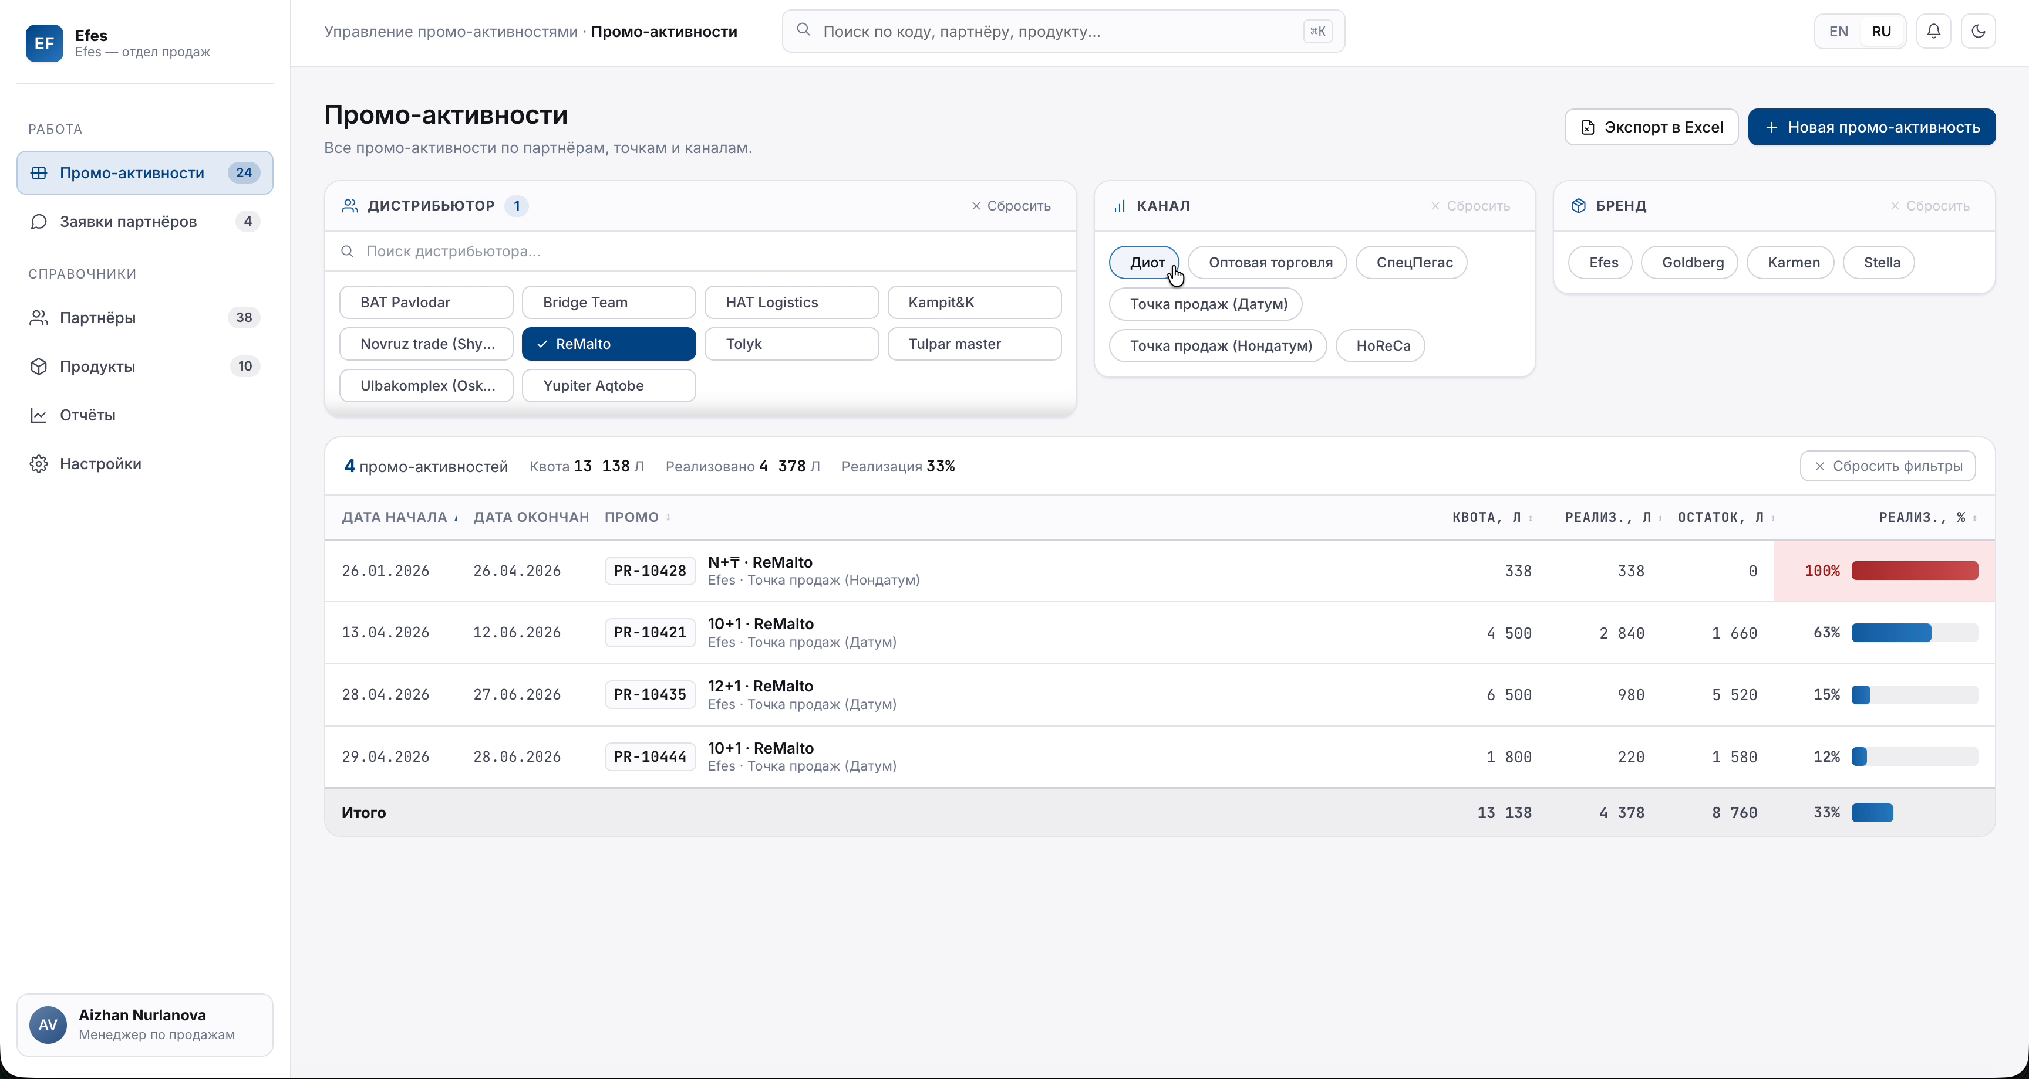
THE SYSTEM
The promo dashboard
“A single window for the entire promo-activity lifecycle — from the partner’s request to the compensation calculation.”
Live recording of the platform
Efes Kazakhstan
Efes Nexus

Slide 8







WHAT'S NEXT
Future development possibilities
The platform is already live — the next steps extend it: from AI search over promo history to 1C invoice validation and new calculation types.
AI Search & Knowledge Base
1C Invoice Validation
Scaling the calculations
Historical Promo Calendar
Search and answers to questions about current and historical promo activities.
Automatic validation of exports and invoices from 1C.
Extending calculations to other compensation types — e.g. the Kega Boom calculation.
A calendar of all current and historical promo activities.
Example: “Which promos ran for Ulba in July 2024, 2025 and 2026?”
Effect: −30% of trade & sales-controlling specialists’ time; checking 1C from every point manually — ∞ hours.
Foundation ready: shared quota, price and period logic is already in the system.
How it works: clicking a date shows the activities that were active in that period.
New promo mechanics plug straight into the platform — partners are notified the instant they go live.
Efes Kazakhstan
Efes Nexus

Slide 9
THE TEAM
Who builds Efes Nexus
The platform is built by a team of five engineers led by the founding engineer of the project.
ROLE ON THE PROJECT
AS
Founding and lead engineer of Efes Nexus. Owns the platform architecture, the process model and the Panorama and 1C integrations.
THE TEAM
Team lead of four developers: frontend, backend, integrations and rollout. All development is done in-house, with no subcontractors.
Aset Seksenali
Founding engineer · team lead
WHAT IS ALREADY DONE
asetseksenali@gmail.com
Three promo-activity BPMN processes modelled, the limits of KZPromotion mapped, and a working platform built and running.
Efes Kazakhstan
Efes Nexus

Slide 10
COMMERCIAL PROPOSAL
Pricing and phases
The platform is deployed on the Efes Kazakhstan server — no separate infrastructure is needed. Phase 1 covers everything shown in this deck; phase 2 is taken up at the client’s discretion.
PHASE 1 · PLATFORM ROLLOUT
PHASE 2 · OPTIONAL
5,000,000 KZT
+ 5,000,000 KZT
everything shown in this deck
further development possibilities
Creating, changing and closing promo activities
AI Search & Knowledge Base — search across promo history
Partner notifications and Panorama synchronisation
1C Invoice Validation — checking exports and invoices
Compensation calculations and report exports
Scaling calculations to other compensation types
Partner stock checks and promo pre-calculations
Historical promo activity calendar
Deployment on the Efes Kazakhstan server, team training
Taken up separately, after phase 1 goes live.
Phase 1 — 5,000,000 KZT for a working platform on the client’s own server. Phase 2 is optional and is paid for only if Efes decides to start it.
Efes Kazakhstan
Efes Nexus

