Slide 1
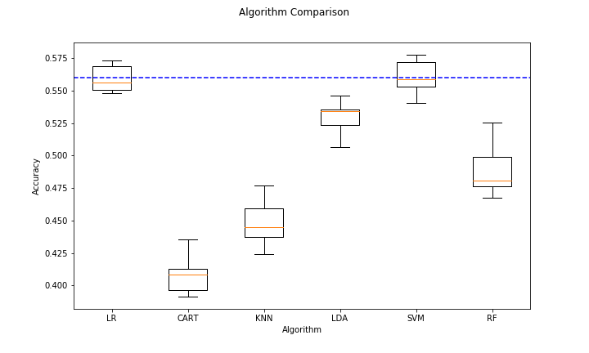
MasterChef – Gather insights from Recipe Data
Predict User Rating
Goals
We set out to solve two problems. First, we wanted to predict recipe review rating based on recipe information. Second, we wanted to figure out different types of recipes based on recipe information such as ingredients used.
Class distribution and defining the baseline model(simplest possible prediction)
Selecting a machine learning model using k-fold cross validation
Rating class | Frequency
Exceptional Rating: 4 | 1,432
Good Rating: 3.5 | 6,452
Average Rating: 3 | 2,955
Negative Rating: <3 | 655
We evaluated cross-fold prediction accuracy on 6 models: Logistic regression(LR), Decision Tree(CART), K-nearest neighbor(KNN), Linear discriminant analysis(LDA), Support vector machine(SVM), and Random forest(RF).
Results: none of the algorithms were able to satisfactorily surpass the baseline model accuracy. LR fit was better than SVM in terms of model variability.
Data
We scrapped 11,494 recipes presently in Epicurious.com as our dataset after filtering out any recipe with less than 10 reviews. For each recipe, we scrapped the following information:
Title
Image source
Number of reviews
Rating
Make-it-again score
List of ingredients
List of tags
Preparation
Since the problem is a classification, we have selected the class that has the most observations and use that class as the result for all predictions as our null model. Hence the baseline model accuracy is 56% (6,452/11,494).
Validation strategy
We randomly portioned the dataset into training and testing sets constituting 80% and 20% of the recipes respectively.
We approached a k-fold cross validation strategy to select a suitable model for prediction. We use the k-fold on the training dataset that we set up based on the split.
Feature engineering and testing association
We also engineered 5 additional features, that were also statistically significant, as features for modeling.
feature | test | statistic | P-value
Image uploaded | Chi-square test of independence | 365.03 | 8.29e-79
Number of ingredients | 1-way ANOVA | 31.30 | 3.81e-20
Number of Tags | 1-way ANOVA | 11.70 | 1.17e-07
Length of the preparation text | 1-way ANOVA | 37.04 | 8.19e-24
Length of the title text | 1-way ANOVA | 14.96 | 1.027e-09
Prediction Accuracy on the test dataset(20%) using LR was 0.568
Feature extraction from text data
We apply text analytics to the preparation text to construct a sparse matrix of TF-IDF features. We ended up getting 7784 features. In order to reduce the complexity of fitting the model, we apply PCA to the sparse matrix to reduce the feature set to 500 (variance explained by PCA components reduced to 71.3%)
Further Research
Use hyper parameter tuning
Preprocess text data
Fit the data using neural nets

Slide 2
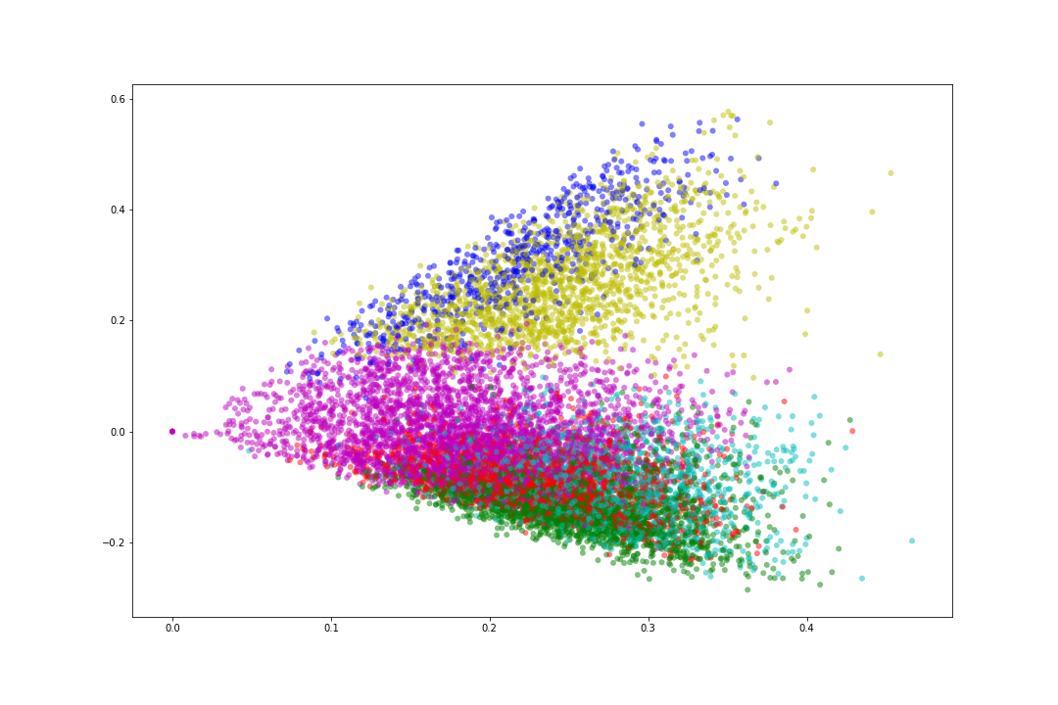
MasterChef – Gather insights from Recipe Data
Clustering
Goals
We set out to solve two problems. First, we wanted to predict recipe review rating based on recipe information. Second, we wanted to figure out different types of recipes based on recipe information such as ingredients used.
Dessert/Chocolate
Clustering recipes
We applied the unsupervised learning strategy of k-means clustering on ingredients(tf-tid vectorized), which we could then validate using recipe’s tags.
With k=6, the algorithm gave a fair distribution of recipes per cluster. Below table depicts the recipes per cluster and the general theme found based on tags.
Bakery/kid-Friendly
Bakery/Sugar Conscious
Cluster # | Recipes | Color | Theme
0 | 692 | Blue | Dessert/Chocolate
1 | 2482 | Green | Healthy/Salad
2 | 1800 | Red | Healthy/Asian
3 | 1458 | Cyan | Soup/Winter
4 | 1670 | Yellow | Bakery/kid-friendly
5 | 3392 | Magenta | Bakery /Sugar Conscious
Soup/Winter
Healthy/Asian
Healthy/Salad
Visualizing clusters
We applied PCA on ingredients to visualize the clusters.

