Slide 1
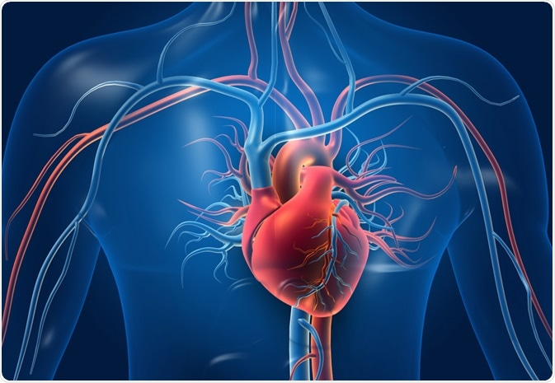
Heart Failure Prediction
Team:

Slide 2
Goal
To determine the most important features in heart failure/heart disease. Utilize machine learning and data visualization tools for better understanding.

Slide 3

Process
Teamwork
Decide on the models of Supervised and Unsupervised ML:
Logistic Regression
KNN, Random Forest
Clustering
Draw conclusion based on these models.
Data cleaning, analysis and visualization.

Slide 4
Findings
55% of the patients have heart disease in the dataset
Men are almost 2 and 1/2 times more likely have a heart disease than women.
Person with ASY-Asymptomatic chest pain has almost 2 times more likely have a heart disease than person with TA -Typical Angina chest pain.
Exercise-induced angina with 'Yes' almost 2.4 times more likely have a heart disease than exercise-induced angina with 'No’
Highly correlated variables to hear diseases were: OldPeak, Chest Pain type and Exercise Angina.
Possibility of clustering – 3-5 groups can be formed to predict heart failure.

Slide 5
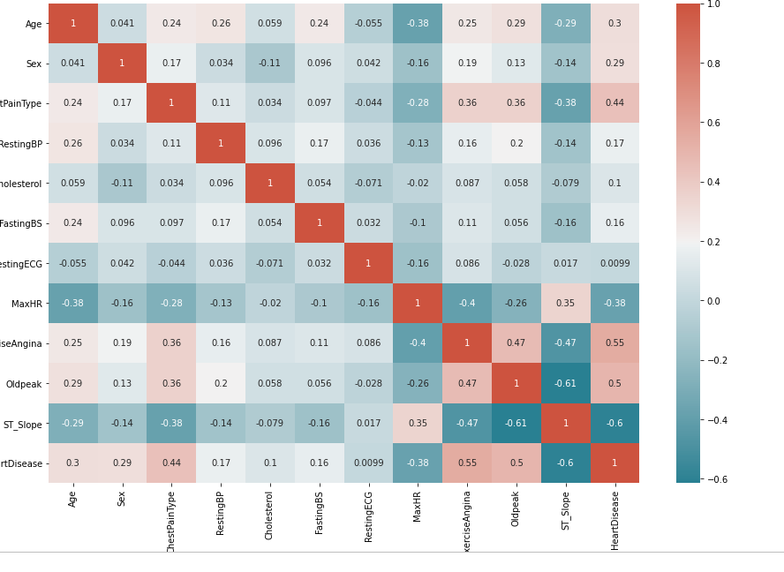
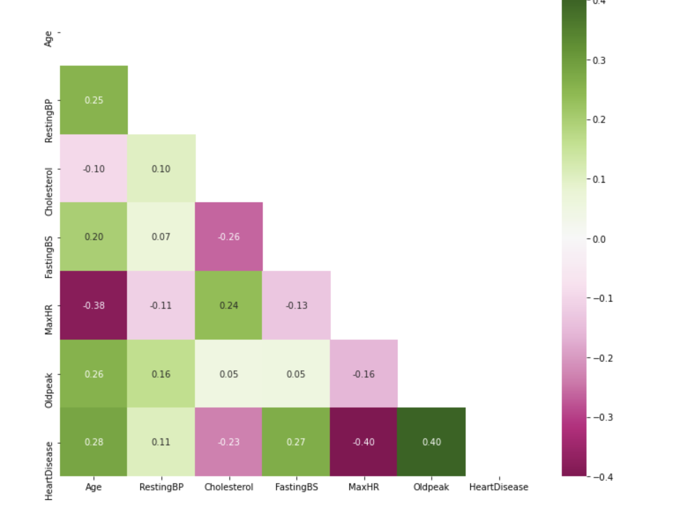
Data Visualization

Slide 6
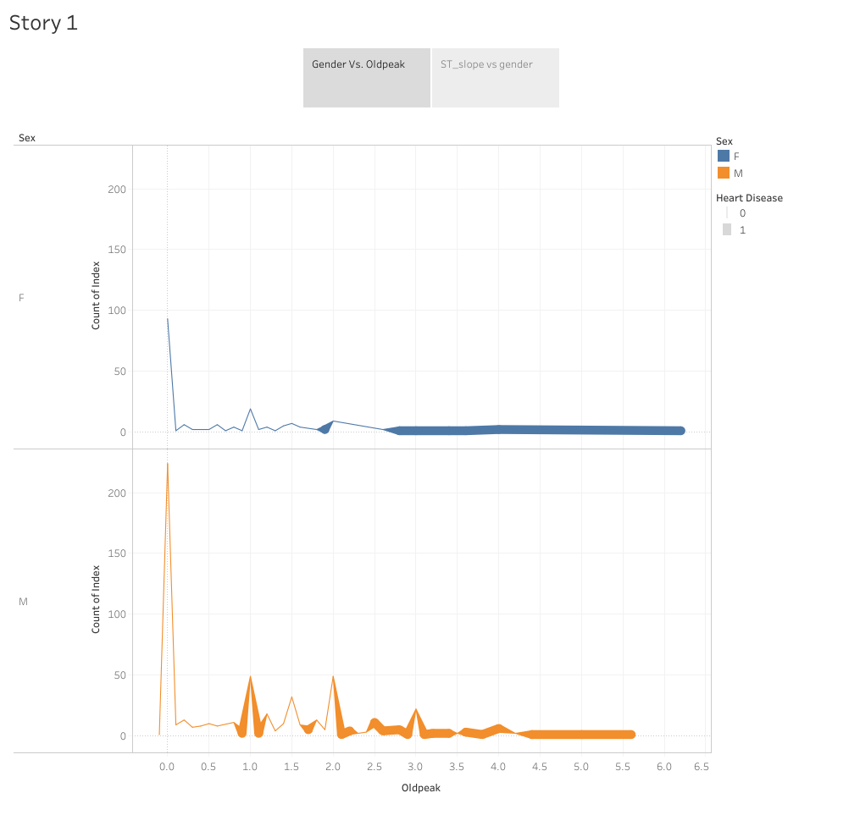
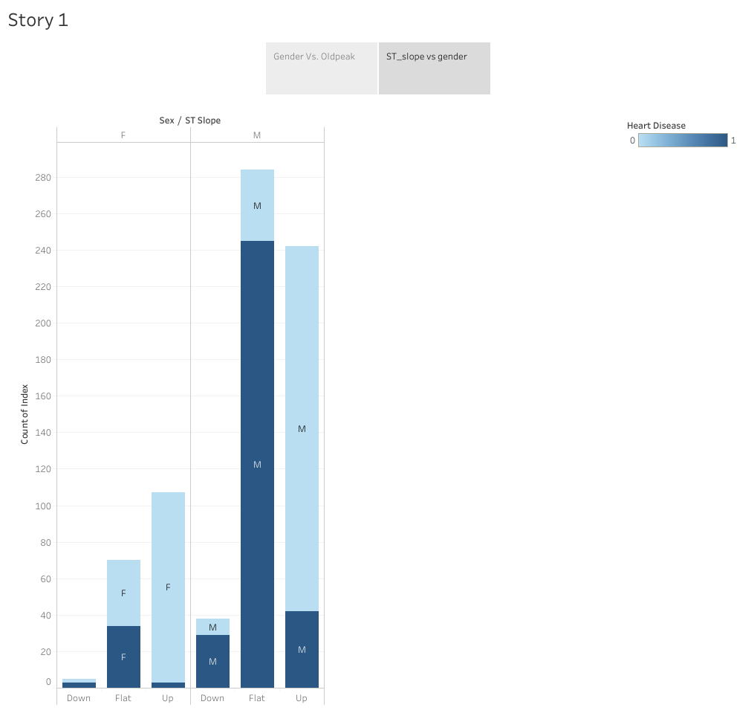

Slide 7
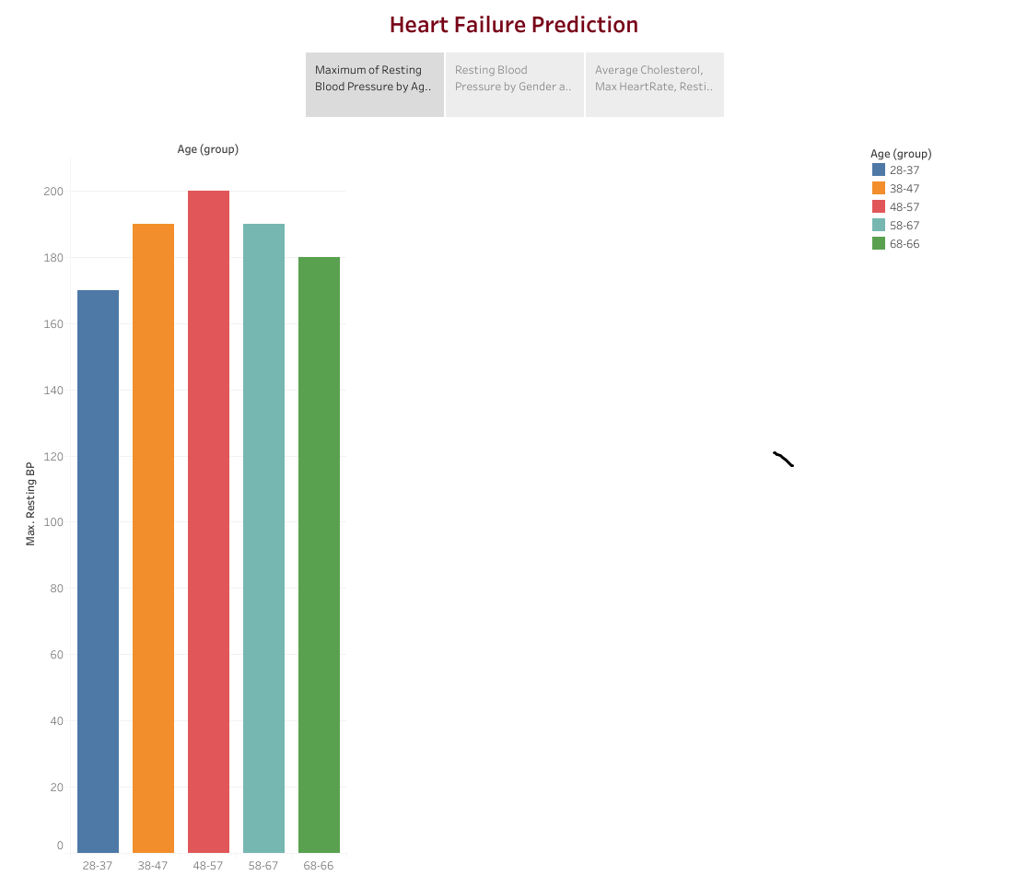
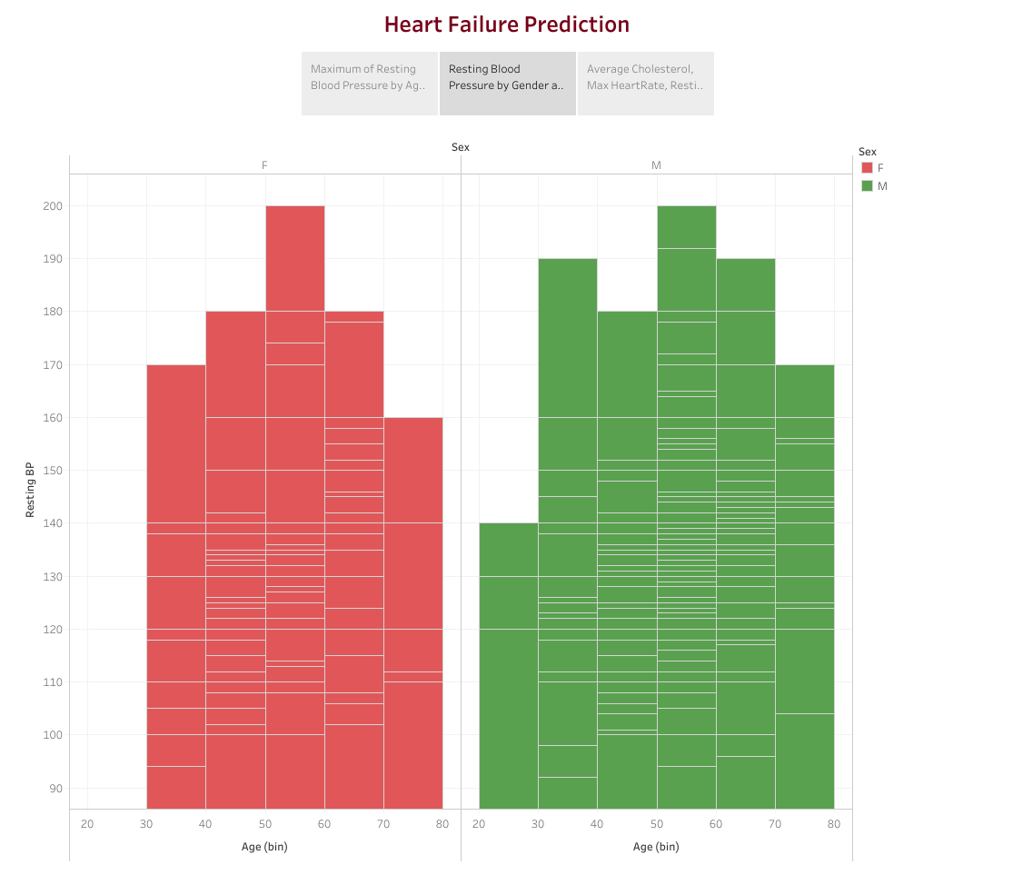
Resting Blood Pressure

Slide 8
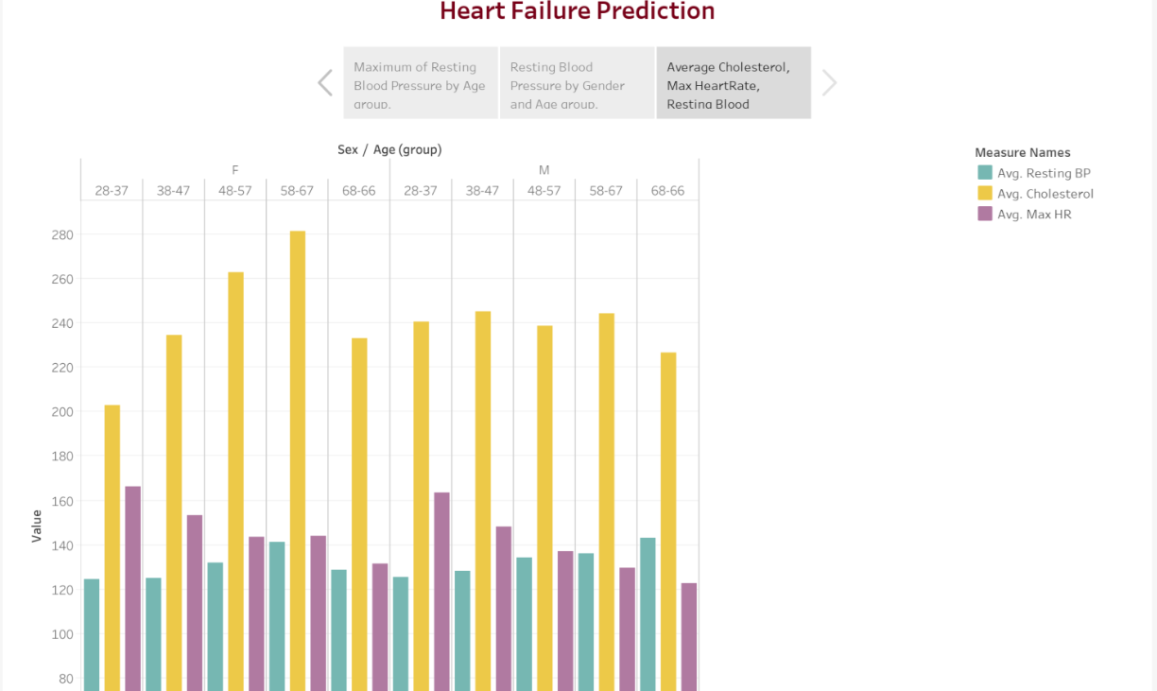
Findings

Slide 9
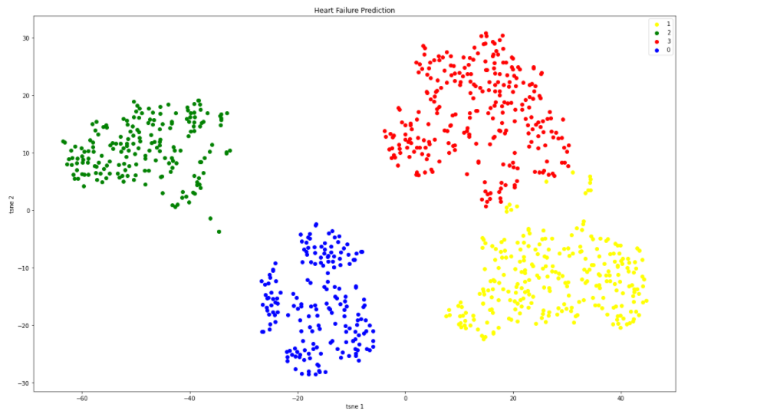
Unsupervised ML - Clustering

Slide 10
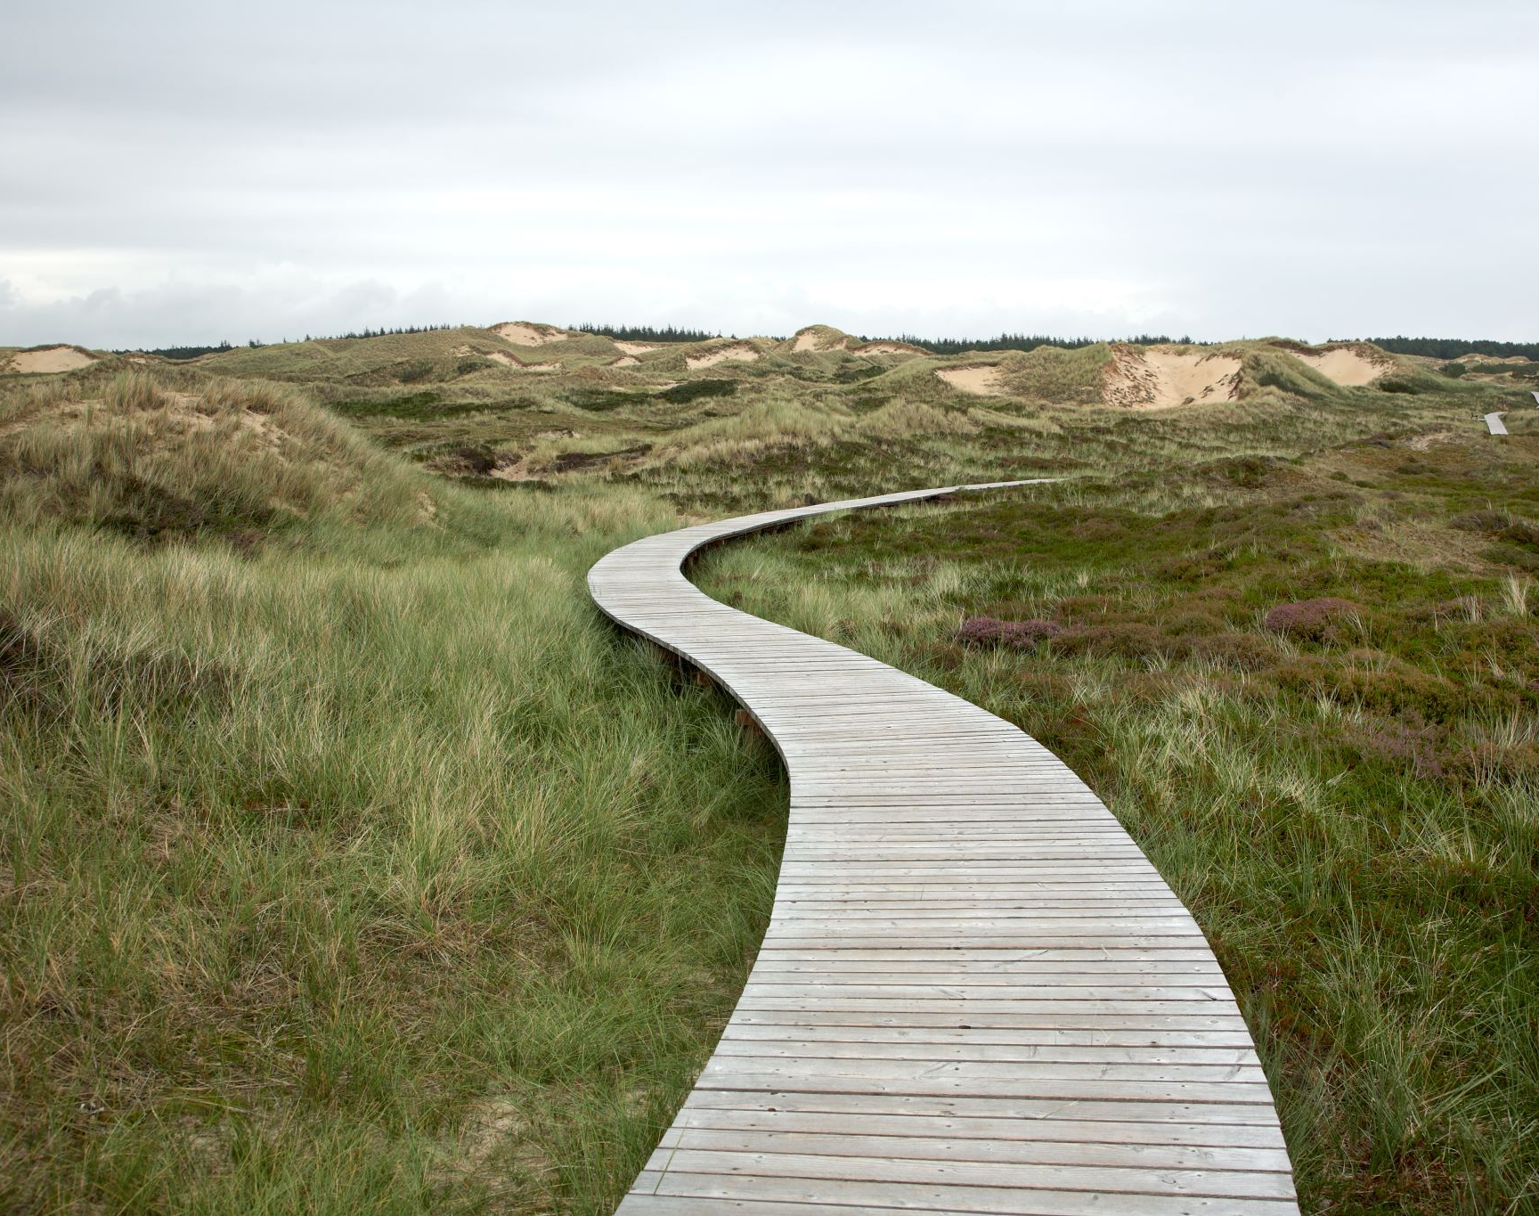
Next Steps
Look into separating into different dataset based on gender to possibly remove bias.
Explore other ML models.
Re-do the clustering by removing the outliers.
Keep in touch.

