Slide 1

AI-Powered Dashboard for Green Infrastructure Siting in South Florida
Ahmed S. Elshall, Ph.D.
Assistant Professor - Environmental Engineering
U.A. Whitaker College of Engineering
Joint Appointment with The Water School
Email: aelshall@fgcu.edu
Mewcha A. Gebremedhin, Ph.D.
Postdoctoral Research Scholar
U.A. Whitaker College of Engineering
Email: mgebremedhin@fgcu.edu
Notes:
Assisted Agents (Level 1): These are AI systems that support scientists in narrow, well-defined tasks.
Examples:
Literature search engines powered by LLMs.
Automated data cleaning or visualization tools.
Machine learning models for prediction (e.g., climate or groundwater models you might use in hydrology).
Key Feature: Human-in-the-loop is essential; the AI only assists.

Slide 2
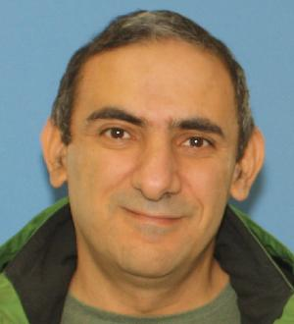

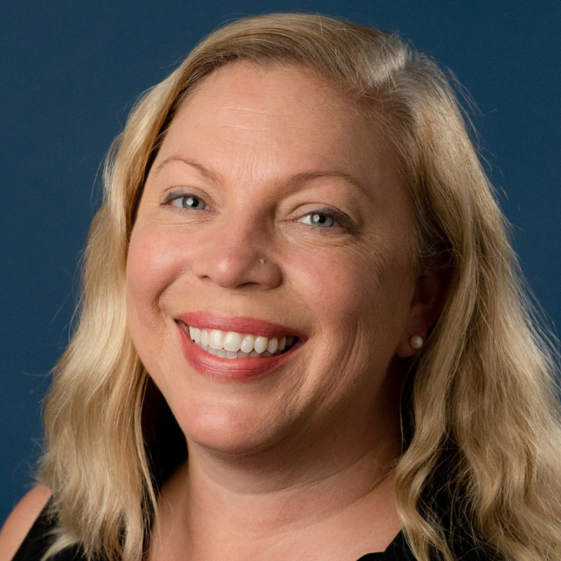

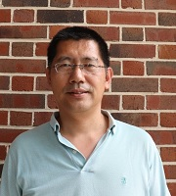



Nature-based Infrastructure for Enhancing Climate Resiliency of Groundwater Resources in South Florida
Ahmed Elshall, WCE and TWS
Mewcha Gebremedhin, WCE
Shelly Krueger, UF
Seneshaw Tsegaye, WCE
Ming Ye, FSU
USGS Caribbean-Florida Water Science Center

Slide 3
Project Overview
Assess climate change impacts
Evaluate nature-based infrastructure for mitigation (local or regional)
Collaborative modeling
Web-based platform for data sharing
Groundwater education and outreach
Notes:
Quantifying the impacts of climate change on surface-groundwater interactions, groundwater resources, water quality in terms of salinity (undergoing). This is particularly related to the changing rainfall pattern and SLR rise under different scenarios
Collaborating with stakeholders to evaluate nature-based infrastructure for mitigation and adaptation solutions (Next step). This could be at local or regional scale (any suggestion on this would be also appreciated)
Conducting outreach campaigns to increase community awareness about the resilience of groundwater resources in South Florida (using different outlet medias).
Developing a user-friendly web-based platform to provide stakeholders with access to project data, supporting decision-making and community engagement. This helps to the goal of making data FAIR: Findable, Accessible, Interoperable, and Reusable

Slide 4
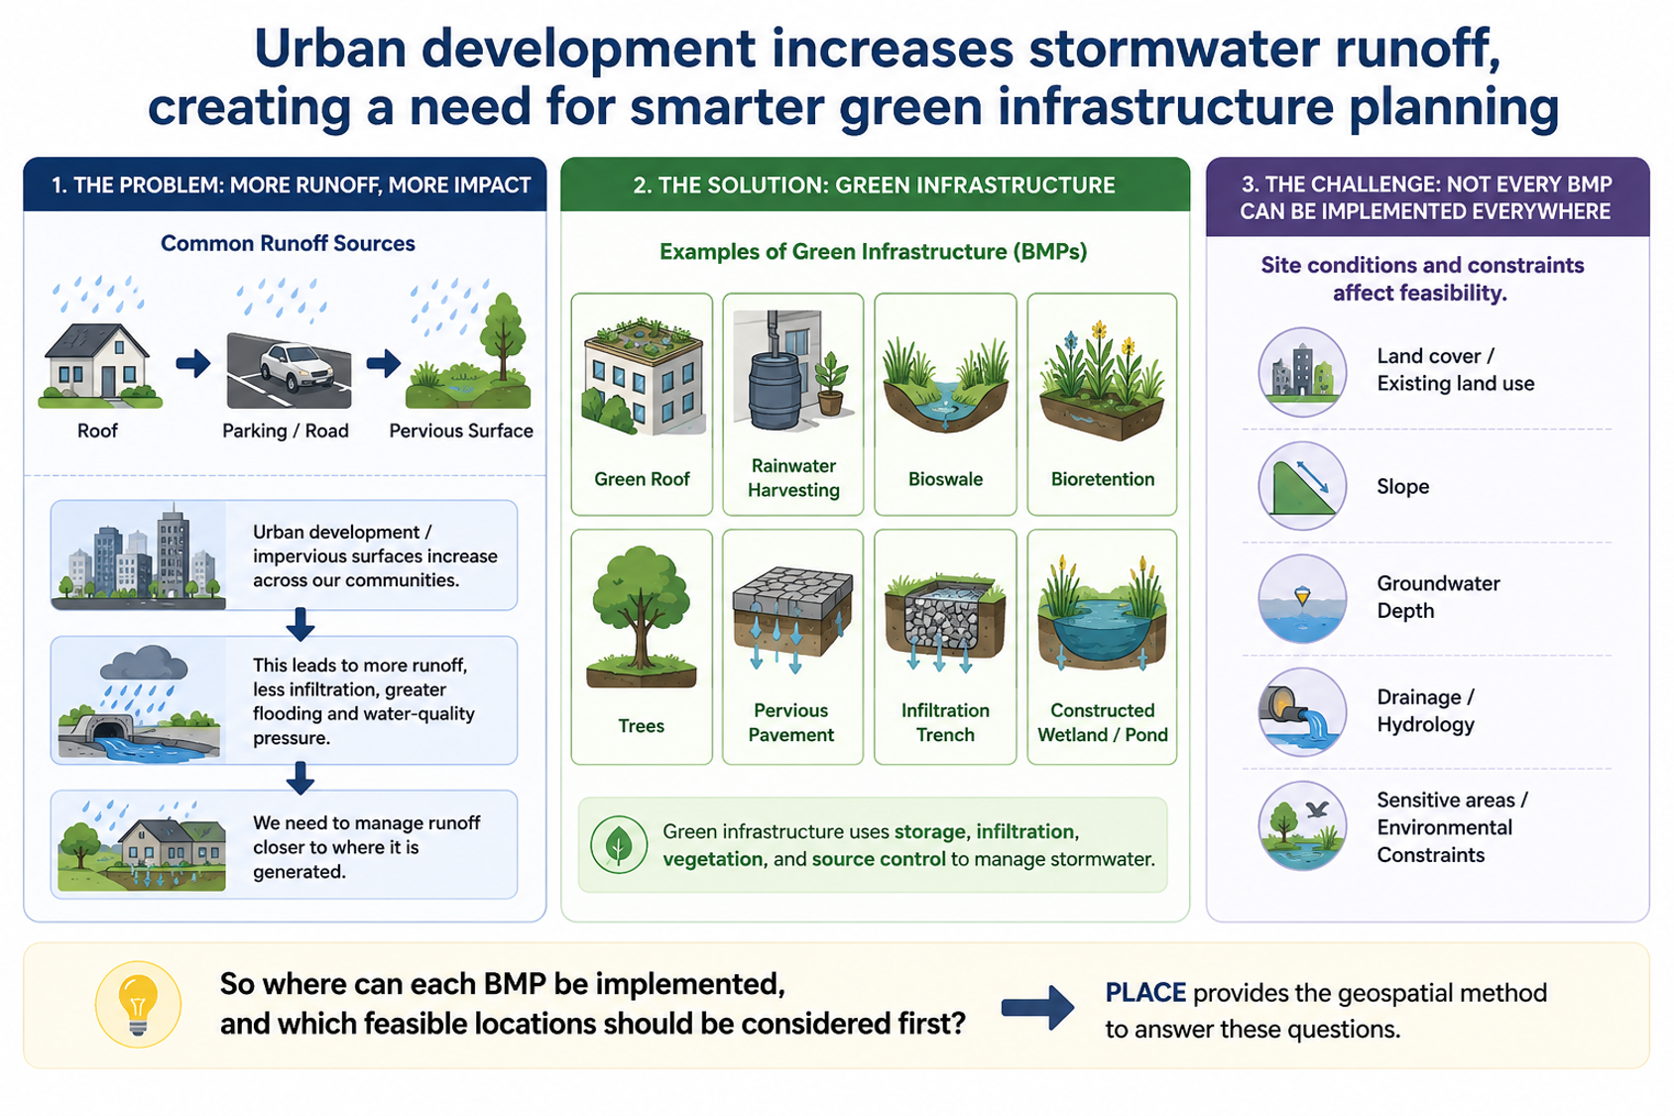


Urban development increases stormwater runoff creating a need for effective green infrastructure planning
Runoff Sources
Green Infrastructure (BMPs)
Site conditions
Roof
Parking/Road
Pervious Surface
Gray infrastructure
Green infrastructure
GI PLACE: Geospatial method for BMPs placement
ChatGPT generated icons
Notes:
Urban development-> impervious surface -> increased surface runoff
When we urbanize a landscape, we replace soil and vegetation with roofs, roads, and parking lots.
Rainfall that previously infiltrated into the ground now becomes runoff,
Traditionally, we manage this runoff using gray infrastructure
pipes, culverts, channels, and large storage systems
The philosophy is basically, get the water out of here:
Collect and drain: But as development increases runoff, we need larger infrastructure, which can move even more water downstream even faster.
less infiltration, increased flooding, water quality issues
Green infrastructure: Manage runoff closer to where it generated (nature-bases solution)
Green infrastructure takes a different approach.
Instead of only asking how we can convey the water, we ask how we can manage it close to where it is generated.
We can use green roofs, rainwater harvesting, bioswales, bioretention, pervious pavement, trees, infiltration systems, wetlands, and ponds to store, infiltrate, or slow runoff.
But here is the challenge: we cannot put every BMP everywhere
Site conditions, feasibility constraints and priories)
A green roof needs a roof.
Pervious pavement needs a paved surface.
An infiltration system needs appropriate soil, slope, groundwater separation, and available land.
So green infrastructure is fundamentally a spatial siting problem.
That is the problem our PLACE framework is designed to address.
So where can each BMP be implemented, and which feasible locations should be considered first?
PLACE provides the geospatial method for answering these questions.

Slide 5
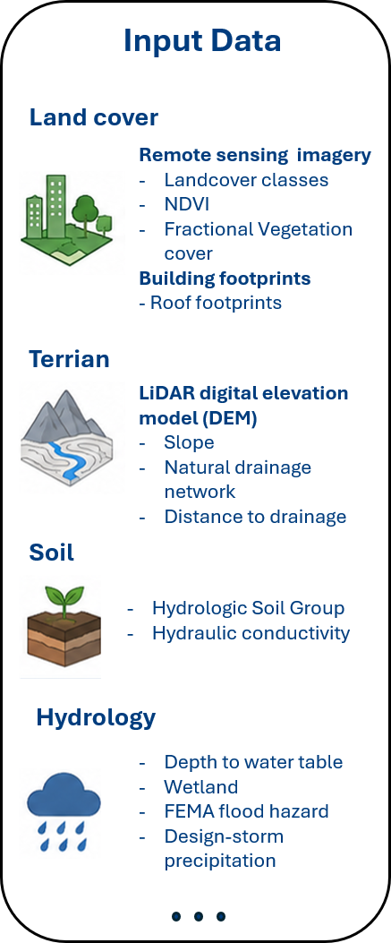
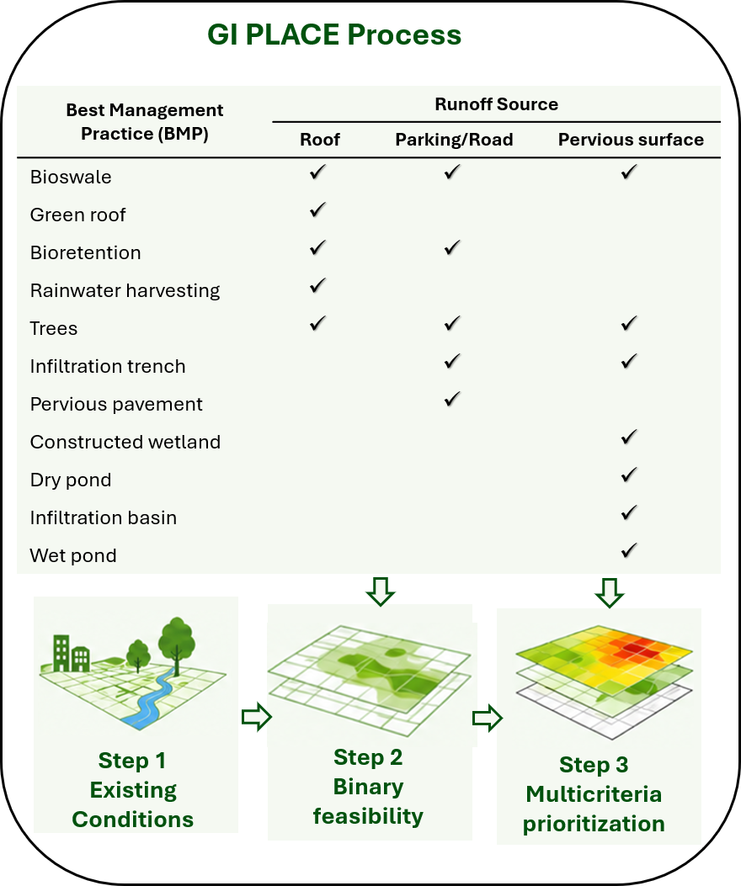
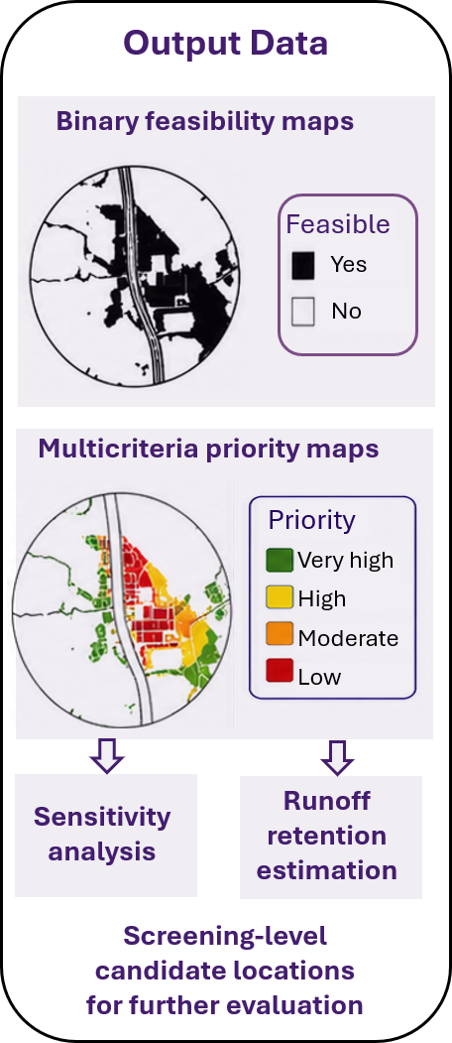
Turning GI PLACE method to interactive dashboard for green infrastructure planning
Notes:
That is where PLACE comes in. The good news for you is that we already developed the method, so you do not have to spend the semester inventing another acronym.
PLACE basically does three things. It characterizes the existing conditions, identifies where each BMP is feasible, and then prioritizes the feasible locations.
For Bonita Bay, we already have the spatial data, the processing workflow, and the Python code. Your task is to extend that workflow to Lee and Collier counties. That means obtaining and processing the same types of data—land cover, buildings, roads, terrain, soils, groundwater, wetlands, floodplains, rainfall, drainage, and so on.
Once those inputs are prepared, PLACE produces the outputs we need—primarily feasibility maps, priority maps, and supporting tables for each BMP.
So you are not starting from a blank screen. We have the recipe. Your job is to help us cook for two counties instead of one neighborhood.

Slide 6
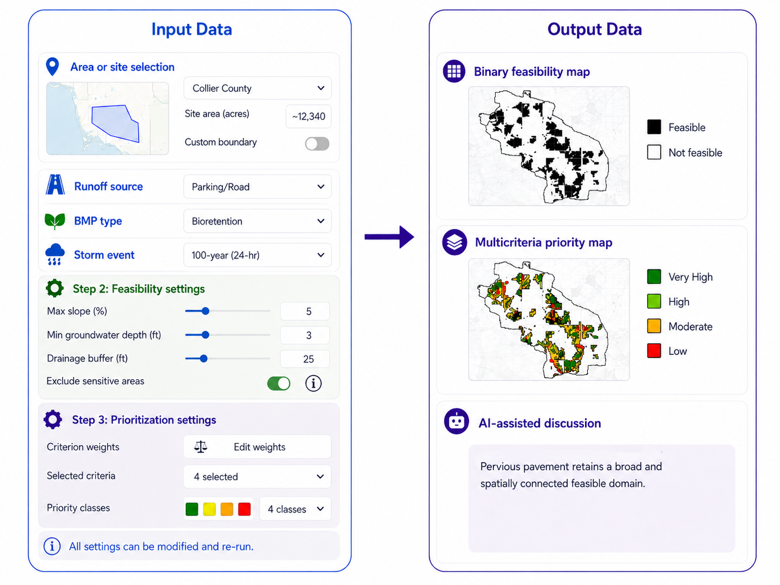
AI-powered dashboard for site-specific green infrastructure planning: User selects, GI PLACE calculates, the dashboard shows and AI explains
Instructed ChatGPT generated image
Notes:
Interactive AI-powered dashboard for identifying and prioritizing green infrastructure locations for stormwater management
Now the basic idea of the dashboard is actually very simple.
The user selects an area in Lee or Collier County, chooses the BMPs they want to evaluate, and can also adjust the feasibility and prioritization settings.
Then they click a button.
Behind that innocent little button, PLACE does all the unpleasant work—GIS processing, constraints, calculations, and prioritization.
The user gets back something useful—where each BMP is feasible, where the priority locations are, and the supporting maps and tables for that site.
And then comes the AI part. We give those outputs to an LLM so it can explain the results and help the user understand why certain locations or BMPs were prioritized.
So the workflow is basically: the user selects, PLACE calculates, the dashboard shows, and AI explains.
Your challenge is to make everything between that first click and the final answer look easy—even though we know it is not.

Slide 7
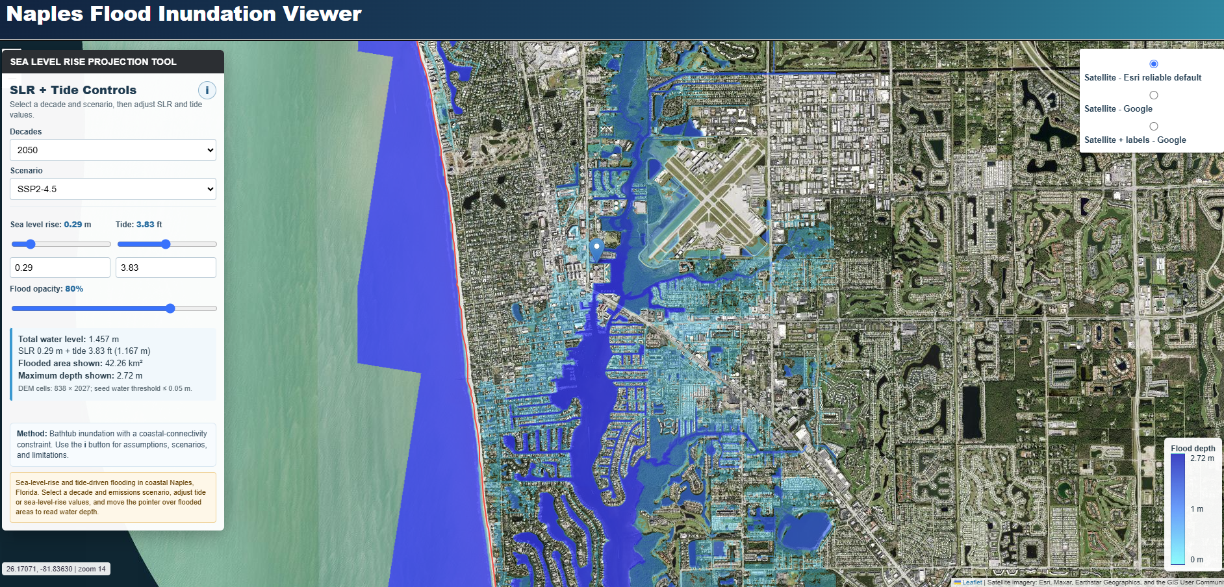
Project 2: Integrating bathtub inundation modeling and LLMs for coastal flood screening in South Florida

Slide 8
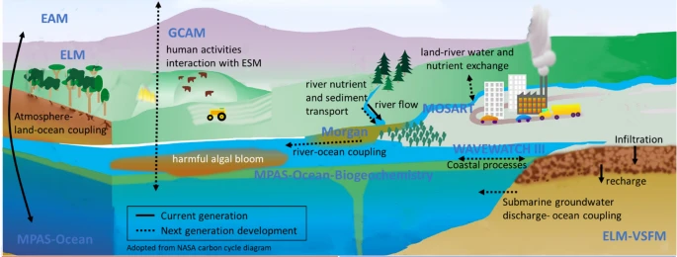


Project 3: Machine learning for analysis of nutrient loading mitigation to reduce red tide task
Notes:
Scenario Analysis of Nutrient Loading Mitigation to Reduce Red Tide Risk: Involves enhancing harmful algal bloom mitigation through advanced machine learning with feature analysis

Slide 9
Project support
Provide project datasets and guidance on Python packages
Assist with the design of web-based UI
Manuscript mentorship for high-quality peer-reviewed publication
Cover open-access publication fees
Provide full travel support for 1 student (or 2 going together) to present at a national conference (e.g., AGU Fall Meeting, San Francisco)
Service-learning hours
Collaborative teamwork through the project
Notes:
Project datasets and workflows, plus guidance on required Python packages
Frontend guidance for a browser-based UI
Manuscript mentorship with the goal of a high-quality peer-reviewed publication (beyond a capstone report)
Open-access publication fees covered
Travel support for 1 student (or 2 going together) to present at a national conference (e.g., AGU Fall Meeting, San Francisco - One week).
Hands-on experience with geospatial big data
Graduate school preparation
Strong resume (working on an EPA funded grant and CMIP6 data)

Slide 10
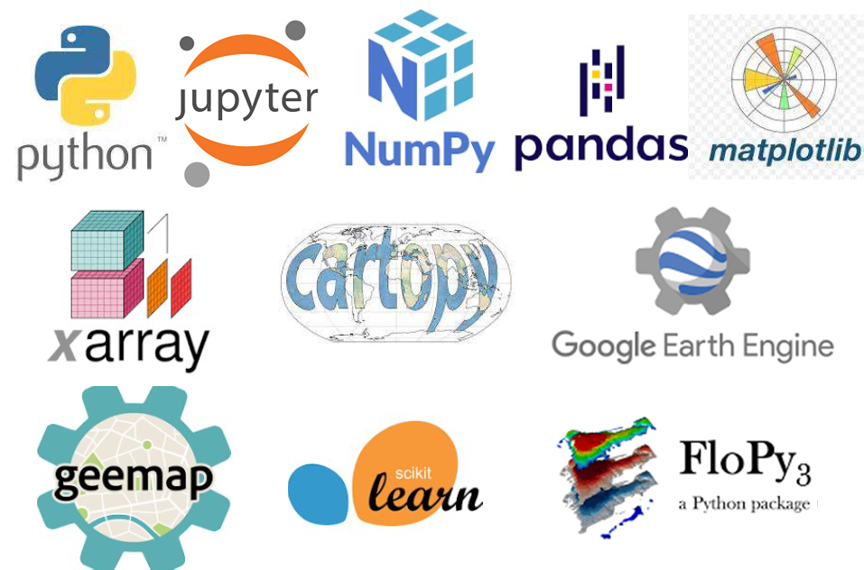

Advertisement: LA Position for Spring 2026
CGN 4404/CGN 5716
Environmental Data Science
Scan for slides and more information

Slide 11
Thank You
Questions?
https://aselshall.github.io/ads/ai
Scan for slides and more information

