Slide 1
INTRODUCTION TO PYTHON LECTURE 5: Numerical Python
Asem Elshimi

Slide 2
Outline
Numpy
Matplotlib

Slide 3
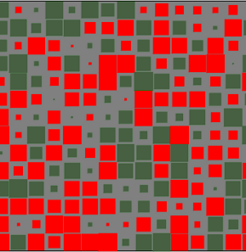
numpy
extension package to Python for multidimensional arrays
closer to hardware (efficiency)
designed for scientific computation (convenience)

Slide 4
Importing libraries
import matplotlib.pyplot as plt
X = [590,540,740,130,810,300,320] Y = [32,36,39,52,61,72,77]
plt.scatter(X,Y)
from my_file1 import *
#my_file1 includes few functions: #sum3 and Is_even etc
sum3(4,5)
Is_even(5)
import math
decibel= 20* math.log10(17.0)
Notice different syntax for import.

Slide 5
Semi-standardized import
import numpy as np
import matplotlib.pyplot as plt
Interface for matplotlib to make it similar to MATLAB

Slide 6
Array based operations [without loops]
#create a list with temperature values
cvalues = list(range(-40,100,20))
#convert to a numpy array
C = np.array(cvalues)
print(C)
type(C)
#convert to F
F= C * 9 / 5 + 32
print(F)
#Lists have to iterate!
fvalues = [ x*9/5 + 32 for x in cvalues]
print(fvalues)
[-40 -20 0 20 40 60 80]
numpy.ndarray
[-40. -4. 32. 68. 104. 140. 176.]
[-40.0, -4.0, 32.0, 68.0, 104.0, 140.0, 176.0]

Slide 7
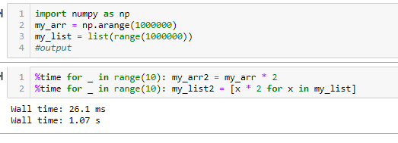
Numpy is faster

Slide 8
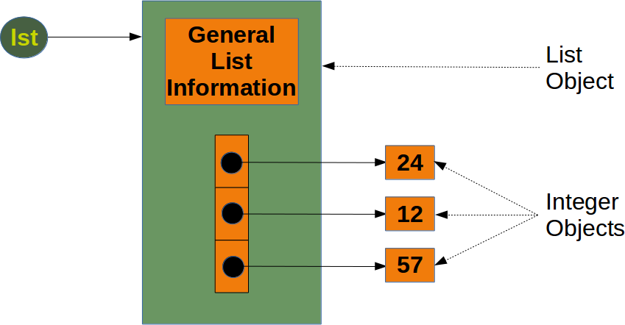
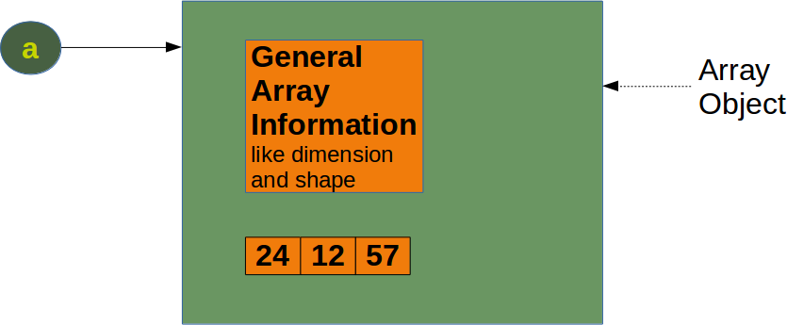
Memory usage
Python list:
List info
n*pointer size
n*object size
numpy arrays:
Array info
n*object size

Slide 9
Numpy syntax
Object
Creating arrays
Indexing & slicing
Use cases

Slide 10
The NumPy ndarray: A Multidimensional Array Object
# Generate some random data
data = np.random.randn(2, 3)
data
data + data
print(data.shape)
print(data.dtype)
array([[-0.2047, 0.4789, -0.5194],
[-0.5557, 1.9658, 1.3934]])
array([[-0.4094, 0.9579, -1.0389],
[-1.1115, 3.9316, 2.7868]])
(2, 3)
float64

Slide 11

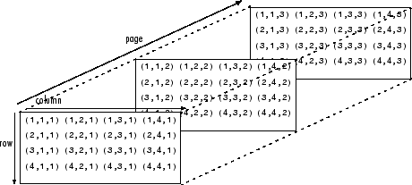

Slide 12
Creating arrays: from lists
data1 = [6, 7.5, 8, 0, 1]
arr1 = np.array(data1)
print(data1)
print(arr1)
[6, 7.5, 8, 0, 1]
[6. 7.5 8. 0. 1. ]

Slide 13
Creating arrays: 2D -- from lists
data2 = [[1, 2, 3, 4], [5, 6, 7,8]]
arr2 = np.array(data2)
Arr2
print(arr2.ndim)
print(arr2.shape)
array([[1, 2, 3, 4],
[5, 6, 7, 8]])
2
(2, 4)

Slide 14
Creating arrays: zeros and ones
np.zeros(10)
np.ones((3, 6))
np.ones_like(arr2)
np.full((2, 3, 2),5)
array([0., 0., 0., 0., 0., 0., 0., 0., 0., 0.])
array([[1., 1., 1., 1., 1., 1.],
[1., 1., 1., 1., 1., 1.],
[1., 1., 1., 1., 1., 1.]])
array([[1, 1, 1, 1],
[1, 1, 1, 1]])
array([[[5, 5],
[5, 5],
[5, 5]],
[[5, 5],
[5, 5],
[5, 5]]])

Slide 15
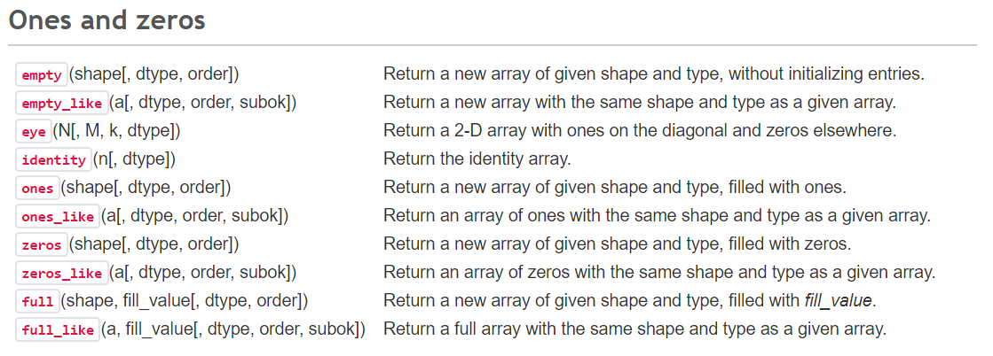

Slide 16
Creating arrays: arrange and linspace
print( np.arange(1, 100, 20))
print(np.linspace(1, 100, 7))
[ 1 21 41 61 81]
[ 1. 17.5 34. 50.5 67. 83.5 100. ]
arange: step.
linspace: number of steps.k
Q: endpoint of linspace?
Q: Multidimensional arange?

Slide 17
Arithmetic [element wise]
arr = np.array([[1., 2., 3.], [4., 5., 6.]])
print(1 / arr)
print(arr ** 0.5)
arr2 = np.array([[0., 4., 1.], [7., 2., 12.]])
print(arr2 > arr)
[[1. 0.5 0.33333333]
[0.25 0.2 0.16666667]]
[[1. 1.41421356 1.73205081]
[2. 2.23606798 2.44948974]]
[[False True False]
[ True False True]]

Slide 18
Indexing
list
ndarray
b = np.diag(np.arange(3))
print(b)
b[1,1]
ls1=[[0,0,0],[0,1,0],[0,0,2]]
print(ls1)
ls1[1][1]
[[0 0 0]
[0 1 0]
[0 0 2]]
[[0, 0, 0], [0, 1, 0], [0, 0, 2]]
1
1

Slide 19
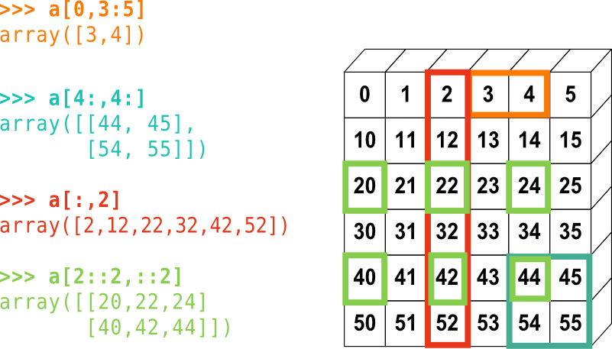
Slicing

Slide 20
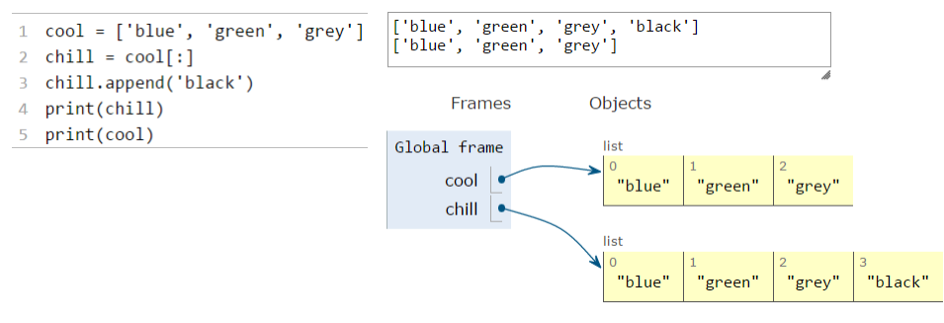
Recall cloning from lists
Create a new list and copy every element using:
chill = cool[:]

Slide 21
Mutability
list
ndarray
lst = [0, 1, 2, 3, 4, 5, 6, 7, 8, 9]
lst2 = lst[2:6]
lst2[0] = 22
lst2[1] = 23
print(lst)
A = np.array([0, 1, 2, 3, 4, 5, 6, 7, 8, 9])
S = A[2:6]
S[0] = 22
S[1] = 23
print(A)
A = np.array([0, 1, 2, 3, 4, 5, 6, 7, 8, 9])
S = A[2:6].copy()
S[0] = 22
S[1] = 23
print(A)
[0, 1, 2, 3, 4, 5, 6, 7, 8, 9]
[ 0 1 22 23 4 5 6 7 8 9]
[ 0 1 2 3 4 5 6 7 8 9]

Slide 22
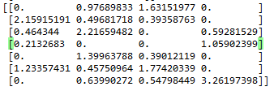
Boolean indexing
data = np.random.randn(7, 4)
print(data)
boolmask=data<0
print(boolmask)
data[data<0]=0
print(data)
[[-1.66242323 0.97689833 1.63151977 -0.30667844]
[ 2.15915191 0.49681718 0.39358763 -2.15413683]
[ 0.464344 2.21659482 -2.59028366 0.59281529]
[ 0.2132683 -0.65344045 -0.1768013 1.05902399]
[-0.48605123 1.39963788 0.39012119 -1.23126857]
[ 1.23357431 0.45750964 1.77420339 -0.06870388]
[-2.2654817 0.63990272 0.54798449 3.26197398]]
[[ True False False True]
[False False False True]
[False False True False]
[False True True False]
[ True False False True]
[False False False True]
[ True False False False]]

Slide 23
Using Numpy
So many applications.
Linear algebra:
Specially to solve optimization problems.
Loop vectorization.
Control systems and signal processing.
Data analysis [Pandas is much better.]

Slide 24

Linear algebra: scalar product
x = np.array([1,2,3])
y = np.array([-7,8,9])
dot = np.vdot(x,y)
36

Slide 25

Matrix operations

Slide 26
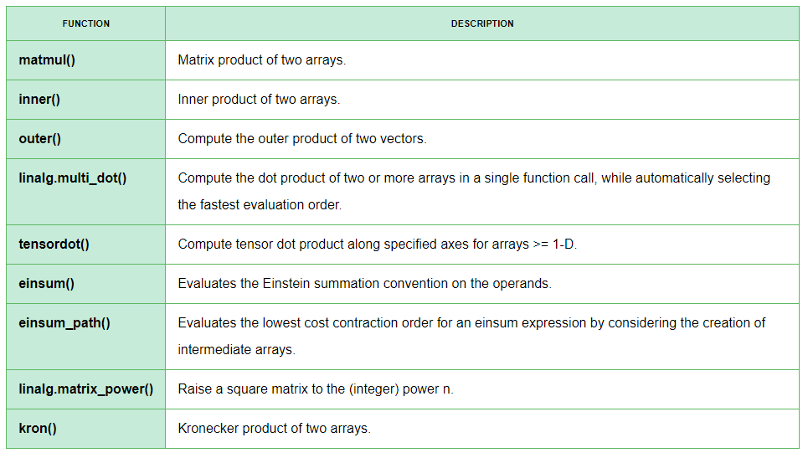
Matrix operations

Slide 27
np.linalg
A = np.array([[6, 1, 1],
[4, -2, 5],
[2, 8, 7]])
print(np.linalg.matrix_rank(A))
print(np.trace(A))
print(np.linalg.det(A))
print(np.linalg.inv(A))
print(np.linalg.matrix_power(A, 3))
3
11
-306.0
[[ 0.17647059 -0.00326797 -0.02287582]
[ 0.05882353 -0.13071895 0.08496732]
[-0.11764706 0.1503268 0.05228758]]
[[336 162 228]
[406 162 469]
[698 702 905]]

Slide 28
Eigen values
a = np.diag((1, 2, 3))
print(a)
vals, vects = np.linalg.eig(a)
print(vals)
print(vects)
[[1 0 0]
[0 2 0]
[0 0 3]]
[1. 2. 3.]
[[1. 0. 0.]
[0. 1. 0.]
[0. 0. 1.]]

Slide 29
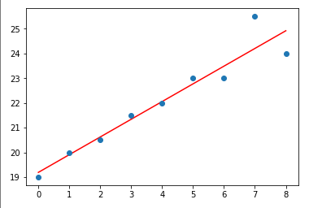
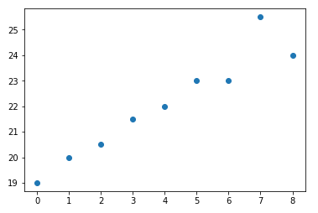
Least squares
# x co-ordinates
x = np.arange(0, 9)
# linearly generated sequence
y = [19, 20, 20.5, 21.5, 22, 23, 23, 25.5, 24]
plt.plot(x, y, 'o')
plt.show()
# obtaining the parameters of regression line
A = np.array([x, np.ones(9)])
w = np.linalg.lstsq(A.T, y)[0]
# plotting the line
line = w[0]*x + w[1] # regression line
plt.plot(x, line, 'r-')
plt.plot(x, y, 'o')
plt.show()

Slide 30

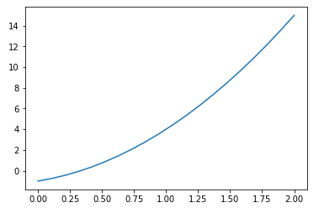
Polynomials
p = np.poly1d([3, 2, -1])
p
p(0)
p.roots
p.order
x = np.linspace(0, 2, 20)
y=p(x)
plt.plot(x,y)
poly1d([ 3, 2, -1])
-1
array([-1. , 0.33333333])

Slide 31
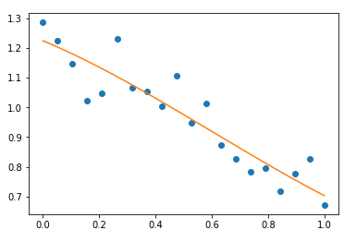
Polynomials
x = np.linspace(0, 1, 20)
y = np.cos(x) + 0.3*np.random.rand(20)
p = np.poly1d(np.polyfit(x, y, 3))
t = np.linspace(0, 1, 200)
plt.plot(x, y, 'o', t, p(t), '-')
plt.show()

Slide 32

Matplotlib
Replaces matlab
Generate scientific quality plots (more on this next lecture)

Slide 33
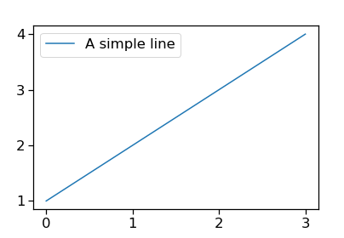
A simple example
import numpy as np
import matplotlib.pyplot as plt
ax = plt.gca()
ax.plot([1, 2, 3, 4])
ax.legend(['A simple line’])
plt.show()

Slide 34
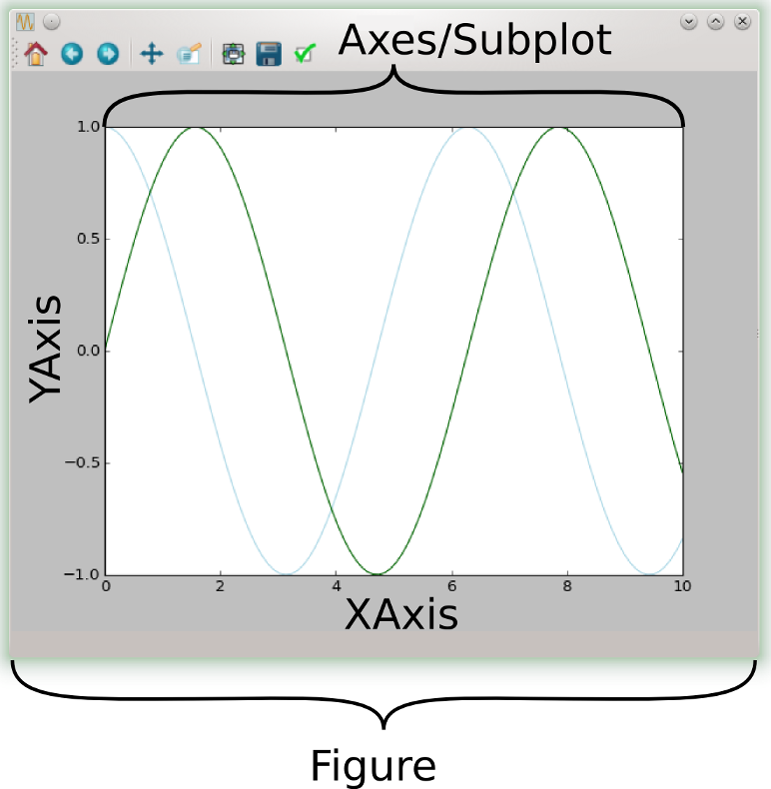
Anatomy of a plot
The Figure is the top-level container in this hierarchy.
Most plotting occurs on an Axes.
Axes and Subplot are almost synonymous.

Slide 35
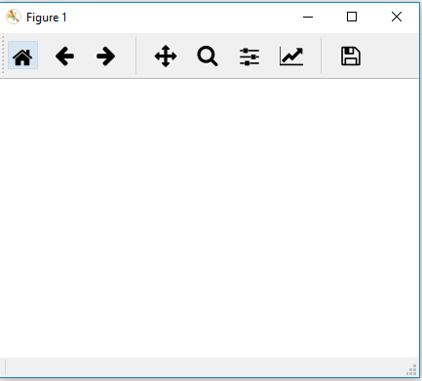
Figures
fig = plt.figure()
plt.show()
You might need:
%matplotlib [Spyder]
Or %matplotlib inline [Jupyter]

Slide 36
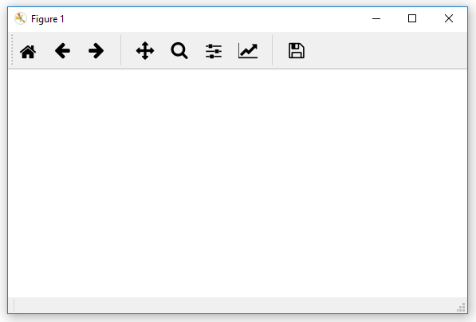
figsize=(width, height)
# Twice as wide as it is tall:
fig = plt.figure(figsize=plt.figaspect(0.5))
plt.show()

Slide 37
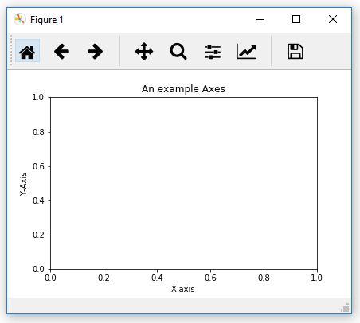
axes
fig = plt.figure()
ax = fig.add_subplot(111)
ax.set_xlabel('X-axis')
ax.set_ylabel('Y-Axis')
ax.set_title('An example Axes')
plt.show()
Exercise: explore tab completion with ax.set_

Slide 38
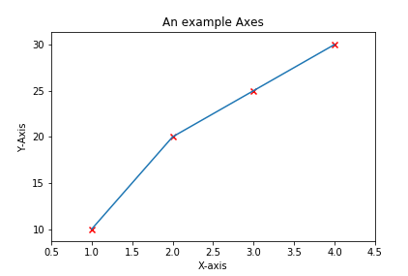
Basic plotting
...
xdata=[1, 2, 3, 4]
ydata=[10, 20, 25, 30]
ax.plot(xdata, ydata)
ax.scatter(xdata,ydata, marker='x’, color='r')
ax.set_xlim(0.5, 4.5)
plt.show()

Slide 39
Axes methods vs. pyplot
...
plt.plot(xdata, ydata)
=[implicitly calls]=
ax.plot(xdata, ydata)
"The Zen of Python" says:
"Explicit is better than implicit"

Slide 40
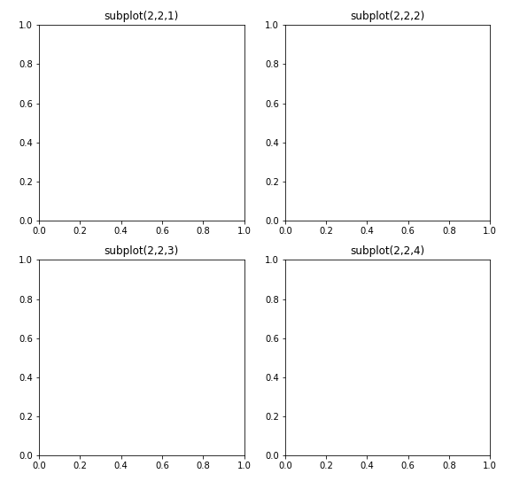
Multiple axes in one figure: subplots
fig=plt.figure()
ax=fig.add_subplot(2,2,1)
ax.set_title('subplot(2,2,1)’)
ax=fig.add_subplot(2,2,2)
ax.set_title('subplot(2,2,2)’)
ax=fig.add_subplot(2,2,3)
ax.set_title('subplot(2,2,3)’)
ax=fig.add_subplot(2,2,4)
ax.set_title('subplot(2,2,4)')
plt.show()

Slide 41
More advanced
Advanced is: https://matplotlib.org/users/gridspec.html
ax = plt.subplot2grid((2, 2), (0, 0))

Slide 42
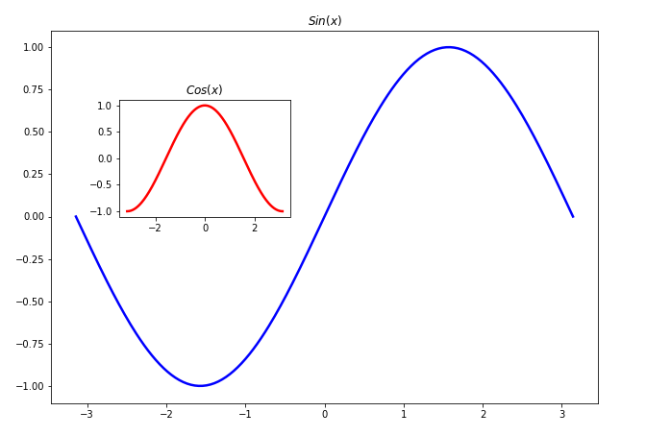
Axes inside axes
X = np.linspace(-np.pi, np.pi, 256)
C,S = np.cos(X), np.sin(X)
fig=plt.figure()
#[left, bottom, width, height]
ax1=plt.axes([0.1,0.1,.8,.8])# main axes
ax1.plot(X, S, color="blue", linewidth=2.5)
ax1.set_title('$Sin(x)$')
ax2=plt.axes([0.2,0.5,.25,.25]) # inset axes
ax2.plot(X, C, color="red", linewidth=2.5)
ax2.set_title('$Cos(x)$')
plt.show()

Slide 43
Next lecture
This lecture: matplotlib anatomy
Next lecture: the art of creating beautiful graphs

Slide 44
Questions?
Thank you!

