Slide 1
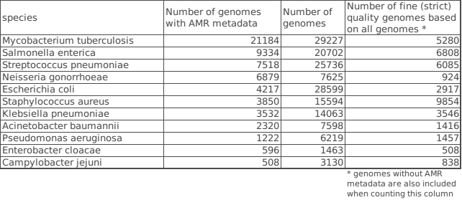
Data set Genome data quality control-Version 1
genome status : not Plasmid
genome_quality : Good
contigs <= 100
fine_consistency>= 97
coarse_consistency >= 98
checkm_completeness >= 98
checkm_contamination <= 2
|genome length - mean length| <= mean_length/20
Notes:
When a k-mer is identical to its reverse complement, both are canonical.
Index(['40μg/ml', '7h10_media_using_agar_proportion', '>16 mg/l',
'Agar proportion', 'BD Phoenix ad E-test', 'BD-Phoenix',
'Disc Diffusion', 'Disk Diffusion', 'Disk diffusion', 'E-test', 'Etest',
'Etest on GC agar supplemented with 1% Vitox',
'Kirby Bauer agar disc diffusion', 'Kirby Bauer disk diffusion',
'Kirby-Bauer disk diffusion', 'Kirby-Bauer disk diffusion agar assay',
'LJ proportion method', 'LJM', 'MGIT', 'MGIT 960', 'MGIT960', 'MIC',
'MIC, broth microdilution', 'MIC:broth microdilution', 'MODS',
'Middlebrooks 7H10 Agar', 'Müeller-Hinton agar dilution',
'N206 card on the Vitek 2', 'Nitrate reductase assay',
'Resistance ratio method on LJ slopes. Modified Marks biphasic method for pyrazinamide, with confirmation in MGIT 960',
'Sensititer Automated Microbiology System', 'Sensititre', 'VITEK 2',
'VITEK ®2', 'Vitek-2', 'Vitek2', 'agar diffusion with Etest',
'agar dilution', 'agar dilution method or Etest',
'agar dilution or Etest', 'agar dilution or broth microdilution',
'agar dilution using Iso-sensitest agar or Muller Hinton agar',
'agar-dilution (16 µg/m', 'agar-dilution (16 µg/ml )',
'agar-dilution (8 µg/ml )', 'agar_dilution',
'beckton,_dickinson_and_company', 'becton,_dickinson_and_company',
'biomérieux', 'break-point technique on Lowenstein-Jensen medium',
'breakpoint', 'british_society_for_antimicrobial_chemotherapy_(bsac)',
'broth dilution', 'broth microdilution',
'broth microdilution (MiCroSTREP plus)', 'broth_microdilution',
'broth_microdilutionl', 'cdc', 'clsi', 'critical concentration',
'disc diffusion on Müller - Hinton II Agar',
'disc diffusion on Müller-Hinton II Agar', 'disc_diffusion',
'disk diffusion', 'disk diffusion or Vitek2', 'disk-diffusion',
'disk_diffusion', 'e-test', 'etest', 'forest_pharmaceuticals',
'glaxosmith_kline_pharmaceuticals', 'kirby_bauer_disk_diffusion',
'liofilchem', 'lowenstein-jensen_medium', 'mgit_960',
'microdilution in cation-adjusted Muller-Hinton broth',
'middlebrook_7h11_agar', 'millimeters', 'narms', 'oxoid',
'pfizer_global_pharmaceuticals', 'thermofisher_scientific',
'trek_diagnostic_systems,_thermo_fischer_scientific', 'vitek_2'],
dtype='object', name='laboratory_typing_method')
Process finished with exit code 0

Slide 2
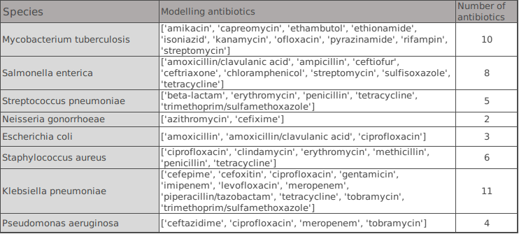
Data set Genome data quality control-Version 1
genome status : not Plasmid
genome_quality : Good
contigs <= 100
fine_consistency>= 97
coarse_consistency >= 98
checkm_completeness >= 98
checkm_contamination <= 2
|genome length - mean length| <= mean_length/20
Notes:
When a k-mer is identical to its reverse complement, both are canonical.
Index(['40μg/ml', '7h10_media_using_agar_proportion', '>16 mg/l',
'Agar proportion', 'BD Phoenix ad E-test', 'BD-Phoenix',
'Disc Diffusion', 'Disk Diffusion', 'Disk diffusion', 'E-test', 'Etest',
'Etest on GC agar supplemented with 1% Vitox',
'Kirby Bauer agar disc diffusion', 'Kirby Bauer disk diffusion',
'Kirby-Bauer disk diffusion', 'Kirby-Bauer disk diffusion agar assay',
'LJ proportion method', 'LJM', 'MGIT', 'MGIT 960', 'MGIT960', 'MIC',
'MIC, broth microdilution', 'MIC:broth microdilution', 'MODS',
'Middlebrooks 7H10 Agar', 'Müeller-Hinton agar dilution',
'N206 card on the Vitek 2', 'Nitrate reductase assay',
'Resistance ratio method on LJ slopes. Modified Marks biphasic method for pyrazinamide, with confirmation in MGIT 960',
'Sensititer Automated Microbiology System', 'Sensititre', 'VITEK 2',
'VITEK ®2', 'Vitek-2', 'Vitek2', 'agar diffusion with Etest',
'agar dilution', 'agar dilution method or Etest',
'agar dilution or Etest', 'agar dilution or broth microdilution',
'agar dilution using Iso-sensitest agar or Muller Hinton agar',
'agar-dilution (16 µg/m', 'agar-dilution (16 µg/ml )',
'agar-dilution (8 µg/ml )', 'agar_dilution',
'beckton,_dickinson_and_company', 'becton,_dickinson_and_company',
'biomérieux', 'break-point technique on Lowenstein-Jensen medium',
'breakpoint', 'british_society_for_antimicrobial_chemotherapy_(bsac)',
'broth dilution', 'broth microdilution',
'broth microdilution (MiCroSTREP plus)', 'broth_microdilution',
'broth_microdilutionl', 'cdc', 'clsi', 'critical concentration',
'disc diffusion on Müller - Hinton II Agar',
'disc diffusion on Müller-Hinton II Agar', 'disc_diffusion',
'disk diffusion', 'disk diffusion or Vitek2', 'disk-diffusion',
'disk_diffusion', 'e-test', 'etest', 'forest_pharmaceuticals',
'glaxosmith_kline_pharmaceuticals', 'kirby_bauer_disk_diffusion',
'liofilchem', 'lowenstein-jensen_medium', 'mgit_960',
'microdilution in cation-adjusted Muller-Hinton broth',
'middlebrook_7h11_agar', 'millimeters', 'narms', 'oxoid',
'pfizer_global_pharmaceuticals', 'thermofisher_scientific',
'trek_diagnostic_systems,_thermo_fischer_scientific', 'vitek_2'],
dtype='object', name='laboratory_typing_method')
Process finished with exit code 0

Slide 3
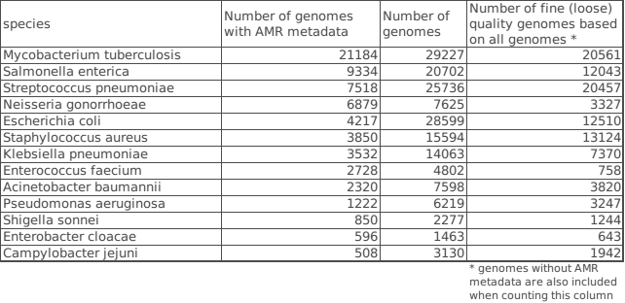
Data set Genome data quality control-Version 2
genome status : not Plasmid
genome_quality : Good
contigs <= 100 or 75% Quartile (the one is chosen to include more strains, w.r.t. each species)
fine_consistency>= 97
coarse_consistency >= 98
checkm_completeness >= 98 and (missing value also accepted)
checkm_contamination <= 2 and (missing value also accepted)
|genome length - mean length| <= mean_length/20
Notes:
When a k-mer is identical to its reverse complement, both are canonical.
Index(['40μg/ml', '7h10_media_using_agar_proportion', '>16 mg/l',
'Agar proportion', 'BD Phoenix ad E-test', 'BD-Phoenix',
'Disc Diffusion', 'Disk Diffusion', 'Disk diffusion', 'E-test', 'Etest',
'Etest on GC agar supplemented with 1% Vitox',
'Kirby Bauer agar disc diffusion', 'Kirby Bauer disk diffusion',
'Kirby-Bauer disk diffusion', 'Kirby-Bauer disk diffusion agar assay',
'LJ proportion method', 'LJM', 'MGIT', 'MGIT 960', 'MGIT960', 'MIC',
'MIC, broth microdilution', 'MIC:broth microdilution', 'MODS',
'Middlebrooks 7H10 Agar', 'Müeller-Hinton agar dilution',
'N206 card on the Vitek 2', 'Nitrate reductase assay',
'Resistance ratio method on LJ slopes. Modified Marks biphasic method for pyrazinamide, with confirmation in MGIT 960',
'Sensititer Automated Microbiology System', 'Sensititre', 'VITEK 2',
'VITEK ®2', 'Vitek-2', 'Vitek2', 'agar diffusion with Etest',
'agar dilution', 'agar dilution method or Etest',
'agar dilution or Etest', 'agar dilution or broth microdilution',
'agar dilution using Iso-sensitest agar or Muller Hinton agar',
'agar-dilution (16 µg/m', 'agar-dilution (16 µg/ml )',
'agar-dilution (8 µg/ml )', 'agar_dilution',
'beckton,_dickinson_and_company', 'becton,_dickinson_and_company',
'biomérieux', 'break-point technique on Lowenstein-Jensen medium',
'breakpoint', 'british_society_for_antimicrobial_chemotherapy_(bsac)',
'broth dilution', 'broth microdilution',
'broth microdilution (MiCroSTREP plus)', 'broth_microdilution',
'broth_microdilutionl', 'cdc', 'clsi', 'critical concentration',
'disc diffusion on Müller - Hinton II Agar',
'disc diffusion on Müller-Hinton II Agar', 'disc_diffusion',
'disk diffusion', 'disk diffusion or Vitek2', 'disk-diffusion',
'disk_diffusion', 'e-test', 'etest', 'forest_pharmaceuticals',
'glaxosmith_kline_pharmaceuticals', 'kirby_bauer_disk_diffusion',
'liofilchem', 'lowenstein-jensen_medium', 'mgit_960',
'microdilution in cation-adjusted Muller-Hinton broth',
'middlebrook_7h11_agar', 'millimeters', 'narms', 'oxoid',
'pfizer_global_pharmaceuticals', 'thermofisher_scientific',
'trek_diagnostic_systems,_thermo_fischer_scientific', 'vitek_2'],
dtype='object', name='laboratory_typing_method')
Process finished with exit code 0

Slide 4
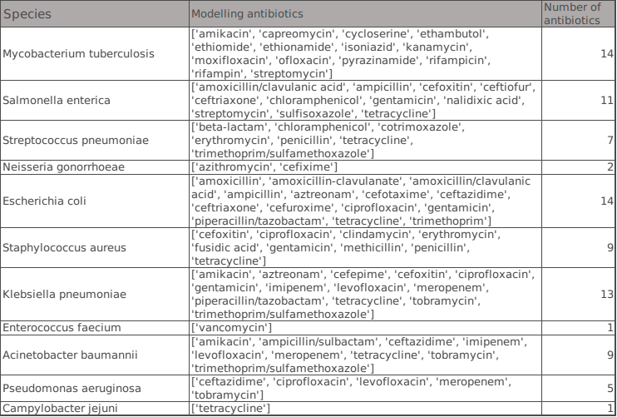
Data set Genome data quality control-Version 2
genome status : not Plasmid
genome_quality : Good
contigs <= 100 or 75% Quartile (the one is chosen to include more strains, w.r.t. each species)
fine_consistency>= 97
coarse_consistency >= 98
checkm_completeness >= 98 and (missing value also accepted)
checkm_contamination <= 2 and (missing value also accepted)
|genome length - mean length| <= mean_length/20
Notes:
When a k-mer is identical to its reverse complement, both are canonical.
Index(['40μg/ml', '7h10_media_using_agar_proportion', '>16 mg/l',
'Agar proportion', 'BD Phoenix ad E-test', 'BD-Phoenix',
'Disc Diffusion', 'Disk Diffusion', 'Disk diffusion', 'E-test', 'Etest',
'Etest on GC agar supplemented with 1% Vitox',
'Kirby Bauer agar disc diffusion', 'Kirby Bauer disk diffusion',
'Kirby-Bauer disk diffusion', 'Kirby-Bauer disk diffusion agar assay',
'LJ proportion method', 'LJM', 'MGIT', 'MGIT 960', 'MGIT960', 'MIC',
'MIC, broth microdilution', 'MIC:broth microdilution', 'MODS',
'Middlebrooks 7H10 Agar', 'Müeller-Hinton agar dilution',
'N206 card on the Vitek 2', 'Nitrate reductase assay',
'Resistance ratio method on LJ slopes. Modified Marks biphasic method for pyrazinamide, with confirmation in MGIT 960',
'Sensititer Automated Microbiology System', 'Sensititre', 'VITEK 2',
'VITEK ®2', 'Vitek-2', 'Vitek2', 'agar diffusion with Etest',
'agar dilution', 'agar dilution method or Etest',
'agar dilution or Etest', 'agar dilution or broth microdilution',
'agar dilution using Iso-sensitest agar or Muller Hinton agar',
'agar-dilution (16 µg/m', 'agar-dilution (16 µg/ml )',
'agar-dilution (8 µg/ml )', 'agar_dilution',
'beckton,_dickinson_and_company', 'becton,_dickinson_and_company',
'biomérieux', 'break-point technique on Lowenstein-Jensen medium',
'breakpoint', 'british_society_for_antimicrobial_chemotherapy_(bsac)',
'broth dilution', 'broth microdilution',
'broth microdilution (MiCroSTREP plus)', 'broth_microdilution',
'broth_microdilutionl', 'cdc', 'clsi', 'critical concentration',
'disc diffusion on Müller - Hinton II Agar',
'disc diffusion on Müller-Hinton II Agar', 'disc_diffusion',
'disk diffusion', 'disk diffusion or Vitek2', 'disk-diffusion',
'disk_diffusion', 'e-test', 'etest', 'forest_pharmaceuticals',
'glaxosmith_kline_pharmaceuticals', 'kirby_bauer_disk_diffusion',
'liofilchem', 'lowenstein-jensen_medium', 'mgit_960',
'microdilution in cation-adjusted Muller-Hinton broth',
'middlebrook_7h11_agar', 'millimeters', 'narms', 'oxoid',
'pfizer_global_pharmaceuticals', 'thermofisher_scientific',
'trek_diagnostic_systems,_thermo_fischer_scientific', 'vitek_2'],
dtype='object', name='laboratory_typing_method')
Process finished with exit code 0

