Slide 1

Read your own Smart Meter
Challenge #3
Derrick Oswald, Herrmann Hueni, Angelos Selviaridis, Christos Konstantinopoulos, Peter Zbinden, Moritz Bolli, Hubert Kirrmann
29. August 2020

Slide 2
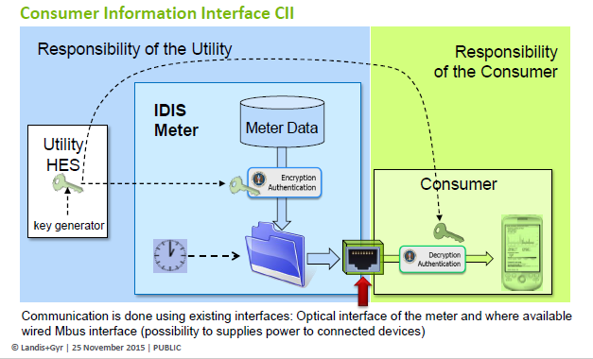
Challenge
Goal
Read your Smart Meter through the local Customer Information Interface (CII) and visualize your consumption. Design a dashboard with the most useful information.
Why
In Switzerland, it is prescribed by law that all electricity Smart Meters installed by utilities must have a local interface (CII), so that customers can have access to their own data.
Transparency is increased as individuals can manage their own data. Innovation is promoted, as precise data is available for free in real time.
See also Challenge: "Unleashing the Swiss Smartmeter'

Slide 3
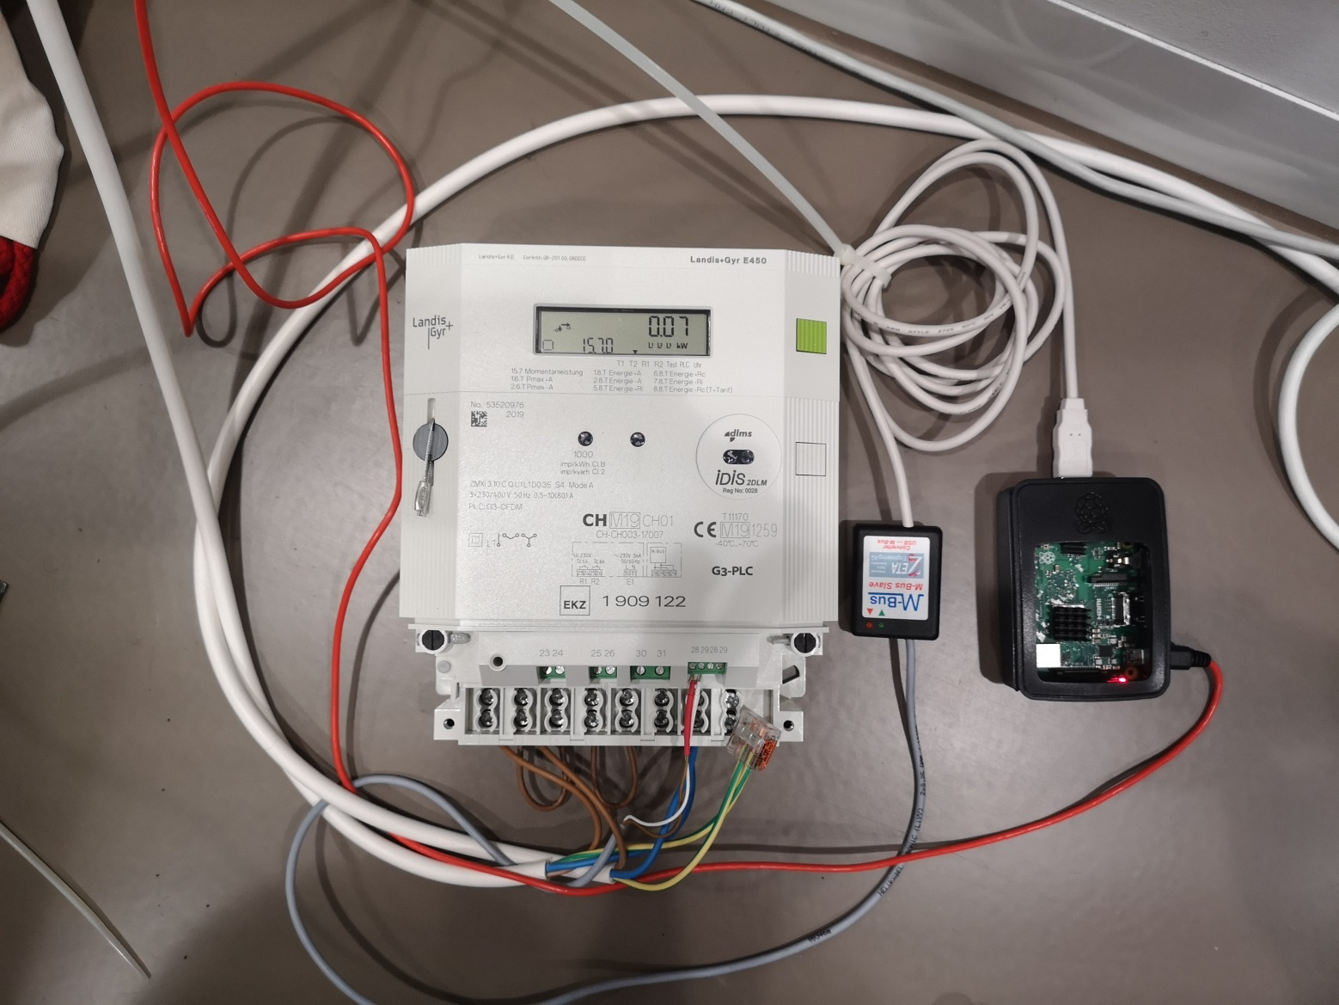
Smart Meter setup
Idea:
Two Smart Meters will be installed on-site and will be measuring the consumption of different devices. The live consumption is to be displayed on a web-based dashboard.
Live measurements are to be combined with historical data.
At the end, the dashboard will be able to display the most important information to an individual about their electricity consumption.
M-Bus converter
smart meter
rasperry PI

Slide 4
How did we proceed
The CII data are stored in a CSV file in the raspberry PI microprocessor.
Looked for a way to get the CSV information from the raspberry PI over the wireless link. Needed for this a “broker” on the PI using Mosquitto, an open source interface for telemetry data (MQTT).
Installed an MQTT broker on the PI and installed the MQTT client on the visualisation computer to feed it with CSV data, using a shell batch file.
Used the Python MQTT client on the visualisation platform to read the data
Did some trial with Openhab that worked unsatisfactorily.
Used a graphical interface (Grafana) that gets the data from the MQTT client using a few lines of Python code.

Slide 5
Landscape
smart meter
raspberry-pi
USB-MBUS converter ETA
Java
CSV file
M-Bus
USB
DLMS
monitor_csv
MQTT pub
MQTT broker
MQTT sub
OPENHAB
cmd
wireless 802.1
MQTT client
browser
putty
Python
INFLUX
Grafana
visualization platform

Slide 6
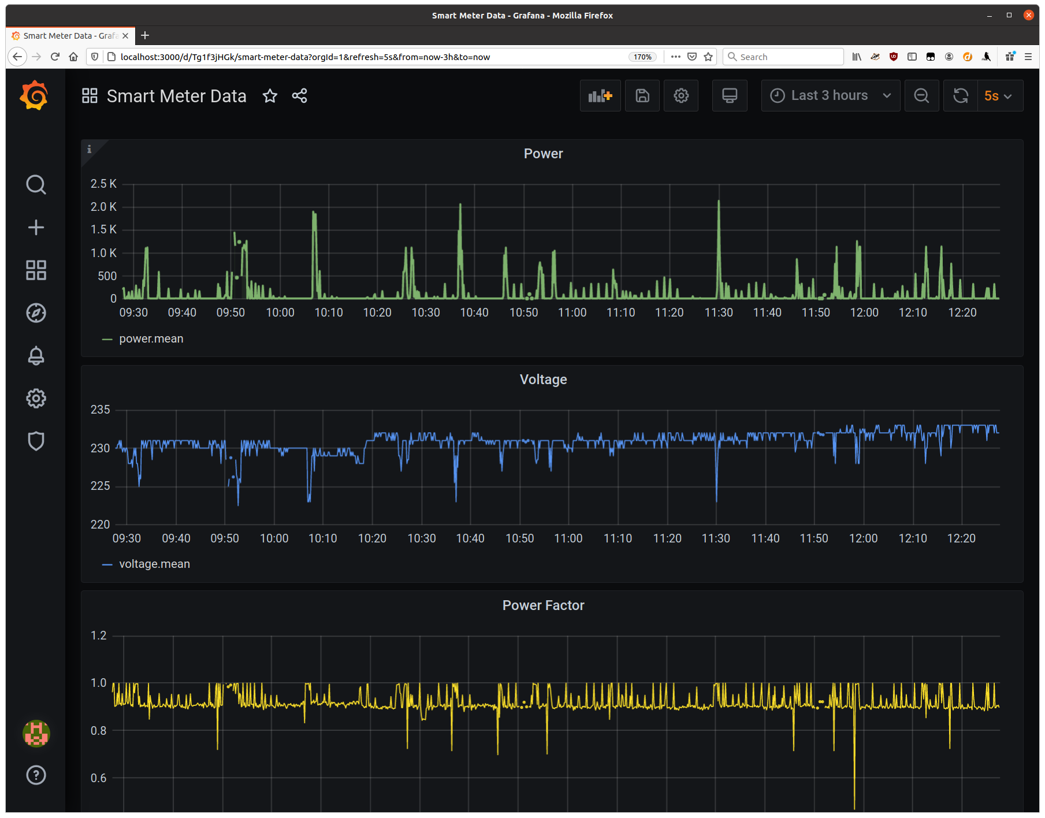
Results
Power
Voltage
Power factor (cos (Φ)

