Slide 1
Group Project
Simulation Engine for Testing Traffic Management Policies

Slide 2
Group Signal Green
Andrea
Adeela
Waqar
James
Yoann

Slide 3
Aim
To Create a simulation engine to test traffic management strategies.
Demonstrate the ability to use the available engineering tools.
Ability to work as a team.

Slide 4
Roles
Adeela & Waqar
Work on network (Roads , Junctions , Traffic ligts)
Yoann and James
Work on Vehicles and behaviour
Andrea
Documentation & Testing

Slide 5
IDE & Framework
Eclipse
Java
Repast Simphony
Recursive Porous Agent Simulation Toolkit
Free
Open-source
Cross-platform
Agent-based
Modelling and Simulation Toolkit

Slide 6
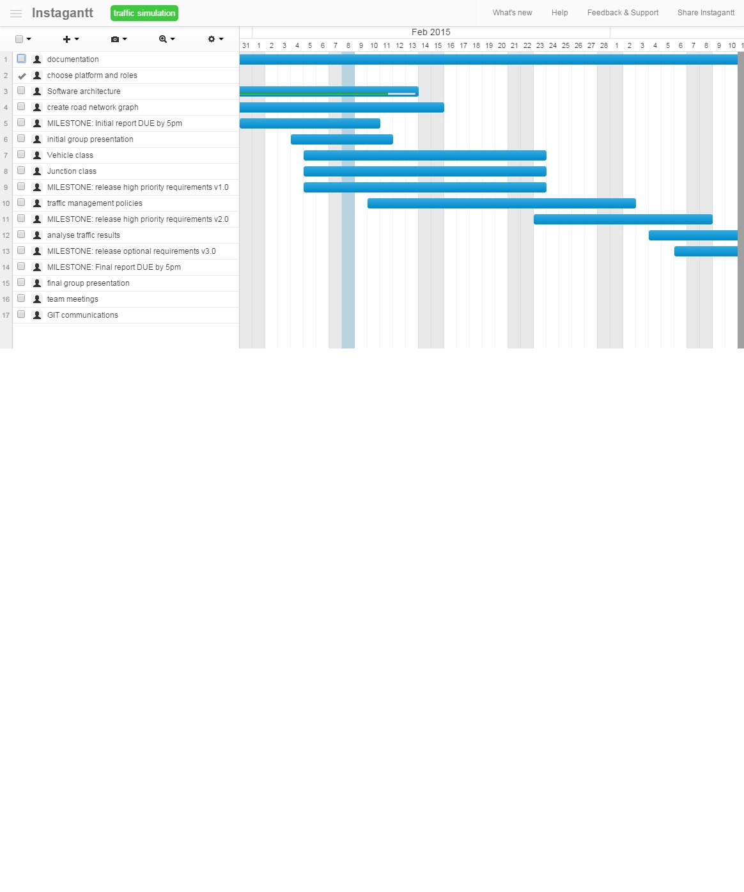
Plan

Slide 7
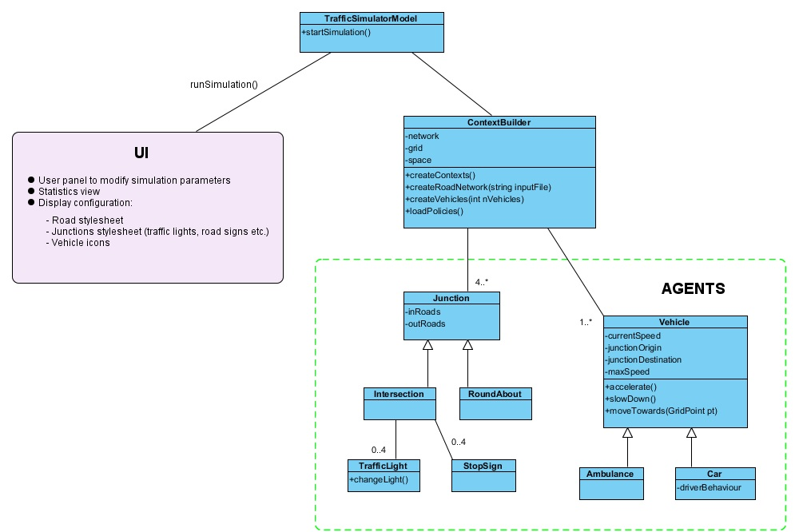
Architecture

Slide 8
Components
Simulation Engine
Environment
Agents
Behaviours of Agents

Slide 9
Simulation Engine
Simulation Model class
Loads the environment .
Starts the UI.
ContextBuilder : A Repast component contains:
Agents: Vehicles, Junctions, TrafficLights etc.
Environment: Grid, Continuous Space, and Road Network digraph.

Slide 10
Environment
Grid: N x N matrix, used by Agents to know their real position.
Continuous Space: (x, y) coordinates used by UI to display Agents during simulation.
Network: a directed graph, representing roads (edges) and intersections (nodes).

Slide 11
Agents
Move within the Environment.
Know their position at any time.
Can inspect Environment to interact with other Agents.

Slide 12
Agents’ Behaviour
Simulation time is measured in discrete ticks.
Methods can be scheduled when time of action is known at compile time.
‘watch’ annotation checks other Agents’ attributes at run time and react according to their behaviour.

Slide 13
Questions????
Thank you!

