Slide 1
SignalGreen Group Project
Simulation Engine for Testing Traffic Management Policies

Slide 2
Group Signal Green
Andrea
Adeela
Waqar
James
Yoann

Slide 3
Aims
Create a simulation engine to test traffic management strategies
Demonstrate the ability to use the available engineering tools
Ability to work as a team

Slide 4
Roles
Adeela and Waqar
Road network
Yoann and James
Vehicles and behaviour
Andrea
Documentation and Coordination

Slide 5
IDE & Framework
Eclipse
Java
Repast Simphony
Recursive Porous Agent Simulation Toolkit
Free
Open-source
Cross-platform
Agent-based
Modelling and Simulation Toolkit

Slide 6
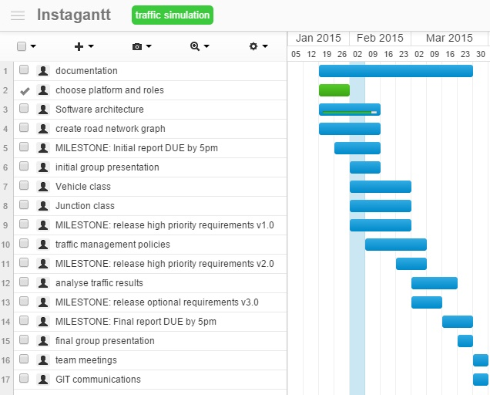
Plan

Slide 7
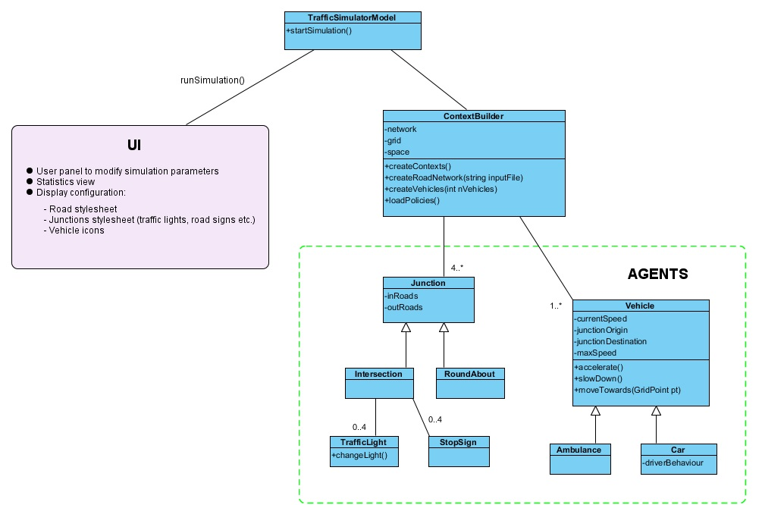
Architecture

Slide 8
Components
Simulation Engine
Environment
Agents
Behaviours of Agents

Slide 9
Simulation Engine
Simulation Model class
Loads the environment
Starts the UI
ContextBuilder : A Repast component contains:
Agents: vehicles, junctions, signals etc.
Environment: grid, continuous space, road network digraph

Slide 10
Environment
Grid: N x N matrix, used by agents to know their real position
Continuous Space: (x, y) coordinates used by UI to display agents during simulation
Network: a directed graph, representing roads (edges) and intersections (nodes)

Slide 11
Agents
Move within the environment
Know their position at any time
Inspect environment to interact with other agents

Slide 12
Agent Behaviour
Simulation time is measured in discrete ticks
Methods can be scheduled when time of action is known at compile time
‘Watch’ annotation checks other agents’ attributes at run time and reacts according to their behaviour

Slide 13
Questions????
Thank you!

