Slide 1
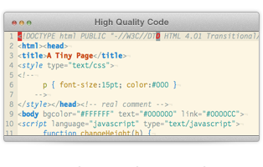
High-Quality Code Construction Team Projects – April 2013
Game “Fifteen”
Team BORON
Telerik students
Telerik Software Academy
html5course.telerik.com

Slide 2
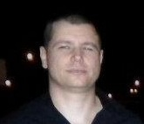

Team members
Асен Георгиев
Георги Русев
Красимир Узунов

Slide 3
High-Quality Code
All unneeded empty lines has been removed.
The curly brackets { and } has been formatted according to the best practices for the C# language.
Appropriate names for variables, fields, properties, methods and classes has been given.
Duplicated code has been removed.
All constant fields has been renamed using PascalCase instead of ALL_CAPS.

Slide 4
High-Quality Code
Enumeration members has been renamed from camelCase to PascalCase.
Unit tests for all methods has been added to ensure the entire project functionality.
Code coverage of the unit tests more than 90%.
Game project separated into 2 subprojects: UI and Library.
Loose coupling between methods and classes implemented.

Slide 5

High-Quality Code
Успех на всички!

