Slide 1
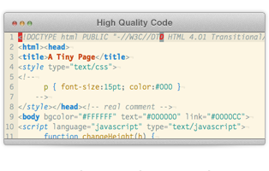
High-Quality Code Construction Team Projects – April 2013
Game “Fifteen”
Team BORON
Telerik students
Telerik Software Academy

Slide 2

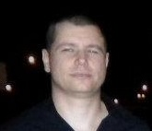

Team members
Асен Въльовски
Георги Русев
Красимир Узунов

Slide 3
High-Quality Code
Give appropriate name for the project, variables, fields, properties, methods and classes.
Separate game project into 2 subprojects: UI and Library.
Loose coupling between methods and classes.
Reformatted the source code:
All unneeded empty lines has been removed.
The curly brackets { and } has been formatted according to the best practices for the C# language.

Slide 4
High-Quality Code
Refactoring the code and fix some bugs and coupling between methods.
Duplicated code has been removed.
Extracted and changing method.
Adding XML Documentation headers to classes and all their methods, properties and constructors.
Unit tests for all methods has been added to ensure the entire project functionality.
Code coverage of the unit tests is 98%.

Slide 5

High-Quality Code
Успех на всички!

