Slide 1
Setup a MongoDB Replica Set
Additional Task
Gilbran Fairuz Maulana

Slide 2
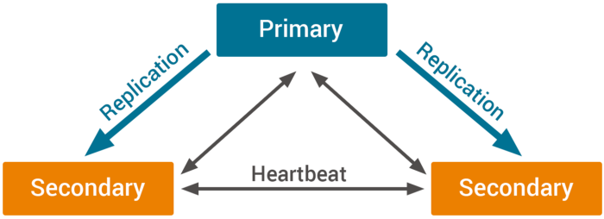
Replica Set

Slide 3
CONTENTS
Tasks:
Install Mongo DB
Configuring Replica Set
Testing the Replication Process

Slide 4
Install
Mongo DB

Slide 5
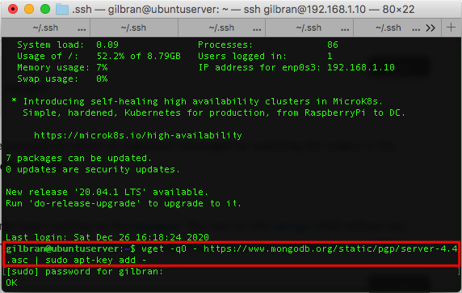
Install Mongo DB

Slide 6
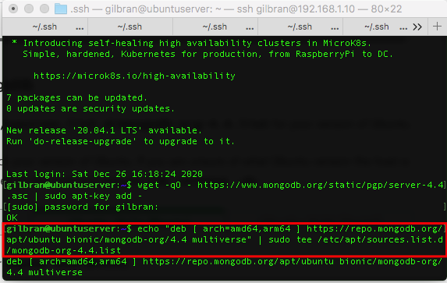
Install Mongo DB

Slide 7
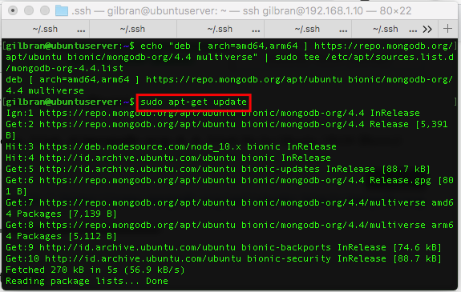
Install Mongo DB

Slide 8
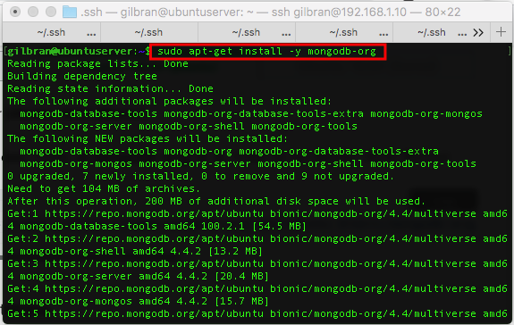
Install Mongo DB

Slide 9
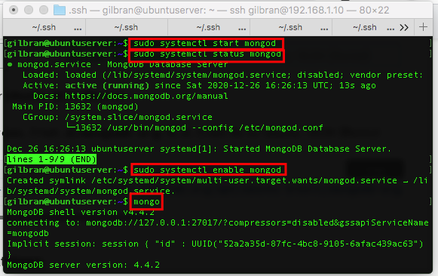
Install Mongo DB

Slide 10
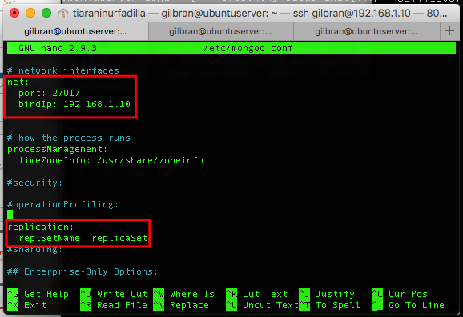
Install Mongo DB

Slide 11
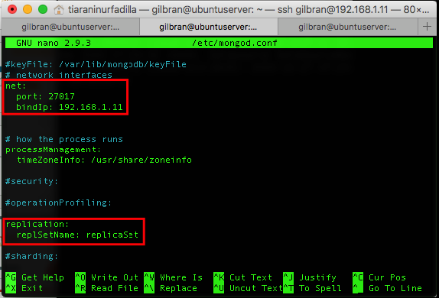
Install Mongo DB

Slide 12
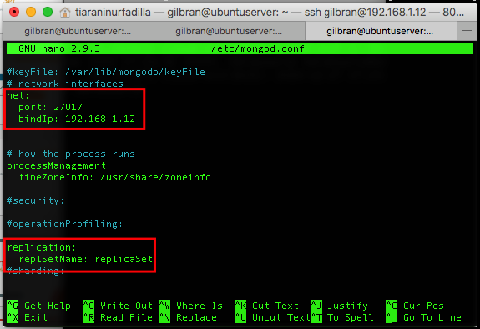
Install Mongo DB

Slide 13
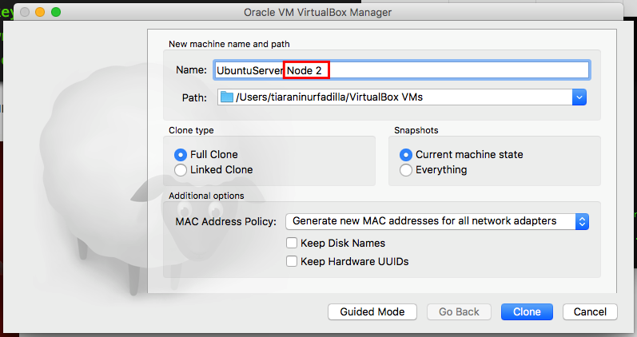
Install Mongo DB

Slide 14
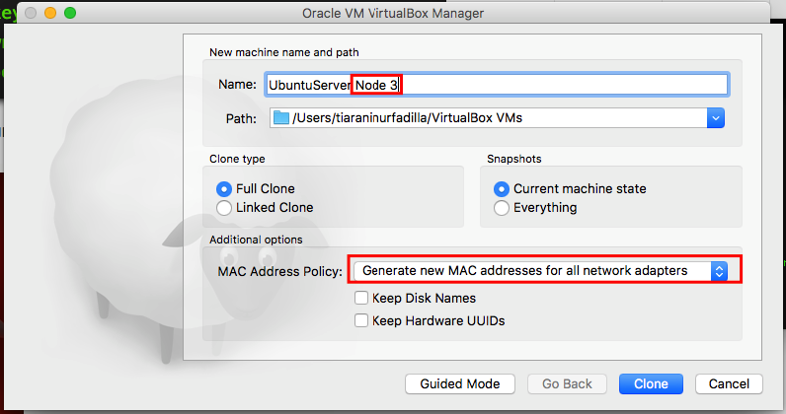
Install Mongo DB

Slide 15
Configuring
Replica Set

Slide 16
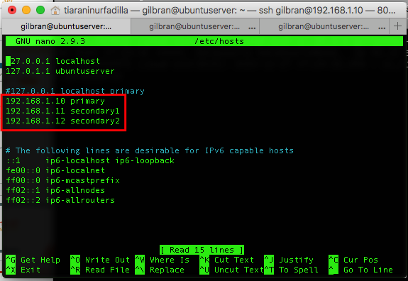
Configuring Replica Set

Slide 17
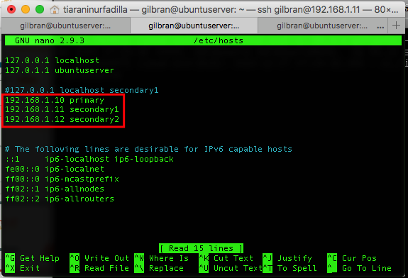
Configuring Replica Set

Slide 18
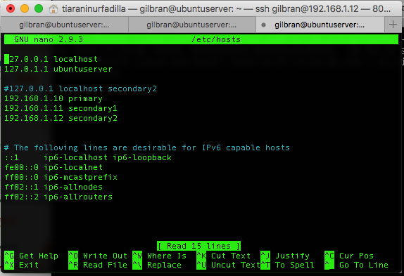
Configuring Replica Set

Slide 19
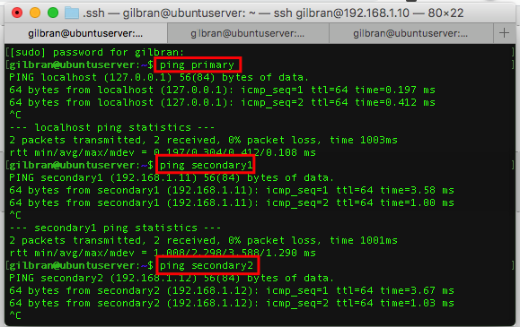
Configuring Replica Set

Slide 20
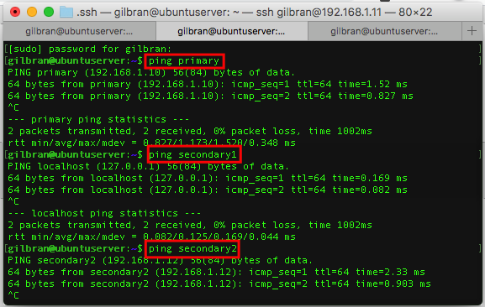
Configuring Replica Set

Slide 21
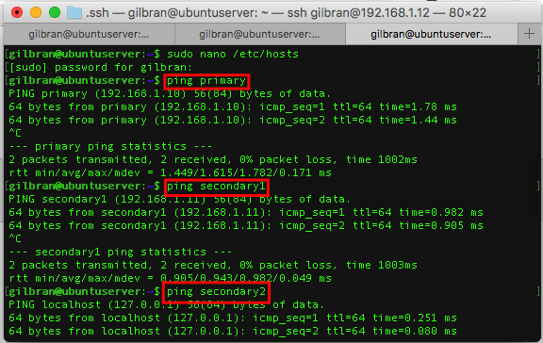
Configuring Replica Set

Slide 22
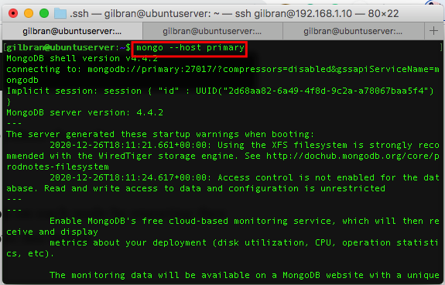
Configuring Replica Set

Slide 23
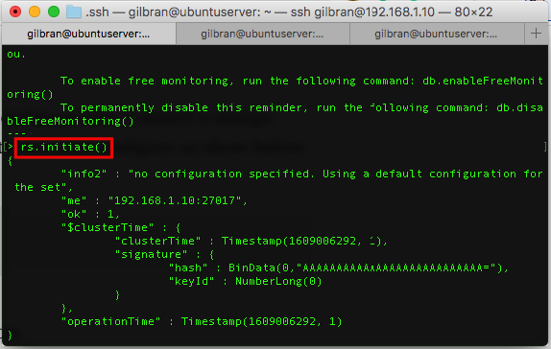
Configuring Replica Set

Slide 24
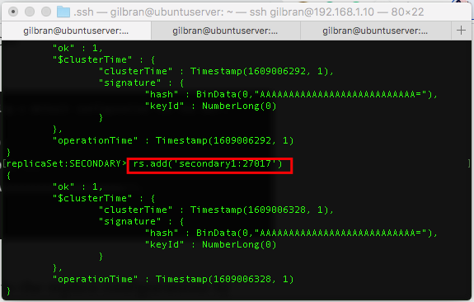
Configuring Replica Set

Slide 25
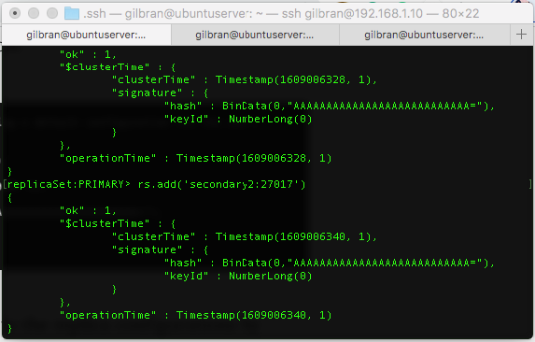
Configuring Replica Set

Slide 26
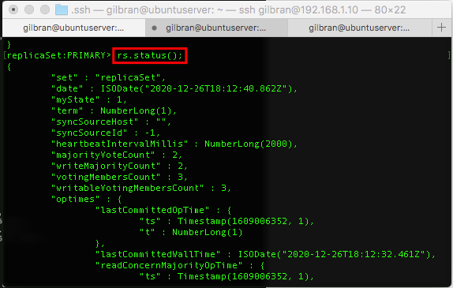
Configuring Replica Set

Slide 27
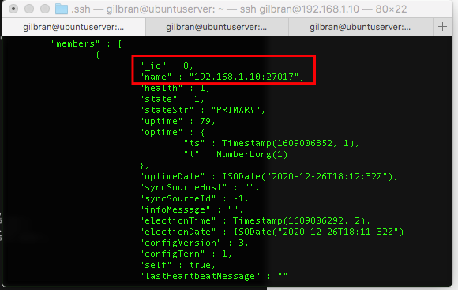
Configuring Replica Set

Slide 28
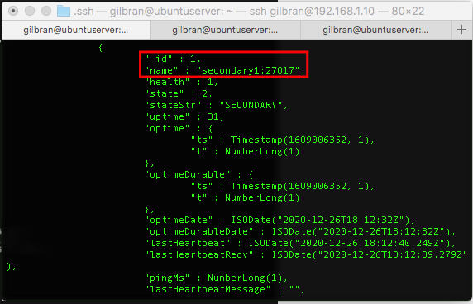
Configuring Replica Set

Slide 29
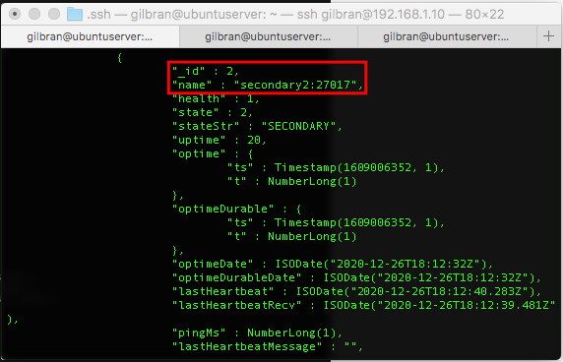
Configuring Replica Set

Slide 30
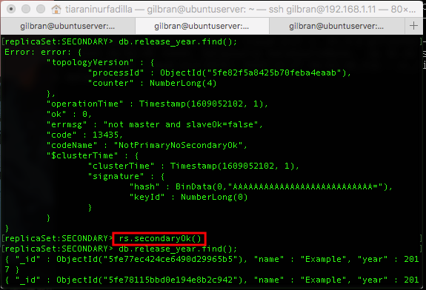
Configuring Replica Set

Slide 31
Testing
The Replication Process

Slide 32
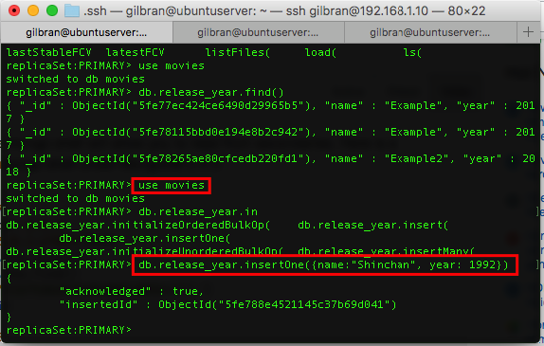
Testing The Replication Process

Slide 33
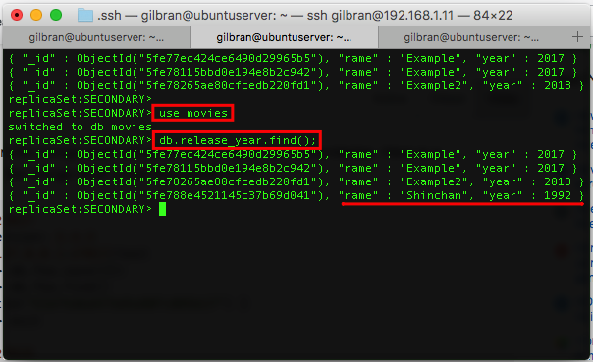
Testing The Replication Process

Slide 34
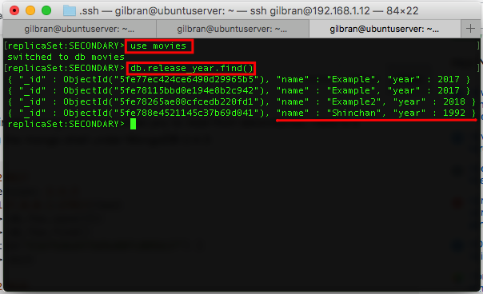
Testing The Replication Process

Slide 35
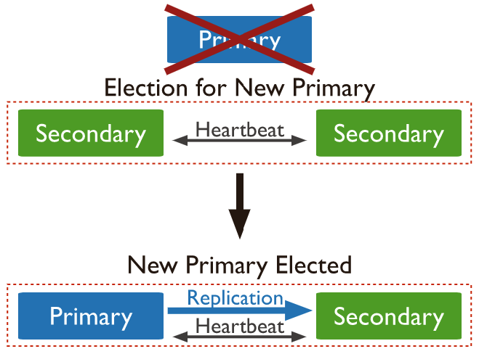
Conditioning Testing

Slide 36
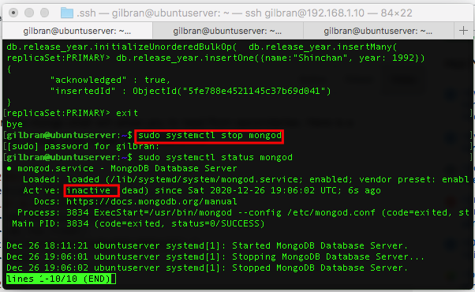
Testing

Slide 37
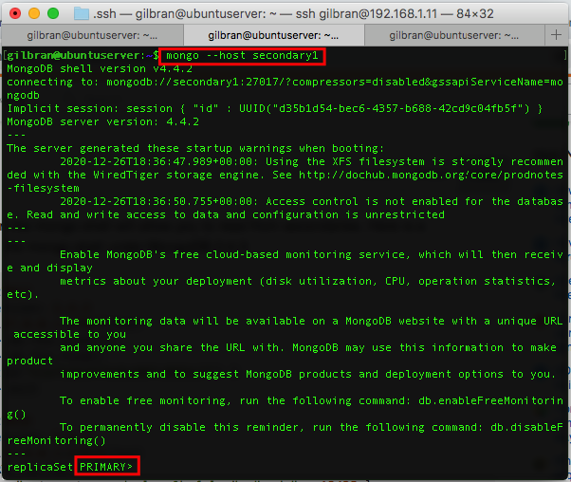
Testing

Slide 38
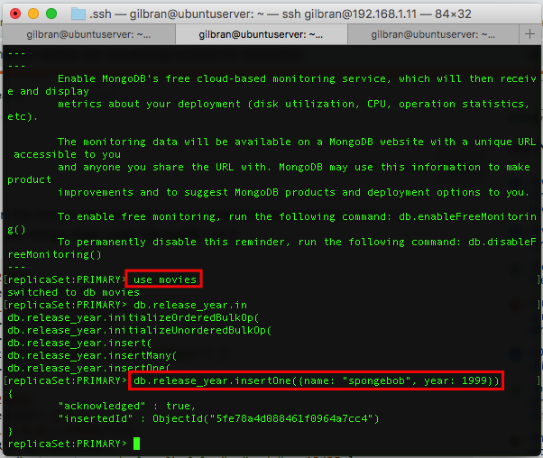
Testing

Slide 39
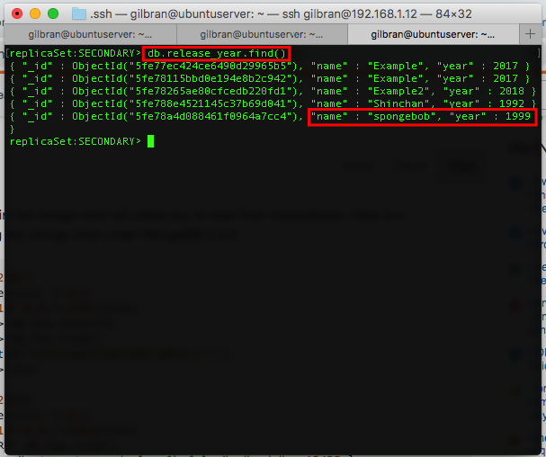
Testing

Slide 40
TERIMA KASIH

