Slide 1
Streptococcus pneumoniae & Viridans group of Streptococci
Professor Sudheer Kher

Slide 2
KEY WORDS
S. pneumoniae
diplococci
Pneumococcus
autolysin
bile solubility test
optochin susceptibility
capsule
Quellung reaction
Inulin fermentation
Mouse pathogenecity

Slide 3
Viridans group of Streptococci
Viridis = Green
Throat commensals, can cause opportunistic infections.
ά - Haemolytic on blood agar.
Species – S. mitis, mutans, salivarius, sanguis.
Tooth extraction – Transient bacteremia leading to implantation on damaged/prosthetic heart valves – Commonest species - sanguis.
Dental caries - Commonest species – mutans.

Slide 4
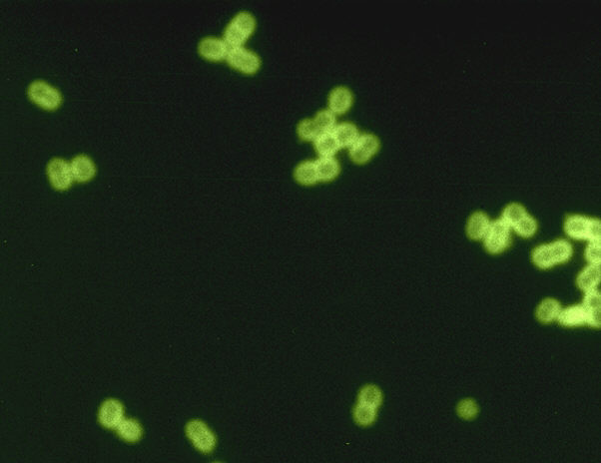
S. pneumoniae

Slide 5
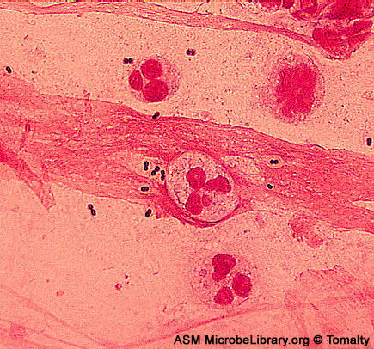
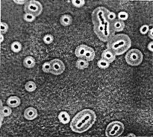
Important features
Gram + , Lanciolate, capsulated diplococci

Slide 6
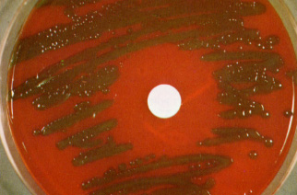
Important features
Aerobes & facultative anaerobes. Growth improved by 5-10 % CO₂
Colonies on BA –ά - Haemolytic, dome shaped later showing flat and concentric ring pattern (carrom coin)
Mucoid appearance

Slide 7
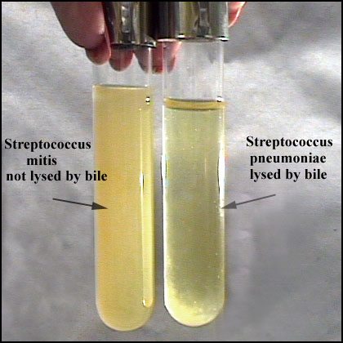
Important features
Catalase & oxidase negative
Bile soluble
Inulin fermentation
Optochin (ethyl dihydrocuprein) sensitive
Pathogenic to mice

Slide 8
Antigens
Most important – Type specific capsular polysaccharide also called SSS (specific soluble substance). More than 90 serotypes detected.
Typing methods –
Agglutination
Quellung reaction
Precipitation for SSS

Slide 9
S. pneumoniae
leading cause of lobar pneumonia
particularly young and old
after damage to upper respiratory tract
*e.g. following viral infection
bacteremia
meningitis
middle ear infections (otitis media)
Sinusitis, bronchitis, eye infections.

Slide 10
S. pneumoniae
ά - hemolytic
pneumolysin
degrades red blood cells under aerobic conditions
grows well on sheep blood agar
no group antigen

Slide 11
Diagnosis - spinal fluid
direct Gram staining
detection of capsular antigen

Slide 12
Autolysis - identification
autolysin
Bile
teichoic acid
-choline
peptidoglycan
cell
membrane
lipoteichoic acid

Slide 13
C polysaccharide
Teichoic acid
Precipitates in serum
C-reactive protein – An abnormal protein (β-globulin) that precipitates with somatic C antigen of pneumococci appears in acute phase sera in pnemonia and disappears in convalescence. Also occurs in many other pathological conditions. This is called CRP or acute phase protein.
Used to monitor response to treatment in various conditions like rheumatic fever and is replacing ESR.

Slide 14
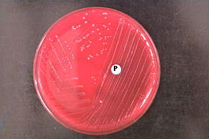
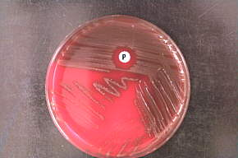
Identification
Not optochin sensitive
Not Pneomococci
optochin sensitive
Pneomococci

Slide 15
Capsule
Prominent in virulent strains
Anti-phagocytic
Carbohydrate antigens - vary among strains
Immunity - serotype specific
Vaccine contains multiple serotypes
Only for susceptible population

Slide 16
Quellung reaction
Using antisera
Capsule "fixed"
Visible microscopically

Slide 17
Pathogenesis
Teichoic acid
complement activation
large numbers of inflammatory cells at infection site

Slide 18
Therapy
S. pneumoniae
most strains susceptible to penicillin
resistance is uncommon but known (5%)
Third generation of cephalosporin or Vancomycin

Slide 19
Prophylaxis
Polyvalent polysaccharide capsular antigens of 23 most common serotypes given to population at high risk
Absent/dysfunctional spleen
Sickle cell disease
Coeliac disease
Chronic renal/lung/heart/liver disease
NOT given to children < 2yrs, immunosuppression / deficiency, lymphoreticular malignancy

Slide 20
Differences between Viridans Gp & Pneumococci
Point | Pneumococci | Viridans Gp
Morphology | Capsulated, lanceolate, diplococci | Oval or rounded in chains
Quellung test | + | -
Colonies | Dome shaped→ Draughtsman | Dome shaped
Growth in liquid | Uniform turbidity | Granular turbidity with powdery deposits
Bile solubility | + | -
Inulin fermentation | + | -
Optochin sensitivity | + | -
Intraperitoneal inoculation in mice | Fatal Infection | Non-pathogenic

Slide 21
KEYWORDS
S. pneumoniae
diplococci
Pneumococcus
autolysin
bile solubility test
optochin susceptibility
capsule
Quellung reaction
Inulin fermentation
Mouse pathogenecity

Slide 22
