Slide 1
Predicting 30-Day All-Cause Readmission from HOSPITAL Discharge Summary
Cynthia Pedrasa
Notes:
Welcome to the capstone presentation on predicting 30-day acr from Hosp Discharge summary
Project Motivation is to optimally predict 30-day, all-cause hospital readmissions, which occur when a patient is readmitted to an inpatient hospital for any reason within 30 days of a prior inpatient discharge
1. What question/questions are you trying to solve?
* What are the outcomes you think you will find (could use mutually exclusive collectively exhaustive for this)? Why do they matter?
* How would a person or business take action upon learning the results of your project? How will your findings be _useful_?
* What version this question would allow me to find an answer in 2-3 days?
* What version of this question would allow me/motivate me to work on this problem even after completing Flatiron School?
2. What are some data sources that would allow you to answer this?
* What is the ideal data you would hope to gather to answer this question?
* Potentially missing data, that could cause omitted variable bias?
4. Is this a classification task? A regression task? Both?
5. What are the challenges or obstacles you foresee with this project?
6. What are your next steps moving forward?

Slide 2






HOSPITAL Readmissions
“Common, expensive and often preventable“ occurrences in acute-care medicine
Quality of care barometer – provide a basis to compare hospital performance measures
A strategy to address this issue is to utilize risk stratification to better target patient engagement.
Notes:
Medical literature refers to hospital readmission as and often avoidable

Slide 3
Readmissions: Clinical & financial problem
2012
CMS began penalizing hospitals for 30-day readmissions Oct. 1, 2012 at 1 percent, upping the penalty rate to 2 percent for fiscal year 2014
2020
CMS will cut payments to the penalized hospitals by as much as 3 percent for each Medicare case during fiscal 2020, which runs Oct. 1 through September 2020
COST
All-cause readmissions - The average cost of a readmission for any given cause is $11,200, with a 21.2 percent readmission rate.
https://www.beckershospitalreview.com/quality/6-stats-on-the-cost-of-readmission-for-cms-tracked-conditions.html
https://www.beckershospitalreview.com/finance/cms-penalizes-2-583-hospitals-for-high-readmissions-5-things-to-know.html
Notes:
Hospital readmissions are costly and studies show that pt that are readmitted increases their risk for pt mortality, and exposure to hospital /nosocomial infections.
It is

Slide 4
Business
Pinpoint patients with high readmission risk to reduce the occurrences of preventable hospital readmissions and avoidable admissions.
ML out-predicts common approaches to readmission risk stratification by rendering more precise and complete views into patient predispositions
Improve resource utilization and increase operational efficiency
A positive financial return is expected by decreasing the hospital’s excess readmission ratio that reduces payments for hospitals whose 30-day readmission rates are high relative to other facilities
Improve hospital rating based on lower readmission rate and increased patient satisfaction
drivers

Slide 5
Problem
How can we use unstructured data to predict the hospitalized patient’s risk for 30-day readmissions?
How can we risk stratify and rank patient/encounters with the highest probability of getting readmitted within 30 days?
Which features are important predictors of 30-day all-cause readmission in patients?
Notes:
aim to optimally predict 30-day, all-cause hospital readmissions, which occur when a patient is readmitted to an inpatient hospital for any reason within 30 days of a prior inpatient discharge

Slide 6
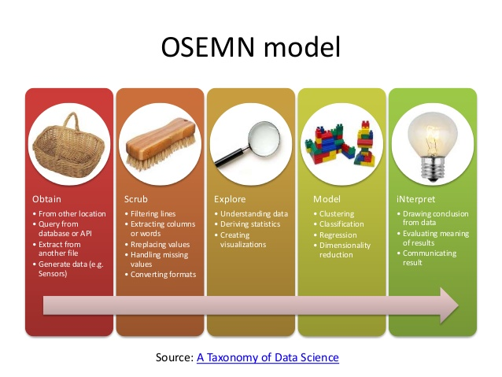

DATA SCIENCE PROCESS
Obtain-Requirements and information gathering on the problem.
Scrub- Pre-processing our data (removing nulls, outliers, normalization, feature selection)
Explore-Understand the cohort characteristics and impactful predictors
Model-Build and tune the model
iNterpret - and communicate results to stakeholders.
Notes:
We are going to. Use the framework as the problem solving methodology

Slide 7









Obtain the data: MIMIC III Data Set
Deindentified health-related dataset represents 11 years (2001-2012) of clinical care at Beth Israel Deaconess Medical Center. It contains data regarding the care of over 40,000 real patients, and as such requires credentialing before access. MIMIC-III is a relational database consisting of 26 tables.
Labs
Diagnosis
Admission
Procedures
Notes
Meds
Prescription
Services
Microbiology
Notes:
The Data source is from MIMIC-III (‘Medical Information Mart for Intensive Care’) is a large, single-center database comprising information relating to patients admitted to critical care units at a large tertiary care hospital. Data includes vital signs, medications, laboratory measurements, observations and notes charted by care providers, fluid balance, procedure codes, diagnostic codes, imaging reports, hospital length of stay, survival data, and more. This contains real patient that were de-identified but still needs protection & privacy safeguards thus the need for completion of some courses including HIPPA privacy.

Slide 8
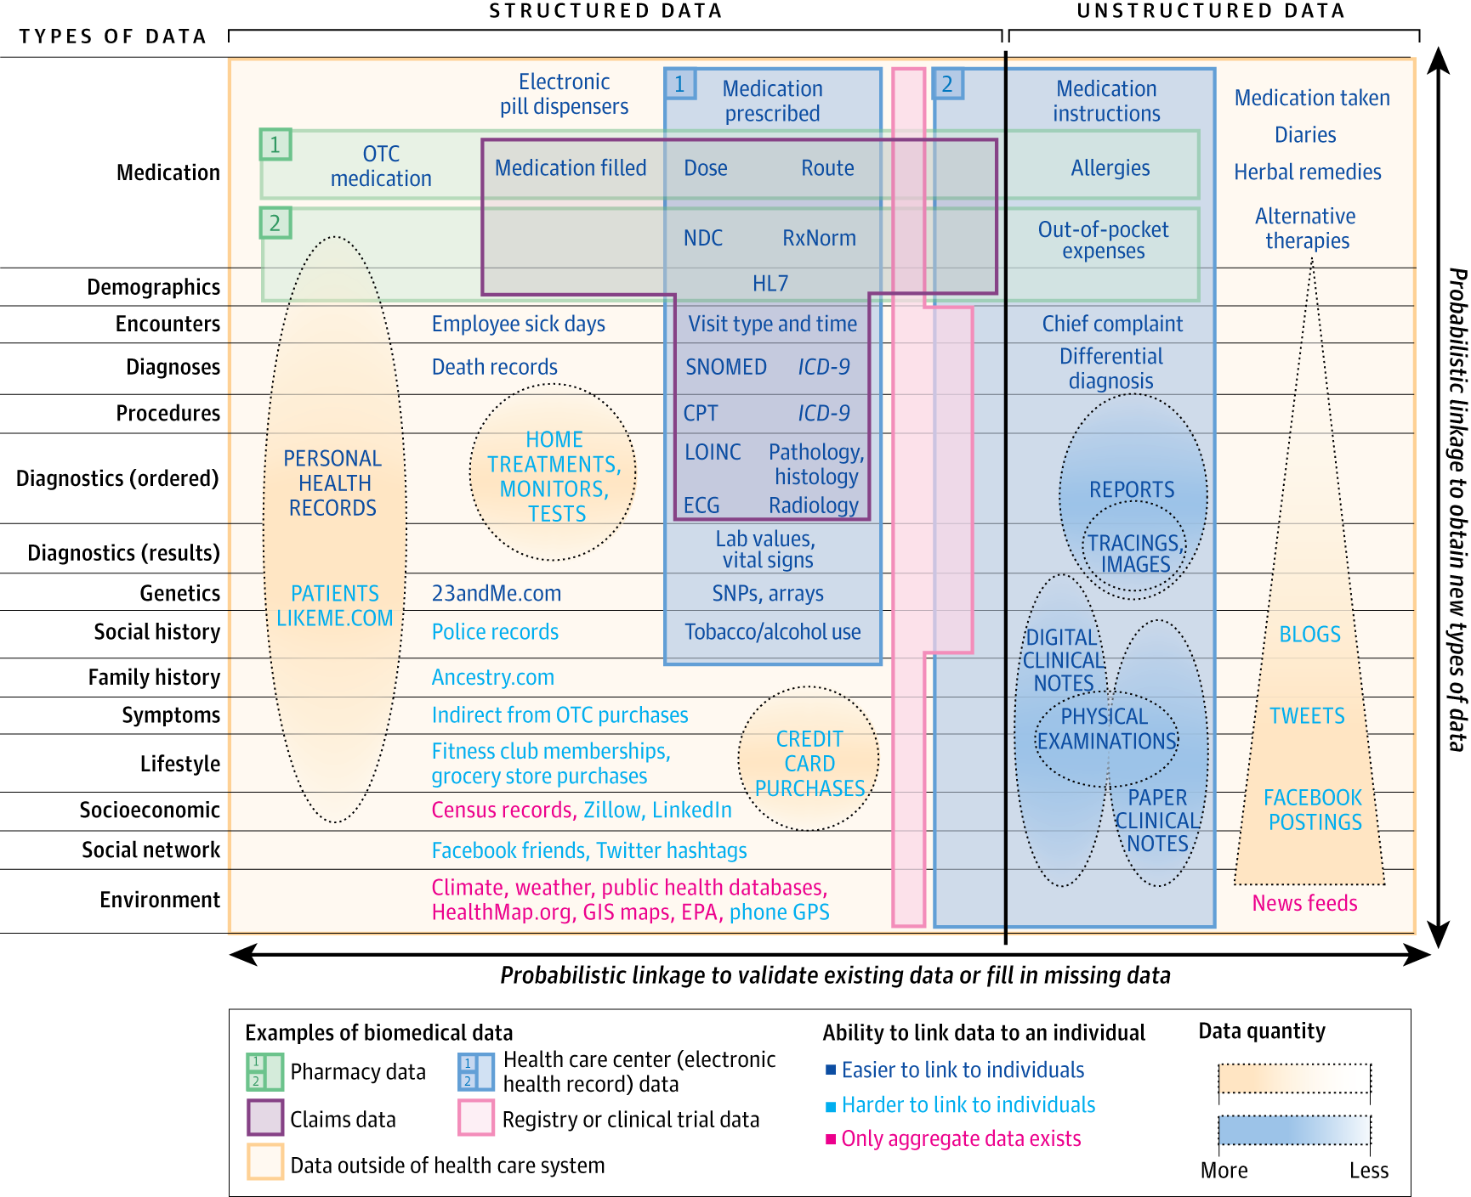
Untapped Unstructured data
Source: Weber GM, et al., Finding the missing link for big biomedical data. JAMA 2014; 311(24):
Notes:
Medical big data refers to large-scale data that is difficult to handle with existing database management systems in a digitalized healthcare environment including medical centers, wearable devices, and social medias. The medical data, which are exploding exponentially, also include large volume of structured and unstructured data as other domains [1].
The big problem of healthcare fields is that about 80% of medical data remains unstructured and untapped after it is created (e.g., text, image, signal, etc.) [2]. Since it is hard to handle this type of data for Electronic Medical Record or most hospital information system, it tends to be ignored, unsaved, or abandoned in most medical centers for a long time [3]. Although a lot of data are still created in many hospitals, it is hard to be connected with medical big data research and artificial intelligence industry in healthcare. Therefore, we need to manage those unmanaged unstructured big data in healthcare systems before mentioning development of medical artificial intelligence which is currently based on machine learning technology.
Medical data are exploding exponentially. Consist of both structured & unstructured data= clinical data use is limited to the structured information.
about 80% of medical data remains unstructured and untapped after it is created . (text/ documents, images, information from wearable devices.
we need to manage those unmanaged unstructured big data
Barriers to healthcare data:
patient protection
* data quality
* cost(monetary, time,resources)
* transparency*
disparate rules across stakeholders

Slide 9
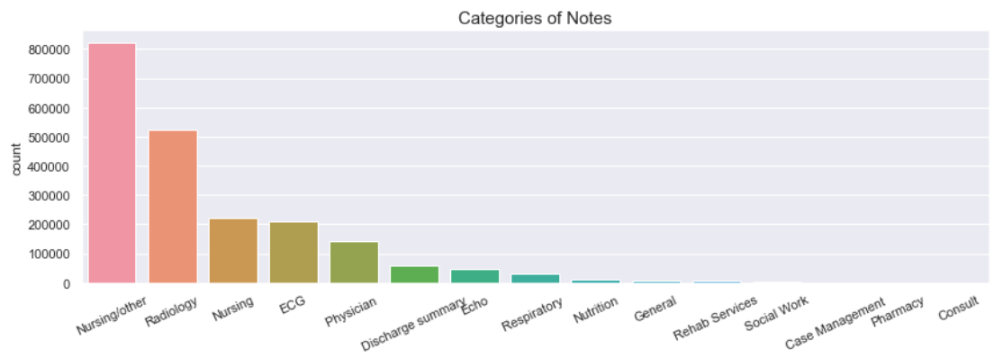
Unstructured clinical NOTES
Notes:
.
More than 80 percent of a healthcare organization's data is unstructured, which complicates traditional data analysis. – meaning it cannot readily be collected and analyzed using standard methods.
medical literature is doubling every five years, healthcare organizations are drowning in data and are challenged to gain reliable, actionable insights from information.
Many unstructured notes in the form of physician notes, discharge summaries, ,Nursing assessment, Radiology notes, result notes, physician history, etc. are generated daily by the multi-disciplinary healthcare workers
https://www-03.ibm.com/press/us/en/pressrelease/42179.wss

Slide 10
Discharge Summary components
Patient/
Admission
Pending Results/ Test Follow-up/Discharge Medication List
Caregivers
Diagnosis/
Problem List
Resolved Hospital Problems
Summary of Hospital Course
Procedures
Discharge Plan of Care
Date of Follow-up appointment
Notes:
The Joint Commission, a quality organization that plays a critical role in care transitions and patient safety,
Hospital discharge summaries serve as the primary documents communicating a patient’s care plan to the post-hospital care team. Often, the discharge summary is the only form of communication that accompanies the patient to the next setting of care. High-quality discharge summaries are generally thought to be essential for promoting patient safety during transitions between care settings, particularly during the initial post-hospital period.
The Joint Commission has established standards (Standard IM.6.10, EP 7) outlining the components that each hospital discharge summary should contain. These components are:
1. Reason for hospitalization.
2. Significant findings.
3. Procedures and treatment provided.
4. Patient’s discharge condition.
5. Patient and family instructions (as appropriate).
6. Attending physician’s signature.
https://www.ncbi.nlm.nih.gov/books/NBK43715/table/advances-kind_31.t2/?report=objectonly

Slide 11
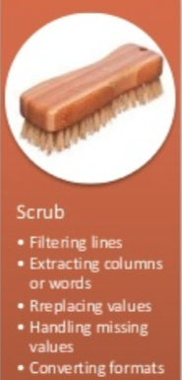
Query the Admissions table
Convert strings to dates
Get the next unplanned admission
Calculate days until next admission
Filter out elective encounters
Query the Notes table
Filter to Discharge Summaries
Filter out Notes marked in error
Merge Notes & Admissions
Get one summary per admission
Remove Newborn encounters
Create the class label
Create the training & test sets
Scrub the Data

Slide 12
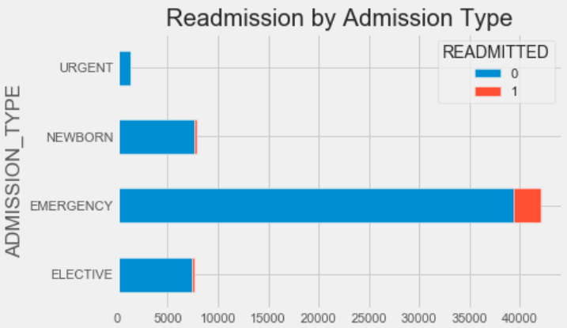
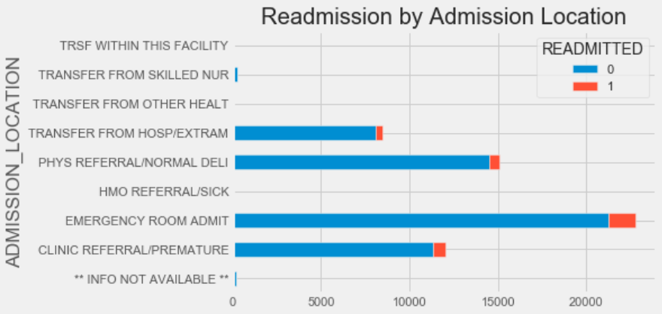
Data exploration

Slide 13
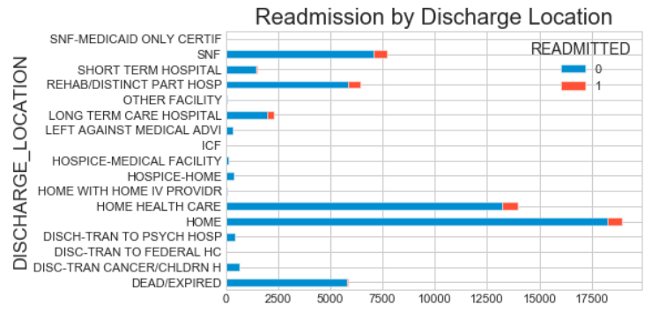
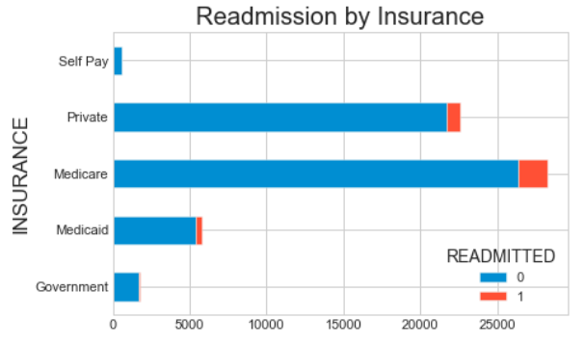
Data exploration

Slide 14
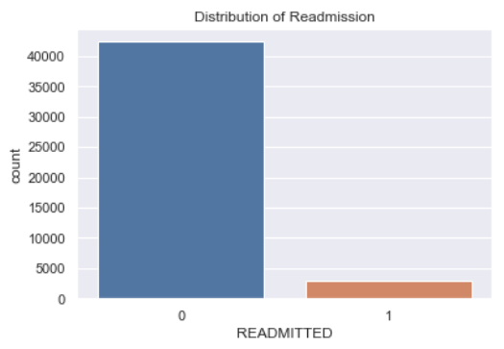
Class label
Imbalanced Class
Readmitted (minority) class is important
Resample the training set
Cross validation
Resample with different ratios
Use Tree-Based Algorithms
Ensemble different resampled datasets
Use the right evaluation metrics
Notes:
Most machine learning algorithms for classification predictive models are designed and demonstrated on problems that assume an equal distribution of classes
The minority “readmitted” class is harder to predict because there are few examples of this class.
It is more challenging for a model to learn the characteristics of examples from this class, and to differentiate examples from this class from the majority class (not readmitted class).
The abundance of examples from the majority class (or classes) can swamp the minority class and this is usually the case for clinical classification problems/disease detection.
cross-validation should always be done before over-sampling the data to avoid overfitting our model
https://www.kdnuggets.com/2017/06/7-techniques-handle-imbalanced-data.html

Slide 15
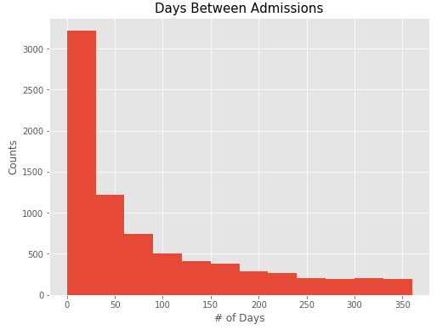
All Cause readmissions - # days between

Slide 16
TEXT PROCESSING
Text cleaning is task specific – medical abbreviations
Split discharge summary into words/tokens
Remove punctuation
Remove non-alphabetic characters
Remove new line/carriage return/stop words
Bag-of-Words Model (BoW)
Count Vectorizer & TF-IDF
Notes:
Most machine learning algorithms for classification predictive models are designed and demonstrated on problems that assume an equal distribution of classes
The minority “readmitted” class is harder to predict because there are few examples of this class.
It is more challenging for a model to learn the characteristics of examples from this class, and to differentiate examples from this class from the majority class (not readmitted class).
The abundance of examples from the majority class (or classes) can swamp the minority class and this is usually the case for clinical classification problems/disease detection.
cross-validation should always be done before over-sampling the data to avoid overfitting our model
https://www.kdnuggets.com/2017/06/7-techniques-handle-imbalanced-data.html

Slide 17
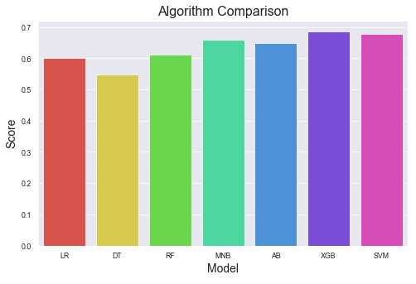
MODEL SELECTION
Model ROCAUC
LR 0.600403
DT 0.548500
RF 0.612230
MNB 0.660130
AB 0.650057
XGB 0.687193
SVM 0.678143
Notes:
Use Tree-Based Algorithms
Model Score
LR 0.567820
DT 0.561150
RF 0.590717
BRF 0.635710
GB 0.635877
AB 0.619583
XGB 0.641097
SVM 0.621500
Accuracy Score –misleading since we are working with a a dataset with highly unbalanced classes, where there is a disparity between the number of positive and negative labels.
If the classifier always "predicts" the most common class without performing any analysis of the features, it will still have a high accuracy rate.

Slide 18
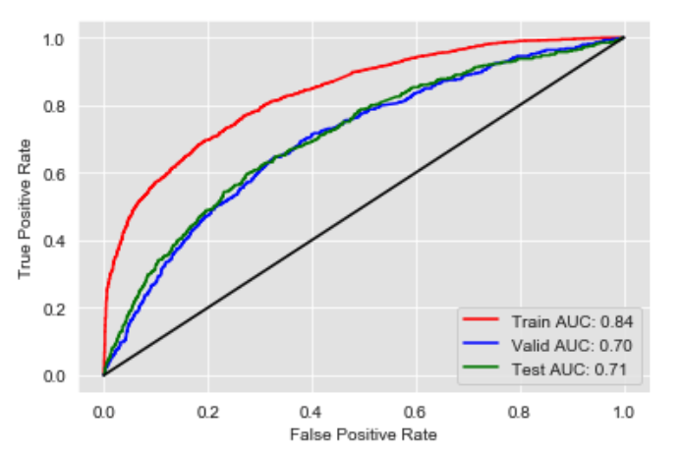
TRAIN, VALIDATION, TEST SCORES
Train AUC:0.837
Valid AUC:0.700
Test AUC:0.708
Train accuracy:0.751
Valid accuracy:0.690
Test accuracy:0.680
Train recall:0.691
Valid recall:0.610
Test recall:0.631
Train precision:0.785
Valid precision:0.121
Test precision:0.111
Train specificity:0.811
Valid specificity:0.696
Test specificity:0.683
Notes:
XGBoost Classifier was selected as the model with the best AUC score to predict readmissions from discharge notes.
Train Test Split
For cross-validation,the dataset was split into training, validation, and test sets.
Grid-search was run to determine the best parameters for the selected classifier.
The hypertuned parameters were fit on the training data and assessed using the following metrics:
Validation accuracy
Confusion matrices
ROC curves
ROC is a probability curve and AUC represents degree or measure of separability. It tells how much model is capable of distinguishing between classes.
Higher the AUC, better the model is at distinguishing between patients with readmissions and no readmissions.
The AUC function takes both the true outcomes (0,1) from the test set and the predicted probabilities for the positive class.
True Positive Rate (TPR) is the proportion of actual readmissions that the test correctly predicted would be readmitted.
False Positive Rate (FPR) is the proportion of patients whom the model predicted would be readmitted, but were not.
ROC is the graphical representation of the balance between TPR and FPR at every possible decision boundary
AUC is a single number that can evaluate a model’s performance, regardless of the chosen decision boundary
If we were to choose a boundary of .7, readmittance probability above .7 is a readmission, everyone below is not

Slide 19

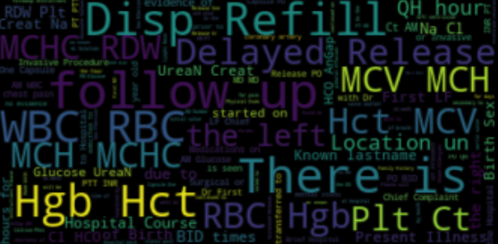
Word CLOUD
Readmitted
Not Readmitted
Notes:
After cleaning the text and splitting them into tokens, we converted the discharge summary text to numbers.
Bag-of-Words Model (BoW) For this project we will be utilizing the Bag-of-Words Model, or BoW. This model doesn’t focus about the order of words but focuses on the occurrence of words in a document or the degree to which they are present in encoded.
Count Vectorizer Count Vectorizer will be utilized to tokenize a collection of text documents, build a vocabulary of known words and also to encode new documents using that vocabulary. An encoded vector is returned with a length of the entire vocabulary and an integer count for the number of times each word appeared in the document. Here are the steps:
Create an instance of the CountVectorizer class.
vector = CountVectorizer(max_features = 3000, tokenizer = clean_tokenize, stop_words = stop_words)
Call the fit() function in order to learn a vocabulary from one or more documents.
vector.fit(df_train.TEXT.values)
Call the transform() function on one or more documents as needed to encode each as a vector.
X_train_tf = vect.transform(df_train.TEXT.values) X_valid_tf = vect.transform(df_valid.TEXT.values)
TF-IDF - Term Frequency - Inverse Document Frequency - word frequency scores that try to highlight words that are more frequent in a documents but not across documents.
Term Frequency: summarizes how often a given word appears within a document
Inverse Document Frequency: downscales words that appear a lot across documents TF-IDF will tokenize documents, learn the vocabulary and inverse document frequency weightings, and also to encode new documents using that vocabulary

Slide 20
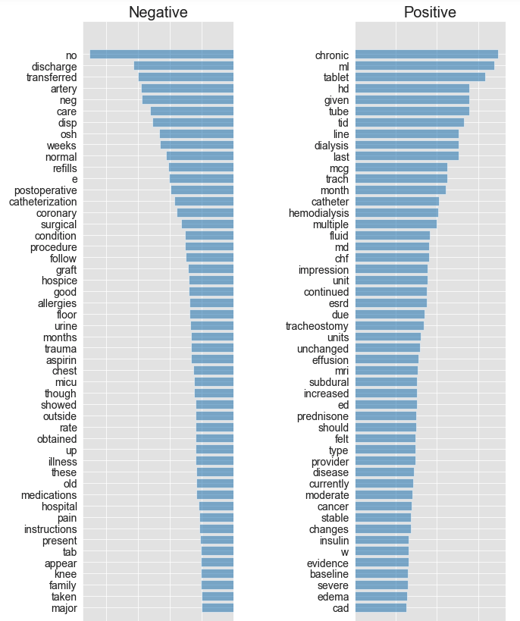
Feature importance
Notes:
Model provides estimates of feature importance from a trained predictive model. Importance provides a score that indicates how useful or valuable each feature was in the construction of the boosted decision trees within the model.. The more an attribute is used to make key decisions with decision trees, the higher its relative importance. allowing attributes to be ranked and compared to each other.

Slide 21
Performance Metrics
Confusion Matrix - a table showing correct predictions and types of incorrect predictions.
Precision - proportion of + identifications that are correct (TP/(TP+FP))
Recall - proportion of actual positives identified correctly (TP/(TP+FN))
Receiver operating characteristics curve - diagnostic ability of a binary classifier
Notes:
https://towardsdatascience.com/methods-for-dealing-with-imbalanced-data-5b761be45a18
Change the performance metric
As we saw above, accuracy is not the best metric to use when evaluating imbalanced datasets as it can be very misleading. Metrics that can provide better insight include:
Confusion Matrix: a table showing correct predictions and types of incorrect predictions.
Precision: the number of true positives divided by all positive predictions. Precision is also called Positive Predictive Value. It is a measure of a classifier’s exactness. Low precision indicates a high number of false positives.
Recall: the number of true positives divided by the number of positive values in the test data. Recall is also called Sensitivity or the True Positive Rate. It is a measure of a classifier’s completeness.
Low recall indicates a high number of false negatives.
F1: Score: the weighted average of precision and recall.
Let’s see what happens when we apply these F1 and recall scores to our logistic regression from above.
These scores don’t look quite so impressive. Let’s see what other methods we might try to improve our new metrics.
Change the algorithm
While in every machine learning problem, it’s a good rule of thumb to try a variety of algorithms, it can be especially beneficial with imbalanced datasets. Decision trees frequently perform well on imbalanced data. They work by learning a hierarchy of if/else questions and this can force both classes to be addressed.
One of the major issues that novice users fall into when dealing with unbalanced datasets relates to the metrics used to evaluate their model.
Using simpler metrics like accuracy_score can be misleading. These scores don’t look quite so impressive. Let’s see what other methods we might try to improve our new metrics.

Slide 22
Interpretation
XGBoost Classifier was selected as the best model to predict readmissions from discharge notes.
BoW with XGB model yields slightly better result than TF-IDF and the complex Neural Network model.
Increasing n-gram range did not improve scores for BoW method.
Reduce overfitting - early stop and
Algorithm | Score
Basic XGB Initial AUC BoW | 68.72
Tuned XGB BoW | 70.8
XGBt BoW bi-gram | 70.2
XGBt BoW tri-gram | 69.70
XGBt TF-IDF tri-gram | 68.06
Neural Networks | 66.90
regularization
Notes:
https://www.ncbi.nlm.nih.gov/pmc/articles/PMC5510858/

Slide 23
Future Work
Compared to random predictions, results from our predictive model (AUC=.71) is a good baseline for further improving our model.
Explore other unstructured notes or combine with structured clinical information to strengthen predictive scores.
Feature engineering, ensemble of models and parameter tuning of the model will help the adoption of the model as a clinical decision system for evaluating readmission
Notes:
Predicting hospital readmissions based on unstructured data opens many opportunities in predictive analytics where a vast amount of untapped data could be utilized to improve outcomes for the patients, lower healthcare cost while providing quality care.

Slide 24
















Change the risk trajectory
Prediction of patients at risk
Discharge Planning/
Care Coordination
Social Determinants of Health
Patient Education
Partnerships in Value-based care
Telehealth
/Chats
Health Information Exchange
Discharge Planning
Dashboards
/Analytics
Post-Discharge
Appointments
Medication
Reconciliation
Socio-economic
needs
Reporting Signs &
symptoms
Collaboration
Care Coordination
Patient Portals/
Chatbots
Telehealth Visits

Slide 25


Thank you!
Keep in touch!
in

