Slide 1


ANALISI DI MERCATO 2022-2023
SIAFA 19/05/2023
Serena Alderisi
M.Sc. Data Scientist

Slide 2
Table of Contents
01
ANN review
02
Python Script
03
Final Project
04
Extra
ANN fundamentals
Hands on a Deep Neural Network for Californian House Classification
Assignments Definition
Deep Dive in Data related Career Paths

Slide 3


Slide 4
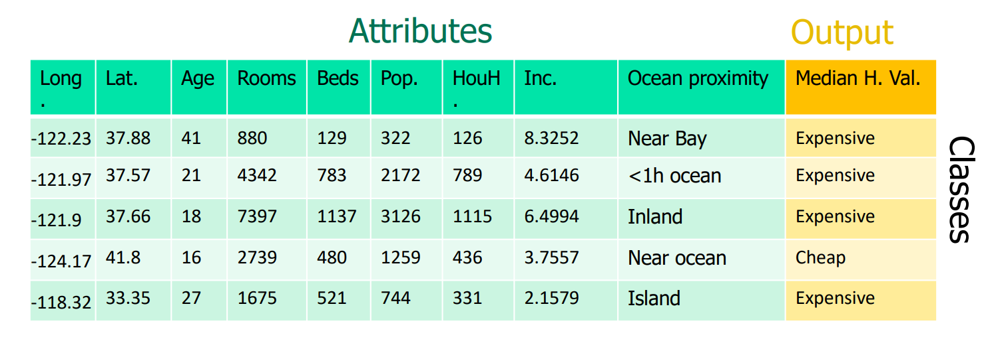
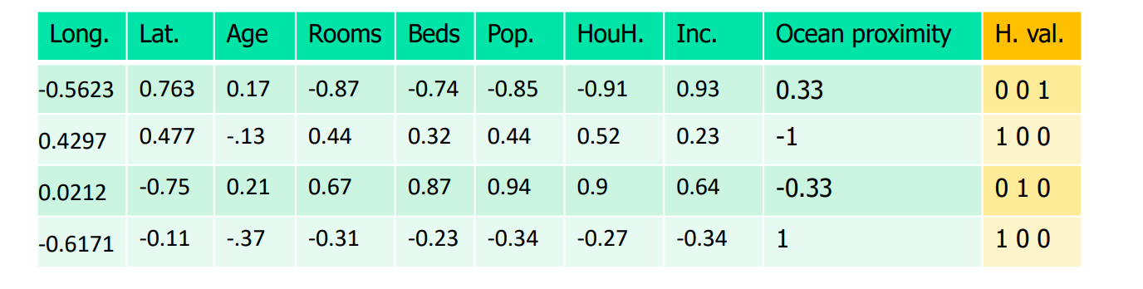
Case Study
California housing dataset Median house classification problem
Median house value:
Cheap [15, 141.3];
Averaged [141.4, 230.2];
Expensive [230.3, 500] th$.
Hot Encoded
Attributes:
longitude, latitude, median age,
total rooms, total bedrooms,
population, households, median income, ocean proximity.

Slide 5
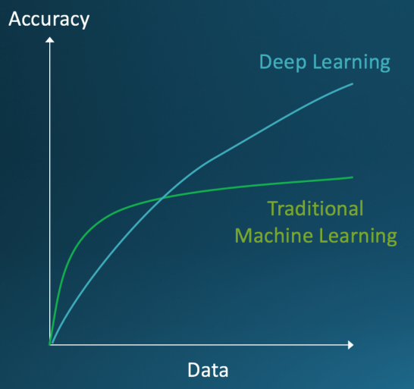
From ML to Deep Learning
We could make the one-hidden layer NN more powerful by adding more hidden neurons, but with just one level of abstraction, fitting large datasets is very hard with shallow NN.
We can rather increase the number of layers
Multiple layers of abstraction to progressively extract higher level features from the raw input, and pick out which features improve performance.
Deep NN can achieve better accuracy than shallow NN.
Deep learning comes into play to solve the difficulties arisen from training deep neural networks

Slide 6
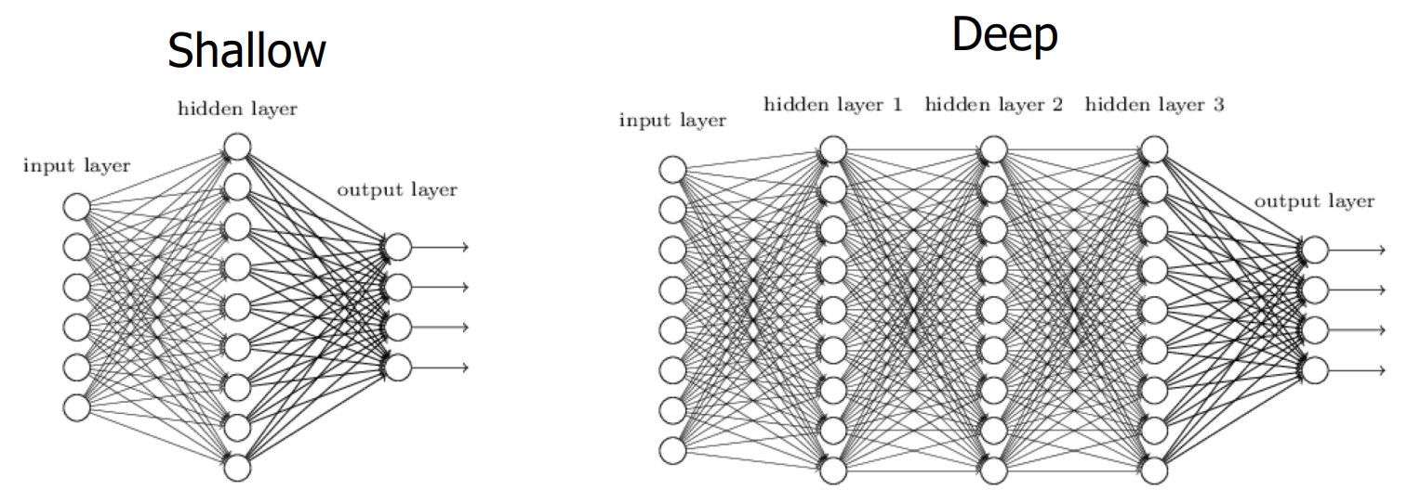
From Shallow to Deep

Slide 7
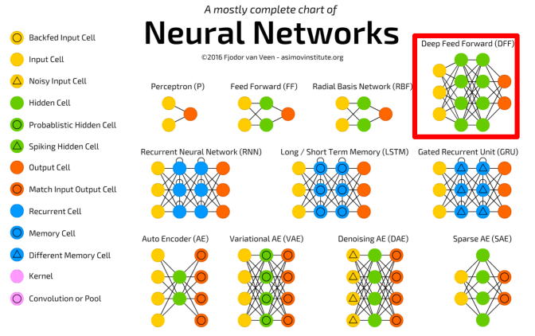
ANN type

Slide 8
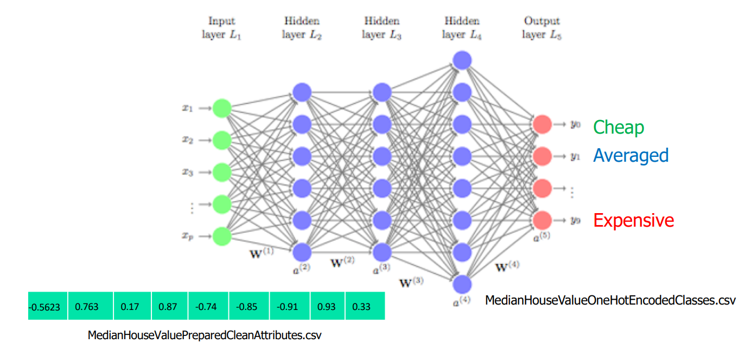
ANN Architecture n.1
Hyperparameters:
9-10,000-10,000-10,000-3
Learning rate: 0.1;
Batch size: 500
Activation functions: tanh - softmax

Slide 9



Hands on pt.1
2. Deep ANN with tanh and Keras.ipynb

Slide 10
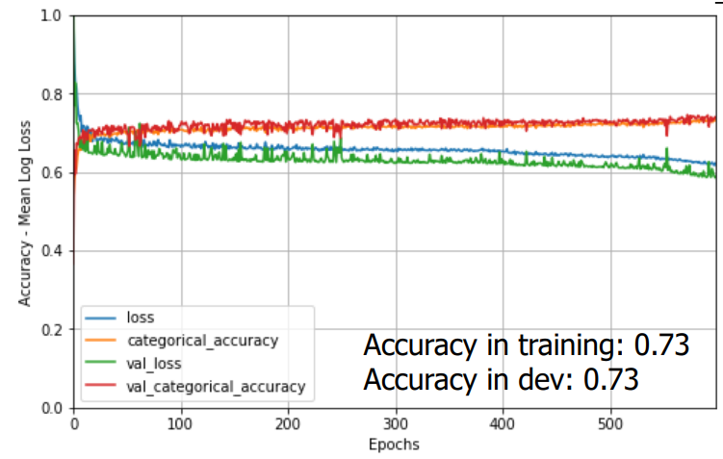
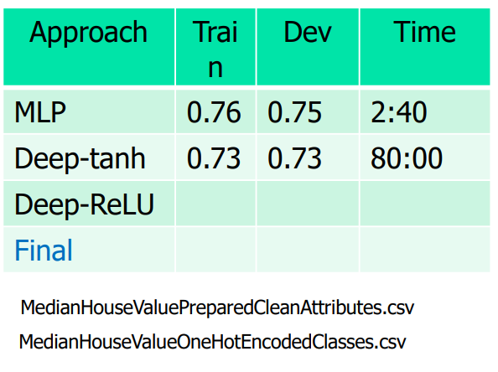
Hands on pt.1 results
Deep ANN tanh results
Hyperparameters:
Stop condition: 600 epochs
Learning rate =0.1
Mini-batch size = 500
Hidden layers = 10,000-10,000-10,000
Activation functions: tanh - softmax

Slide 11
Saturation
In summary, when an activation function saturates, it means that it reaches extreme output values and becomes relatively flat, which can lead to difficulties in training neural networks.
activation functions like ReLU have become popular alternatives to address these challenges.
This usually happens with tanh and sigmoid activation functions.
If near output layers are saturated at, -1 (0) or 1, the asymptotes of the tanh (sigmoid) function, near input layers have gradients of nearly 0. Derivatives are nearly 0 in the asymptotes.
This may occur during early stages of training.
The final trained network converges to a poor local optimum.
Vanishing gradients problem appears in feedforward NN trained with BP.
Solution: ReLU and its variants.
Relu activation functions do not saturate for positive inputs, which means it does not suffer from the vanishing gradient problem. It allows the gradients to flow more freely during backpropagation, leading to faster convergence and better learning in deep neural networks.

Slide 12
ANN Architecture n.2
Hyperparameters:
9-10,000-10,000-10,000-3
Learning rate: 0.1;
Batch size: 500
Activation functions: ReLU - softmax

Slide 13
Hands on pt.2
3. Deep ANN with ReLU and Keras.ipynb

Slide 14
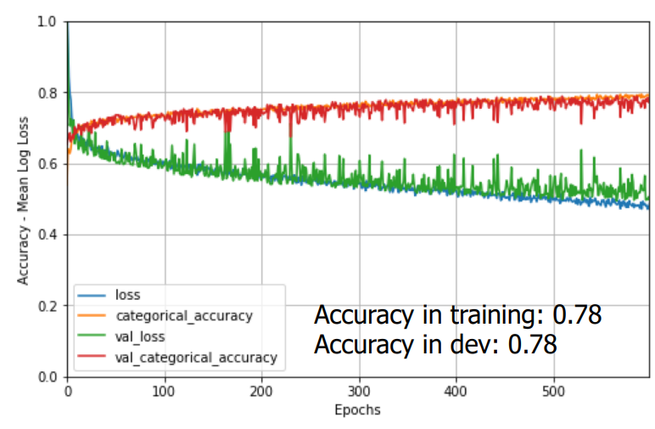
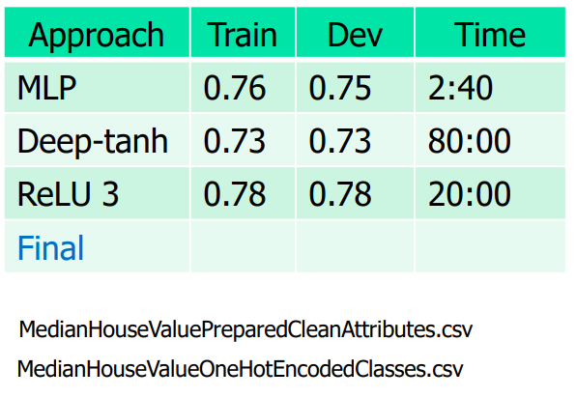
Hands on pt.2 results
Deep ANN tanh results
Hyperparameters:
Stop condition: 600 epochs
Learning rate =0.1
Mini-batch size = 500
Hidden layers = 10,000-10,000-10,000
Activation functions: ReLU - softmax

Slide 15
Now is your turn!
Discover the impact of different activation functions, regularization techniques and play around trying different configurations of
your first artificial neural network!

Slide 16

Final Project
The final project has following goal:
Improve the performance (running time and accuracy trade-off) of the basic deep neural network “3. Deep ANN with ReLU and Keras.ipynb)” and explain results and attempts.
Each group will provide a power point presentation about the work that has been done.
Each group will have a slot of 10 minutes to present their results.
Each team member will have the chance to present.
The groups are organized as the following:
Name | Members | Presentation Order
Group A | Jacopo Esposito, Vittorio Zoccola, | 2
Group B | Angelo Pio Tuccillo, Gennaro di Stasio, Martina Ruggiero | 1
Group C | Davide Fiorentini, Pasquale Ruopolo, Fabrizio Zheng | 3
Group D | Rosa Izzo, Serena Fucile, Sarconio Daniele | 4
Group E | Francesco Palmisano, Andrea Cappabianca , Milena Aiello | 5

Slide 17
Complementary Readings
Building our first neural network in keras
Neural networks and deep learning
fighting-overfitting-with-l1-or-l2-regularization
l1-and-l2-regularization-methods- lasso and ridge regression

Slide 18
Thank you! Any Questions?

