Slide 1
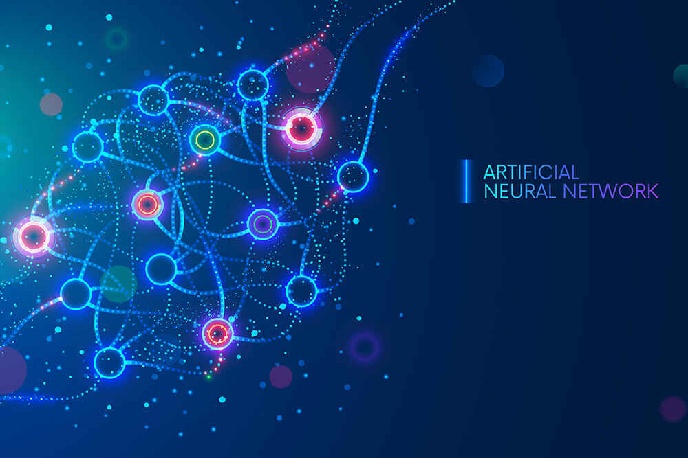

ANALISI DI MERCATO 2022-2023
SIAFA 19/05/2023
Serena Alderisi
M.Sc. Data Scientist

Slide 2
Table of Contents
01
ANN review
02
Python Script
03
Final Project
04
Extra
ANN fundamentals
Hands on a Deep Neural Network for Californian House Classification
Assignments Definition
Deep Dive in Data related Career Paths

Slide 3


Slide 4
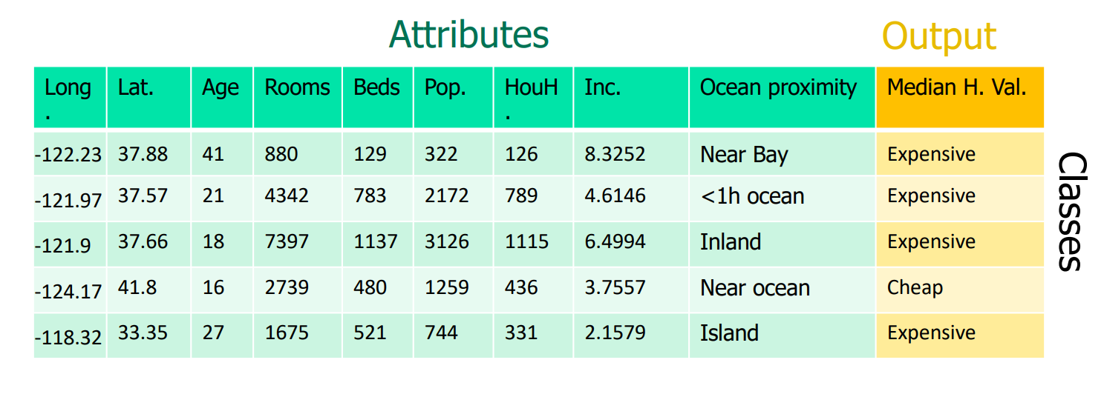
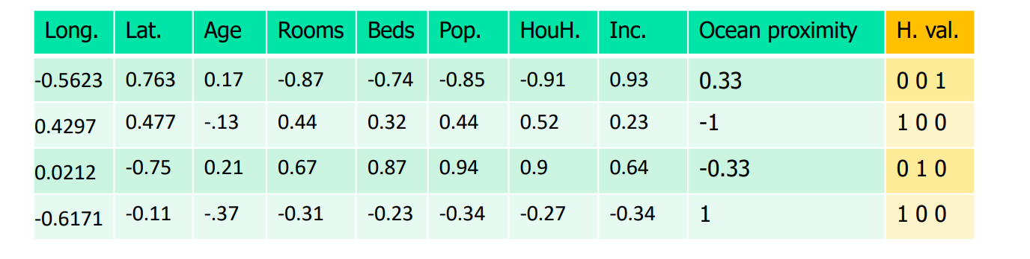
Case Study
California housing dataset Median house classification problem
Median house value:
Cheap [15, 141.3];
Averaged [141.4, 230.2];
Expensive [230.3, 500] th$.
Hot Encoded
Attributes:
longitude, latitude, median age,
total rooms, total bedrooms,
population, households, median income, ocean proximity.

Slide 5
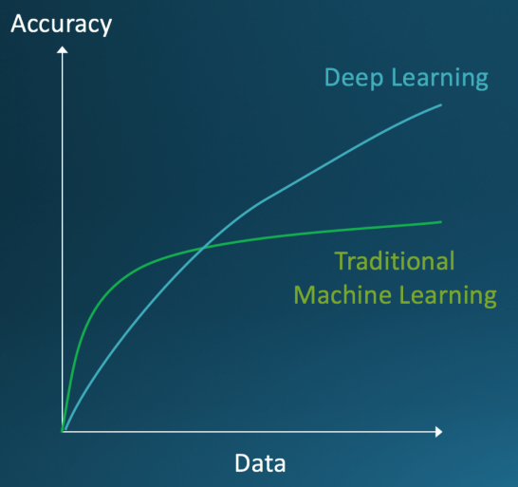
From ML to Deep Learning
We could make the one-hidden layer NN more powerful by adding more hidden neurons.
In fact, one-hidden layer NN can approximate functions with an arbitrary low error. n Just one level of abstraction. n Fitting large datasets is very hard with shallow NN.
We can rather increase the number of layers:
Multiple layers of abstraction to progressively extract higher level features from the raw input, and pick out which features improve performance.
Deep NN can achieve better accuracy than shallow NN. n Deep learning comes into play to solve the difficulties arisen from training deep neural networks

Slide 6
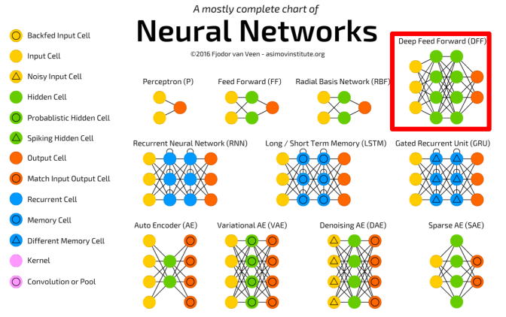
ANN type

Slide 7
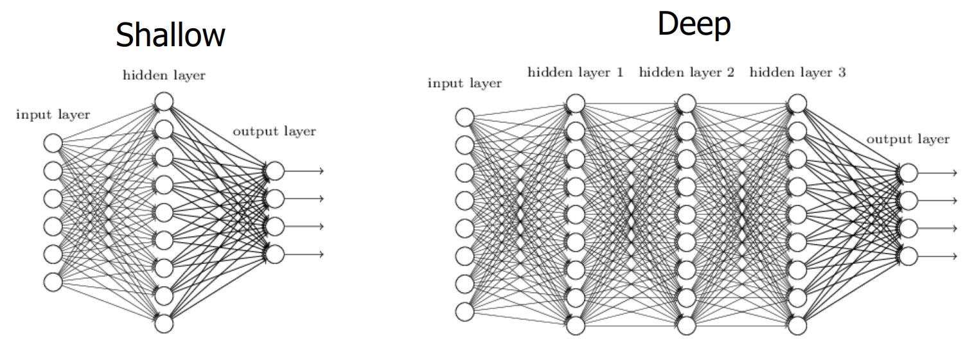
From Shallow to Deep

Slide 8
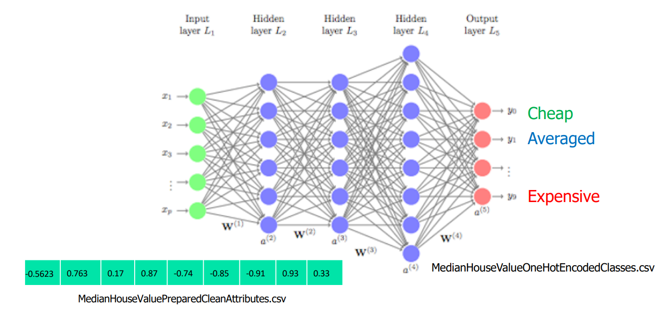
ANN Architecture
Hyperparameters:
9-10,000-10,000-10,000-3
Learning rate: 0.1;
Batch size: 500
Activation functions: tanh - softmax

Slide 9



Hands on
One Hidden Layer with Tensorflow

Slide 10
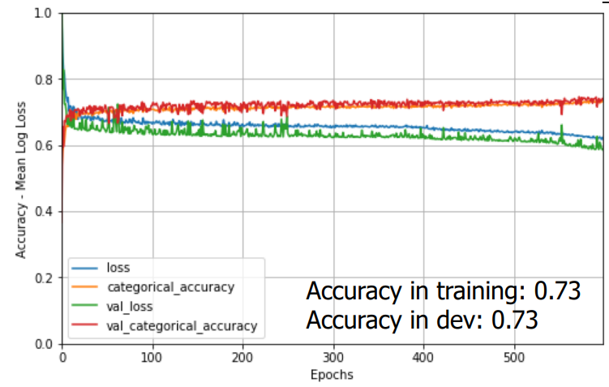
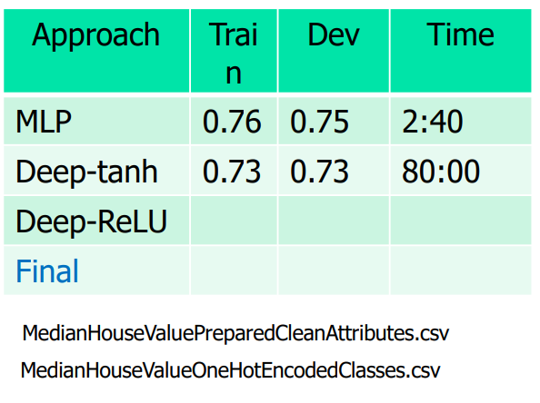
Hands on results
Deep ANN tanh results
Hyperparameters:
Stop condition: 600 epochs
Learning rate =0.1
Mini-batch size = 500
Hidden layers = 10,000-10,000-10,000
Activation functions: tanh - softmax

Slide 11
Work Groups Plan
The following table displays the working groups that will perform the ANN Optimization assignment in Python.
Each group will provide a short presentation on the achieved results on 26/05/2023.
Name | Members
Group A | Jacopo Esposito, Vittorio Zoccola,
Group B | Angelo Pio Tuccillo, Gennaro di Stasio, Martina Ruggiero
Group C | Davide Fiorentini, Pasquale Ruopolo, Fabrizio Zheng
Group D | Rosa Izzo, Serena Fucile, Sarconio Daniele
Group E | Francesco Palmisano, Andrea Cappabianca , Milena Aiello

Slide 12


Final Project
The presentation has 2 goals :
1. Improve the performance of the basic shallow network (1.One Hidden Layer with Tensorflow.ipynb) and briefly showing the obtained results.
This task has the 30% of impact on the project.
2. Improve the performance of the basic deep neural network (2.Deep ANN with tanh and Keras.ipynb) and explain results and attempts.
This task has the 70% of impact on the project.
Each group will provide a power point presentation about the work that has been done.
Each group will have a slot of 10 minutes to present their results.
Each team member will have the chance to present.

Slide 13
Complementary Readings
Building our first neural network in keras
Neural networks and deep learning

Slide 14
Thank you! Any Questions?

