Slide 1


ANALISI DI MERCATO 2022-2023
SIAFA 10/05/2023
Extra: Carreer Paths
Serena Alderisi
M.Sc. Data Scientist

Slide 2
My Experience
COMMISSION THESIS PREDISENT
BRUSSELS
MSC DEGREE
DS SPEAKER
ISTAT
Universite’ Libre
de Bruxelles
Intermediate English
Beginner Spanish
Data Science at Universidad Politecnica de Madrid
Thesis in Machine Learning
applied to COVID-19
University Talks and Conference
Keynote Speaker
University Thesis commision member and President for Big Data Students at Juan Pablo II
Internship as
Data Analyst
VIENNA
First experience
abroad
2018
2019
2020
2021
2022
2023
CAPGEMINI
MADRID
SIEMENS
ADJUNCT
PROFESSOR
BACHELOR
DEGREE
Technical Analyst
Development and
Customization on
Microsoft
Dynamics 365 and
MS SQL
Universidad Politecnica
de Madrid
MSc Degree +
Intermediate Spanish
Gratued with honors in
Statistics and Compuer Science at Università
degli studi di Napoli Partheope – Thesis in
Risk Management and
Financial Time Series
Data Scientist and Machine Learning expert in Cybersecurity
Intensive ANN course at Università
degli studi di Napoli Partheope

Slide 3
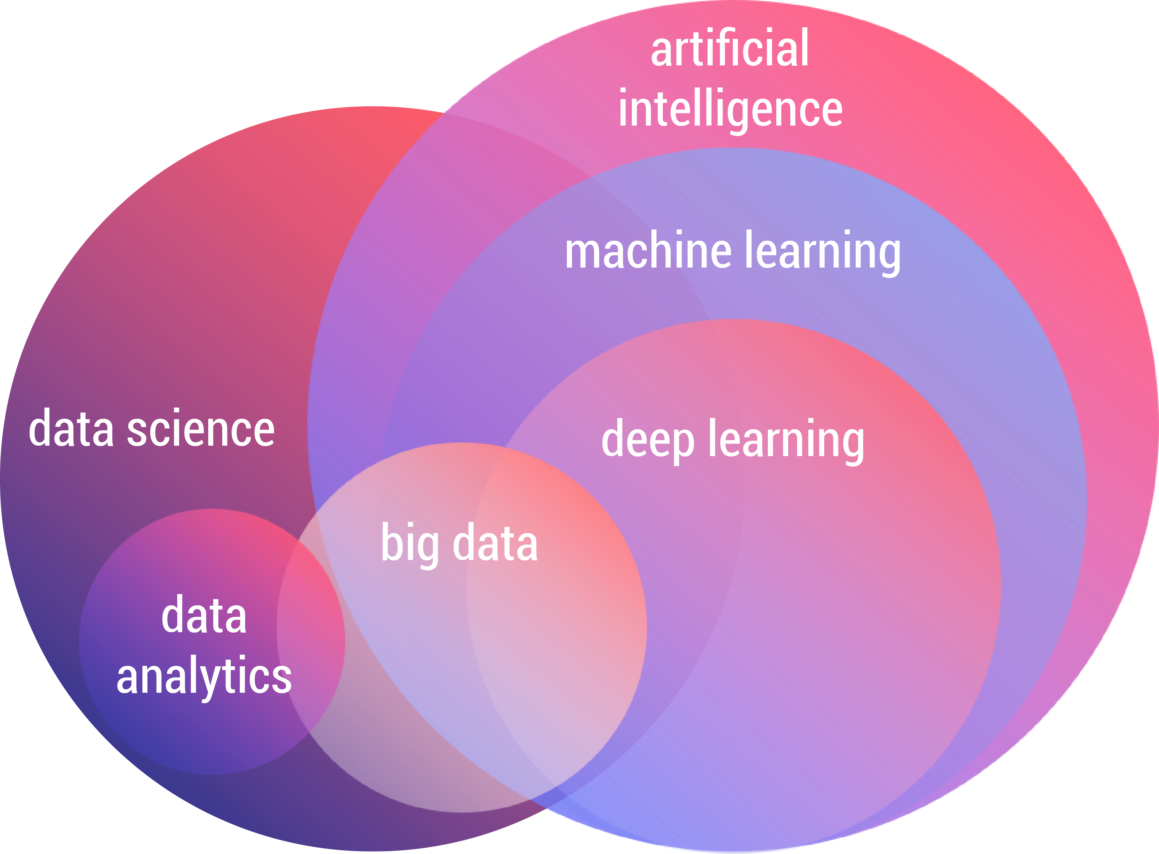
AI Fields Comparison

Slide 4
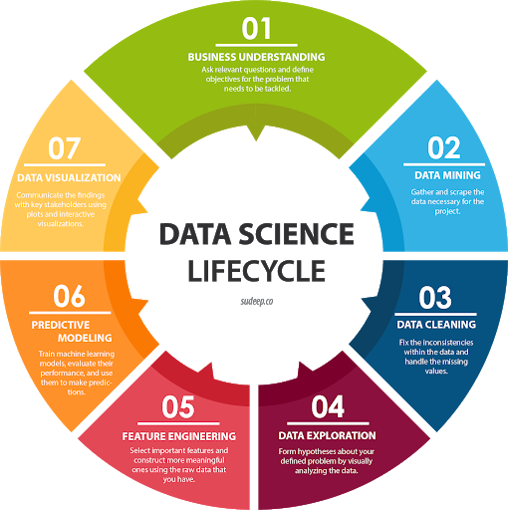






“ A Multidisciplinary Approach ”
Data Science

Slide 5
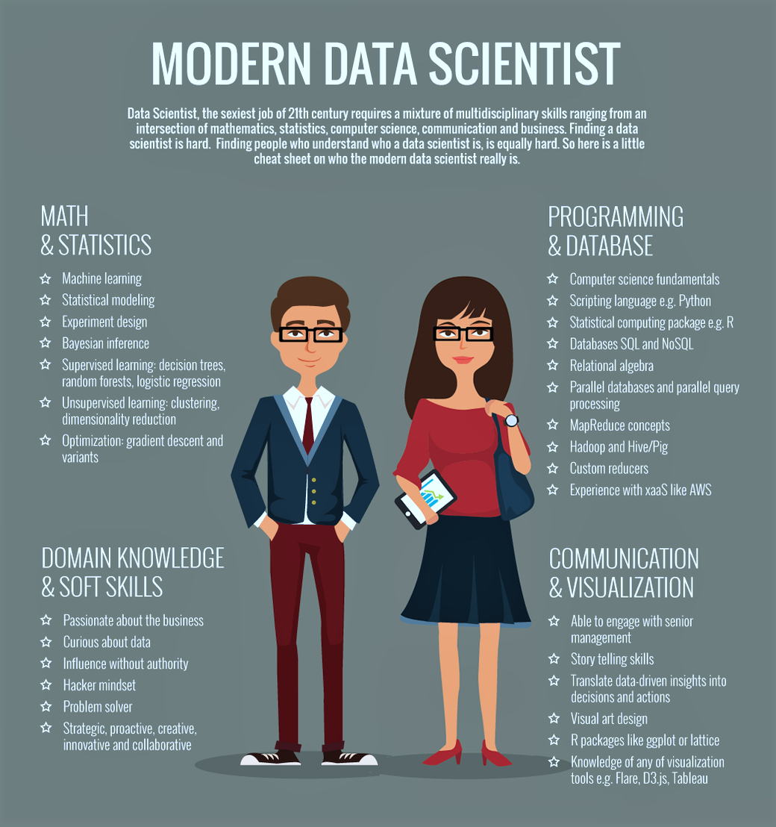
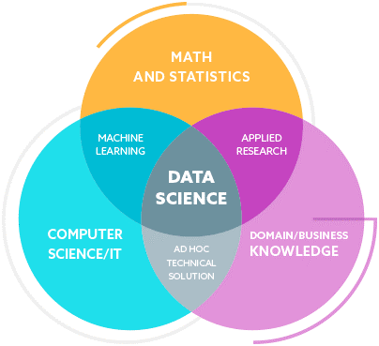
Data Science

Slide 6
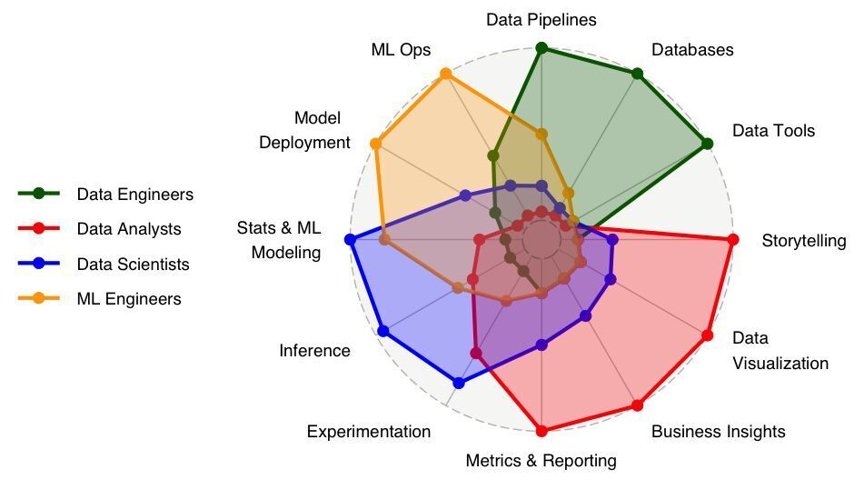
Job titles Comparison

Slide 7
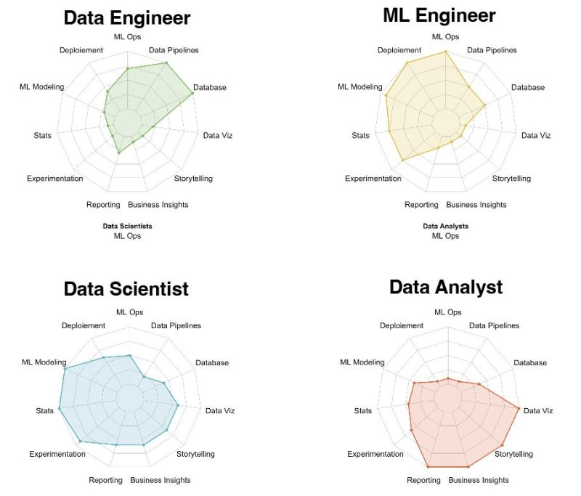

Slide 8
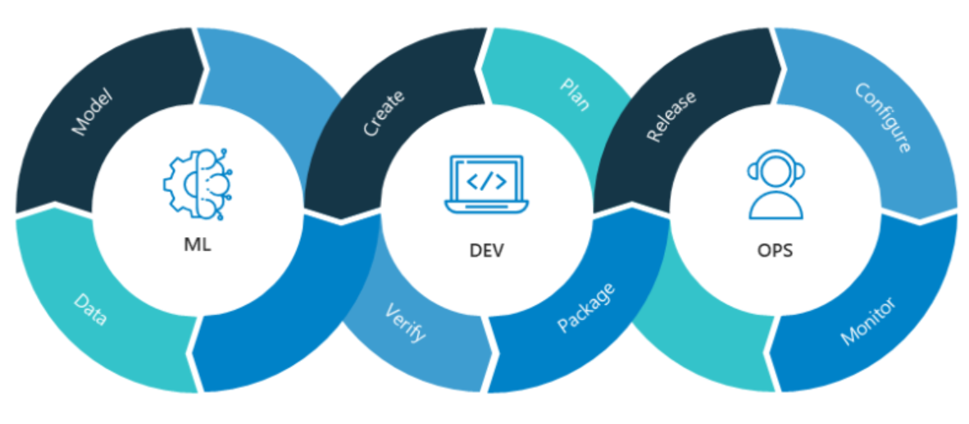
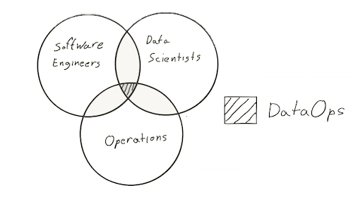
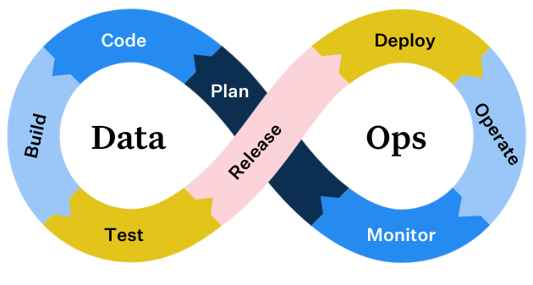
Tasks Comparison

Slide 9
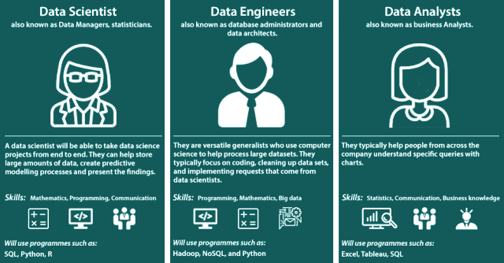
Job titles Comparison

Slide 10
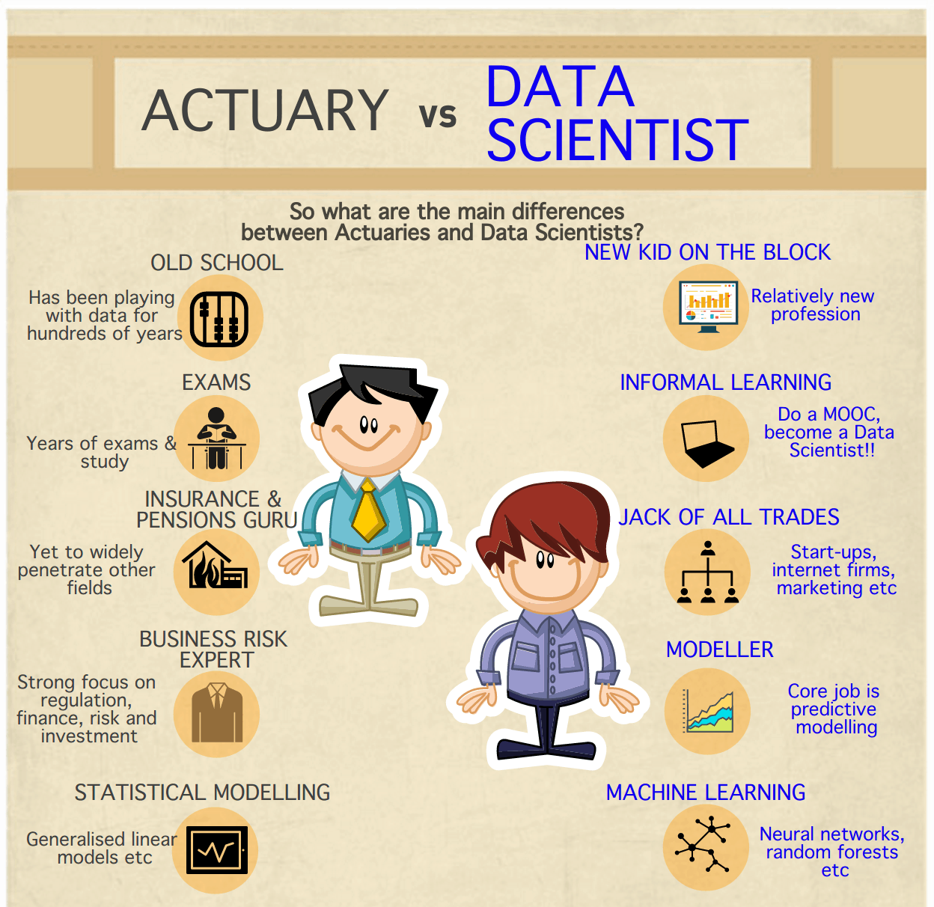
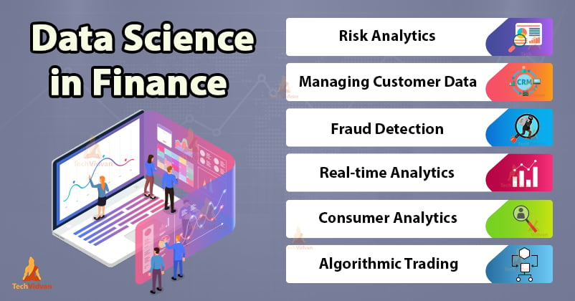
Financial/Ensurance field

Slide 11
Reccomended Readings
Data analyst career paths
Financial Data Analyst
Healthcare data analyst
Sports analyst
Highest paying data careers
Actuary vs data scientist
Statisticians job carrers
Job titles comparison in Data fields

Slide 12
GOOD LUCK! Any Questions?

