Slide 1
References

Slide 2
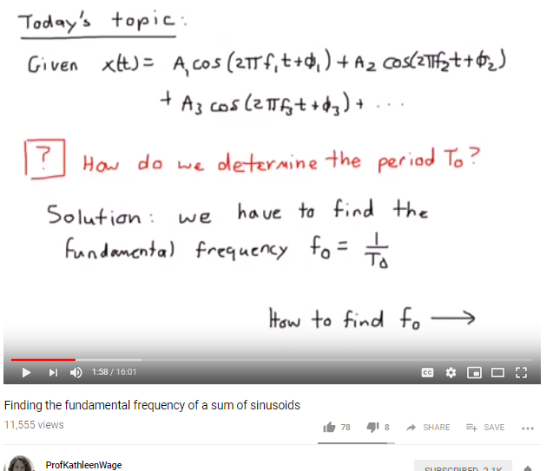
New fundamental frequency of a sum of sinusoids
https://www.youtube.com/watch?v=F_pdpbu8bgA

Slide 3
How to do integration, differentiation
https://www.integral-calculator.com/
https://www.symbolab.com/solver/integral-calculator
https://www.wolframalpha.com/input/?i=integrate+t*exp(i*w*k*t)

Slide 4
Some relevant Videos
Some more https://youtu.be/5uDxKJ4zZ3Y
https://youtu.be/ZVX3j8pSazw
http://lpsa.swarthmore.edu/Fourier/Series/ExFS.html
Pg 25 in slide
https://www.dropbox.com/s/l2tsykynuh99o3e/2TF-L1.pdf?dl=0

