Slide 1
Fourier Analysis and Synthesis An Intuitive Introduction
Chng Eng Siong
NTU, Singapore, Oct 2018

Slide 2
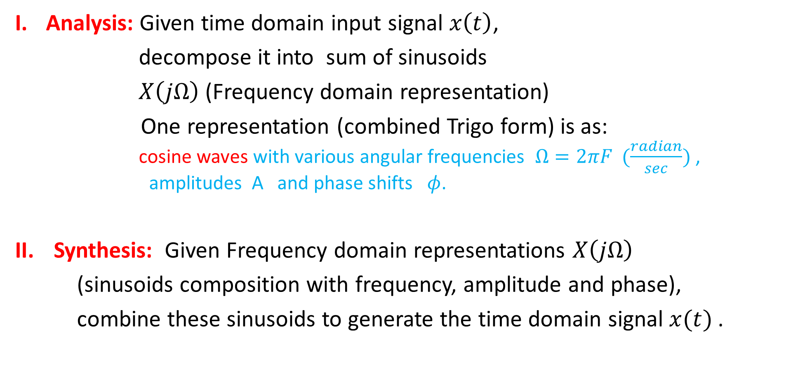
1A. What is Fourier Analysis & Synthesis?
Analysis: Given time domain input signal $x\left(t\right)$,
decompose it into sum of sinusoids
$X\left(jΩ\right)$(Frequency domain representation)
One representation (combined Trigo form) is as: cosine waves with various angular frequencies $Ω=2πF (\frac{radian}{sec})$ , amplitudes A and phase shifts $φ$.
Synthesis: Given Frequency domain representations $X\left(jΩ\right)$
(sinusoids composition with frequency, amplitude and phase),
combine these sinusoids to generate the time domain signal $x(t)$.

Slide 3
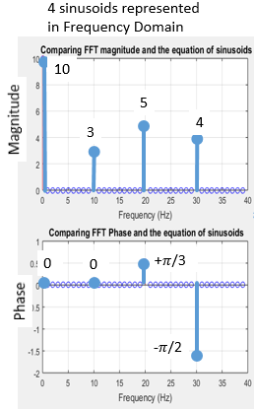
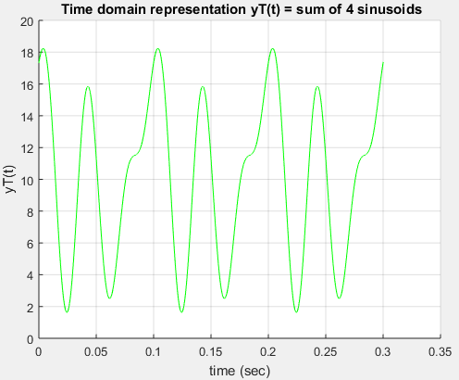
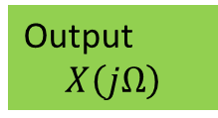
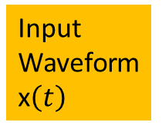
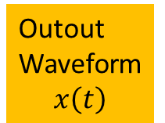
1A. Overview
Fourier Analysis
Fourier
Synthesis
Input Waveform
x$\left(t\right)$
Outout
Waveform
$$x\left(t\right)$$
Output $$X\left(jΩ\right)$$
Frequency Domain
Time Domain
Time Domain

Slide 4
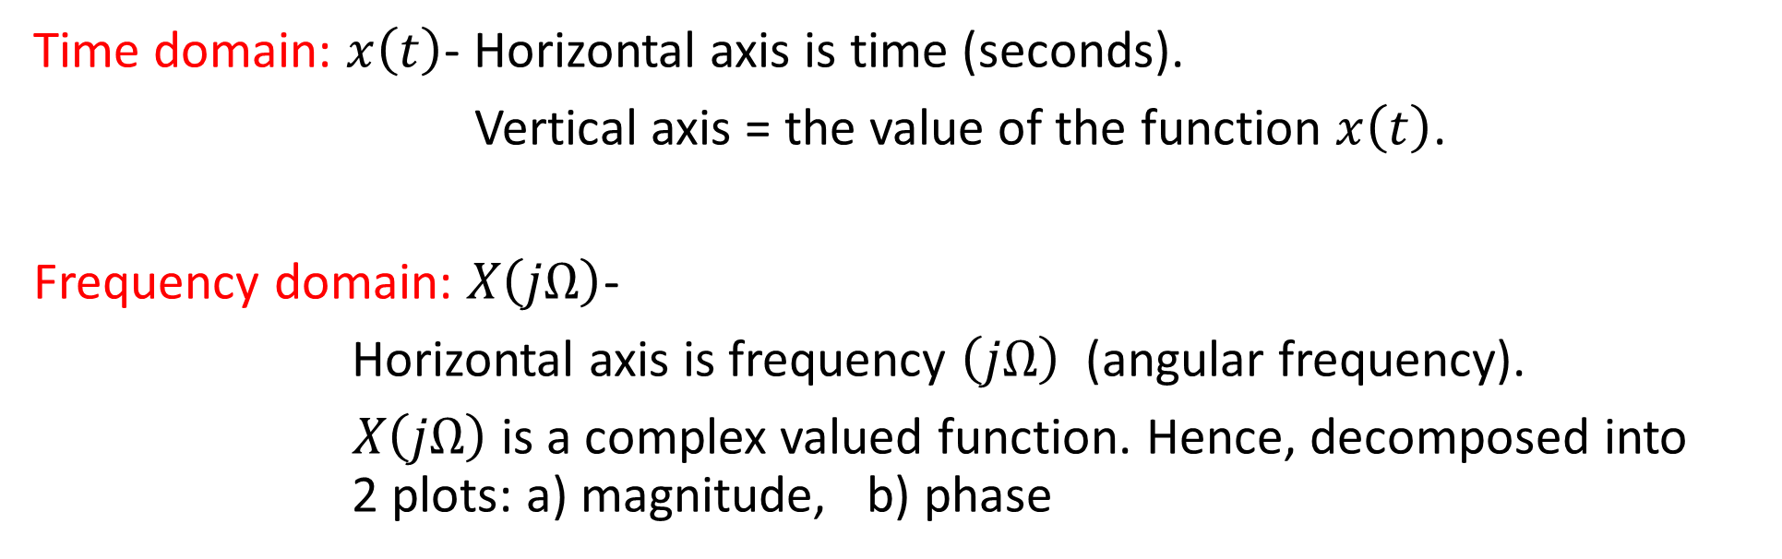
1B. What is Time vs Frequency Representation?
Time domain: $x\left(t\right)$- Horizontal axis is time (seconds).
Vertical axis = the value of the function $x\left(t\right)$.
Frequency domain: $X\left(jΩ\right)$-
Horizontal axis is frequency $\left(jΩ\right)$ (angular frequency).
$X\left(jΩ\right)$ is a complex valued function. Hence, decomposed into 2 plots: a) magnitude, b) phase
Link – explaining why notation $X\left(jΩ\right)vs X\left(Ω\right)$
https://dsp.stackexchange.com/questions/23228/what-is-the-difference-between-xj-omega-and-x-omega-notation

Slide 5
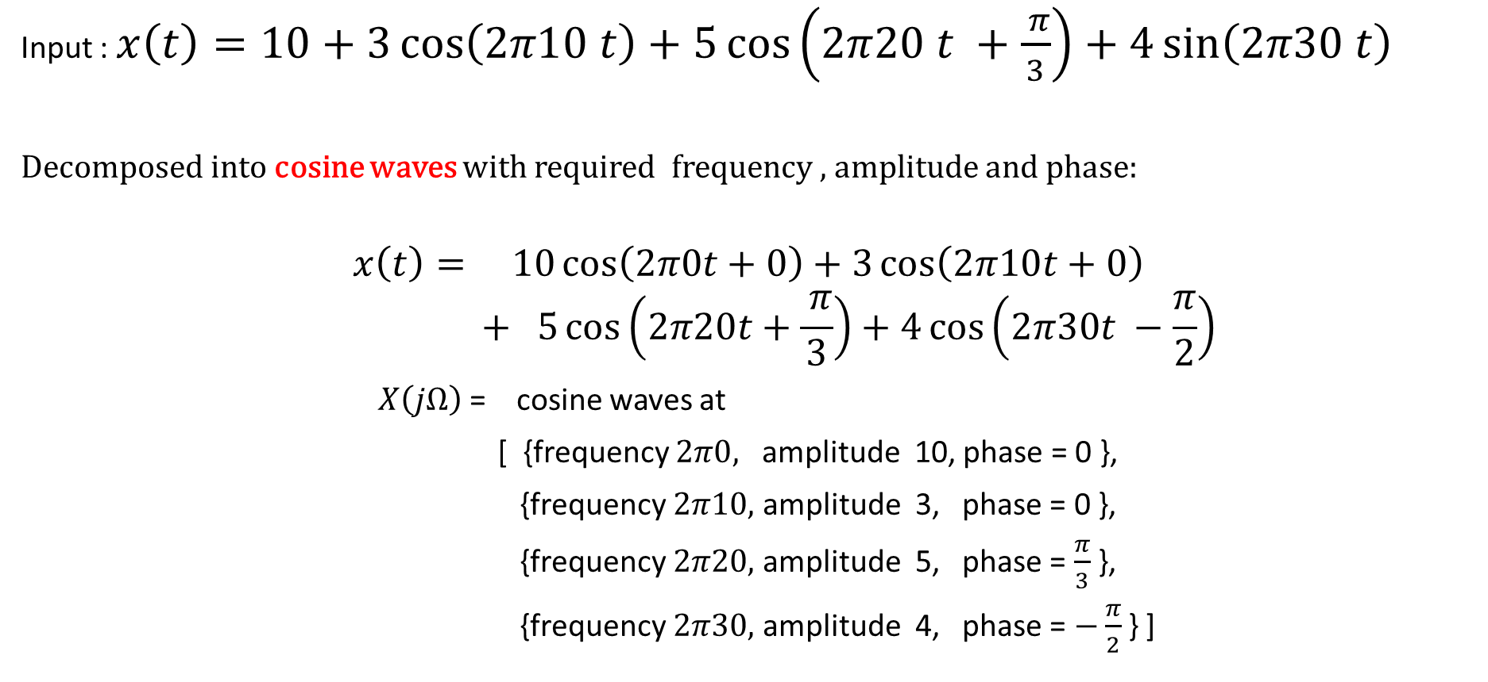
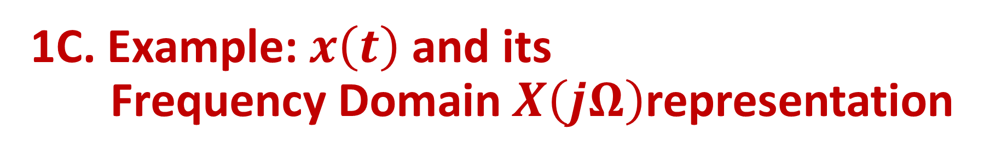
1C. Example: $x\left(t\right)$ and its Frequency Domain $X\left(jΩ\right)$representation
Input : $x\left(t\right)=10+3\cos\left(2π10 t\right)+5\cos\left(2π20 t +\frac{ π}{3}\right)+4\sin\left(2π30 t\right)$
Decomposed into cosine waves with required frequency , amplitude and phase:
$$x\left(t\right)= 10\cos\left(2π0t+0\right)+3\cos\left(2π10t+0\right)$$
$$+ 5\cos\left(2π20t+\frac{ π}{3}\right)+4\cos\left(2π30t −\frac{π}{2}\right)$$
$X\left(jΩ\right)$= cosine waves at
[ {frequency $2π0,$ amplitude 10, phase = 0 },
{frequency $2π10,$ amplitude 3, phase = 0 },
{frequency $2π20,$ amplitude 5, phase = $\frac{π}{3}$},
{frequency $2π30,$ amplitude 4, phase = $−\frac{π}{2}$} ]

Slide 6
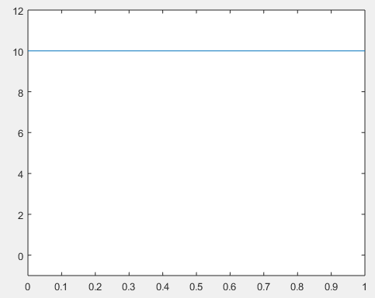
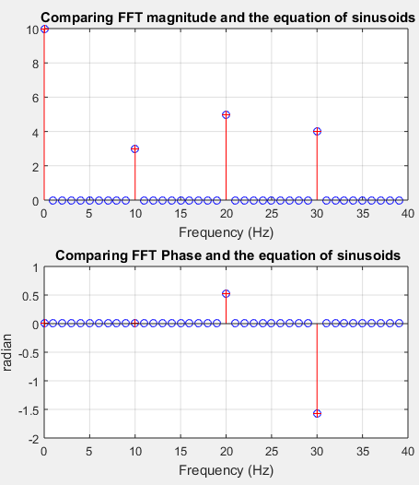
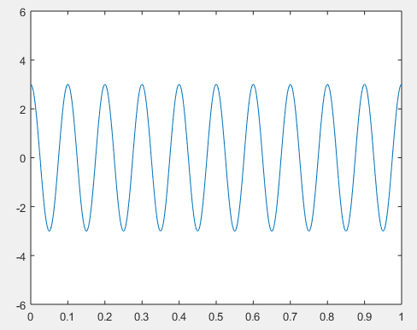
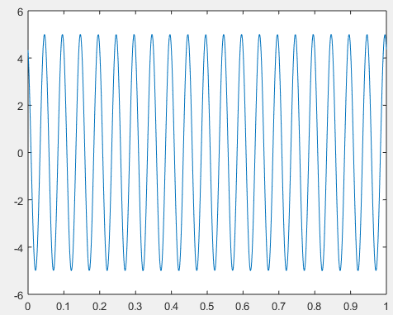
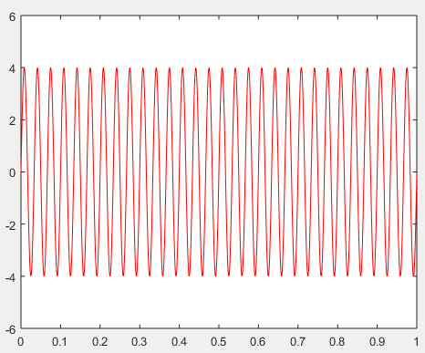
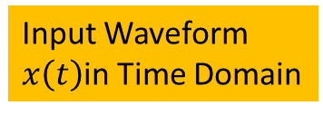




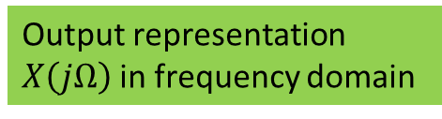
1C. Fourier Analysis
Decomposed into 4 sinusoids (time domain)
4 sinusoids represented
in Frequency Domain
10
10
10
0Hz
5
Magnitude
4
3
3
18
10Hz, 0 phase shift
10
5
0
0
+$π$/3
2
20Hz
Phase
$20 Hz, \frac{π}{3}$ phase shift
4
-$π$/2
30Hz
$30Hz, \frac{−π}{2}$ phase shift
Input Waveform
$x\left(t\right)$in Time Domain
Output representation $X\left(jΩ\right)$in frequency domain
Fourier Analysis

Slide 7
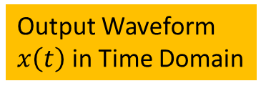




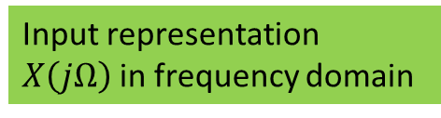
4 sinusoids represented
in Frequency Domain
1C. Fourier Synthesis
Each sinusoids (time domain)
Frequency, Magnitude, Phase
10
10
5
Magnitude
4
0Hz
3
Input Waveform (periodic)
3
18
10Hz, 0 phase shift
+$π$/3
5
10
0
0
Phase
$20 Hz, \frac{π}{3}$ phase shift
2
-$π$/2
4
$30Hz, \frac{−π}{2}$ phase shift
Input representation $X\left(jΩ\right)$in frequency domain
Output Waveform
$x\left(t\right)$ in Time Domain
Fourier Synthesis

Slide 8
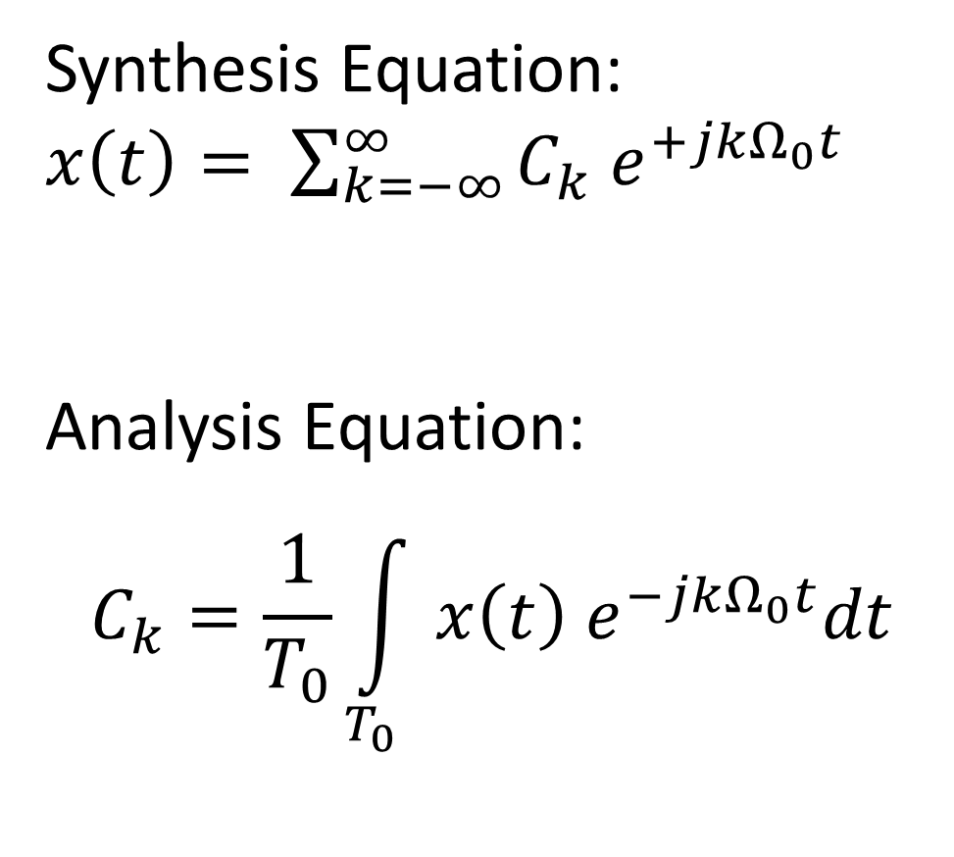
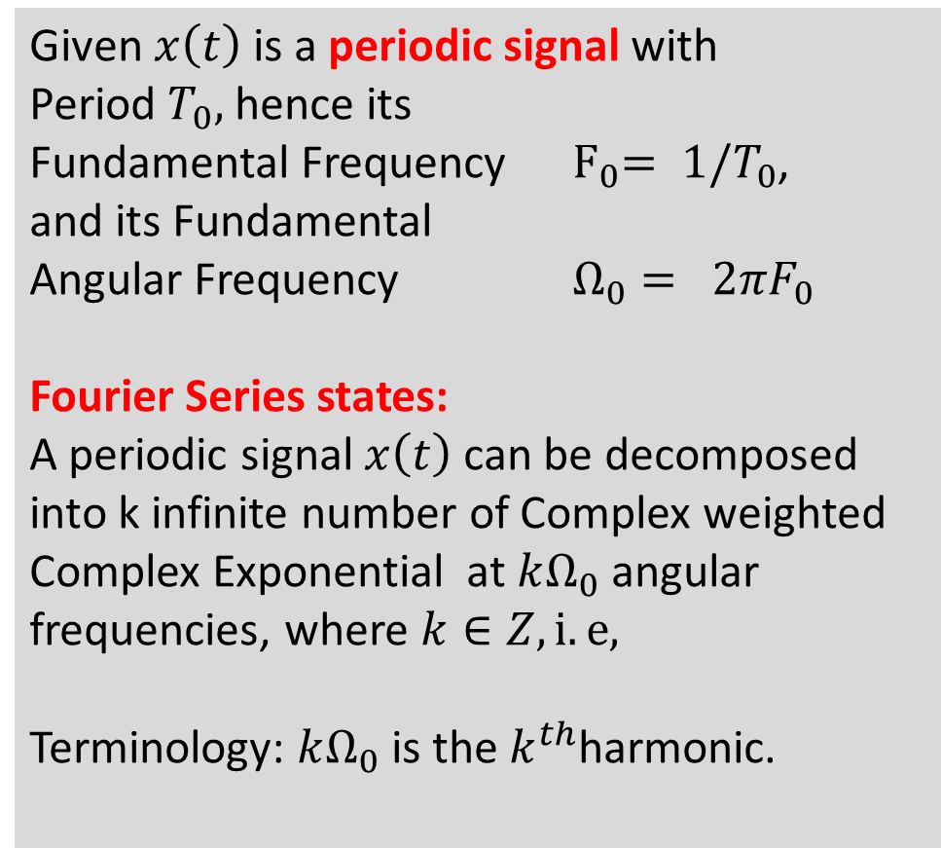
1D. Continuous Time Fourier Analysis and Synthesis (Fourier Series)
Given $x\left(t\right)$ is a periodic signal with Period $T_{0},$hence its Fundamental Frequency ${ F}_{0}= 1/T_{0}$,
and its Fundamental Angular Frequency $Ω_{0}= 2πF_{0}$
Fourier Series states:
A periodic signal $x\left(t\right)$ can be decomposed
into k infinite number of Complex weighted Complex Exponential at $kΩ_{0}$ angular frequencies, where $k∈Z, i.e,$
Terminology: $kΩ_{0}$ is the $k^{th}$harmonic.
Synthesis Equation:
$x\left(t\right)= \sum_{k=−∞}^{∞}{C_{k} e^{+jkΩ_{0}t }}$
Analysis Equation:
$$C_{k}=\frac{1}{T_{0}}\int_{T_{0}}{x\left(t\right) e^{−jkΩ_{0}t}dt}$$

Slide 9
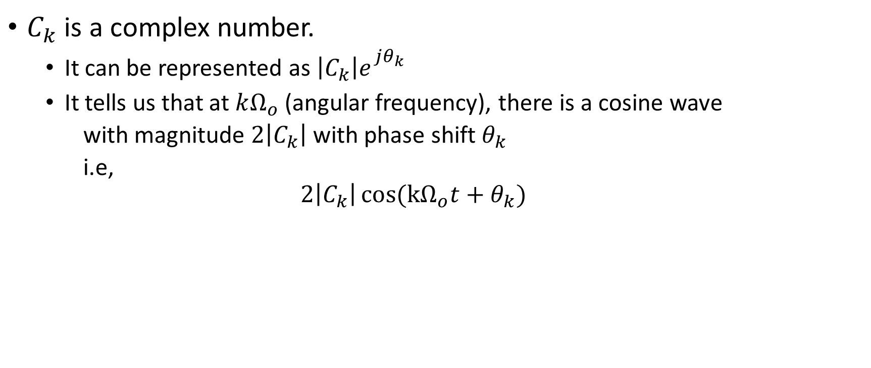

What is $C_{k}$? The Fourier Series coefficient
$C_{k}$ is a complex number.
It can be represented as $\left|C_{k}\right|e_{}^{jθ_{k}}$
It tells us that at $kΩ_{o}$ (angular frequency), there is a cosine wave
with magnitude $2\left|C_{k}\right|$ with phase shift $θ_{k}$
i.e,
$$2\left|C_{k}\right|\cos{({kΩ}_{o}t+θ_{k}) }$$

Slide 10
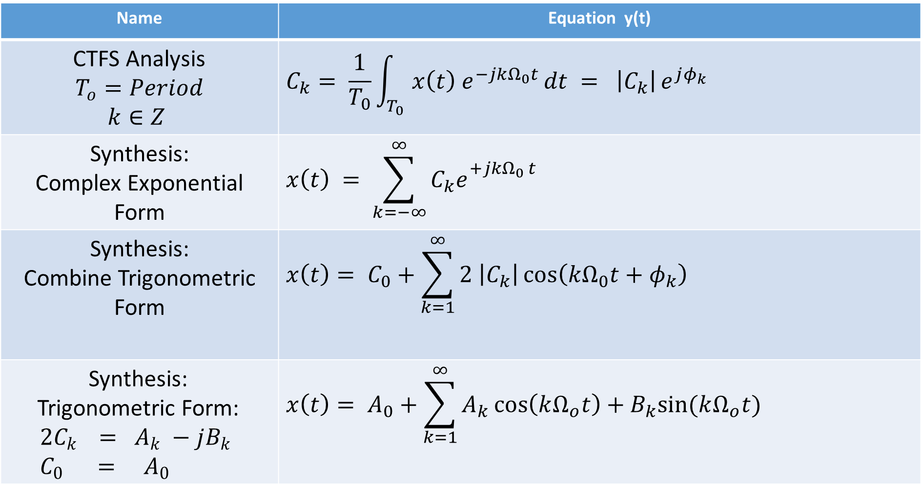
1D. Different Forms of CTFS Synthesis Representations
Name | Equation y(t)
CTFS Analysis $$T_{o}=Period$$ $k∈Z$ | $$C_{k}= \frac{1}{T_{0}}\int_{T_{0}}{x\left(t\right) e^{−jkΩ_{0}t }dt = \left|C_{k}\right|}e^{jφ_{k}}$$
Synthesis: Complex Exponential Form | $$x\left(t\right) = \sum_{k=−∞}^{∞}{C_{k}e_{}^{+jkΩ_{0 }t}}$$
Synthesis: Combine Trigonometric Form | $$x\left(t\right)= C_{0}+\sum_{k=1}^{∞}{2 \left|C_{k}\right|\cos\left(kΩ_{0}t+φ_{k}\right)}$$
Synthesis: Trigonometric Form: $${2C}_{k } = A_{k} −jB_{k} \\ C_{0} = A_{0}$$ | $${x\left(t\right)= A}_{0}+\sum_{k=1}^{∞}{A_{k}\cos\left(kΩ_{o}t\right)+B_{k}sin⁡(kΩ_{o}t) }$$

Slide 11
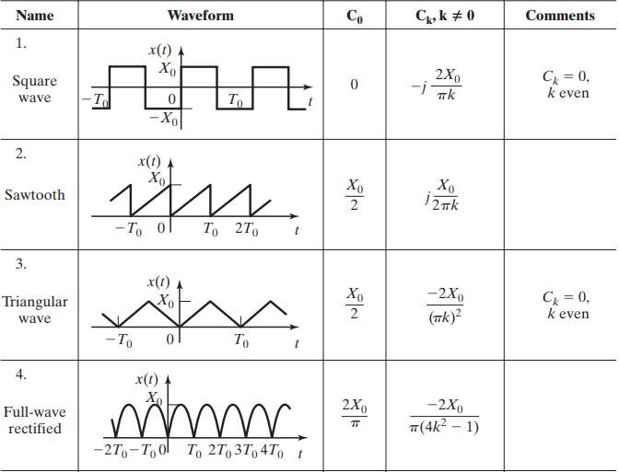
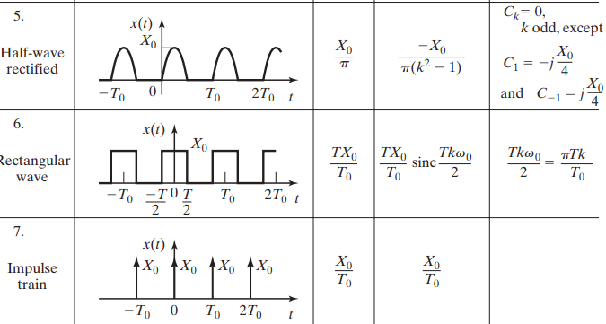
1D Common FS of periodic CT signals Pg 168, Philips and Parr, Signals, Systems and Transform

Slide 12
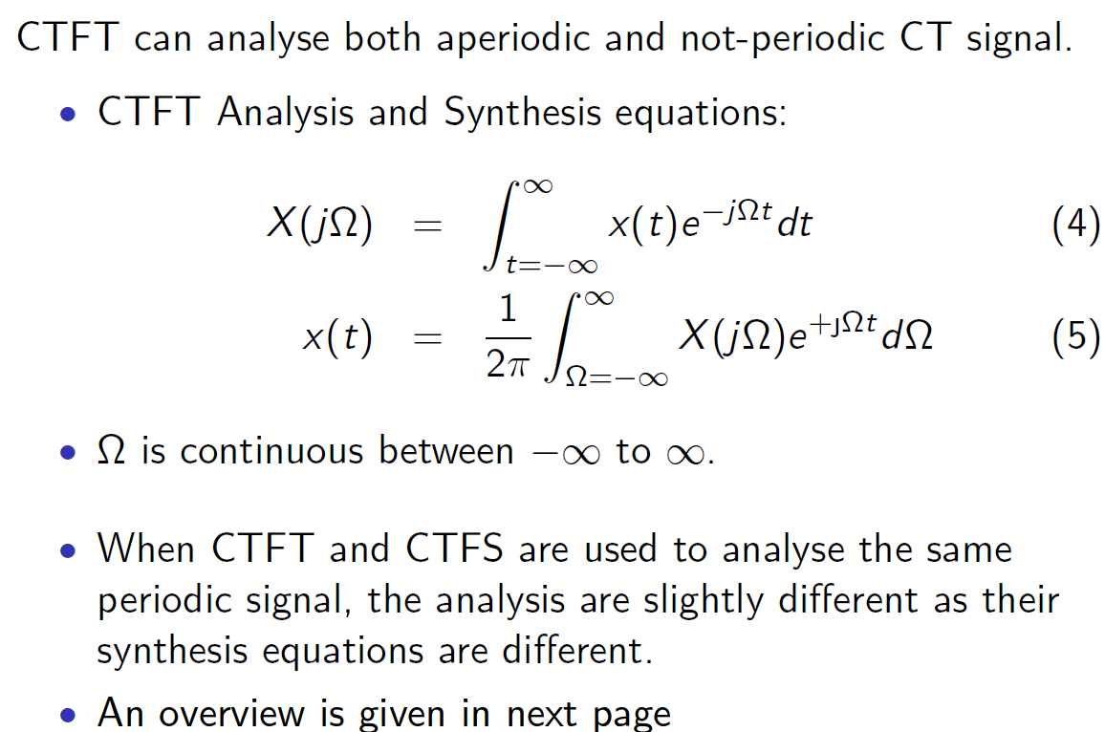
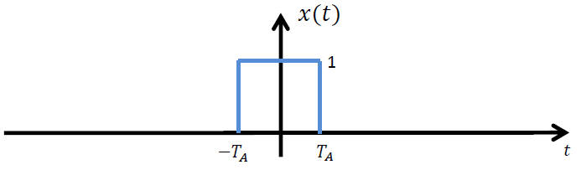
1E. Continuous Time Fourier Analysis and Synthesis (Fourier Transform)

Slide 13
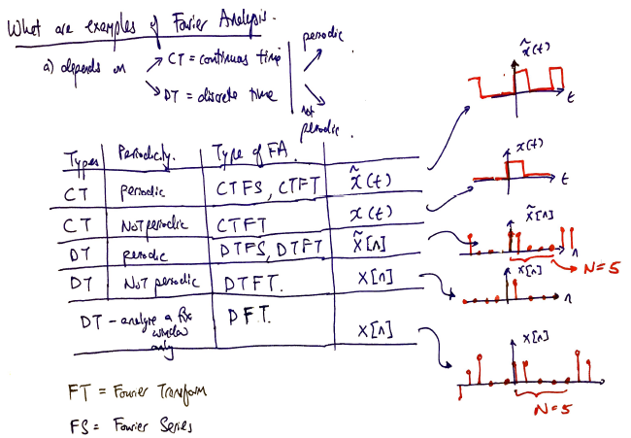
2) Types of Fourier Transform
S/N | Input Signal | Types of Fourier Transform
A | CT+aperiodic | CTFT
B | CT+periodic | CTFS, CTFT
C | DT+aperiodic | DTFT
D | DT+periodic | DTFS, DTFT
Legend:
CT = continuous Time,
DT = discrete Time
FT = Fourier transform
FS = Fourier Series

Slide 14
Appendix: Fourier Series Trigo -> Complex Exponential

Slide 15
Appendix: Fourier Series Complex Exponential -> combined Trigo

