Slide 1
What is Fourier Transform
CES

Slide 2
Questions we wish to answer
1) What is time and frequency representation? Of a signal
2) What does Fourier Transform do?
3) How many types of Fourier Transform?
4) What is the representation of
y1(t) = Acos(2\piFt)
y1a(t) = Acos(2\piFt + theta1)
y2(t) = Asin(2\piFt)
y2a(t) = Asin(2\piFt + theta2
5) What is the Fourier Transform of a periodic Square,
Letr visualize the perioic square as more terms are added.
6) How to calculate the Fourier coefficients
- Table of common FS and FT

Slide 3
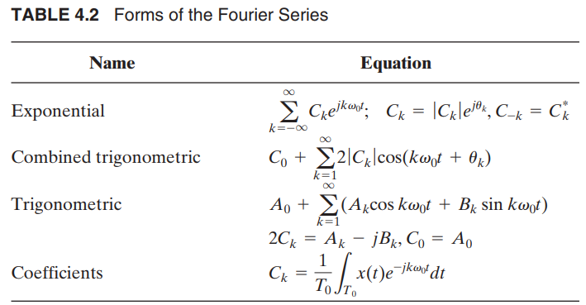
Various CT FS representations
Pg 158, 4th edition, “Signals System and Transform” by Philips and Parr

Slide 4
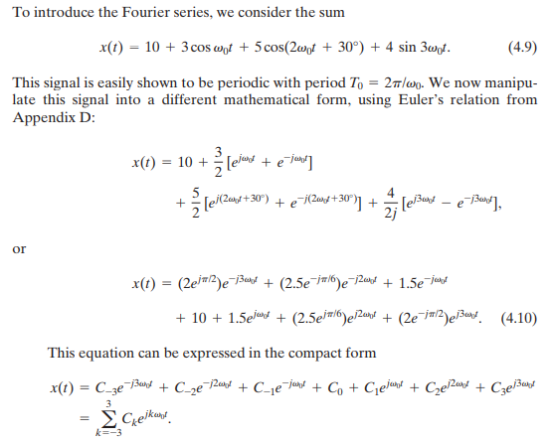
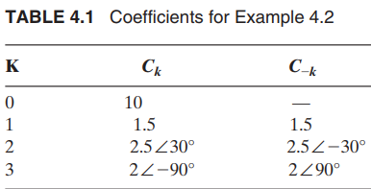
Introduction to CTFS – example from sum of sinusoids Example: Philips and Parr : pg 156

Slide 5
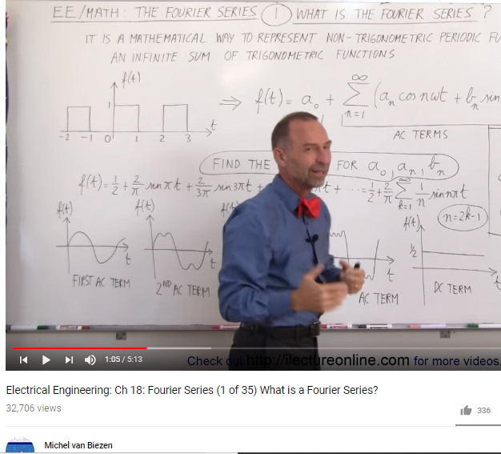
Some great references Worked Example:
Michael van Biezen – youtube
Electrical Engineering: Ch 18: Fourier Series (1 of 35) What is a Fourier Series?
https://www.youtube.com/watch?v=28oKg7GMbvI&list=PLX2gX-ftPVXVScC8Hz8nmcZTAMXTluTIn
http://www.ilectureonline.com/search/fourier#

Slide 6
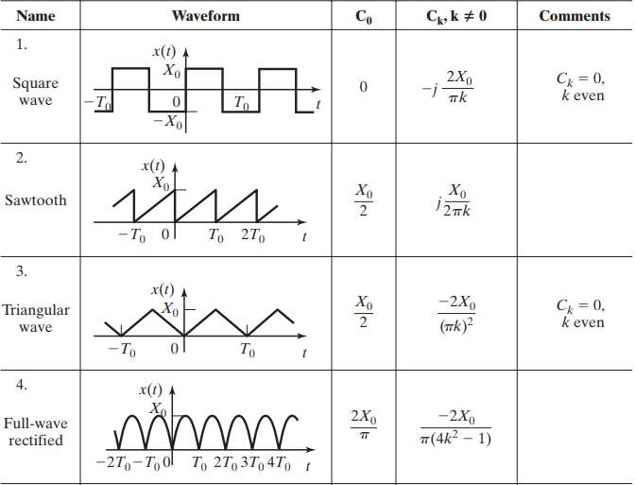
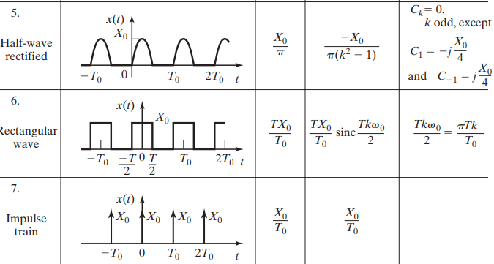
Common FS of periodic CT signals Pg 168, Philips and Parr

Slide 7
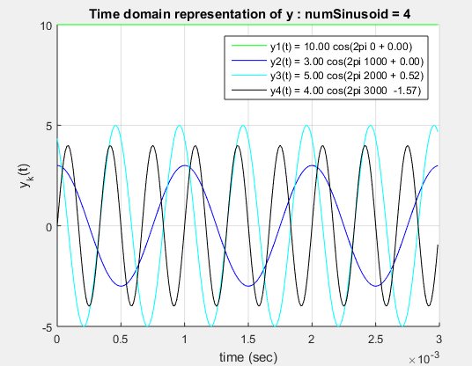
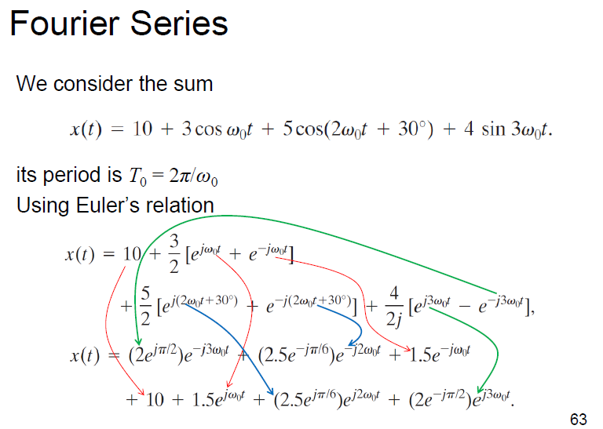
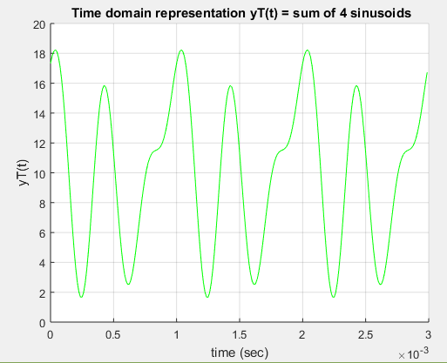
My Matlab Code - DIY
Using fundamental frequency F0 = 1/T0 = 1000 Hz
Github -

Slide 8
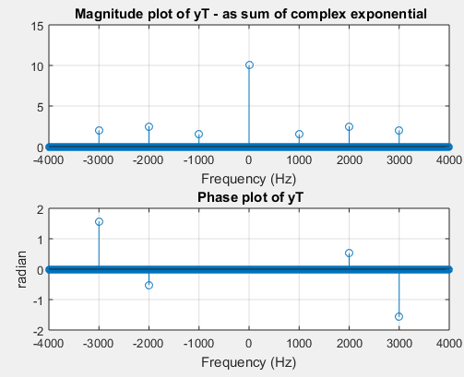
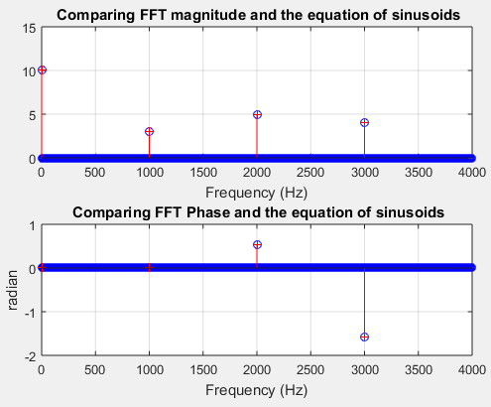
Complex exponential representation
Combined trigo Fourier Series representation

