Slide 1
What is Fourier Transform? An intuitive interpretation
Chng Eng Siong
NTU
Oct 2018

Slide 2
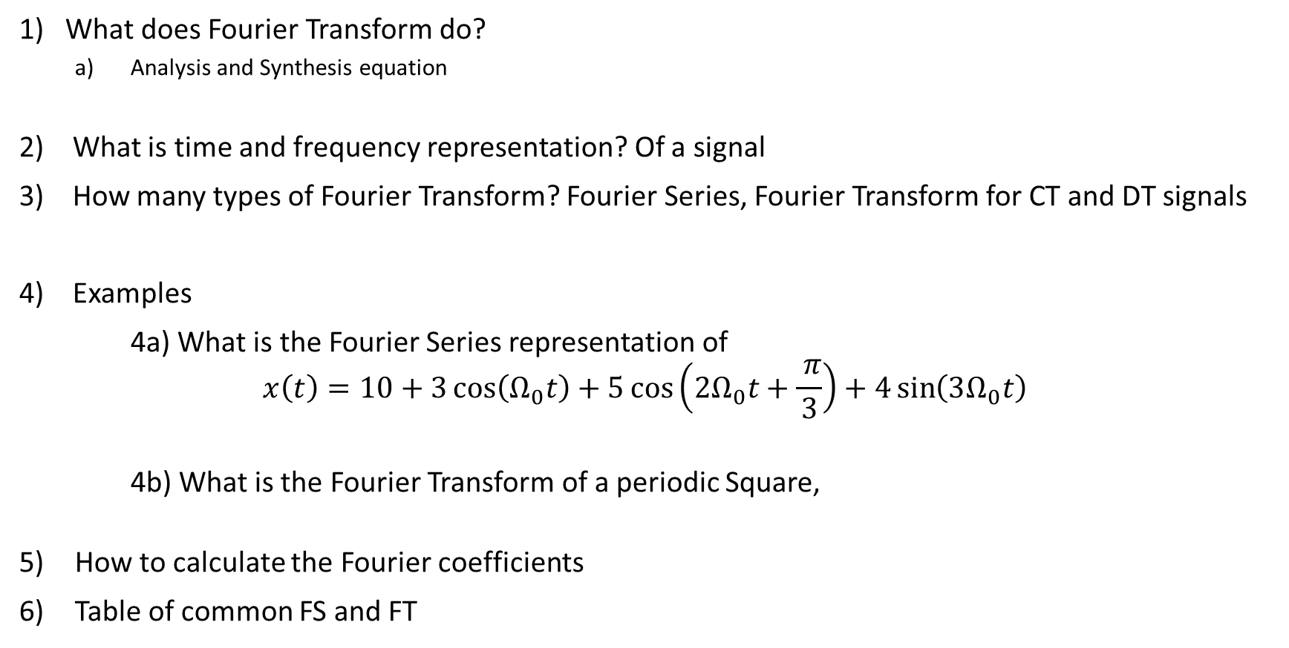
Fourier Transform: Questions we wish to answer
1) What does Fourier Transform do?
Analysis and Synthesis equation
2) What is time and frequency representation? Of a signal
3) How many types of Fourier Transform? Fourier Series, Fourier Transform for CT and DT signals
4) Examples
4a) What is the Fourier Series representation of
$$x\left(t\right)=10+3\cos\left(Ω_{0}t\right)+5\cos\left(2Ω_{0}t+\frac{ π}{3}\right)+4\sin\left(3Ω_{0}t\right)$$
4b) What is the Fourier Transform of a periodic Square,
How to calculate the Fourier coefficients
Table of common FS and FT

Slide 3
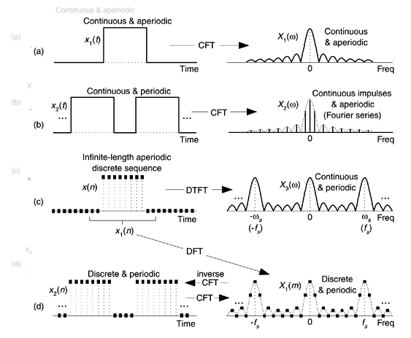
3) Types of Fourier Transform
CTFT
S/N | Input Signal | Types of Fourier Transform
A | CT+aperiodic | CTFT
B | CT+periodic | CTFS, CTFT
C | DT+aperiodic | DTFT
D | DT+periodic | DTFS, DTFT
CTFT and CTFS
DTFT
Legend:
CT = continuous Time,
DT = discrete Time
FT = Fourier transform
FS = Fourier Series
DTFT and DTFS

Slide 4
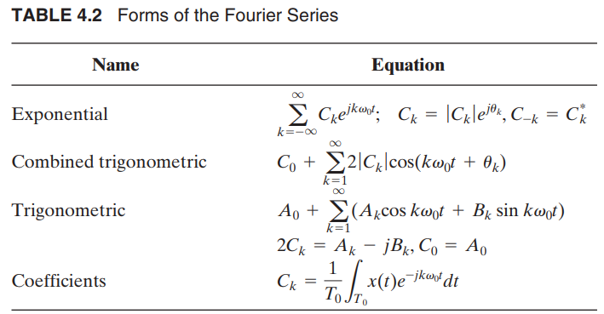
3A) Various CTFS Continuous Time Fourier Series Representations
Pg 158, 4th edition, “Signals System and Transform” by Philips and Parr

Slide 5
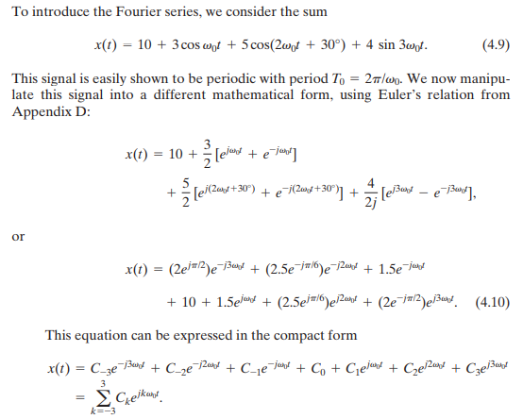
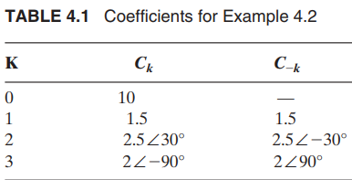
4a) Introduction to CTFS – example from sum of sinusoids Example: Philips and Parr : pg 156

Slide 6
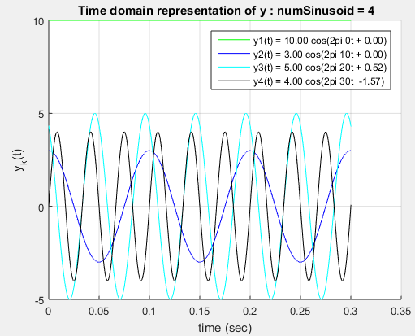
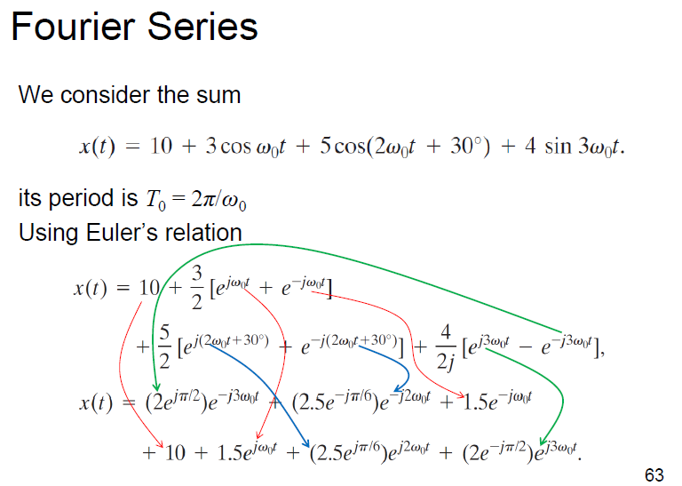
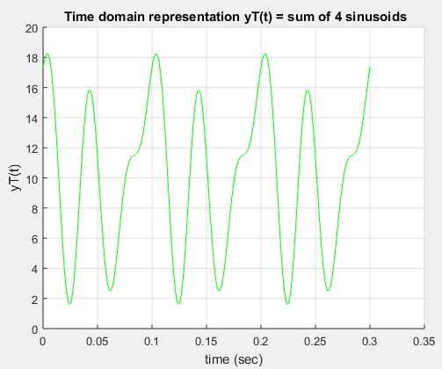
4a) My Matlab Code Expt
Using fundamental frequency F0 = 1/T0 = 10 Hz
Github - https://github.com/aseschng/DSP-Matlab-Fourier-Series

Slide 7
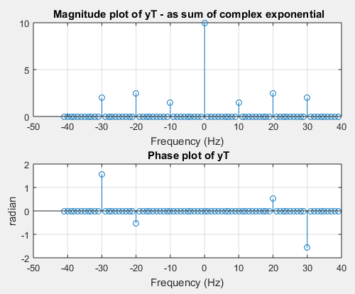
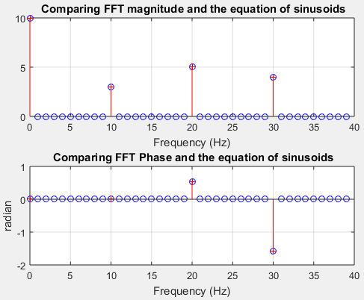
4a) My Matlab Code Expt
Complex exponential representation
Combined trigo Fourier Series representation

Slide 8
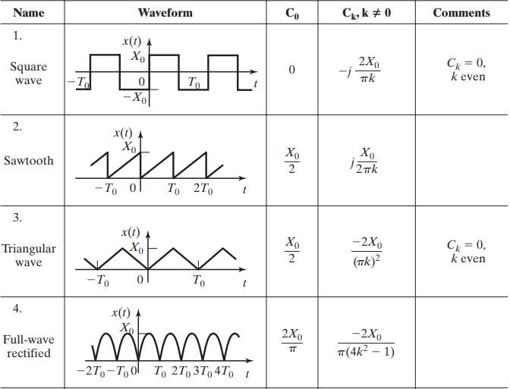
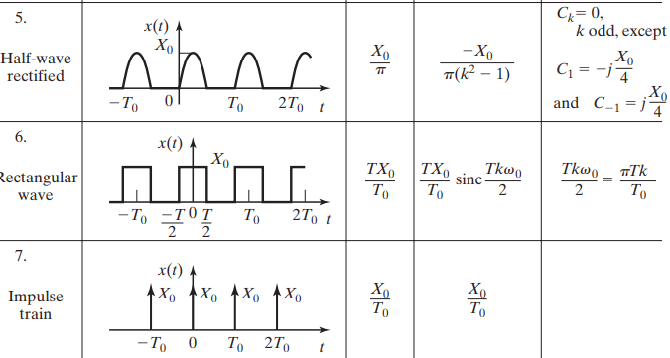
6) Common FS of periodic CT signals Pg 168, Philips and Parr

Slide 9
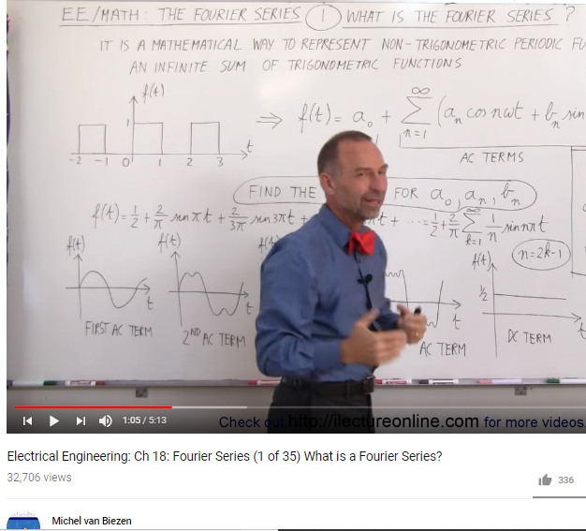
7) Some great references Worked Example:
Michael van Biezen – youtube
Electrical Engineering: Ch 18: Fourier Series (1 of 35) What is a Fourier Series?
https://www.youtube.com/watch?v=28oKg7GMbvI&list=PLX2gX-ftPVXVScC8Hz8nmcZTAMXTluTIn
http://www.ilectureonline.com/search/fourier#

