Slide 1
Phonon evaluation
Comp session of
Notes:
1

Slide 2
Download template
- Open this URL by firefox
https://www.dropbox.com/s/l3lb571e77w7vt9/
files.zip?dl=0
- Pick up the downloaded file 'files.zip'
on your Desktop.
(File includes all the I/O for phonon calc.)
- Unzip the file to get
~/Desktop/files
Notes:
2

Slide 3
Confirm your contents
% pwd
/Users/maezono/Desktop/files
% ls
1_scf/ 4_phdos/ 7_disp_phband/ As.pbe-n-van.UPF*
2_phonon/ 5_freeE/ 8_phonon_separated/ Ga.pbe-n-van.UPF*
3_q2r/ 6_phband/ 9_dynmat/
Each folder contains step-by-step
procedure of phonon calculations
Notes:
3

Slide 4
Procedure
overview
pw.x : evaluating wavefunction
1_scf/
ph.x/q2r.x : evaluating the 2nd. order force constant
2_phonon/, 3_q2r/
matdyn.x : calculating phonon DOS, dispersion
4_phdos/, 6_phband/
fqha.x : evaluating Helmholtz free energy
5_freeE/
plotband.x : making phonon dispersion graph
7_disp_phband/
Notes:
4

Slide 5
pw.x
pw.x: evaluating wavefunction
1) Go to '1_scf/' directory
2) Follow the instruction shown by Ichibha
outputs
gaas.wfc : wavefunction data
gaas.wfc1,2,...,N : wave function data
for parallel processing
gaas.save : eigen values of KS orbitals
Notes:
5

Slide 6
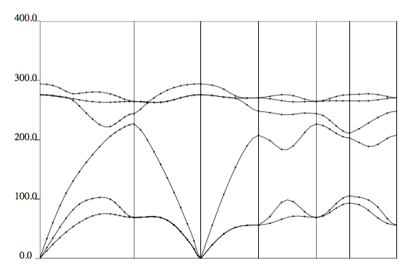
Getting smooth q-dep.
q2r.x/Fourier transform from 'q to r'
ph.x
'discrete q-pt' evaluation
Fourier Tr. to 'r'
q2r.x
again inv-Fourier Tr. to 'q'
'continuous q-pt' interpolation
Notes:
6

Slide 7
ph.x
ph.x/q2r.x: evaluating the 2nd. order force constant
1) Go to '2_phonon/' directory
2) copy wavefunction from 1_scf
cp ../1_scf/gaas.* .
3) Follow the instruction shown by Ichibha
outputs
gaas.dyn1,2,... : force constants of sampling q point
Notes:
7

Slide 8
q2r.x
ph.x/q2r.x: evaluating the 2nd. order force constant
1) Go to '3_q2r/' directory
2) copy the force constants of sampling q points
cp ../2_phonon/gaas.dyn* .
3) Follow the instruction shown by Ichibha
outputs
gaas444.fc : force constants of real space space
Notes:
8

Slide 9
Getting smooth q-dep.
q2r.x/Fourier transform from 'q to r'
ph.x
'discrete q-pt' evaluation
Fourier Tr. to 'r'
q2r.x
again inv-Fourier Tr. to 'q'
'continuous q-pt' interpolation
Notes:
9

Slide 10
matdyn.x /DOS
matdyn.x : calculating phonon DOS, dispersion
1) Go to '4_phdos/' directory
2) copy the force constants of sampling real space
cp ../3_q2r/gaas444.fc .
3) Follow the instruction shown by Ichibha
outputs
PHDOS.out : phonon DOS data
Notes:
10

Slide 11
fqha.x
fqha.x : evaluating Helmholtz free energy
1) Go to '5_freeE/' directory
2) get the phonon DOS
cp ../4_phdos/PHDOS.out .
3) Follow the instruction shown by Ichibha
outputs
gaas.thermal : Helmholtz free energy
Notes:
11

Slide 12
matdyn.x/dispersion
matdyn.x : calculating phonon DOS, dispersion
1) Go to '6_phband/' directory
2) copy the force constants of sampling real space
cp ../3_q2r/gaas444.fc .
3) Follow the instruction shown by Ichibha
outputs
matdyn.modes : force constants of picked up q points
gaas.freq : frequencies of picked up q points
Notes:
12

Slide 13
plotband.x
plotband.x : making phonon dispersion graph
1) Go to '7_disp_phband/' directory
2) copy the phonon dispersion data
cp ../6_phband/gaas.freq .
3) Follow the instruction shown by Ichibha
outputs
gaas-phdisp.ps : phonon dispersion graph image
gaas-phdisp.xmgr : phonon dispersion data
Notes:
13

Slide 14
fin
Notes:
14

Slide 15
ph.x
For each
point, mode frequency
is given
as eigen values of this eigen equation
(1)
Here,
(2)
This matrix is calculated in a few sampling points
Following process, we’ll get
for arbitrary
Notes:
15

Slide 16
q2r.x
(3)
Fourier transform
(4)
is approximated by
(5)
Here, is number of sampling
points
Notes:
16

Slide 17
matdyn.x
substitute
(5)
into
(2)
finally, you can get
(6)
Notes:
17

