Slide 1
Hands-on: Band structure and DOS metals/insulators
Tutors: Alberto Carta, Fatema Mohamed, Bryce Rodrigue Malonda and George Manyali

Slide 2
Topics of Day3 hands-on session:
How to relax a structure (graphane and oxygen adsorption)
How to run post-processing calculations to plot DOS (dos.x), PDOS (projwfc.x) and band-structure (bands.x).
How to choose the smearing and the broadening parameters for metals.
How to compute forces and stresses.

Slide 3
Exercise 1
Forces and relaxation

Slide 4
Input file scf calculation
Input file for relaxation
&CONTROL
calculation = 'scf',
prefix = 'Graphane',
outdir = '/tmp',
pseudo_dir = '../../pseudo',
/
&SYSTEM
….
….
/
&ELECTRONS
conv_thr = 1.0d-8
/
ATOMIC_SPECIES
C 12.0107 C.pbe-rrkjus.UPF
H 1.00007 H.pbe-rrkjus.UPF
ATOMIC_POSITIONS alat
...
K_POINTS automatic
9 9 1 0 0 0
&CONTROL
calculation = 'relax',
prefix = 'Graphane',
outdir = '/tmp',
pseudo_dir = '../../pseudo',
/
&SYSTEM
….
….
/
&ELECTRONS
conv_thr = 1.0d-8
/
&IONS
/
ATOMIC_SPECIES
C 12.0107 C.pbe-rrkjus.UPF
H 1.00007 H.pbe-rrkjus.UPF
ATOMIC_POSITIONS alat
...
K_POINTS automatic
9 9 1 0 0 0
Ions is jargon for atoms, this cell
must appear!

Slide 5
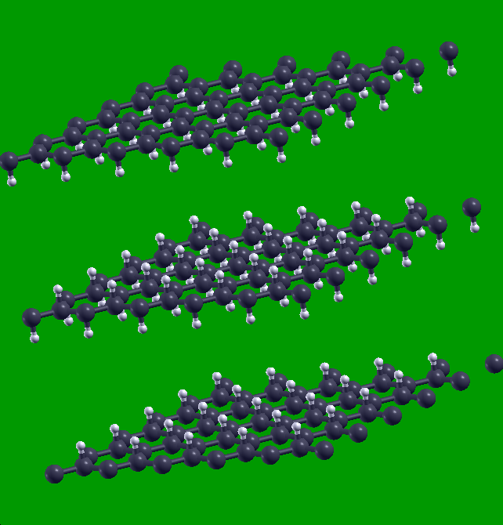
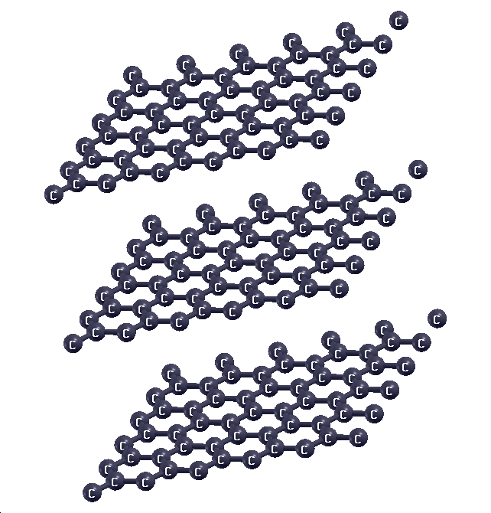
Buckling of graphane
Graphane is hydrogenated graphene → hydrogen saturates double-bonds / pi-delocalized cloud

Slide 6
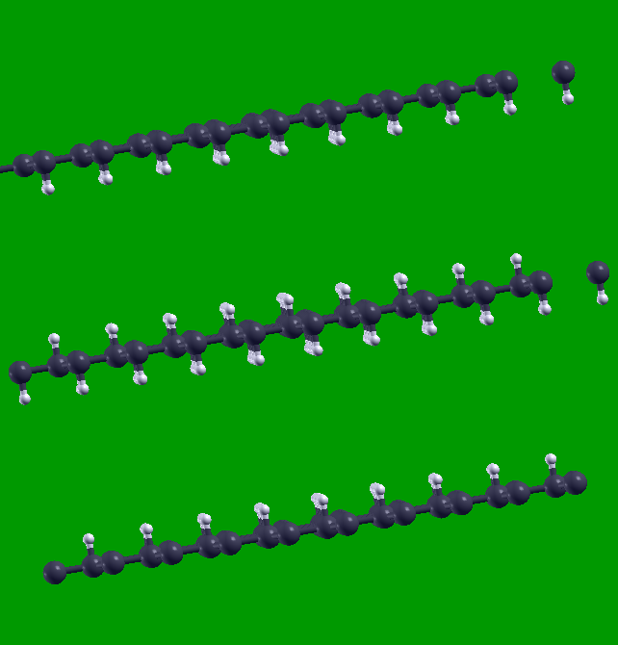
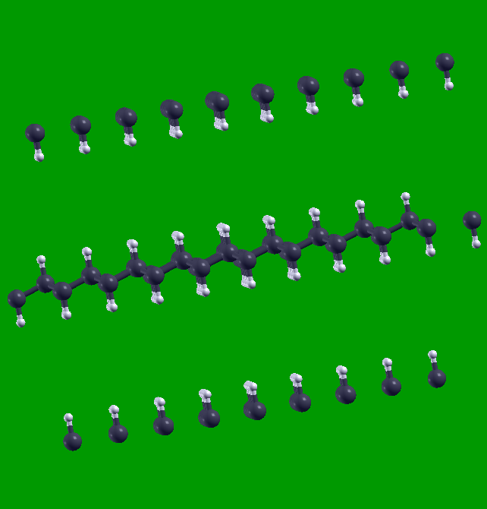
Buckling of graphane

Slide 7
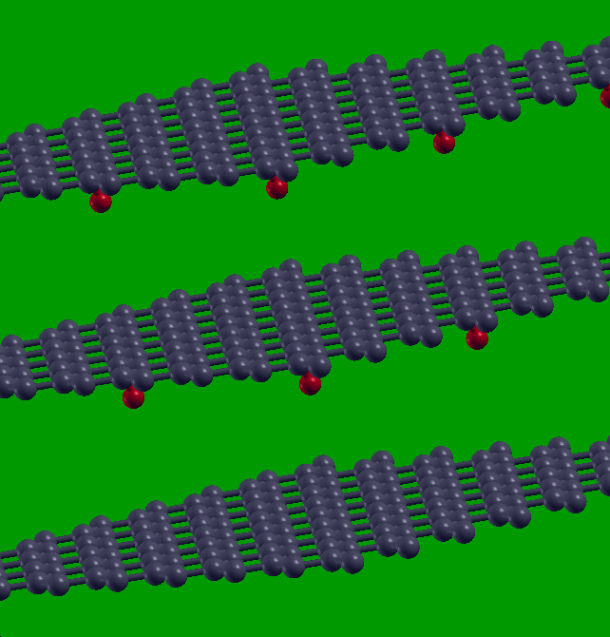
Oxygen adsorption on graphene
Oxygen is strongly electronegative → electron acceptor

Slide 8
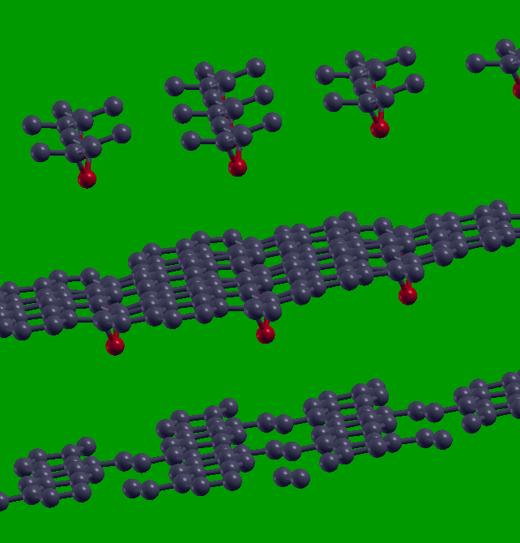
Oxygen adsorption on graphene
Oxygen is strongly electronegative → electron acceptor

Slide 9
Exercise 2
Follow up on silicon for Si

Slide 10
Input file scf calculation
Input file for relaxation of unit cell
&CONTROL
calculation='scf',
prefix='silicon',
pseudo_dir='../../pseudo/',
outdir='./tmp'
/
&SYSTEM
ibrav = 2,
celldm(1) = 10.6,
nat = 2,
ntyp = 1,
nbnd=10,
ecutwfc = 36,
/
&ELECTRONS
/
ATOMIC_SPECIES
Si 28.086 Si.pz-vbc.UPF
ATOMIC_POSITIONS
Si 0.00 0.00 0.00
Si 0.25 0.25 0.25
K_POINTS automatic
6 6 6 1 1 1
&CONTROL
calculation='vc-relax',
prefix='silicon',
pseudo_dir='../../pseudo/',
outdir='./tmp'
/
&SYSTEM
ibrav = 2,
celldm(1) = 10.6,
nat = 2,
ntyp = 1,
nbnd=10,
ecutwfc = 36,
/
&ELECTRONS
/
&IONS
/
&CELL
/
ATOMIC_SPECIES
Si 28.086 Si.pz-vbc.UPF
ATOMIC_POSITIONS
Si 0.00 0.00 0.00
Si 0.25 0.25 0.25
K_POINTS automatic
6 6 6 1 1 1
Slightly different
calculation mode
We need also a CELL section

Slide 11
Relax lattice constant for Si
Run `pw.x < si.relax.in | tee si.relax.out` and consider the following:
Compare the lattice volume to the one we optimized on Day 2, are they the same?
What is the code doing from iteration to iteration?
The new lattice constant is given in terms of the starting one, try to compute the relaxed lattice constant from the output and compare with the one we optimized on Day 2.

Slide 12
Density of State (DOS) for Si
The procedure to compute the DOS is the following:
Use pw.x to calculate the density (calculation = ’scf’)
Use pw.x to calculate the electronic eigenvalues on more k-point grids (calculation = ’nscf’)
Use dos.x to compute the total DOS, will be produced in a data-file.
Important: we must keep the prefix same outdir and prefix for “nscf” and “scf” pw.x calculations and for the dos.x calculation.

Slide 13
Input file si.scf.in
Input file si.scf.in
&CONTROL
calculation='scf'
restart_mode='from_scratch',
prefix = 'Si',
pseudo_dir = '../../pseudo'
outdir='./tmp'
/
&SYSTEM
ibrav = 2,
celldm(1) = 10.262,
nat = 2,
ntyp = 1,
ecutwfc = 20.0,
ecutrho = 200.0,
/
&ELECTRONS
/
ATOMIC_SPECIES
Si 28.086 Si.pbe-rrkj.UPF
ATOMIC_POSITIONS alat
Si 0.00 0.00 0.00
Si 0.25 0.25 0.25
K_POINTS automatic
6 6 6 1 1 1
&CONTROL
calculation='nscf'
restart_mode='from_scratch',
prefix = 'Si',
pseudo_dir = '../../pseudo'
outdir='./tmp'
/
&SYSTEM
ibrav = 2,
celldm(1) = 10.262,
nat = 2,
ntyp = 1,
ecutwfc = 20.0,
ecutrho = 200.0,
nbnd=-8
occupations = ’tetrahedra
/
&ELECTRONS
/
ATOMIC_SPECIES
Si 28.086 Si.pbe-rrkj.UPF
ATOMIC_POSITIONS alat
Si 0.00 0.00 0.00
Si 0.25 0.25 0.25
K_POINTS automatic
12 12 12 1 1 1
to calculate unoccupied bands, look at
number of Kohn-Sham states In the
si.scf.out.

Slide 14
Input file si.dos.in
&dos
outdir = ’./tmp’,
prefix=’Si’,
fildos=’si.dos’,
/
The same as in the scf and nscf input

Slide 15
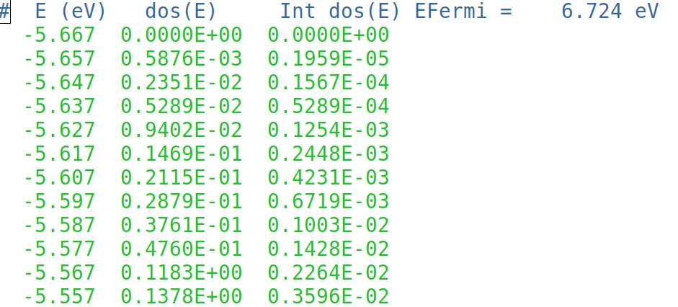
Data file si.dos
Gnuplot script: plot_dos.gp
DOS is shifted such that the Fermi energy corresponds to zero of energy.
Use the Fermi energy from the file si.nscf.out.
After running the script, visualize the file DOS.eps using evince or okular command.

Slide 16
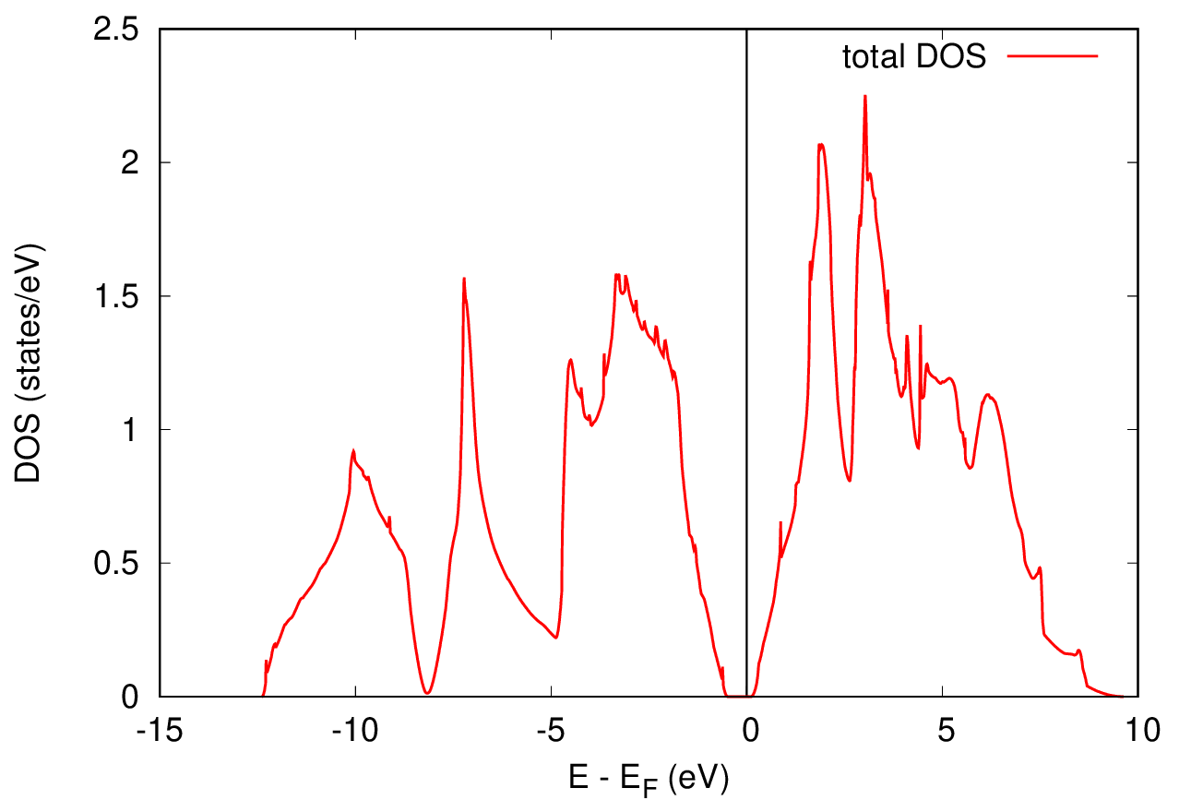
Density of State (DOS) for Si

Slide 17
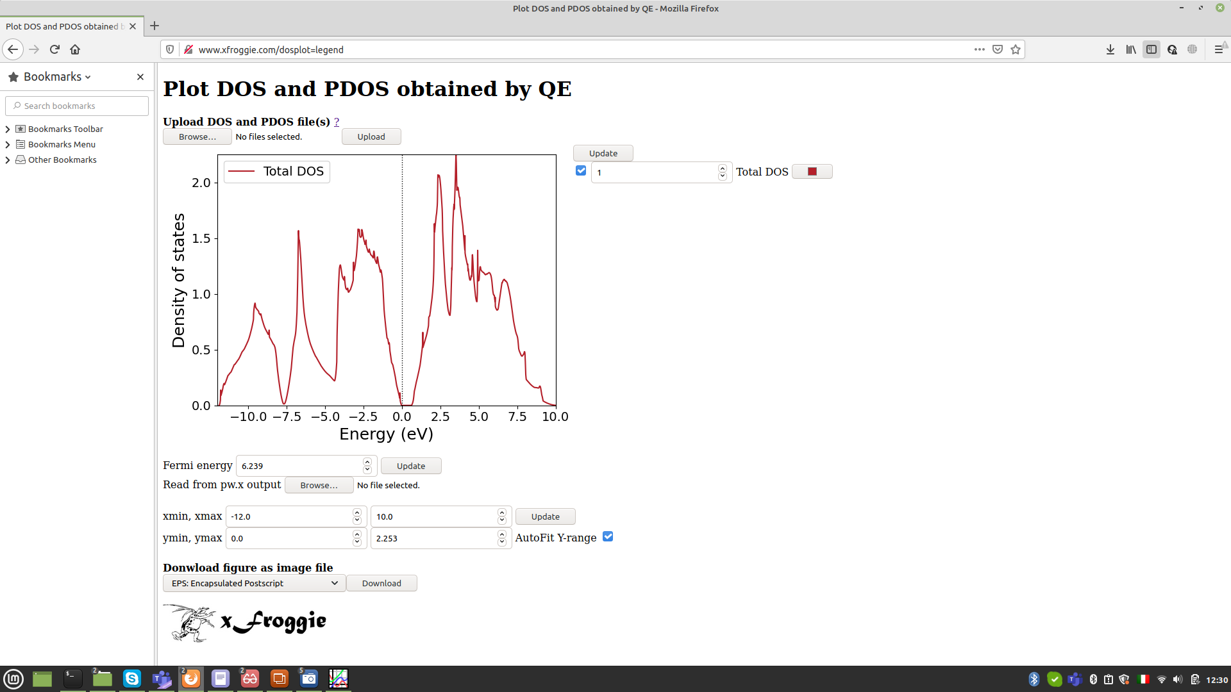
Ab initio Calculation Tutorial: For Materials Analysis, Informatics and Design, by Ryo Maezono

Slide 18
Projected Density of State (PDOS) for Si
The PDOS allows us to get the contribution from each atom in the cell and/or each of their orbital contributions. We can achieve it using projwfc.x.
The calculation steps are similar, the differences are in the input files for dos and pdos.
Input file si.pdos.in
&PROJWFC
outdir = ’./tmp’,
prefix=’Si’,
filpdos=’si.dos’,
/
See the difference w.r.t dos.x
run the PDOS calculation, execute ‘projwfc.x’ as:
$ projwfc.x < si.pdos.in | tee si.pdos.out
Output: Have a look at si.pdos.out file. the PDOS values are written in the file {filpdos}.pdos_atm#N(Si)_wfc#M(l), where N, M, and l are the atom number, wfc number, and atomic wavefunction read from pseudopotential file.

Slide 19
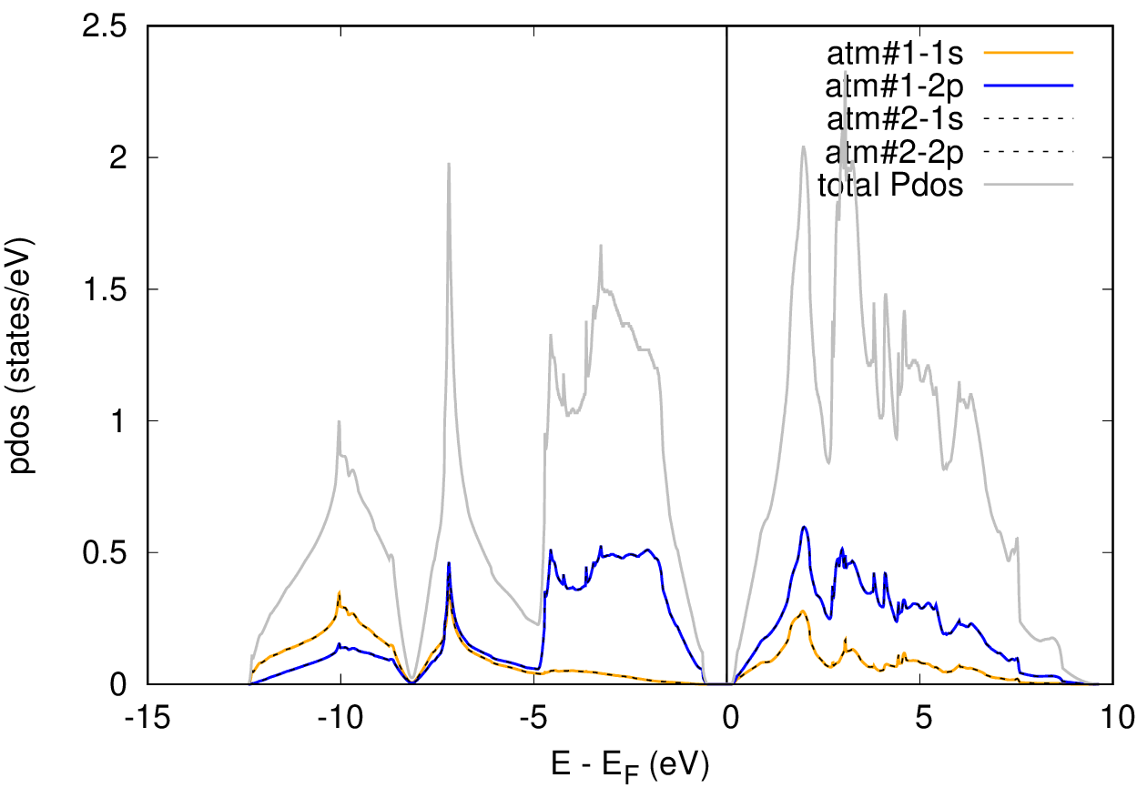
Projected Density of State (PDOS) for Si
To Plot the data: use xFroggie or gnuplot script plot_pdos.gp on your directory

Slide 20
Exercise 3
Band structure for Si

Slide 21
Band Structure of Silicon
The scheme to compute the band structure is the following:
SCF pw.x calculation (calculation = ’scf’)
“bands”-type non-SCF pw.x calculation (fixed-potential) with:
bands.x calculation, which, among others, produces data-files for the plot.
calculation = ’bands’
number of bands (variable nbnd) is specified
a suitable path of k-points is specified in K-POINTS card. The k-point path must be continuous in k-space.
Important: we must keep the prefix same outdir and prefix for “nscf” and “scf” pw.x calculations and for the bands.x calculation.

Slide 22
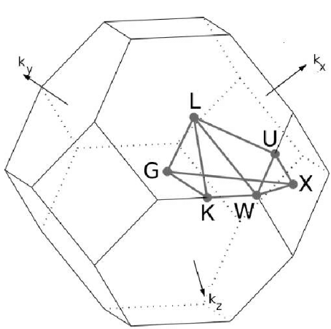
k-path for Band Structure calculation
The k-path in BZ for fcc crystal can be specified using xcrysden as follow:
Open the file si.scf.in with xcrysden.
Select: Tools → k-path selection
Select the path by clicking on a sequence of high-
symmetry points: W – Γ – X – W – L – Γ
Specify how many k points to be calculated (Ex: 100)
save the k-path to file. (.pwscf extension is required for
formatting the file for pw.x)

Slide 23
Input file si.bands.in
&CONTROL
calculation='bands'
restart_mode='from_scratch',
prefix = 'Si',
pseudo_dir = '../../pseudo'
outdir='./tmp'
verbosity = 'high'
/
&SYSTEM
ibrav = 2,
celldm(1) = 10.262,
nat = 2,
ntyp = 1,
ecutwfc = 12.0,
ecutrho = 200.0,
nbnd=8
/
&ELECTRONS
/
ATOMIC_SPECIES
Si 28.086 Si.pbe-rrkj.UPF
ATOMIC_POSITIONS alat
Si 0.00 0.00 0.00
Si 0.25 0.25 0.25
K_POINTS {crystal_b}
6
0.50 0.25 0.75 30 !W
0.00 0.00 0.00 30 !G
0.50 0.00 0.50 30 !X
0.50 0.25 0.75 30 !W
0.50 0.50 0.50 30 !L
0.00 0.00 0.00 30 !G

Slide 24
An input file for the data post processing program bands.x. This program
print the eigenvalues to the file specified in ”filband”
&BANDS
outdir = ’./tmp’,
prefix=’Si’,
filband=’si_bands’,
/
The same as in the scf and bands input
Contains data for bands
Run the postprocessing calculation (bands.x):
$ bands.x < bands.in | tee bands.out
bands data are stored in three files with different formats, among which we
have bands.dat.gnu (can be plotted with gnuplot) and bands.dat can be
visualized using the program plotband.x.

Slide 25
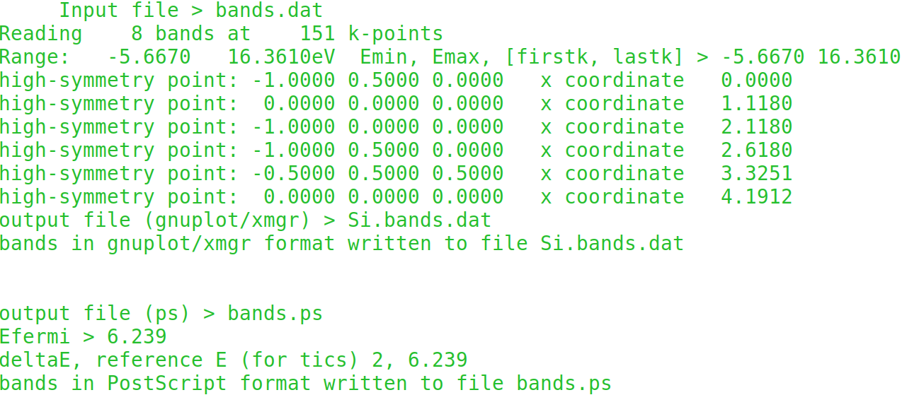
The program plotband.x can be to obtain a postscript file of the band
structure and a set of data files that can be plotted with xmgr
plotband.x prompts for terminal input:
$ plotband.x

Slide 26
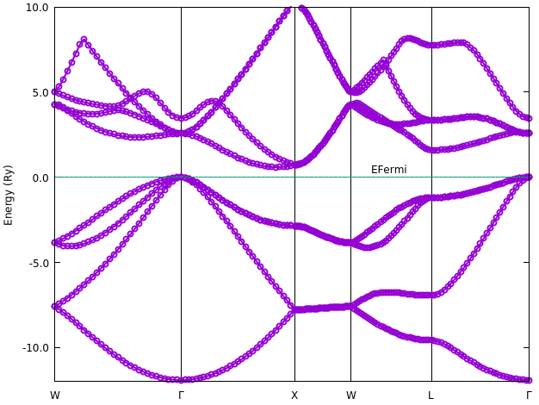
Band Structure of Silicon
Try to plot with xFroggie: https://xfroggie.com/

Slide 27
Exercise 2
A metallic example: Aluminum

Slide 28
A metallic example: Aluminum
Let us consider Aluminum, in the fcc phase. It is a metal, only valence bands and a few k-points will not suffice.
move to the Day3/example2.Al directory
read the pw.x input file al.scf.in
notice the presence of new variables: occupations, smearing, degauss;
run pw.x as:
$ pw.x < al.scf.in | tee al.scf.out
in the output file notice that
– the number of bands (Kohn-Sham states) is automatically set to a value larger than the number of electrons divided by 2
– the Fermi energy is computed.

Slide 29
Convergence with respect to k-points, degauss, and smearing
In this exercise we will compute the total energy for this fcc Al with the following values for degauss, k-point meshes and different smearing variables:
degauss variable, in range from 0.01 to 0.11
k-points: N×N×N ( 1×1×1) with N=6,8,10, …, 16
smearing variable, possible values: ’gauss’ (or ’g’), ’marzari-vanderbilt’
(or ’m-v’), ’methfessel-paxton’ (or ’m-p’)
run pw.x for run-al file at different directories in ex1-conv:
Plot the convergence of the total energy with respect to the number of k-points for the different smearing values.

Slide 30
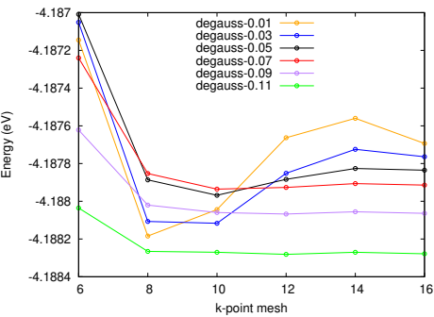
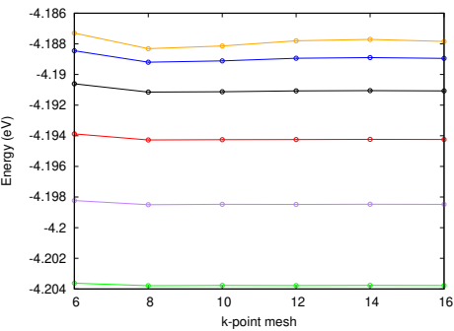
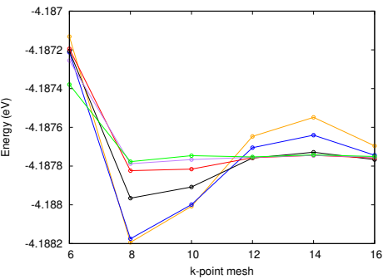
Convergence with respect to k-points, degauss, and smearing
marzari-vanderbilt
gaussian
methfessel-paxton

Slide 31
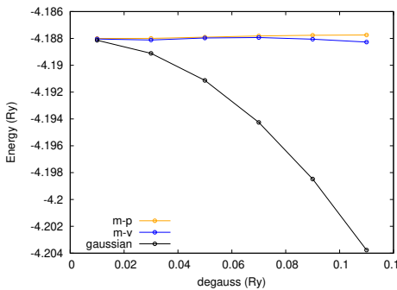
Convergence with respect to k-points, degauss, and smearing
Choose a suitable k-point mesh and plot the total energy as a function of degauss for Marzari-Vanderbilt and Gaussean smearing.

Slide 32
Density of state (DOS) and Projected DOS (PDOS) for Al
Use the procedure given in the instructions for example1:
move to Day3/example2.Al/ex2.dos/ directory and
Self-consistent calculation (pw.x)
Select a finer mesh of k points by doing Non self-consistent calculation (pw.x)
a dos.x calculation to calculate DOS
a projwfc.x calculation to calculate PDOS projected to atomic states

Slide 33
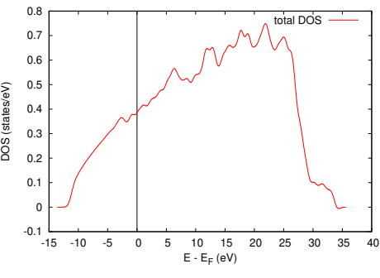
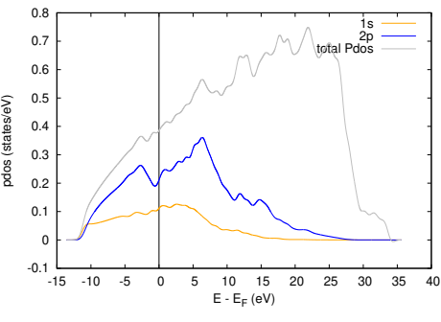
Density of state (DOS) and Projected DOS (PDOS) for Al

Slide 34
Band structure for Al
Use the procedure given in the instructions for example1:
move to Day3/example2.Al/ex2.bands/ directory and
Self-consistent calculation (pw.x)
Select a k-point path (i.e. by using XCrysDen, ... ) and do “bands”-type non-SCF pw.x calculation
a bands.x calculation print the eigenvalues and plot them using gnuplot or
Use the program plotband.x

Slide 35
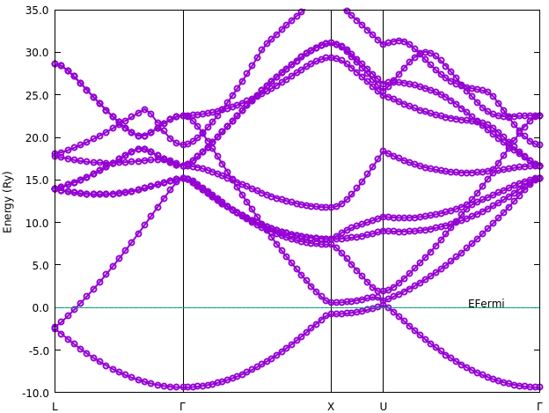
Band structure for Al

