Slide 1
DAY 3: Exchange Correlational Functional
Go to the exercise 3 folder
cd ASESMA2025/Hands-on-basic/Day3/

Slide 2


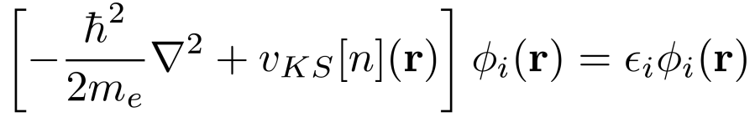
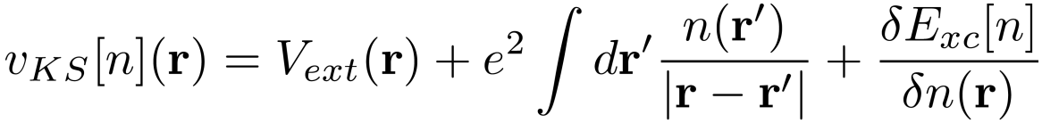
Kohn-Sham DFT
KS MAPPING
electrons
Kohn-Sham particles
interaction
(non-interacting)
external potential
effective potential

Slide 3
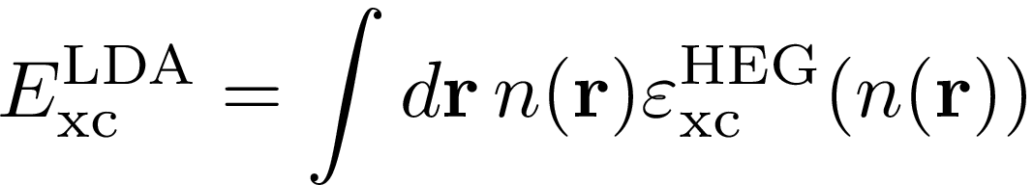
The exchange and correlation energy functional
LDA: The xc energy density of the inhomogeneous system in r is locally approximated with that of a homogeneous electron gas with density n(r)

Slide 4
The exchange and correlation energy functional
LDA: The xc energy density of the inhomogeneous system in r is locally approximated with that of a homogeneous electron gas with density n(r)
GGA: include the dependence on the gradient of the density

Slide 5
The exchange and correlation energy functional
LDA: The xc energy density of the inhomogeneous system in r is locally approximated with that of a homogeneous electron gas with density n(r)
GGA: include the dependence on the gradient of the density
Meta-GGA: include the dependency on the laplacian of the density and kinetic energy density

Slide 6
The exchange and correlation energy functional
LDA: The xc energy density of the inhomogeneous system in r is locally approximated with that of a homogeneous electron gas with density n(r)
GGA: include the dependence on the gradient of the density
Meta-GGA: include the dependency on the laplacian of the density and kinetic energy density
Hybrid functionals: include a fraction of Fock exchange

Slide 7
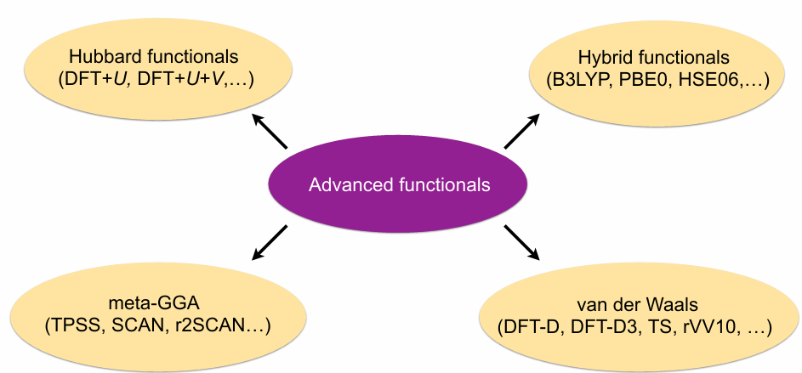
Some advanced exchange-correlation functionals

Slide 8
Some drawbacks of LDA / GGA
Self-interaction errors
Consequences: - over delocalization of electrons (d and f)
- incorrect description of charge transfer
- incorrect energetics of chemical reactions
- underestimation of band gaps
- …
Lack of non-locality
Consequences: - incorrect description of weak long-range (Van der Waals) interactions
- inadequate description of bond breaking and formation
- no Rydberg series
- …

Slide 9
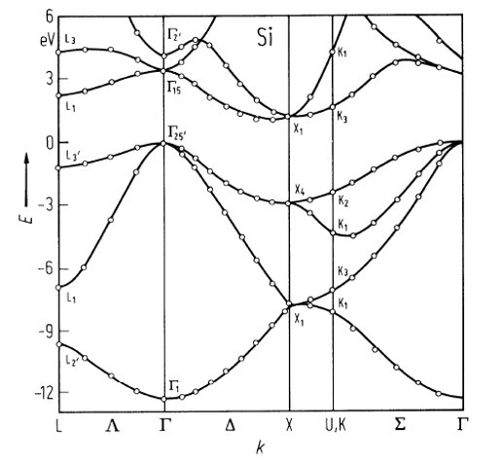
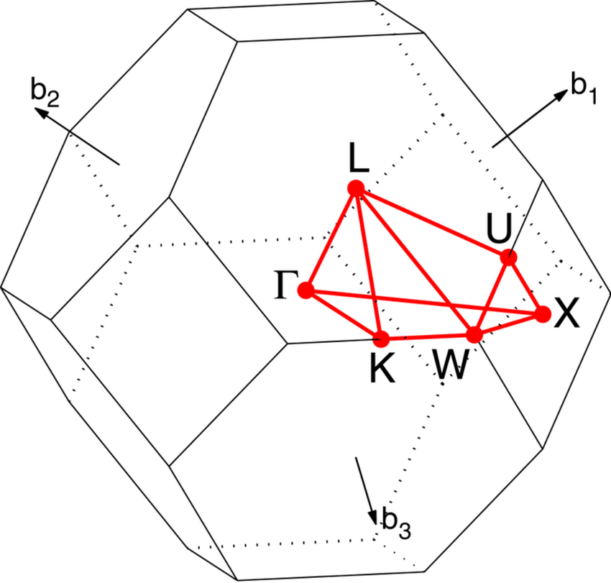
FCC Silicon
Goal of exercise3
z
a₁
y
a₂
a₃
a₀

Slide 10
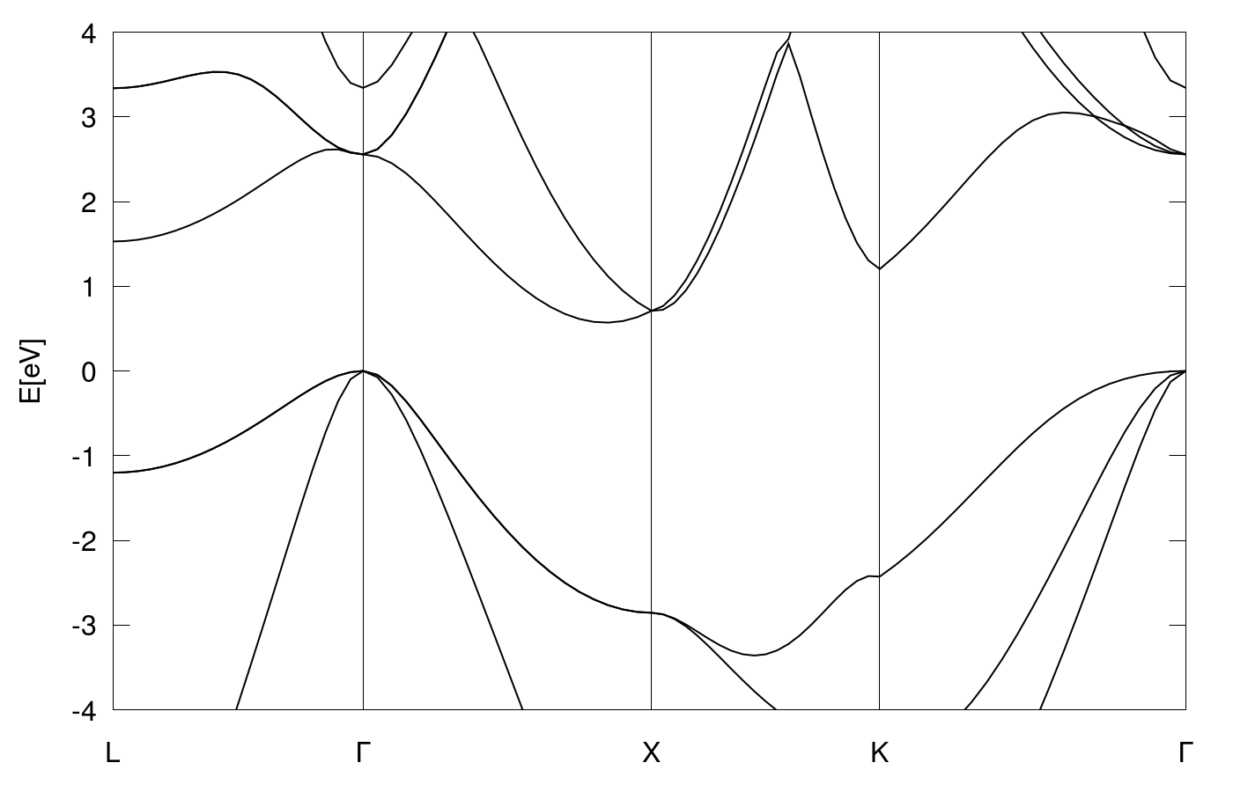
LDA Silicon band structure
E_{g}^{direct} = 2.55 eV
E_{g}^{indirect} = 0.66 eV
 | indirect | direct
E_{g} Exp.​ | 1.17​ | 3.35​

Slide 11
GGA Silicon band structure
E_{g}^{direct} = 2.57 eV
E_{g}^{indirect} = 0.73 eV
 | indirect | direct
E_{g} Exp.​ | 1.17​ | 3.35​

Slide 12
Silicon band Gap: summary
ecut = 20 Ry, k mesh: 6 x 6 x 6
Functional​ | indirect Gap​ | Direct Gap | Band width
LDA | 0.66 | 2.55 | 11.94
GGA​ | 0.73 | 2.57 | 11.90
Exp. | 1.17 | 3.35 | 12.5

Slide 13
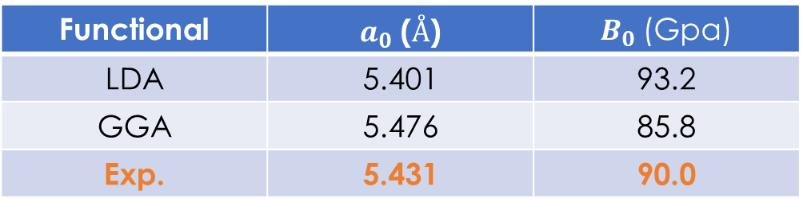
Silicon Lattice Parameter: summary
ecut = 36 Ry, k mesh: 6 x 6 x 6
Functional​ | $a_{0}$ ($Å$) | $B_{0}$(Gpa)
LDA | 5.401 | 93.2
GGA​ | 5.476 | 85.8
Exp. | 5.431 | 90.0

