Slide 1

Day 3 Hands-on:
Bandstructures, metals and XC functionals
Tutors: Alberto Carta / Chiara Cignarella / Nelson Dzade / George Manyali / James Sifuna / Fatema Mohamed / Omamuyovwi Rita Jolayemi / Maram Ali Ahmed Musa
Today’s Themes:
Performing band structure calculations
DFT calculations for metals: smearing parameters
XC functionals: LDA and PBE

Slide 2
Topics of the session
1. Performing band structure calculation
2. Performing metallic calculation: smearing
3. Exchange correlation functional

Slide 3
Exercise 1
Performing band structure calculations, example for Silicon and Aluminum

Slide 4
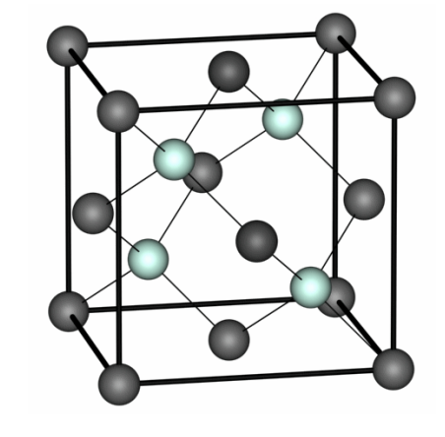
1. Exercise 1: Silicon
&CONTROL
calculation = 'scf’,
…
/
&SYSTEM
ibrav = 2,
celldm(1) = 10.2,
nat = 2,
ntyp = 1,
ecutwfc = 20,
/
&ELECTRONS
/
ATOMIC_SPECIES
Si 28.086 Si.pbe-rrkj.UPF
ATOMIC_POSITIONS
Si 0.00. 0.00. 0.00
Si 0.25. 0.25 0.25
K_POINTS automatic
6 6 6 0 0 0
To compute the band structure of Silicon, go to folder:
ASESMA2025/Day3/example1.bandstructure/ex1.Si

Slide 5
1. Exercise 1: Band structure of Silicon
The scheme to compute the bands is the following:
Perform the SCF Calculation: Use pw.x to calculate the density (calculation = ’scf’)
pw.x –in si.scf.in > si.scf.out
Perform a bands- type NSCF Calculation: Use pw.x to with:
calculation = ’bands’
number of bands (variable nbnd) to be computed (if nothing is specified, the default is used)
a suitable path of k-points in specified K-POINTS card. The k-point path must be continuos in k-space.
Calculate Bands datafile: Use bands.x, which, among others, produces data-files for the plot.
Plot the bands: Use gnuplot to plot the band structures store in the file bands.dat.gnu.
Important: we must keep the prefix same outdir and prefix for “nscf” and “scf” pw.x and for the bands.x calculations!

Slide 6
1. Exercise 1: Silicon
Perform a bands- type NSCF Calculation: : Use pw.x to with calculation= ‘bands’
pw.x –in si.bands.in> si.bands.out
&CONTROL
calculation='bands'
prefix = 'Si',
pseudo_dir = '../../pseudo'
outdir='./tmp'
/
&SYSTEM
ibrav = 2,
celldm(1) = 10.262,
nat = 2,
ntyp = 1,
ecutwfc = 12.0,
ecutrho = 200.0,
nbnd = 10
/
&ELECTRONS
/
……
…
ATOMIC_SPECIES
Si 28.086 Si.pbe-rrkj.UPF …
ATOMIC_POSITIONS alat
Si 0.00 0.00 0.00
Si 0.25 0.25 0.25
K_POINTS {crystal_b}
6
0.50 0.25 0.75 30 !W
0.00 0.00 0.00 30 !G
0.50 0.00 0.50 30 !X
0.50 0.25 0.75 30 !W
0.50 0.50 0.50 30 !L
0.00 0.00 0.00 30 !G
Input file for band calculation looks like this:

Slide 7
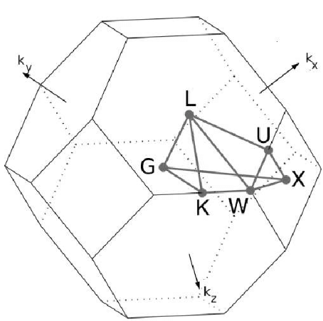
1. Exercise 1: Band structure of Silicon
How to specify the k-path for band structure calculation:
Use the k-path selection tool of xcrysden:
1. Open the file si.scf.in with xcrysden;
2. Select: Tools → k-path selection ;
3. Select the path by clicking on a sequence of
high-symmetry points: W – Γ – X – W – L – Γ ;
4. Specify how many k points to be calculated (Ex: 100)
5. Save the k-path to file. (.pwscf extension is required for formatting the file for pw.x).
Insert manually, or use the Seek- Path tool online:
https://www.materialscloud.org/work/tools/seekpath

Slide 8
1. Exercise 1: Silicon
Calculate Bands datafile: Use bands.x, which, among others, produces data-files for the plot.
bands.x –in bands.in> bands.out
An input file for the data post processing program bands.x:
&BANDS
outdir = ’./tmp’,
prefix=’Si’,
filband=’bands.dat’,
/
This program print the eigenvalues to the file specified in ”filband” .
Bands data are stored in three files with different formats, among which we have bands.dat.gnu (can be plotted with gnuplot) and bands.dat can be visualized using the program plotband.x.

Slide 9
1. Exercise 1: Silicon
Plot with gnuplot: run gnuplot plot_bands.gp
The program plotband.x can be useful to obtain a postscript file of the band structure and a set of data files that can be plotted with xmgr. → type plotband.x on the terminal, which prompts the terminal input:
Input file > bands.dat Reading 10 bands at 151 k-points Range: -5.8760 17.7160eV Emin, Emax, [firstk, lastk] > -5.8760 17.7160 high-symmetry point: -1.0000 0.5000 0.0000 x coordinate 0.0000 high-symmetry point: 0.0000 0.0000 0.0000 x coordinate 1.1180 high-symmetry point: -1.0000 0.0000 0.0000 x coordinate 2.1180 high-symmetry point: -1.0000 0.5000 0.0000 x coordinate 2.6180 high-symmetry point: -0.5000 0.5000 0.5000 x coordinate 3.3251 high-symmetry point: 0.0000 0.0000 0.0000 x coordinate 4.1912 output file (gnuplot/xmgr) > si.bands.dat bands in gnuplot/xmgr format written to file si.bands.dat output file (ps) > bands.ps Efermi > 6.0653 deltaE, reference E (for tics) 2, 6.0653 bands in PostScript format written to file bands.ps

Slide 10
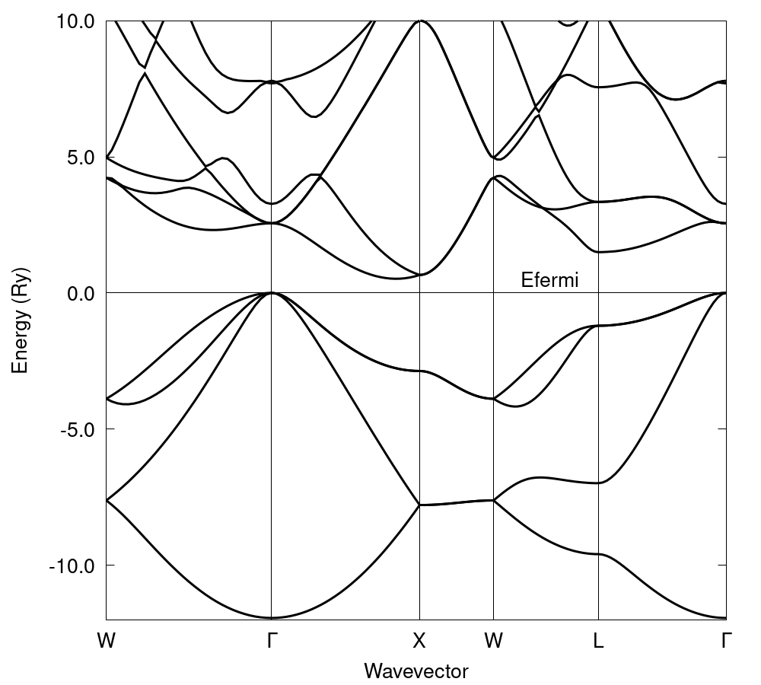
1. Exercise 1: Silicon
Optional homework: can you calculate the DOS of Silicon?

Slide 11
1. Exercise 2: Aluminum
To compute the band structure of Silicon, go to folder:
ASESMA2025/Day3/example1.bandstructure/ex2.Al
and use the same procedure for silicon:
Self-consistent calculation (pw.x)
Select a k-point path (i.e. by using XCrysDen, ... ) and do “bands”-type non-SCF pw.x calculation
Run a bands.x calculation
Plot the results using gnuplot, or run plotband.x
Optional homework: converge the ecut_wfc and k-points for Aluminium, as done in Day2 (you find the scripts in folder ex2.Al/convergence_test)

Slide 12
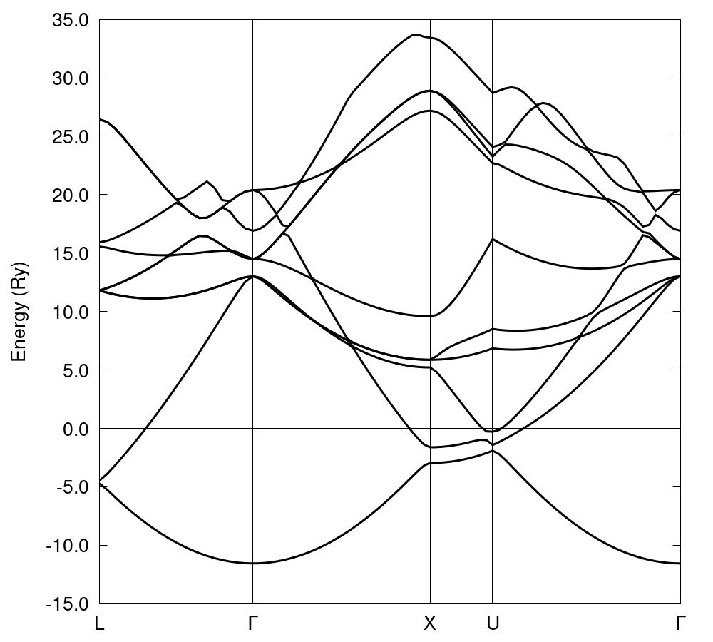
1. Exercise 2: Aluminum

Slide 13
Exercise 2
Performing metallic calculations: smearing

Slide 14
Exercise 2: smearing
In this exercise we will compute the total energy for this fcc Al with the following values for degauss, k-point meshes and different smearing variables:
degauss variable, in range from 0.01 to 0.11
k-points: N×N×N ( 1×1×1) with N=6,8,10, …, 16
smearing variable, possible values: ’gauss’ (or ’g’), ’marzari-vanderbilt’
(or ’m-v’), ’methfessel-paxton’ (or ’m-p’)
Follow the instructions in example2.smearing:
Plot the convergence of the total energy with respect to the number of k-points for the different smearing values.

Slide 15
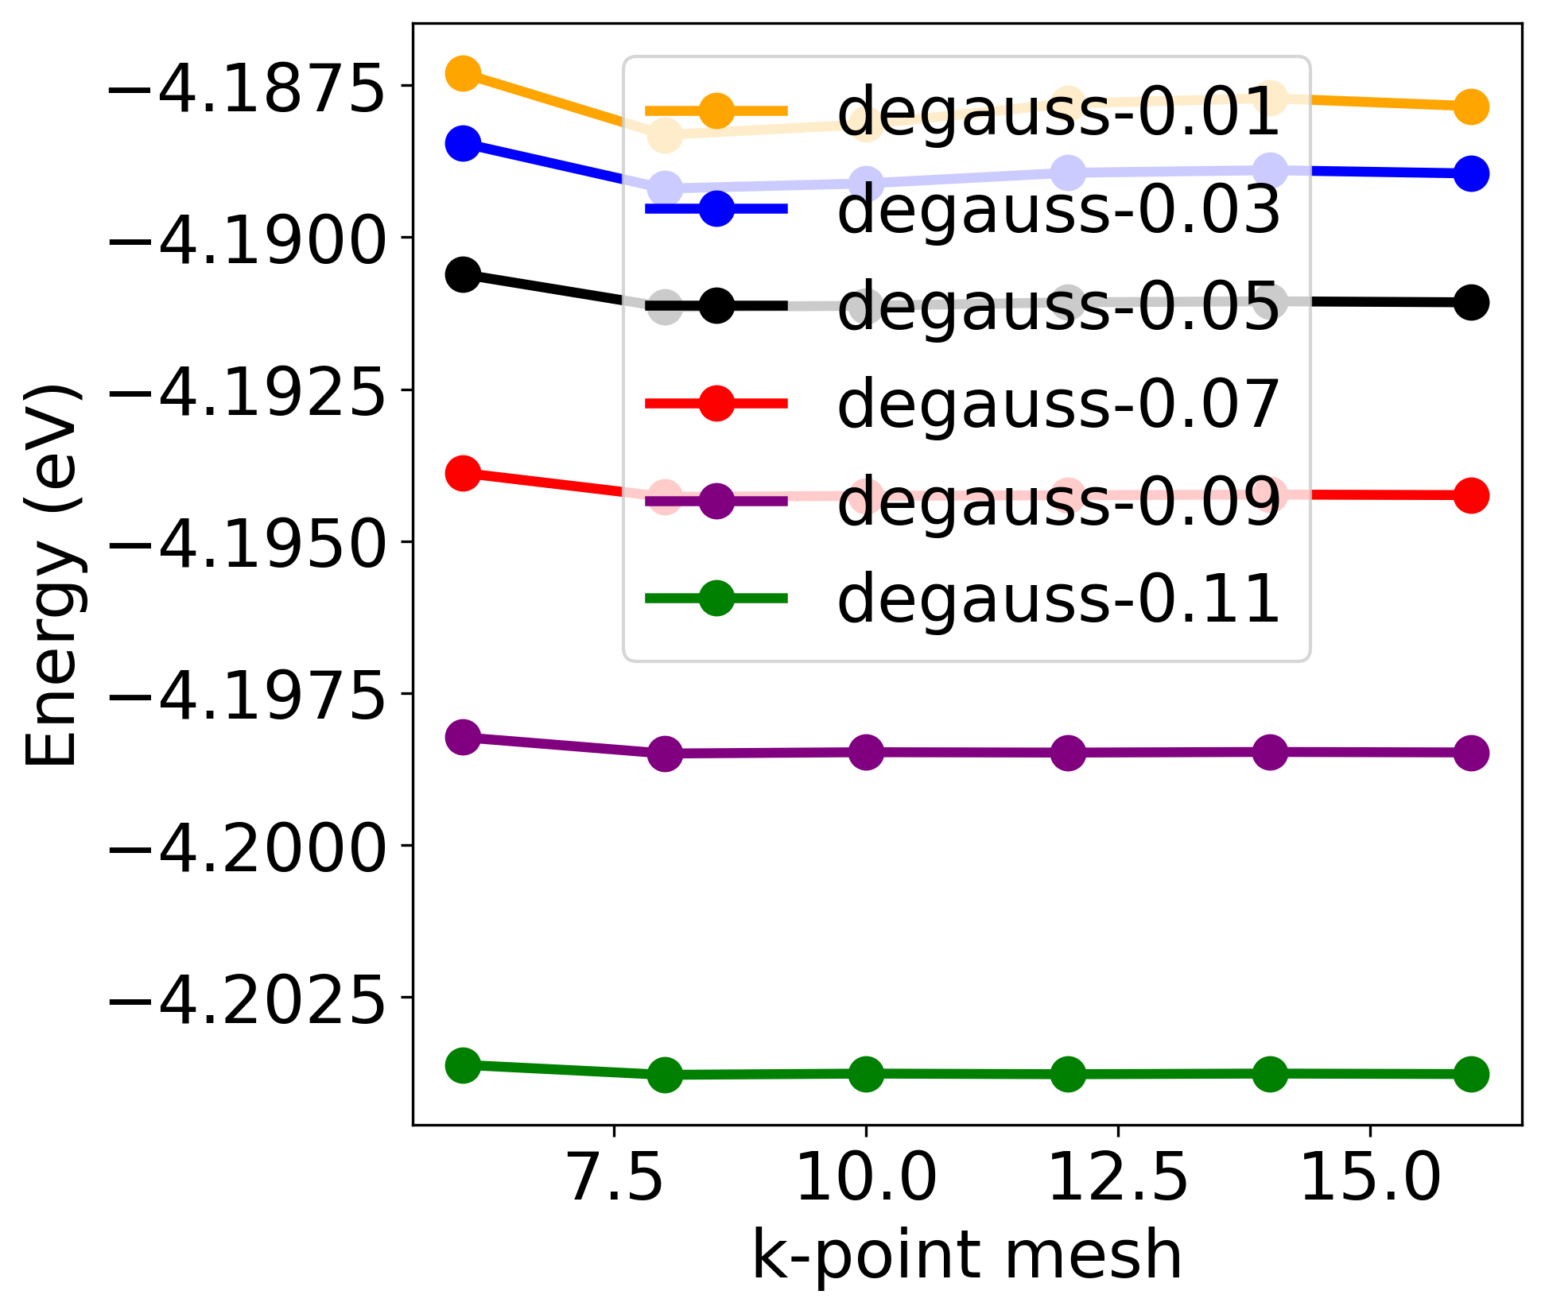
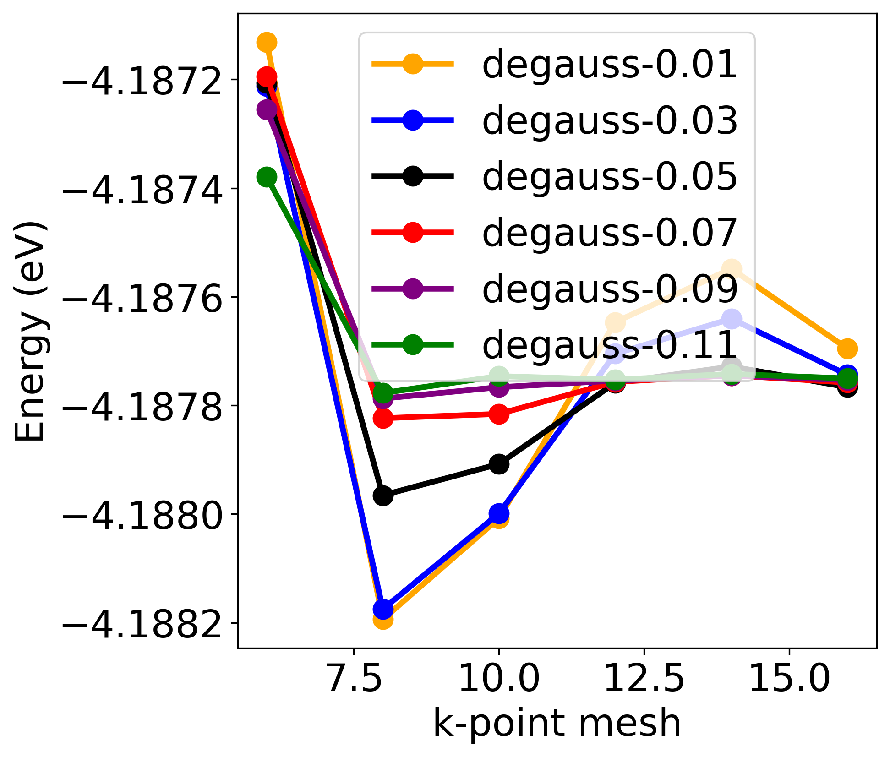
Exercise 2: smearing
Gaussian
Methfessel-Paxton

Slide 16
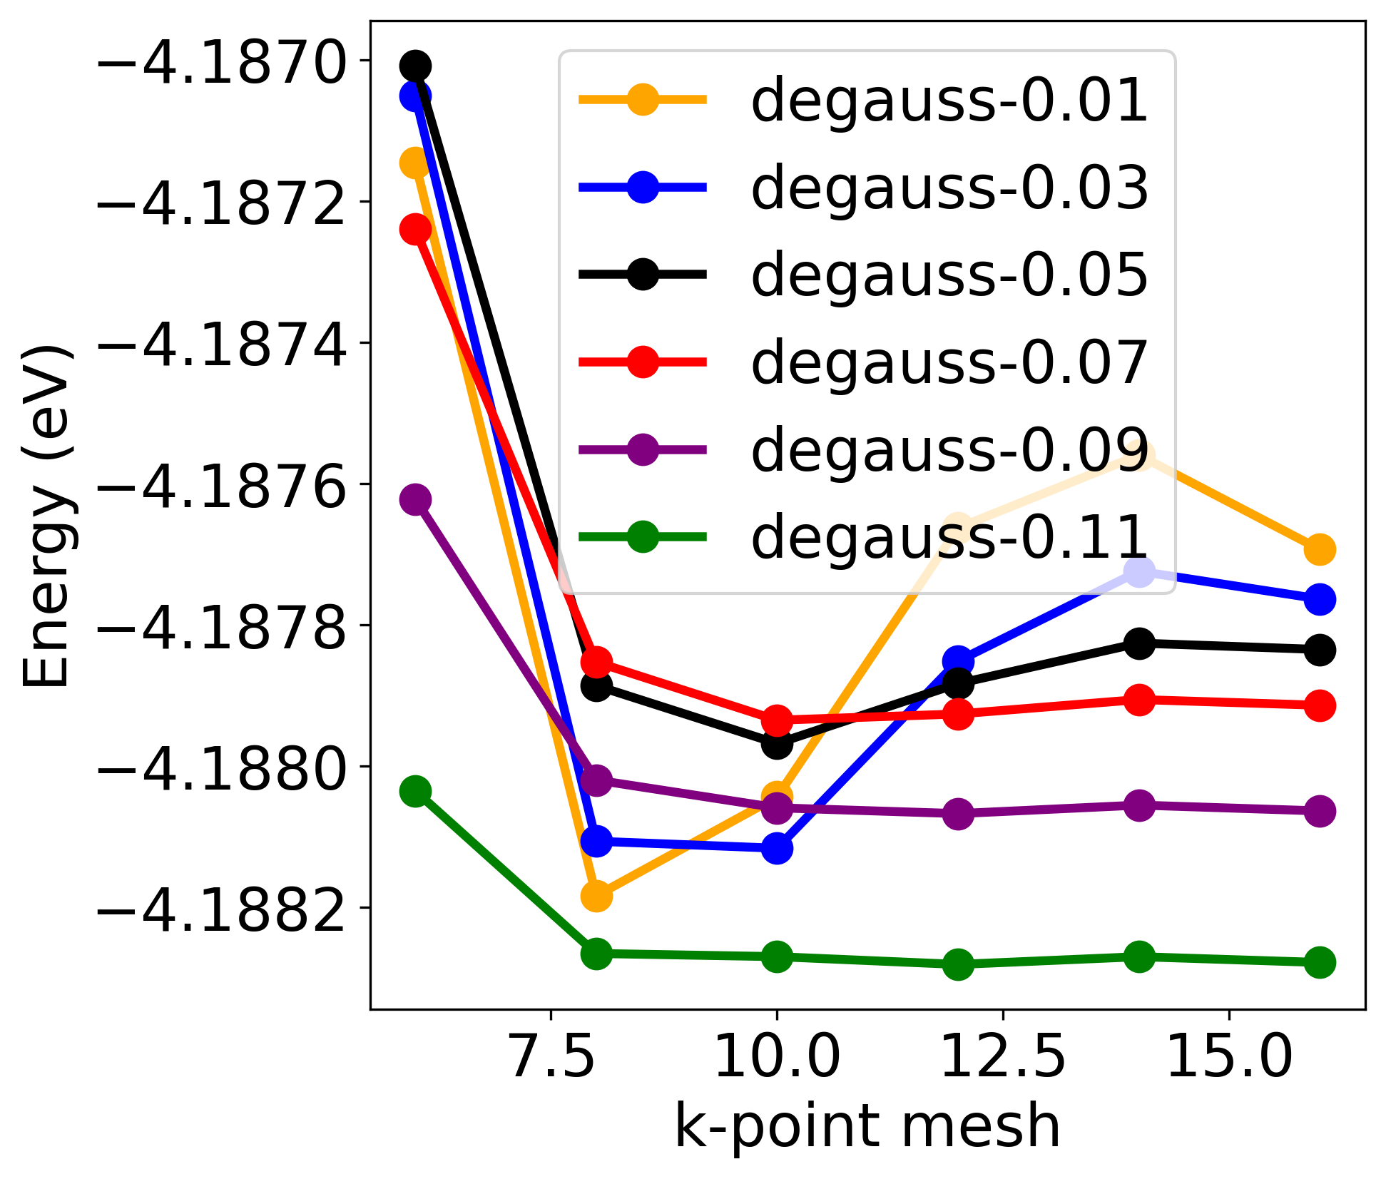
Exercise 2: smearing
Marzari-vanderbilt
Methfessel-Paxton

Slide 17
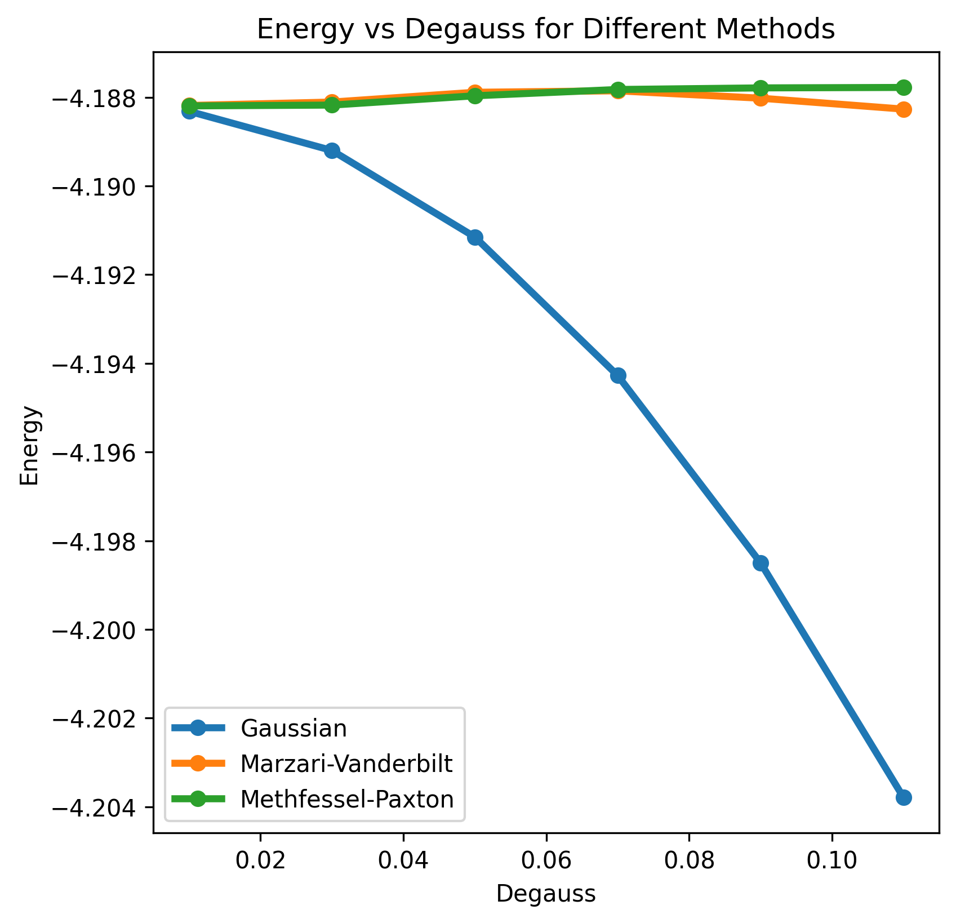
Exercise 2: smearing
Choose a suitable k-point mesh and plot the total energy as a function of degauss for Marzari-Vanderbilt and Gaussean smearing.

Slide 18
Exercise 3
Exchange correlation functional

Slide 19
DAY 3: Exchange Correlational Functional
Go to the exercise 3 folder
cd ASESMA2025/Hands-on-basic/Day3/

Slide 20


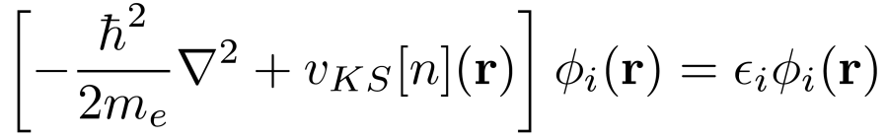
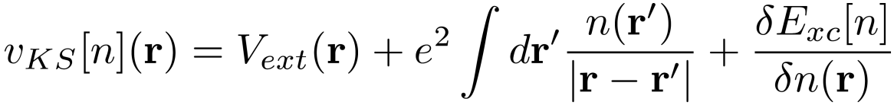
Kohn-Sham DFT
KS MAPPING
electrons
Kohn-Sham particles
interaction
(non-interacting)
external potential
effective potential

Slide 21
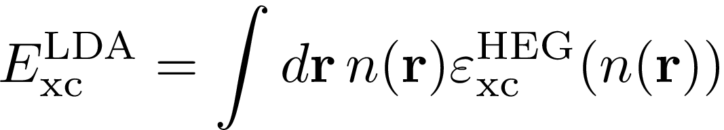
The exchange and correlation energy functional
LDA: The xc energy density of the inhomogeneous system in r is locally approximated with that of a homogeneous electron gas with density n(r)

Slide 22
The exchange and correlation energy functional
LDA: The xc energy density of the inhomogeneous system in r is locally approximated with that of a homogeneous electron gas with density n(r)
GGA: include the dependence on the gradient of the density

Slide 23
The exchange and correlation energy functional
LDA: The xc energy density of the inhomogeneous system in r is locally approximated with that of a homogeneous electron gas with density n(r)
GGA: include the dependence on the gradient of the density
Meta-GGA: include the dependency on the laplacian of the density and kinetic energy density

Slide 24
The exchange and correlation energy functional
LDA: The xc energy density of the inhomogeneous system in r is locally approximated with that of a homogeneous electron gas with density n(r)
GGA: include the dependence on the gradient of the density
Meta-GGA: include the dependency on the laplacian of the density and kinetic energy density
Hybrid functionals: include a fraction of Fock exchange

Slide 25
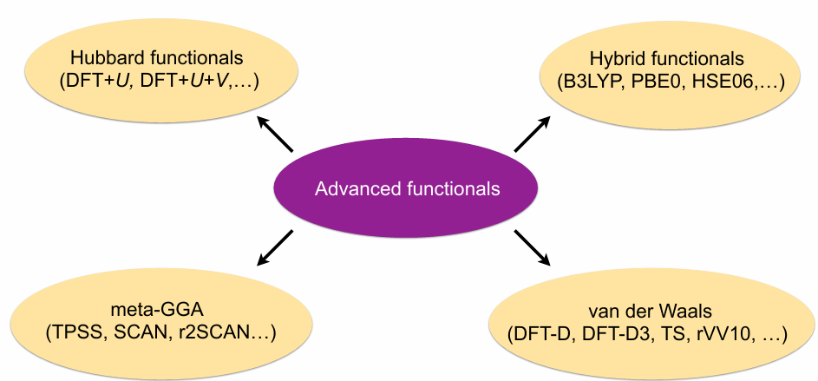
Some advanced exchange-correlation functionals

Slide 26
Some drawbacks of LDA / GGA
Self-interaction errors
Consequences: - over delocalization of electrons (d and f)
- incorrect description of charge transfer
- incorrect energetics of chemical reactions
- underestimation of band gaps
- …
Lack of non-locality
Consequences: - incorrect description of weak long-range (Van der Waals) interactions
- inadequate description of bond breaking and formation
- no Rydberg series
- …

Slide 27
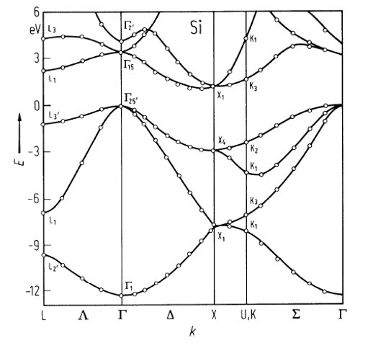
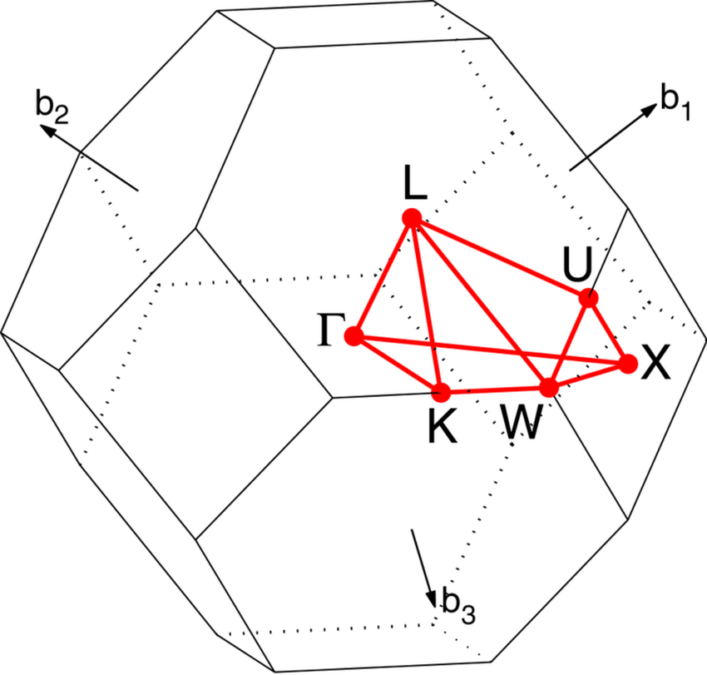
FCC Silicon
Goal of exercise3
z
a₁
y
a₂
a₃
a₀

Slide 28
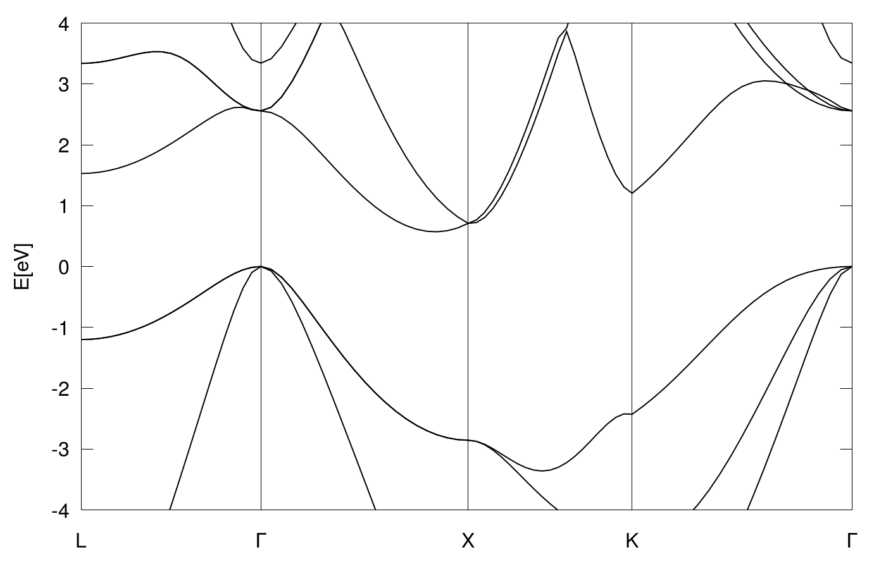
LDA Silicon band structure
E_{g}^{direct} = 2.55 eV
E_{g}^{indirect} = 0.66 eV
 | indirect | direct
E_{g} Exp.​ | 1.17​ | 3.35​

Slide 29
GGA Silicon band structure
E_{g}^{direct} = 2.57 eV
E_{g}^{indirect} = 0.73 eV
 | indirect | direct
E_{g} Exp.​ | 1.17​ | 3.35​

Slide 30
Silicon band Gap: summary
ecut = 20 Ry, k mesh: 6 x 6 x 6
Functional​ | indirect Gap​ | Direct Gap | Band width
LDA | 0.66 | 2.55 | 11.94
GGA​ | 0.73 | 2.57 | 11.90
Exp. | 1.17 | 3.35 | 12.5

Slide 31
Silicon Lattice Parameter: summary
ecut = 36 Ry, k mesh: 6 x 6 x 6
Functional​
LDA | 5.401 | 93.2
GGA​ | 5.476 | 85.8
Exp. | 5.431 | 90.0

Slide 32
Thank you!
Questions?

