Slide 1


Day 4 Hands on: Forces and phonons
Tutors: Chiara Cignarella / Alberto Carta / Nelson Dzade / George Manyali / James Sifuna / Fatema Mohamed / Omamuyovwi Rita Jolayemi / Maram Ali Ahmed Musa
Today’s theme:
1) Relaxations: adsorption of oxygen on graphene and automatic lattice constant optimization
2) Phonons: compute phonon in $Γ$ and along the BZ, for Si and AlAs

Slide 2
Exercise 1: Learning Goals: optimize atomic position and lattice constants

Slide 3
Exercise 1
Topics of the exercise:
1. How to perform relaxation of atomic structure (graphane and oxygen adsorption)
2. Understanding forces.
3. Optimizing the lattice constant of Silicon and comparing with total energy approaches
4. Understanding stresses.

Slide 4
Exercise 1.1: graphane and O adsorption
Input file scf calculation
Input file for relaxation
&CONTROL
calculation = 'scf',
prefix = 'Graphane',
outdir = '/tmp',
pseudo_dir = '../../pseudo',
/
&SYSTEM
….
….
/
&ELECTRONS
conv_thr = 1.0d-8
/
ATOMIC_SPECIES
C 12.0107 C.pbe-rrkjus.UPF
H 1.00007 H.pbe-rrkjus.UPF
ATOMIC_POSITIONS alat
...
K_POINTS automatic
991 000
&CONTROL
calculation = 'relax',
prefix = 'Graphane',
outdir = '/tmp',
pseudo_dir = '../../pseudo',
/
&SYSTEM
….
….
/
&ELECTRONS
conv_thr = 1.0d-8
/
&IONS
/
ATOMIC_SPECIES
C 12.0107 C.pbe-rrkjus.UPF
H 1.00007 H.pbe-rrkjus.UPF
ATOMIC_POSITIONS alat
...
K_POINTS automatic
991 000
This relaxes only the atomic positions
Ions is jargon for atoms, this cell
must appear!

Slide 5
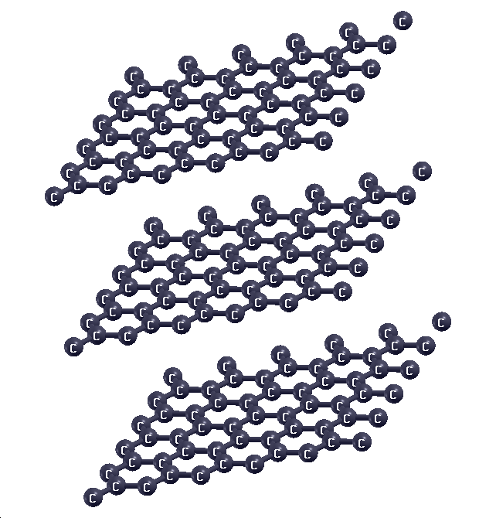
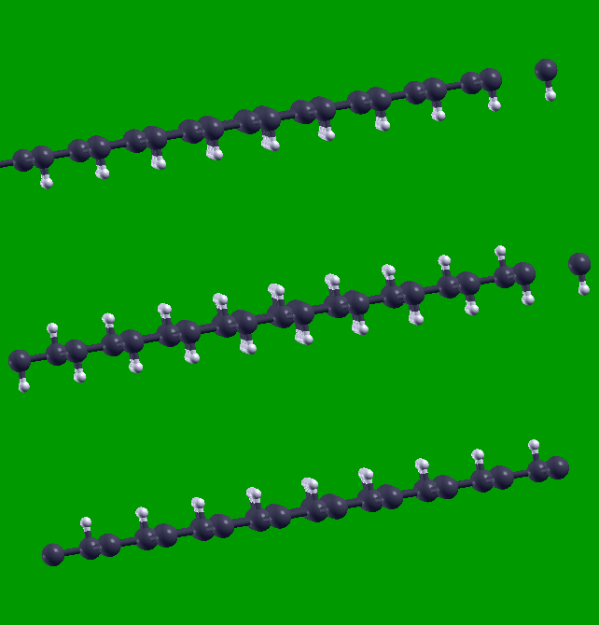
Exercise 1.1: graphane
Graphane is hydrogenated graphene:
→ H saturates double-bonds and destroys the pi-delocalized cloud
→ remove tendency to be planar (why?)

Slide 6
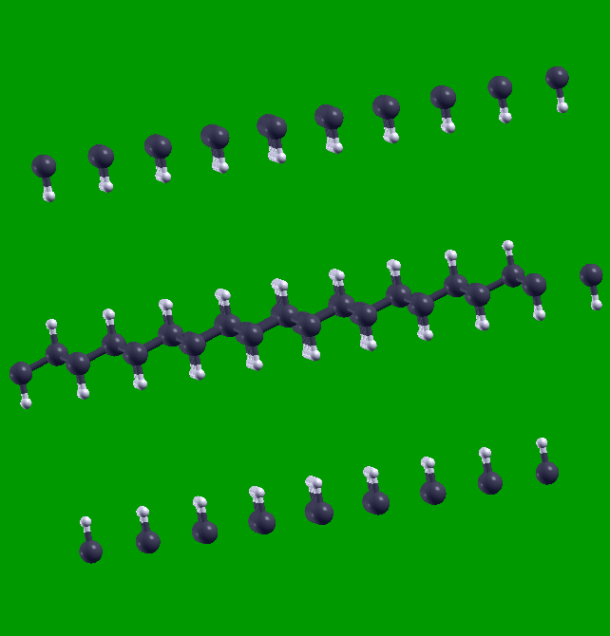
Exercise 1.1: graphane buckling
Relax
→

Slide 7
Exercise 1.1: finding forces
Output relaxation file
Iteration #1
Forces acting on atoms (cartesian axes, Ry/au):
atom 1 type 2 force = -0.00000000 -0.00000000 0.29668613
atom 2 type 1 force = 0.00000000 0.00000000 0.24378433
atom 3 type 1 force = 0.00000000 0.00000000 -0.24378433
atom 4 type 2 force = 0.00000000 0.00000000 -0.29668613
Total force = 0.543053 Total SCF correction = 0.000031
What is the condition on forces for the material to be in equilibrium?
Iteration #6
Forces acting on atoms (cartesian axes, Ry/au):
atom 1 type 2 force = 0.00000000 0.00000000 0.00017761
atom 2 type 1 force = 0.00000000 0.00000000 -0.00064644
atom 3 type 1 force = 0.00000000 0.00000000 0.00064644
atom 4 type 2 force = 0.00000000 -0.00000000 -0.00017761
Total force = 0.000948 Total SCF correction = 0.000003
Energy error = 2.7E-05 Ry
Gradient error = 6.5E-04 Ry/Bohr

Slide 8
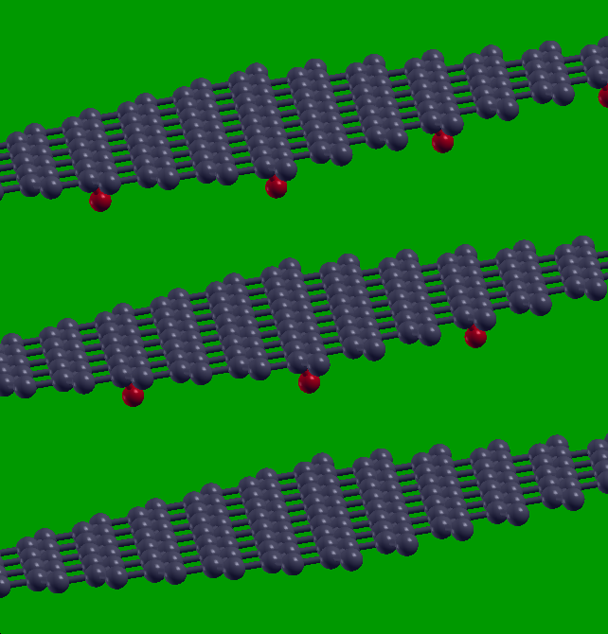
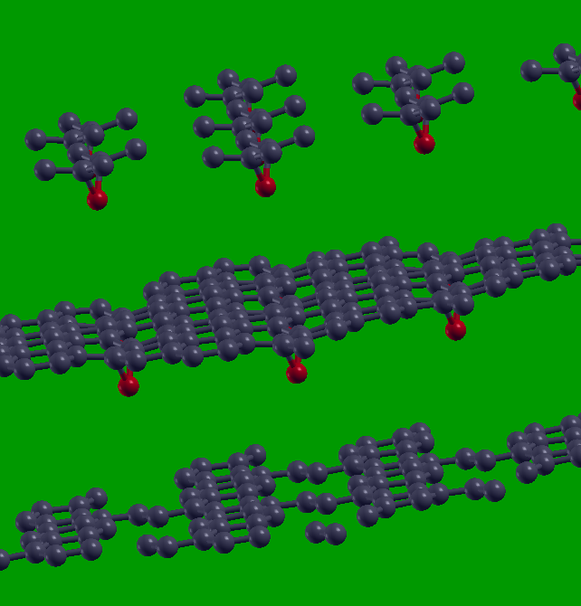
Exercise 1.1: O adsorption on graphene
Oxygen is strongly electronegative → electron acceptor
Relax
→

Slide 9
Exercise 1.1: optimizing silicon
Input file for cell relaxation
&CONTROL
calculation='vc-relax',
prefix='silicon',
pseudo_dir='../../pseudo/',
outdir='./tmp'
/
&SYSTEM
ibrav = 2,
celldm(1) = 10.6,
nat = 2,
ntyp = 1,
nbnd=10,
ecutwfc = 36,
/
&ELECTRONS
/
&IONS
/
&CELL
/
ATOMIC_SPECIES
Si 28.086 Si.pz-vbc.UPF
ATOMIC_POSITIONS
Si 0.00 0.00 0.00
Si 0.25 0.25 0.25
K_POINTS automatic
6 6 6 1 1 1
This relaxes both cell and atomic positions
We need also a CELL section

Slide 10
Exercise 1.1: finding stresses
Output relaxation file
Iteration #1
Forces acting on atoms (cartesian axes, Ry/au):
atom 1 type 1 force = 0.00000000 0.00000000 0.00000000
atom 2 type 1 force = 0.00000000 0.00000000 0.00000000
Total force = 0.000000 Total SCF correction = 0.000000
Computing stress (Cartesian axis) and pressure
total stress (Ry/bohr**3) (kbar) P= -85.01
-0.00057789 -0.00000000 0.00000000 -85.01 -0.00 0.00
-0.00000000 -0.00057789 0.00000000 -0.00 -85.01 0.00
0.00000000 0.00000000 -0.00057789 0.00 0.00 -85.01
Iteration #6
Forces acting on atoms (cartesian axes, Ry/au):
atom 1 type 1 force = -0.00000000 -0.00000000 -0.00000000
atom 2 type 1 force = 0.00000000 0.00000000 -0.00000000
Total force = 0.000000 Total SCF correction = 0.000000
Computing stress (Cartesian axis) and pressure
total stress (Ry/bohr**3) (kbar) P= 0.29
0.00000194 0.00000000 -0.00000000 0.29 0.00 -0.00
0.00000000 0.00000194 -0.00000000 0.00 0.29 -0.00
-0.00000000 -0.00000000 0.00000194 -0.00 -0.00 0.29

Slide 11
End of exercise 1
Questions?

Slide 12
Topics of the following session: Phonons
Exercise 2: Phonons at Gamma in non-polar materials
Exercise 3: Phonons dispersion in non-polar materials
Exercise 4: Phonon at Gamma in polar materials
Optional:
Exercise 5: Phonon dispersion in polar materials
Exercise 6: Phonon dispersion with negative phonons

Slide 13
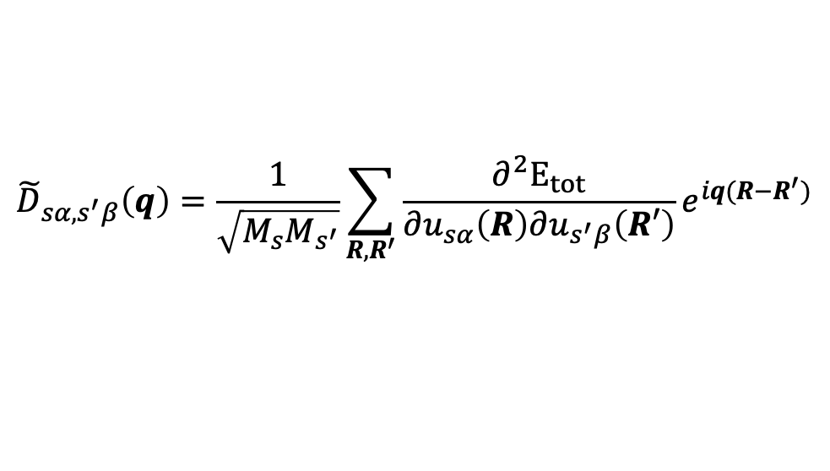
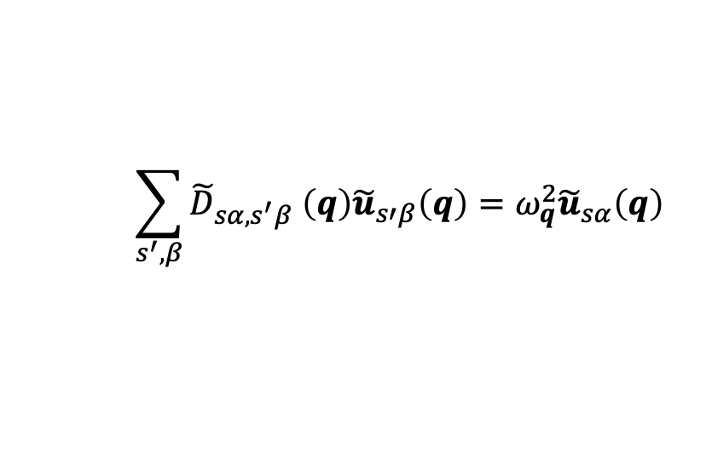
Introduction: Phonons
Normal mode frequencies, , and eigenvectors, are determined by the secular equation:
where
is the dynamical matrix.
This Matrix can be calculated from linear response and diagonalized to get phonon modes at q.
$$\sum_{s^{′}, β}{{\tilde{D}}_{sα,s^{′}β} \left(q\right){\tilde{u}}_{s′β}\left(q\right)=ω_{q}^{2}{\tilde{u}}_{sα}\left(q\right)}$$
$${\tilde{D}}_{sα,s^{′}β}\left(q\right)=\frac{1}{\sqrt{M_{s}M_{s^{′}}}}\sum_{R,R^{′}}{\frac{∂^{2}E_{tot}}{∂u_{sα}\left(R\right)∂u_{s^{′}β}\left(R′\right)}e^{iq(R−R^{′})}}$$
Interatomic Force Constant (IFC)

Slide 14
Exercise 2: Phonons at Gamma in non-polar materials

Slide 15
Exercise 2: Phonons at $Γ$ in non-polar materials
Go to the directory with the input files:
cd ~/ASESMA2025/Day4/example2.phonon.Gamma.Si/
In this directory you will find:
README.md – File describing how to do the exercise
Si.scf.in – Input file for the SCF ground-state calculation
Si.ph.in – Input file for the phonon calculation at Γ
Si.dynmat.in – Input file to impose the acoustic sum rule
reference – Directory with the reference results

Slide 16
Exercise 2: Phonons at $Γ$ in non-polar materials
&CONTROL
calculation = 'scf’,
prefix = 'si’,
pseudo_dir = '../pseudo/’,
outdir = ‘../tmp’
/
&SYSTEM
ibrav = 2,
celldm(1) = 10.2,
nat = 2,
ntyp = 1,
ecutwfc = 60,
ecutrho = 720
/
&ELECTRONS
mixing_beta=0.7,
conv_thr=1d-10,
/
ATOMIC_SPECIES
Si 28.086 Si.pz-vbc.UPF
ATOMIC_POSITIONS
Si 0.00. 0.00. 0.00
Si 0.25. 0.25 0.25
K_POINTS automatic
4 4 4 1 1 1
Step 1: Perform a Self-Consistent Field
ground-state calculation for silicon at the equilibrium structure using the pw.x program.
mpirun –np 4 pw.x –in Si.scf.in > Si.scf.out
Smaller than for simple total energy!
Input Output

Slide 17
Exercise 2: Phonons at $Γ$ in non-polar materials
Step 2: Perform a phonon calculation at Γ using the ph.x program.
Input file for phonon at Gamma
mpirun –np 4 ph.x –in Si.ph.in > Si.ph.out
&inputph
prefix = ‘si',
tr2_ph = 1.0d-14,
amass(1) = 28.0855,
epsil = .true.
outdir = './tmp'
fildyn = 'Si.dyn',
/
0.0 0.0 0.0
The same prefix as in the SCF calculation
Threshold for self-consistency
Atomic mass
To calculate the dielectric tensor and effective charges
Directory for temporary files
File containing the dynamical matrix
Coordinates of the q point (Γ) in units of 2*pi/a in the
Cartesian reference system

Slide 18
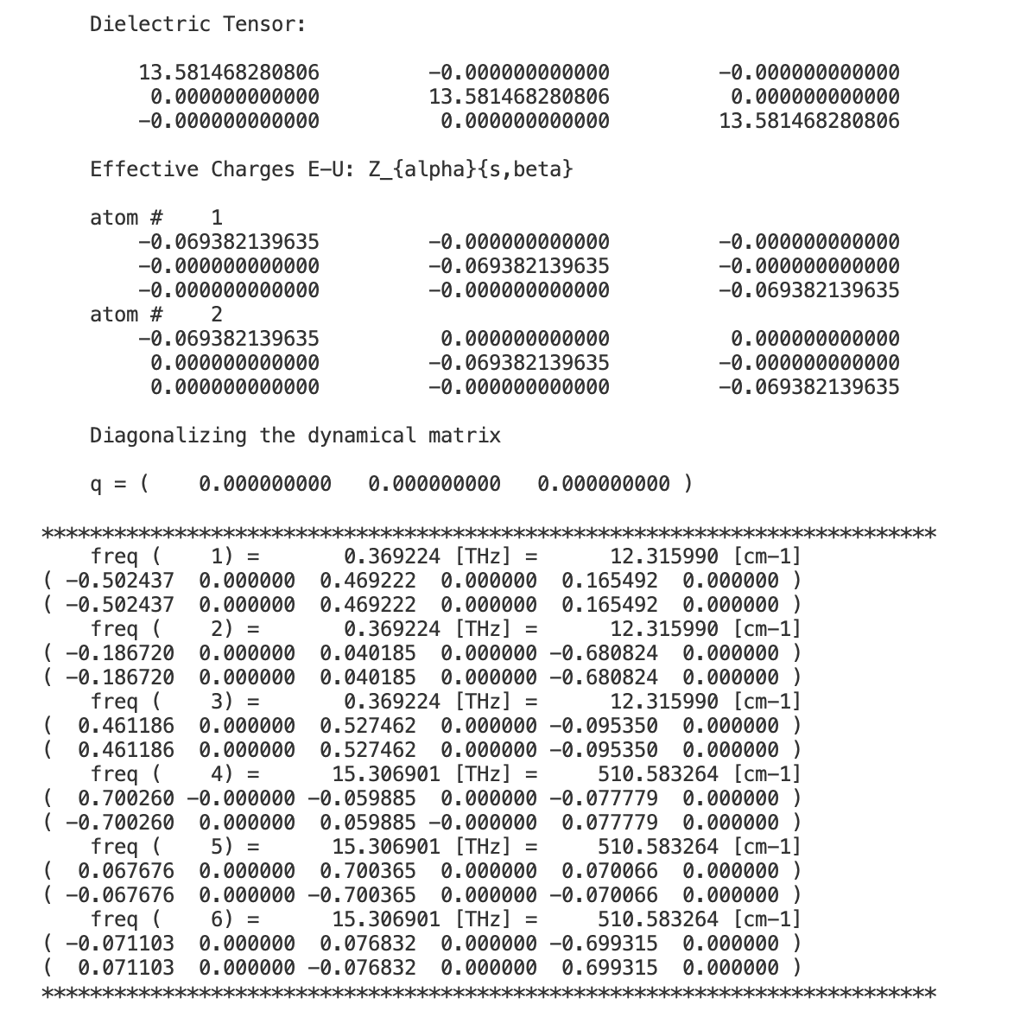
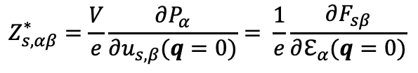
Exercise 2: Phonons at $Γ$ in non-polar materials
Dynamical matrix file: Si.dyn
Dielectric constant and Born
effective charges (BECs)
$$Z_{s,αβ}^{∗}=\frac{V}{e}\frac{∂P_{α}}{∂u_{s,β}(q=0)}= \frac{1}{e}\frac{∂F_{sβ}}{∂ℇ_{α}(q=0)}$$

Slide 19
Exercise 2: Phonons at $Γ$ in non-polar materials
Dynamical matrix file: Si.dyn
Acoustic modes (in-phase)
Optical modes (out-of-phase)

Slide 20
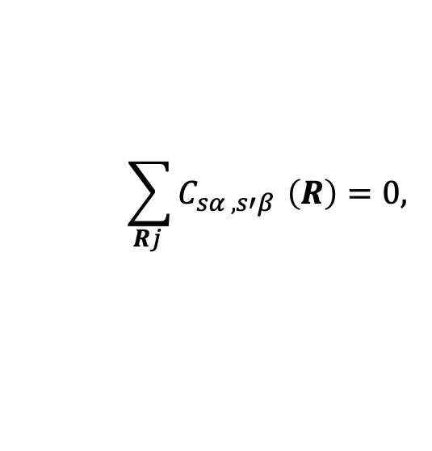
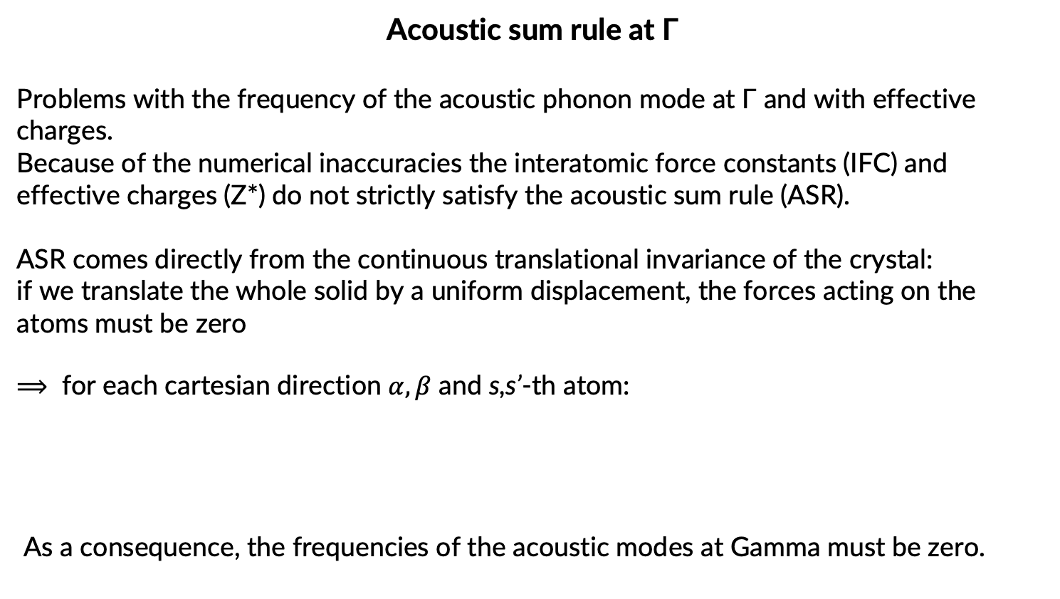
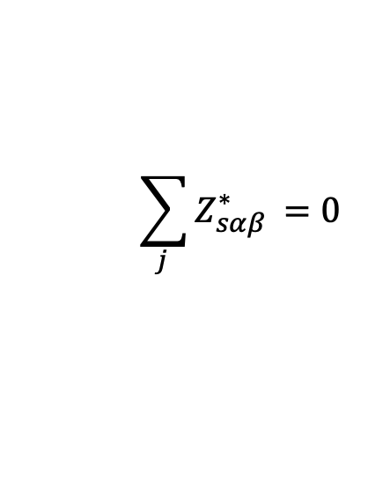
Exercise 2: Phonons at $Γ$ in non-polar materials
Acoustic sum rule at Γ
Problems with the frequency of the acoustic phonon mode at Γ and with effective charges.
Because of the numerical inaccuracies the interatomic force constants (IFC) and effective charges (Z*) do not strictly satisfy the acoustic sum rule (ASR).
ASR comes directly from the continuous translational invariance of the crystal:
if we translate the whole solid by a uniform displacement, the forces acting on the atoms must be zero
⟹ for each cartesian direction $α,β$ and s,s’-th atom:
As a consequence, the frequencies of the acoustic modes at Gamma must be zero.
$$\sum_{Rj }{C_{sα ,s′β }}\left(R\right)=0,$$
$$\sum_{j }{Z_{sαβ }^{∗}}=0$$

Slide 21
Exercise 2: Phonons at $Γ$ in non-polar materials
Acoustic sum rule at Γ
Reason for numerical inaccuracy:
Insufficiently accurate SCF thresholds (in pw.x and/or ph.x)
XC energy is computed in real space. More problematic for GGA than in LDA, for US pseudopotentials it could require large ecutrho.
K-points sampling not accurate enough (especially, BECs and dielectric constant required denser k-point sampling).

Slide 22
Exercise 2: Phonons at $Γ$ in non-polar materials
Acoustic sum rule at Γ
The acoustic sum rule (ASR) can however be imposed after the phonon calculations. To do this we use the dynmat.x program that imposes the ASR on the elements of the dynamical matrix and diagonalize it.
The input file is Si.dynmat.in :
Step 3: Run a dynmat.x calculation to impose the ASR
mpirun –np 4 dynmat.x –in Si.dynmat.in > Si.dynmat.out
&input
fildyn = 'Si.dyn',
asr = 'simple',
/
File containing the dynamical matrix
A way to impose the acoustic sum rule (simple, crystal, one-dim, zero-dim, all)

Slide 23
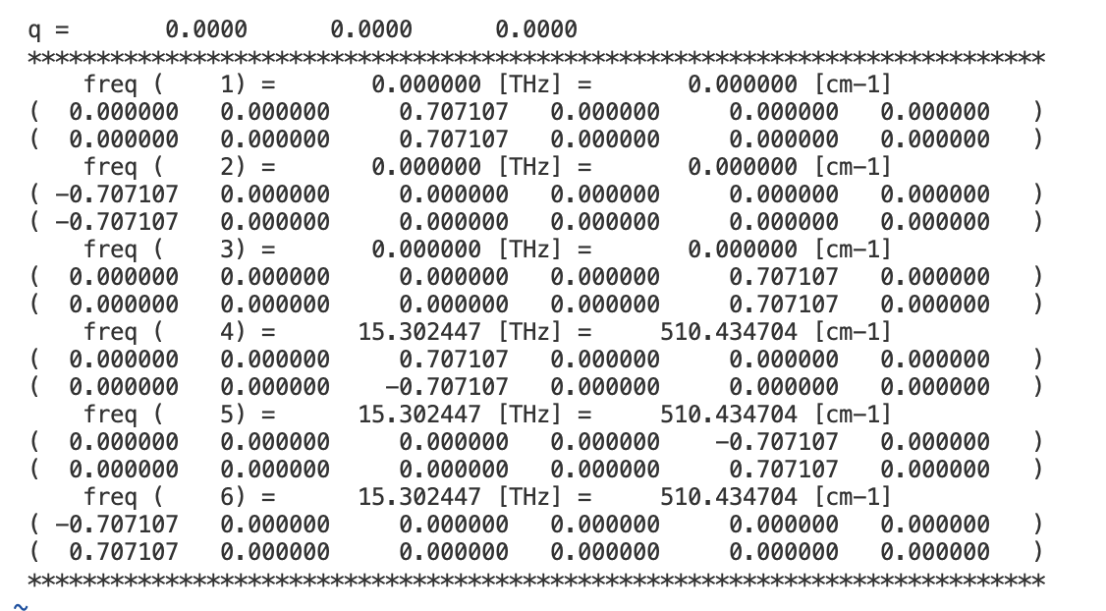
Exercise 2: Phonons at $Γ$ in non-polar materials
The program dynmat.x produces the file dynmat.out which contains
the new acoustic frequencies, which are exactly equal to zero

Slide 24
Exercise 3: Phonons dispersion in non-polar materials

Slide 25
Exercise 3: Phonons dispersion in non-polar materials
Go to the directory with the input files:
cd ~/ASESMA2025/Day4/example3.phonon.dispersion.Si/
In this directory you will find:
README.md – File describing how to do the exercise
Si.scf.in – Input file for the SCF ground-state calculation
Si.ph.in – Input file for the phonon calculation at Γ
Si.q2r.in – Input file for calculation of Interatomic Force Constants
Si.matdyn.in – Input file for Fourier Interpolation for various q points
Si.plotband.in - Input file for plotting a phonon dispersion
reference – Directory with the reference results

Slide 26

Exercise 3: Phonons dispersion in non-polar materials
Step 1: Perform a Self-Consistent Field
ground-state calculation for silicon at the equilibrium structure using the pw.x program.
&inputph
prefix = ‘si',
tr2_ph = 1.0d-14,
amass(1) = 28.0855,
ldisp = .true.,
nq1 = 4,
nq2 = 4,
nq3 = 4,
outdir = './tmp'
fildyn = 'Si.dyn',
/
mpirun –np 4 pw.x –in Si.scf.in > Si.scf.out
Step 2: Perform a phonon calculation on a
uniform grid of q points the ph.x program.
mpirun –np 4 ph.x –in Si.ph.in > Si.ph.out
Flags for the calculation on a grid
Uniform grid of q points:
$q_{ijk}=\frac{i−1}{nq1}G_{2}+\frac{j−1}{nq2}G_{1}$+ $\frac{k−1}{nq3}G_{1}$

Slide 27
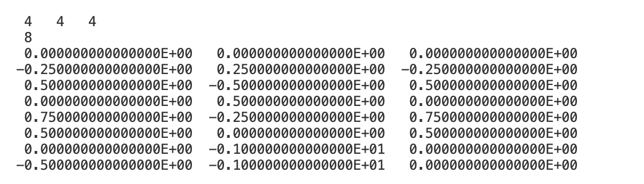
Exercise 3: Phonons dispersion in non-polar materials
4x4x4 = 64 q-points => Use of symmetry => 8 non-equivalent q points
The file Si.dyn0 contains a list of the non-equivalent q points (8, in this case).
The phonon code ph.x generates a file for every non-equivalent q point (Si.dyn1,
Si.dyn2, ..., Si.dyn8), which contain information about dynamical matrices,
phonon frequencies and atomic displacements

Slide 28

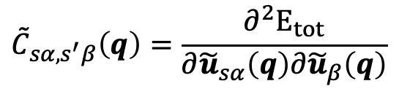

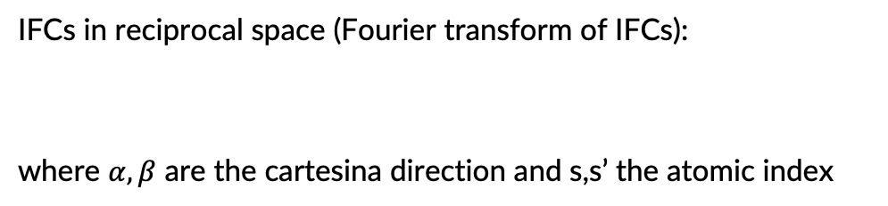
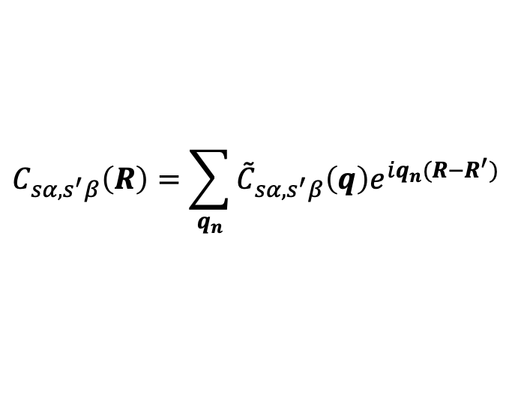
Exercise 3: Phonons dispersion in non-polar materials
Step 3: Calculation of the Interatomic Force Constants (IFC) using
the q2r.x program
IFCs in reciprocal space (Fourier transform of IFCs):
where $α,β$ are the cartesina direction and s,s’ the atomic index
$${\tilde{C}}_{sα,s^{′}β}\left(q\right)=\frac{∂^{2}E_{tot}}{∂{\tilde{u}}_{sα}\left(q\right)∂{\tilde{u}}_{β}\left(q\right)}$$
$$C_{sα,s^{′}β}\left(R\right)=\sum_{q_{n}}{{\tilde{C}}_{sα,s^{′}β}\left(q\right)e^{iq_{n}(R−R^{′})}}$$
$${\tilde{C}}_{sα,s^{′}β}\left(q\right)$$
$$C_{sα,s^{′}β}\left(R\right)$$
Fourier transforms of IFCs on a grid of q points nq1 x nq2 x nq3 in reciprocal space
IFCs in a supercell nq1 x nq2 x nq3 in real space

Slide 29
Exercise 3: Phonons dispersion in non-polar materials
Step 3: Calculation of the Interatomic Force Constants (IFC) using
the q2r.x program
mpirun –np 4 q2r.x –in Si.q2r.in > Si.q2r.out
&input
fildyn = 'Si.dyn',
zasr = 'simple',
flfrc = 'Si444.fc',
/
File containing the dynamical matrix
A way to impose the acoustic sum rule (simple, crystal, one-dim, zero-dim, all)
Output file of the interatomic force constants
Note: The denser the grid of q points, the larger the vectors R for which the IFCs are calculated.

Slide 30
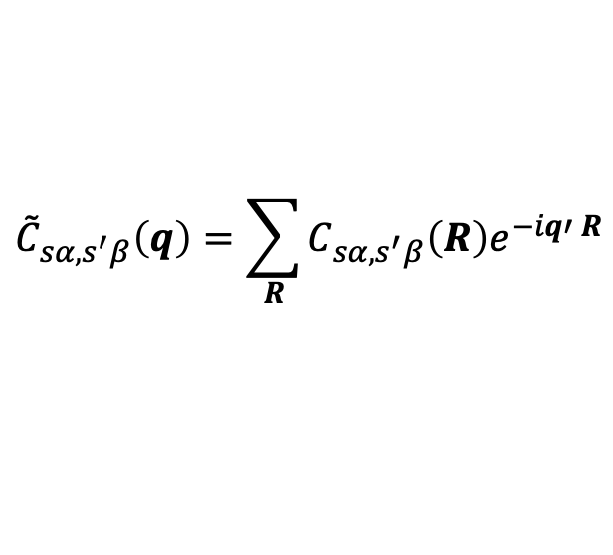


Exercise 3: Phonons dispersion in non-polar materials
Step 4: Calculate phonons at generic q' points using IFC using the matdyn.x code
$${\tilde{C}}_{sα,s^{′}β}\left(q\right)=\sum_{R}{C_{sα,s^{′}β}\left(R\right)e^{−iq′ R}}$$
$$C_{sα,s^{′}β}\left(R\right)$$
$${\tilde{C}}_{sα,s^{′}β}\left(q′\right)$$
Fourier interpolation
IFC's on a grid in real space
Fourier transforms of IFC's at
generic q' points in reciprocal space
&input
asr = 'simple',
amass(1) = 28.0855,
flfrc = 'Si444.fc',
flfrq = 'Si.freq'
/
396
0.000000 0.000000 0.000000 0.000000
0.012658 0.000000 0.000000 0.012658…
mpirun –np 4 matdyn.x –in Si.matdyn.in > Si.matdyn.out
File containing the the interatomic force constants from q2r.x
Output file with the interpolated frequencies
Number of q points
Coordinates of the q points

Slide 31
Exercise 3: Phonons dispersion in non-polar materials
Step 5: Plot the phonon dispersion using the plotband.x program and gnuplot.
plotband.x < Si.plotband.in > Si.plotband.out
Si.freq
0 600
freq.plot
freq.ps
0.0
100.0 0.0
Input file with the frequencies at various q' points
Range of frequencies for a visualization
Output file with frequencies which will be used for plot
Plot of the dispersion (we will produce another one)
Fermi level (needed only for band structure plot)
Freq. step and reference freq. on the plot freq.ps
Use gnuplot and the file plot_dispersion.gp in order to plot the phonon dispersion of silicon
(look at the file experimental_data.dat for the experimental reference).
You will get a postscript file phonon_dispersion.eps which you can visualize.

Slide 32
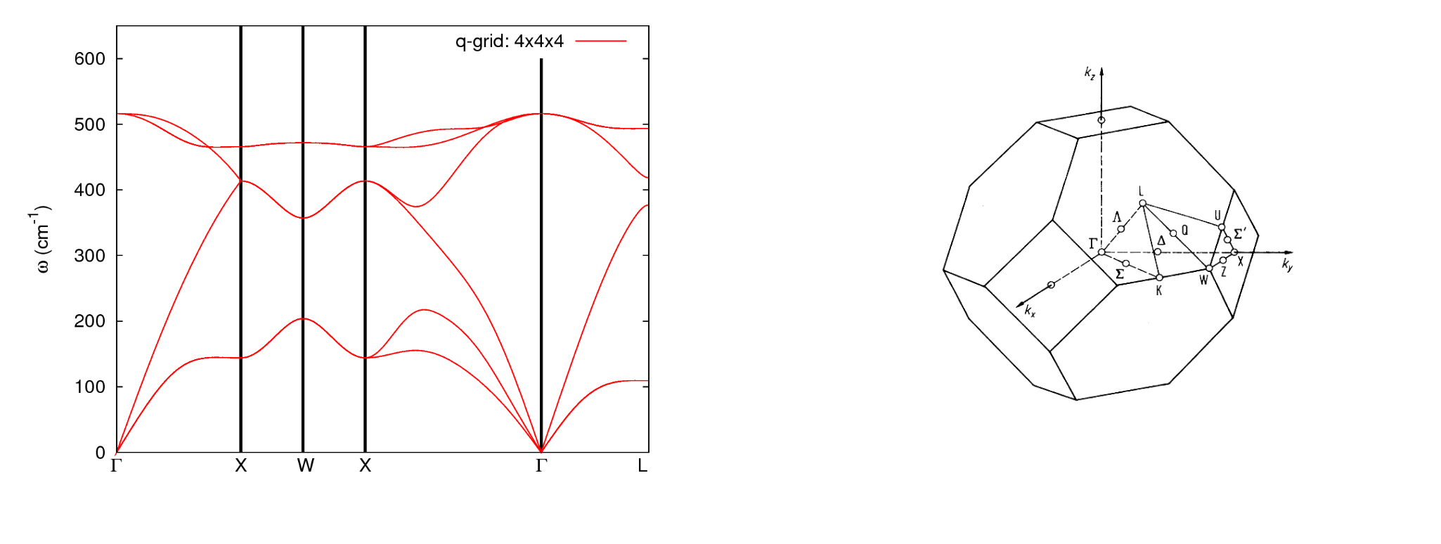
Exercise 3: Phonons dispersion in non-polar materials
Phonon dispersion of silicon along some high-symmetry directions in the Brillouin zone
(file phonon_dispersion.eps).

Slide 33
Exercise 3: Phonons dispersion in non-polar materials
How to determine whether the quality of the Fourier interpolation is satisfactory?
Compare with the direct calculation (no interpolation)!
Homework-1: Perform a direct phonon calculation (no interpolation) at several q'
points and make a comparison with the phonon frequencies obtained from the
interpolation. (Use exercise2 as an example).
Some q' points along the Gamma-X high symmetry line are listed in the file reference/q_points_direct_calc.txt
Homework-2: Perform a phonon dispersion calculation for several q-points grids
(eg. 2x2x2, 4x4x4, and 6x6x6) and compare the dispersions. Do they converge?

Slide 34
Exercise 3: Phonons dispersion in non-polar materials
The phonon modes are not always easy to visualize, especially if we are not at Γ.
An online phonon visualizer is very helpful in this regard.
https://interactivephonon.materialscloud.io
Let’s click on the link and look at your phonons.

Slide 35
Exercise 4: Phonons at Gamma in polar materials

Slide 36
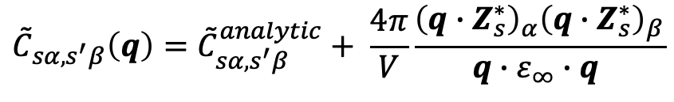
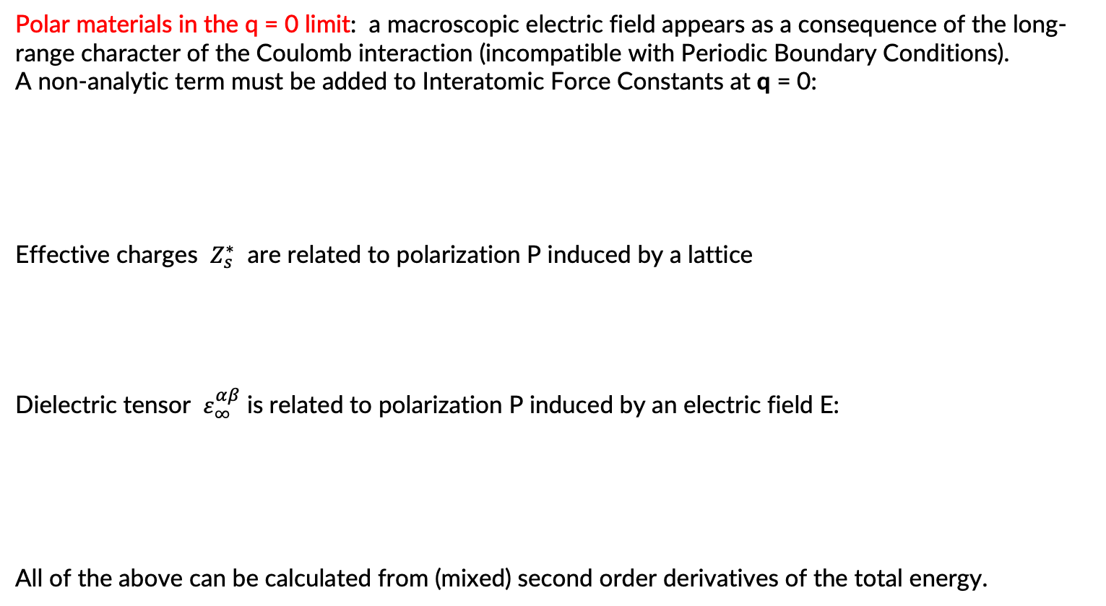
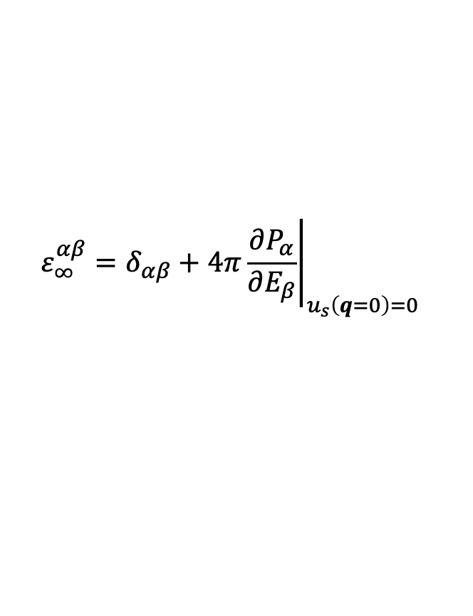

Phonons in polar materials
Polar materials in the q = 0 limit: a macroscopic electric field appears as a consequence of the long-range character of the Coulomb interaction (incompatible with Periodic Boundary Conditions).
A non-analytic term must be added to Interatomic Force Constants at q = 0:
Effective charges $Z_{s}^{∗}$ are related to polarization P induced by a lattice
Dielectric tensor $ε_{∞}^{αβ}$ is related to polarization P induced by an electric field E:
All of the above can be calculated from (mixed) second order derivatives of the total energy.
$${\tilde{C}}_{sα,s^{′}β}\left(q\right)={\tilde{C}}_{sα,s^{′}β}^{analytic}+ \frac{4π}{V}\frac{{\left(q∙Z_{s}^{∗}\right)}_{α}{\left(q∙Z_{s}^{∗}\right)}_{β}}{q∙ε_{∞}∙q }$$
$$Z_{s,αβ}^{∗}=V\frac{∂P_{α}}{∂u_{s}^{β}}$$
$$ε_{∞}^{αβ}=δ_{αβ}+4π{\left.\frac{∂P_{α}}{∂E_{β}}\right|}_{u_{s}\left(q=0\right)=0}$$

Slide 37
Exercise 4: Phonons at Gamma in polar materials
Go to the directory with the input files:
cd ~/ASESMA2025/Day4/example4.phonon.Gamma.AlAs/
In this directory you will find:
README.md – File describing how to do the exercise
AlAs.scf.in – Input file for the SCF ground-state calculation
AlAs.ph.in – Input file for the phonon calculation at Γ
AlAs.dynmat.in – Input file for Fourier Interpolation for various q points
reference – Directory with the reference results

Slide 38
Exercise 4: Phonons at Gamma in polar materials
Step 1: Perform a Self-Consistent Field ground-state calculation for AsAl at the equilibrium structure using the pw.x program.
mpirun –np 4 pw.x –in AlAs.scf.in > AlAs.scf.out
Phonons at Gamma
&inputph
prefix = 'AlAs',
tr2_ph = 1.0d-14,
amass(1) = 26.98,
amass(2) = 74.92,
epsil = .true.
outdir = './tmp'
fildyn = 'AlAs.dyn',
/
0.0 0.0 0.0
Step 2: Perform a phonon calculation in Gamma using ph.x.
mpirun –np 4 ph.x –in AlAs.ph.in > AlAs.ph.out

Slide 39
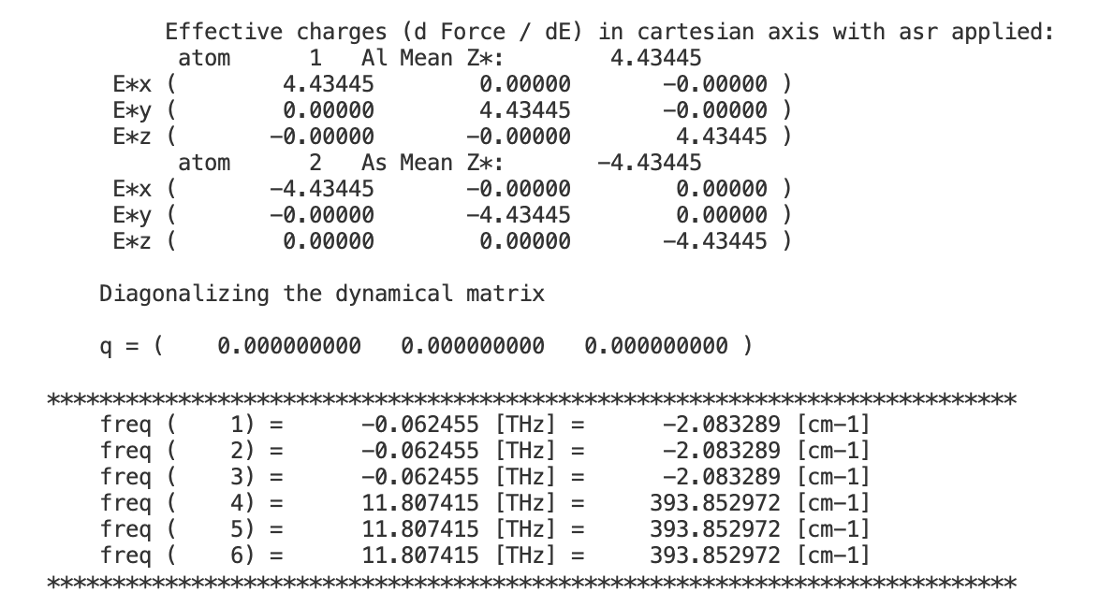

Exercise 4: Phonons at Gamma in polar materials
In the file ph.AlAs.out you will find information about the dielectric tensor
and effective charges (BECs)
$$Z_{s,αβ}^{∗}=\frac{V}{e}\frac{∂P_{α}}{∂u_{s,β}(q=0)}= \frac{1}{e}\frac{∂F_{sβ}}{∂ℇ_{α}(q=0)}$$
No LO-TO splitting

Slide 40
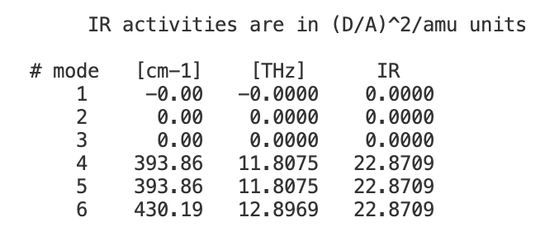
Exercise 4: Phonons at Gamma in polar materials
Step 3: Impose Acoustic Sum Rule and add the non analytic LO-TO splitting using the dynmat.x program
mpirun –np 4 dynmat.x –in AlAs.dynmat.in > AlAs.dynmat.out
&input
fildyn = 'AlAs.dyn',
asr='simple',
amass(1)=26.98,
amass(2)=74.92
q(1) = 1.0,
q(2) = 0.0,
q(3) = 0.0
/
LO-TO splitting
Direction in the Brillouin zone along which we want to compute the LO-TO splitting

Slide 41
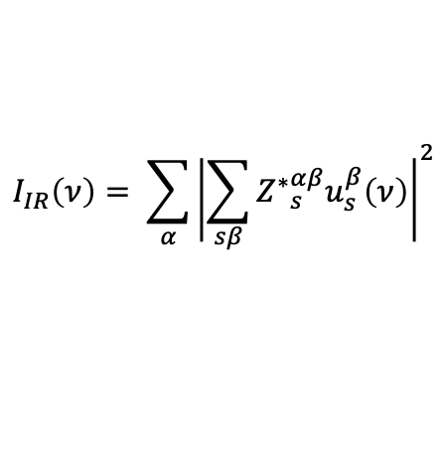
Exercise 4: Phonons at Gamma in polar materials
Step 3: Impose Acoustic Sum Rule and add the non analytic LO-TO splitting using the dynmat.x program
mpirun –np 4 dynmat.x –in AlAs.dynmat.in > AlAs.dynmat.out
&input
fildyn = 'AlAs.dyn',
asr='simple',
amass(1)=26.98,
amass(2)=74.92
q(1) = 1.0,
q(2) = 0.0,
q(3) = 0.0
/
$$I_{IR}\left(ν\right)= \sum_{α}{{\left|\sum_{sβ}{{Z^{∗}}_{s}^{αβ}u_{s}^{β}\left(ν\right)}\right|}^{2}}$$
IR intensities
can be calculated directly from effective charges and phonon displacement patterns

Slide 42
Exercise 5 (Optional): Phonons dispersion in polar materials

Slide 43
Exercise 5: Phonons dispersion in polar materials
Go to the directory with the input files:
cd ~/ASESMA2025/Day4/example5.phonon.dispersion.AlAs/
In this directory you will find:
README.md – File describing how to do the exercise
AlAs.scf.in – Input file for the SCF ground-state calculation
AlAs.ph.in – Input file for the phonon calculation at Γ
AlAs.q2r.in – Input file for calculation of Interatomic Force Constants
AlAs.matdyn.in – Input file for Fourier Interpolation for various q points
AlAs.plotband.in – Input file for plotting a phonon dispersion
reference – Directory with the reference results

Slide 44
Exercise 5: Phonons dispersion in polar materials
Step 1: Perform a Self-Consistent Field ground-state calculation at the equilibrium structure using the pw.x program.
mpirun –np 4 pw.x –in AlAs.scf.in > Si.scf.out
Step 2: Perform a phonon calculation on a uniform grid of q points the ph.x program.
mpirun –np 4 ph.x –in AlAs.ph.in > AlAs.ph.out
Step 3: Calculation of the Interatomic Force Constants (IFC) using the q2r.x program
mpirun –np 4 q2r.x –in AlAs.q2r.in > AlAs.q2r.out
Step 4: Calculate phonons at generic q' points using IFC using the matdyn.x code
mpirun –np 4 matdyn.x –in AlAs.matdyn.in > AlAs.matdyn.out
Step 5: Plot the phonon dispersion using the plotband.x program and gnuplot.
plotband.x < AlAs.plotband.in > AlAs.plotband.out
(Note: some parts of the input files are left empty for you to fill !

Slide 45
Exercise 6 (Optional): Phonon dispersion with negative phonons

Slide 46
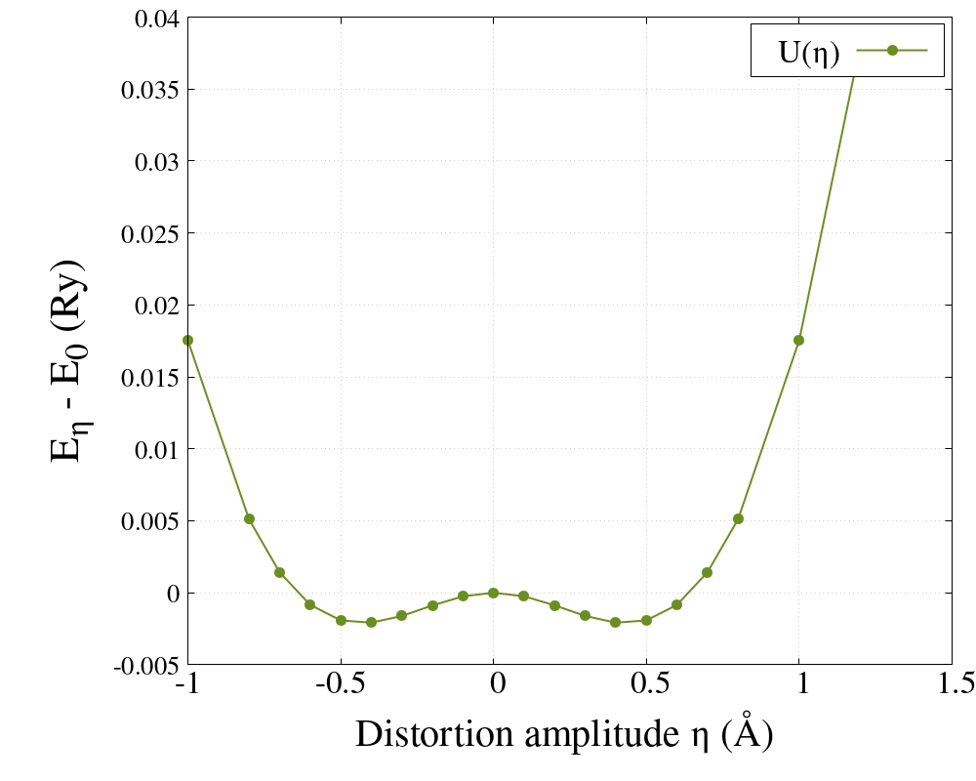

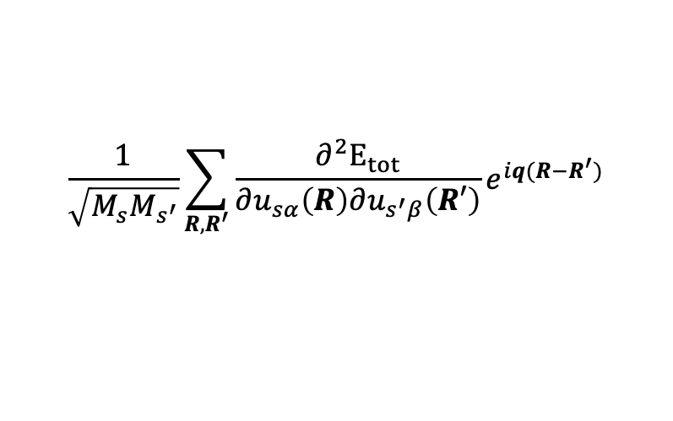
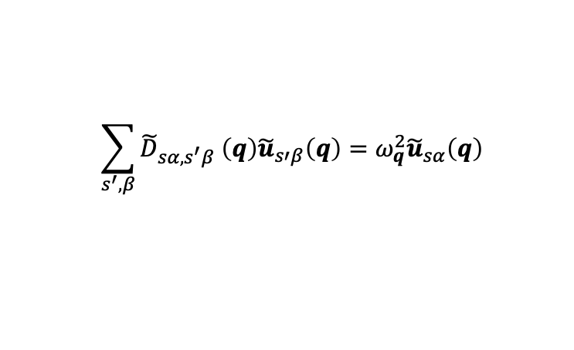

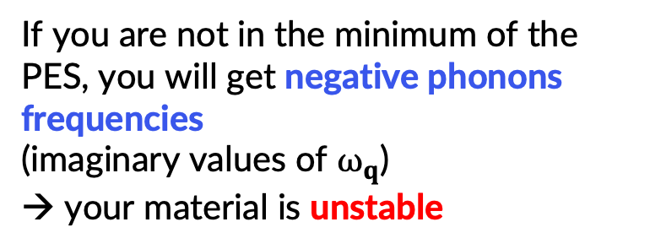
Exercise 6 : Negative phonons
Phonons are the solution of the secular equation:
$$\sum_{s^{′}, β}{{\tilde{D}}_{sα,s^{′}β} \left(q\right){\tilde{u}}_{s′β}\left(q\right)=ω_{q}^{2}{\tilde{u}}_{sα}\left(q\right)}$$
$${\tilde{D}}_{sα,s^{′}β}\left(q\right)=$$
$$\frac{1}{\sqrt{M_{s}M_{s^{′}}}}\sum_{R,R^{′}}{\frac{∂^{2}E_{tot}}{∂u_{sα}\left(R\right)∂u_{s^{′}β}\left(R′\right)}e^{iq(R−R^{′})}}$$
If you are not in the minimum of the PES, you will get negative phonons frequencies
(imaginary values of $ω_{q}$)
→ your material is unstable
$$(where η is :ηu_{k}=ηε_{k}e^{iqR_{l}})$$

Slide 47
Exercise 6: Negative phonons
Go to the directory with the input files:
cd ~/ASESMA2025/Day4/example6.negative.phonon/
In this directory you will find:
README.md – File describing how to do the exercise
Si.scf.in – Input file for the SCF ground-state calculation
Si.ph.in – Input file for the phonon calculation at Γ
Si.q2r.in – Input file for calculation of Interatomic Force Constants
Si.matdyn.in – Input file for Fourier Interpolation for various q points
Si.plotband.in – Input file for plotting a phonon dispersion
reference – Directory with the reference results

Slide 48
Exercise 6: Negative phonons
Step 1: Perform a Self-Consistent Field ground-state calculation at the equilibrium structure using the pw.x program.
mpirun –np 4 pw.x –in Si.scf.in > Si.scf.out
Step 2: Perform a phonon calculation on a uniform grid of q points the ph.x program (here we use 2x2x2).
mpirun –np 4 ph.x –in Si.ph.in > Si.ph.out
Step 3: Calculation of the Interatomic Force Constants (IFC) using the q2r.x program
mpirun –np 4 q2r.x –in Si.q2r.in > Si.q2r.out
Step 4: Calculate phonons at generic q' points using IFC using the matdyn.x code
mpirun –np 4 matdyn.x –in Si.matdyn.in > Si.matdyn.out
Step 5: Plot the phonon dispersion using the plotband.x program and gnuplot.
plotband.x < Si.plotband.in > Si.plotband.out

Slide 49
Exercise 6: Negative phonons
Look at the results of the phonon dispersion: can you explain what you see? What is the difference with the band dispersion in exercise3?

Slide 50
Thank you!
Questions?

