Slide 1

Day 3 Hands on:
Tutors: Alberto Carta/ Chiara Cignarella / Omamuyovwi Rita Jolayemi / Nelson Dzade / George Manyali / James Sifuna / Fatema Mohamed / Maram Ali Ahmed Musa
Brief description of the tutorials:
1) Band structure calculation for Silicon and Aluminium
2)
3)

Slide 2
Exercise 1 : Band structure
How to calculate the band structure, example for Silicon and Aluminum

Slide 3
Topics of the session
1. Band structure calcualtion of Si and Al
Silicon
Aluminium
2.
3.

Slide 4
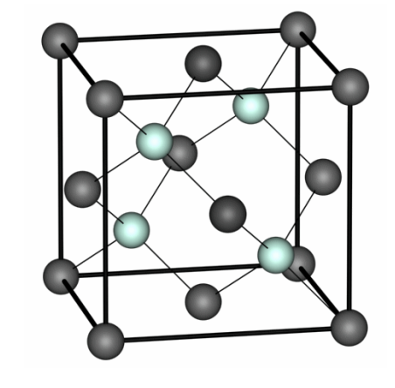
1. Exercise 1: Silicon
&CONTROL
calculation = 'scf’,
…
/
&SYSTEM
ibrav = 2,
celldm(1) = 10.2,
nat = 2,
ntyp = 1,
ecutwfc = 20,
/
&ELECTRONS
/
ATOMIC_SPECIES
Si 28.086 Si.pbe-rrkj.UPF
ATOMIC_POSITIONS
Si 0.00. 0.00. 0.00
Si 0.25. 0.25 0.25
K_POINTS automatic
6 6 6 0 0 0
To compute the band structure of Silicon, go to folder:
ASESMA2025/Day3/example1.bandstructure/ex1.Si

Slide 5
1. Exercise 1: Band structure of Silicon
The scheme to compute the bands is the following:
Perform the SCF Calculation: Use pw.x to calculate the density (calculation = ’scf’)
pw.x –in si.scf.in > si.scf.out
Perform a bands- type NSCF Calculation: Use pw.x to with:
calculation = ’bands’
number of bands (variable nbnd) to be computed (if nothing is specified, the default is used)
a suitable path of k-points in specified K-POINTS card. The k-point path must be continuos in k-space.
Calculate Bands datafile: Use bands.x, which, among others, produces data-files for the plot.
Plot the bands: Use gnuplot to plot the band structures store in the file bands.dat.gnu.
Important: we must keep the prefix same outdir and prefix for “nscf” and “scf” pw.x and for the bands.x calculations!

Slide 6
1. Exercise 1: Silicon
Perform a bands- type NSCF Calculation: : Use pw.x to with calculation= ‘bands’
pw.x –in si.bands.in> si.bands.out
&CONTROL
calculation='bands'
prefix = 'Si',
pseudo_dir = '../../pseudo'
outdir='./tmp'
/
&SYSTEM
ibrav = 2,
celldm(1) = 10.262,
nat = 2,
ntyp = 1,
ecutwfc = 12.0,
ecutrho = 200.0,
nbnd = 10
/
&ELECTRONS
/
……
…
ATOMIC_SPECIES
Si 28.086 Si.pbe-rrkj.UPF …
ATOMIC_POSITIONS alat
Si 0.00 0.00 0.00
Si 0.25 0.25 0.25
K_POINTS {crystal_b}
6
0.50 0.25 0.75 30 !W
0.00 0.00 0.00 30 !G
0.50 0.00 0.50 30 !X
0.50 0.25 0.75 30 !W
0.50 0.50 0.50 30 !L
0.00 0.00 0.00 30 !G
Input file for band calculation looks like this:

Slide 7
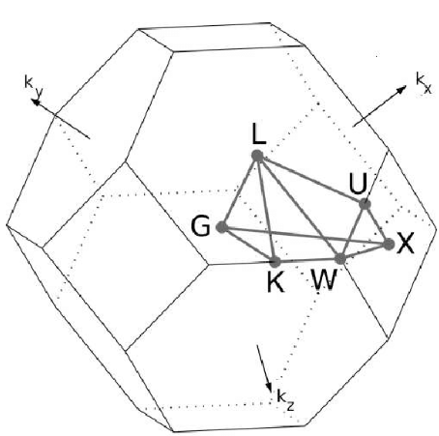
1. Exercise 1: Band structure of Silicon
How to specify the k-path for band structure calculation:
Use the k-path selection tool of xcrysden:
1. Open the file si.scf.in with xcrysden;
2. Select: Tools → k-path selection ;
3. Select the path by clicking on a sequence of
high-symmetry points: W – Γ – X – W – L – Γ ;
4. Specify how many k points to be calculated (Ex: 100)
5. Save the k-path to file. (.pwscf extension is required for formatting the file for pw.x).
Insert manually, or use the Seek- Path tool online:
https://www.materialscloud.org/work/tools/seekpath

Slide 8
1. Exercise 1: Silicon
Calculate Bands datafile: Use bands.x, which, among others, produces data-files for the plot.
bands.x –in bands.in> bands.out
An input file for the data post processing program bands.x:
&BANDS
outdir = ’./tmp’,
prefix=’Si’,
filband=’bands.dat’,
/
This program print the eigenvalues to the file specified in ”filband” .
Bands data are stored in three files with different formats, among which we have bands.dat.gnu (can be plotted with gnuplot) and bands.dat can be visualized using the program plotband.x.

Slide 9
1. Exercise 1: Silicon
Plot with gnuplot: run gnuplot plot_bands.gp
The program plotband.x can be useful to obtain a postscript file of the band structure and a set of data files that can be plotted with xmgr. → type plotband.x on the terminal, which prompts the terminal input:
Input file > bands.dat Reading 10 bands at 151 k-points Range: -5.8760 17.7160eV Emin, Emax, [firstk, lastk] > -5.8760 17.7160 high-symmetry point: -1.0000 0.5000 0.0000 x coordinate 0.0000 high-symmetry point: 0.0000 0.0000 0.0000 x coordinate 1.1180 high-symmetry point: -1.0000 0.0000 0.0000 x coordinate 2.1180 high-symmetry point: -1.0000 0.5000 0.0000 x coordinate 2.6180 high-symmetry point: -0.5000 0.5000 0.5000 x coordinate 3.3251 high-symmetry point: 0.0000 0.0000 0.0000 x coordinate 4.1912 output file (gnuplot/xmgr) > si.bands.dat bands in gnuplot/xmgr format written to file si.bands.dat output file (ps) > bands.ps Efermi > 6.0653 deltaE, reference E (for tics) 2, 6.0653 bands in PostScript format written to file bands.ps

Slide 10
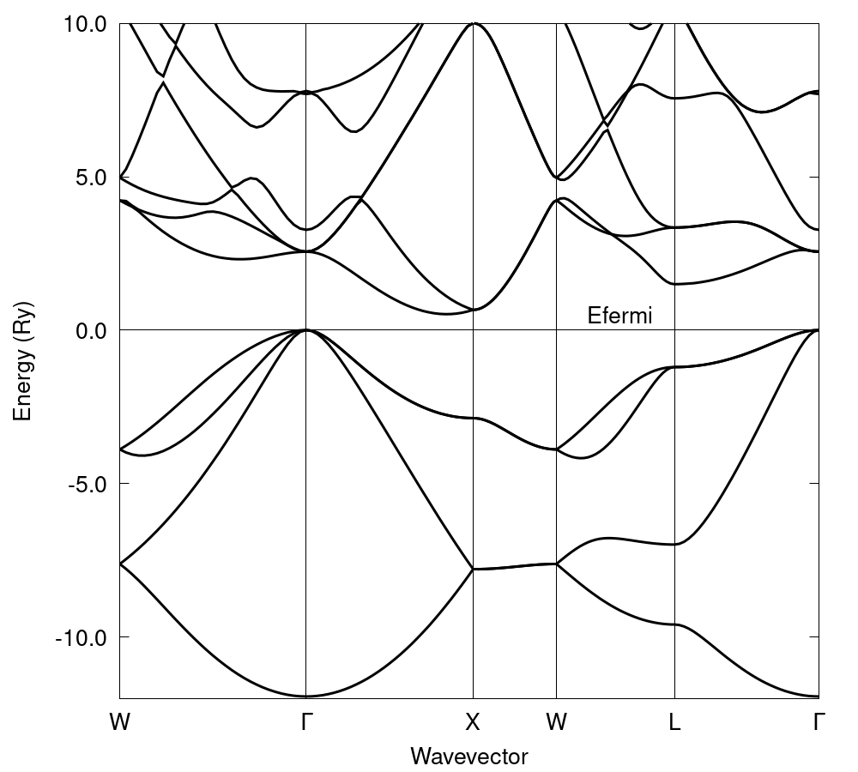
1. Exercise 1: Silicon
Optional homework: can you calculate the DOS of Silicon?

Slide 11
1. Exercise 2: Aluminum
To compute the band structure of Silicon, go to folder:
ASESMA2025/Day3/example1.bandstructure/ex2.Al
and use the same procedure for silicon:
Self-consistent calculation (pw.x)
Select a k-point path (i.e. by using XCrysDen, ... ) and do “bands”-type non-SCF pw.x calculation
Run a bands.x calculation
Plot the results using gnuplot, or run plotband.x
Optional homework: converge the ecut_wfc and k-points for Aluminium, as done in Day2 (you find the scripts in folder ex2.Al/convergence_test)

Slide 12
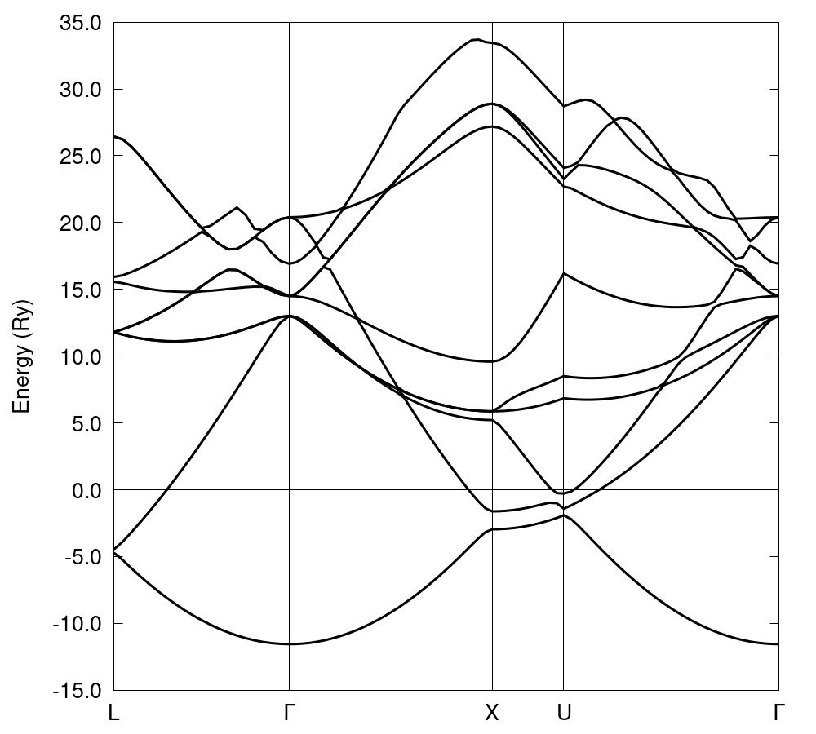
1. Exercise 2: Aluminum

Slide 13
Thank you!
Questions?

