Slide 1
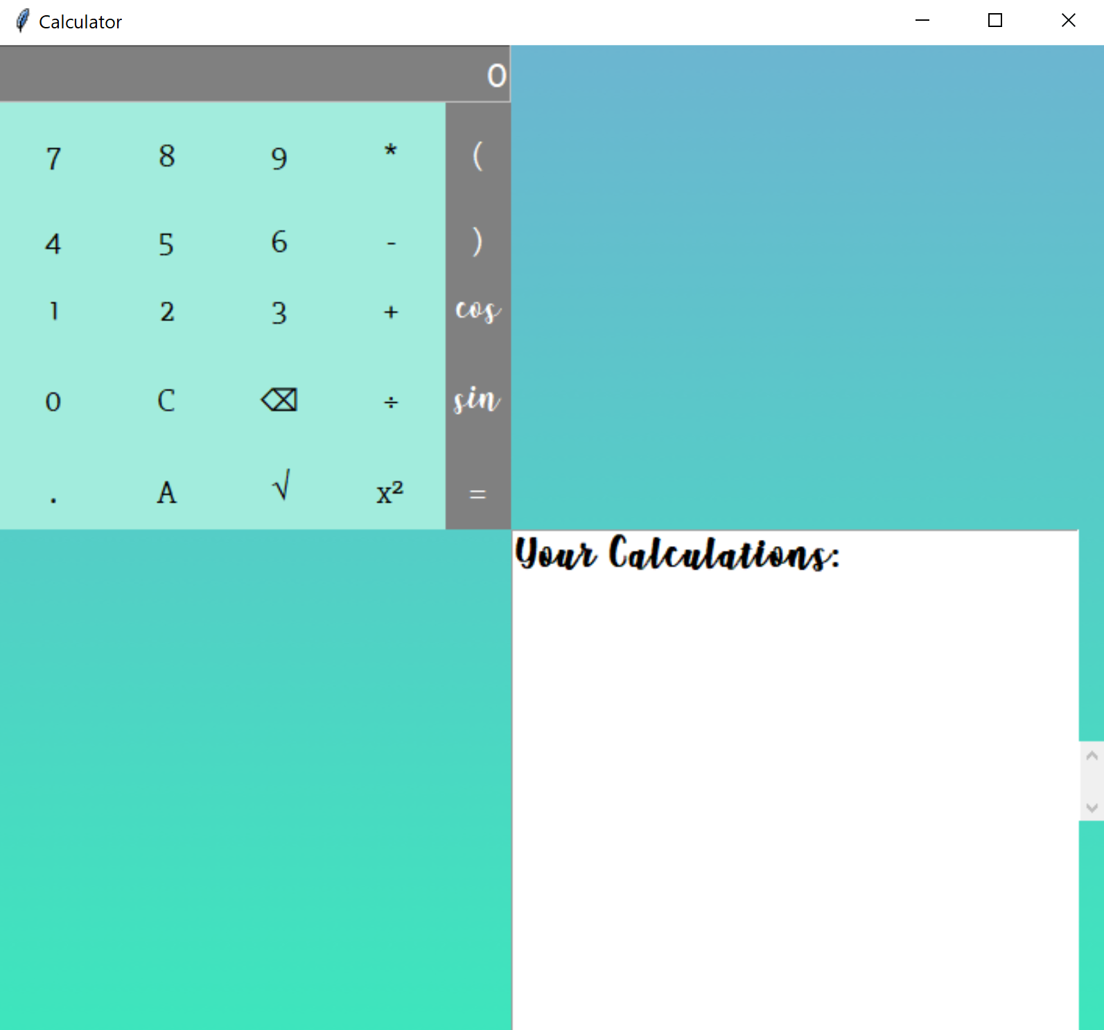
GUI Calculator with Tkinter
By: Avneet Sethi

Slide 2
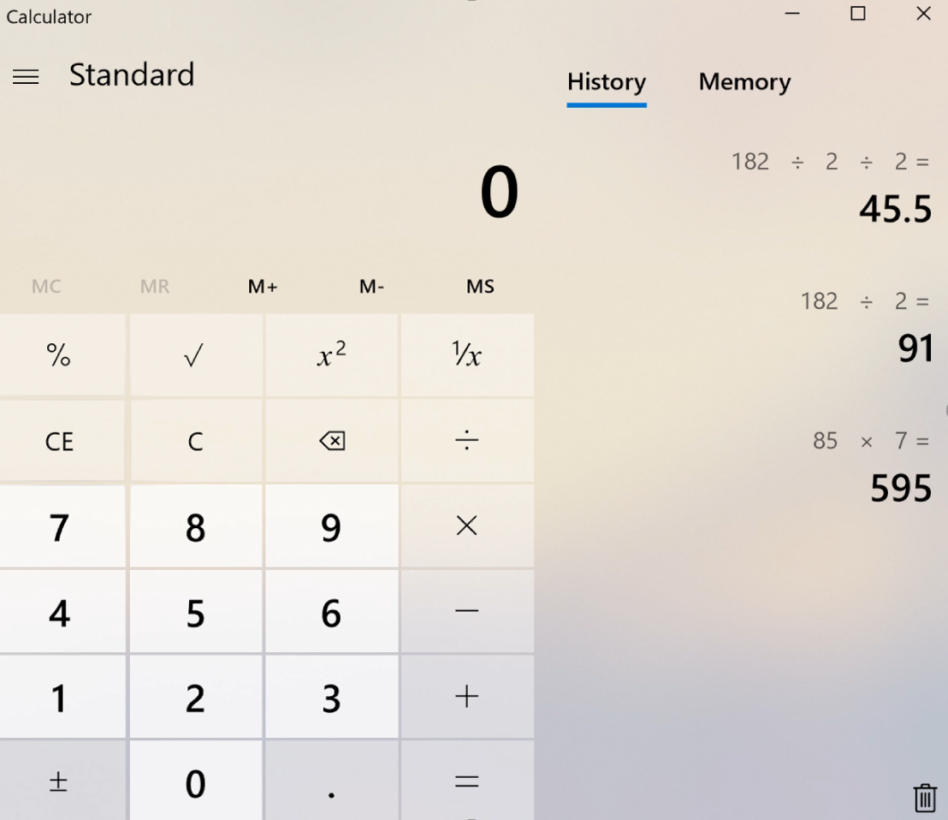

Desired Output
Perform operations, including:
+, -, x, /
C (Clear)
Back
$\sqrt{}, x^{2},$sin(x), cos(x)
+/- (Positive/Negative)
Store results of previous operations into the History tab (stack)
Clear results in the History tab
x
Windows 10 Calculator

Slide 3
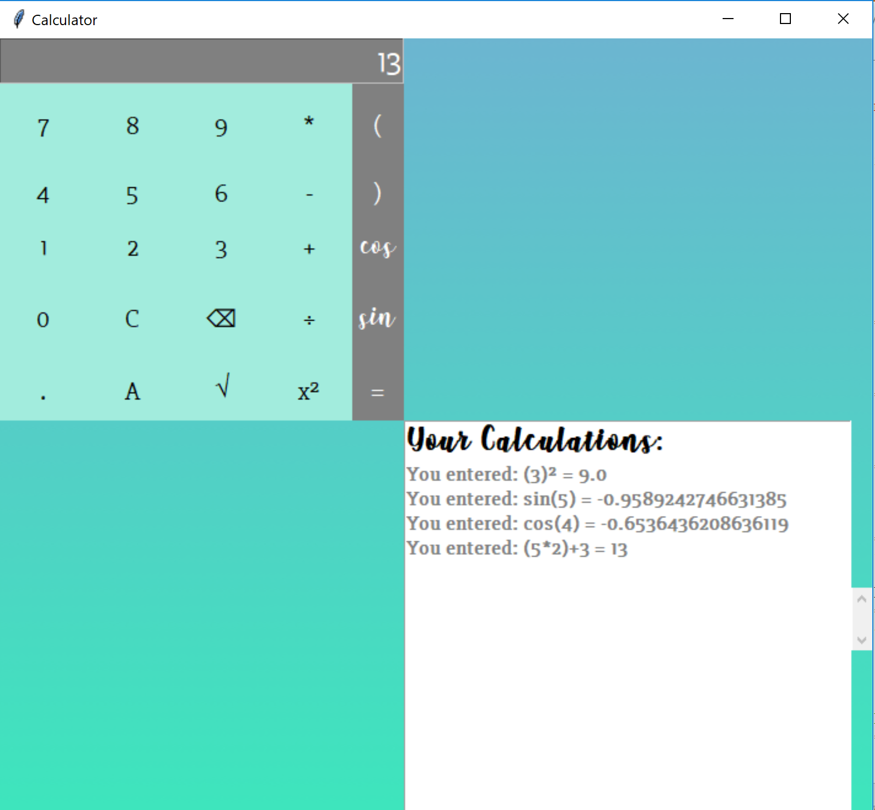

Result
Perform operations, including:
+, -, x, /
C (Clear)
Back
$\sqrt{}, x^{2},$sin(x), cos(x)
+/- (Positive/Negative)
Evaluate expressions using parentheses
Retrieve last result with ‘A’ / answer button
Store results of previous operations into the textbox
x

Slide 4
Implementation
Created a text entry field for the calculator
Used a grid layout for the buttons with the Tkinter Library
Made the buttons functional to perform operations and display the result in the text view
Imported Math Module for sqrt, squared, cos, and sin functions
Used eval() to evaluate the expressions
Created a textbox with scrollbar to display the result of previous computations

Slide 5
Implementation
Steps:
Convert operand to a string and add it to the 'expression' string buttonclick()
Set the input text in the text entry field to the 'expression' string
Perform calculation when = is pressed buttonequals()
Parse the expression to int and evaluate using eval(). Then, convert result to string and store in 'evaluated’
Execute corresponding methods for sin(), cos(), squared(), sqrt(), backspace(), clear()
Display result in the textbox

Slide 6
Live Demo

