Slide 1

Relay
Emanon - CEN4010 Group 10
Maxon Corvil, Ashley Davis, Patrick Messina, Michael Niebauer, Andrew Sexton

Slide 2
Available at:
https://lamp.cse.fau.edu/~cen4010_fa21_g10/relay/

Slide 3
Roles & Contributions
Andrew Sexton (team lead )
Managed the group Github repository and Jira workspace.
Led team meetings
Guided the project’s direction
assisted with some of the back and front-end development, including implementing the chatroom feature.
Patrick Messina (Front-end developer)
helped with testing the site
Wrote and implemented test plans.

Slide 4
Roles & Contributions
Maxon Corvil (Front-end Lead)
Did the HTML and Css design for a majority of the site.
Made most of the Balsamiq mockups
Although we could not implement it on the LAMP server, he did make a working Email verification / 2FA system as well.
Ashley Davis (Back-end Developer)
Implemented the image and picture uploading feature of our site.
Implemented the search feature
helped with testing and bug fixes for the other features of the site.

Slide 5
Roles & Contributions (Cont.)
Michael Niebauer - Back-end Lead.
Created our initial prototype which laid the foundation for the Create Account, Login, Feeds, Create Post, and Friends features.
Did most of the php including database connections
Helped develop functions into their final state.

Slide 6
Product Summary
Purpose
Relay is intended to be a social media site that is able to provide stronger and more personal connections between its users than other competing social media sites. Relay’s purpose is to make users feel more connected to each other through real time conversations.
Motivation
Our primary motivation with relay was to create a product that is different from the current mainstream social media websites. We also valued the idea of people talking to one another directly and with the ongoing pandemic we thought that a live chat implementation would be different and valuable for people during and after the pandemic. Overall, This project was created in response to the limitations that social distancing has imposed upon connecting with friends and family.

Slide 7
Product Summary
Functionalities
With the purpose and motivation of relay being to maintain communication during social distancing, the main function of relay is to provide users with an alternative to live in person conversations with the convenience of finding it in a social media application. The best part about relay is that conversation is optional and the wait for responses are minimal.
Target Audience
The target audience for relay is any individual who would like to supplement the lack of live fast paste interaction caused by the pandemic. When it comes to post pandemic life, relay also would provide users an outlet to share their lives and perspective through post while continuing to allow users to stay connected.

Slide 8
System Implementation
Frontend HTML, CSS, JavaScript
Backend
PHP
.
LAMP
MySQL
LAMP
Bootstrap

Slide 9
Non-Functional Requirements
Performance
Supports up to 30 concurrent users
Response time at expected load of 5-10 users: 50 ms max
Response time at maximum capacity of 30 users: 500 ms max
Usability
Ease of use
System is compatible on browsers: Google Chrome, Mozilla Firefox, Safari, and Internet Explorer
Best experienced through desktop

Slide 10
Non-Functional Requirements
Privacy and Security
Accounts require a username, email and characteristics of a strong password to create an account and log in to for future use
Only creators of the site have access to the secure database
Storage
System is stored on the group’s LAMP server at lamp.cse.fau.edu
Backup files are stored in the group’s GitHub repository
System has plenty of storage available to leave room for any bug fixing

Slide 11
Non-Functional Requirements
Availability
System is available whenever the LAMP server is available, minus any downtime
Testing
Exception handling embedded in program to ensure the system does not break if an error occurs
System will output the reason for the error and either ask the user to enter another input or redirect the user to another page

Slide 12
Features
Create an account
Create, view, and interact with posts
Chat with friends in live chat rooms
See who’s online
Add friends and adjust level of friendship
Search for users and posts
Manage content privacy
View profiles

Slide 13
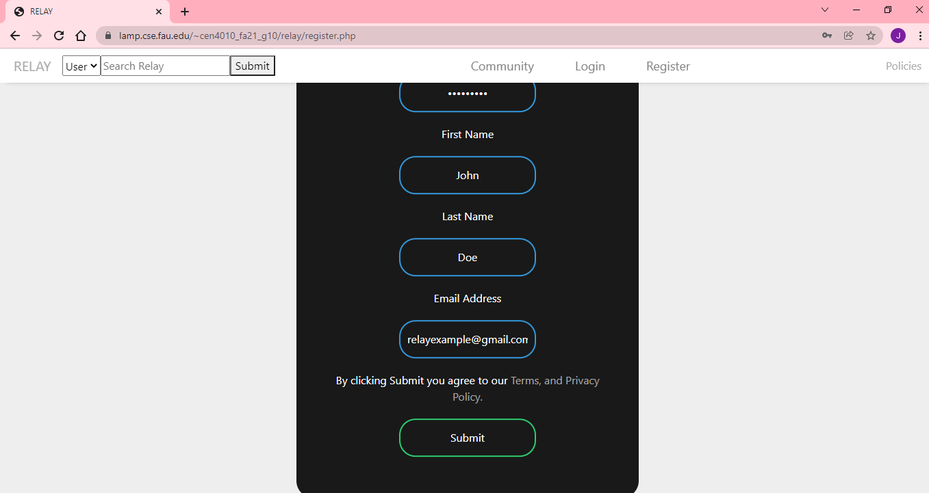
Register
Registration requires username, double-entry password, first name, last name, and email address
Password must be 8 characters in length and contain at least one of each of the following: -Uppercase letter -Lowercase letter -Number

Slide 14
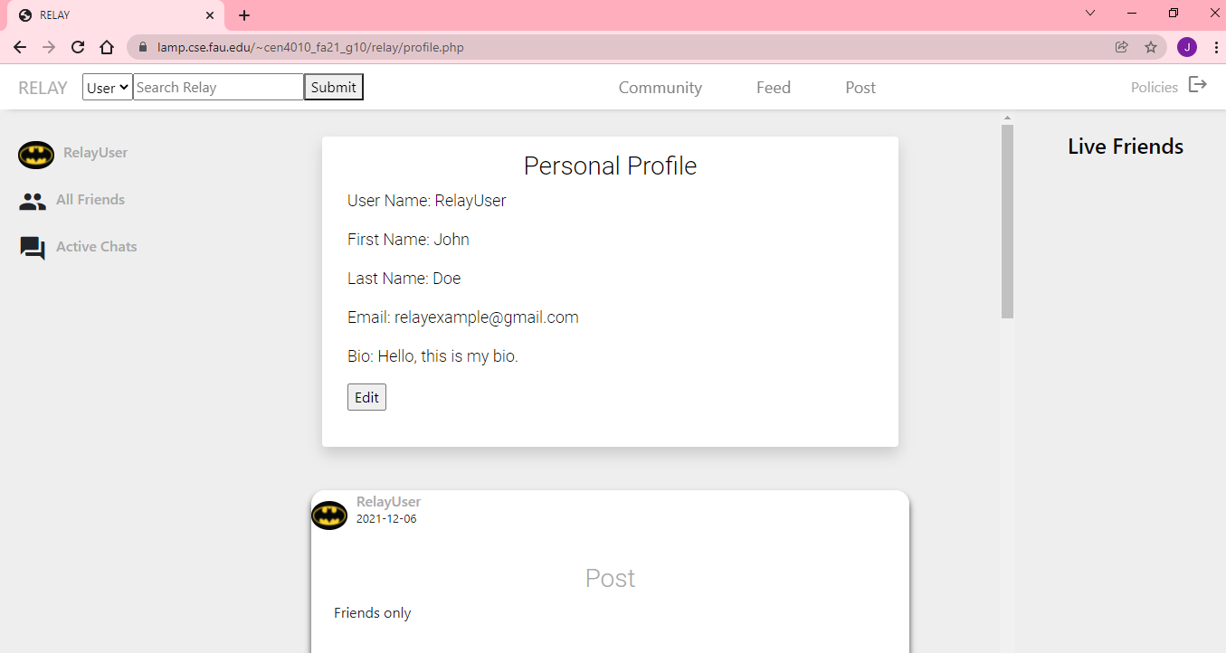
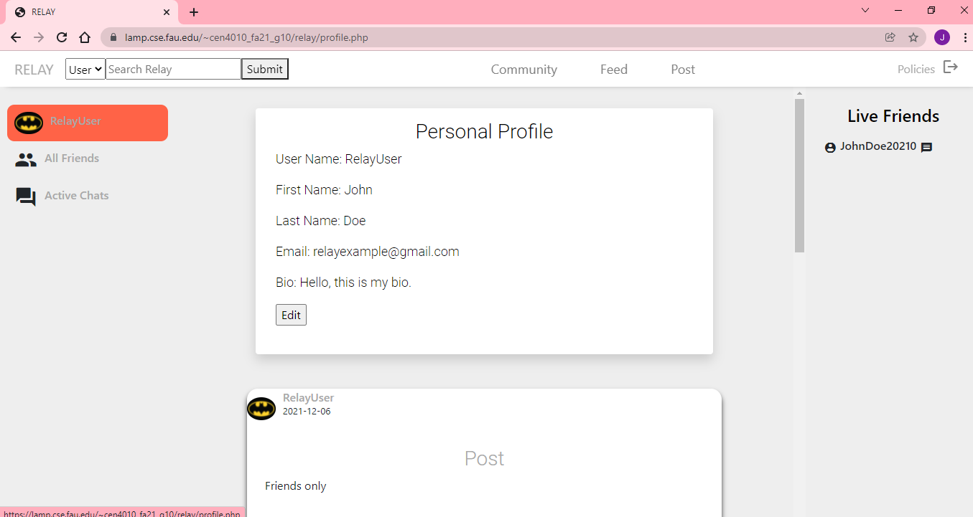
Profile
User can view their profile by clicking on their username
Edit bio
View other profiles by clicking on their username

Slide 15
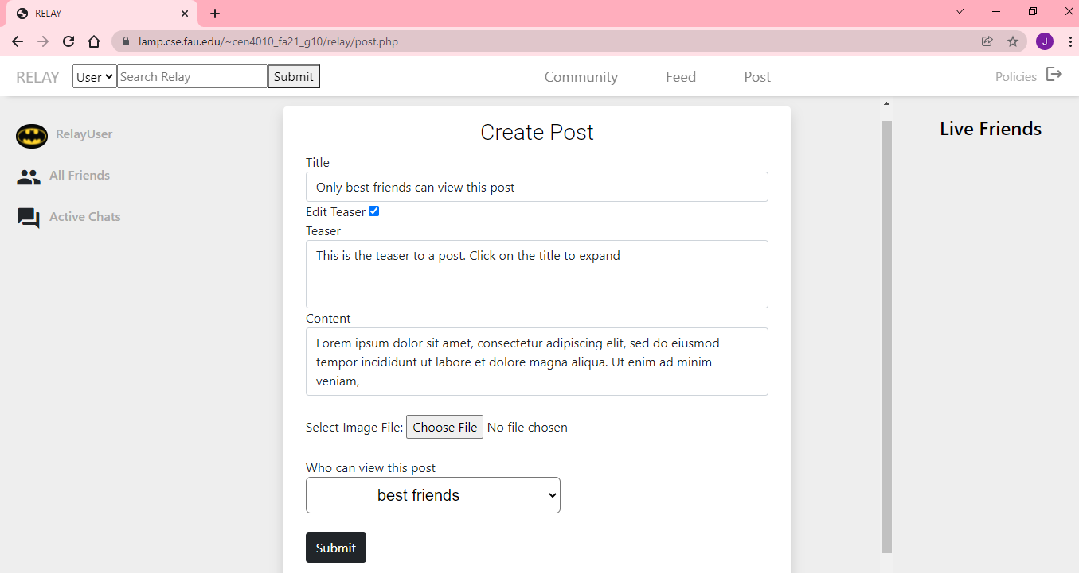
Create A Post
Update friends and family with posts
Teaser
Short Posts- Under 199 characters
Long Posts- Over 200 characters
Images- Up to 3MB

Slide 16
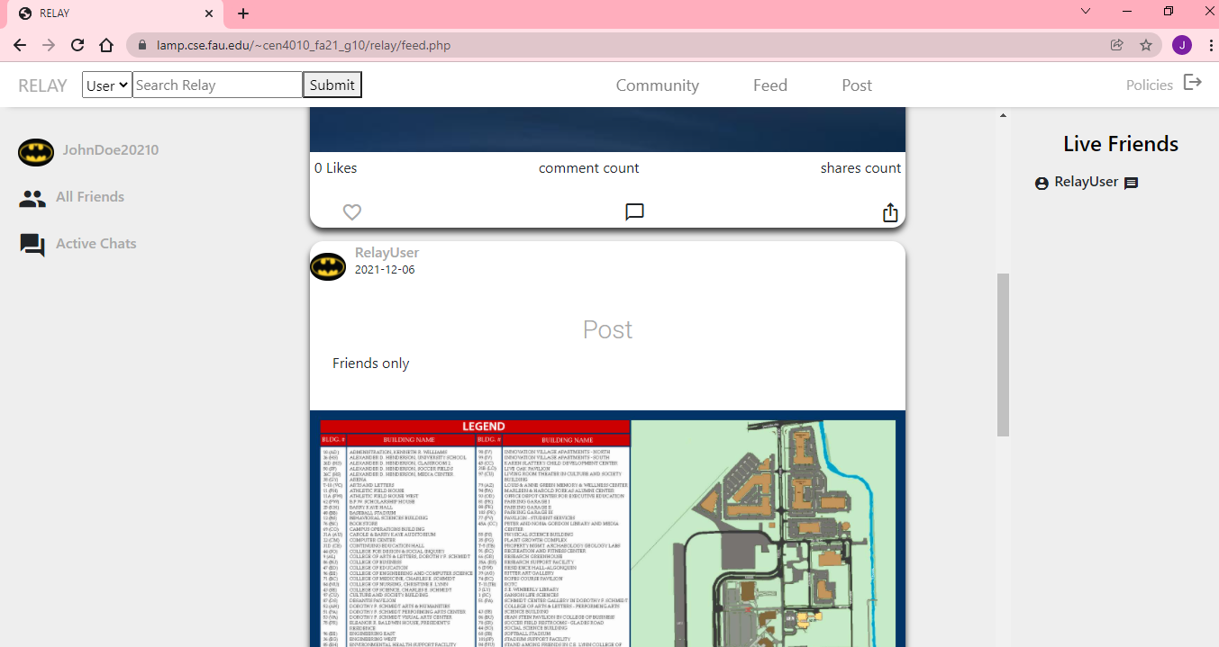
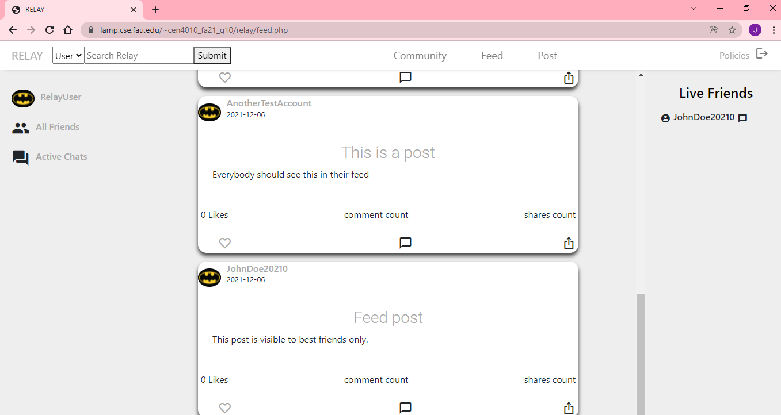
Feed
The community feed displays posts created by all users who have set to share their posts publicly
The personal feed displays posts created by friends and best friends of the user

Slide 17
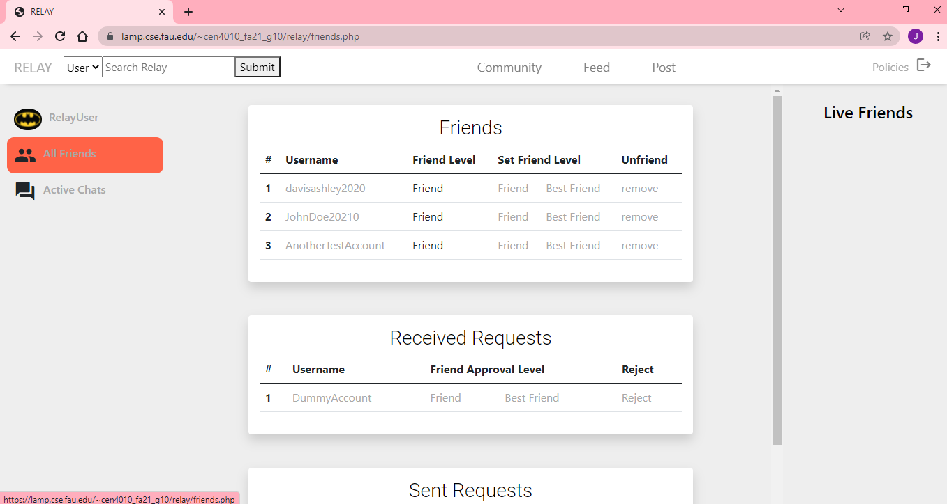
Manage Friends
View and manage friends list
Accept/Decline requests
Friend- Share posts with all friends
Best Friend- Upgraded level of privacy to share posts with selected friends

Slide 18
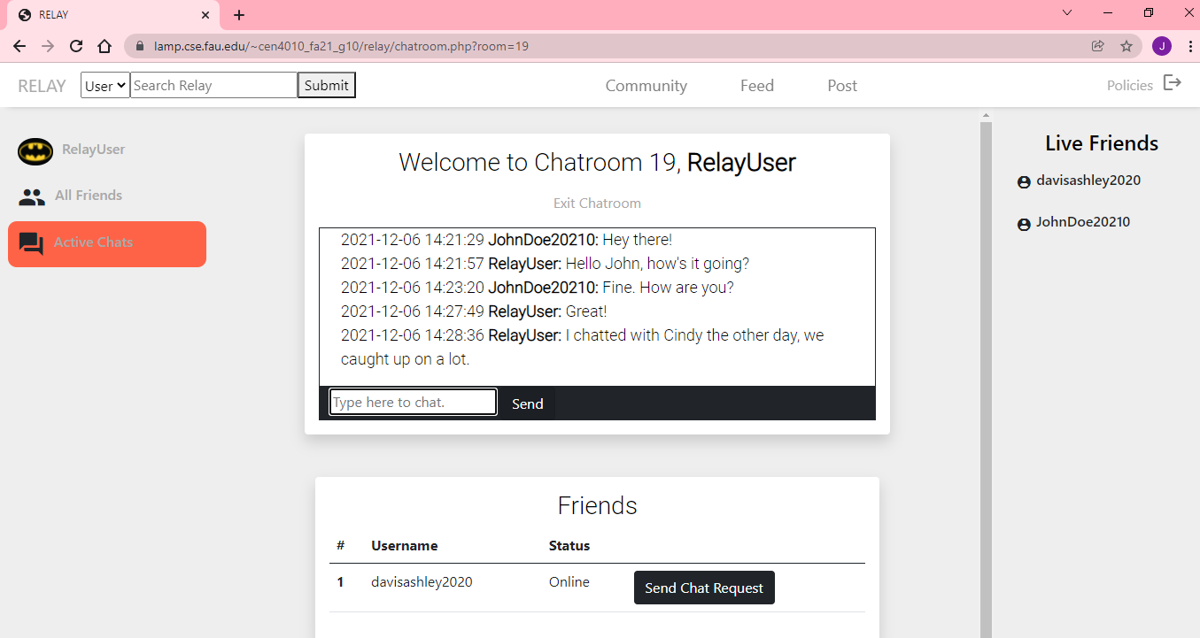
Chat Room
Chat with online friends
Send a chat request or accept a request to start a conversation
Once finished, user may exit chatroom and the conversation will disappear

Slide 19
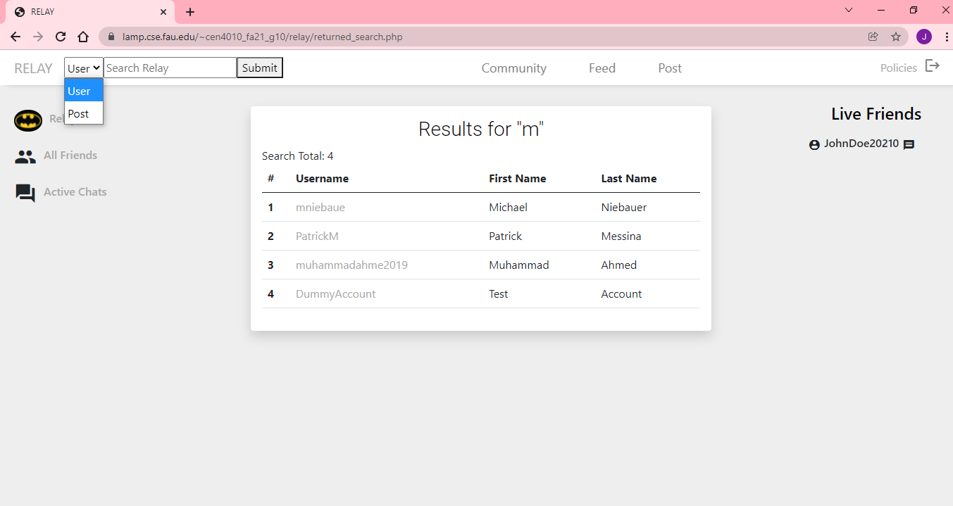
Search
User can search for other users or posts
Search for user includes username, first name, and last name
Search for post includes title and description

Slide 20
Unfinished Features
Commenting on posts
Post sharing
Unliking posts
The promised features were unable to be implemented due to priorities and time constraints.

Slide 21
Lessons Learned
Start early.
Have regularly scheduled meetings to go over completed / pending tasks.
Clearer direction of responsibilities for each group member

