Slide 1
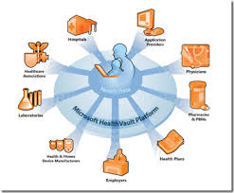
Enhanced Attribute Based Encryption Technique for Securing Personal Health Records using Cloud Computing
Enhanced Attribute Based Encryption Technique for securing personal health records using Cloud Computing

Slide 2
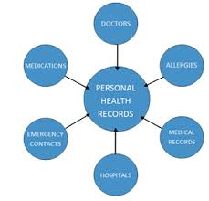
ABSTRACT
Emerging patient-centric model of health information exchange.
High cost and maintaining specialized data centers
Enhancement to verify the trustworthiness of the TPA.
Many security and privacy risks.
Used to encrypt patient’s PHR file
Enhanced Attribute Based Encryption Technique for securing personal health records using Cloud Computing

Slide 3


Relies on sharing of computer resources
Access from anywhere
Automated backups and upgrade
Modern web based integration
Enhanced Attribute Based Encryption Technique for securing personal health records using Cloud Computing

Slide 4
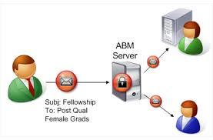
INTRODUCTION
PHR maintains patients health record in the cloud.
Third Party Auditor checks the integrity of outsourced data.
Auditing process should bring in no new vulnerabilities.
Provide security ABE Encryption is used.
Authorized users may need to access the PHR for personal use.
Enhanced Attribute Based Encryption Technique for securing personal health records using Cloud Computing

Slide 5
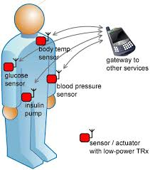
LITERATURE SURVEY
Data security and privacy in WBAN.
Allows the data of a patient’s vital body parameters and movements.
Communicated using short-range wireless communication techniques.
Avoid from high key management complexity for each owner and user.
Enhanced Attribute Based Encryption Technique for securing personal health records using Cloud Computing

Slide 6
EXISTING SYSTEM
Stored medical records of their patients on paper locally
Easily misused by the unauthorized users
Manage privacy and confidentiality of individual medical records
Enhanced Attribute Based Encryption Technique for securing personal health records using Cloud Computing

Slide 7


PROPOSED
SYSTEM
Achieve fine-grained and scalable data access control for PHRs
Manage the keys of a small number of users in the personal domain.
ABE technique is used to encrypt each patient’s PHR file.
Patients have full privacy control over their PHRs.
Enhanced Attribute Based Encryption Technique for securing personal health records using Cloud Computing

Slide 8

SYSTEM SPECIFICATION
HARDWARE REQUIREMENTS
Processor - Pentium –III
Speed - 1.1 Ghz
RAM - 256 MB(min)
Hard Disk - 20 GB
Enhanced Attribute Based Encryption Technique for securing personal health records using Cloud Computing

Slide 9

SYSTEM SPECIFICATION
SOFTWARE REQUIREMENTS
Operating System : Windows 7
Application Server : Netbeans 6.0.1
Front End : Java
Server side Script : Java Server Pages.
Database : MYSQL
Enhanced Attribute Based Encryption Technique for securing personal health records using Cloud Computing

Slide 10
SYSTEM ARCHITECTURE
Each user obtain keys from every owner.
Key management on behalf of all PHR owners.
Requires too much trust on a single authority.
Key escrow also known as a cryptosystem .
Need to decrypt encrypted data .
Enhanced Attribute Based Encryption Technique for securing personal health records using Cloud Computing

Slide 11
PATIENT FRAMEWORK CENTRIC
KEY POLICY ATTRIBUTE-BASED ENCRYPTION (KP-ABE):
SETUP GENERATION
ENCRYPTION
SECRET GENERATION
DECRYPTION
EMERENGY DEPARTMENT
READ ONLY KEYS GENERATED
Enhanced Attribute Based Encryption Technique for securing personal health records using Cloud Computing

Slide 12

MODULES
Patient centric framework
Key distribution
Grained data access control
Enhanced Attribute Based Encryption Technique for securing personal health records using Cloud Computing

Slide 13

DESCRIPITIONS
Patient centric framework
Public Domain
Secret Key
Patient centric framwork
Personal Domain
Access the PHR
Enhanced Attribute Based Encryption Technique for securing personal health records using Cloud Computing

Slide 14


CONTD…
Key distribution
Secret Key
Encrypt the File
PHR
Key Generation
KP-Distribution
Enhanced Attribute Based Encryption Technique for securing personal health records using Cloud Computing

Slide 15
CONTD…
Grained data access control
Personal Domain
PHR
EHR File
ABE Sharing the files
Health Provider
Enhanced Attribute Based Encryption Technique for securing personal health records using Cloud Computing

Slide 16
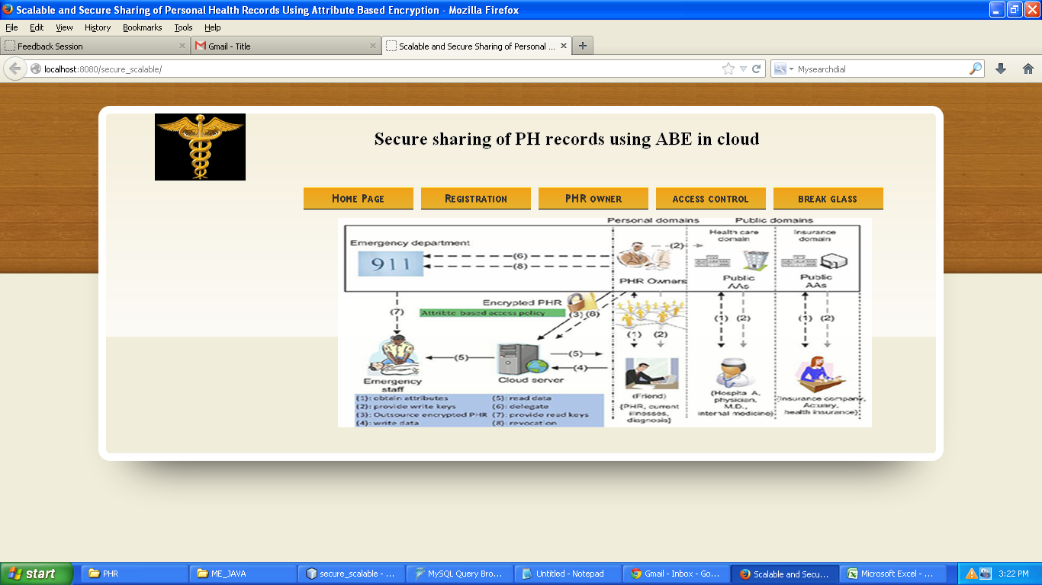
HOME PAGE
Enhanced Attribute Based Encryption Technique for securing personal health records using Cloud Computing

Slide 17
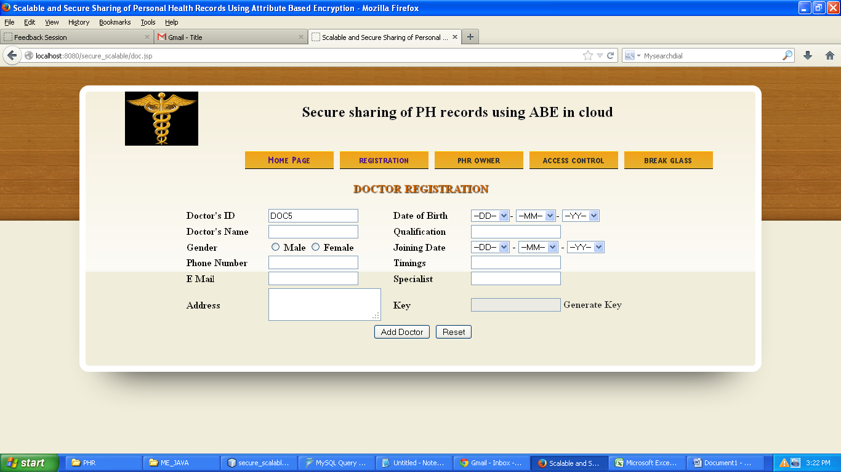
DOCTOR REGISTRATION PAGE
Enhanced Attribute Based Encryption Technique for securing personal health records using Cloud Computing

Slide 18
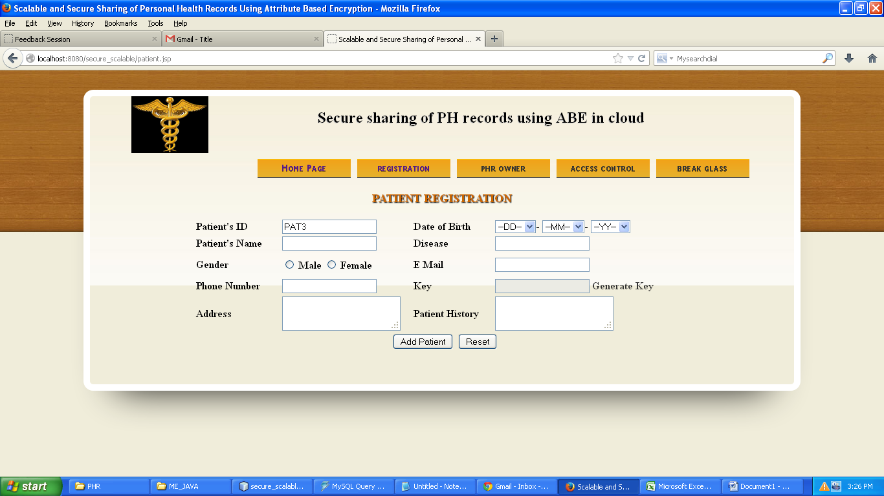
PATIENT REGISTRATION PAGE
Enhanced Attribute Based Encryption Technique for securing personal health records using Cloud Computing

Slide 19
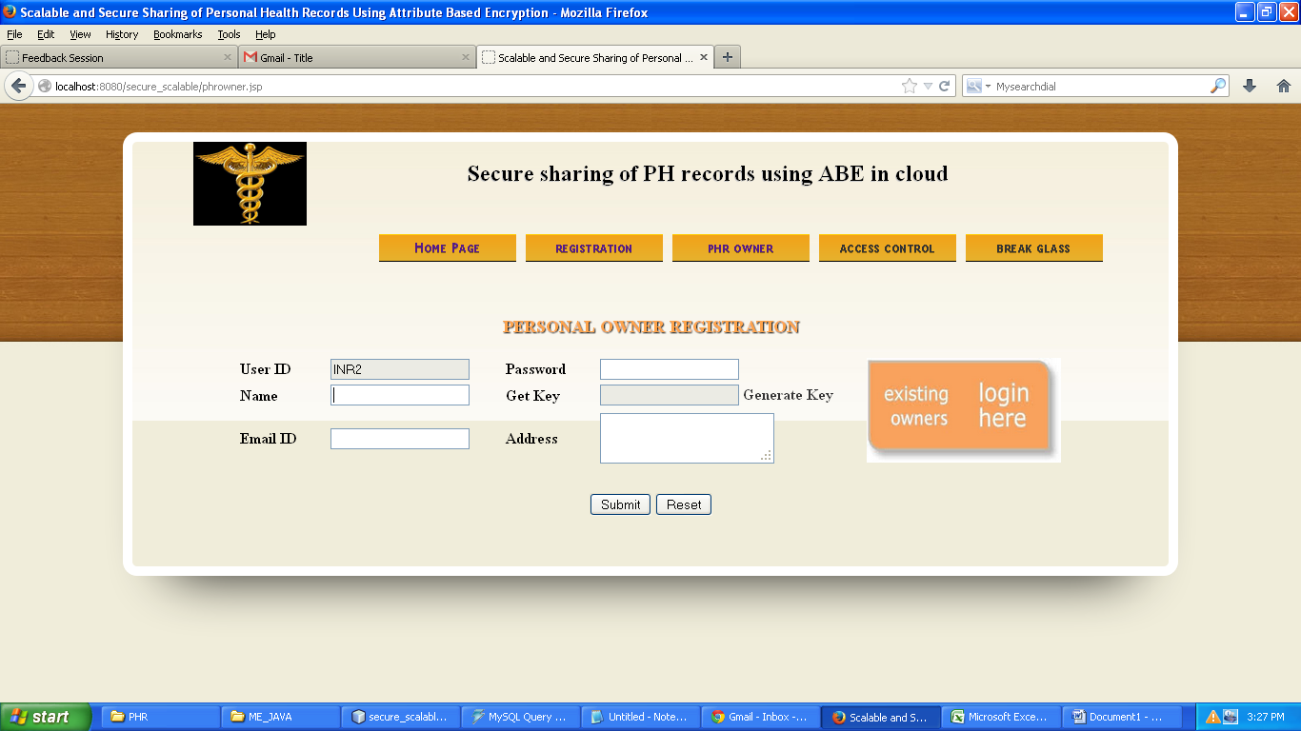
PERSONAL OWNER REGISTRATION PAGE
Enhanced Attribute Based Encryption Technique for securing personal health records using Cloud Computing

Slide 20
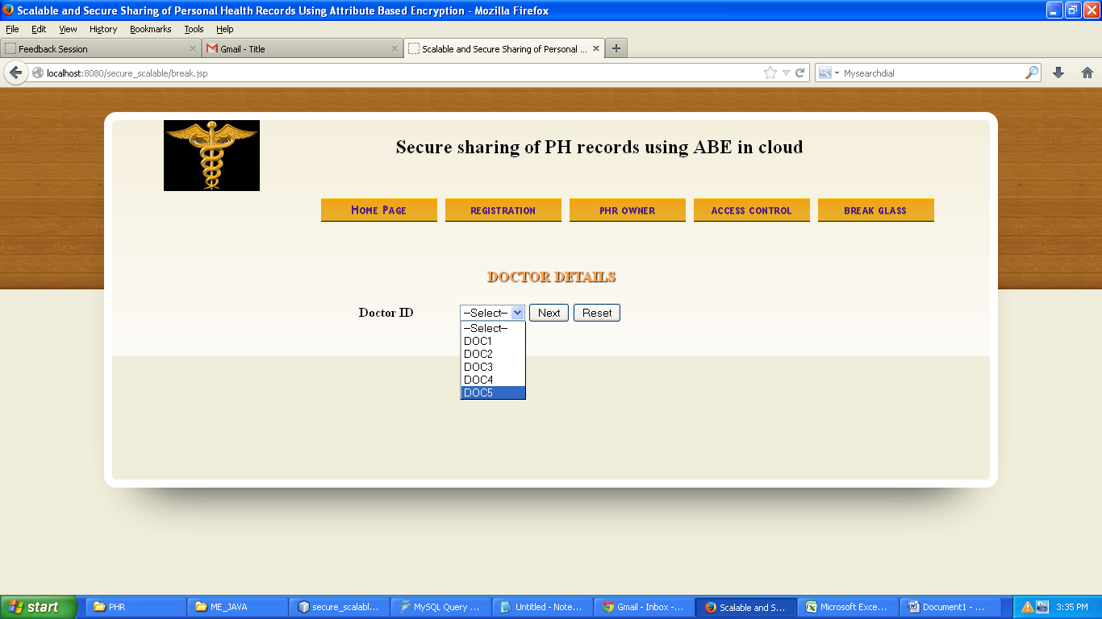
DOCTOR DETAILS PAGE
Enhanced Attribute Based Encryption Technique for securing personal health records using Cloud Computing

Slide 21
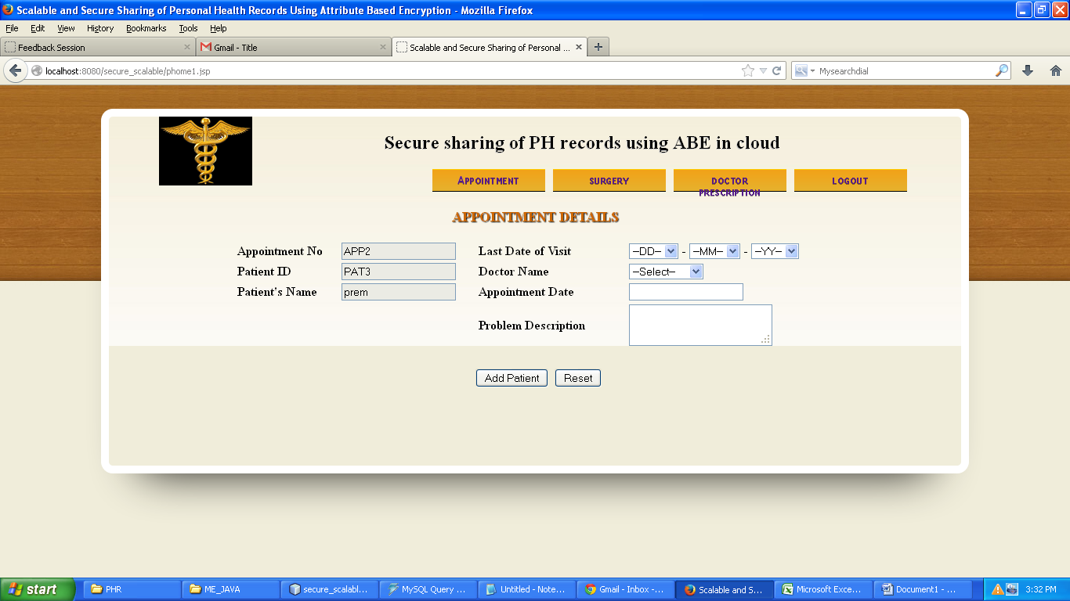
APPOINMENT DETAILS PAGE
Enhanced Attribute Based Encryption Technique for securing personal health records using Cloud Computing

Slide 22
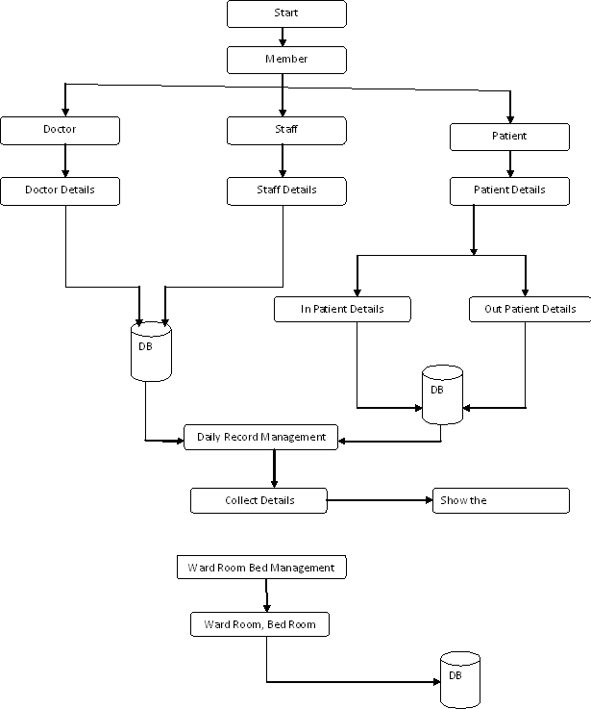
DATA FLOW DIAGRAM
Enhanced Attribute Based Encryption Technique for securing personal health records using Cloud Computing

Slide 23
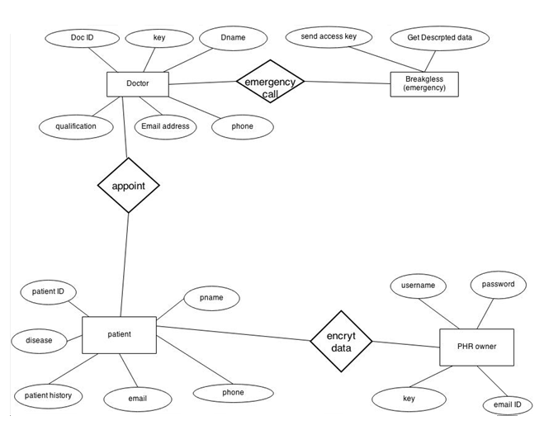
E-R DIAGRAM
Enhanced Attribute Based Encryption Technique for securing personal health records using Cloud Computing

Slide 24
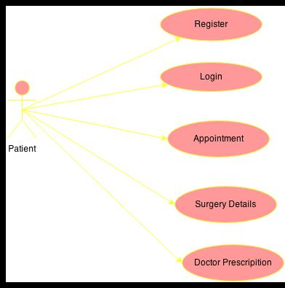
USECASE
Enhanced Attribute Based Encryption Technique for securing personal health records using Cloud Computing

Slide 25

CONCLUSION
Enhance the HSN with a third party auditor to verify the cloud server that stores and process the PHRs
We leave the full-fledged implementation of the mechanism on commercial public cloud as an important future extension
Enhanced Attribute Based Encryption Technique for securing personal health records using Cloud Computing

Slide 26
REFERENCE
BOOK REFERENCE
[1] M. Armbrust, A. Fox, R. Griffith, A.D. Joseph, R.H. Katz, A.Konwinski, G. Lee, D.A.Patterson, A. Rabkin, I. Stoica, and M.Zaharia, “Above the Clouds: A Berkeley View of Cloud Computing,” Feb. 2009.
[2] M.A. Shah, R. Swaminathan, and M. Baker, “Privacy-Preserving Audit and Extraction of Digital Contents,” Cryptology ePrint Archive, Report 2008/186, 2008SS
Enhanced Attribute Based Encryption Technique for securing personal health records using Cloud Computing

Slide 27
THANK YOU
Enhanced Attribute Based Encryption Technique for securing personal health records using Cloud Computing

