Slide 1
NORA EOS
Enterprise Operating System
ECHO • HERA • ARGUS

Slide 2
What is NORA EOS?
An AI-powered enterprise operating system built for modern teams
Three integrated modules that automate communication, project management, and performance tracking
Connects Gmail, Google Calendar, and internal task management into one intelligent layer
Every module feeds data to the others — creating a closed-loop productivity system
ECHO
HERA
ARGUS
Smart Email Assistant
Project Orchestrator
Productivity Intelligence
AI email classification, reply suggestions, calendar management, and chat-driven drafting
Natural language project creation, Kanban board, Gantt timeline, and team capacity management
Automated scoring across 4 metrics, AI recommendations, and transparent performance tracking

Slide 3
System Architecture
Each module runs as an independent microservice with its own database
Cross-service communication via authenticated REST APIs
Shared Celery + Redis worker pipelines for background processing
LLM integration (Groq / Llama 3.3 70B) powers AI features across all modules
Gmail and Google Calendar APIs provide real-time email and scheduling data
ECHO
Gmail API • Calendar API • Chat LLM
↑↓ Notifications + Team Lookup
HERA
Orchestration LLM • Task DB • Scheduling
↑↓ Metrics Collection
ARGUS
Scoring Engine • Advice LLM • Metrics API

Slide 4
ECHO
Smart Email Assistant
AI-powered email management, reply suggestions, and calendar intelligence

Slide 5
ECHO — Core Features
Email Classification
AI Reply Suggestions
Incoming emails are automatically categorized as Work, Personal, Meeting, Newsletter, or Urgent using AI
ECHO drafts personalized replies based on the user’s writing style — users accept, edit, or reject
Chat-Driven Email Drafting
Calendar Intelligence
Users ask ECHO to draft emails via chat — recipients are resolved from contacts or HERA project teams
Direct event creation from chat, conflict detection, and automated meeting proposals with confirmation flow
Cross-Module Notifications
Daily Digest
Task assignments from HERA appear as notifications — deadline reminders trigger automatically
AI-generated summary of email activity, urgency breakdown, and suggestion acceptance stats

Slide 6
ECHO — User Flow
1
Google Login
2
Onboarding
3
Dashboard
OAuth authentication grants access to Gmail and Calendar
6-step walkthrough — fetches and classifies 20 emails on completion
Summary card, next meeting, email cards with AI suggestions, task cards
4
Chat
5
Email Actions
6
Calendar
Ask anything — ECHO responds with text, email drafts, or calendar events
Accept suggestion, write custom reply, or draft from chat and send
Create events, detect conflicts, send meeting proposals with auto-confirmation

Slide 7
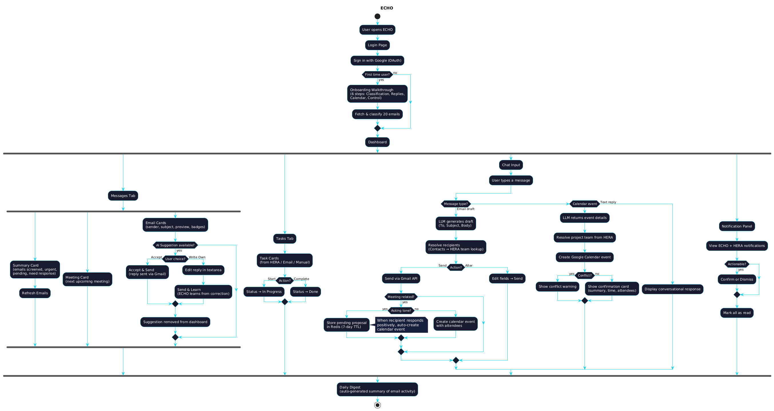
ECHO — Architecture Diagram

Slide 8
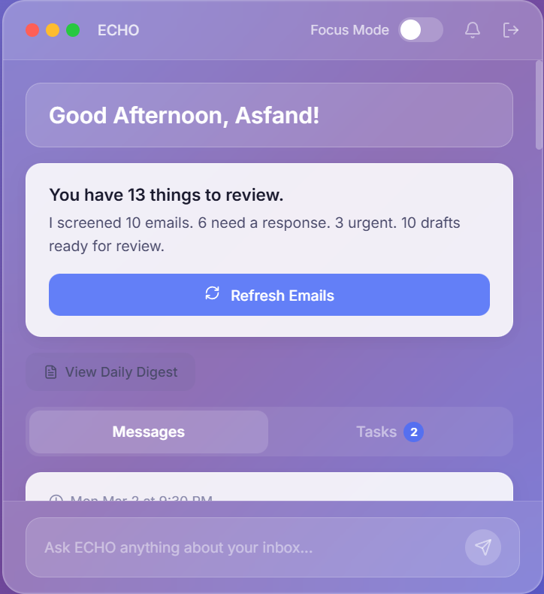
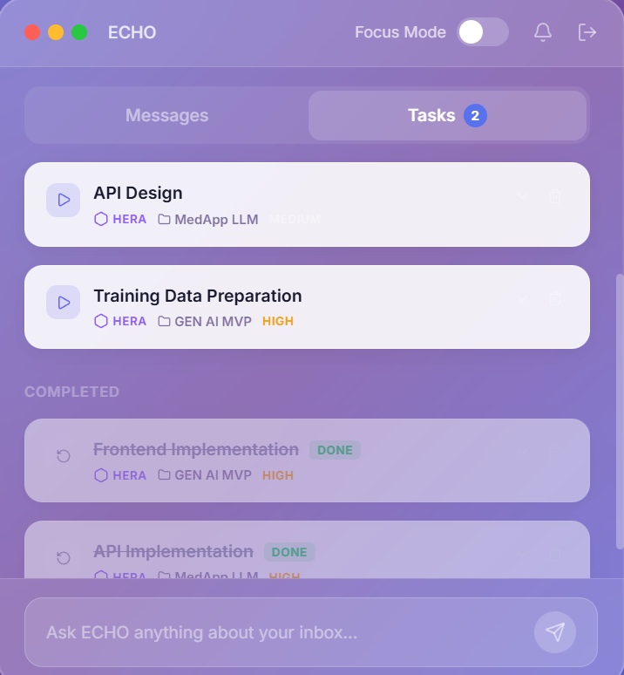
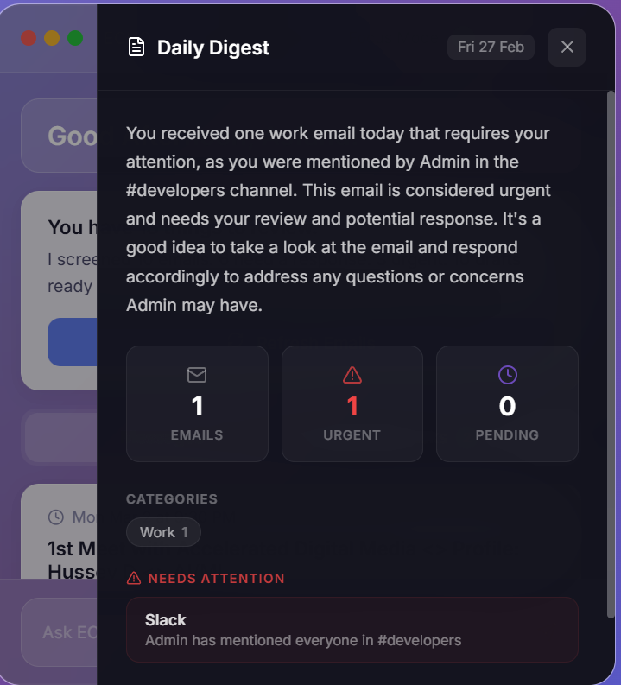
ECHO — Dashboard, Tasks & Daily Digest
Dashboard with summary card and email stats
Tasks tab with HERA-synced task cards
AI-generated daily email digest

Slide 9
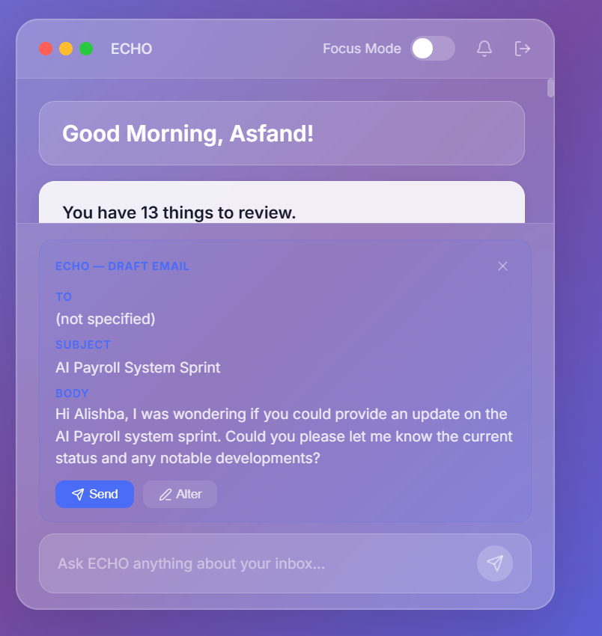
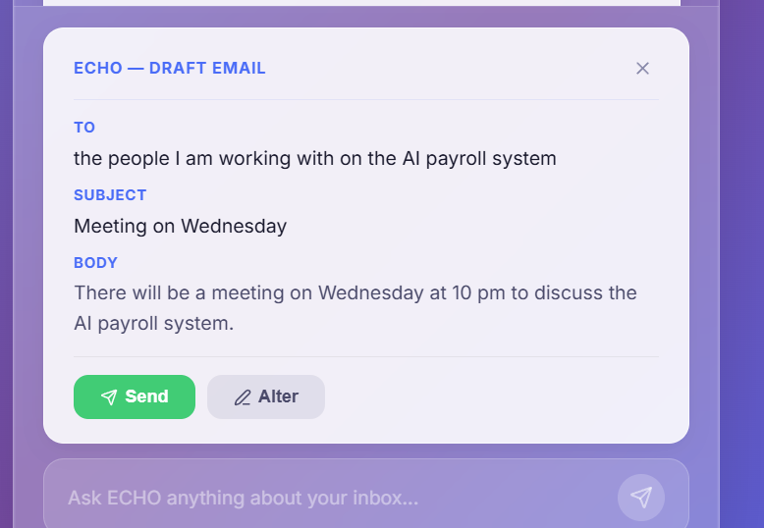
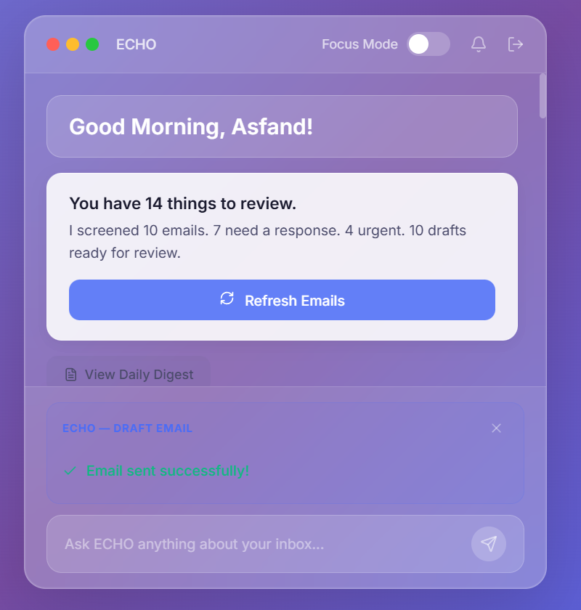
ECHO — Chat Email Drafting & Sending
AI-drafted email with Send / Alter buttons
Draft to project team (resolved via HERA)
Email sent confirmation via Gmail API

Slide 10
HERA
Project Orchestration Engine
Natural language project creation, real-time task tracking, and team management

Slide 11
HERA — Core Features
AI Orchestration
Kanban Board
Describe a project in plain English or upload documents — HERA generates tasks, assigns team members, and builds a sprint plan
Real-time board with To Do, In Progress, and Done columns — updates every 5 seconds as employees work
Gantt Timeline
Team Management
Visual schedule with task bars, dependency tracking, today marker, and overdue/blocked indicators
Member cards with workload meters, skill badges, and capacity limits to prevent over-allocation
Employee Portal
Cross-Module Sync
Employees see only their assigned tasks — start, complete, and track deadlines independently
Task assignments trigger ECHO notifications — ECHO queries HERA for project team lookups

Slide 12
HERA — Admin Flow
1
2
3
4
5
6
Login
→
Orchestrate
→
Review
→
Board
→
Timeline
→
Team
Manager enters email and password
Describe project or upload docs — AI generates task breakdown
Adjust assignments, add/delete tasks, confirm with Start Project
Real-time Kanban — click any task to edit status, assignee, priority
Gantt chart with dependencies, deadlines, and blocked task indicators
Manage members, skills, and workload capacity
Employee Flow
Login
My Tasks
Execute
Timeline
Enter email only
View assigned tasks with priorities and deadlines
Start → In Progress → Complete
Personal Gantt view of task schedule

Slide 13
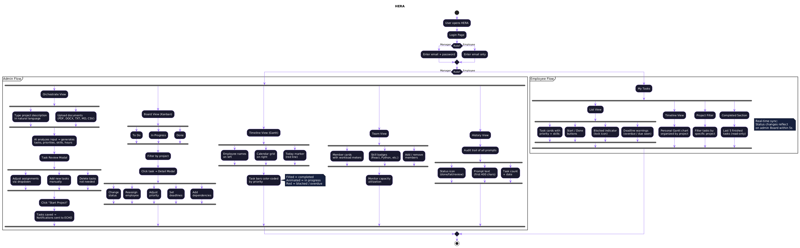
HERA — Architecture Diagram

Slide 14
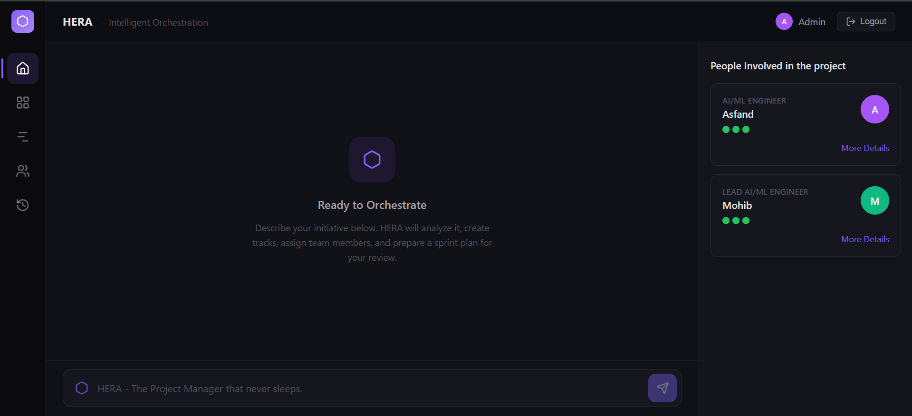
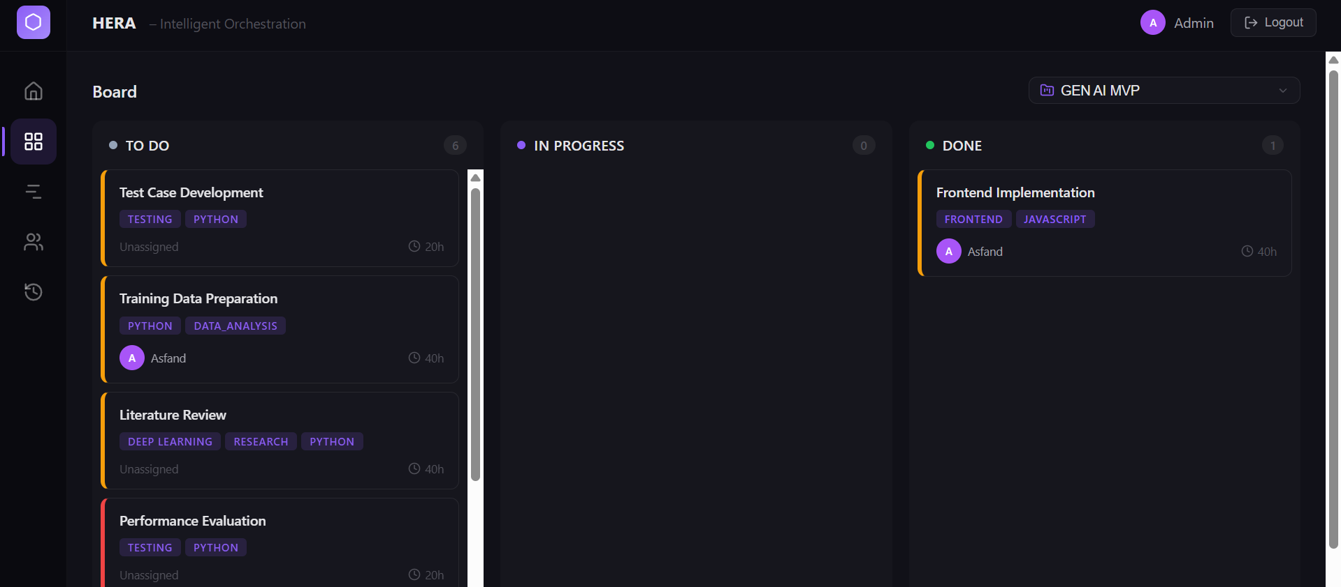
HERA — Orchestrate & Board
AI project generation with team panel
Real-time Kanban board with task cards

Slide 15
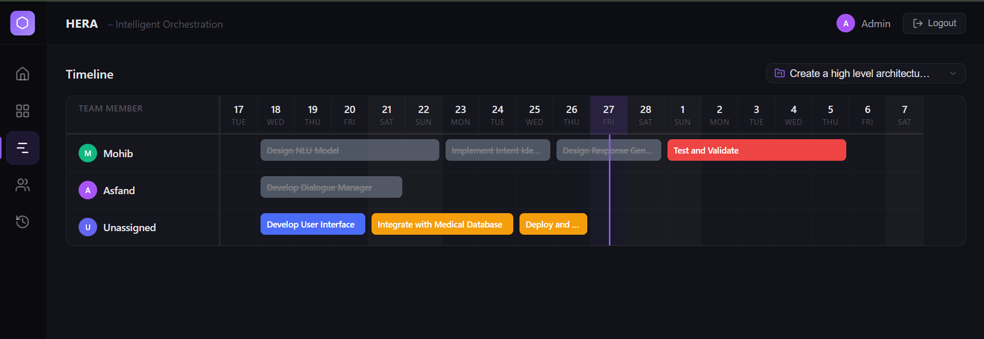
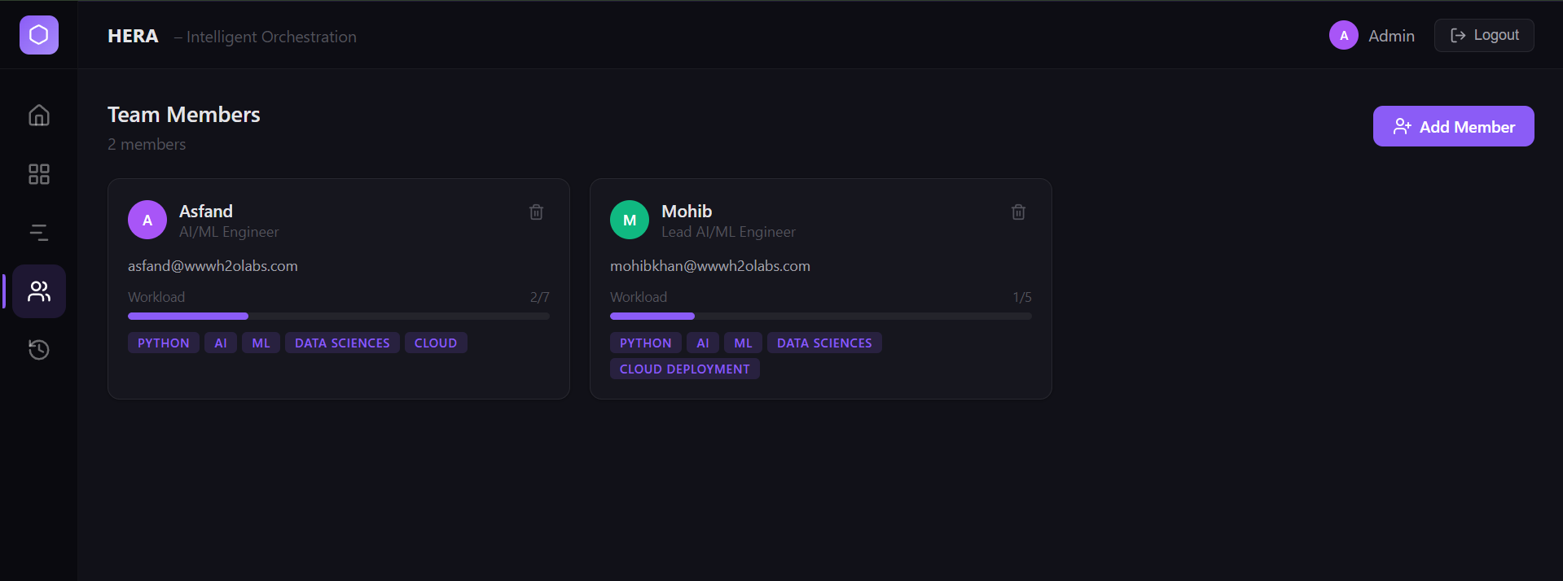
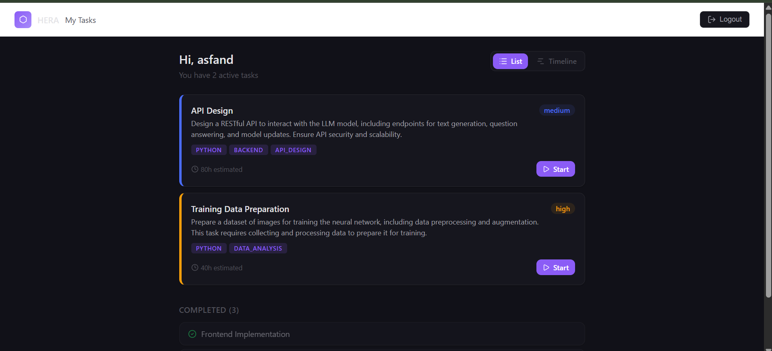
HERA — Timeline, Team & Employee Portal
Gantt timeline with dependencies
Member cards with workload and skills
Employee task view with Start/Done actions

Slide 16
ARGUS
Productivity Intelligence
Automated performance scoring, AI recommendations, and transparent metrics

Slide 17
ARGUS — Scoring Model
Overall Score = Task Completion × 0.40 + Timeliness × 0.25 + Communication × 0.20 + Engagement × 0.15
Task Completion
Timeliness
Communication
Engagement
40%
25%
20%
15%
Completion rate + priority-weighted output from HERA
On-time delivery rate for tasks with deadlines
Email suggestion acceptance rate from ECHO
Notification read and action rate from ECHO
All data sourced transparently from HERA and ECHO — no subjective factors

Slide 18
ARGUS — Two User Paths
Manager Dashboard
Employee — My Score
Four stat cards: employee count, team average, top performer, needs support
Category averages: visual bar charts across all 4 scoring dimensions
Team leaderboard: color-coded scores with trend arrows (improving/declining/stable)
Click any employee to drill into their detail page
Employee detail: score gauge, breakdown bars, AI recommendations, score history
AI advice cards with High / Medium / Low priority levels
Personal score gauge with color-coded performance label
Score breakdown: 4 horizontal bars showing each metric weight
"How is my score calculated?" — expandable formula with full transparency
Data sources clearly labeled: which metric comes from HERA vs ECHO
Dismissible AI recommendations personalized to their weak areas
Score history table to track personal trends over time

Slide 19
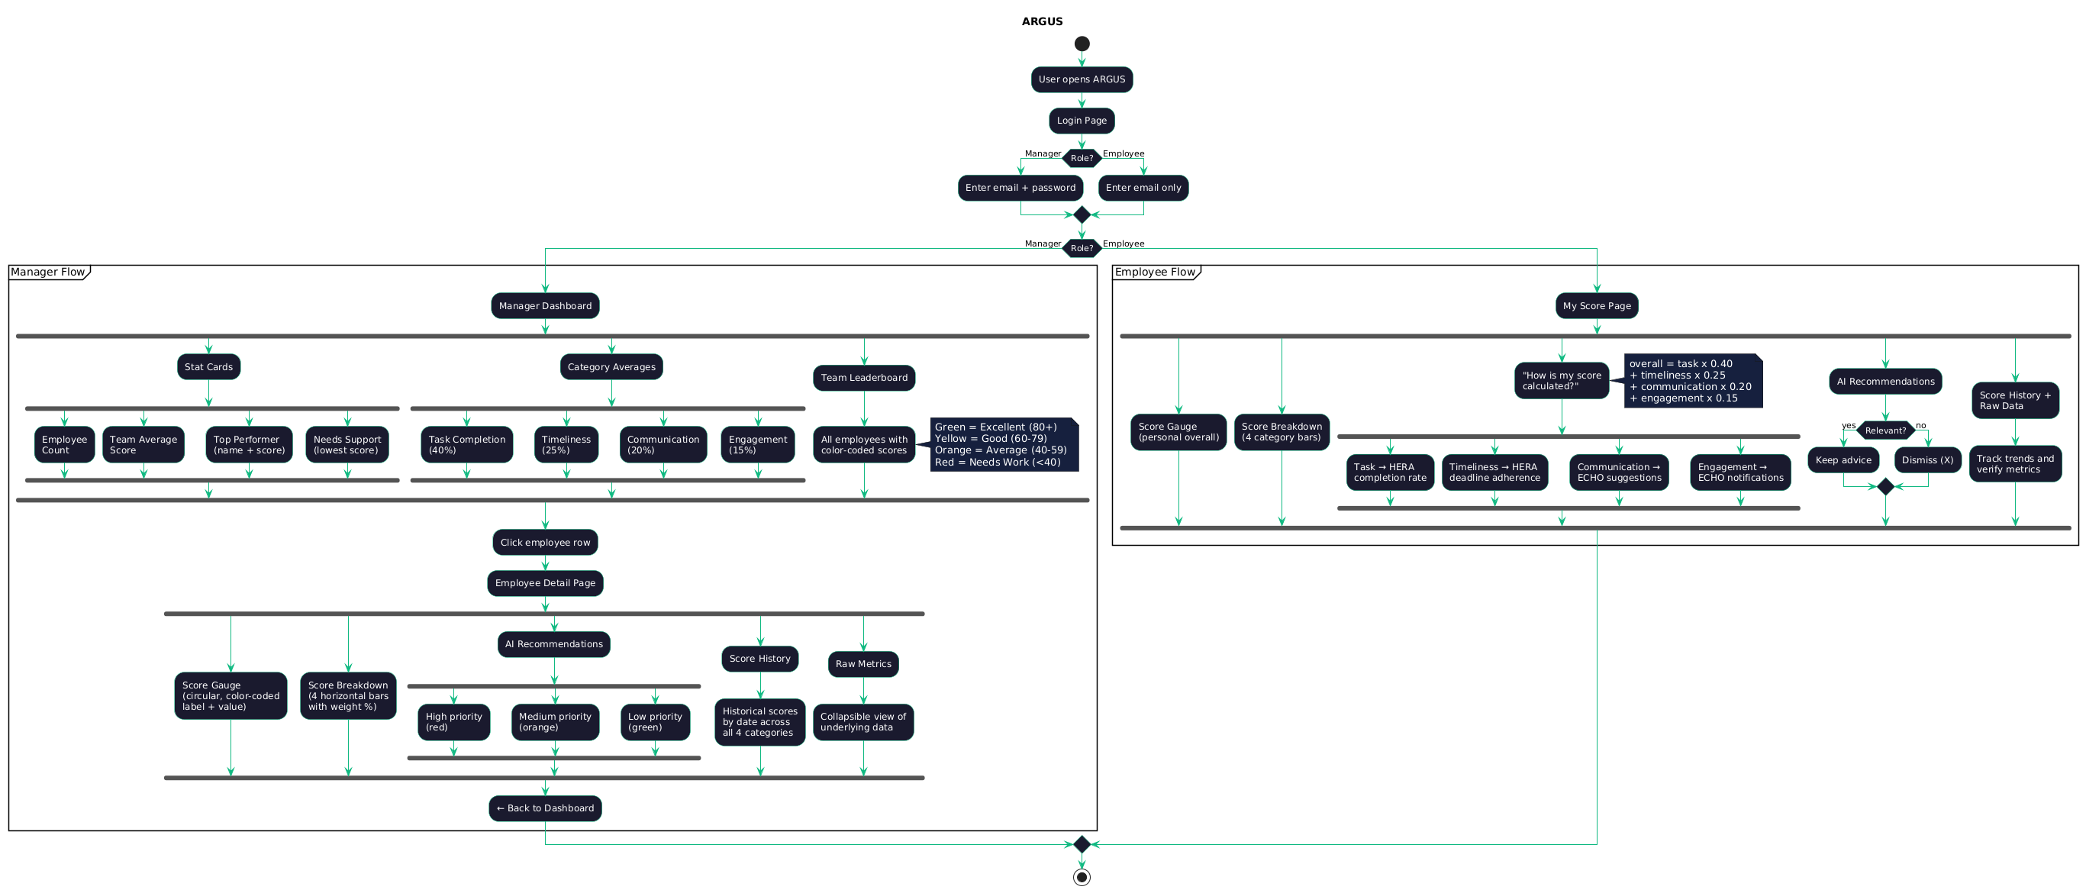
ARGUS — Architecture Diagram

Slide 20
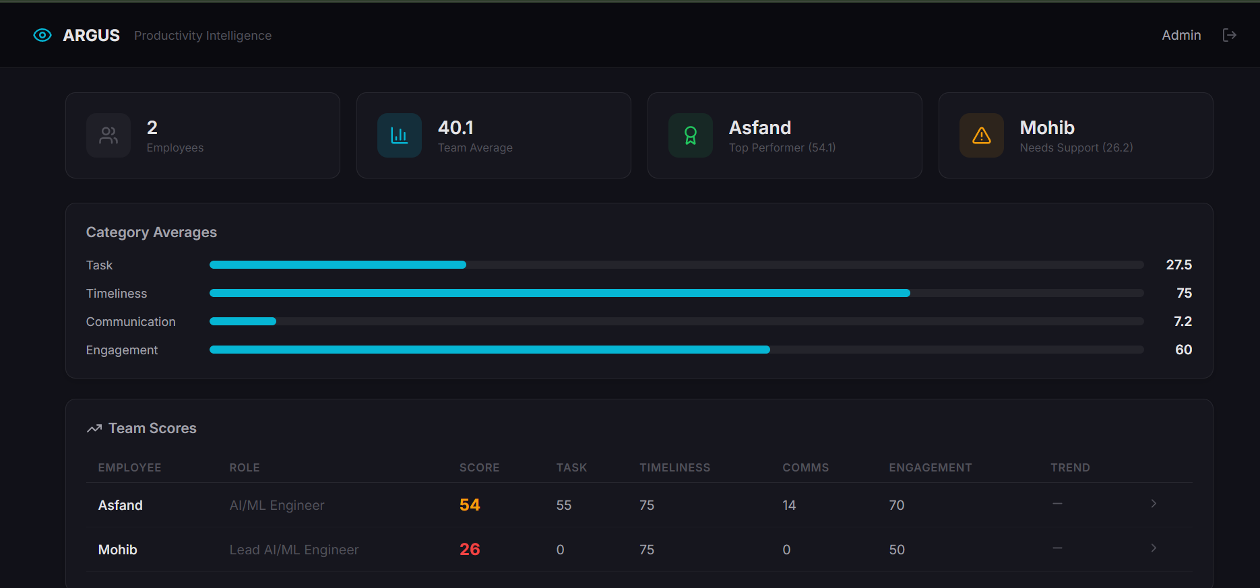
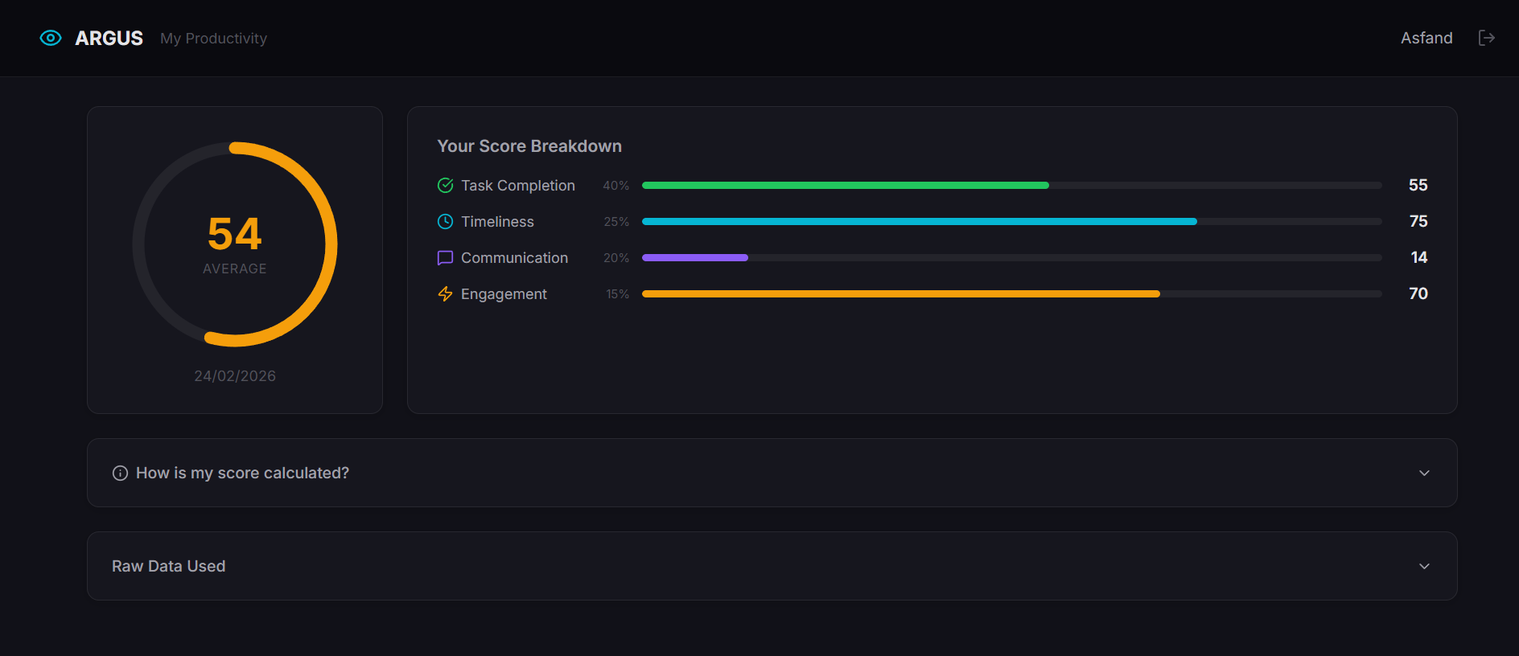
ARGUS — Screenshots
Manager dashboard: team stats, leaderboard, AI recommendations
Employee My Score: gauge, breakdown, and formula transparency

Slide 21
Cross-Module Integration
HERA → ECHO
Task assignments in HERA trigger real-time notifications in ECHO for assigned employees
ECHO → HERA
ECHO queries HERA to resolve project team members when drafting emails or creating calendar events
HERA → ARGUS
Task completion rates and deadline adherence feed into ARGUS for productivity scoring
ECHO → ARGUS
Suggestion acceptance rates and notification engagement feed into ARGUS scoring
ARGUS → Managers
AI-generated insights help managers make informed decisions about task assignments in HERA

Slide 22
Technology Stack
Backend
Frontend
AI / LLM
Infrastructure
FastAPI (Python)
SQLAlchemy + PostgreSQL
Celery + Redis
Async/await throughout
React 18
Vite build tool
Lucide icons
Custom glassmorphic CSS
Groq API
Llama 3.3 70B Versatile
JSON-structured outputs
Temperature-tuned per task
Docker Compose
Microservice architecture
Gmail & Calendar APIs
OAuth 2.0 authentication

Slide 23
Thank You
NORA EOS — ECHO • HERA • ARGUS
Questions?

