Slide 1
Grizzlies Helping Grizzlies
Asfarah Rahman

Slide 2
Agenda
Project Description
User Stories
Enhancements
Problems & Solutions
Demo
Questions

Slide 3
PROJECT DESCRIPTION
Grizzlies helping grizzlies is a charity drive to collect toys, clothing, monetary gifts and food items.
Created a Windows Forms application in C# that manages donor and donation information.
The application contains a data grid view to keep track of donor and donation info.
Access database to store information permanently

Slide 4
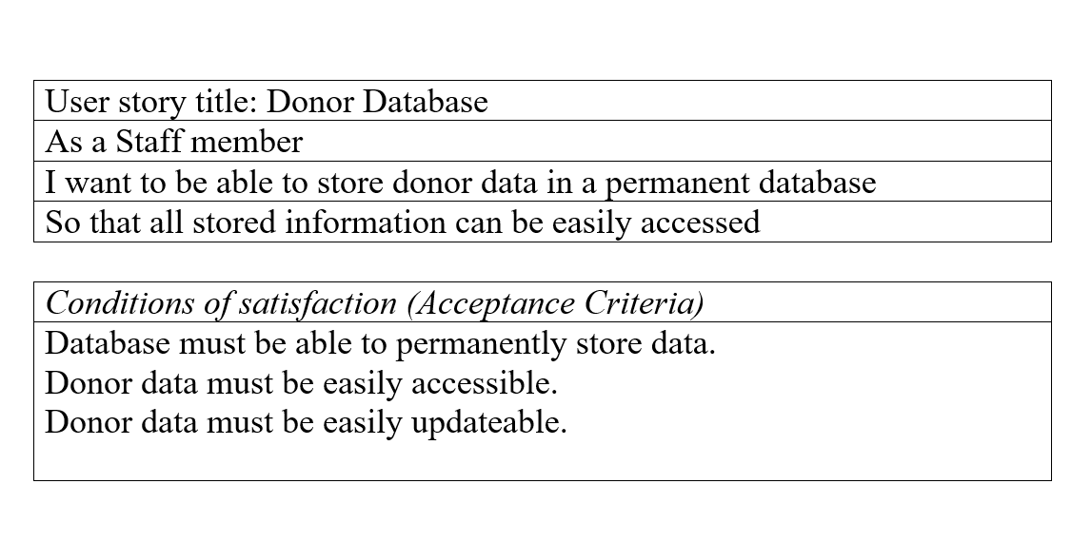
USER STORIES: DONORS

Slide 5
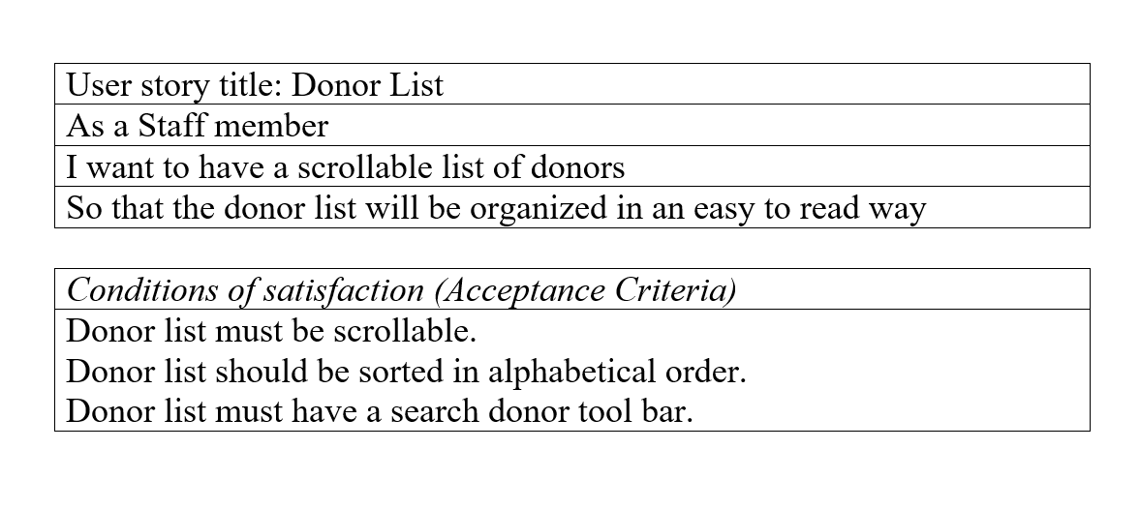
USER STORIES: DONORS

Slide 6
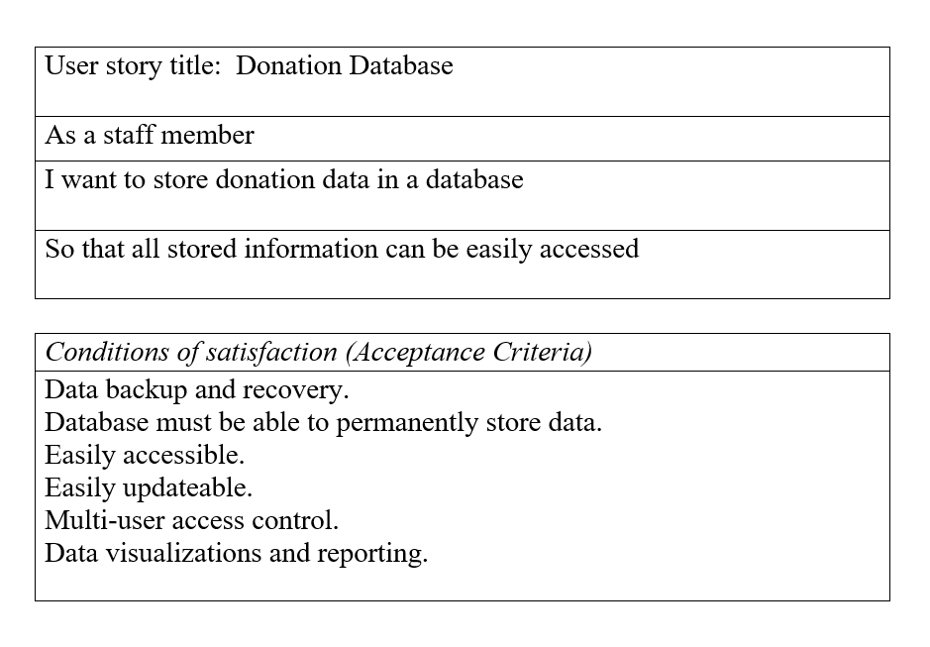
USER STORIES: DONATIONS

Slide 7
ENHANCEMENTS
Access database to store data for donors
Access database to store data for donations
Search tab to display donor and donation value for a specific type of donation

Slide 8
PROBLEMS & SOLUTIONS
Donation database column names were key words → Change my column names
The database wasn’t saving the type and value of the donation due to the reset text function → Rearrange the code before the reset text

Slide 9

DEMO

Slide 10

QUESTIONS ?

