Slide 1
QIC Final Report Quantum & P vs NP problem
2022.06.09 (Thurs.)
組員1: D10943012 電子博一 梁峻瑋

Slide 2
Outline
Part 0: Motivation
Part 1: Computer System——Classical vs Quantum
Part 2: Two guesses of complexity theory
Part 3: Studying mainstream
Part 4: Reference

Slide 3

Part 0: Motivation
Most EDA problems ≥ NP-hard
Floorplan: Slicing Tree, B* tree, Sequential pair
If the classical computer cannot solve …
Quantum Computer?
Quantum Annealing?
…
As an EDA researcher …

Slide 4
Part 0: Motivation
Quantum for EDA ??? 🤔🤔🤔
Solve NPC problems efficiently
➧ Complexity theory (Part1 / Part2)
➧ Robuster quantum model (Part3)
Speed-up optimization algorithm
Ex: Linear programming, Simulated Annealing
➧ Quantum LP / Quantum for interior-point algorithm[*1]
➧ Quantum annealing

Slide 5
Outline
Part 0: Motivation
Part 1: Computer System——Classical vs Quantum
Part 2: Two guesses of complexity theory
Part 3: Studying mainstream
Part 4: Reference

Slide 6
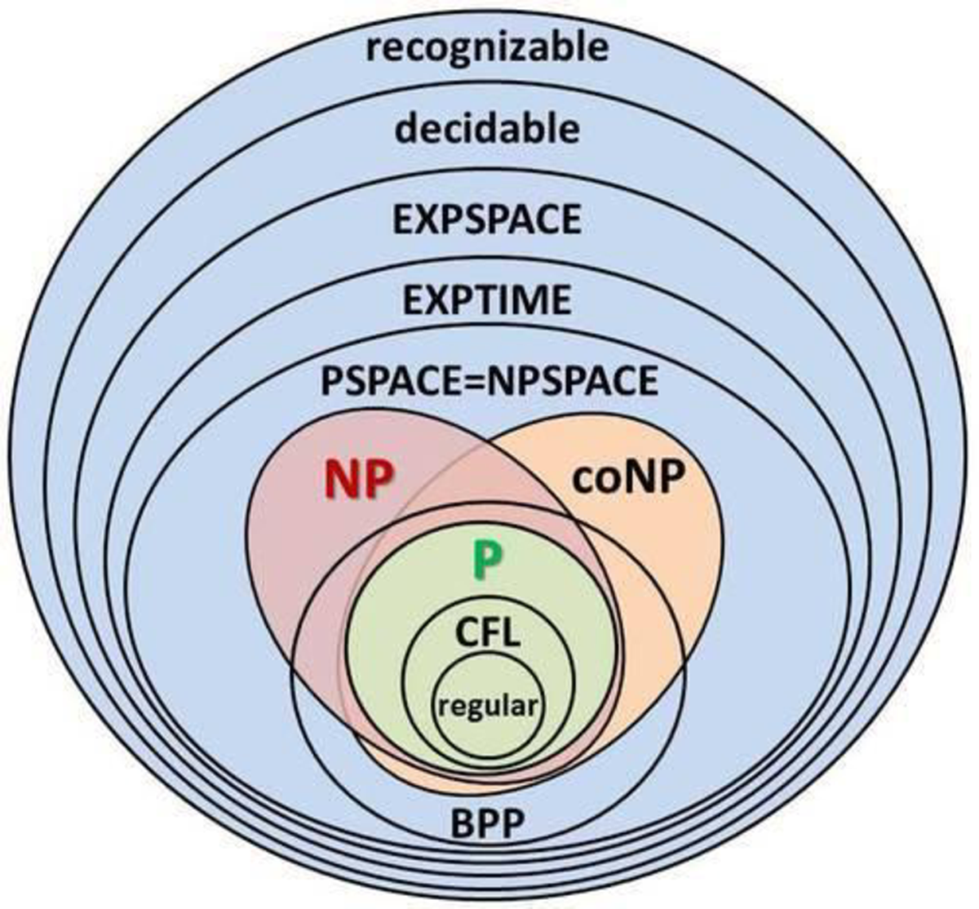
Part 1: Computer System Classical
Complexity Category
Decision Problem Version ➧
P := A Prob. has polynomial time algorithm
NP ⇔ A Prob. can polynomially verify the correctness (of solut.)
coNP ⇔ A Prob. can polynomially verify the fault (of solution)
BPP := A Prob. has polynomial time algorithm with certainty

Slide 7
Part 1: Computer System Classical
Relationship
P ⊆ NP ∩ coNP ⊆ PSPACE
P == NP (?)
P == coNP (?)
PSPACE := A prob. has polynomial space algorithm

Slide 8
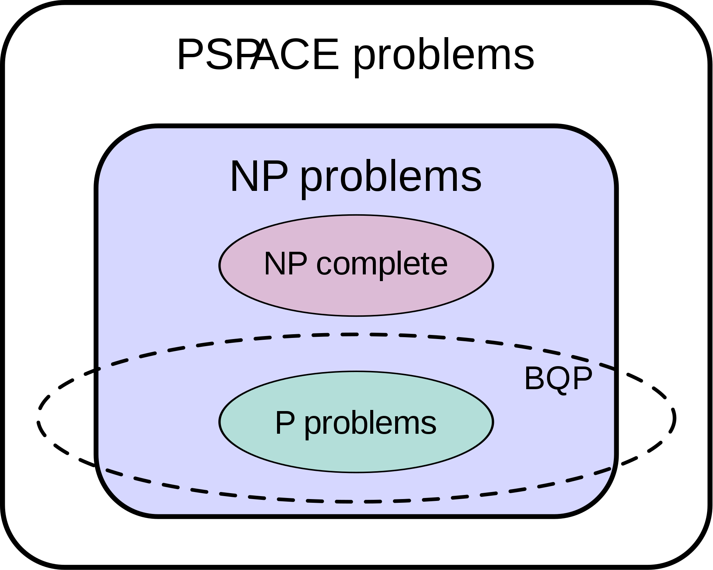
Part 1: Computer System Quantum
Complexity Category
Decision Problem Version ➧
BQP ~= BPP in quantum
BQP := A Prob. has polynomial time algorithm with certainty
Relationship:
P ⊆ NP ∩ coNP ⊆ PSPACE
P ⊆ BPP ⊆ BQP ⊆ PSPACE
BPP ⊆ BQP by universal quantum gate theorem
BQP ⊆ PSAPCE by BQP ⊆ PP [2]

Slide 9
Outline
Part 0: Motivation
Part 1: Computer System——Classical vs Quantum
Part 2: Two guesses of complexity theory
Part 3: Studying mainstream
Part 4: Reference

Slide 10
Part 2: Guess of Complexity Theory BPP < BQP … Quantum Advantage(?)
Quantum Advantage(?)
Ex: Shor’s algorithm ➧ Integer factorization
Suppose “N=21, t=9, a=2, measurement result y = 427”
➧ y/N = 427/512 = 1/(1+1/(5+1/(42+1/2))) = [1,5,42,2]
➧ [1,5]=5/6 is the first a_{i} satisfies |y/N-l/r| ≦ 1/(2N²), obtain r=6
➧ Check r=6 is the period of f(x)=2^{x} mod N
➧ f(6) = 2⁶-1 mod 21 = (2³+1)(2³-1) mod 21 = 0 ➧ 21=3*7
Correctness
Existence: continued fractions is a O(n²) converge sequence
Uniqueness: “proof by contradiction“
|y/N-l₀/r₀| ≦ 1/(2N²), |y/N-l₁/r₁| ≦ 1/(2N²) |l₀/r₀-l₁/r₁| ≦ 1/(N²)

Slide 11
Part 2: Guess of Complexity Theory BPP < BQP … Quantum Advantage(?)
Quantum Advantage(?)
Integer factorization
Quantum: Shor’s algorithm ➧ O(n³)
Classical: Best record ➧ about 2^{O(n^1/3)}
However…
✘: lower bound(Classical Integer factorization)
❓: May exist classical polynomial time algorithm

Slide 12
Part 2: Guess of Complexity Theory NP ≮ BQP… NP is intractable for quantum
P ⊆ NP ∩ coNP ⊆ PSPACE
P ⊆ BPP ⊆ BQP ⊆ PSPACE
If X ∈ NP \ BQP ➧ X ∉ BQP ➧ X ∉ P ➧ P ≠ NP
X := Graph Isomorphism Problem
X in NP
can verify correctness in C(|V|,2) time
X is special case of NPC
❓: P < X < NPC, a hierarchy between NPC & P [6]

Slide 13
Part 2: Guess of Complexity Theory NP ≮ BQP… NP is intractable for quantum
P ⊆ NP ∩ coNP ⊆ PSPACE
P ⊆ BPP ⊆ BQP ⊆ PSPACE
If X ∈ NP \ BQP ➧ X ∉ BQP ➧ X ∉ P ➧ P ≠ NP
X := Graph Isomorphism Problem
X in naCQP [7]
BQP ⊆ naCQP
X is thought outside BQP
➧ (Roughly) BQP is not enough, even for NPC ‘s lower hierarchy

Slide 14
Outline
Part 0: Motivation
Part 1: Computer System——Classical vs Quantum
Part 2: Two guesses of complexity theory
Part 3: Studying mainstream
Part 4: Reference

Slide 15
Part 3: Studying mainstream
1993[8]
Robust model: special quantum computer(power)
2000[9]
Robust model: adiabatic evolution
A kind of quantum annealing / Adiabatic Theorem
2001[10](Big Step)
Randomly generated small NPC instances
Polynomially solved by “adiabatic evolution”

Slide 16
Part 3: Studying mainstream
2008[11]
Another robust model
standard quantum + chaotic dynamical system
2014[12]
Computing quantum discord is NPC
A way to say “this problem is “intractable”
Quantum version NP-reduction(?)

Slide 17
Outline
Part 0: Motivation
Part 1: Computer System——Classical vs Quantum
Part 2: Two guesses of complexity theory
Part 3: Studying mainstream
Part 4: Reference

Slide 18
Reference
[*1] Casares, Pablo AM, and Miguel Angel Martin-Delgado. "A quantum interior-point predictor–corrector algorithm for linear programming." Journal of physics A: Mathematical and theoretical 53.44 (2020): 445305.
[1] Lima, Matheus Sant’Ana. "Information theory inspired optimization algorithm for efficient service orchestration in distributed systems." Plos one 16.1 (2021): e0242285.
[2] Adleman, Leonard M., Jonathan DeMarrais, and Ming-Deh A. Huang. "Quantum computability." SIAM Journal on Computing 26.5 (1997): 1524-1540.
[3] Bernstein, Ethan, and Umesh Vazirani. "Quantum complexity theory." SIAM Journal on computing 26.5 (1997): 1411-1473.
[4] https://en.wikipedia.org/wiki/BQP#/media/File:BQP_complexity_class_diagram.svg.
[5] Fortin, Scott. "The graph isomorphism problem." (1996).
[6] Schöning, Uwe. "Graph isomorphism is in the low hierarchy." Journal of Computer and System Sciences 37.3 (1988): 312-323.
[7] Aaronson, Scott, et al. "The space" just above" BQP." Proceedings of the 2016 ACM Conference on Innovations in Theoretical Computer Science. 2016.
[8] Černý, Vladimír. "Quantum computers and intractable (NP-complete) computing problems." Physical Review A 48.1 (1993): 116.
[9] Farhi, Edward, et al. "Quantum computation by adiabatic evolution." arXiv preprint quant-ph/0001106 (2000).
[10] Farhi, Edward, et al. "A quantum adiabatic evolution algorithm applied to random instances of an NP-complete problem." Science 292.5516 (2001): 472-475.
[11] Ohya, Masanori, and Igor V. Volovich. "New quantum algorithm for studying NP-complete problems." Selected Papers Of M Ohya. 2008. 83-90.
[12] Huang, Yichen. "Computing quantum discord is NP-complete." New journal of physics 16.3 (2014): 033027.

