Slide 1
Final-Porject-Report
N-detect TDF ATPG and Compression
Group 10
Part1: R08921053 電機研一 梁峻瑋
Part2: D08943013 電子博一 Utkarsh Kathuria
Part3: R08921106 電機研一 劉邦佐

Slide 2
Outline
Part 1: New idea of TDF-ATPG
Part 1: New idea of N-det
Part 1: Result before test compression
Part 2:
Part 2:
Part 3:
Part 3:

Slide 3
New ideas: TDF-ATPG
Want to generate patterns=(V1, V2) for LOS.
This idea actually is from other group:
“
”
A little bit lazy, but easy and fast.

Slide 4
New ideas: TDF-ATPG
Want to generate patterns=(V1, V2) for LOS.
This idea actually is from other group:
“Use PODEM to get V2 first.
Then shift 1 bit with 0/1 to try V1.”
A little bit lazy, but easy and fast.

Slide 5
Outline
Part 1: New idea of TDF-ATPG
Part 1: New idea of N-det
Part 1: Result before test compression
Part 2:
Part 2:
Part 3:
Part 3:

Slide 6
New idea: N-det
Paper: Run N-1 iterations, each iteration:
- 1 tdf-sim with T1, T2, …, Tk on TFMD-container.
- 1 ATPG on Fk-container.
Tdf-simulation’s work is not so efficient!

Slide 7
New idea: N-det
How about:
“ ”
“ ”
Maintain last round’s result to this round.
Copy fault’s information before perform ATPG.

Slide 8
New idea: N-det
How about:
“Do tdf-sim only with Tk on TFMD In k-round.”
“Use memory space to exchange run-time.”
Maintain last round’s result to this round.
Copy fault’s information before perform ATPG.

Slide 9
Outline
Part 1: New idea of TDF-ATPG
Part 1: New idea of N-det
Part 1: Result before test compression
Part 2:
Part 2:
Part 3:
Part 3:

Slide 10
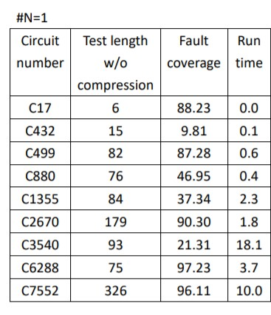
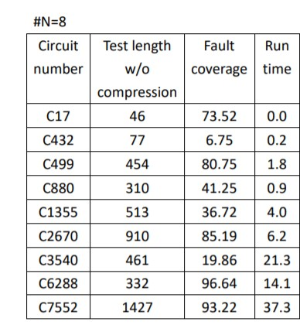
#Part1-Results: N=1 v.s. N=8
Test length Ratio:
5.1/ 5.5/ 4.0/ 6.1/ 5.0/ 4.9/ 4.4/ 4.3

Slide 11
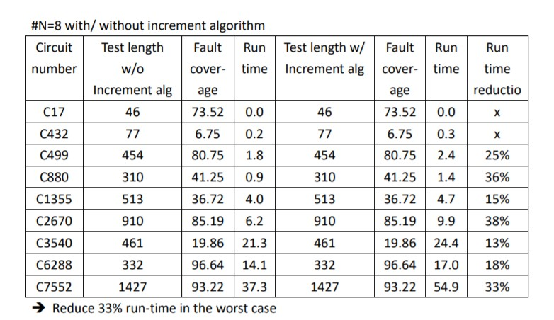
#Part1-Results: New idea in 8-det
Run-time reduction:
x/ x/ 25%/ 36%/ 15%/ 38%/ 13%/ 18%/ 33%
Test pattern & fault coverage are the same.

Slide 12
Outline
Part 1: New idea of TDF-ATPG
Part 1: New idea of N-det
Part 1: Result before test compression
Part 2:
Part 2:
Part 3:
Part 3:

