Slide 1
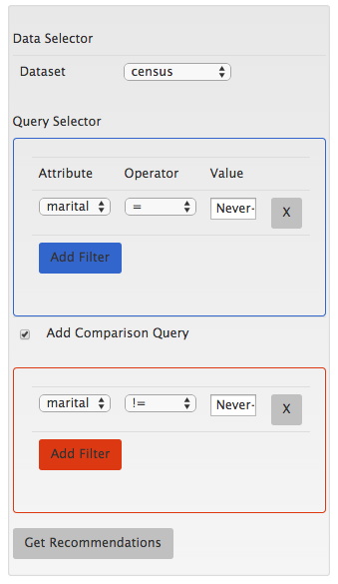
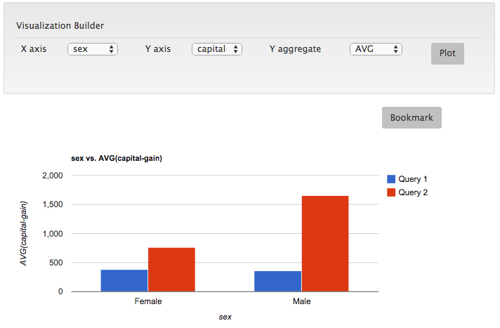
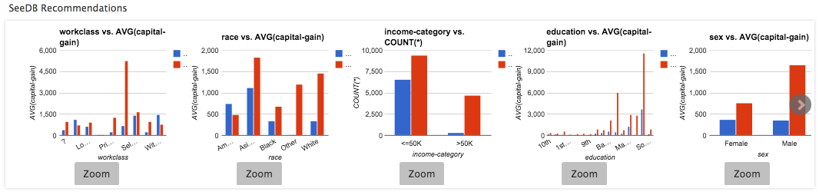
B
A
C
D

Slide 2
R
B
R
M
B
R
B
M
M
B
M
B
M
B

Slide 3
SeeDB: what’s interesting about my query?

Slide 4
Introduction
Why do we need this:
Visualizations can identify interesting trends and help gain insights
But picking the right visualization that will show interesting trends is challenging and requires significant trial and error

Slide 5
System Architecture
Adding group-by + aggregate
Compute utility
Results
UI
Interactions

Slide 6
Demo
Demo walkthrough

Slide 7






User
Selection criteria
SeeDB Frontend
SeeDB engine
Backend DBMS
Query Builder
Q
View Query Generator
SeeDB generated visualizations
SeeDB Optimizer
View and interact with visualizations
Utility Computation and View Selection
Most relevant views

Slide 8
User
Selection criteria
SeeDB Client
SeeDB Server
Query Builder
Q
View Generator
DBMS
SeeDB generated visualizations
Execution Engine
Most relevant views
View and interact with visualizations
View Processor

Slide 9


SeeDB Backend
User
Selection criteria
View Generator
SeeDB Frontend
Query Builder
Q
DBMS-based Execution Engine
Main Memory Execution Engine
SeeDB generated visualizations
Optimizer
SQL Queries
View and interact with visualizations
Most relevant views
DBMS
File System
View Processor

Slide 10
V₁
V₂
V₃
Utility
V₄
Views

