Slide 1
Gadget Seller
Get your Gadgets

Slide 2
Group Members
Afnan Jarif
180042139
Khalid Masum
180042133
Asfi Rahman
180042116

Slide 3
Contents
1.Introduction
2.Problems during in store shopping.
3.Motive
5.Feature analysis.
6.Technology Used.
7. Timeline description.
4.Usage scenario

Slide 4
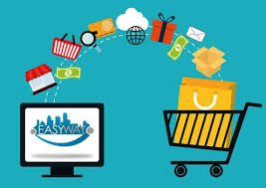
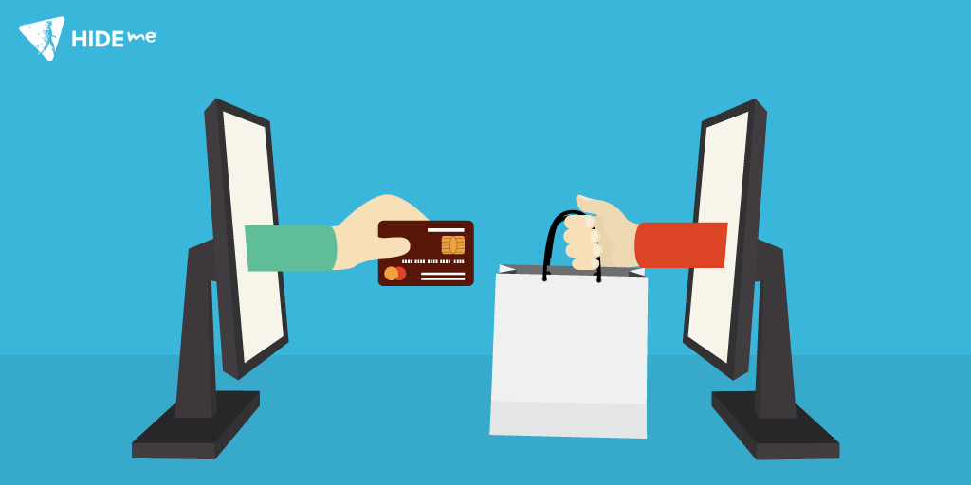
Introduction
The activity of purchasing products, goods and groceries over internet is known as online shopping.
We can buy or sell gadgets.
There are many online shopping sites but for
Gadgets and other grocery there have lackings
One can also use points for parchasing products.

Slide 5
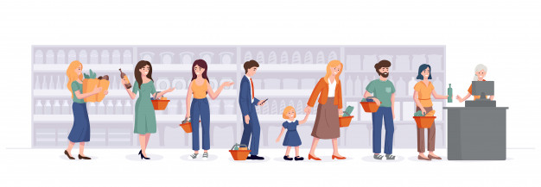
Problems during in store shopping
More time and energy is needed.
Can’t compare different product according to prize.
Varieties are not available.
Have to wait in line.

Slide 6
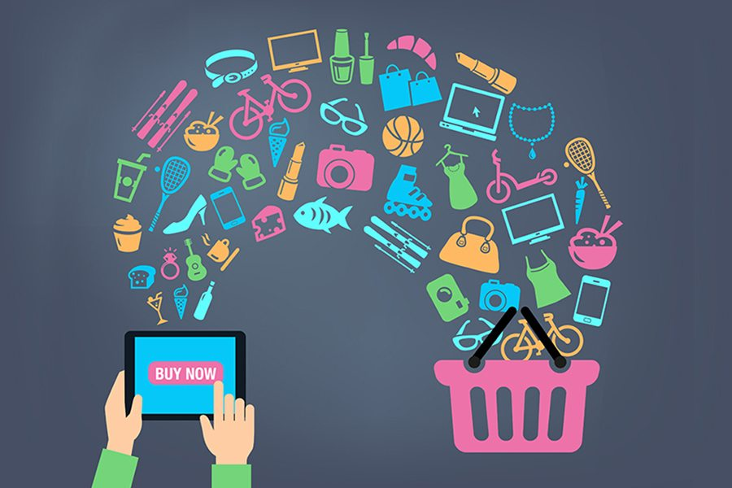
Motive
Creating a place where Customers can view and buy tgings and also can buy or sell things, Using points which can be earned by regular product purchasing from our site.

Slide 7
Usage Scenario
Gadget seller
Business Person
Moderators:
Can change or update products
Admin
Can do everything as moderator as well as remove or add moderators. Basically head .
Customer
View thing, send location info and buy products and earn points.
Reselling things with those points

Slide 8
Features
Customer Perspective:
View and buy things
Earning points by buying things
Selling their own item using these points
Buying any item using points
Businessperson perspective:
Getting statistics about the shop
Adding, removing and updating the products

Slide 9

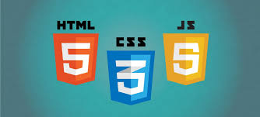


Technologies to be Used

Slide 10
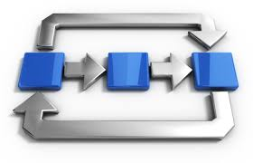
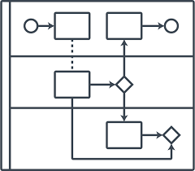
Activity & Swimlane Diagram

Slide 11
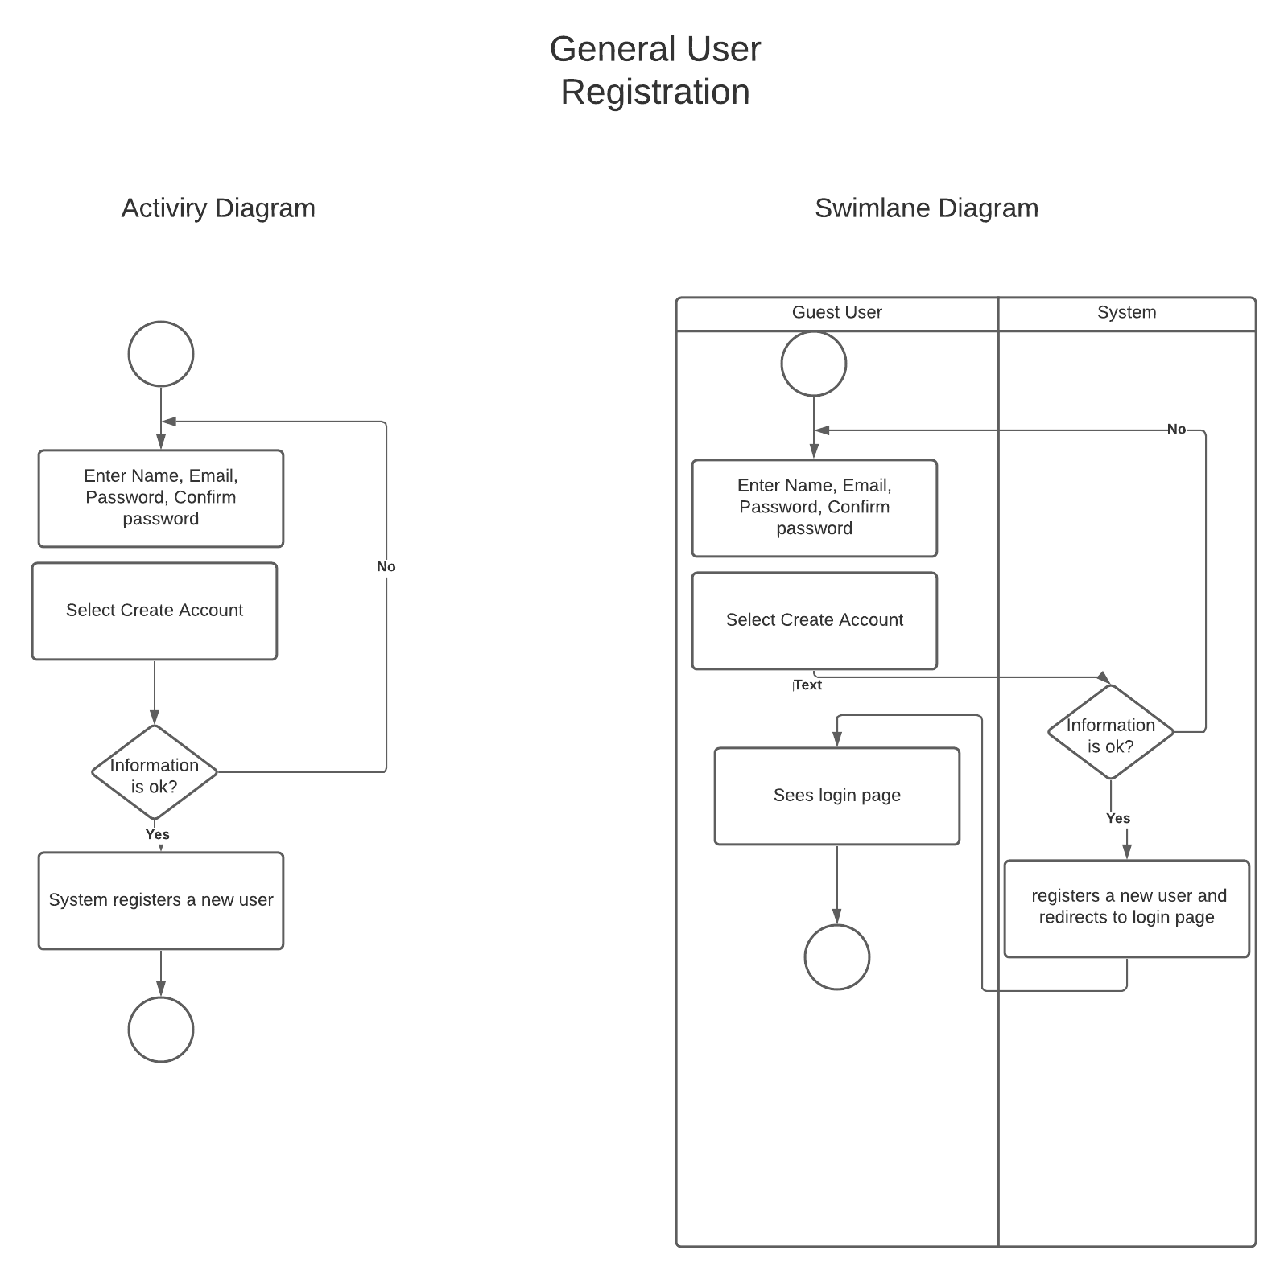

Slide 12
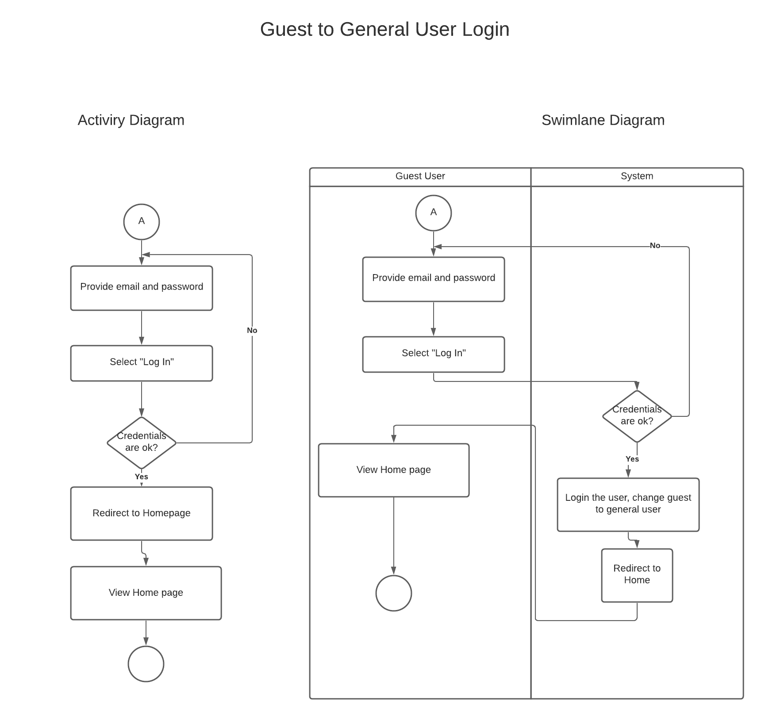

Slide 13
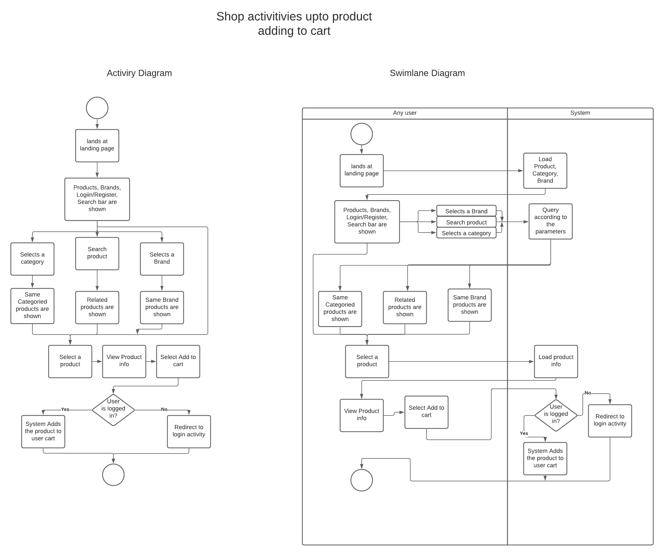

Slide 14
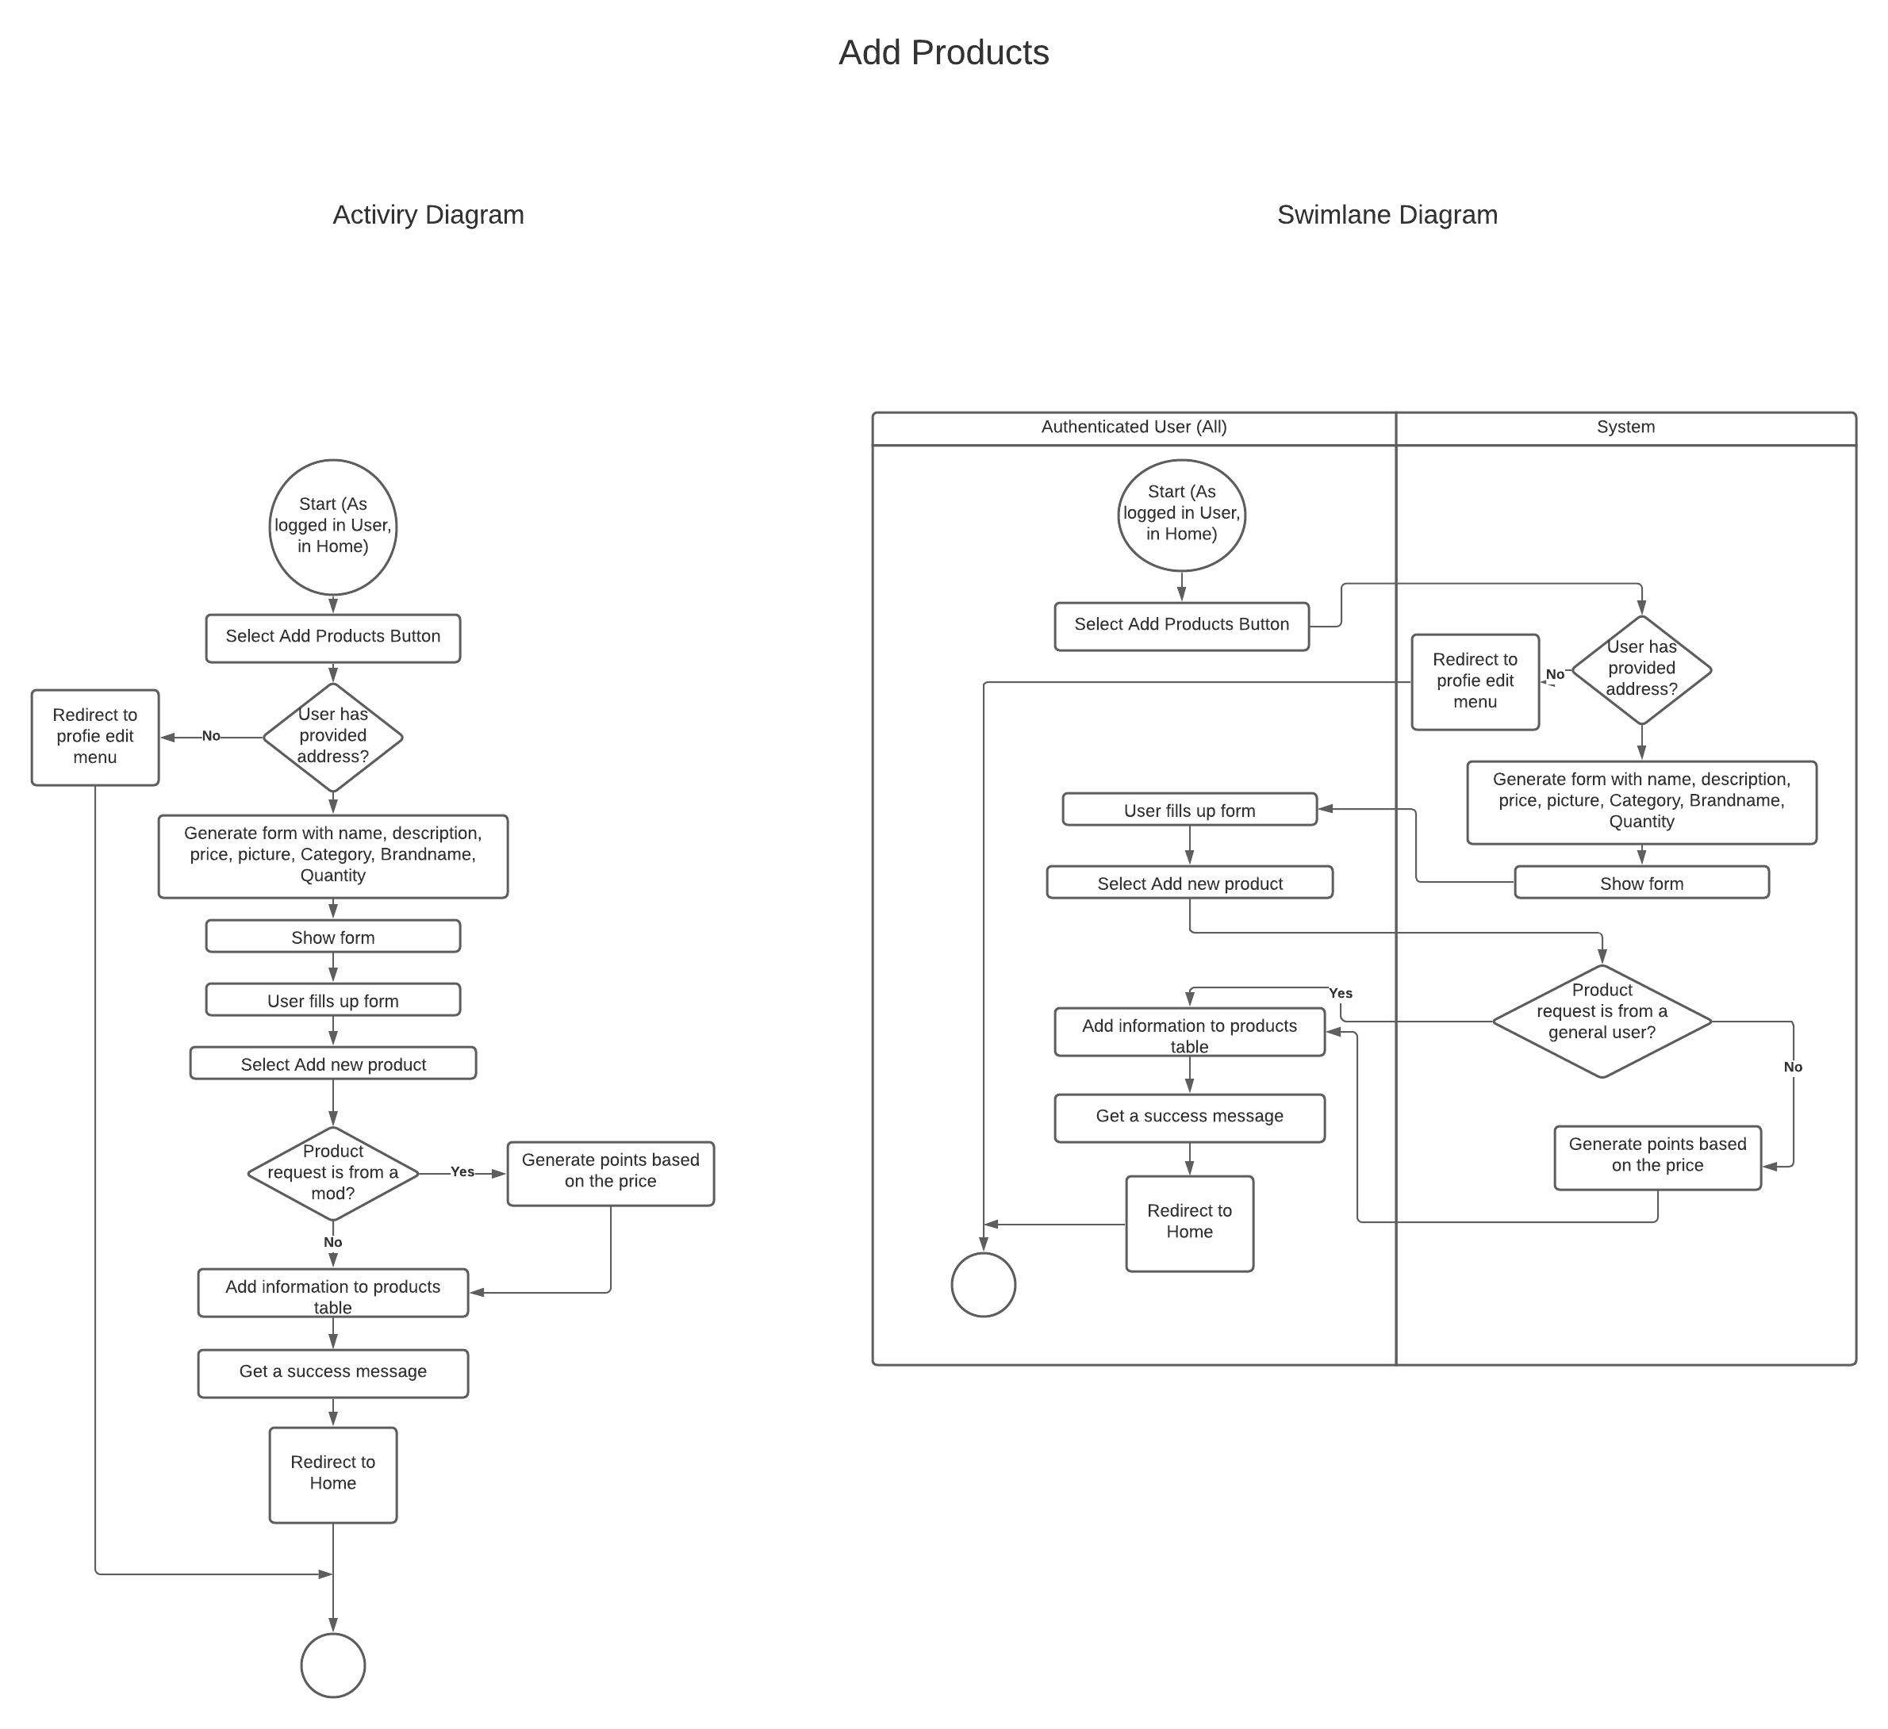

Slide 15
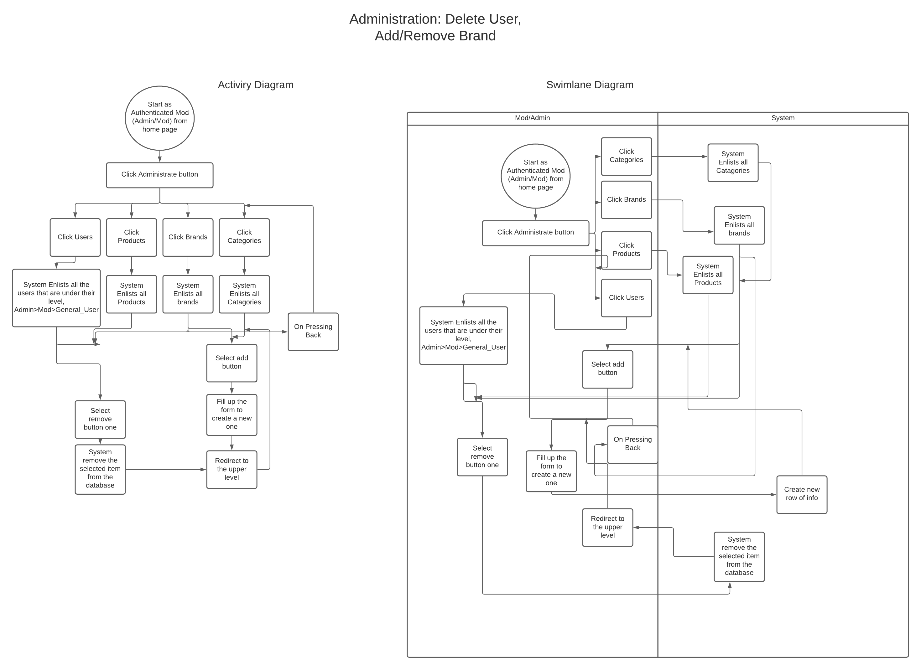

Slide 16
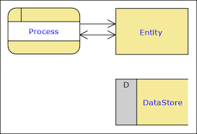
Data Flow Diagram

Slide 17
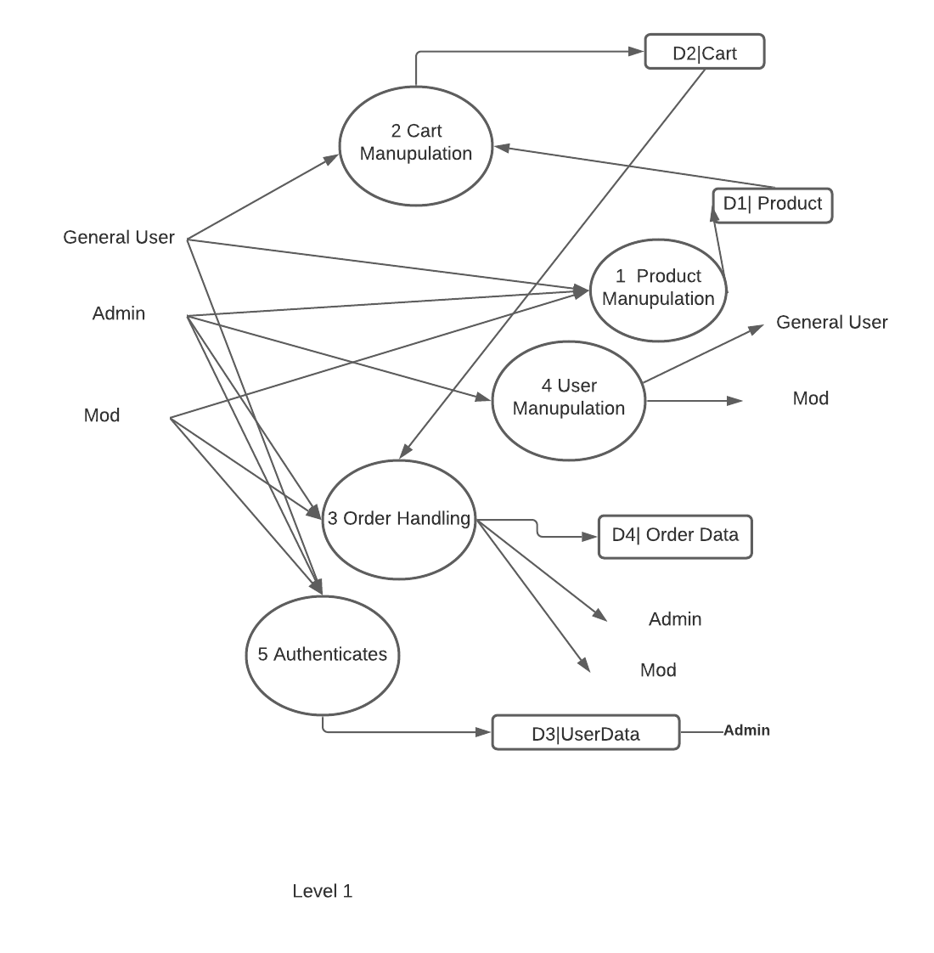
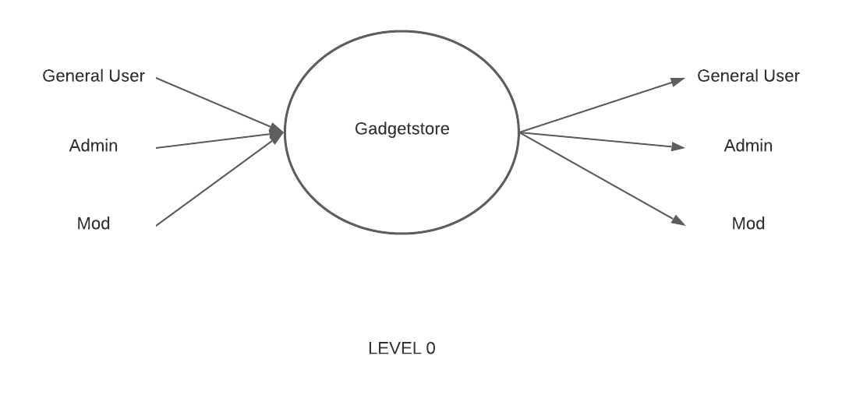

Slide 18
Timeline
Requirement Gathering: October 14
Feasibility Study: October -16-21
Designing: October 23-30
Coding:
Frontend -> November 1- November 20
Backend ->November 21-December 30
Testing and Debugging: January 1- January 10

Slide 19
Conclusion
The project is about to transforming a general store to an online one. So the solution is possible through a software and there are many examples we see in the real world.
The software uses many technologies. Since it’s our first project with web there maybe vulnerabilities. Students can use this software to their security based skills and we welcome it, once the software is completed.
Let’s proceed to the prototype now….

