Slide 1
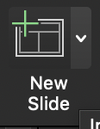
HealthMate
Team 02
Asfiya Misba – 1002028239
Sahiba Khan - 1002083293

Slide 2
Agenda
Introduction
Planning
Design
Implementation
Testing
Future Scope
Demo

Slide 3
Introduction
The HealthMate app is dedicated to fostering holistic wellness by combining cutting-edge technology with a user-centric approach.
At the core of the HealthMate project is a commitment to providing a seamless and personalized experience for every user. From a secure and easy registration process to detailed profile management, the app ensures that each individual can tailor their health journey according to their unique preferences and fitness objectives.
HealthMate introduces an innovative approach to hydration management. The app includes dynamic water intake reminders, offering customizable notifications and real-time monitoring to ensure users maintain optimal hydration levels throughout the day.
The project aims to revolutionize the way users track and achieve their fitness goals.

Slide 4
SDLC Model - Agile

Slide 5
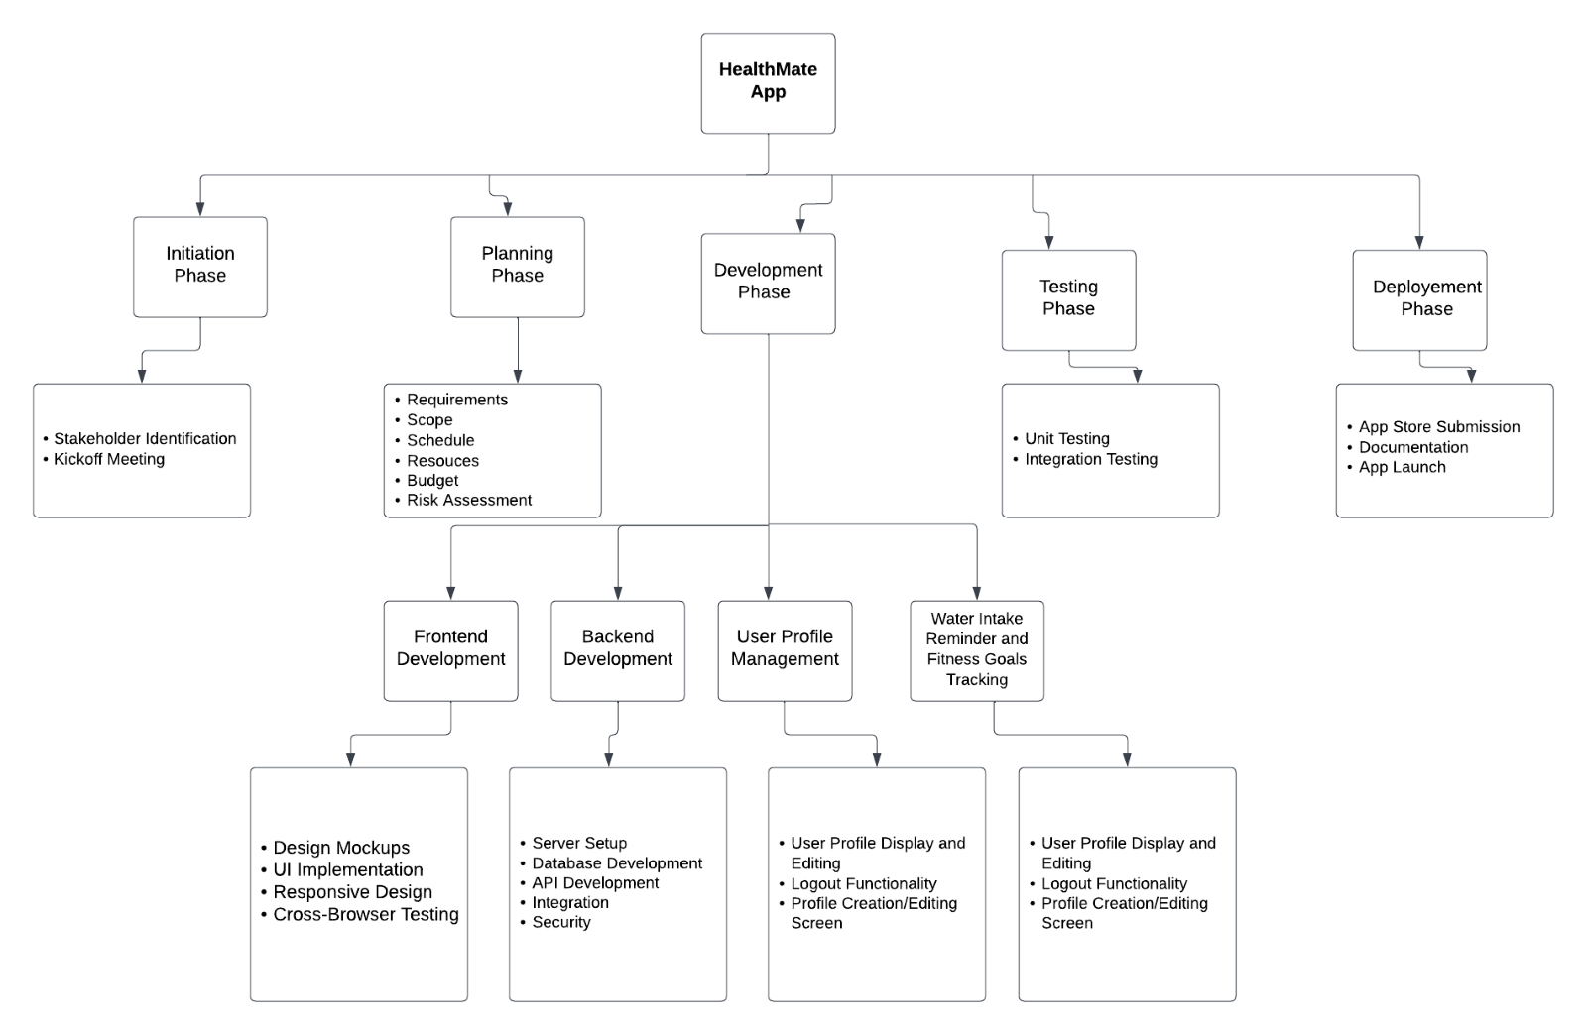
Planning WBS

Slide 6
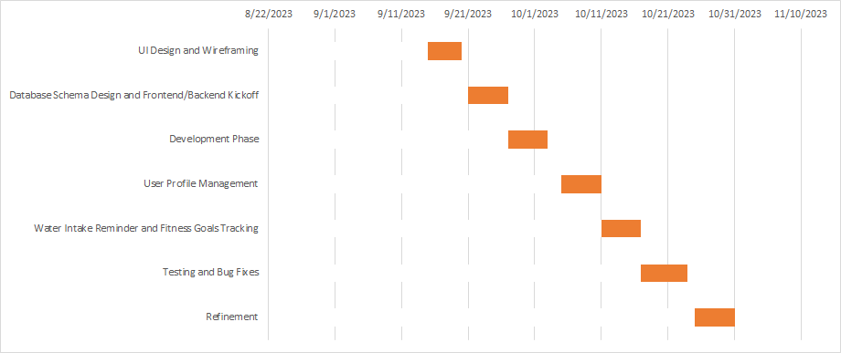
Planning - Gantt Chart

Slide 7
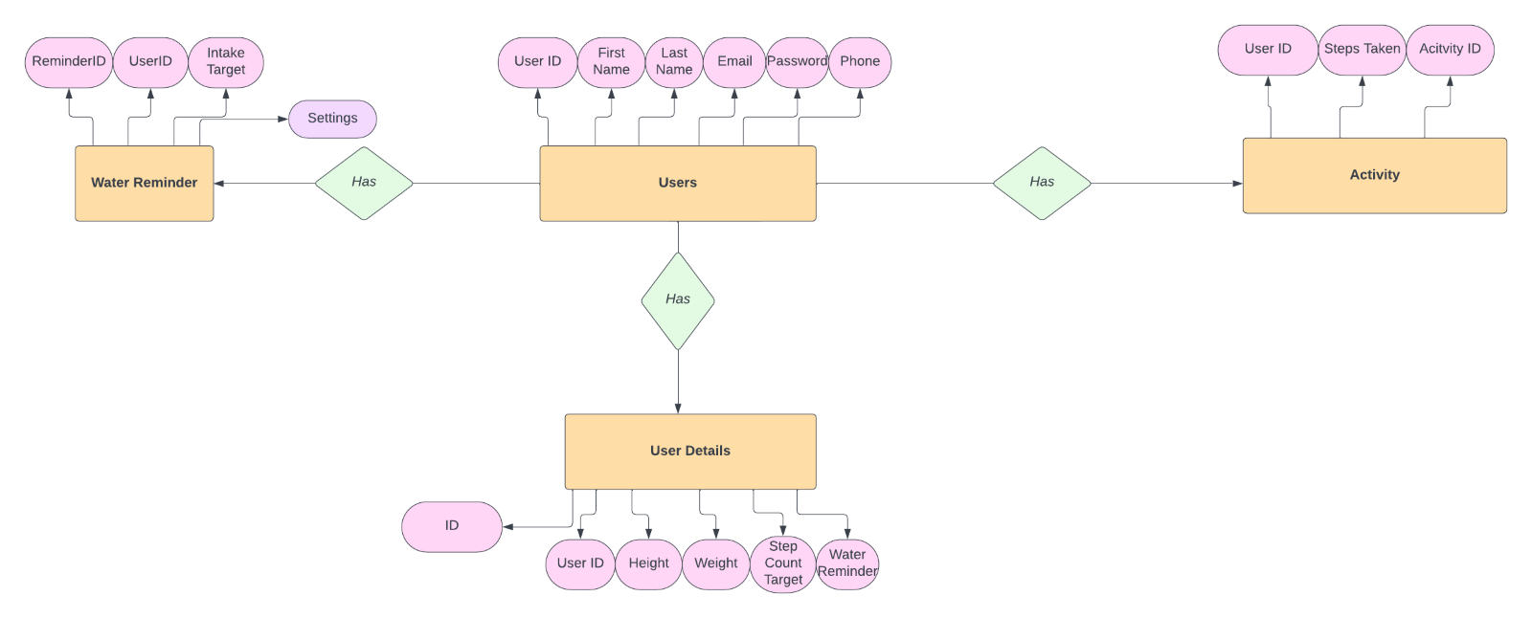
Design – ER Diagram

Slide 8
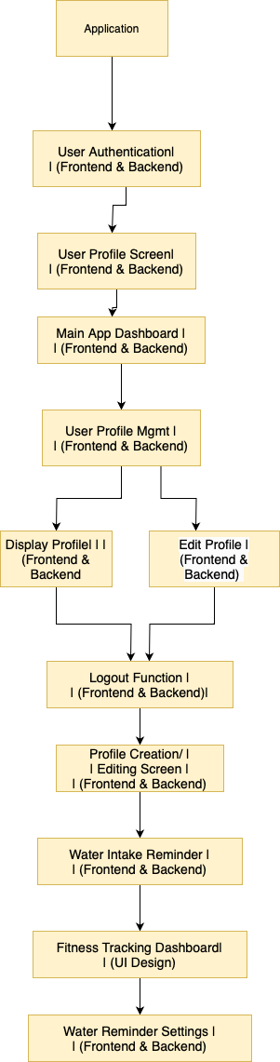
Design - Flowchart

Slide 9
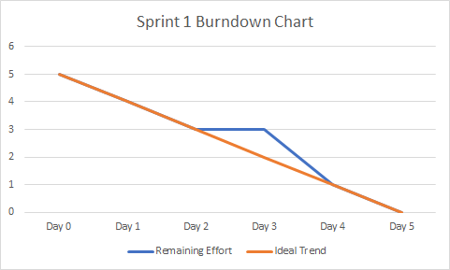
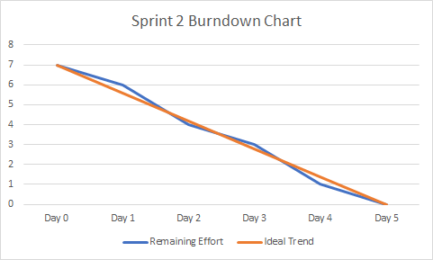
Burndown Charts

Slide 10
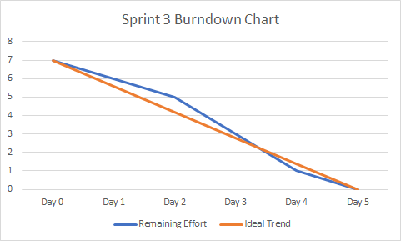
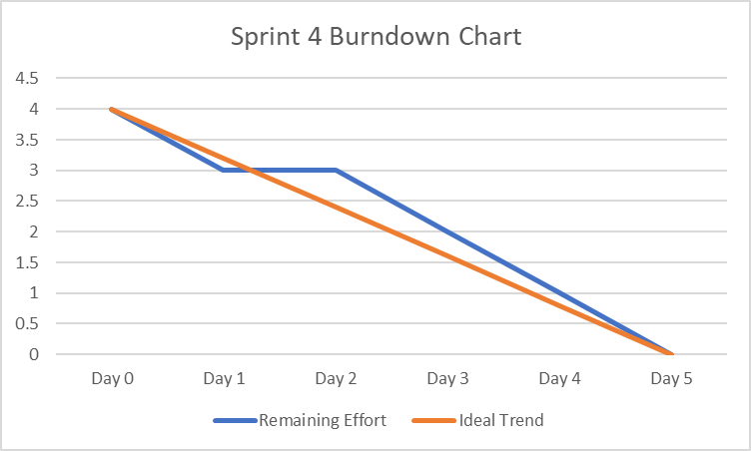
Burndown Charts

Slide 11
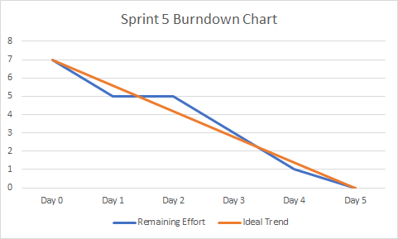
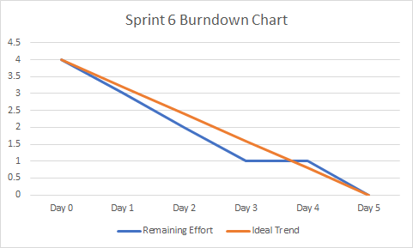
Burndown Charts

Slide 12
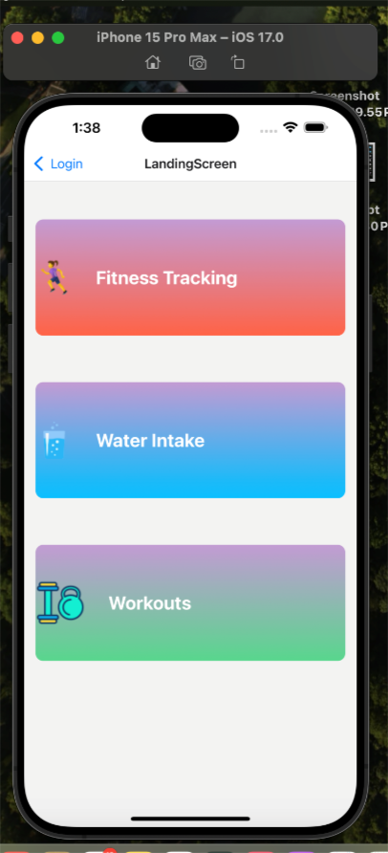
Implementation
Tools Used:
Front-end: React Native
Backend: Node.js
Database: MySQL
Testing: Jest, Mocha

Slide 13
Modules
User Authentication Module
Profile Management Module
Water Intake Reminder Module
Fitness Goal Tracking Module
Fitness Video Access Module

Slide 14
Manual Testing – Sprint 1
Test Case Description | Preconditions | Test Steps | Expected Result | Result
Ensure all stakeholders' inputs are collected. | - N/A | 1. Gather input from stakeholders. | Stakeholders' inputs are documented. | Pass
Verify that non-functional requirements are considered. | - N/A | 1. Review non-functional requirements (e.g., responsiveness, accessibility). | Non-functional requirements are incorporated into design decisions. | Pass
Check for error messages for missing or unclear UI requirements. | - N/A | 1. Review UI requirements documentation. | Clear documentation with no missing elements. | Pass
Confirm wireframes cover all UI elements in requirements. | - N/A | 1. Review wireframes against UI requirements. | Wireframes align with UI requirements. | Pass
Validate wireframes' understandability for all team members. | - N/A | 1. Gather feedback on wireframes from both technical and non-technical team members. | Wireframes are easily understandable by all team members. | Pass
Ensure error messages for missing or incomplete wireframes. | - N/A | 1. Validate completeness of wireframes. | No missing or incomplete wireframes. | Pass
Check for error messages or warnings in the design iteration process. | - N/A | 1. Iteratively review and refine design. | No errors or warnings are present in the design iterations. | Pass
Ensure stakeholders are informed of errors or inconsistencies. | - N/A | 1. Communicate design errors or inconsistencies to stakeholders. | Stakeholders are aware and informed of any design issues. | Pass

Slide 15
Manual Testing – Sprint 2
Test Case Description | Preconditions | Test Steps | Expected Result | Result
Verify database schema alignment with application data model. | - N/A | 1. Review the database schema against the application's data model. | Database schema aligns with the data model. | Pass
Check for appropriate error messages during database setup. | - N/A | 1. Simulate errors during database setup. | Appropriate error messages are displayed for each scenario. | Pass
Ensure error handling for invalid database structure definitions. | - N/A | 1. Intentionally provide invalid structure definitions. | System gracefully handles invalid structure definitions. | Pass
Ensure error messages for incorrect relationships or cardinalities. | - N/A | 1. Intentionally set incorrect relationships. | Error messages indicate incorrect relationships. | Pass
Verify system alerts for potential integrity violations. | - N/A | 1. Intentionally violate data integrity. | System alerts users to potential integrity violations. | Pass
Check for errors in depicting relationships and cardinalities. | - N/A | 1. Review graphical depiction of relationships. | Relationships and cardinalities are accurately depicted. | Pass
Check for errors when dependencies cannot be installed. | - N/A | 1. Intentionally fail dependency installation. | Appropriate error messages are displayed for failed dependencies. | Pass
Verify setup process gracefully handles configuration errors. | - N/A | 1. Intentionally provide incorrect configuration. | Setup process gracefully handles configuration errors. | Pass
Ensure error messages for failures in environment setup. | - N/A | 1. Simulate environment setup failures. | Appropriate error messages for failed environment setup. | Pass
Ensure appropriate error responses for invalid API requests. | - N/A | 1. Make invalid API requests. | Appropriate error responses for invalid requests. | Pass
Verify frontend gracefully handles errors in data fetching. | - N/A | 1. Simulate errors during frontend data fetching. | Frontend gracefully handles errors and provides feedback. | Pass
Confirm error responses for failed endpoint access. | - N/A | 1. Attempt to access non-existing endpoints. | Appropriate error responses for failed endpoint access. | Pass

Slide 16
Manual Testing – Sprint 3
Test Case Description | Preconditions | Test Steps | Expected Result | Result
Check for error messages when user registration fails. | - N/A | 1. Attempt user registration with invalid data. | Appropriate error messages are displayed for registration failures. | Pass
Verify appropriate error responses for failed login attempts. | - N/A | 1. Attempt login with incorrect credentials. | Appropriate error responses for failed login attempts. | Pass
Ensure error handling for authentication token generation issues. | - N/A | 1. Simulate issues during token generation. | System handles token generation issues gracefully. | Pass
Ensure error handling for scenarios where user profile data cannot be retrieved. | User has a registered account. | 1. Invalidate user profile data retrieval. | Appropriate error responses for failed profile data retrieval. | Pass
Verify errors during profile updates are communicated to the user. | User is logged in. | 1. Intentionally fail profile updates. | User is informed of errors during profile updates. | Pass
Confirm error responses for failed profile data retrieval. | User has a registered account. | 1. Invalidate user profile data retrieval. | Appropriate error responses for failed profile data retrieval. | Pass
Check for error messages when the dashboard cannot be loaded. | User is logged in. | 1. Intentionally fail dashboard loading. | Appropriate error messages for failed dashboard loading. | Pass
Verify error responses provided for failed data fetching. | User is logged in. | 1. Intentionally fail data fetching. | Appropriate error responses for failed data fetching. | Pass
Ensure error handling for dashboard rendering issues. | User is logged in. | 1. Simulate dashboard rendering issues. | System gracefully handles dashboard rendering issues. | Pass

Slide 17
Manual Testing – Sprint 4
Test Case Description | Preconditions | Test Steps | Expected Result | Result
Ensure error handling for cases where user profiles cannot be edited. | User is logged in. | 1. Invalidate user profile editing. | Appropriate error responses for failed profile editing. | Pass
Verify errors during profile editing are communicated to the user. | User is logged in. | 1. Intentionally fail profile editing. | User is informed of errors during profile editing. | Pass
Confirm error responses for failed profile editing. | User is logged in. | 1. Invalidate user profile editing. | Appropriate error responses for failed profile editing. | Pass
Check for errors during the logout process and display appropriate messages. | User is logged in. | 1. Intentionally fail logout process. | Appropriate error messages for logout failure. | Pass
Verify attempting to log out without proper authentication results in an error. | - N/A | 1. Attempt to log out without authentication. | Appropriate error messages for unauthorized logout. | Pass
Ensure error handling for logout failure scenarios. | User is logged in. | 1. Simulate logout failure scenarios. | Appropriate error responses for logout failure. | Pass
Ensure error messages displayed for invalid profile creation attempts. | - N/A | 1. Attempt to create a profile with invalid data. | Appropriate error messages for invalid profile creation. | Pass
Verify appropriate error responses for failed profile editing. | User is logged in. | 1. Intentionally fail profile editing. | Appropriate error responses for failed profile editing. | Pass
Confirm error messages for profile creation failures. | - N/A | 1. Simulate profile creation failure scenarios. | Appropriate error messages for profile creation failures. | Pass

Slide 18
Manual Testing – Sprint 5
Test Case Description | Preconditions | Test Steps | Expected Result | Result
Check for error messages when saving water intake reminder settings fails. | User is logged in. | 1. Intentionally fail saving reminder settings. | Appropriate error messages for failed reminder setting updates. | Pass
Verify errors during reminder setting updates are communicated to the user. | User is logged in. | 1. Simulate errors during reminder setting updates. | User is informed of errors during reminder setting updates. | Pass
Ensure error handling for failed reminder setting updates. | User is logged in. | 1. Intentionally fail saving reminder settings. | Appropriate error responses for failed reminder setting updates. | Pass
Ensure error handling for scenarios where the fitness dashboard cannot be displayed. | User is logged in. | 1. Simulate failure in loading the fitness dashboard. | Appropriate error messages for failed dashboard rendering. | Pass
Verify that errors are communicated during UI interactions with fitness tracking. | User is logged in. | 1. Intentionally fail UI interactions in fitness tracking. | User is informed of errors during UI interactions. | Pass
Confirm error messages for failed dashboard rendering. | User is logged in. | 1. Simulate failure in loading the fitness dashboard. | Appropriate error messages for failed dashboard rendering. | Pass
Check for error messages when reminders fail to trigger. | User is logged in. | 1. Intentionally fail reminder triggering. | Appropriate error messages for failed reminder triggering. | Pass
Verify errors during reminder processing are logged for investigation. | User is logged in. | 1. Monitor system logs during reminder processing. | Errors during reminder processing are logged for investigation. | Pass
Ensure error handling for reminder setting failures. | User is logged in. | 1. Intentionally fail reminder setting. | Appropriate error responses for failed reminder setting. | Pass

Slide 19
Manual Testing – Sprint 6
Test Case Description | Preconditions | Test Steps | Expected Result | Result
Verify that appropriate error messages are displayed for failed functionality tests. | - N/A | 1. Execute functionality tests with intentional failures. | Appropriate error messages for failed functionality tests. | Pass
Check for errors when validating data integrity and communicate issues clearly. | - N/A | 1. Perform data integrity tests with intentional violations. | Clear communication of data integrity issues. | Pass
Confirm error messages for failed end-to-end tests. | - N/A | 1. Execute end-to-end tests with intentional failures. | Appropriate error messages for failed end-to-end tests. | Pass
Ensure that errors identified during testing are logged for developers. | - N/A | 1. Log errors identified during testing. | Errors are logged for developer investigation. | Pass
Verify that errors mentioned in bug reports are resolved in a timely manner. | - N/A | 1. Track and resolve reported bugs. | Reported bugs are resolved in a timely manner. | Pass
Confirm error messages for identified bugs. | - N/A | 1. Verify error messages associated with resolved bugs. | Error messages for resolved bugs are confirmed. | Pass

Slide 20
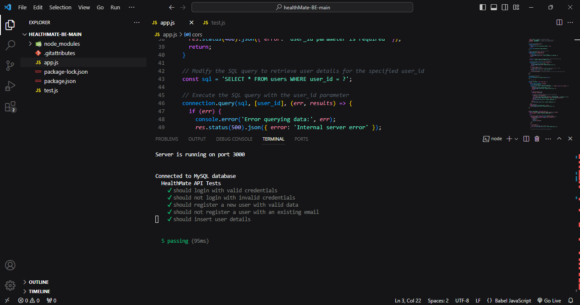
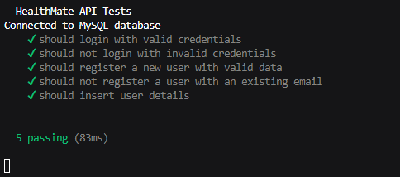
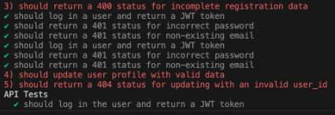
Automation Testing

Slide 21
Task | Sahiba Khan | Asfiya Misba
Sprint 1 - UI Design and Wireframing
- Gather UI requirements | 1 day | -
- Create wireframes | - | 1 day
- Review and iterate designs | - | 1 day
Sprint 2 - Database Schema Design and Frontend/Backend Kickoff
- Define database structure | 1 day | -
- Create entity-relationship diagram | 1 day | -
- Set up development environments (Frontend and Backend) | 1 day | -
- Frontend and Backend development kickoff | - | 1 day
Sprint 3 - Development Phase
- Develop User Authentication (Frontend and Backend) | 2 days | -
- Implement User Profile Screen (Frontend and Backend) | 2 days | -
- Implement Main App Dashboard/Home Screen (Frontend and Backend) | - | 4 days

Slide 22
Task | Sahiba Khan | Asfiya Misba
Sprint 4 - User Profile Management
- Implement User Profile Display and Editing (Frontend and Backend) | 2 days | -
- Implement Logout Functionality (Frontend and Backend) | - | 2 days
- Implement Profile Creation/Editing Screen (Frontend and Backend) | - | 2 days
Sprint 5 - Water Intake Reminder and Fitness Goals Tracking
- Implement Water Intake Reminder Settings Screen (Frontend and Backend) | 2 days | -
- Design Fitness Tracking Dashboard (UI) | 1 day | -
- Implement Water Intake Reminder Settings (Frontend and Backend) | - | 3 days
Sprint 6 – Testing, Bug Fixes and Refinement
- Collaborate on functionality tests, bug identification, and fixes | 3.5 days | 3.5 days
- Review and optimize code | 1.5 days | -
- Enhance UI/UX | - | 1 day
- Conduct performance testing | 1 day | 1 day

Slide 23
Future Scope
Dark Mode & Light Mode:
Features: Personalized themes for comfortable viewing.
Benefits: Reduces eye strain, enhances visual appeal.
Heart Rate Tracking:
Features: Real-time monitoring, customizable zones.
Benefits: Optimizes cardiovascular health.
Workout Video Suggestions:
Features: AI-driven recommendations, diverse routines.
Benefits: Engaging, personalized fitness experience.
Diet Plans:
Features: Personalized meal plans, nutrient tracking.
Benefits: Supports health goals, easy dietary management.

Slide 24
Demo

Slide 26
References
https://www.clearpointstrategy.com/blog/18-key-performance-indicators
https://www.investopedia.com/terms/k/kpi.asp
https://confluence.atlassian.com/jira
https://perpet.io/blog/what-should-be-ui-ux-design-of-fitness-app/

