Slide 1
Active Wheelset Steering (AWS)
SD2231
May 3, 2018
A. Qazizadeh

Slide 2
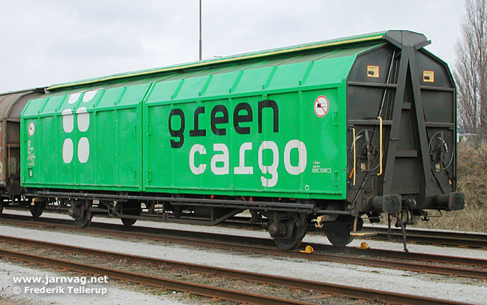
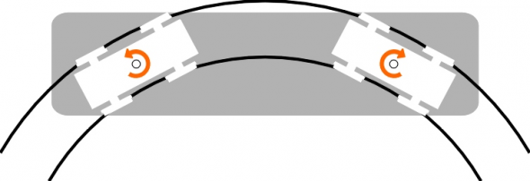
Two-axle rail vehicle
Candidate for a passenger vehicle?
poor comfort
low hunting speed
limited wheelbase (limiting capacity)
Why?
no bogie poor curving (wear, squeal noise)
limited wheelbase

Slide 3
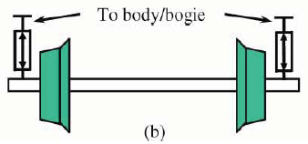
Active Wheelset steering
Possible solution:
Active Wheelset Steering
better curving (less wear)
increasing wheelbase (increasing capacity)
Wheelset top view

Slide 4
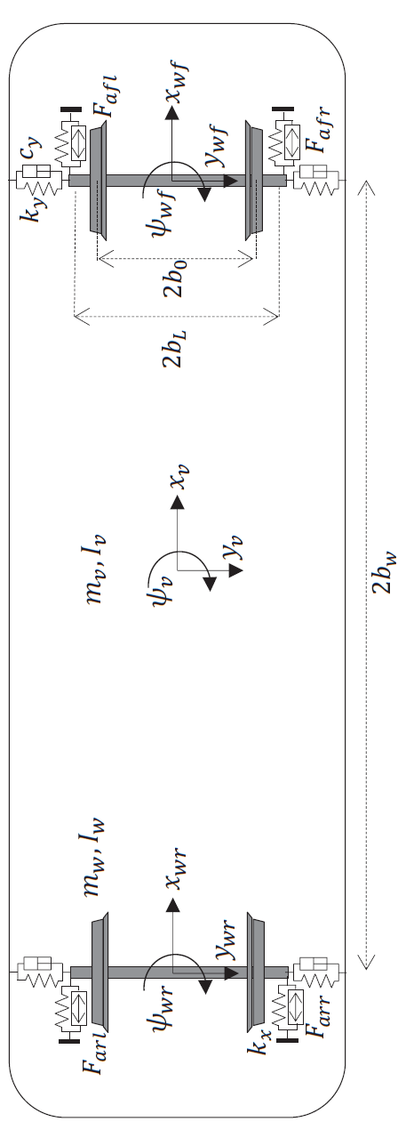
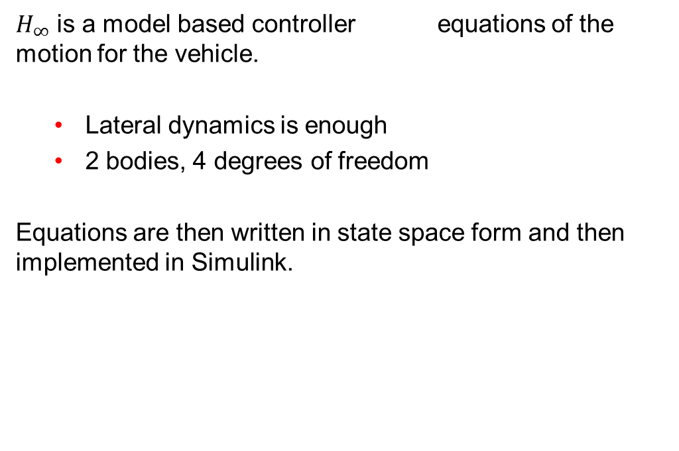
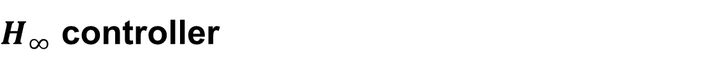
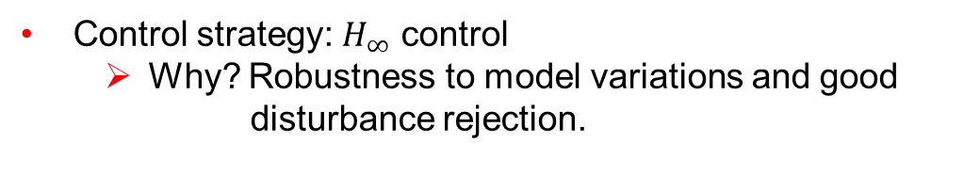
$H_{∞}$ controller
Control strategy: $H_{∞}$ control
Why? Robustness to model variations and good disturbance rejection.
$H_{∞}$ is a model based controller equations of the motion for the vehicle.
Lateral dynamics is enough
2 bodies, 4 degrees of freedom
Equations are then written in state space form and then implemented in Simulink.

Slide 5
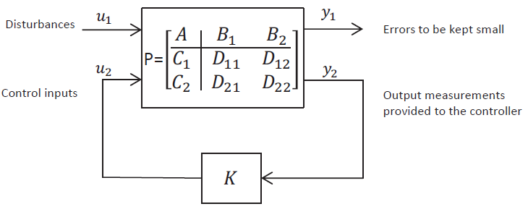

Controller design: $H_{∞}$ controller
input yaw angle of the wheelset
output torque to be applied by actuators

Slide 6
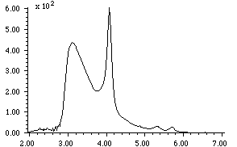


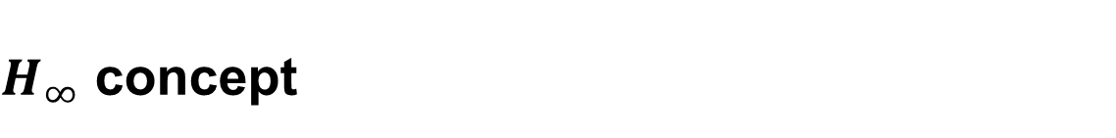



$H_{∞}$ concept
$H_{∞}$ norm:
of a transfer function is its maximum magnitude over the whole frequency range.
${\left\|T(iw)\right\|}_{∞}=\sup_{w}{ \left|T(iw)\right|}$
T(s)
r
$$P(s)$$
y
$H_{∞}$ control tries to design the controller $K$ such that the infinity norm of the closed loop transfer function $T(s)$ is minimized.
We can focus this minimization process on specific frequency ranges by proper weighting functions $W(s)$ (penalizing)
+
-
$$K(s)$$
$$W(S)$$
frequency

Slide 7
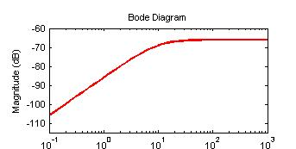
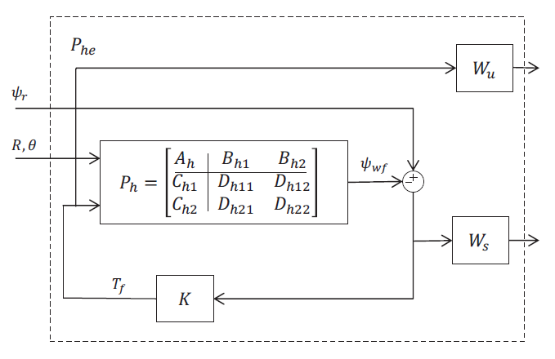
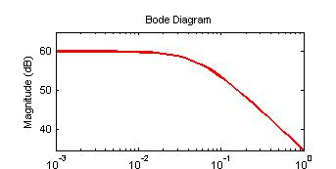
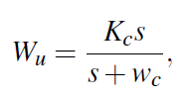

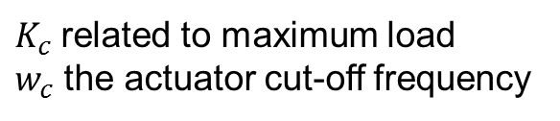

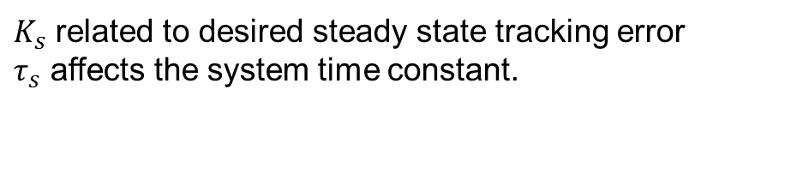
Weighting functions
reference yaw angle
The $H_{∞}$control is tuned through selection of weighting functions
radius, cant angle
wheelset yaw
torque
error signal
$K_{c}$related to maximum load
$w_{c}$ the actuator cut-off frequency
$K_{s}$ related to desired steady state tracking error
$τ_{s}$ affects the system time constant.

Slide 8
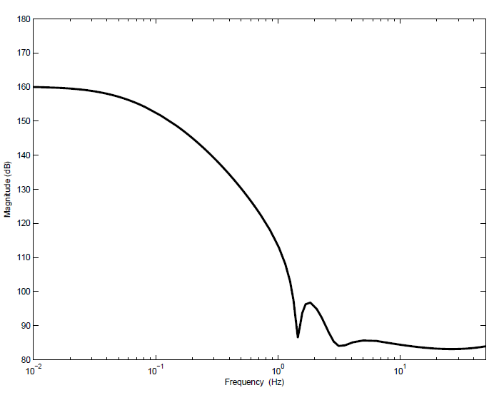

Designed Controller $K$
controller has high magnitude at lower frequencies which provides good reference tracking and low magnitude at higher frequencies for better disturbance rejection.

Slide 9
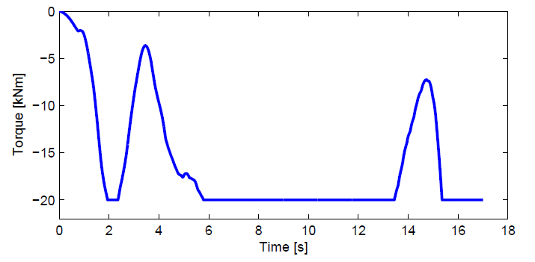
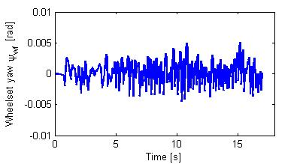
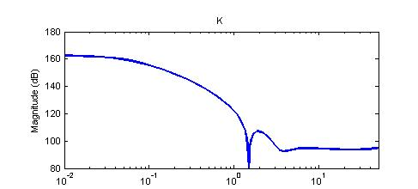
Actuator force request
Low frequency content as expected from the physics of the problem.
Random behaviour
Follows low frequency and disregards high frequencies.

Slide 10
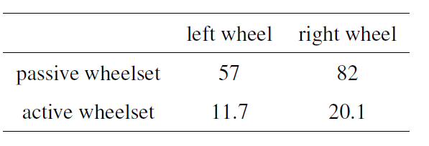

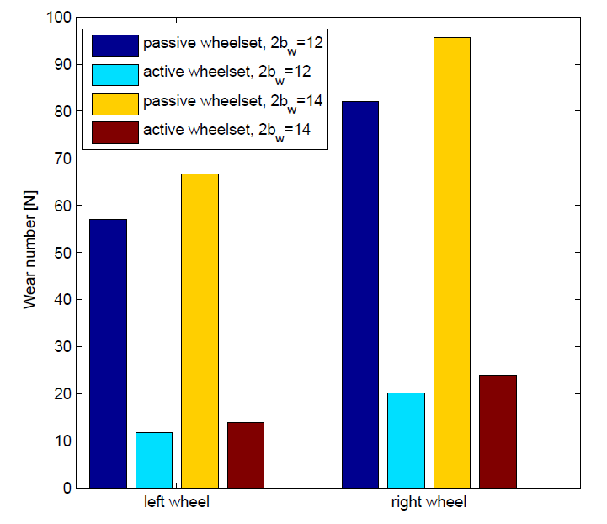
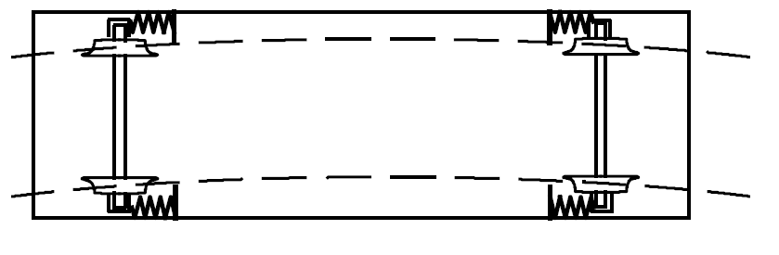

Wear number
wear number [N]
Increasing axle distance by 2 m
$$2b_{w}$$
By increasing wheelbase wear number increases as well.
AWS brings significant reduction in wear number.

Slide 11
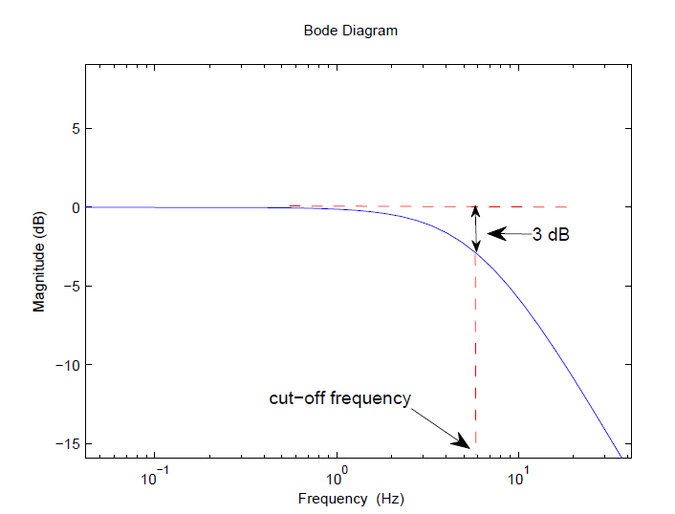
Cut-off frequency:
Cut-off frequency is a boundary in a system’s frequency response at which energy flowing through the system is dropped to half the pass-band power:

