Slide 1
APPLIED VEHICLE DYNAMICS SD2231 – Lab 1 Group 4 Slip Control
Ansh Gandhi
Ankur Fartyal

Slide 2
Our unique feature
Created scripts that automate simulations and generate results and usage of Simulation Data inspector to compare results during tuning
Using both pedal position and acceleration to design the activation logic.
ABS operates using both motor and brake torques.
Work ongoing – Implementing TCS to control both motor and brake torque
Notes:
1. to optimize the feedthrough gains and controller gains using minimal manual iterations.
4. Implementing TCS to not only lower the torque but also to provide brake torque (assuming brake by wire) in order to handle the transient phase at launch more gracefully.

Slide 3
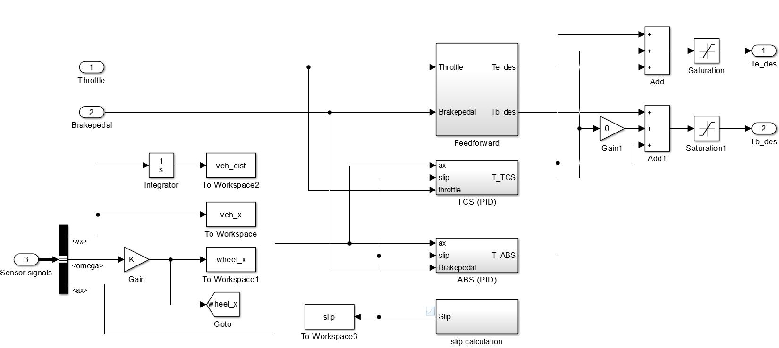
Controller Block

Slide 4
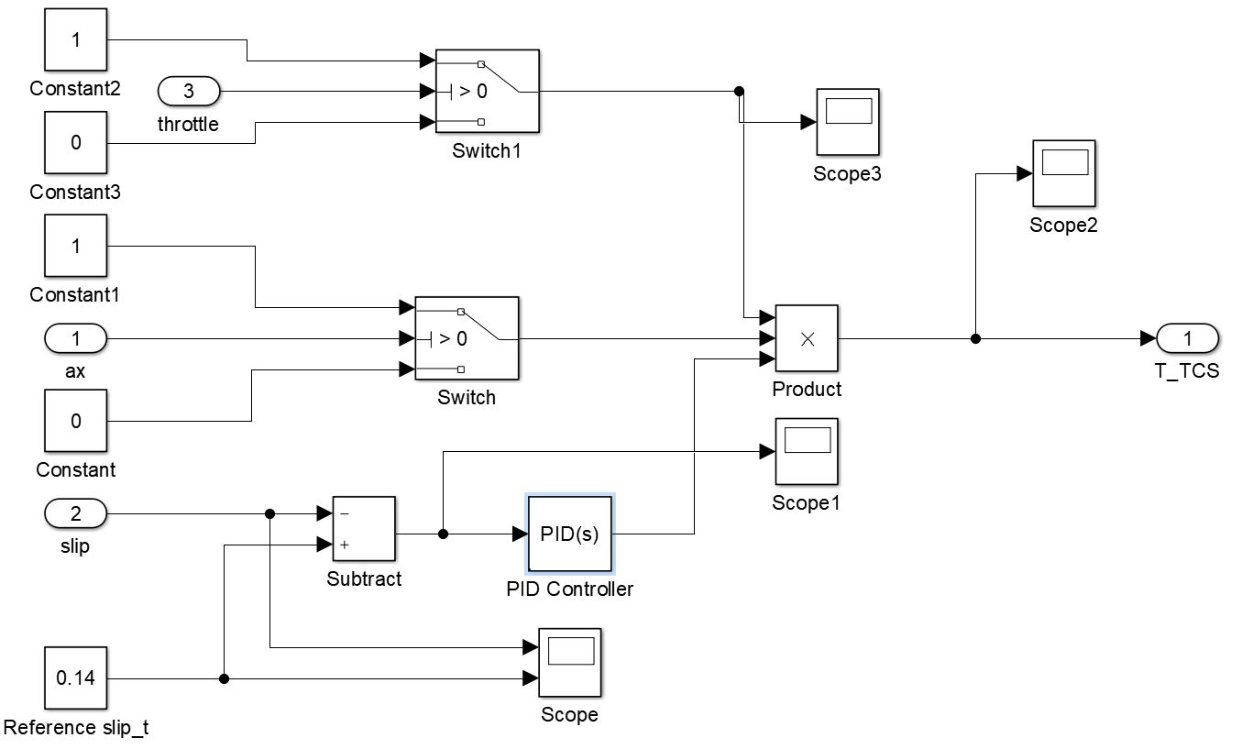
Activation Logic TCS

Slide 5
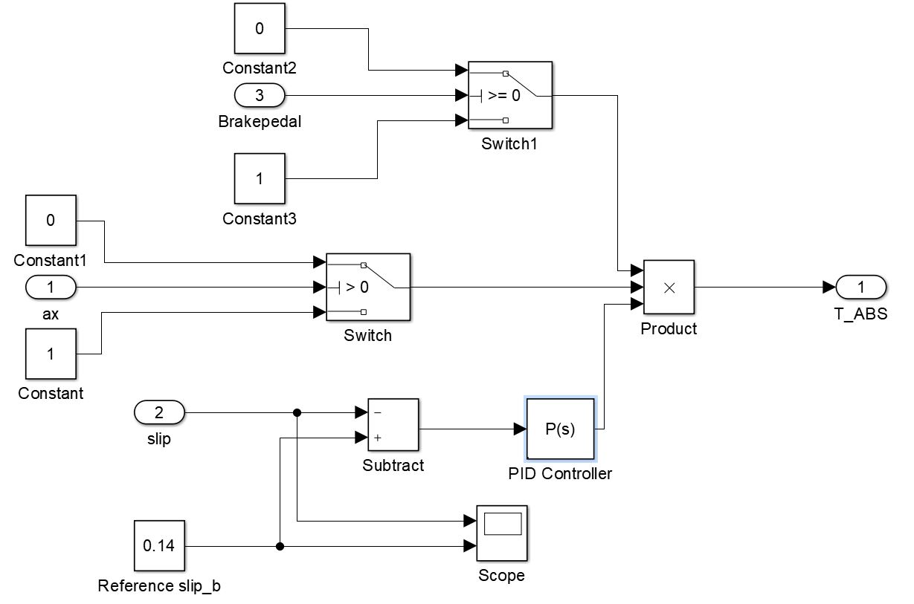
Activation Logic ABS

Slide 6
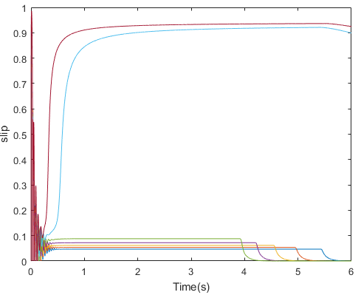
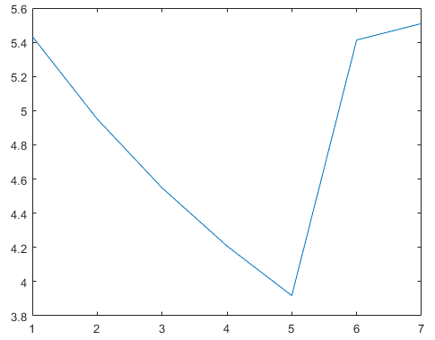
Iterative Looping

Slide 7
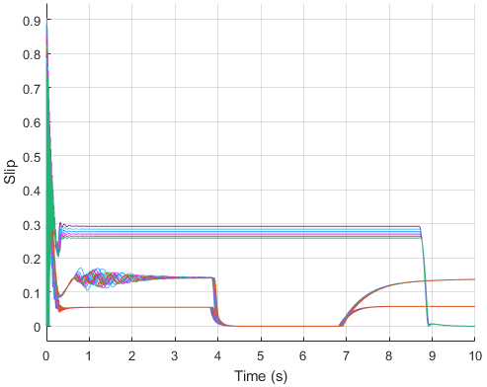
Iterative Tuning of Controllers

Slide 8
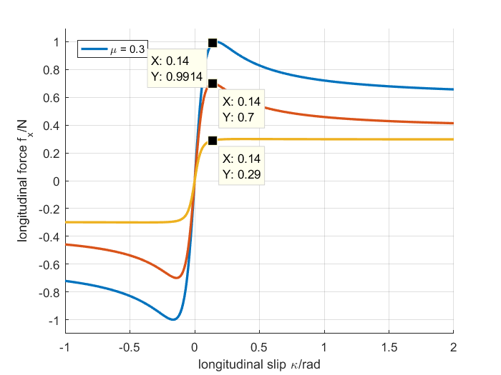
Deciding reference Mu values

Slide 9
Our most difficult part
Debugging and establishing robust activation logic
Troubleshooting the ‘delta torque logic’ to foresee and avoid pitfalls
Implementing TCS in both motor and brake torques leads to very unexpected results for which there are a few possible theories but no clear explanation. The expected result was that the system would be able to approach desired slip faster.
Arriving at single gain values for P, PD, PI and PID for all surfaces at the same time in the road vehicle was a very tedious job.
Quantifying ‘instability’ in Task 2c for Rail vehicles. Which slip is considered too much?
Notes:
4. Specially for TCS because the controller that gave the best control characteristics usually gave worse times than the uncontrolled case due to the transient phase at launch.

Slide 10
Our Final Results

Slide 11
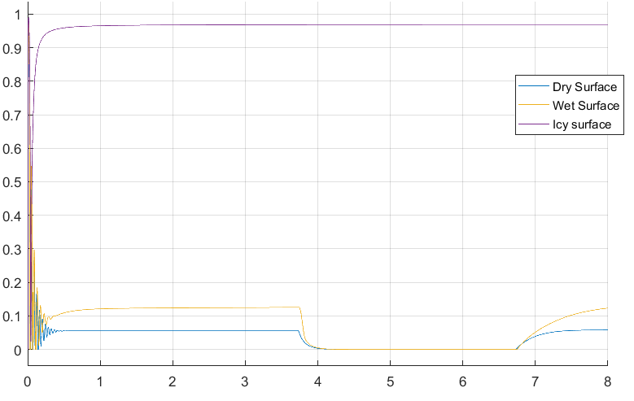
Uncontrolled Traction

Slide 12
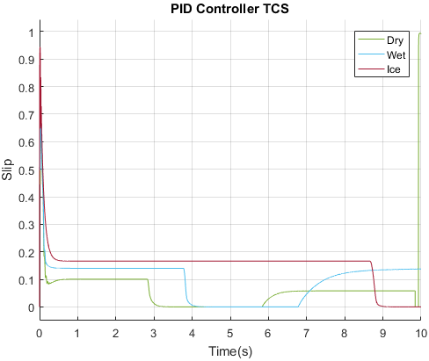
Road Traction Control System

Slide 13
Road Vehicle: TCS acceleration times (in seconds)
Controller | Dry | Wet | Ice
Uncontrolled | 3.73 s | 3.74 s | 8.56 s
P | 2.94 s | 3.88 s | 8.81 s
PD | 2.84 s | 3.76 s | 8.60 s
PI | 2.93 s | 3.88 s | 8.77 s
PID | 2.82 s | 3.78 s | 8.67 s
PID Controller saves 0.91 seconds (on Dry surface)
Notes:
Red- lowest times- best possible controlled
Green-uncontrolled time is lowest

Slide 14
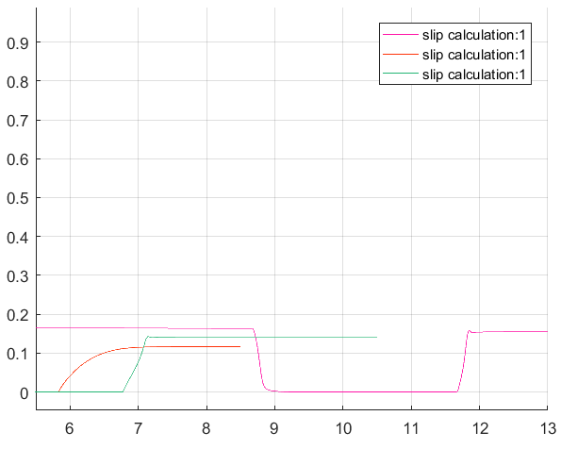
Road Anti Lock Braking System

Slide 15
Road Vehicle: ABS braking distance (in meters)
Controller | Dry | Wet | Ice
Uncontrolled | 45.69m | 56.64m | 176.03m
P | 33.48m | 54.26m | 177.20m
PD | 32.44m | 54.26m | 177.23m
PI | 32.44m | 54.26m | 177.20m
PID | 32.09m | 54.25m | 177.79m
PID Controller saves 13.6m on Dry and 2.39m on Wet
All controllers give similar results. PD and PID give most stable response

Slide 16
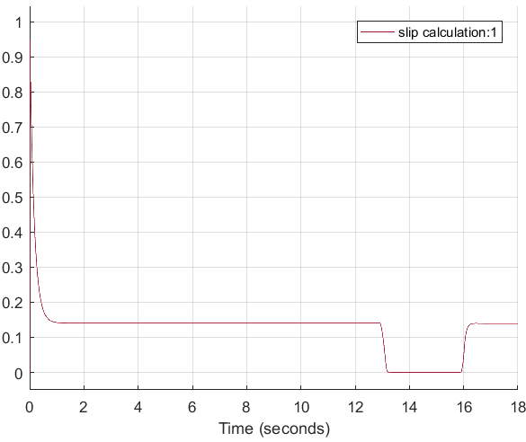
Rail Slip Control

Slide 17
Rail Vehicle: TCS acceleration times (in seconds)
Controller | Acceleration time (in seconds)
Uncontrolled | 12.80 s
P | 13.02 s
PD | 12.92 s
PI | 13.02 s
PID | 12.90 s
PID Controller gives best controlled time
and most stable response
Notes:
No difference between P and PI

Slide 18
Rail Vehicle: ABS braking distance (in meters)
Controller | Braking Distance (in meters)
Uncontrolled | 300.74m
P | 284.78m
PD | 284.79m
PI | 284.78m
PID | 284.79m
PID gives most stable response despite a negligible tradeoff
in stopping distance

Slide 19
Questions!!

