Slide 1
Microprocessor assignment
SIMPLE ARDUINO HAND GESTURE CONTROL
CAR

Slide 2
ABSTRACT
Gesture Controlled Car is a robot which can be controlled by simple human gestures.
The user just needs to wear a gesture device in which a sensor is included.
The sensor will record the movement of hand in a specific direction which will result in the motion of the robot in the respective directions.

Slide 3
ABSTRACT
The robot and the Gesture instrument are connected wirelessly through radio waves.
User can interact with the robot in a more friendly way due to the wireless communication.
We can control the car using accelerometer sensors connected to a hand glove.

Slide 4
MECHANISM
Movement of car is controlled by the differential mechanism.
The mechanism involves the rotation of both forth & rear wheels of left or right side to move in the anticlockwise direction and the other pair to rotate in the clockwise direction which makes the car to rotate about its own axis without any kind of forward or backward motion.
The main advantage of this mechanism is the car with this mechanism can take sharp turn without any difficulty.

Slide 5
INTRODUCTION
The robot is usually an electro-mechanical machine that can perform tasks automatically.
Robots can be autonomous, semi-autonomous or remotely controlled.

Slide 6
HUMAN-MACHINE INTERACTION
An important aspect of a successful robotic system is the Human-Machine interaction.
Gestures originate from any bodily motion or state but commonly originate from the face or hand. Gesture recognition can be considered as a way for computer to understand human body language.
This has minimized the need for text interfaces and GUIs (Graphical User Interface).

Slide 7
GESTURE
A gesture is an action that has to be seen by someone else and has to convey some piece of information. Gesture is usually considered as a movement of part of the body, esp. a hand or the head, to express an idea or meaning.

Slide 8
Hardware requirements
Arduino UNO
Adxl335 accelerometer
HT12E + HT12D Encoder Decoder IC
RF Wireless Transmitter Receiver Module
Few jumper wires
Bread board
L293D Motor Driving Module

Slide 9
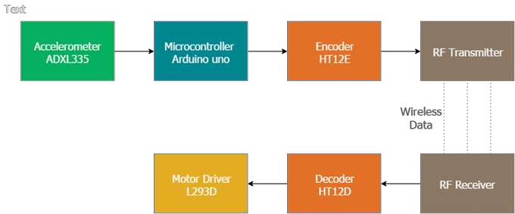
BLOCK DIAGRAM

Slide 10
ARDUINO UNO
The Uno is a microcontroller board based on the ATmega328P. It has 14 digital input/output pins (of which 6 can be used as PWM outputs), 6 analog inputs, a 16 MHz quartz crystal, a USB connection, a power jack, an ICSP header and a reset button.
It contains everything needed to support the microcontroller; simply connect it to a computer with a USB cable or power it with a AC-to-DC adapter or battery to get started..

Slide 11
“UNO”
"Uno" means one in Italian and was chosen to mark the release of Arduino Software (IDE) 1.0. The Uno board and version 1.0 of Arduino Software (IDE) were the reference versions of Arduino, now evolved to newer releases.
The Uno board is the first in a series of USB Arduino boards, and the reference model for the Arduino platform; for an extensive list of current, past or outdated boards see the Arduino index of boards.

Slide 12
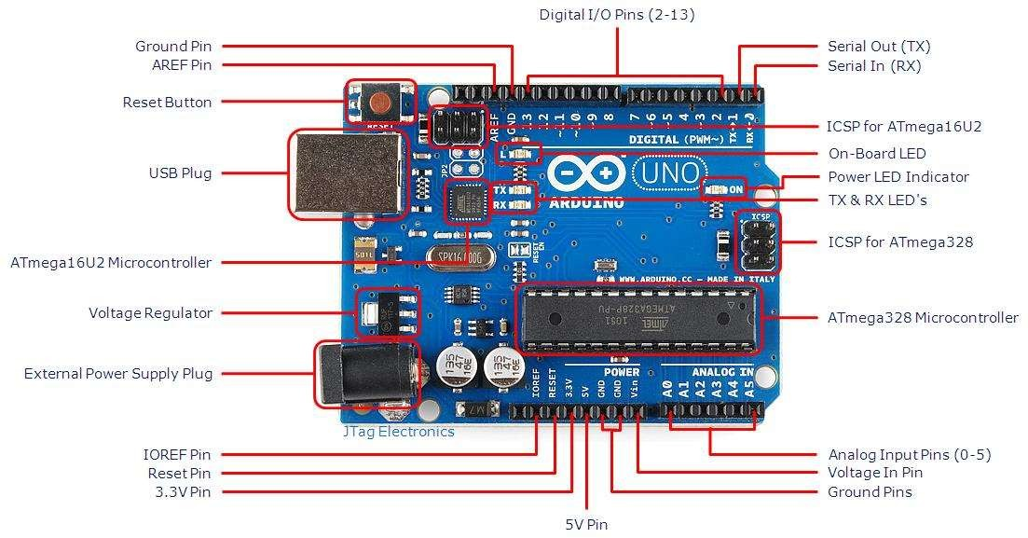
ARDUINO BLOCK DIAGRAM

Slide 13
Adxl335 Accelerometer
This is a complete three-axis acceleration measurement system. ADXL335 has a minimum measurement range of ±3g.
It contains a poly-silicon-surface micro-machined sensor and signal-conditioning circuitry to implement open-loop acceleration measurement architecture.
Output signals are analogue voltages that are proportional to acceleration.

Slide 14
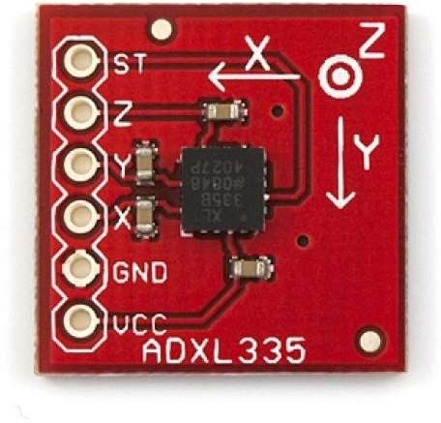
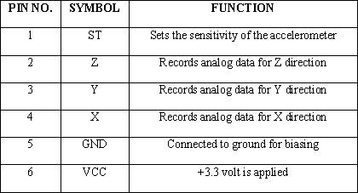
Accelerometer Diagram
ADXL335 Accelerometer
Pin description for Accelerometer

Slide 15
HT12E ENCODER
is an encoder integrated circuit of 212 series of encoders. They are paired with 212 series of decoders for use in remote control system applications. It is mainly used in interfacing RF and infrared circuits.
Simply put, HT12E converts the parallel inputs into serial output. It encodes the 12 bit parallel data into serial for transmission through an RF transmitter. These 12 bits are divided into 8 address bits and 4 data bits.

Slide 16
WORKING OF HT12E ENCODER
HT12E has a transmission enable pin which is active low. When a trigger signal is received on TE pin, the programmed addresses/data are transmitted together with the header bits via an RF or an infrared transmission medium
HT12E begins a 4-word transmission cycle upon receipt of a transmission enable.
This cycle is repeated as long as TE is kept low. As soon as TE returns to high, the encoder output completes its final cycle and then stops

Slide 17
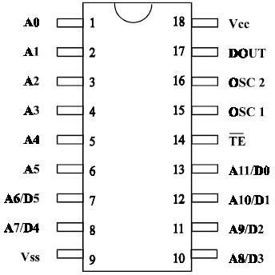
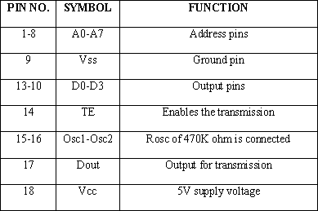
PIN DIAGRAM
Figure HT12E IC
Pin description for HT12E

Slide 18
HT12D Decoder IC
HT12D is a decoder integrated circuit that belongs to 2¹² series of decoders. This series of decoders are mainly used for remote control system applications, like burglar alarm, car door controller, security system etc.
HT12D is capable of decoding 12 bits, of which 8 are address bits and 4 are data bits. The data on 4 bit latch type output pins remain unchanged until new is received.

Slide 19
FUNCTION OF HT12D DECODER
In simple terms, HT12D converts the serial input into parallel outputs.
It decodes the serial addresses and data received by, say, an RF receiver, into parallel data and sends them to output data pins.
The serial input data is compared with the local addresses three times continuously.
The input data code is decoded when no error or unmatched codes are found.
A valid transmission in indicated by a high signal at VT pin.

Slide 20
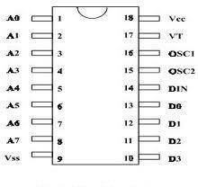
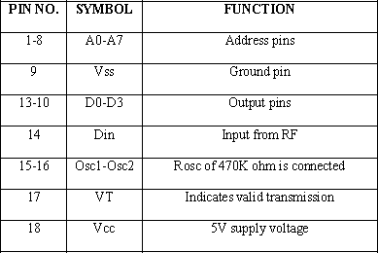
PIN DIAGRAM
Pin description for HT12D
Figure HT12dD IC

Slide 21
RF Module
Radio frequency (RF) is a rate of oscillation in the range of about 3 KHz to 300 GHz, which corresponds to the frequency of radio waves, and the alternating currents which carry radio signals.
Although radio frequency is a rate of oscillation, the term "radio frequency" or its abbreviation "RF" are also used as a synonym for radio – i.e. to describe the use of wireless communication, as opposed to communication via electric wires
The RF module is working on the frequency of 433 MHz and has a range of 100-200 meters

Slide 22
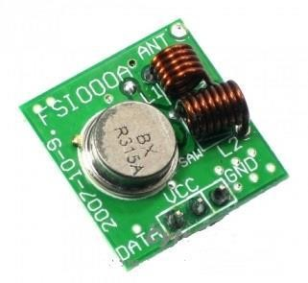
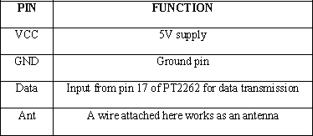
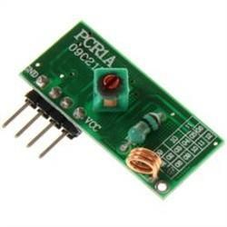
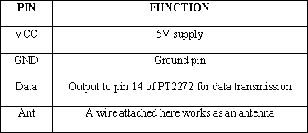
RF-TRANSMITTER & RECEIVER
Figure RF Transmitter
Table Pin description for RF Tx
Figure RF Receiver
Table Pin description for RF Rx

Slide 23
Motor Driving Module (L293D)
It is also known as H-Bridge or Actuator IC. Actuators are those devices which actually gives the movement to do a task like that of a motor. In the real world there are different types of motors available which work on different voltages. So we need a motor driver for running them through the controller.
The output from the microcontroller is a low current signal. The motor driver amplifies that current which can control and drive a motor. In most cases, a transistor can act as a switch and perform this task which drives the motor in a single direction.

Slide 24
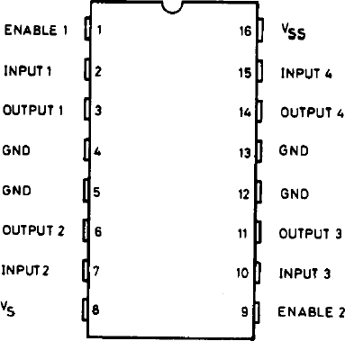
PIN DIAGRAM

Slide 25
FUNCTION OF MOTOR-DRIVING MODULE.
Turning a motor ON and OFF requires only one switch to control a single motor in a single direction.
We can reverse the direction of the motor by simply reversing its polarity.
This can be achieved by using four switches that are arranged in an intelligent manner such that the circuit not only drives the motor, but also controls its direction.
Out of many, one of the most common and clever design is a H-bridge circuit where transistors are arranged in a shape that resembles the English alphabet "H".

Slide 26
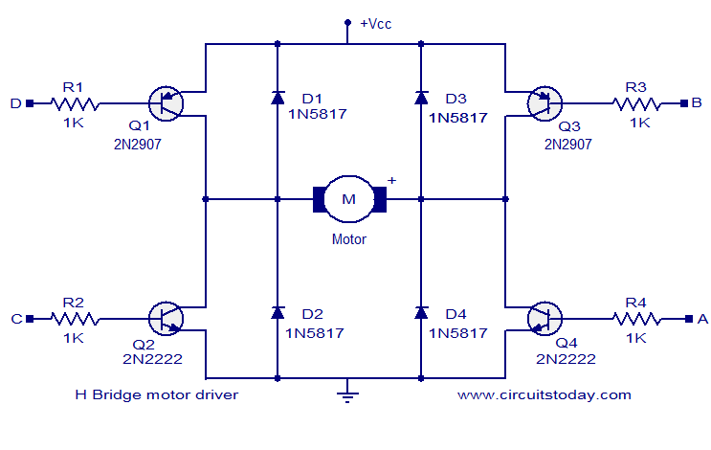
H-BRIDGE CIRCUIT

Slide 27
As seen in the image, the circuit has four switches A, B, C and D. Turning these switches ON and OFF can drive a motor in different ways.
When switches A and D are on, motor rotates clockwise.
When B and C are on, the motor rotates anti-clockwise.
When A and B are on, the motor will stop.
Turning off all the switches gives the motor a free wheel drive.
Turning on A& C at the same time or B & D at the same time shorts the entire circuit. So, never try to do it.

Slide 28
DC MOTORS
A machine that converts DC power into mechanical power is known as a DC motor. Its operation is based on the principle that when a current carrying conductor is placed in a magnetic field, the conductor experiences a mechanical force.
DC motors have a revolving armature winding but non-revolving armature magnetic field and a stationary field winding or permanent magnet.
Different connections of the field and armature winding provide different speed/torque regulation features.
The speed of a DC motor can be controlled by changing the voltage applied to the armature or by changing the field current.

Slide 29
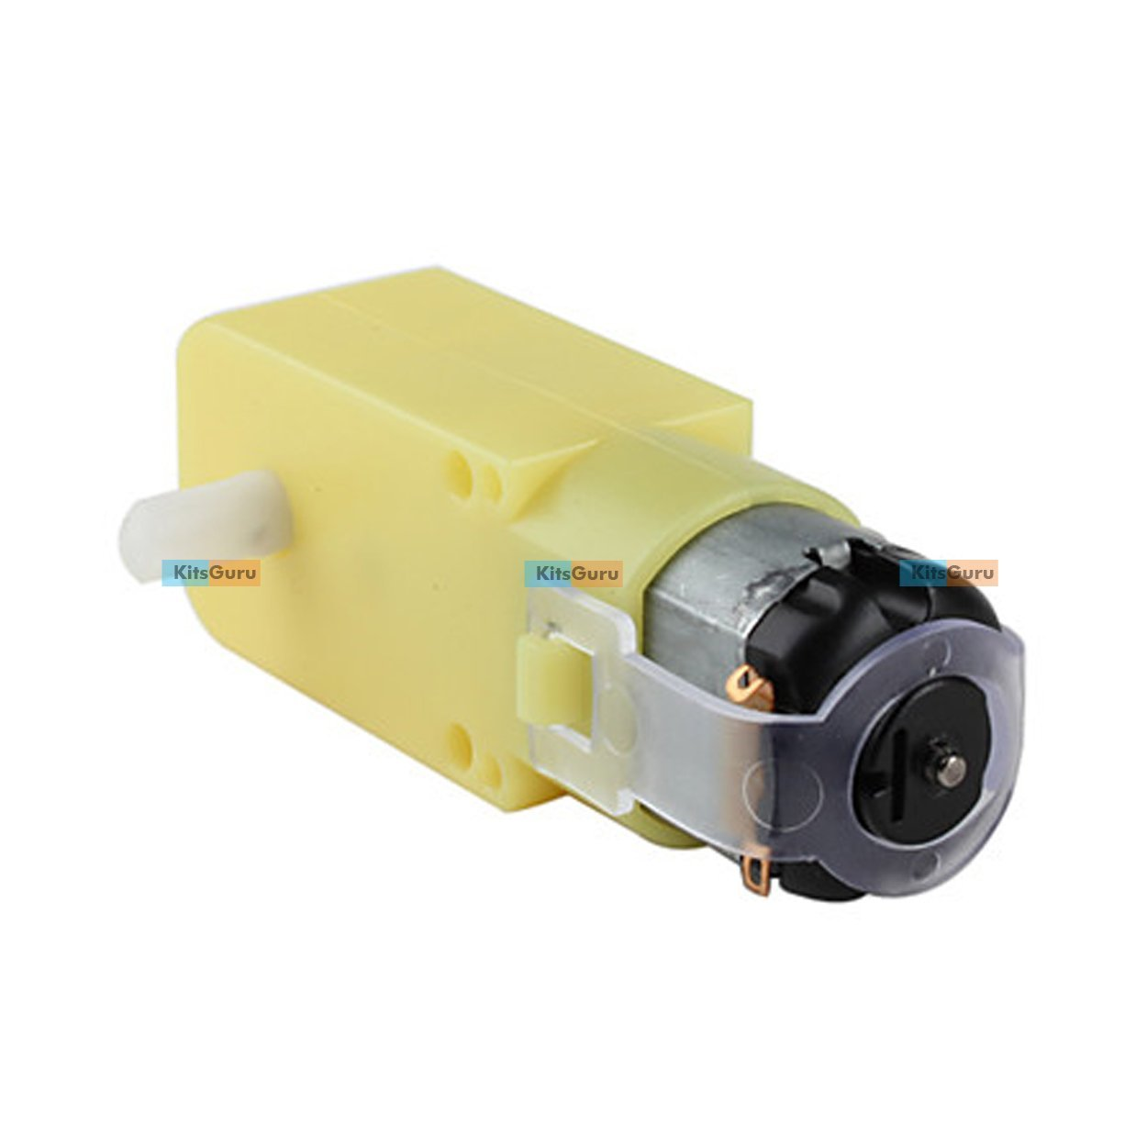
FIG:DC MOTOR

Slide 30

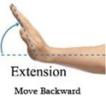


Working
We achieved our objective without any hurdles i.e. the control of a robot using gestures. The robot is showing proper responses whenever we move our hand. Different Hand gestures to make the robot move in specific directions are as follow:
Move Backward
Move forward
Move Right
Move Left

Slide 31
The robot only moves when the accelerometer is moved in a specific direction. The valid movements are as follows
DIRECTION | ACCELEROMETER ORIENTATION
Forward | +y
Backward | -y
Right | +x
Left | -x
Stop | Rest

Slide 32
LIMITATIONS AND FUTURE WORK
The on-board batteries occupy a lot of space and are also quite heavy. We can either use some alternate power source for the batteries or replace the current DC Motors with ones which require less power.
Secondly, as we are using RF for wireless transmission, the range is quite limited; nearly50- 80m. This problem can be solved by utilizing a GSM module for wireless transmission. The GSM infrastructure is installed almost all over the world. GSM will not only provide wireless connectivity but also quite a large range.
Thirdly, an on-board camera can be installed for monitoring the robot from faraway places. All we need is a wireless camera which will broadcast and a receiver module which will provide live streaming.

Slide 33
Future Scope
The on-board batteries occupy a lot of space and are also quite heavy. We can either use some alternate power source for the batteries or replace the current DC Motors with ones which require less power.
Secondly, as we are using RF for wireless transmission, the range is quite limited; nearly 50- 80m. This problem can be solved by utilizing a GSM module for wireless transmission. The GSM infrastructure is installed almost all over the world. GSM will not only provide wireless connectivity but also quite a large range.
Thirdly, an on-board camera can be installed for monitoring the robot from faraway places. All we need is a wireless camera which will broadcast and a receiver module which will provide live streaming.

Slide 34
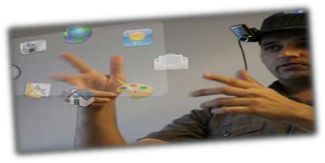
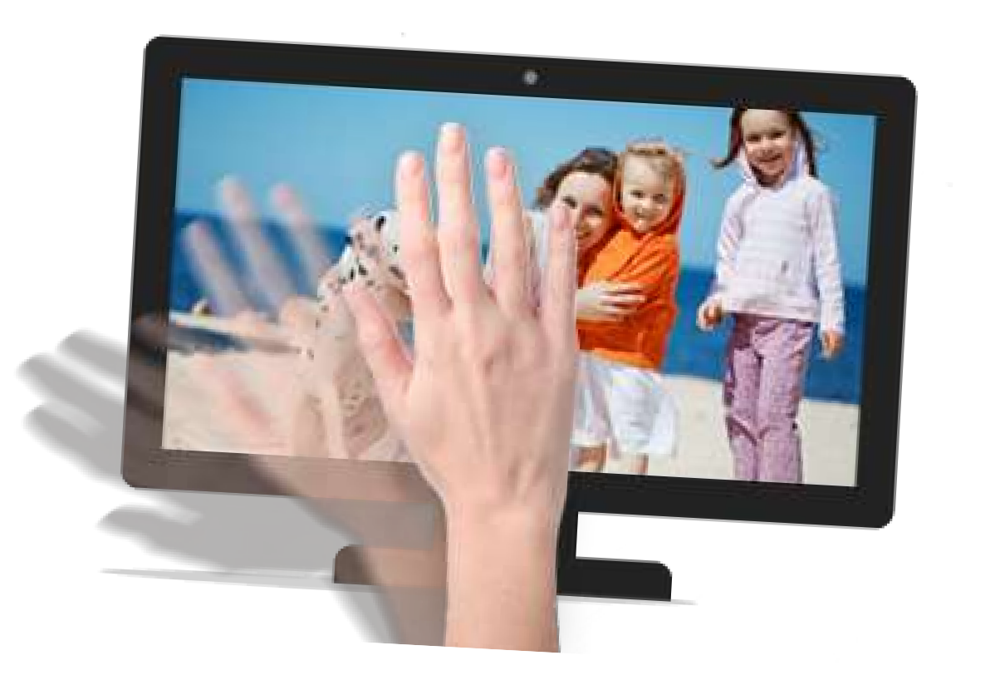

APPLICATION OF GESTURE RECOGNITION
Gesture recognition has wide ranging applications such as the following
Enabling very young children to interact with computers
Medically monitoring patients’ emotional states or stress levels
Navigating and/or manipulating in virtual environments
Communicating in video conferencing
Public Display Screens: Information display screens in Supermarkets, Post Offices ,Banks that allows control without having to touch the device.
Robots: Controlling robots without any physical contact between human and computer.

Slide 35
CONCLUSION
The purpose of project is to control a toy car using accelerometer sensors attached to a hand glove.
The sensors are intended to replace the remote control that is generally used to run the car.
It will allow us to control the forward and backward, and left and right movements, while using the same accelerometer sensor to control the throttle of the car.

Slide 36
generally,The two types of gestures are:
Online Gestures – Put simply, these are gestures that control a machine or computer system in real time. Also called direct manipulation gestures, these are the sort that let you interact with objects and impose changes viewable as you do them.
Offline Gestures – Gestures that are processed after they’re done are called offline gestures. In other words, these are the gestures that don’t show a real time change.
For example, some new smartphones have the option to open a certain application after a specific gesture is made, this is basically an offline gesture.

Slide 37
Some of the applications include:
Medical Applications – Advanced robotics systems with gesture recognition can be placed in hospitals or homes to recognize and treat life threatening conditions like heart attacks or strokes.
Alternative computer interfaces – Gesture recognition, along with voice recognition, facial recognition, lip movement recognition and eye tracking combined can be used to create something called a perceptual user interface (PUI), a completely different way to interact with computer systems which will improve usability and creativity by leaps and bounds.

Slide 38
Entertainment applications – Most videogames today are played either on game consoles, arcade units or PCs, and all require a combination of input devices. Gesture recognition can be used to truly immerse a players in the game world like never before.
Automation systems – In homes, offices, transport vehicles and more, gesture recognition can be incorporated to greatly increase usability and reduce the resources necessary to create primary or secondary input systems like remote controls, car entertainment systems with buttons or similar.

Slide 39
An easier life for the disabled – One of the biggest challenges faced today is providing separate and equally non cumbersome services to the differently abled and handicapped. While there are special provisions around the world, there’s still huge room for improvement to bring all lives on equal footing. Gesture recognition technology can eliminate a lot of manual labor and make life much easier for those who aren’t as fortunate as most of us are.

Slide 40
SUBMITTED BY:
ABHISHEK KUMAR (005)
AAKRITY SINGH (003)
ANUBHAV SRIVASTAVA(015)

