Slide 1
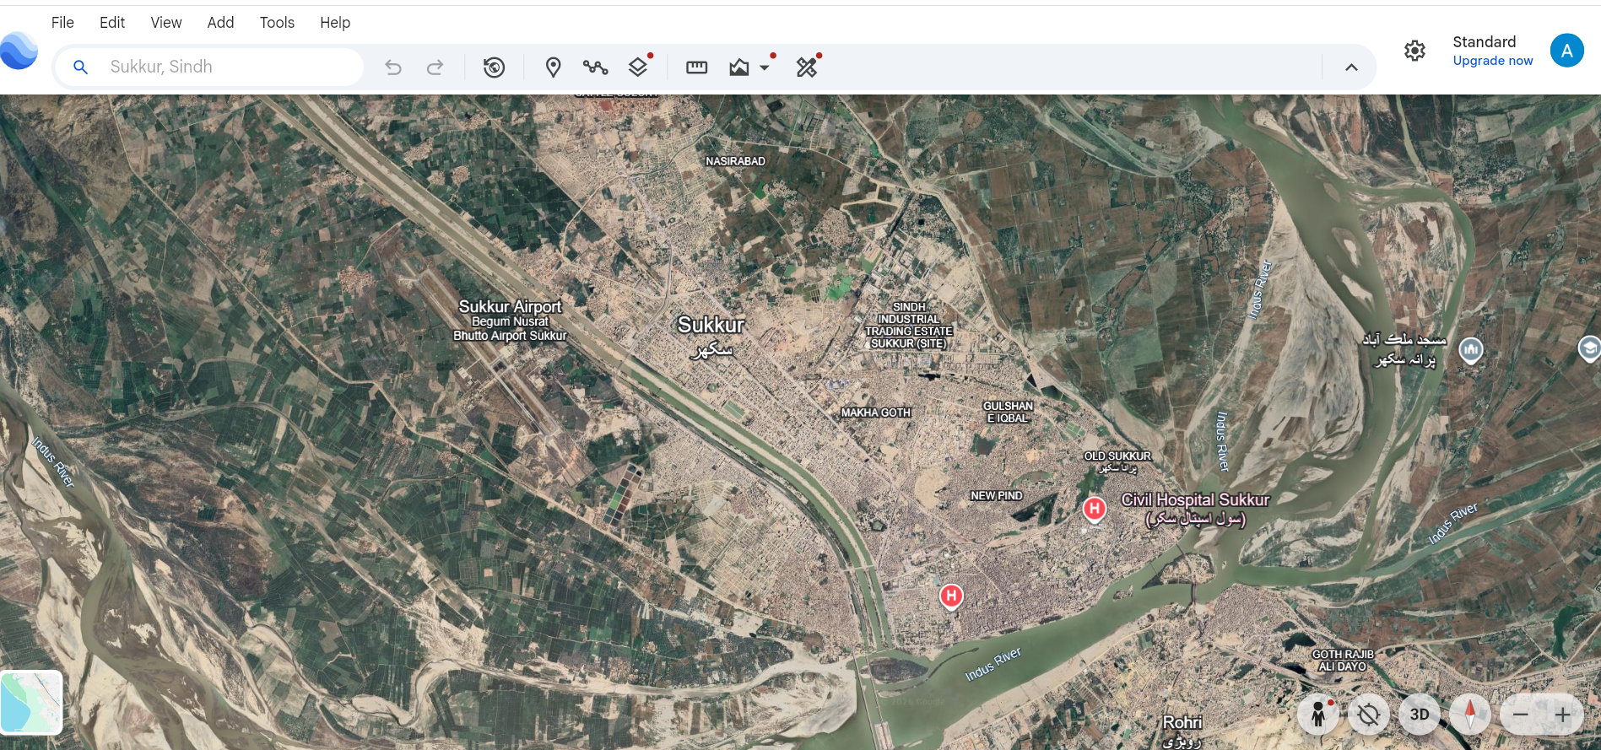
Slide 1 — HCI Focus: Interaction Elements in Google Earth
1
2
3
1. Search Bar
2. Toolbar Icons
3. Navigation & View Controls
Type a place name like Sukkur, Sindh here and the view jumps straight to it so you are not manually panning and zooming across the globe to find a location.
Placemark, path, layers, measure, and photo tools all sit in one row along the top, so the core actions are one click away instead of buried in a menu.
The compass,3D toggle, and zoom buttons in the corner let you rotate, tilt, and zoom the view directly with the mouse instead of relying on keyboard shortcuts.
Asghar Hussain | 2k24/CSE/37 | HCI and Computer Graphics

Slide 2
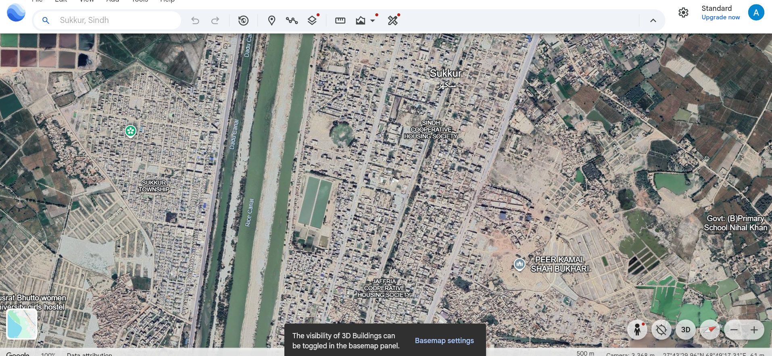
Slide 2 — CG Focus: Rendering / Visual Elements in Google Earth
1
2
3
1. 3D Building Meshes
2. 3D Rendering Toggle
3. Camera Perspective Data
Buildings here are raised polygon shapes with real height data not flat map icons that is why the city reads as solid structures instead of a flat photo from directly above.
This popup shows the 3D buildings layer can be switched on or off from the basemap panel confirming the building meshes are a separate render layer not baked into the satellite imagery.
The altitude and coordinates shown confirm this is a real perspective camera positioned above the terrain, not a flat orthographic map view.
Asghar Hussain | 2k24/CSE/37 | HCI and Computer Graphics

Slide 3
Reflection Questions
Q1. How does the Computer Graphics quality help or hinder the user's ability to interact with the software?
Better rendering quality genuinely makes Google Earth easier to use the 3D buildings and shading let you judge scale, height, and location almost instantly without needing extra labels. The trade off shows up in denser areas more mesh detail and imagery means slower loading so panning and tilting can start to feel laggy right when you need the view to respond quickly.
Q2. What is one simple HCI change you would make to improve the user interface?
One simple fix would be surfacing the 3D buildings toggle right next to the search bar instead of hiding it inside a popup and a separate basemap panel right now a first time user has to accidentally trigger that notification just to discover the option exists.
Asghar Hussain | 2k24/CSE/37 | HCI and Computer Graphics

