Slide 1
Building Universal Windows Apps with XAML/C#
Michael Crump, MS MVP
Sr. Developer Advocate, Telerik
@mbcrump
developer.telerik.com
blogs.telerik.com
michaelcrump.net

Slide 2
What we’ve done before…
Windows
Windows
Phone

Slide 3
Universal Windows Apps in a Nutshell
Allows developers to build applications to run on the converged Windows 8.1 and Windows Phone 8.1 platforms.
VS 2013 RC2 comes with Templates.
You can migrate Windows 8.1/WP8.1 Apps to Universal Apps.

Slide 4
The Programming Model
C / C++
XAML
C# / VB
HTML / CSS
JavaScript
Windows Runtime
Input, Interaction, & Manipulation
DirectX, Media, & Composition
Windows Kernel Services

Slide 5
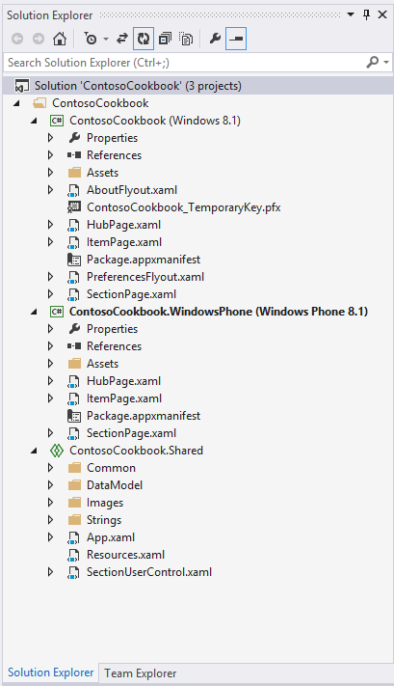
What makes up an app?
Windows 8.1 Project
Windows Phone 8.1 Project
Share Project

Slide 7
Shared Projects vs. PCL?
Shared Projects
Portable Class Libraries
Share source code between projects.
Platform specific code goes under #if or partial classes.
Sharing one binary between projects.
Compile and it works on all known platforms.

Slide 8
Tips and Tricks While Working with Universal Apps
Use conditional constants
#if WINDOWS_PHONE_APP
#if WINDOWS_APP
IntelliSense warnings for platform specific APIs and data binding and resources.
Go to definition support for types, binding and resources.
Quickly switch project using the navigation bar.
Use Blend for Visual Studio 2013 to design for different display sizes without deploying to the simulator or emulator.

Slide 9
Resources
Build 2014 Sessions
http://channel9.msdn.com/Events/Build/2014
Telerik Universal Windows Apps Preview
http://bit.ly/1iHgAKt
Universal Windows Apps Samples
http://bit.ly/ShcX9y
Slides/Source Code
http://github.com/mbcrump
http://speakerdeck.com/mbcrump

Slide 10
Questions?
Michael Crump
@mbcrump
developer.telerik.com
blogs.telerik.com
michaelcrump.net

