Slide 1
GEO: GSE28521
Voineagu, I., Wang, X., Johnston, P., Lowe, J. K., Tian, Y., Mill, J., … Daniel, H. (2013). Transcriptomic Analysis of Autistic Brain Reveals Convergent Molecular Pathology. Nature, 474(7351), 380–384.

Slide 2
Background
The GEO: GSE28521 dataset was chosen because it was one of the largest and well-curated datasets of autism spectrum disorder (ASD) and control brain tissue expression.
The data consists of RNA transcript data from ASD and neurotypical cerebellum, temporal cortex and frontal cortex tissue.
All data used the Illumina GPL6883 platform, was normalized and log2 transformed.
ASD is poorly characterized and is thought to have a variety of causes. This is observable in this dataset, as no simple pattern was obviously visible between ASD and control samples.
Samples have been annotated with two letters, A or C for ASD or control, and C, T or F for cerebellum, temporal cortex and frontal cortex, respectively.

Slide 3
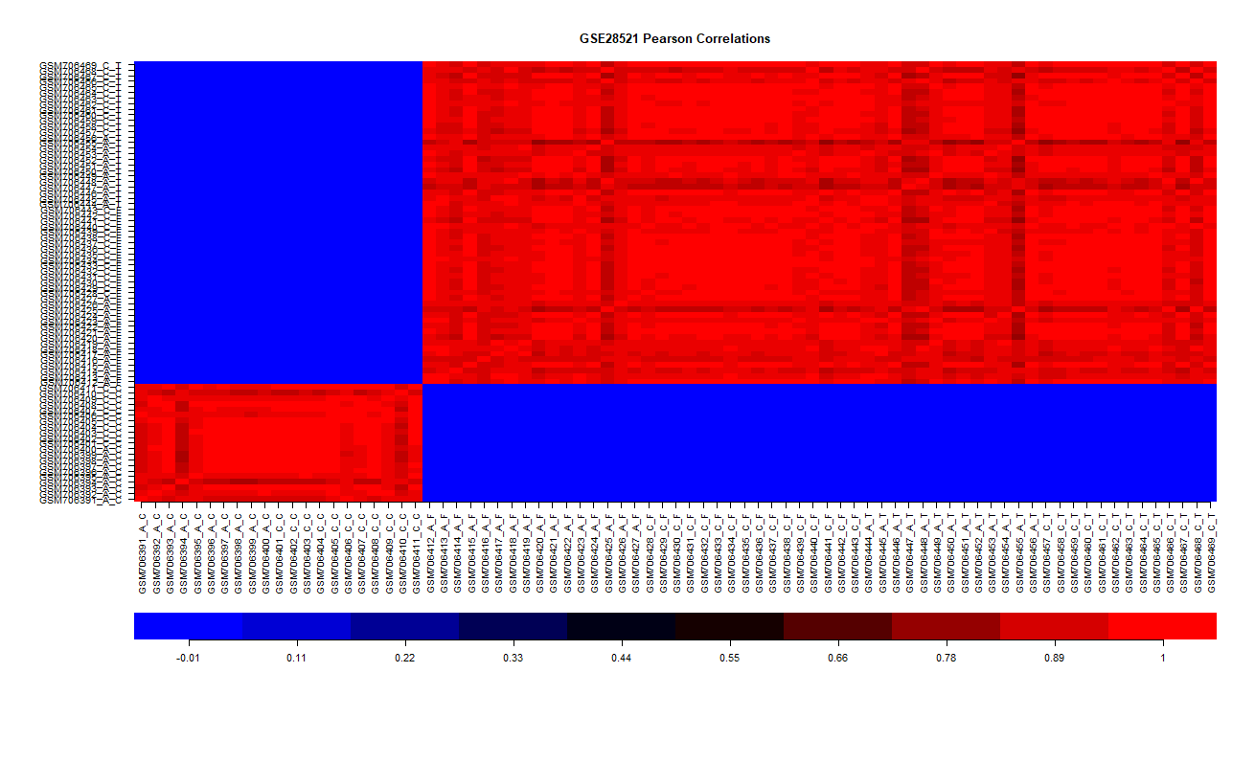
Outlier Processing
A split between cerebellum expression and the other tissues is clearly visible in this heatmap as well as in the plots in the following slides.
The outliers selected for removal were GSM706394_A_C, GSM706410_C_C, GSM706391_A_C, GSM706455_A_T, GSM706425_A_F, GSM706447_A_T and GSM706448_A_T, as they appeared to stand out in all the plots. Their removal did not significantly change the shape of the distribution, but it did smooth it out.

Slide 4
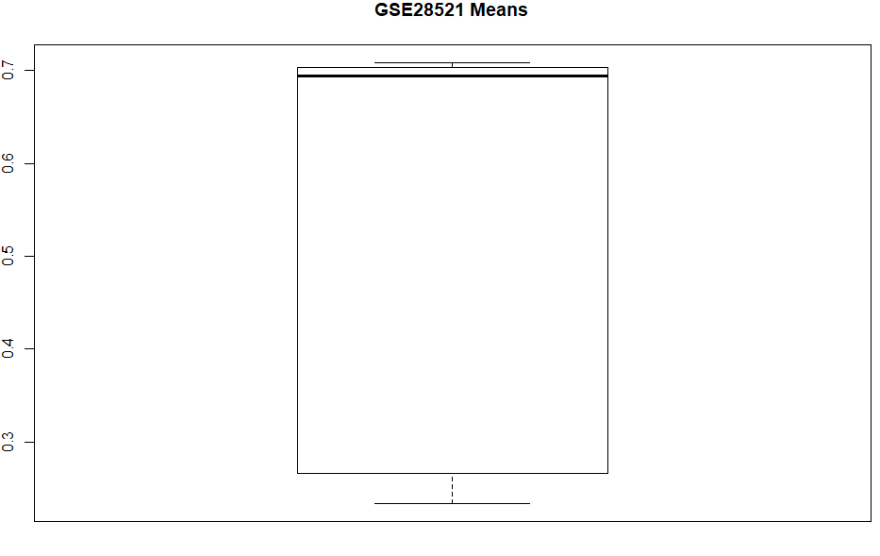
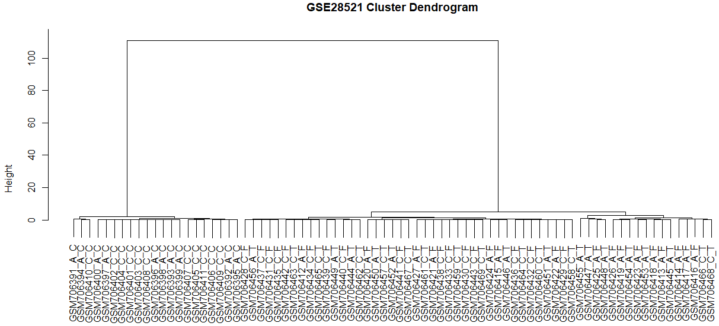

Slide 5
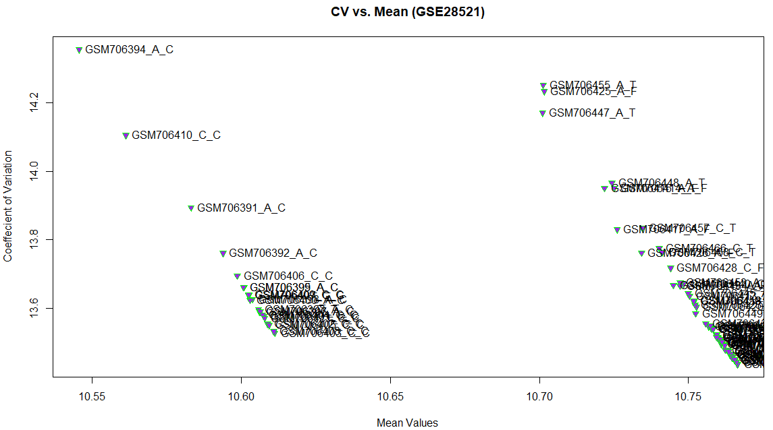
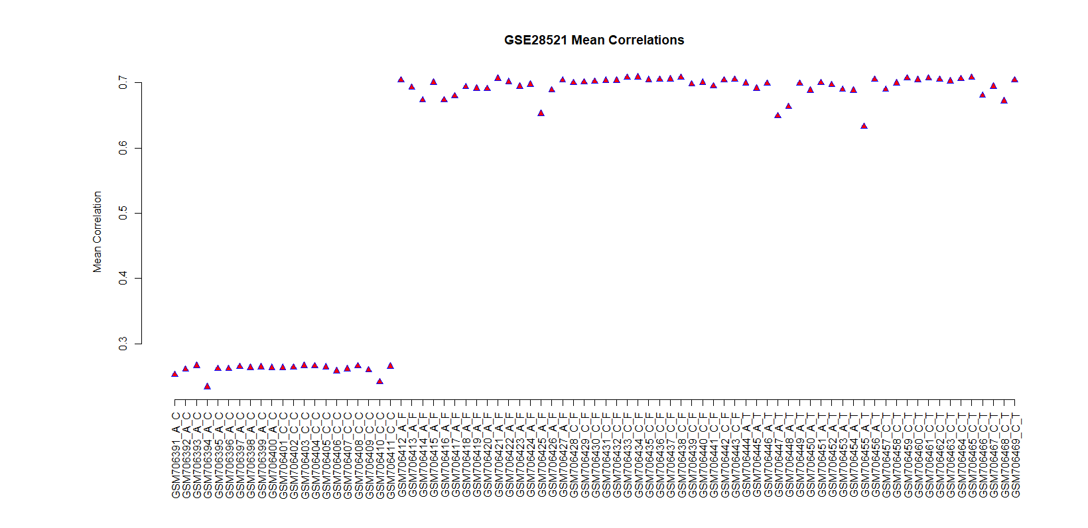

Slide 6
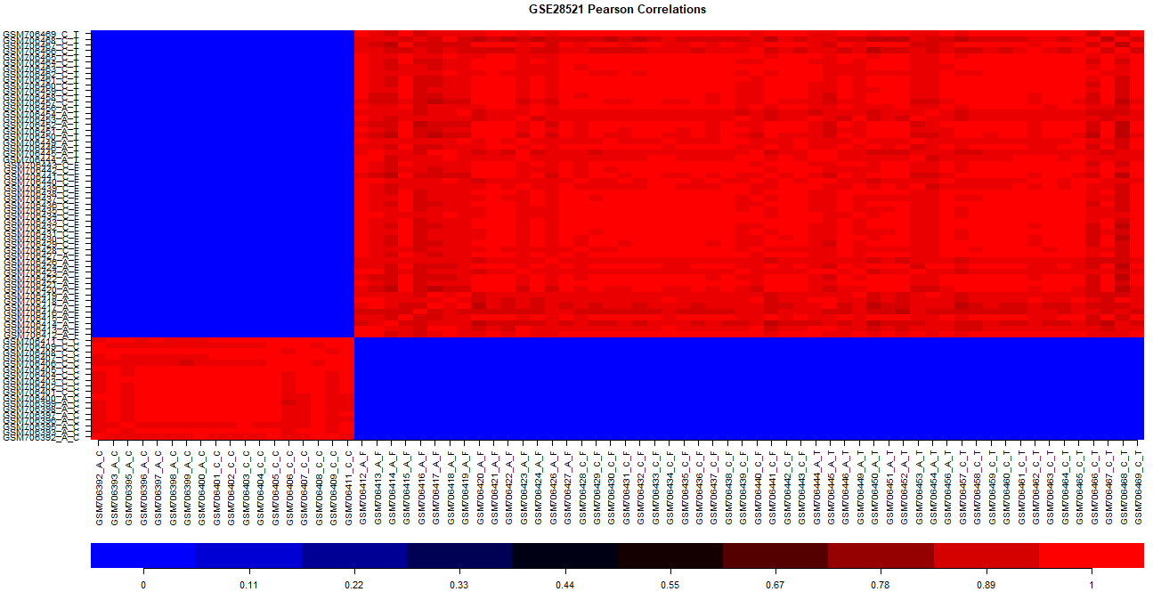
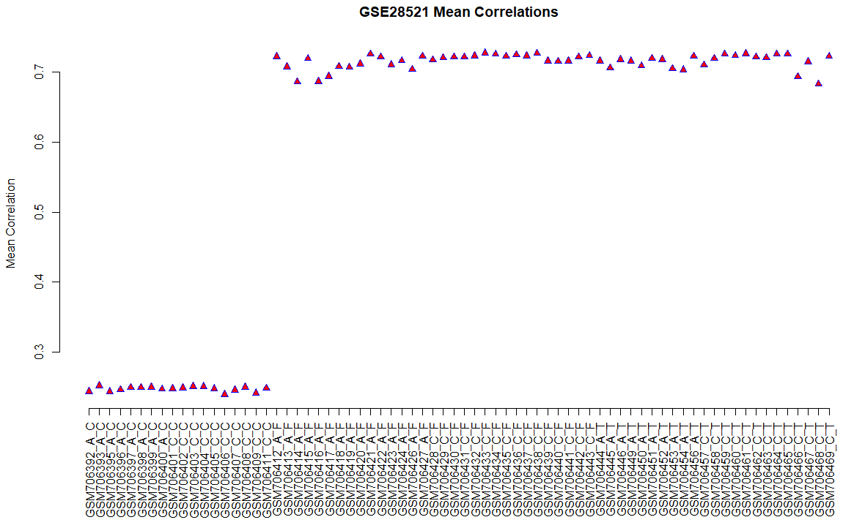
Before outlier removal:
After outlier removal:

Slide 7
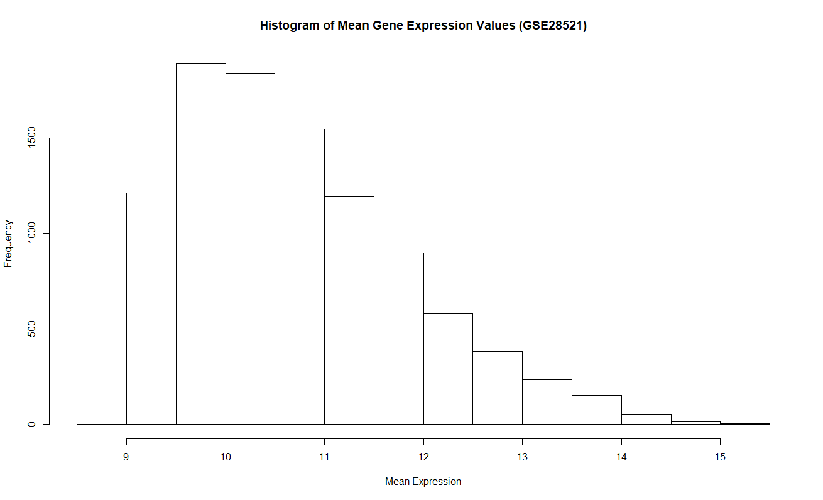
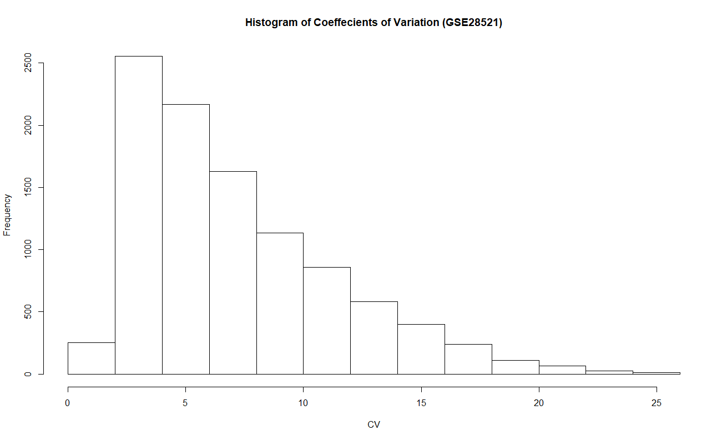
Gene Filtration
Genes with an average expression of 9 or less across samples were removed.
Genes with a coefficient of variation of 2 or less across samples were also removed.

Slide 8
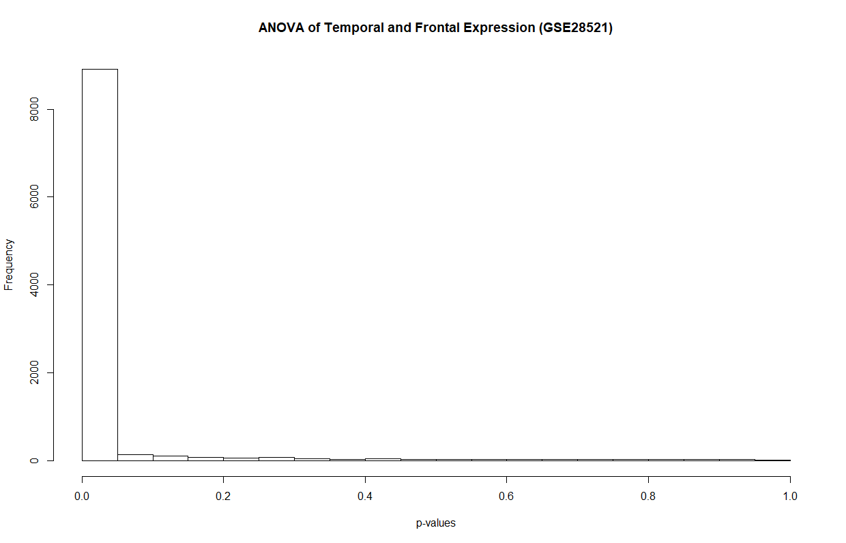
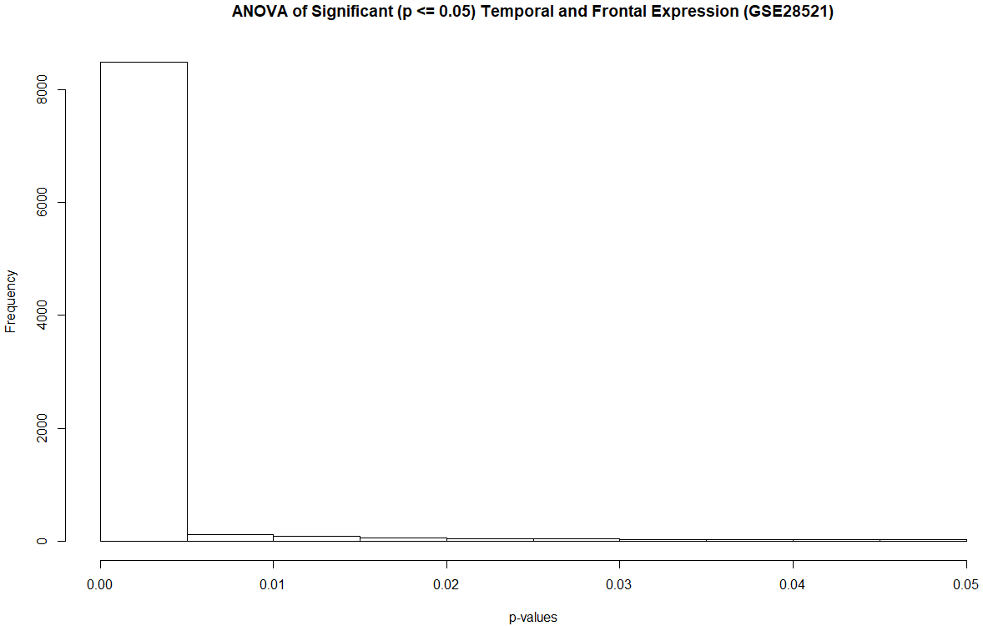
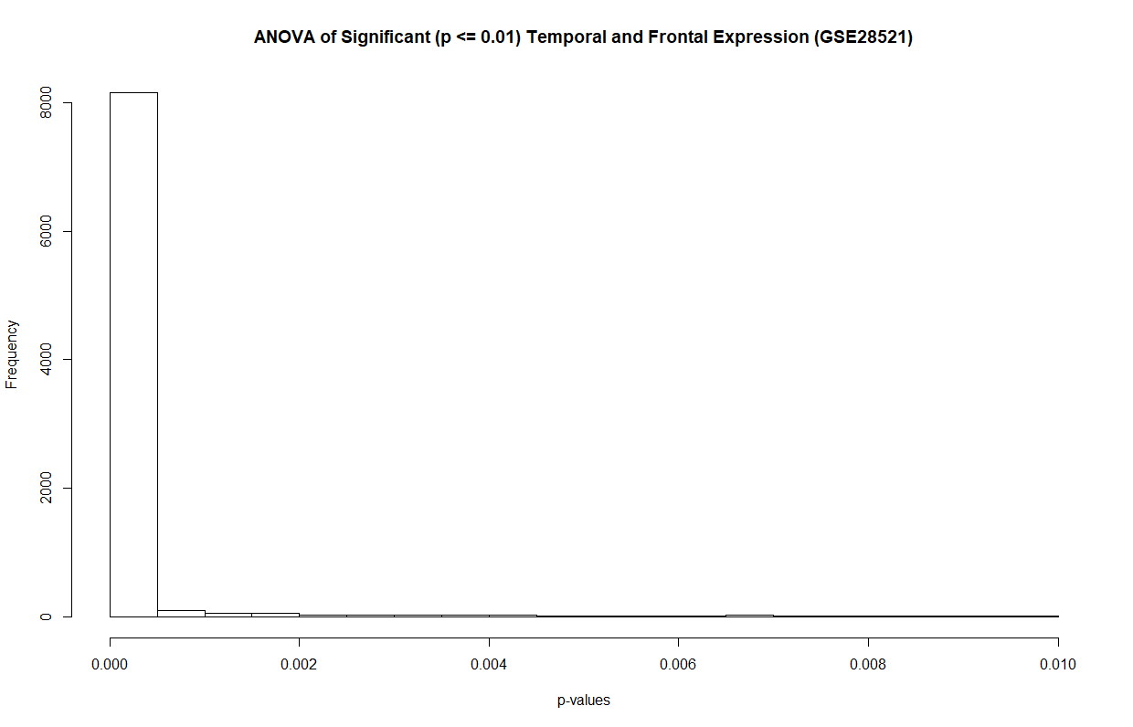
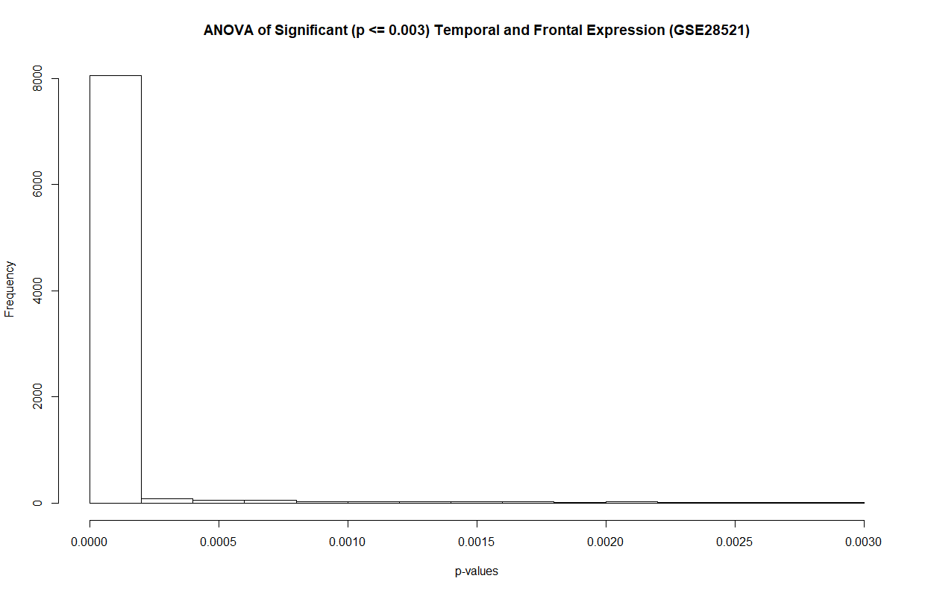
ANOVA
The overwhelming majority of p-values were close less than 0.002.
A total of 8414 genes in 72 samples were retained.

Slide 9

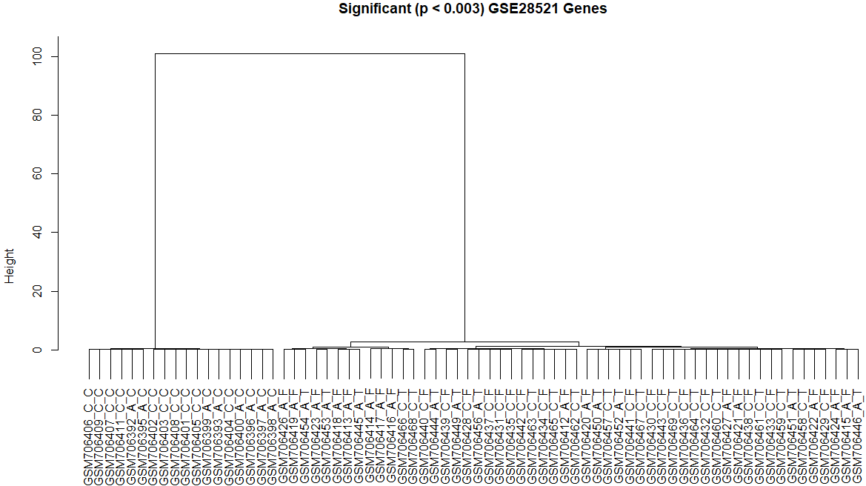
With so many significant genes, the dendrograms of the full set and significant set differ very little.
The specific order of samples changes, but the cerebellum, ASD or control, is always grouped together.

Slide 10
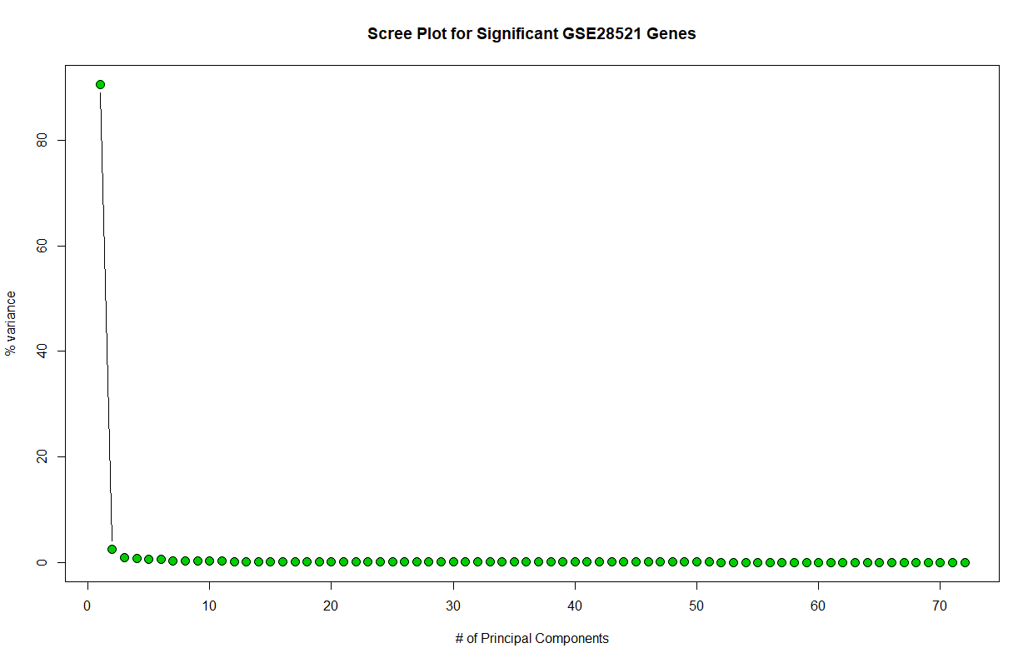
Principal Component Analysis
Importance of components:
PC1 PC2 PC3 PC4 PC5
Standard deviation 86.1532 14.29606 8.67807 7.34298 6.70966
Proportion of Variance 0.9055 0.02493 0.00919 0.00658 0.00549
Cumulative Proportion 0.9055 0.93049 0.93967 0.94625 0.95175
Unsurprisingly, there is one very important dimension (tissue type).

Slide 11
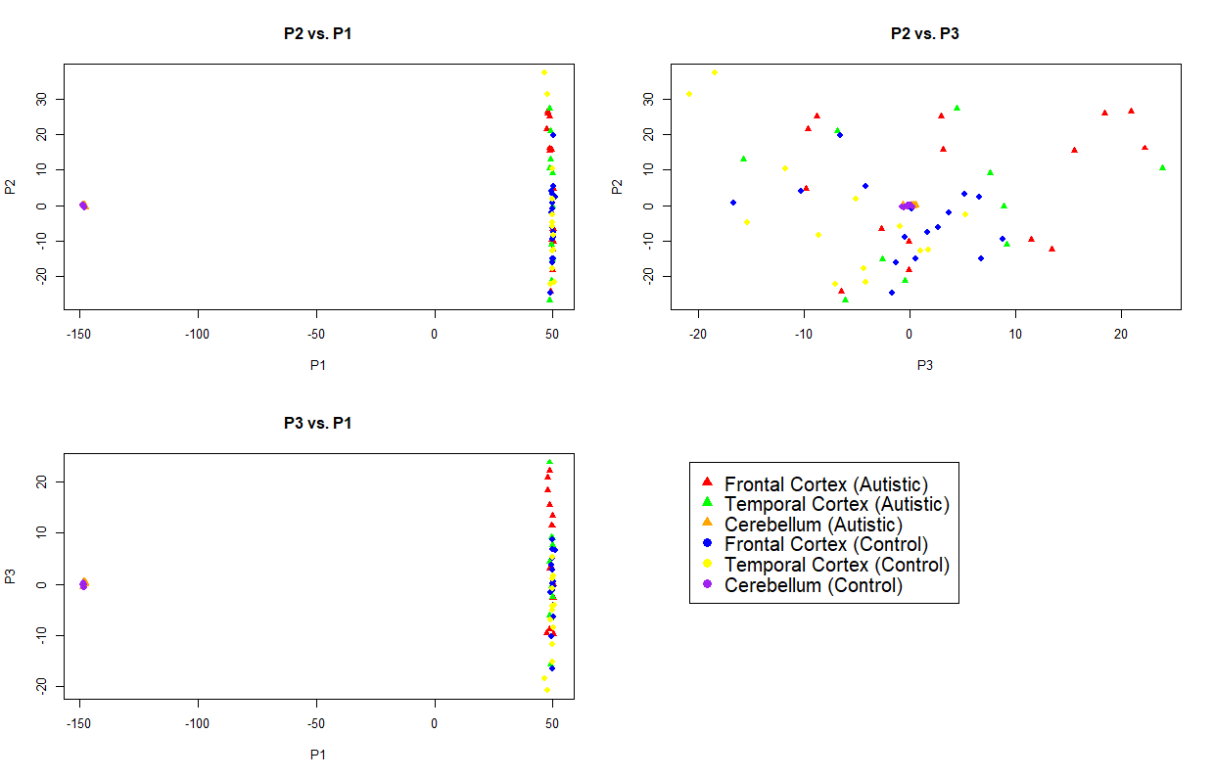

Slide 12
Linear Discriminant Analysis
A predictive model was able to accurately identify cerebellum tissue and condition states.
It was less successful with tissue type and condition state in temporal or frontal cortex samples.
AC AF AT CC CF CT
AC 3 0 0 1 0 0
AF 0 3 2 0 1 2
AT 0 2 0 0 2 0
CC 0 0 0 2 0 0
CF 0 0 1 0 1 1
CT 0 0 0 0 1 1
Fold Change
> top.5.C
ILMN_1665207 ILMN_1676822 ILMN_1689515 ILMN_1671149 ILMN_2361603
1.7942087 1.3097996 1.0723089 0.9952567 0.9060924
> top.5.F
ILMN_1787680 ILMN_2062112 ILMN_2153373 ILMN_1783333 ILMN_1659781
2.117442 1.333940 1.124958 1.094562 1.045396
> top.5.T
ILMN_1787680 ILMN_1729212 ILMN_1795419 ILMN_1784749 ILMN_2153373
2.690193 1.382537 1.303648 1.213922 1.163202
> top.5.A
ILMN_1787680 ILMN_1787680 ILMN_1665207 ILMN_1729212 ILMN_2062112
2.690193 2.117442 1.794209 1.382537 1.333940
C F and T refer to the tissue types, while A is all tissue types combined to show the ASD/control fold changes in general.
change.genes in.C in.F in.T in.A
"ILMN_1665207" "TRUE" "FALSE" "FALSE" "TRUE" 2
"ILMN_1676822" "TRUE" "FALSE" "FALSE" "FALSE" 1
"ILMN_1689515" "TRUE" "FALSE" "FALSE" "FALSE" 1
"ILMN_1671149" "TRUE" "FALSE" "FALSE" "FALSE" 1
"ILMN_2361603" "TRUE" "FALSE" "FALSE" "FALSE" 1
"ILMN_1787680" "FALSE" "TRUE" "TRUE" "TRUE" 3
"ILMN_2062112" "FALSE" "TRUE" "FALSE" "TRUE" 2
"ILMN_2153373" "FALSE" "TRUE" "TRUE" "FALSE" 2
"ILMN_1783333" "FALSE" "TRUE" "FALSE" "FALSE" 1
"ILMN_1659781" "FALSE" "TRUE" "FALSE" "FALSE" 1
"ILMN_1729212" "FALSE" "FALSE" "TRUE" "TRUE" 2
"ILMN_1795419" "FALSE" "FALSE" "TRUE" "FALSE" 1
"ILMN_1784749" "FALSE" "FALSE" "TRUE" "FALSE" 1

Slide 13
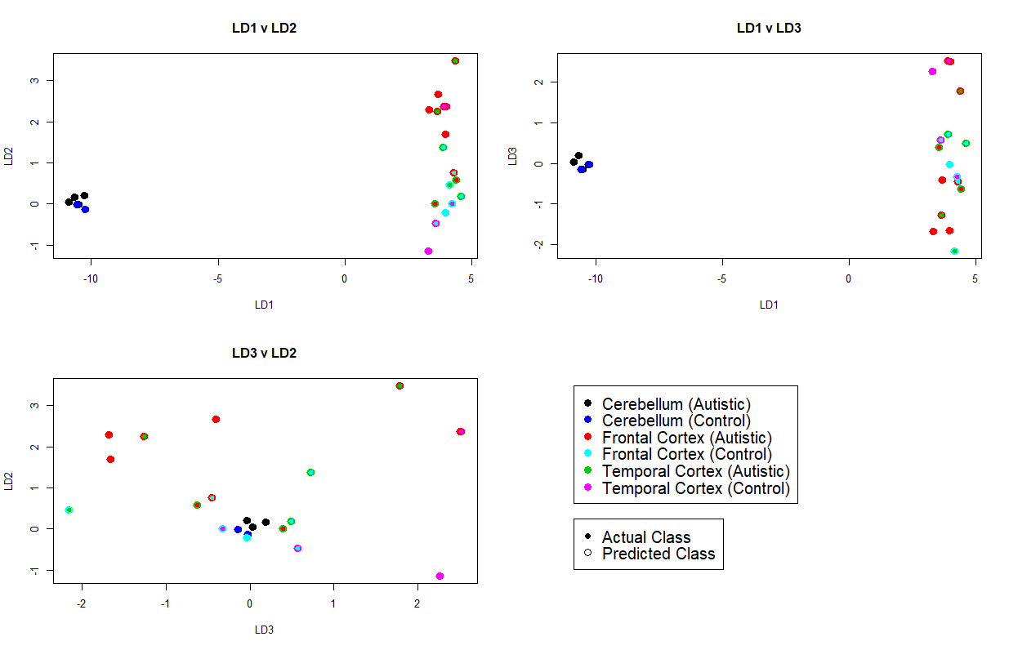

Slide 14
Dataset Restriction
The difference between cerebellum expression and the other tissue types, regardless of state was so stark it washed out other possible relationships.
The cerebellum samples were removed, and the reduced dataset analyzed with the same procedures.
The same outlier samples were removed where applicable, and genes with an average expression value of 9 or less or a coefficient of variation of 2 or less were filtered out as before.

Slide 15
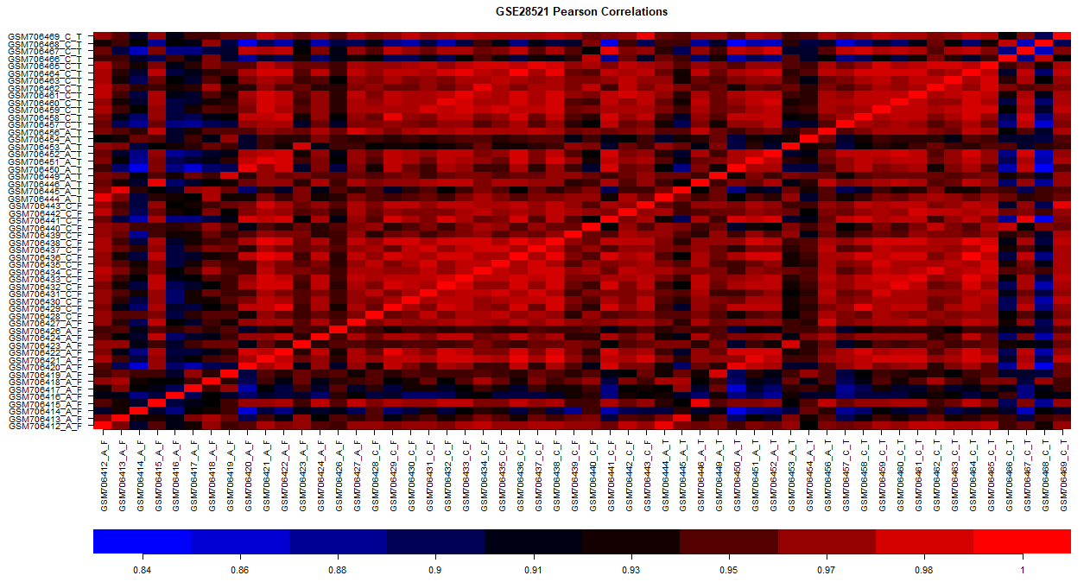
Heatmap of the reduced dataset with outliers removed and genes filtered. Note the the minimum correlation shown is 0.84.

Slide 16
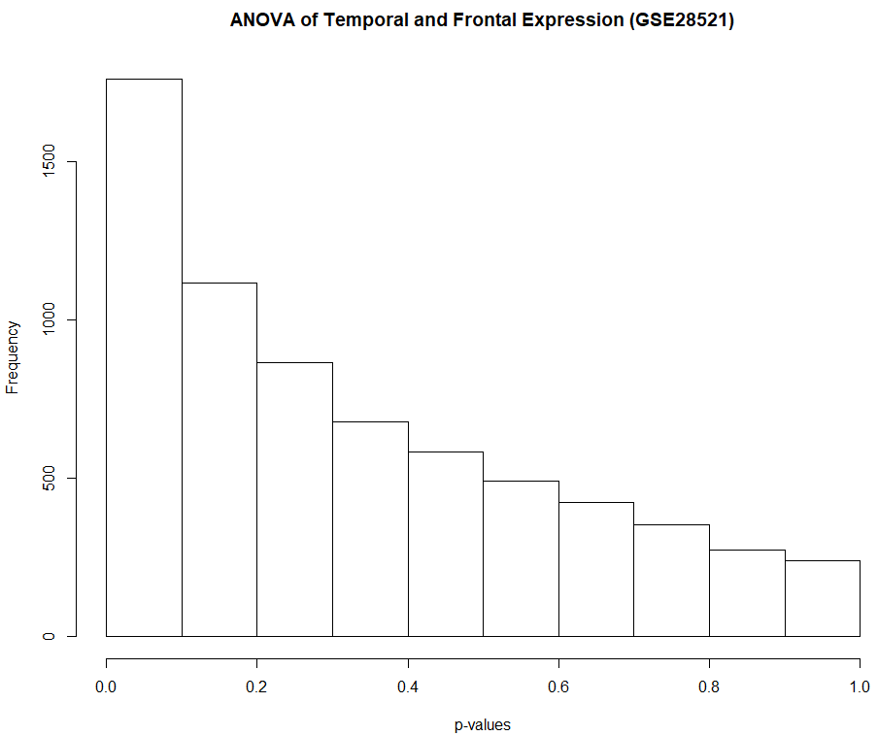
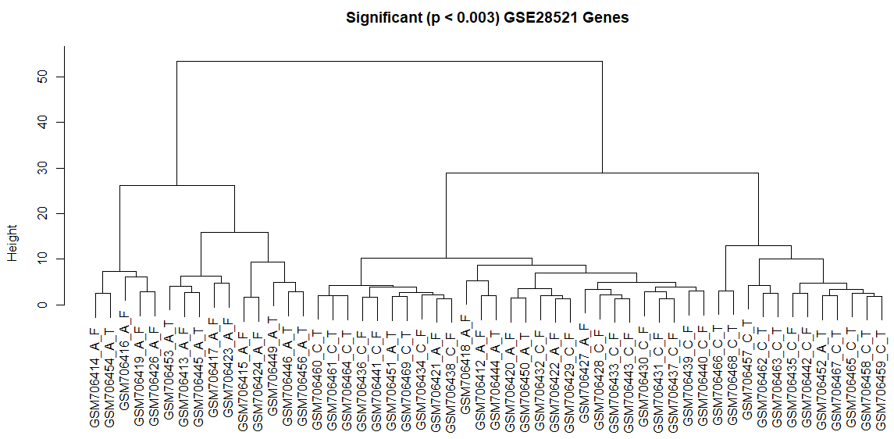
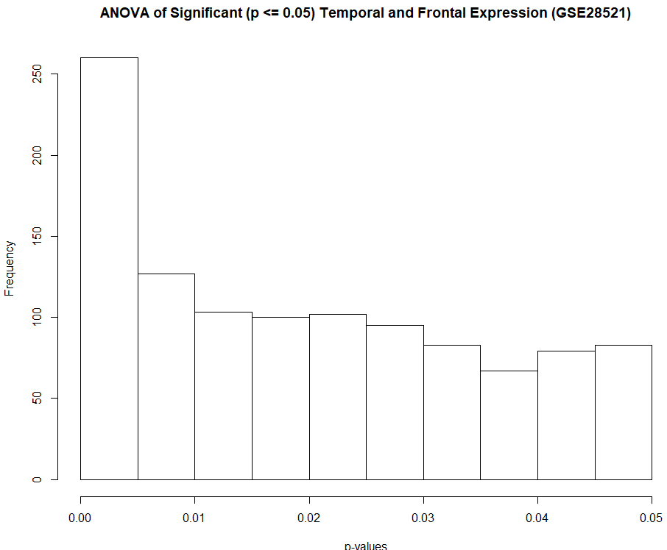
Restricted Set ANOVA
The reduced data still has a large number of highly significant genes, but the spread is less lopsided.
The reduced and filtered data (p <= 0.003) contains 54 samples with 193 genes.
The clustering is also able to distinguish between sample types more accurately.

Slide 17
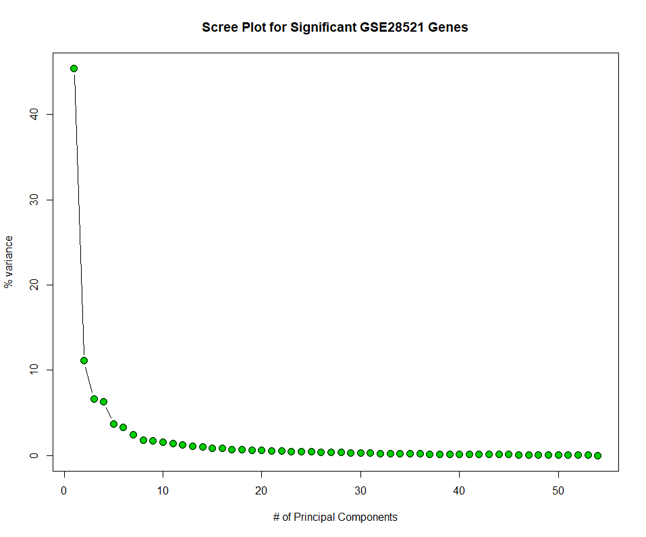
Restricted Data PCA
PCA for the restricted dataset was less lopsided.
In general, the expression of the control samples was relatively cohesive, while the ASD samples showed much greater variation. This is in line with the heterogenous nature of ASD in diagnosis and presentation.
Differences in tissue expression within each group do not appear to be as significant.

Slide 18
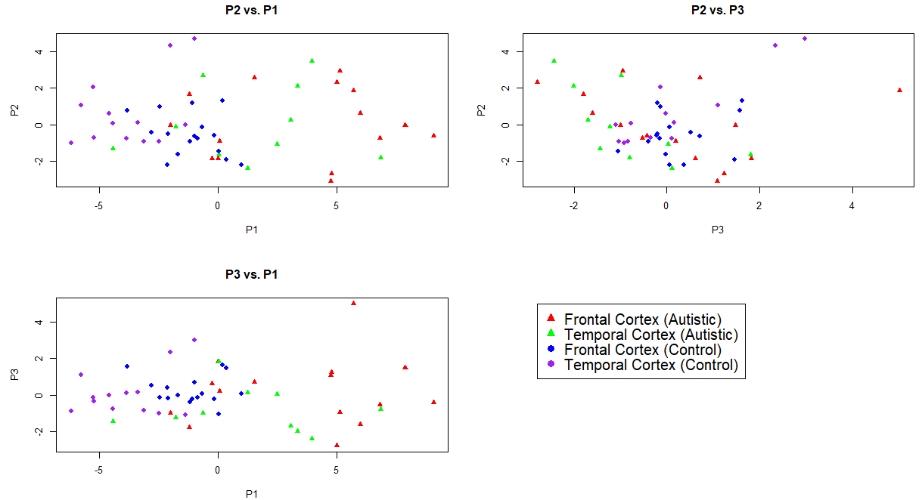

Slide 19
Restricted Data LDA
A predictive model was able to accurately identify frontal cortex ASD and temporal cortex control samples.
The frontal cortex controls were often mistaken for temporal cortex controls, while the temporal cortex ASD samples were mistaken for frontal cortex ASD samples.
AF AT CF CT
AF 4 2 0 0
AT 0 0 1 0
CF 1 1 1 0
CT 0 1 3 5
Fold Change
change.genes in.F in.T in.A
"ILMN_2062112" "TRUE" "TRUE" "TRUE" *
"ILMN_2153373" "TRUE" "TRUE" "TRUE" *
"ILMN_1783333" "TRUE" "FALSE" "FALSE"
"ILMN_2388975" "TRUE" "FALSE" "FALSE"
"ILMN_1729212" "TRUE" "TRUE" "TRUE" *
"ILMN_1795419" "FALSE" "TRUE" "TRUE"
"ILMN_1784749" "FALSE" "TRUE" "TRUE"
> top.5.F
ILMN_2062112 ILMN_2153373 ILMN_1783333 ILMN_2388975 ILMN_1729212
1.3339403 1.1249580 1.0945617 0.9995852 0.9974261
> top.5.T
ILMN_1729212 ILMN_1795419 ILMN_1784749 ILMN_2153373 ILMN_2062112
1.3825370 1.3036476 1.2139222 1.1632023 0.8306985
> top.5.A
ILMN_1729212 ILMN_2062112 ILMN_1795419 ILMN_1784749 ILMN_2153373
1.382537 1.333940 1.303648 1.213922 1.163202
C F and T refer to the tissue types, while A is all tissue types combined to show the ASD/control fold changes in general.

Slide 20
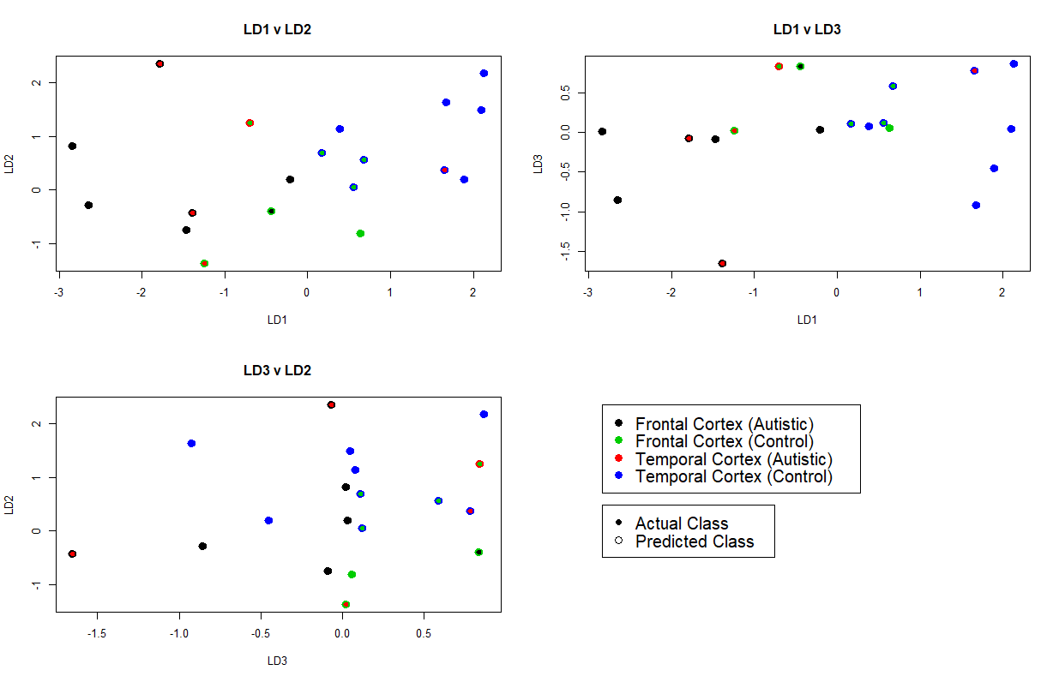

Slide 21


Gene Ontology
The top ten genes by fold change (absolute value) across all groups were investigated via DAVID bioinformatics resources.
The genes identified were: ILMN_1783333, ILMN_2062112, ILMN_1676822, ILMN_1665207, ILMN_1689515, ILMN_1784749, ILMN_1729212, ILMN_2153373, ILMN_1795419, ILMN_1787680
The DAVID functional classification tool did not return any clusters, though several had membrane transport features. 3 genes were associated with the KEGG pathway.
Using a co-expression network, the authors of the dataset were able to identify an upregulation of genes involved in synaptic function, vesicular transport and neuronal projection. The also identified a downregulation of genes involved in immune and inflammatory activity.
There was no overlap between the ten genes identified and the hub genes of the author’s co-expression network.

Slide 22
Conclusions
Overall, the model did not have a lot of success determining the sample type, and changing the threshold of significance for the p-values to provide more information did not change the outcome. This underscores the complexity and heterogeneity of ASD, and reflect the results found in the original source paper.
The authors of the dataset note that ASD appears to involve less structural difference in cortical regions, though this does not account for the models failure to distinguish between control samples.
Given the complexity of ASD, straightforward differences in gene expression were not observable, and the predictive model was not very accurate.
It was interesting to note that the control samples clustered more than the ASD samples in the restricted dataset, reflecting the dysregulated expression associated with the condition.
It is possible that the data was over-filtered, as it had already been prepared and normalized by the authors, though runs with more relaxed thresholds produced the same results.
It is also interesting to note that the genes with the greatest fold change were not in the set of genes identified by the authors’ co-expression network. This could be due to the fact that none of the genes had particularly high fold changes, and that single gene’s fold change in this case might less significant than the change across a class of genes. Changes in disjoint sets of genes could result in the same phenotype or condition, but a method like LDA would not recognize the effects as members of the same class.

