Slide 1
DATA STRUCTURES AND ITS APPLICATIONS (UE22CS252A)
Mini Project

Slide 2
Project Title & Team Members
Title: Road Network Analysis
Team Members:
Mohammed Ashfaq Ali PES2UG22CS316
Mohit Prasad Singh PES2UG22CS320
Motamarri Sai Sathvik PES2UG22CS321
MV Parth PES2UG22CS325

Slide 3
Contribution of each Team Member
Motamarri Sai Sathvik:
Hamiltonian Cycle,
Nth Neighbor Junctions,
Create Network, and
Display Network
Mohammed Ashfaq Ali:
Eulerian Path,
Number of Paths, and
Print all Paths
Mohit Prasad Singh:
Shortest Path, and
Shortest Path via a Junction
MV Parth:
Least Congested Junction,
Most Congested Junction, and
Number of Connections of a Junction

Slide 4
Synopsis
The "Road Network Analysis" project is a program designed to analyze and gain insights from road networks represented as undirected graphs. The project provides a set of tools and functionalities for processing road network data, performing graph-based calculations, and helping users understand the properties and characteristics of the network.
Road network data is read from a CSV file, providing flexibility in working with different road network datasets.

Slide 5
ADT Definition of all the data structures used
ADT Definition of Graph:
Data:
int n // Number of nodes in the graph
int a[MAX][MAX] // Adjacency matrix representing edges between nodes
Operations:
void create_graph(GRAPH *g) // Creates an empty graph
void display(GRAPH *g) // Displays the graph
void degree(GRAPH *g) // Calculate the degree of a specific node
void DFS(GRAPH *g, int v, int * visited, int k) //Performs depth-first traversal in a graph, starting from a specified node, while marking visited nodes and customizing traversal depth if needed.

Slide 6
ADT Definition of all the data structures used
ADT Definition of Stack:
Data:
int a[n] // An array of length n that behaves as a stack
Operations:
Insertion // Inserts elements to an empty stack
Display // Displays the stack from the last to first element(LIFO)

Slide 7
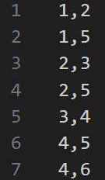
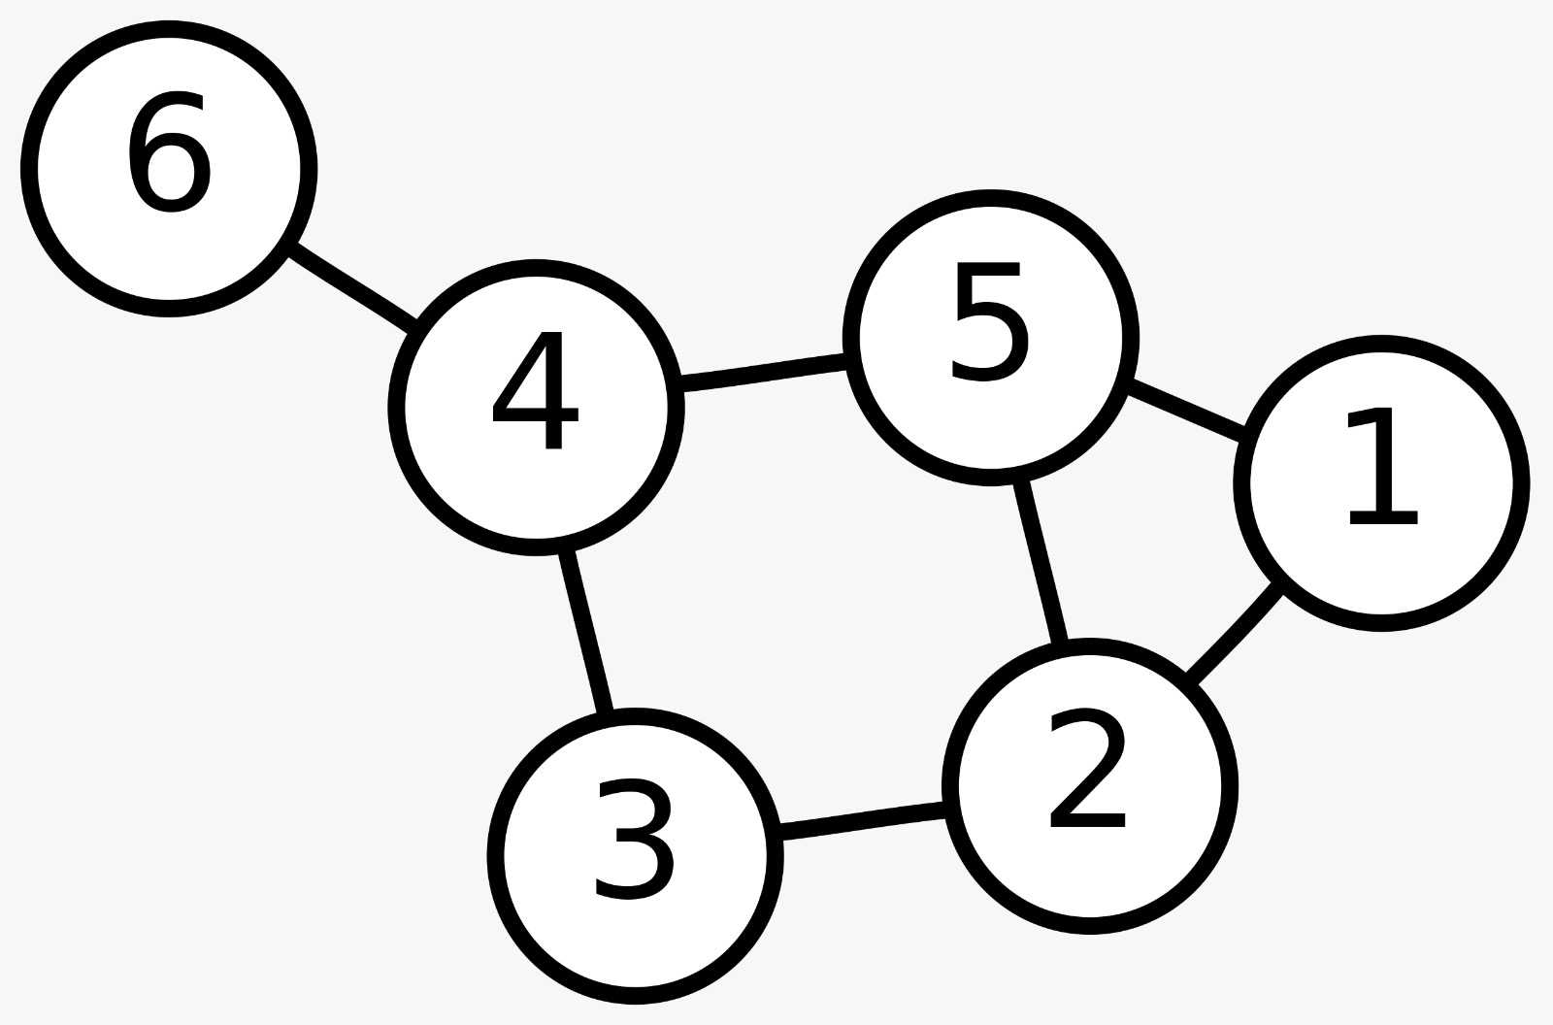
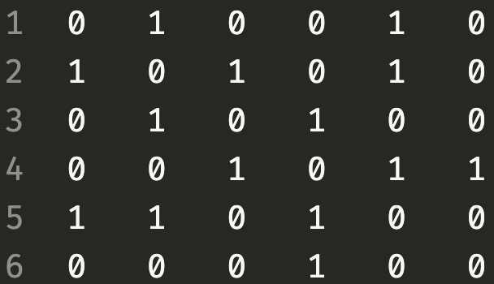
The Example Data Set
Data - Hosa.csv
Visual Representation of the Graph
Output – Test.txt

Slide 8
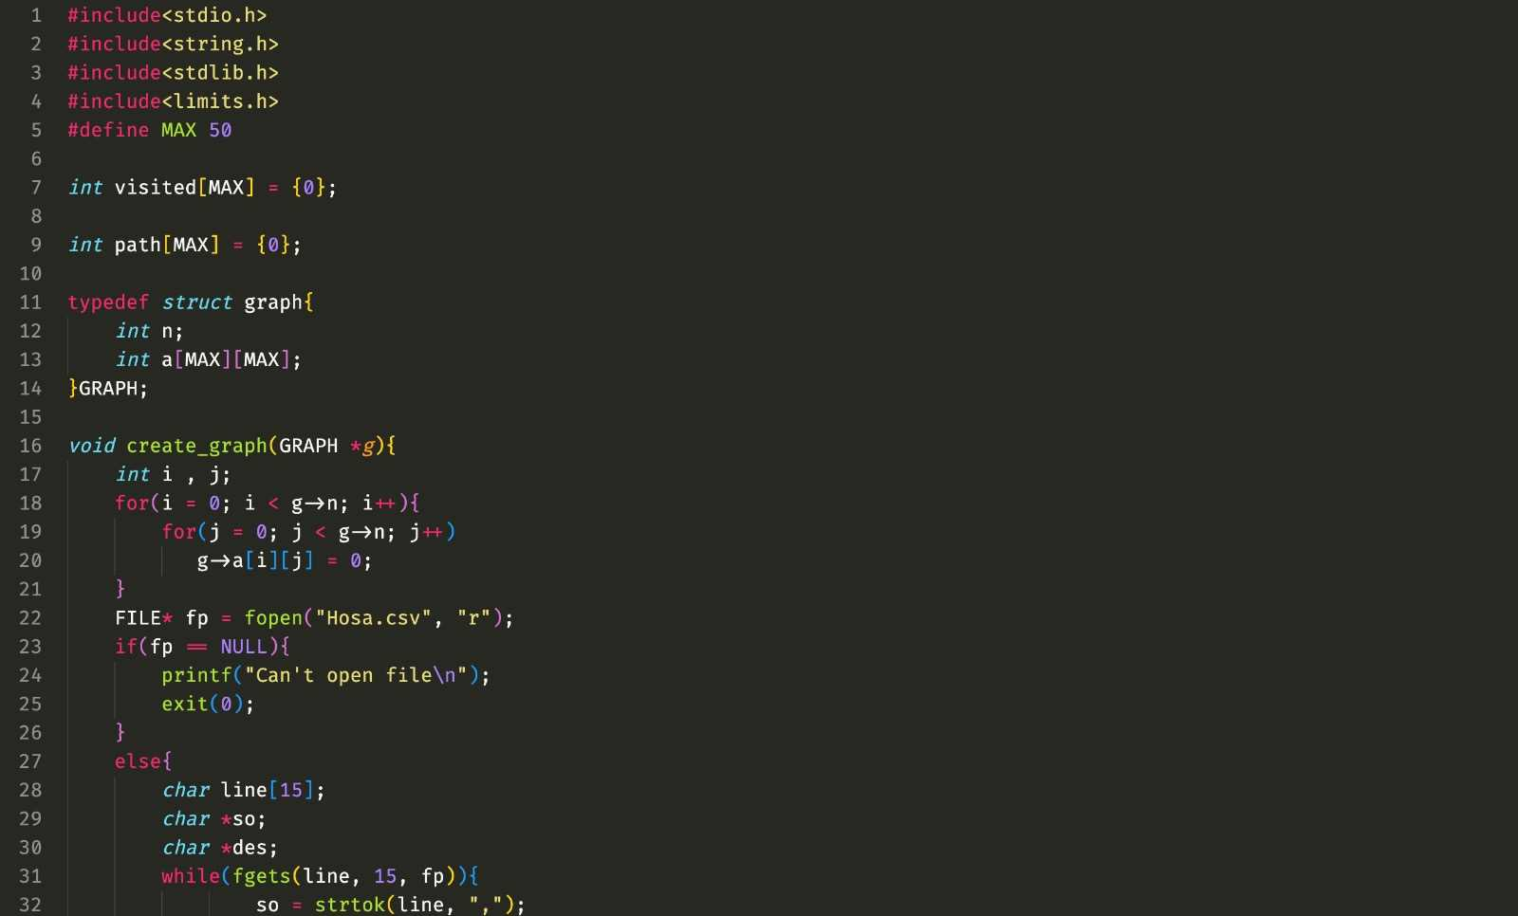
Source Code

Slide 9
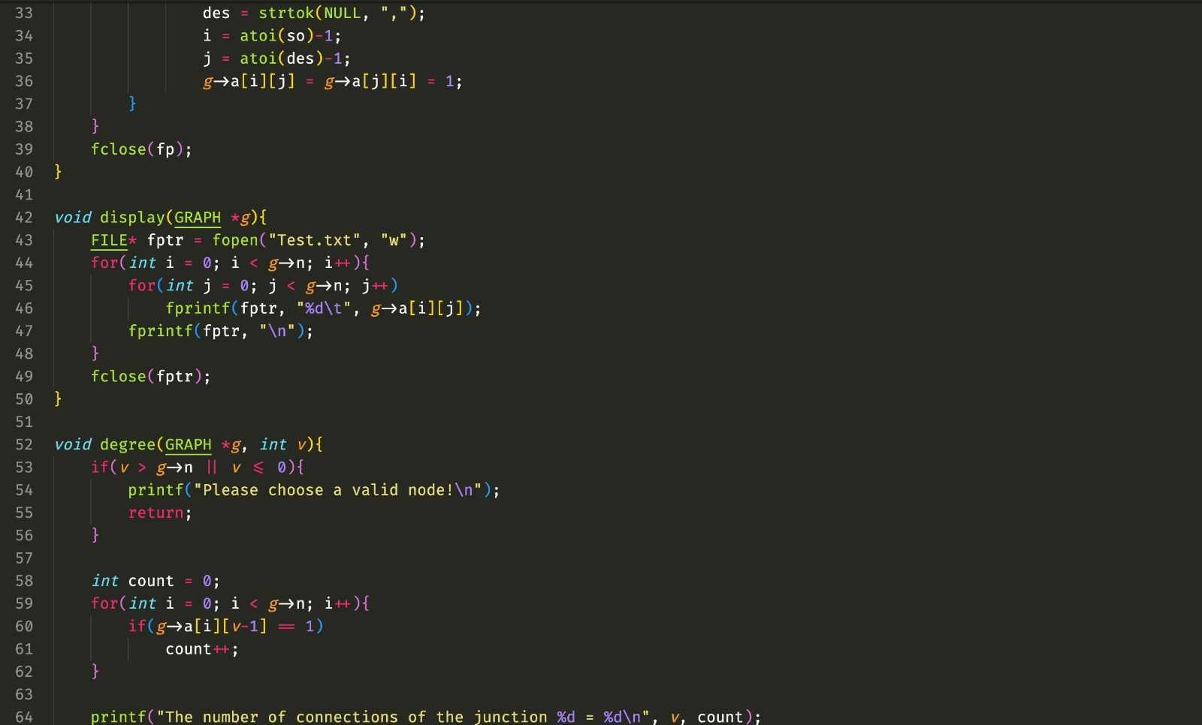
Source Code

Slide 10
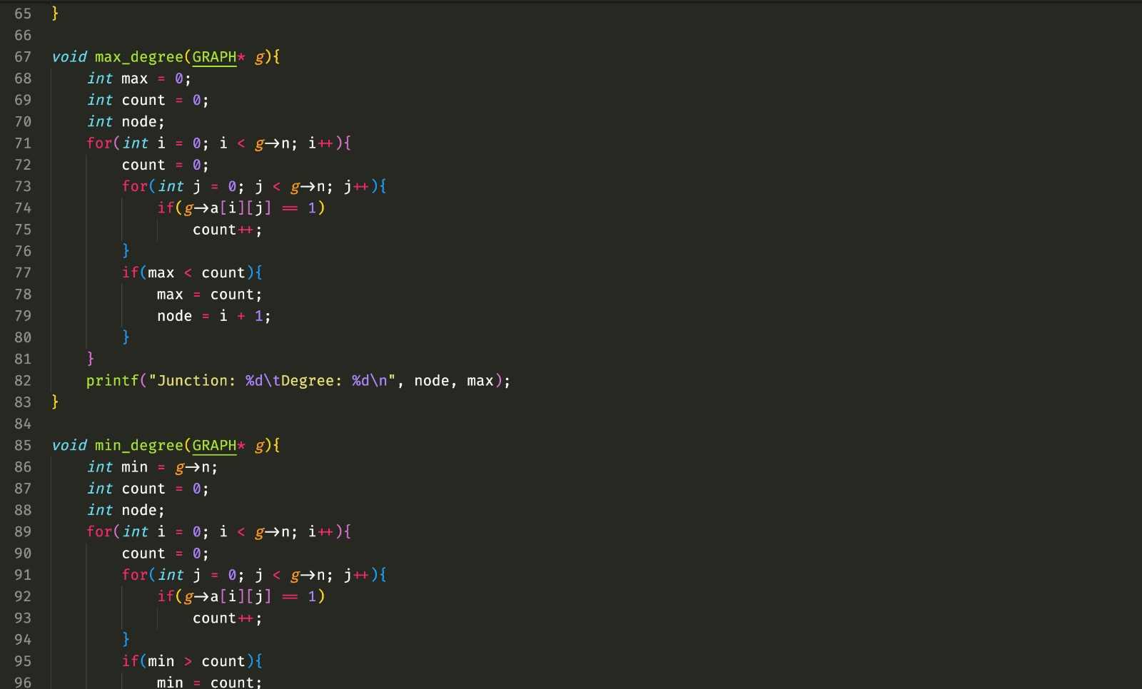
Source Code

Slide 11
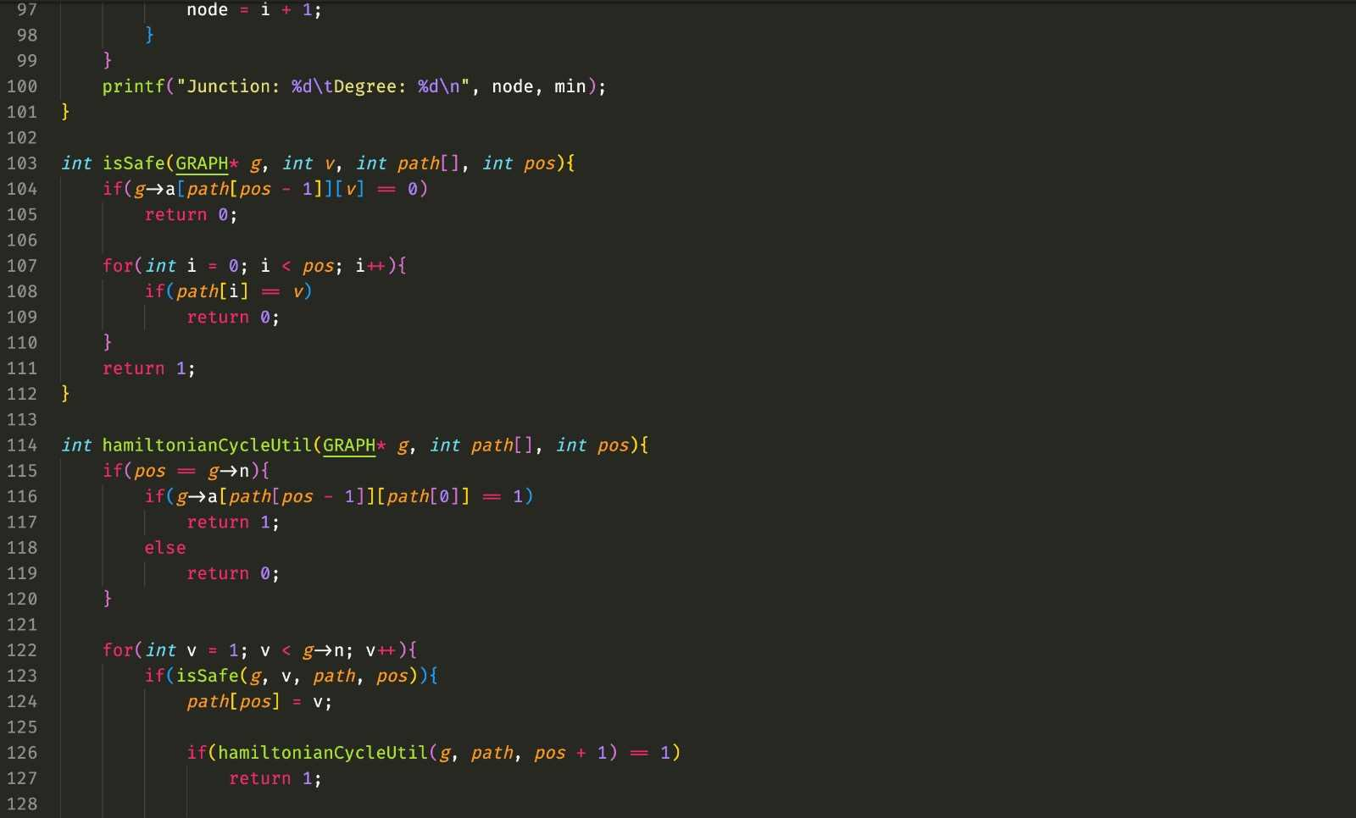
Source Code

Slide 12
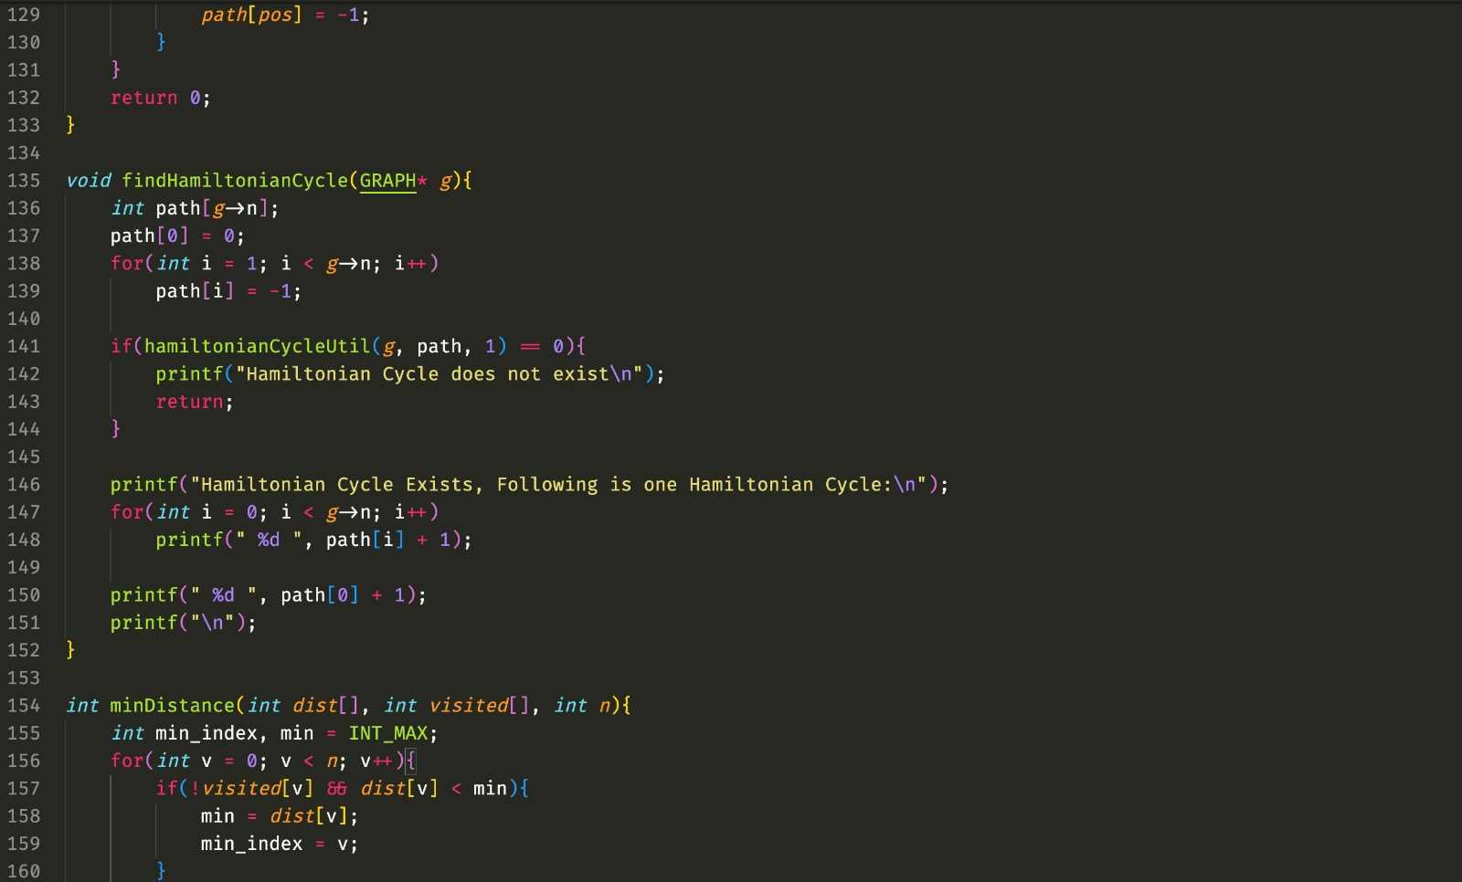
Source Code

Slide 13
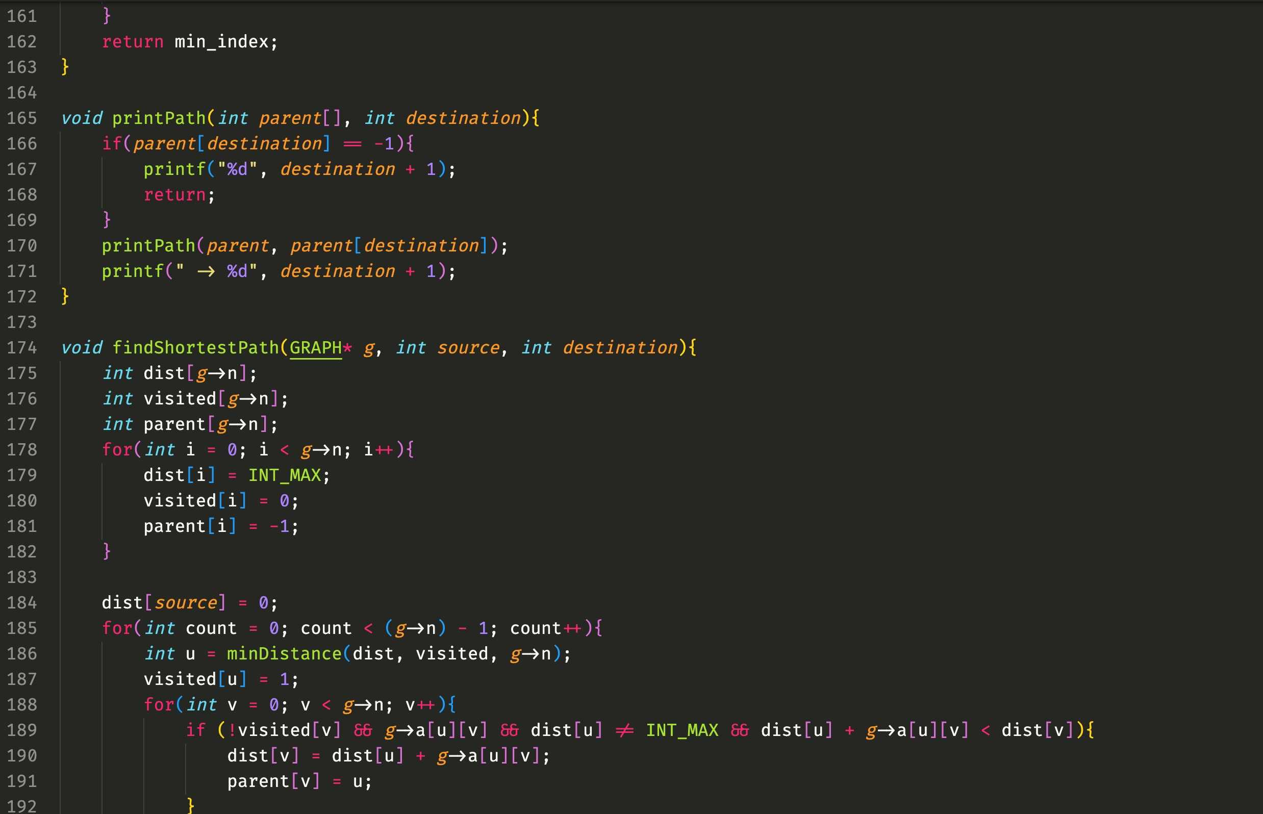
Source Code

Slide 14
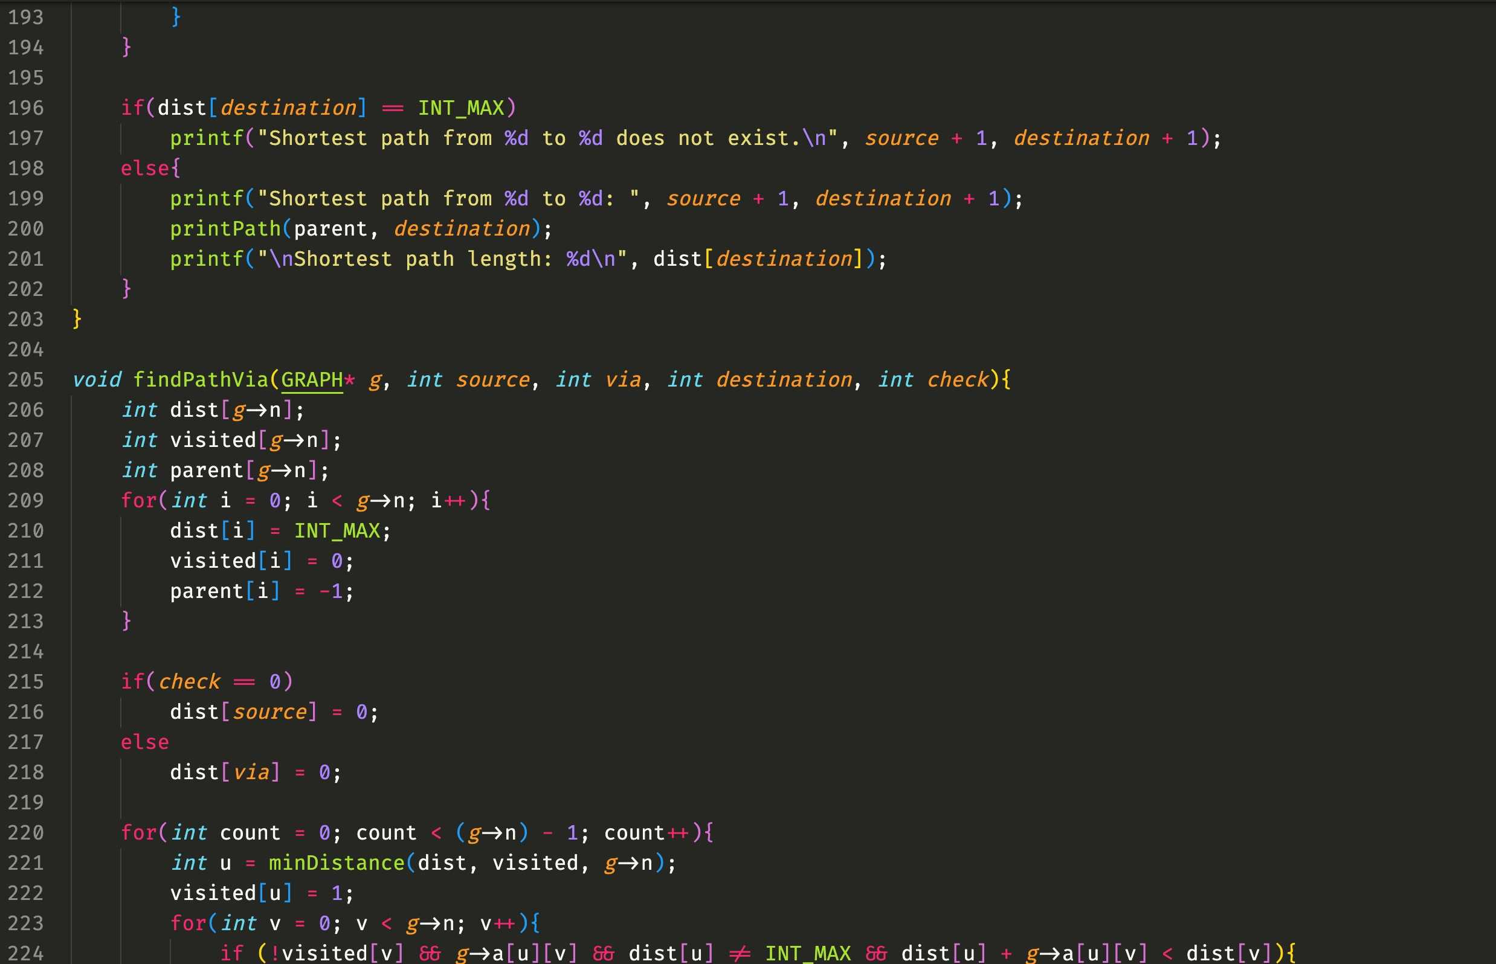
Source Code

Slide 15
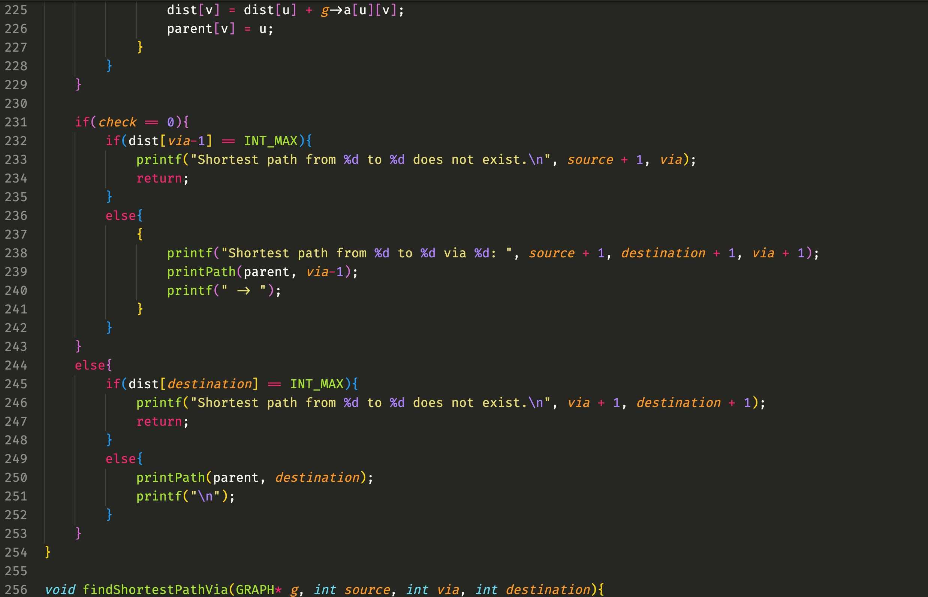
Source Code

Slide 16
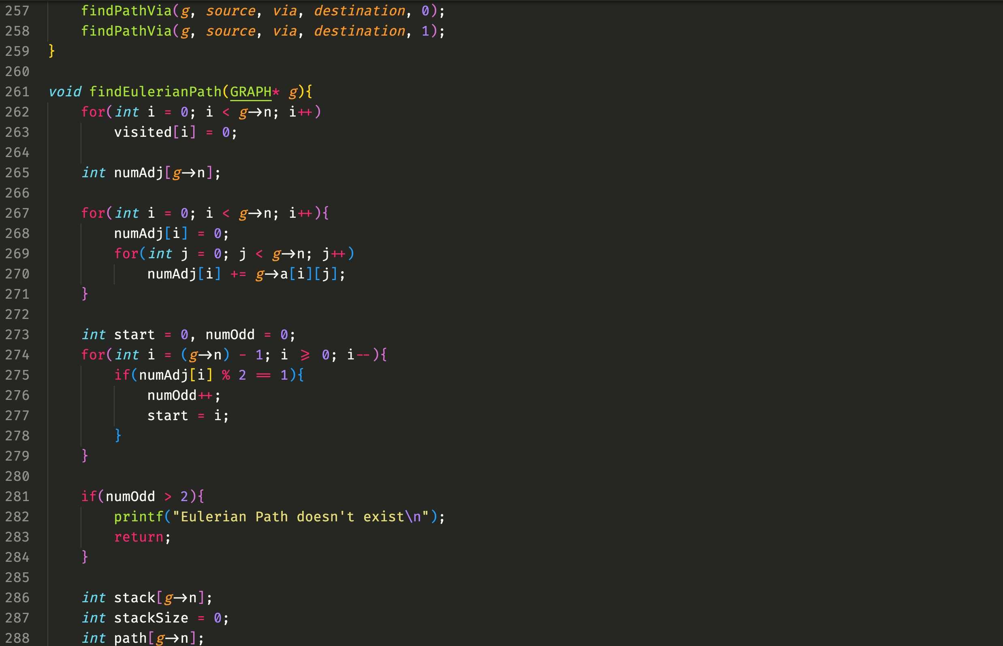
Source Code

Slide 17
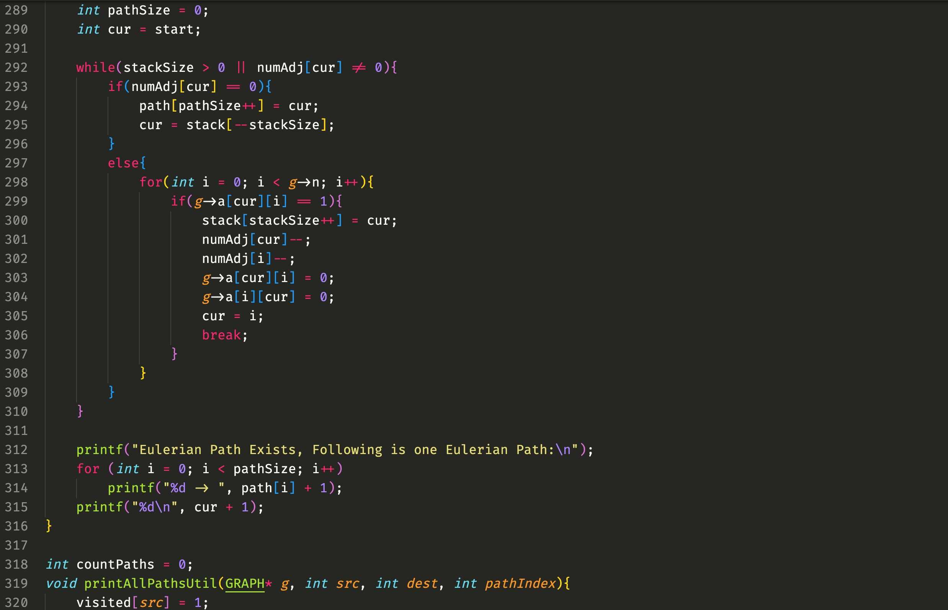
Source Code

Slide 18
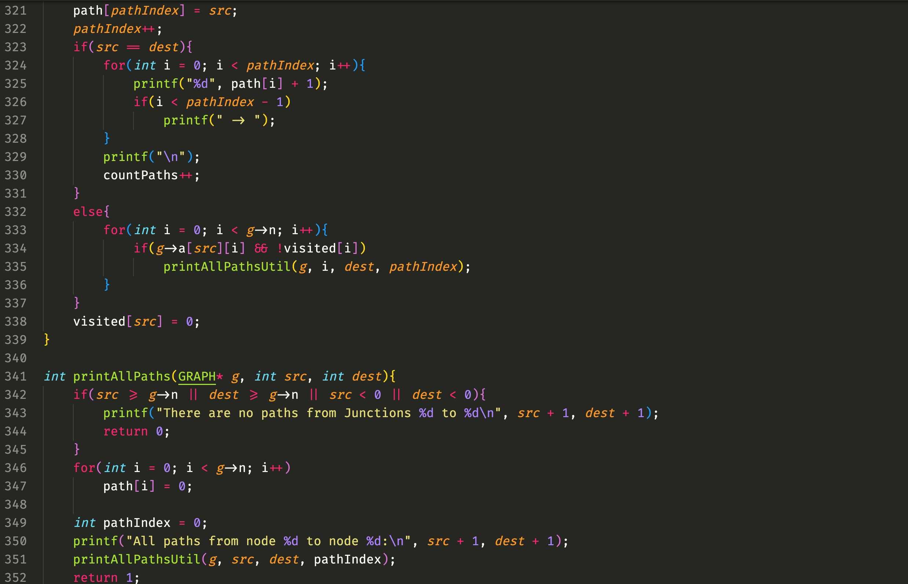
Source Code

Slide 19
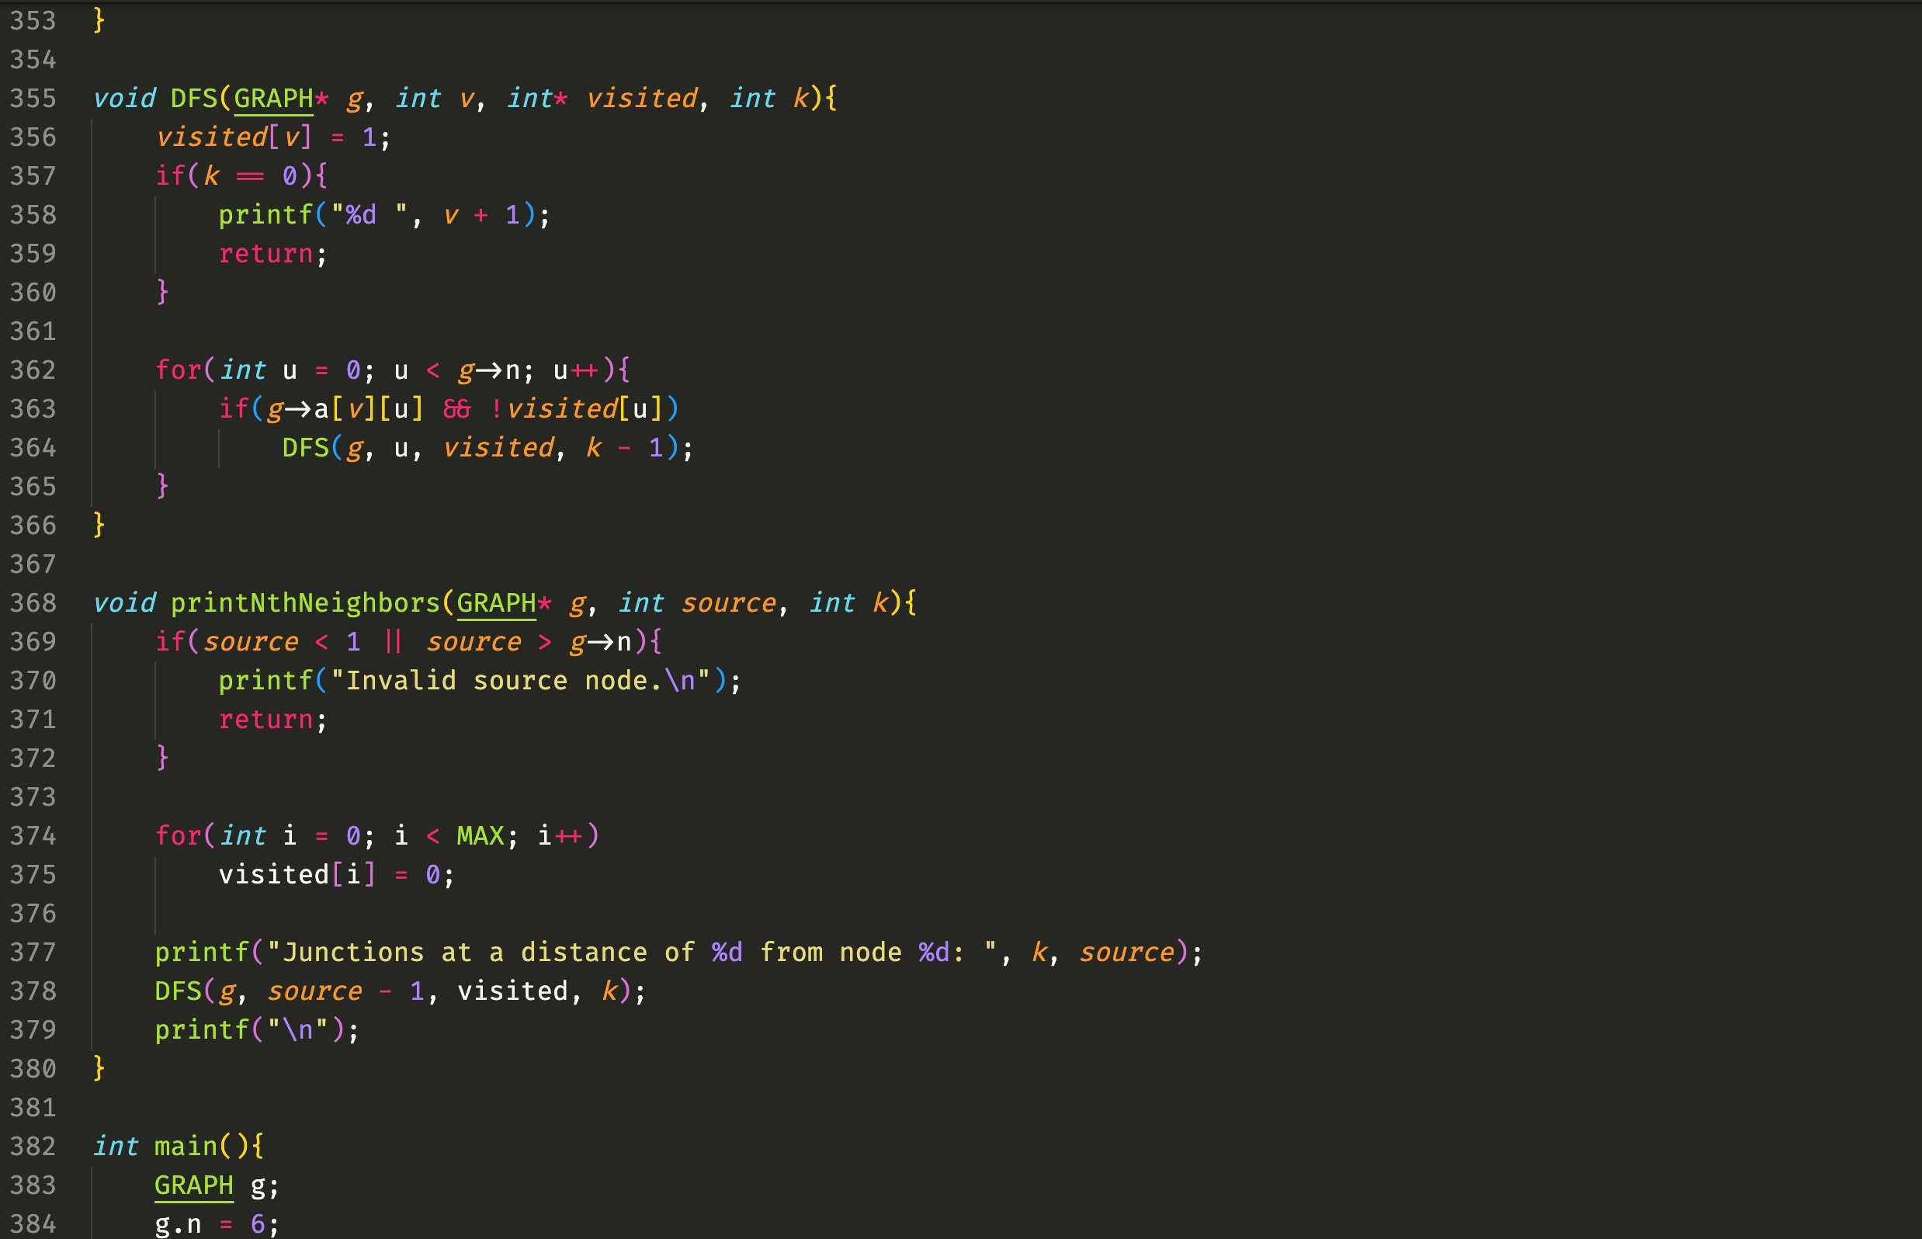
Source Code

Slide 20
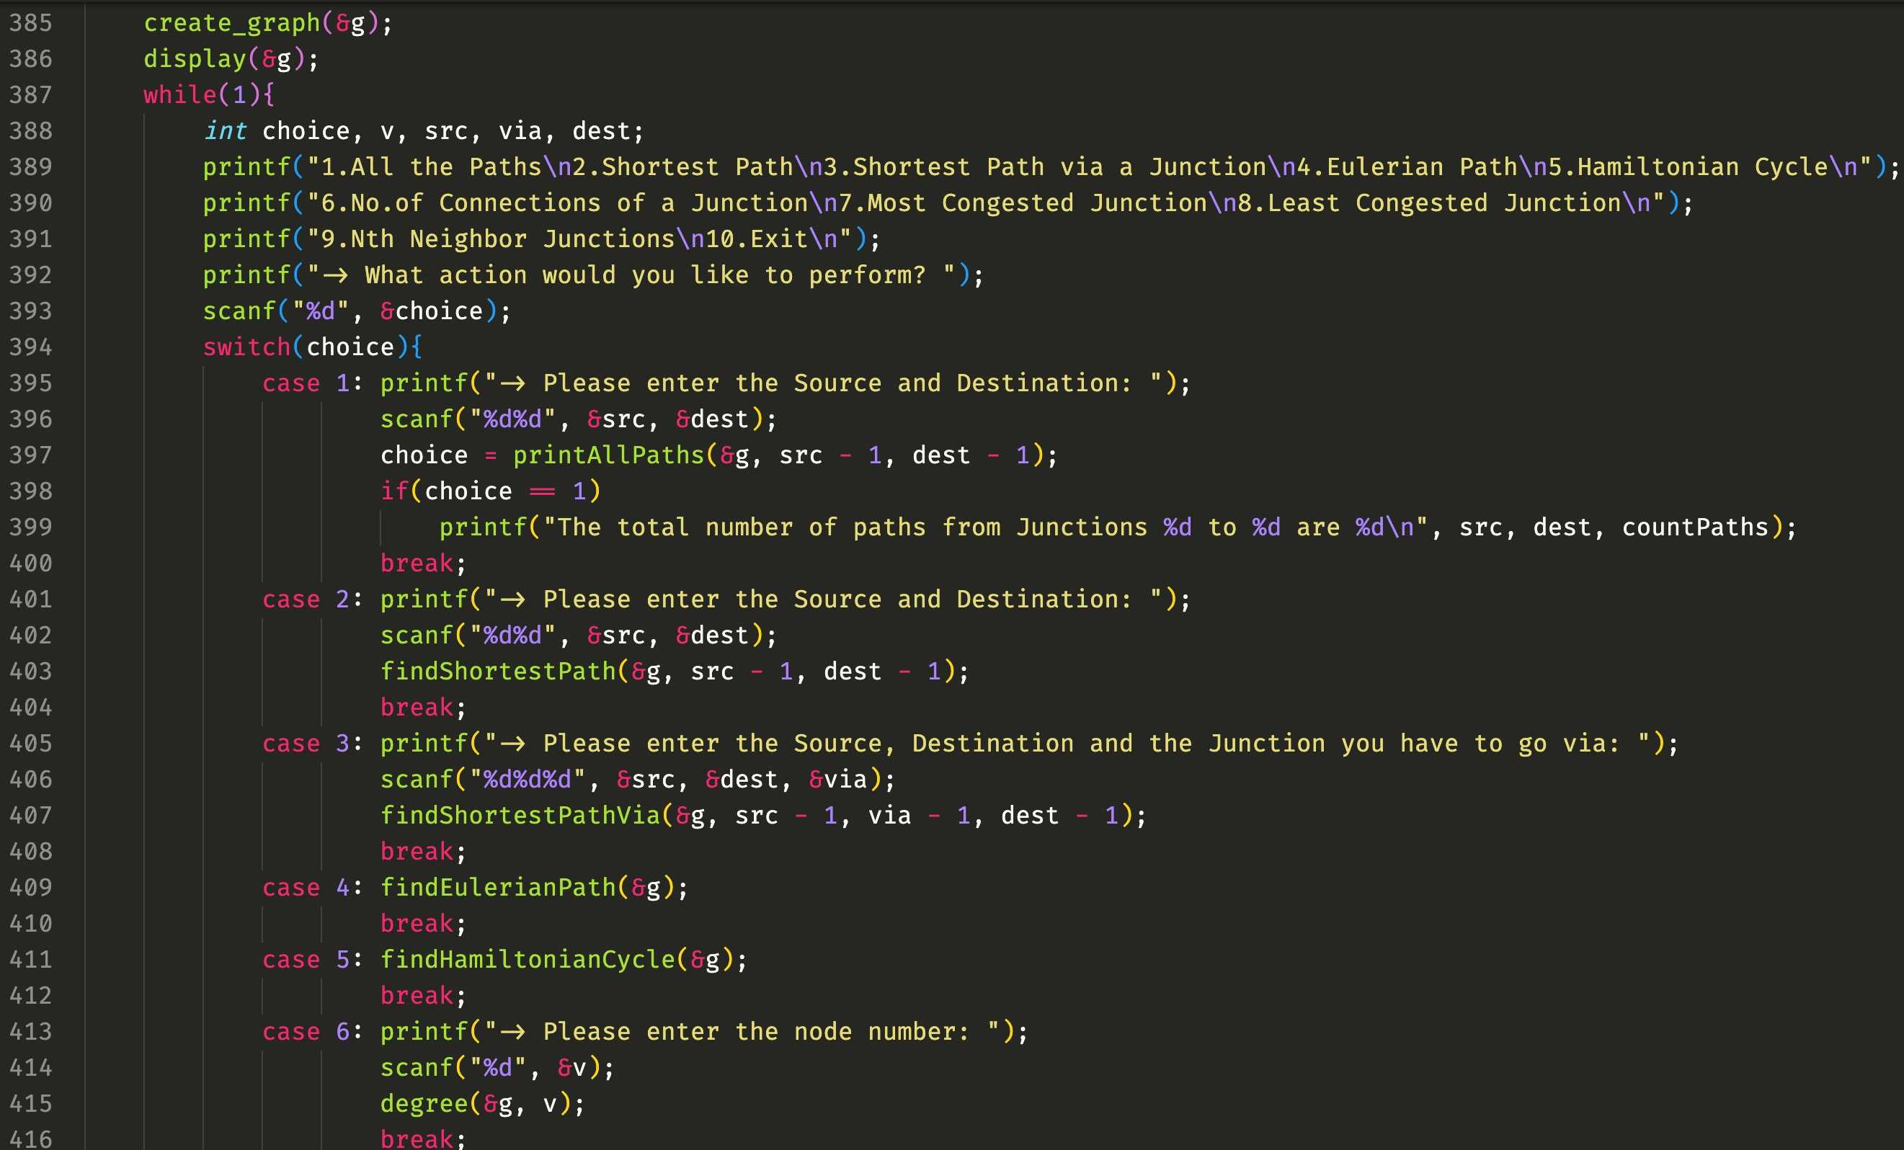
Source Code

Slide 21
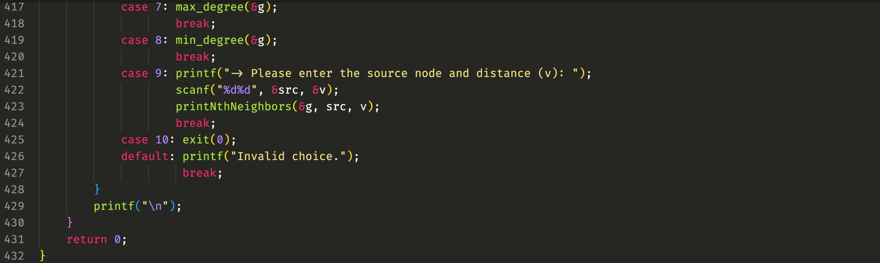
Source Code

Slide 22
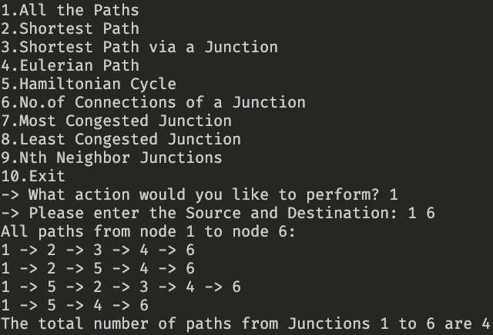
Outputs

Slide 23
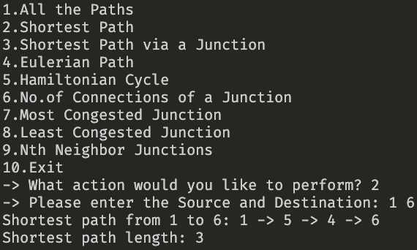
Outputs

Slide 24
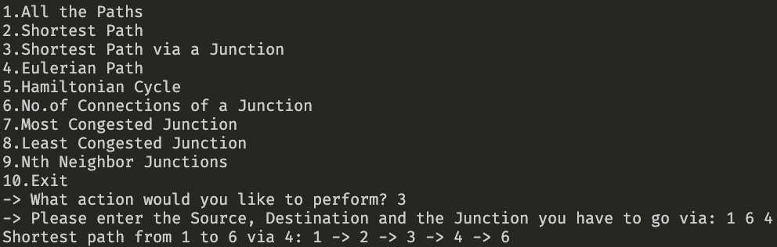
Outputs

Slide 25
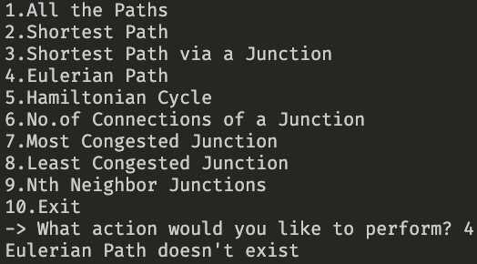
Outputs

Slide 26
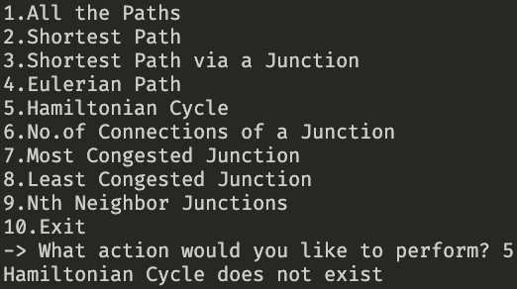
Outputs

Slide 27
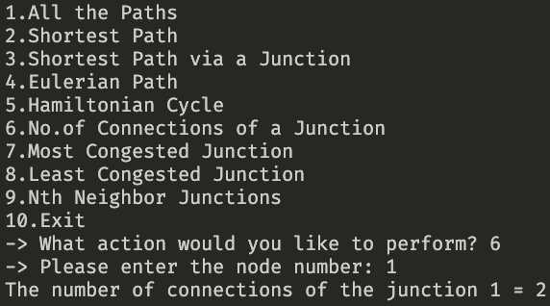
Outputs

Slide 28
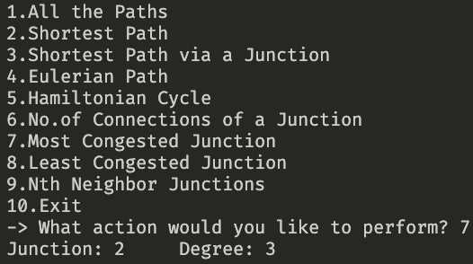
Outputs

Slide 29
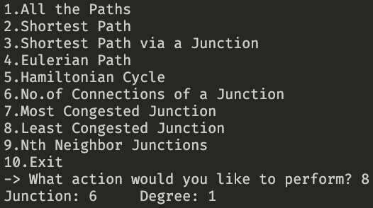
Outputs

Slide 30
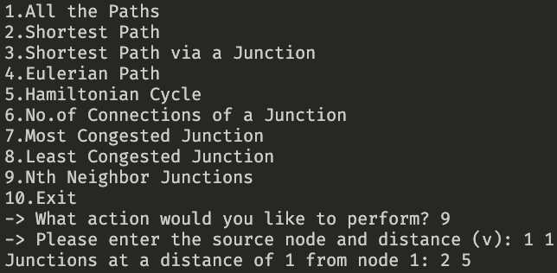
Outputs

Slide 31
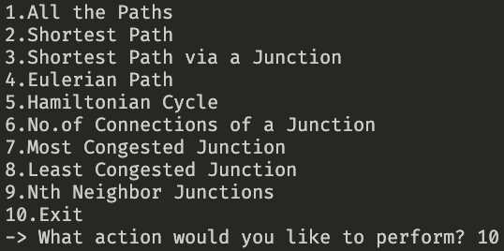
Outputs

Slide 32
Idea Conveyed
1. Route Planning and Optimization:
This project helps users find the shortest paths between junctions in a road network. It's useful for route planning, navigation, and optimization of travel time and fuel consumption. Users can choose the most efficient routes for their journeys.
2. Traffic Flow and Congestion Analysis:
By analyzing the degrees of junctions, the project can identify the most congested and least congested junctions in the road network. This information can be crucial for traffic management and road infrastructure improvement projects.
3. Research and Urban Planning:
Researchers and urban planners can use this project to study and analyze road networks, make recommendations for urban development, and explore the impact of changes in the road infrastructure on traffic flow and connectivity.

Slide 33
Ending Remarks
Thank You!

