Slide 1






Health Insurance Marketplace Analysis using Hadoop & Hive
Aishwarya Gupta,
Priyanka Thota
Rahul Bhogale.

Slide 2

INTRODUCTION
Problem Statement: Many individuals struggle to find suitable health insurance coverage due to the competitive healthcare market in the USA.
55% of people are not aware of insurances
4% are aware of all types

Slide 3

OBJECTIVE
The aim of this project is to utilize the Centers for Medicare & Medicaid Services (CMS) dataset to explore how plan rates and benefits differ by various factors and adopt a consumer-centered approach to help individuals browse and select the most suitable healthcare insurance plans based on their household income and expenses.
Dataset reference:
https://www.cms.gov/cciio/resources/data-resources/marketplace-puf
Size: 4GB

Slide 4

APPROACH
By analyzing the Health Insurance Exchange Public Use Files (Exchange PUFs) for plan years 2017 through 2021, the project will explore different factors such as month-over-month/year-over-year, state, region, family size, age, and insurance coverage. Additionally, the project will examine how discounts are applied to different insurance types and what conditions/treatments are covered by various insurance plans.

Slide 5
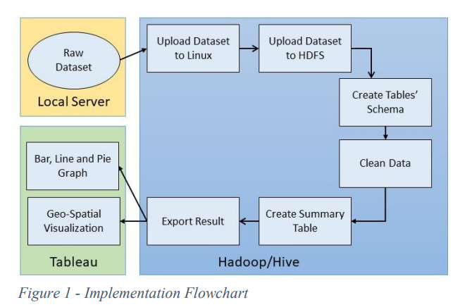
FLOW CHART

Slide 6
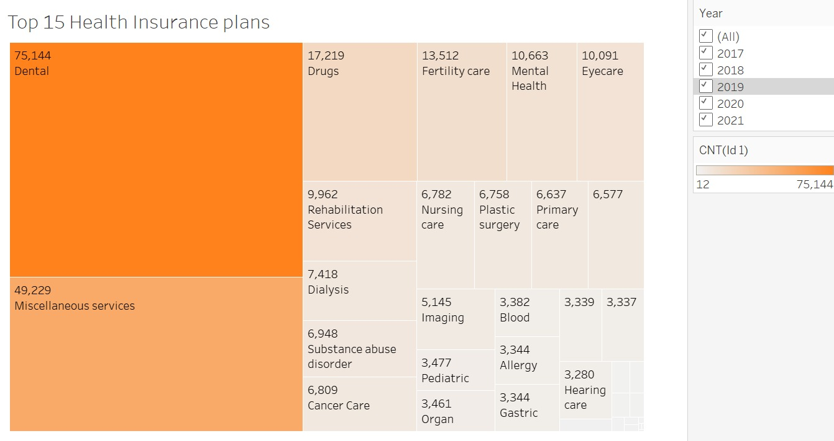
Top 15 insurance plans

Slide 7
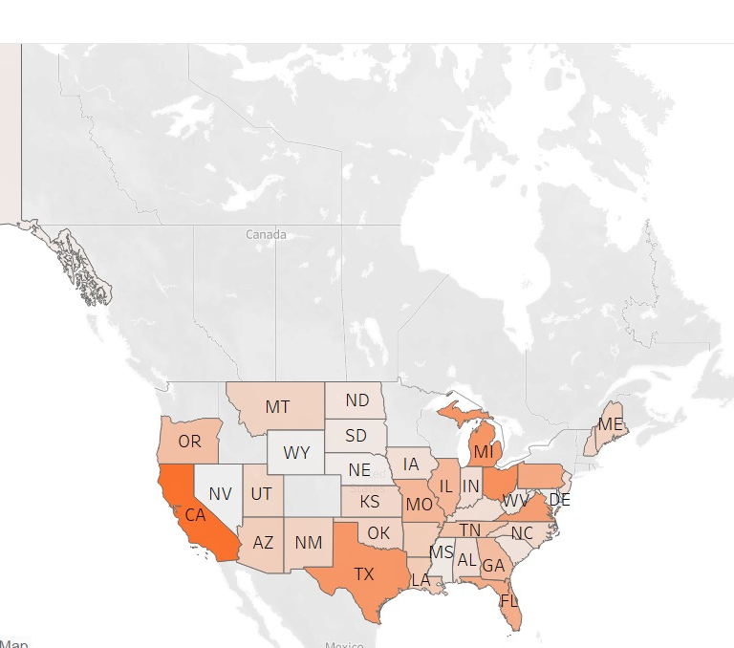
Max Issued Insurance plans by Regionwise

Slide 8
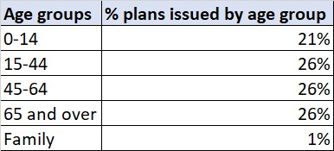
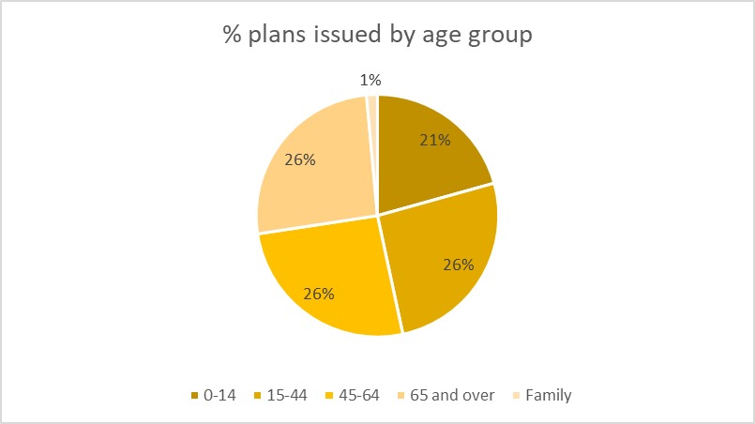
Plans Issued by Age groups

Slide 9
Plan Rates for different age groups
Age groups | Avg Individual rate | Avg Individual & Dependents rate | Avg Couple rate | Avg Couple & Dependents rate
0-14 | 200 | 0 | 0 | 0
15-44 | 450 | 0 | 0 | 0
45-64 | 480 | 0 | 0 | 0
65 and over | 550 | 0 | 0 | 0
Family | 0 | 380 | 350 | 325

Slide 10
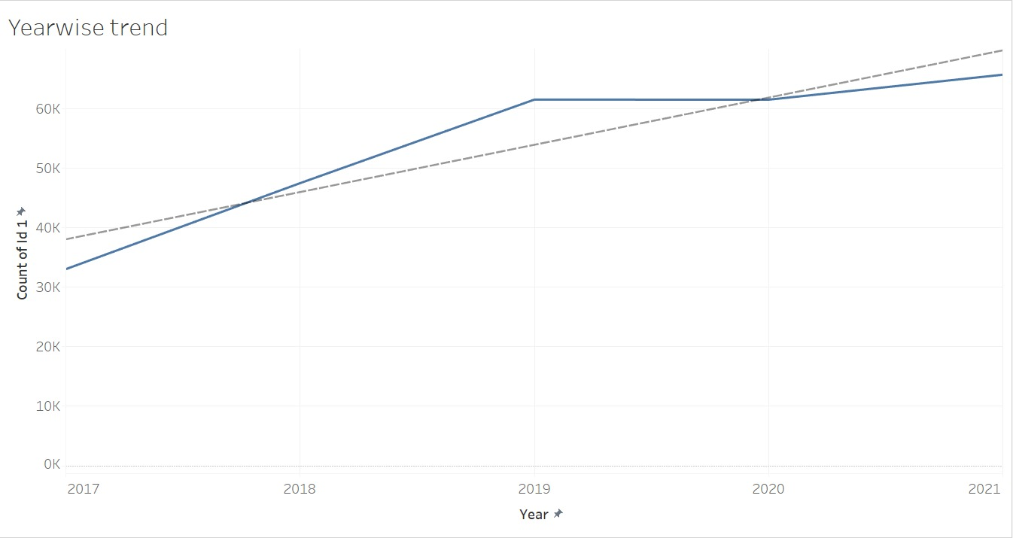
Trendline of Health Insurances from 2017 to 2021
Over 2.5 million more consumers signed up for coverage during the 2022 to the 2021, a 21% increase in subscription base could be seen.

Slide 11
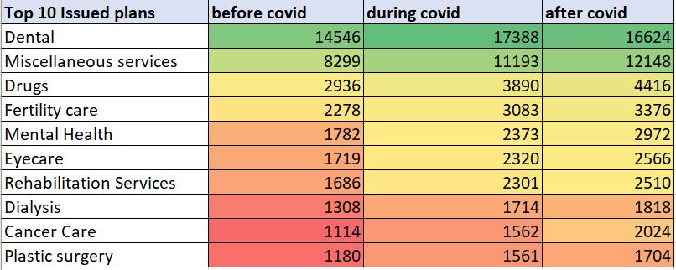
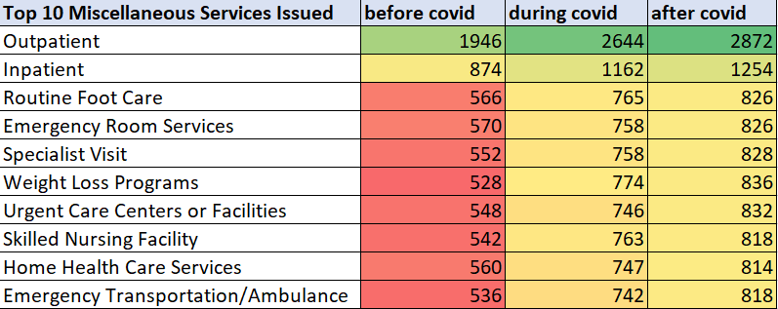
Top10 Health Insurance Plans issued across the covid timeline
Top10 Miscellaneous Services issued across the covid timeline

Slide 12
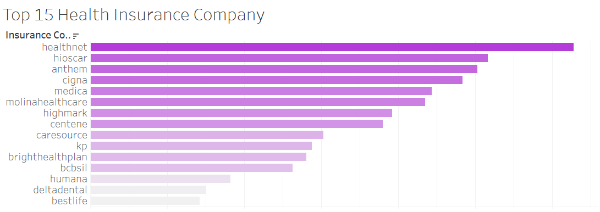
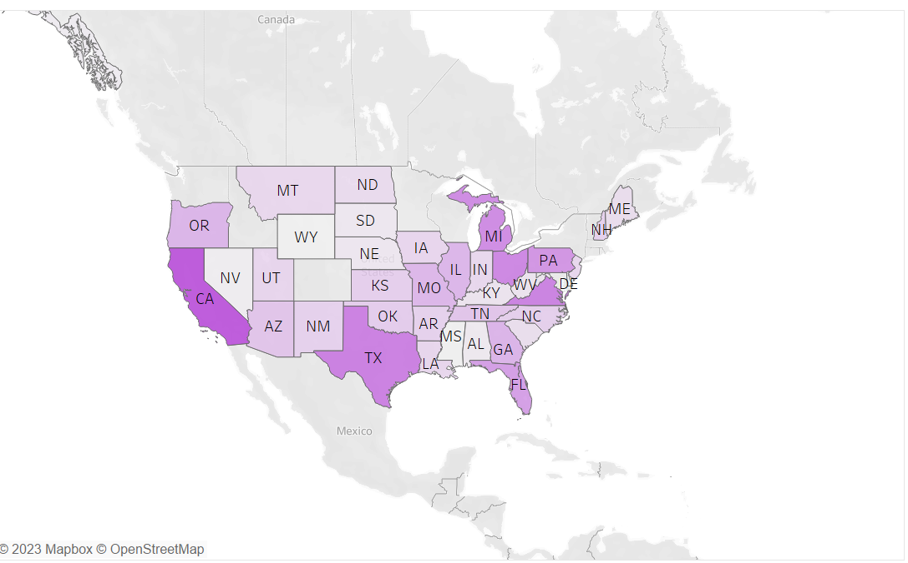

Top 15 Health Insurance companies and maximum coverage

Slide 13
Plan Types & Metal Levels
EPO
HMO
POS
PPO
INDEMITY
BRONZE
SILVER
GOLD
PLATINUM
CATASTROPHE

Slide 14
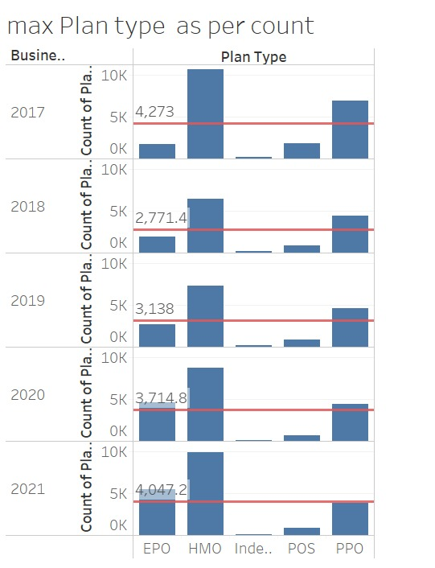
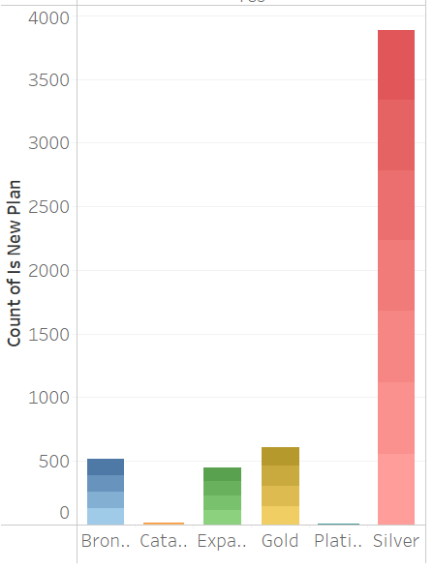
Plan Type Analysis

Slide 15
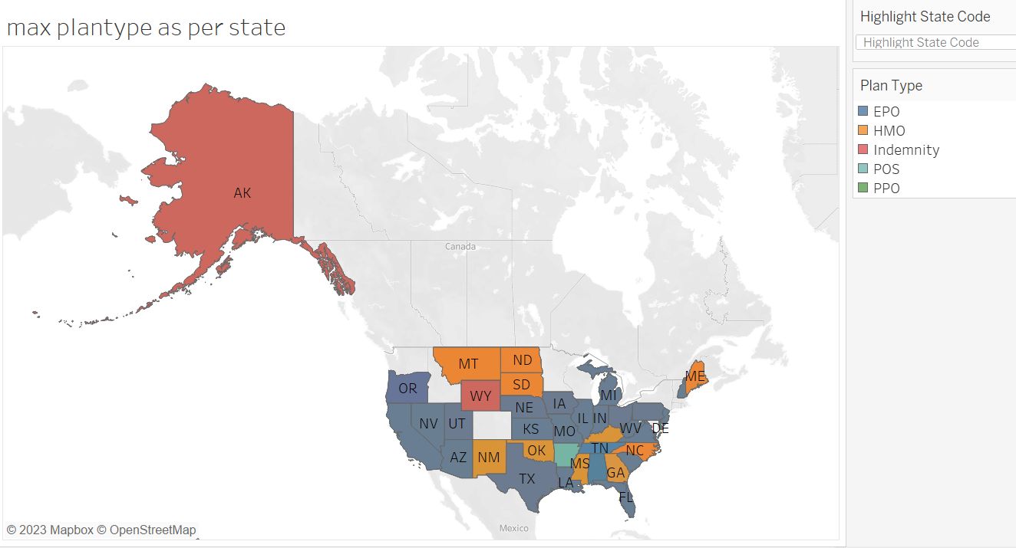
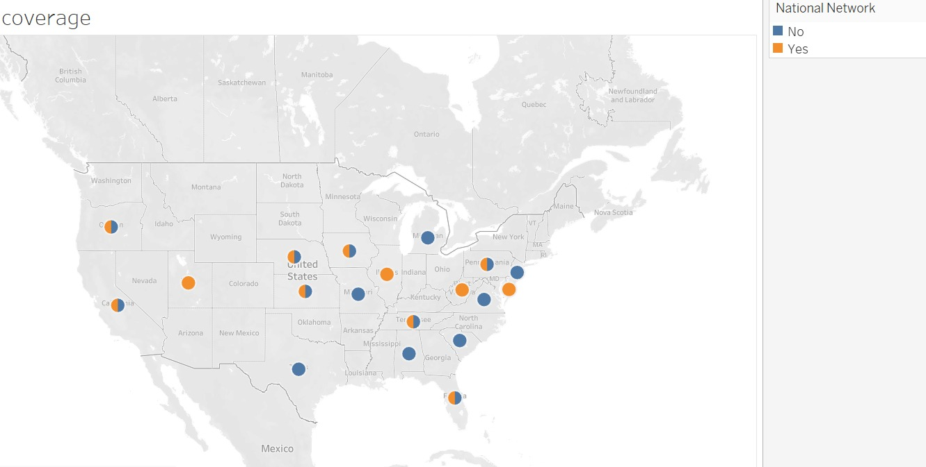
Region wise Analysis

Slide 16
CONCLUSION
Dental plans are popular among children aged 0-14 in the US, and parents/guardians of these children may benefit from exploring dental insurance options.
HMO and EPO plans may be a good choice for individuals seeking plans with comprehensive network coverage, broad service area, and Tier-1 organization partnerships.
Combining plans with higher EHB% and CSRV% with HMO or EPO plans can provide maximum benefits at a lower cost.
Family insurance plans are generally more cost-effective than individual plans, and individuals may want to consider opting for them to save on healthcare expenses.

Slide 17
THANK YOU!

Slide 18

ANY QUESTIONS?

