Slide 1
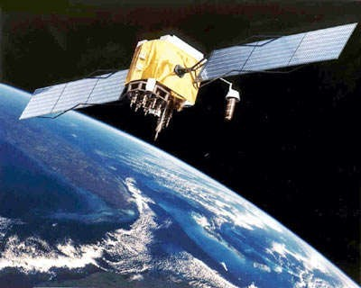
PERSON TRACKING SYSTEM
PRESENTED BY: DREAM HACK
AASHISH KUMAR SINGH
SHUBHAM KUMAR
UTAKERSH SINGH
MOHIT SANWAL

Slide 2
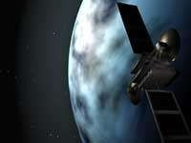
AGENDA
Introduction
Technologies used
Architecture and design of application
Working
GPS Functionality
Applications
Advantages

Slide 3
INTRODUCTION
This Live Tracking system is used to track a person.
Also this application is helpful for women and child.
It also take care of security measures related to women to track herself with their friends and family members who are near by.

Slide 4
Technologies used
FIREBASE
HERE MAP API

Slide 5
Architecture and design of application
Three major segments
INTERNET
GPS
CONTROL
USER

Slide 6
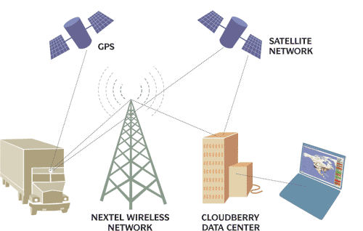
WORKING

Slide 7
GPS FUNCTIONALITY
GPS receiver has to know these things:
The location of at least three satellites above you.
The distance between you and each of those satellites. They can deal with the value of latitude and longitude.
A GPS receiver's job is to locate three or more GPS satellites, figure out the distance to each, and use this information to deduce its own location.
●

Slide 8
APPLICATION
●
GPS Data Logging
●
Real Time Tracking

Slide 9
Advantages
Wearable devices are too costly so we can simply use this mobile application which have same features as the wearable devices.
For security reasons this application is best for women, there are so many plans and ideas that are run by government and telecom companies but they are not sufficient. Thus, this application is useful to track location from starting.

Slide 10
Thank You

