Slide 1
COVID-19 IMPACT ON AIRPORT TRAFFIC
-Aishwarya Tupe
UNDER THE GUIDANCE OF
AISHWARYA SAXENA

Slide 2
INTRODUCTION
The end of a decade of sustained increase in global passenger traffic was highlighted last year. In the second quarter of 2020, the ongoing COVID-19 pandemic brought airports around the world to a halt, resulting in traffic — and income —losses in all regions. While several countries have gradually reopened various areas of their economies since then, numerous states have been hit by successive waves of viruses, prompting many jurisdictions to re-impose partial lockdowns.
This project- COVID - 19 IMPACT ON AIRPORT TRAFFIC, analyses the airport traffic and predicts 2021 circumstances. I have used 80% data of year 2021 into training and 20% data for testing. This of model of mine gives 99.89% accuracy with DecisionTreeClassifier. It is function to measure the quality of split

Slide 3
OBJECTIVE
The current COVID-19 crisis has forced aviation industry to adjust quickly to adapt to the situation. With many aircraft grounded due to significant decrease of passenger demand, the airlines try to find alternate, quick and effective measures to be able to survive as the crisis continue worldwide.
In reaction to the current situation, the International Air Transport Association (IATA) has published its press release, which states that every government have important role to support the aviation industry especially in the financial sector such as direct financial support, loans and tax relief. IATA also mentions that currently, over 2.7 million-airline job is at risk.
The objective of this machine learning project is to analyses and study the impact of covid 19 on airport traffic. It will help us to predict and analyses the data which will help grow their business again.

Slide 4
BACKGROUND
Impact of COVID-19 on airport traffic dataset
This dataset shows traffic to and from the Airport as a Percentage of the Traffic volume during the baseline period. The baseline period used for computing this metric is from 2016 to 2021. Dataset link:- https://ansperformance.eu/data/
Different Algorithms Used:-
Linear Regression, Data Wrangling, Data Cleaning, Exploratory Data Analysis,
Different libraries used:
import numpy as np
import pandas as pd

Slide 5
BACKGROUND
import matplotlib.pyplot as plt
import seaborn as sns
from sorted_months_weekdays import *
from sort_dataframeby_monthorweek import * #for sorting based on month
from sklearn.preprocessing import LabelEncoder
from sklearn.model_selection import train_test_split
from sklearn.preprocessing import StandardScaler
from sklearn.tree import DecisionTreeClassifier

Slide 6
HARDWARE AND SOFTWARE REQUIREMENTS
SOFTWARE TOOLS | MINIMUM REQUIREMENTS
Platform | Windows, Linux or MacOS
Operating System | Windows, Linux or MacOS
Technology | Windows, Linux or MacOS
Scripting | Python
IDE | PyCharm
HARDWARE TOOLS | MINIMUM REQUIREMNTS
Processor | AMD or above
Hard Disk | 8GB
RAM | 8GB
Monitor | 17”Coloured
Mouse | Optical
Keyboard | 122 K

Slide 7
FUTURE SCOPE
The future scope of the project will be that we can use this model to analyze the recent crowd and data, which will help us to make improvements and increase the airport services. Uncertainty will be one of the main elements affecting airport management and airport operations. The airport operator will therefore have to consider strategies that will maximize the business in the short and long terms. COVID 19 effects on airport design and operations will manifest in particular in the social distancing which will affect airport terminal capacity and level of services provided.
Finally, airports that remain resilient with sustainable strategies will be able to offer wider variety of goods and services to air travelers. Successful airports will also learn from the current crisis by diversifying and turning to non-passenger revenue to compensate for the decline in air traffic.

Slide 8
CONCLUSION
With the uncertainty brought by COVID19 on the aviation industry, the organizations need to reassess the different scenarios that can occur and ensure that sustainable and safe airport operations can be maintained. Airports will face unpleasant issues caused by the pandemic such as fewer passengers, costly health regulations and airlines and tenants that do not pay their bills on time. For financial sustainability airports should delay non-essential expenditure, stop non-critical recruitment, coordinate with suppliers to find cost saving solutions, reduce or stop not essential contracts, close or scale down non-operational areas and outsource not core services.
We can conclude, that there was a huge impact of COVID-19 on airport traffic. We can see the below image to grasp a better understanding.

Slide 9
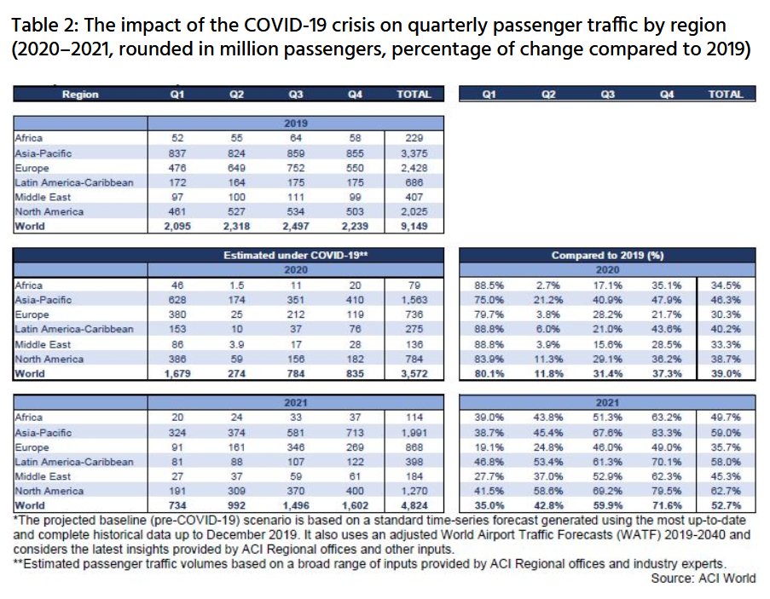

Slide 10
REFERENCES AND BIBLIOGRAPHY
https://www.kaggle.com/aminianam/airport-traffic-analysis
https://www.ncbi.nlm.nih.gov/pmc/articles/PMC7428780/
https://aci.aero/news/2021/03/25/the-impact-of-covid-19-on-the-airport-business-and-the-path-to-recovery/
https://www.sciencedirect.com/science/article/pii/S2590198220300907
https://www.icao.int/sustainability/Pages/Economic-Impacts-of-COVID-19.aspx
https://www.kaggle.com/sainiyash/covid-19-s-impact-on-airport-traffic-analysis
https://www.ifc.org/wps/wcm/connect/26d83b55-4f7d-47b1-bcf3-01eb996df35a/IFC-Covid19-Airport-FINAL_web3.pdf?MOD=AJPERES&CVID=n8lgpkG
https://www.udemy.com/course/machine-learning-data-science-python/learn/lecture/25488602?start=225#overview
https://ansperformance.eu/data/
https://opensky-network.org/

