Slide 1

Amazon S3 (Simple Storage Service)
is a highly scalable, durable, and secure object storage service provided by AWS. It is designed to store and retrieve any amount of data from anywhere on the internet.
It is widely used for storing and retrieving large amounts of unstructured data such as images, videos, backups, and log files.

Slide 2
Buckets 🗄️
A bucket is a container for objects stored in S3. 📦
Bucket names must be globally unique across all AWS accounts. 🌐
Buckets are region-specific, meaning they are created in a specific AWS region. 📍
Objects 🎈
Objects are the fundamental entities stored in S3. 💾
Each object has a unique key (path) within a bucket. 🔑
Keys 🗝️
A key is the unique identifier for an object within a bucket. 🔖
Keys can include prefixes and delimiters to organize objects hierarchically (e.g., folder1/file.txt). 📂
Regions 🗺️
S3 buckets are created in specific AWS regions, allowing you to store data close to users or comply with data residency requirements. 🌍

Slide 3
Versioning 🔄:
Allows multiple versions of an object to be stored, protecting against accidental deletion or overwrites. 🛡️
Replication 🔁
Cross-Region Replication (CRR) 🌍: Copies objects to a different AWS region. ✈️
Same-Region Replication (SRR) 📍: Copies objects within the same AWS region. 🔄
Data Transfer Acceleration ⚡:
Uses CloudFront’s edge locations to speed up data transfers over long distances. 🌐
Event Notifications 🔔:
Triggers notifications or workflows (e.g., using AWS Lambda) when specific events occur (e.g., object creation ➕ or deletion ➖).
Static Website Hosting 🏠:
S3 can host static websites, serving HTML, CSS, and JavaScript files. 💻

Slide 4
ACLs (Access Control Lists) 📜
What it is 🤔:
ACLs are a legacy access control mechanism that grants permissions at the bucket or object level.
They allow you to specify which AWS accounts or predefined groups (e.g., "Everyone" 🌐) can access your buckets or objects.
Features ✨:
Granularity: Can be applied to individual objects or entire buckets 🗄️.
Predefined Groups: Supports groups like "Authenticated Users" (any AWS account) or "Everyone" (public access).
When to Use ❓:
For simple, object-level permissions.
When you need to grant access to specific AWS accounts.
Note 📝: ACLs are less flexible than bucket policies and are generally not recommended for complex access control.

Slide 5
Block Public Access 🚫
What it is 🤔:
A set of bucket-level 🗄️ and account-level 👤 settings that override any other permissions (including ACLs and bucket policies) to block public access to your buckets and objects.
Designed to prevent accidental exposure of data to the public. ⚠️
Account-Level or Bucket-Level 👤🗄️: Can be applied to all buckets in an account or to individual buckets.
When to Use ❓:
To prevent accidental public exposure of sensitive data. ⚠️
When you want to enforce a strict "no public access" policy across your S3 resources. 🔒
Best Practice ✅: Enable Block Public Access by default unless you explicitly need public access. 👍

Slide 6
Bucket Policies 📝
JSON-based policies that define permissions at the bucket level 🗄️.
Allow you to specify who (e.g., IAM users, roles, or AWS accounts) can access the bucket and what actions they can perform (e.g., s3:GetObject, s3:PutObject).
Features ✨:
Fine-Grained Control: Supports complex conditions (e.g., IP restrictions 🌐, time of day ⏰).
Cross-Account Access: Allows you to grant access to other AWS accounts. 🤝
Public Access: Can be used to make a bucket or objects publicly accessible (if not blocked by Block Public Access settings 🚫).
When to Use ❓:
For complex access control scenarios (e.g., granting access to specific IAM users or roles).
When you need to enforce IP-based restrictions or other conditions.
To grant cross-account access to your buckets.
To make a bucket or objects publicly accessible (e.g., for hosting a static website 🏠).

Slide 7
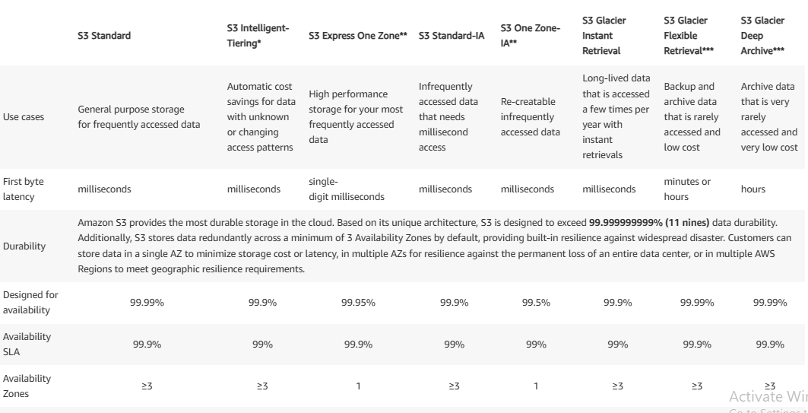
S3 storage classes

